Slide 1
Lecture 11b
Tsunami Impacts
John Rundle GEL/EPS 131

Slide 2
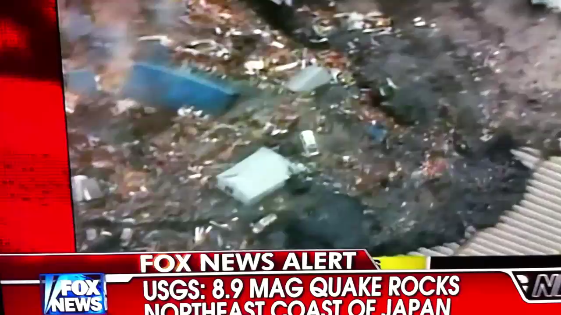
The Tsunami, Sendai Plain
FOX News, March 10 (~11:30 pm PST), 2013

Slide 3
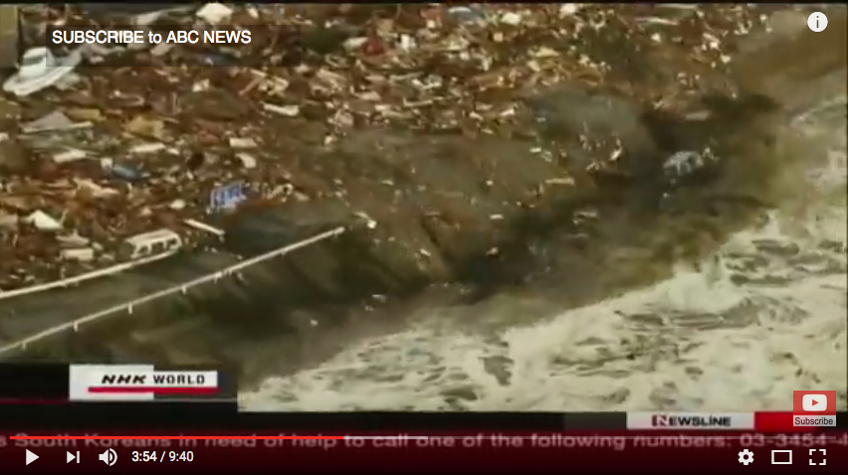
Earthquake and Tsunami ABC News https://www.youtube.com/watch?v=9nTlgtf7TME

Slide 4
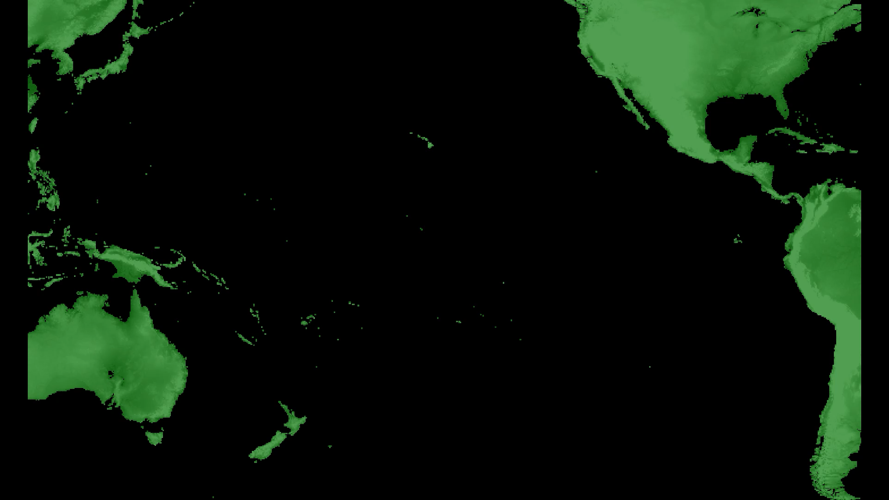
Simulation via Tsunami Squares method

Slide 5
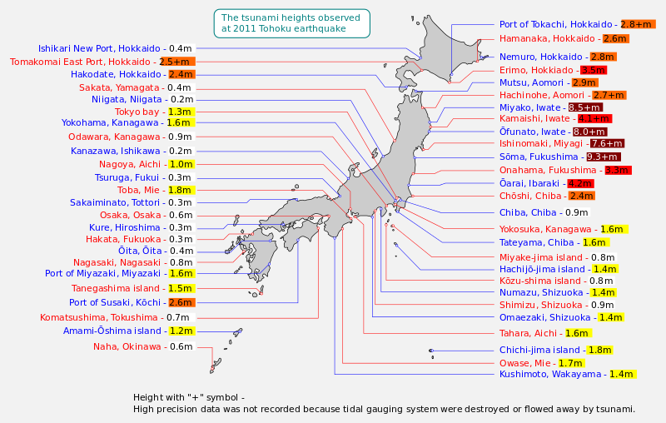
Tsunami Inundation http://en.wikipedia.org/wiki/2011_Tohoku_earthquake_and_tsunami
Lecture 13 will be on Tsunamis

Slide 6
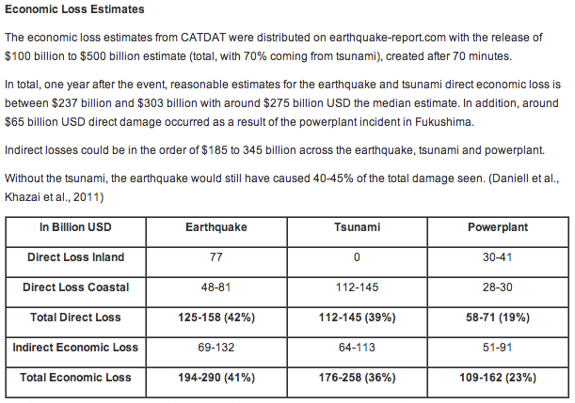
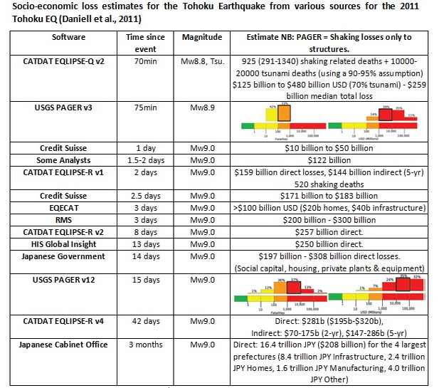
Economic Impacts – 1 Year Later
Quoted from: http://earthquake-report.com/2012/03/10/japan-366-days-after-the-quake-19000-lives-lost-1-2-million-buildings-damaged-574-billion/
Daniell, J.E., Vervaeck, A., Wenzel, F. (2011) “A timeline of the Socio-economic effects of the 2011 Tohoku Earthquake with emphasis on the development of a new worldwide rapid earthquake loss estimation procedure”, Australian Earthquake Engineering Society 2011 Conference, Nov 18-20, Barossa Valley, South Australia.

Slide 7
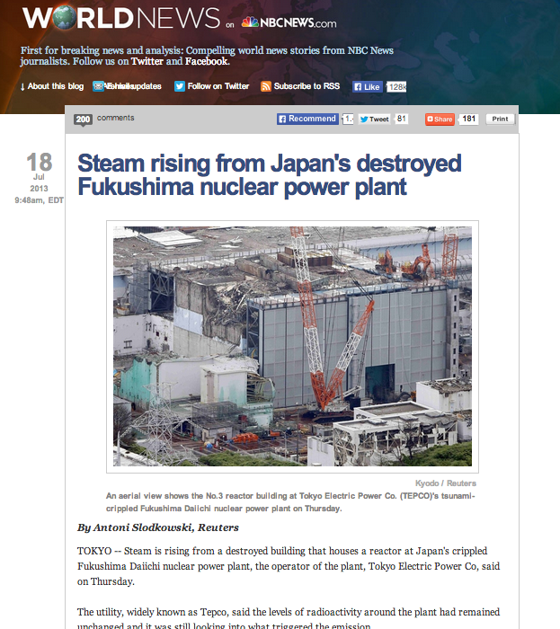
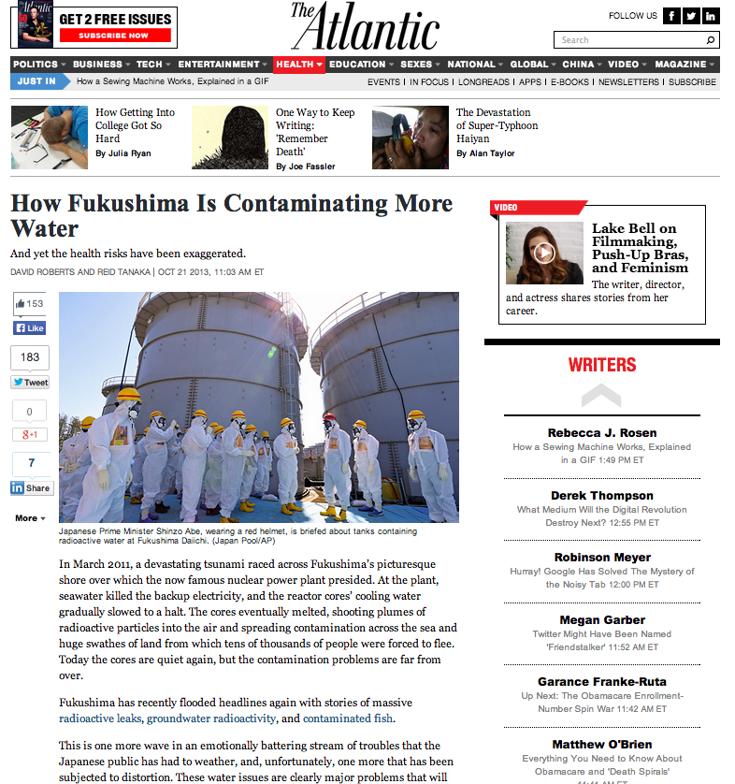
And Problems Continue http://www.theatlantic.com/health/archive/2013/10/how-fukushima-is-contaminating-more-water/280671/ http://worldnews.nbcnews.com/_news/2013/07/18/19540341-steam-rising-from-japans-destroyed-fukushima-nuclear-power-plant
And see also: http://www.brookings.edu/blogs/up-front/posts/2013/03/11-japan-earthquake-ferris-solis

