Slide 1
Lecture 8
Introduction to Probability – I (Expected Value)
John Rundle Econophysics PHYS 255

Slide 2
Current Data https://www.gurufocus.com/yield_curve.php
Current Data
2/2/2021

Slide 3
Current Data
2/2/2021

Slide 4
Statistics of Market Data https://fred.stlouisfed.org/series/A191RL1Q225SBEA
Shaded regions are recessions
Quarterly Change in Real Gross Domestic Product
GDP = Total value of all goods and services

Slide 5
Statistics of Market Data https://fred.stlouisfed.org/series/GDPC1
Total GDP

Slide 6
Statistics of Market Data https://fred.stlouisfed.org/series/USD1MTD156N
These are the lowest interest rates in 4000 years !!
https://www.aei.org/wp-content/uploads/2016/12/Sylla-Dec-15.pdf

Slide 7
Statistics of Market Data https://www.businessinsider.com/chart-5000-years-of-interest-rates-history-2016-6
These are the lowest interest rates in 5000 years !!
Credit: Bank of America Merrill Lynch

Slide 8
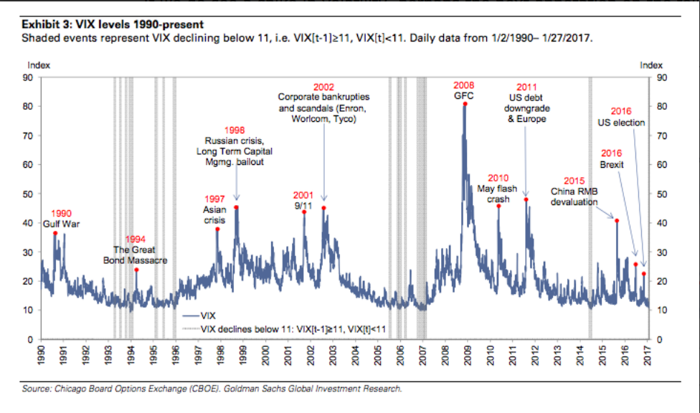
Statistics of Market Data http://seekingalpha.com/article/4040949-mystery-buyer-bets-big-volatility-spike

Slide 9
From Time Series to Histograms http://www.value-at-risk.net/leptokurtosis-conditional-heteroskedasticity/

Slide 10
Histograms and Density Functions https://en.wikipedia.org/wiki/Density_estimation

Slide 11
Histograms and Density Functions https://en.wikipedia.org/wiki/Density_estimation

Slide 12
Statistics of Market Data https://tradeoptionswithme.com/probability-dsitribution-of-stock-market-returns/
Gaussian Normal Distribution
Returns in Percent

Slide 13
Statistics of Market Data https://www.evestment.com/resources/investment-statistics-guide/using-statistics-to-understand-return-characteristics/
Histogram of Monthly Returns

Slide 14
Mean and Standard Deviation https://www.evestment.com/resources/investment-statistics-guide/assessing-skewness-and-kurtosis-in-the-returns-distribution/

Slide 15
Returns Distributions https://www.evestment.com/resources/investment-statistics-guide/assessing-skewness-and-kurtosis-in-the-returns-distribution/

Slide 16
Statistics of Stock Market Data http://investexcel.net/plot-stock-returns-histogram/
Coca-Cola
Google

Slide 17
Statistics of Stock Market Data http://www.investopedia.com/articles/04/092904.asp

Slide 18
Mean-Variance Analysis Illustration http://www.investopedia.com/articles/04/092904.asp

Slide 19
Monte Carlo Simulation – Example http://www.investopedia.com/articles/04/092904.asp

Slide 20
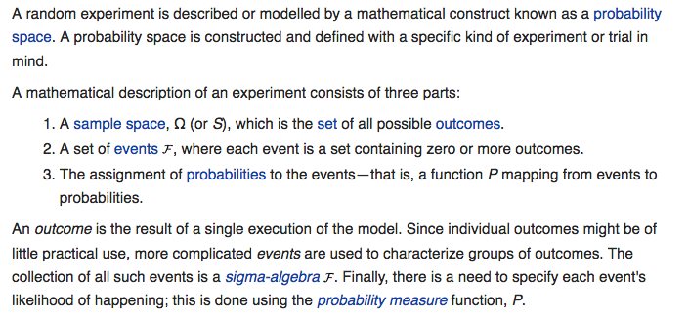
Probability https://en.wikipedia.org/wiki/Experiment_(probability_theory)

Slide 21
Parent Distribution vs. Sample Space https://en.wikipedia.org/wiki/Sample_space
In probability theory, the parent distribution is the entire population of events being sampled by an experiment
The sample space of an experiment or random trial is the set of all possible outcomes or results of that experiment.
A sample space is usually denoted using set notation, and the possible outcomes are listed as elements in the set.
It is common to refer to a sample space by the labels S, Ω, or U (for "universal set").
For example, if the experiment is tossing a coin, the sample space is typically the set {head, tail}.
For tossing two coins, the corresponding sample space would be {(head,head), (head,tail), (tail,head), (tail,tail)}.
For tossing a single six-sided die, the typical sample space is {1, 2, 3, 4, 5, 6} (in which the result of interest is the number of pips facing up).

Slide 22
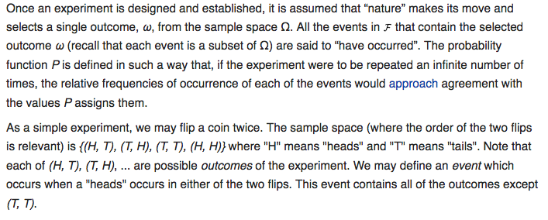
Probability Outcomes https://en.wikipedia.org/wiki/Experiment_(probability_theory)

Slide 23
Probability Distributions https://en.wikipedia.org/wiki/Probability_distribution
To define probability distributions for the simplest cases, one needs to distinguish between discrete and continuous random variables.
In the discrete case, it is sufficient to specify a probability mass function assigning a probability to each possible outcome: for example, when throwing a fair dice, each of the six values 1 to 6 has the probability 1/6.
The probability of an event is then defined to be the sum of the probabilities of the outcomes that satisfy the event
For example, the probability of the event "the die rolls an even value" is Prob ⁡ (2) + Prob ⁡ (4) + Prob ⁡ (6) = 1/6 + 1/6 + 1/6 = 1/2.

Slide 24
Probability Distributions https://en.wikipedia.org/wiki/Probability_distribution
The probability density function (“PDF”) describes the infinitesimal probability of any given value
The probability that the outcome lies in a given interval can be computed by integrating the probability density function over that interval.
The cumulative distribution function (“CDF”) describes the probability that the random variable is no larger (≤) than a given value
The probability that the outcome lies in a given interval can be computed by taking the difference between the values of the cumulative distribution function at the endpoints of the interval.
The cumulative distribution function is the antiderivative of the probability density function provided that the latter function exists.

Slide 25
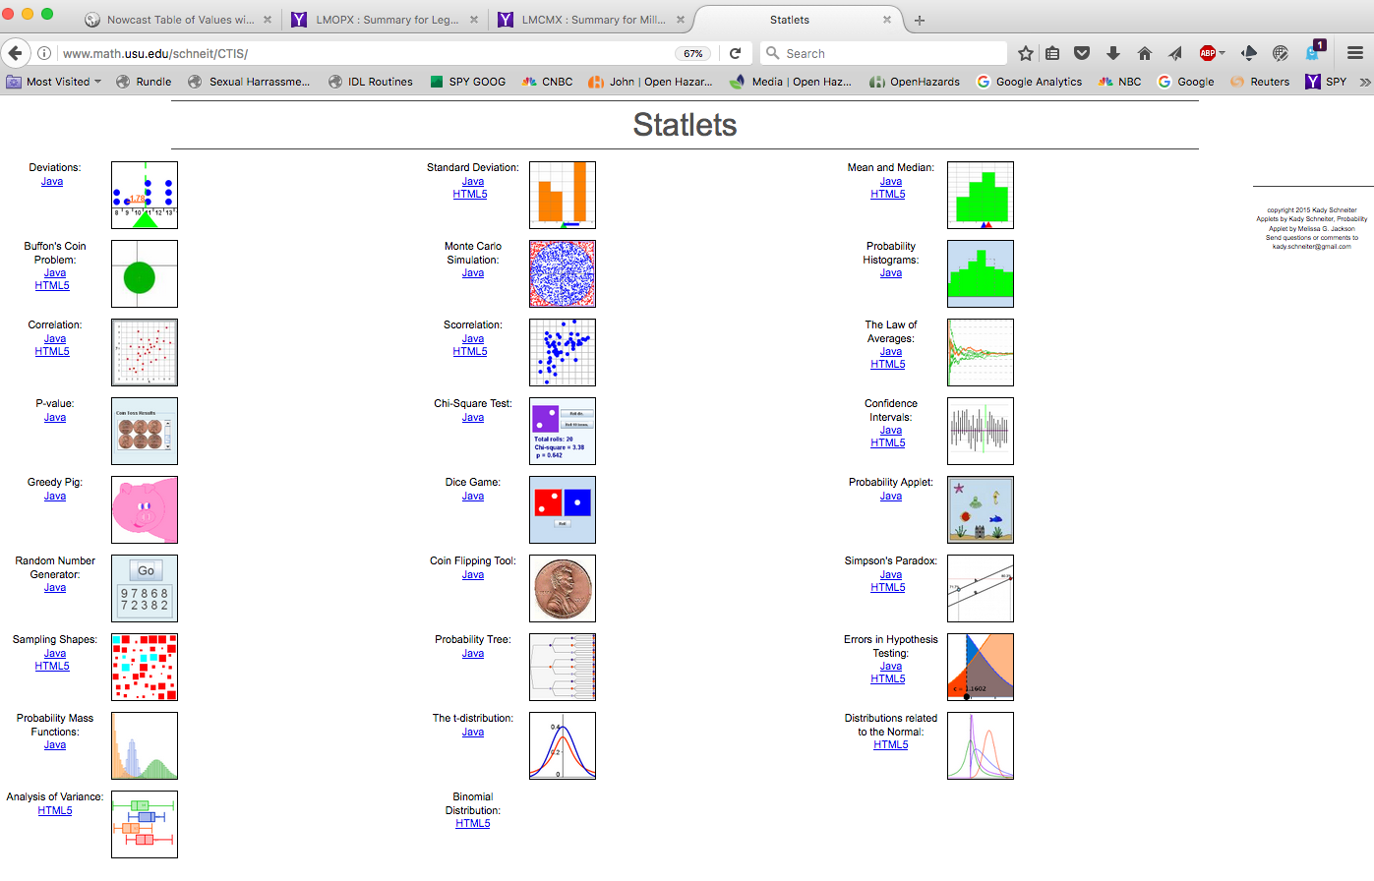
Statlets http://www.math.usu.edu/schneit/CTIS/

Slide 26
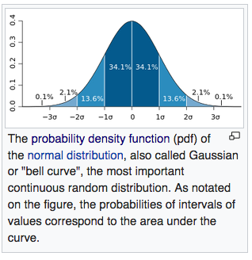
Probability Densities https://en.wikipedia.org/wiki/Probability_distribution
The following terms are used for non-cumulative probability distribution functions:
Probability mass, Probability mass function, PMF: for discrete random variables.
Probability density, Probability density function, PDF: most often reserved for continuous random variables.
A probability density function can be thought of as a histogram that has been normalized so that its total mass is 1.

Slide 27
Probability Densities https://en.wikipedia.org/wiki/Probability_distribution
Basic terms
Mode: for a discrete random variable, the value with highest probability (the location at which the probability mass function has its peak); for a continuous random variable, the location at which the probability density function has its peak.
Tail: the complement of the head within the support; the large set of values where the pmf or pdf is relatively low.
Expected value or mean: the weighted average of the possible values, using their probabilities as their weights; or the continuous analog thereof.
Median: the value such that the set of values less than the median has a probability of one-half.
Variance: the second moment of the pmf or pdf about the mean; an important measure of the dispersion of the distribution.
Standard deviation: the square root of the variance, and hence another measure of dispersion.

Slide 28
Probability Densities https://en.wikipedia.org/wiki/Probability_distribution
Symmetry: a property of some distributions in which the portion of the distribution to the left of a specific value is a mirror image of the portion to its right.
Skewness: a measure of the extent to which a pmf or pdf "leans" to one side of its mean. (The third standardized moment , or moment about the mean, of the distribution.)
Kurtosis: a measure of the "fatness" of the tails of a pmf or pdf.( The fourth standardized moment of the distribution.)

Slide 29
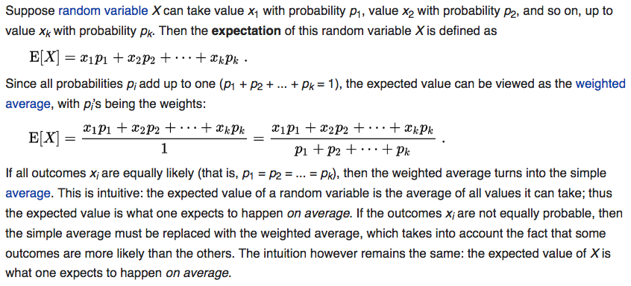
Expected Value (Sample Mean) https://en.wikipedia.org/wiki/Experiment_(probability_theory)

Slide 30
Expected Value (Sample Mean) https://en.wikipedia.org/wiki/Expected_value

Slide 31
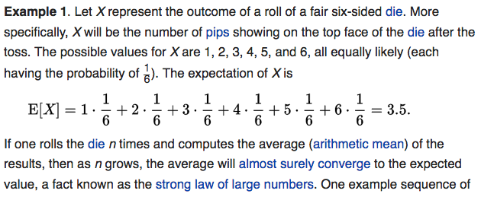
Expected Value (Sample Mean) https://en.wikipedia.org/wiki/Experiment_(probability_theory)

Slide 32
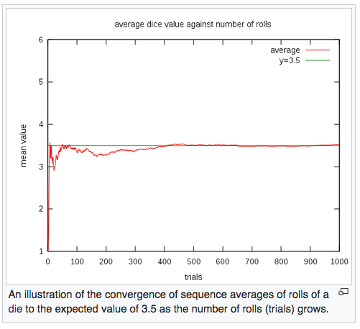
Expected Value (Sample Mean) https://en.wikipedia.org/wiki/Experiment_(probability_theory)
The rate of convergence can be
roughly quantified by
Chebyshev's inequality and the
Berry–Esseen theorem.

Slide 33
Expected Value (Discrete Random Variables) https://en.wikipedia.org/wiki/Experiment_(probability_theory)

Slide 34
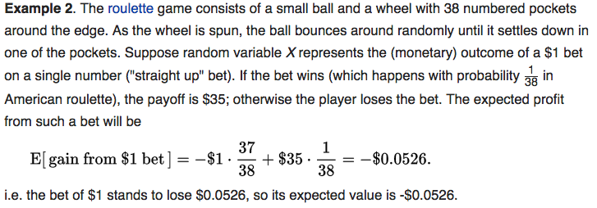
Expected Value (Sample Mean) https://en.wikipedia.org/wiki/Experiment_(probability_theory)
Bad bet !!

Slide 35
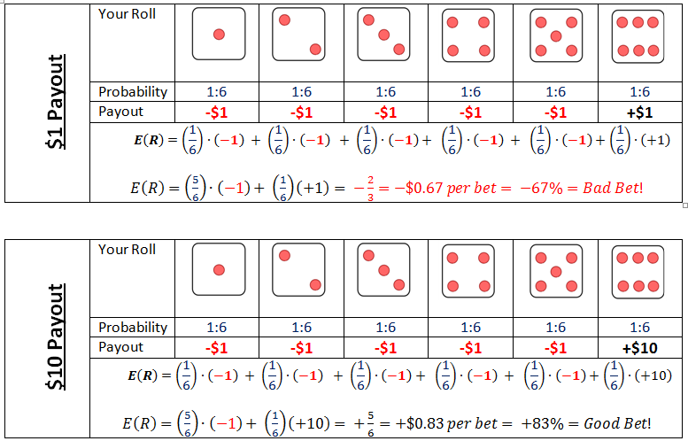
Expectation: Example https://www.boundless.com/finance/textbooks/boundless-finance-textbook/introduction-to-risk-and-return-8/understanding-return-76/expected-return-340-3795/

Slide 36
Expected Value (Continuous Random Variables) https://en.wikipedia.org/wiki/Experiment_(probability_theory)

Slide 37
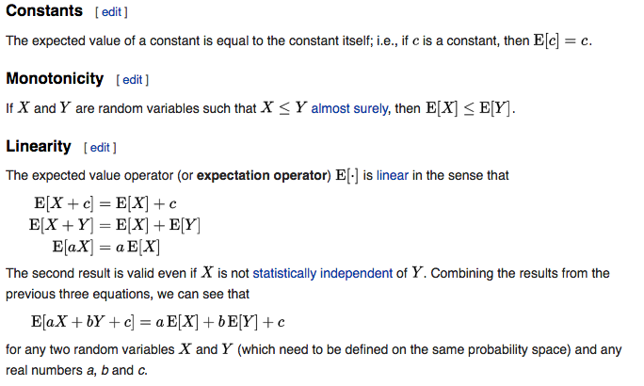
Expected Value: Properties https://en.wikipedia.org/wiki/Expected_value

Slide 38
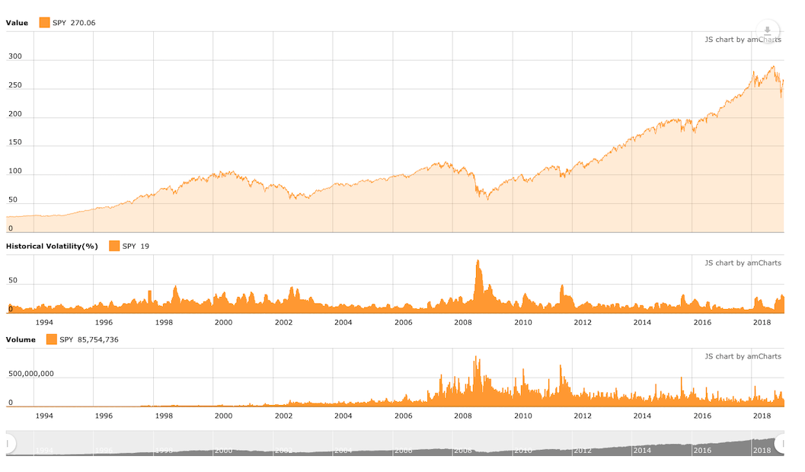
Buy and Hold: Does it Work?
An Application of Probability to the SPY ETF
Holding Period

Slide 39
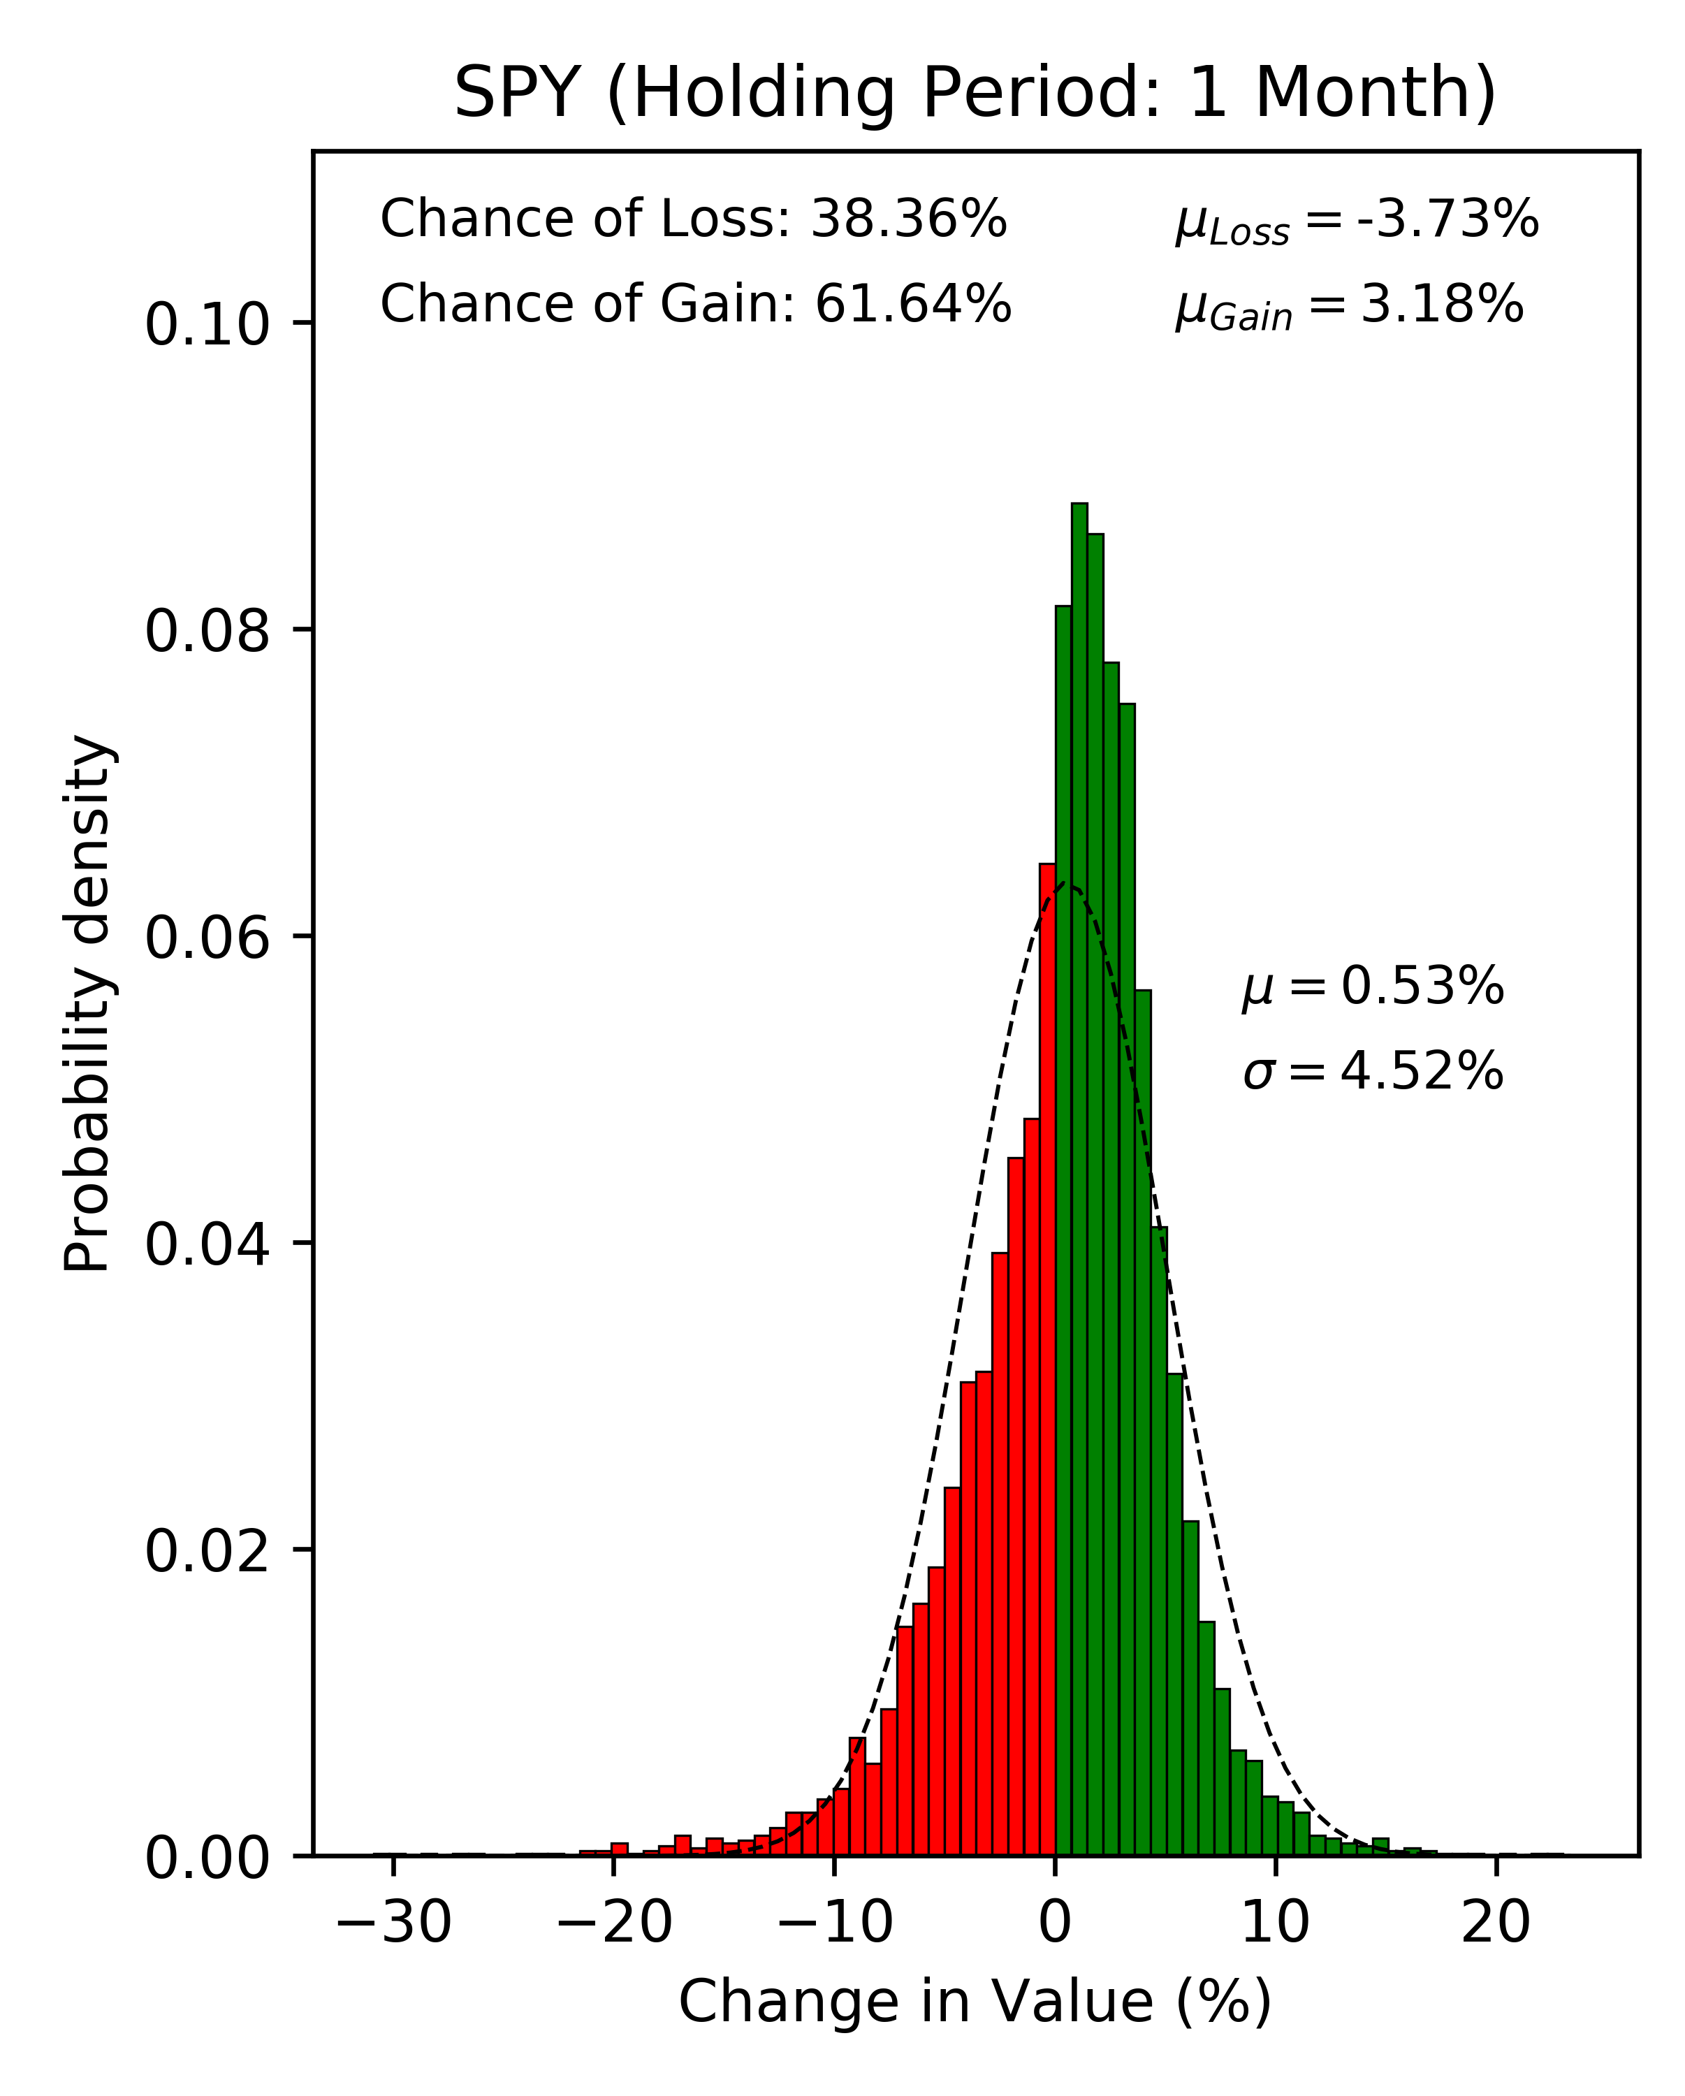
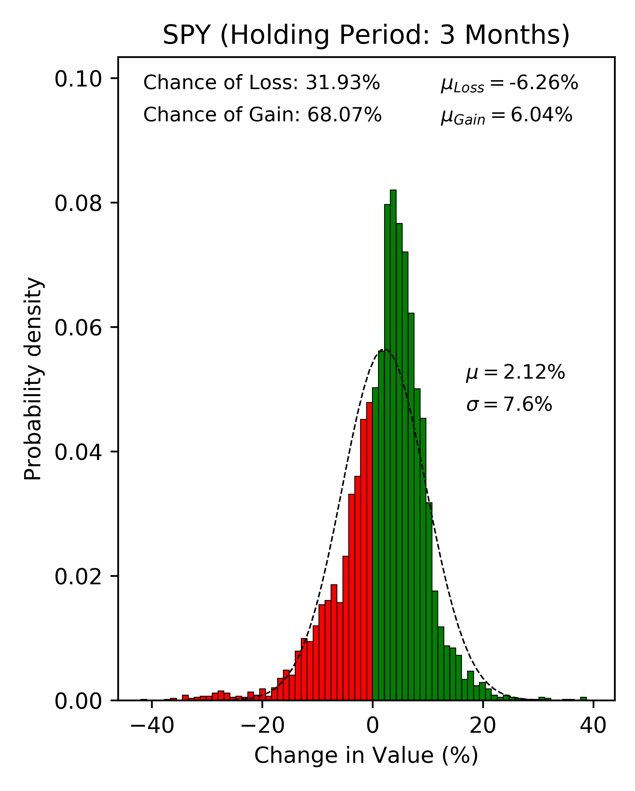
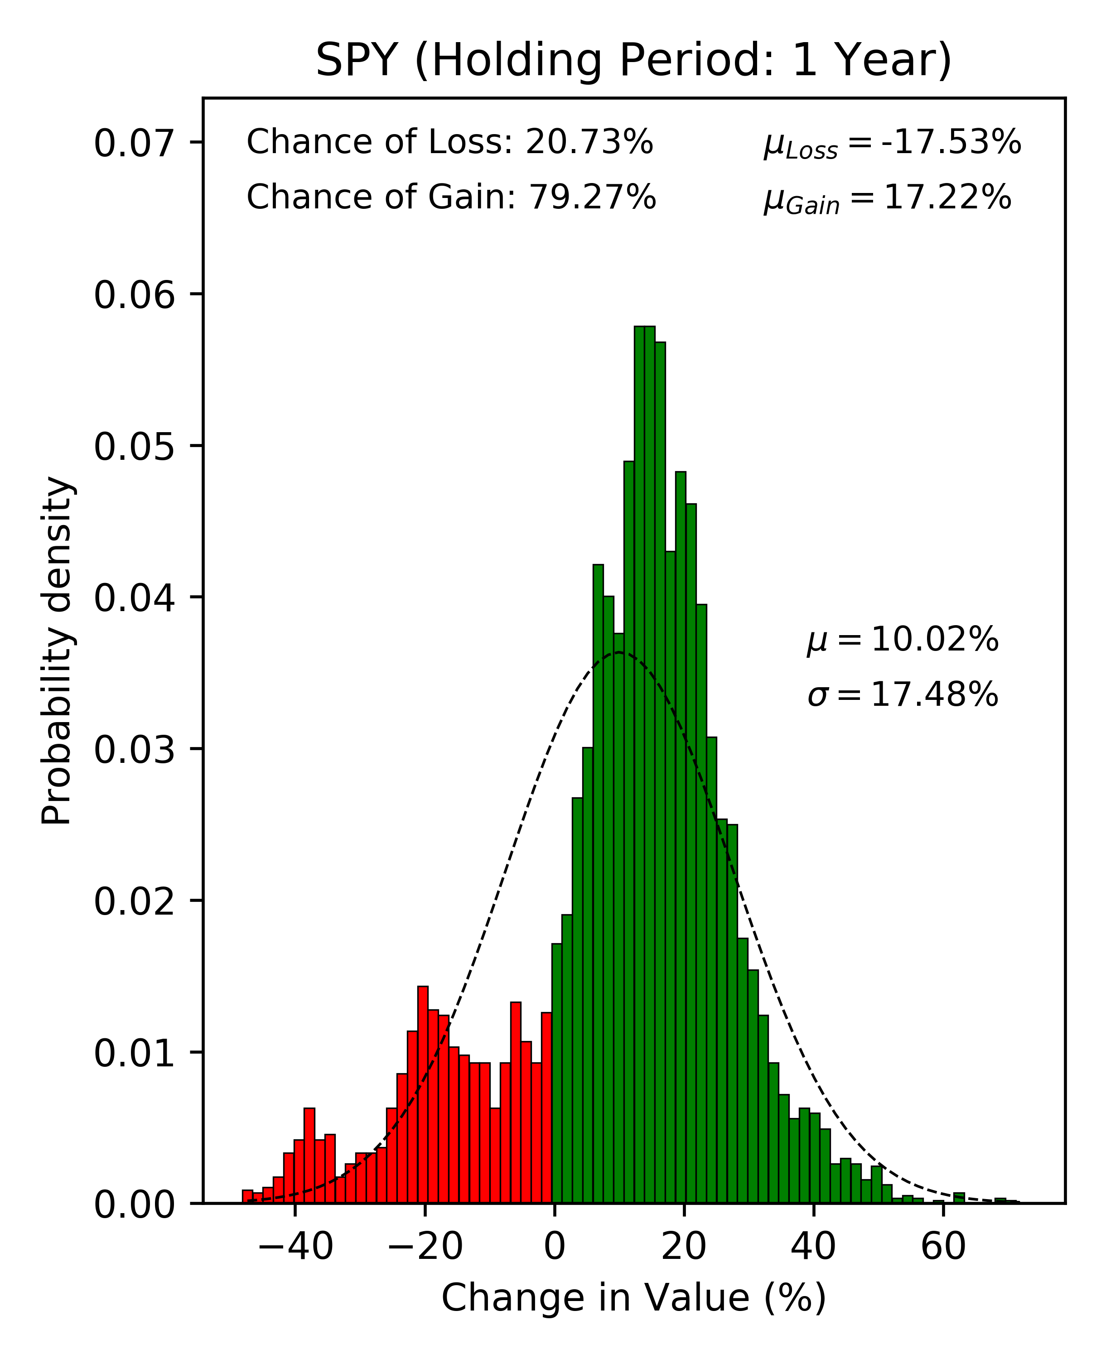
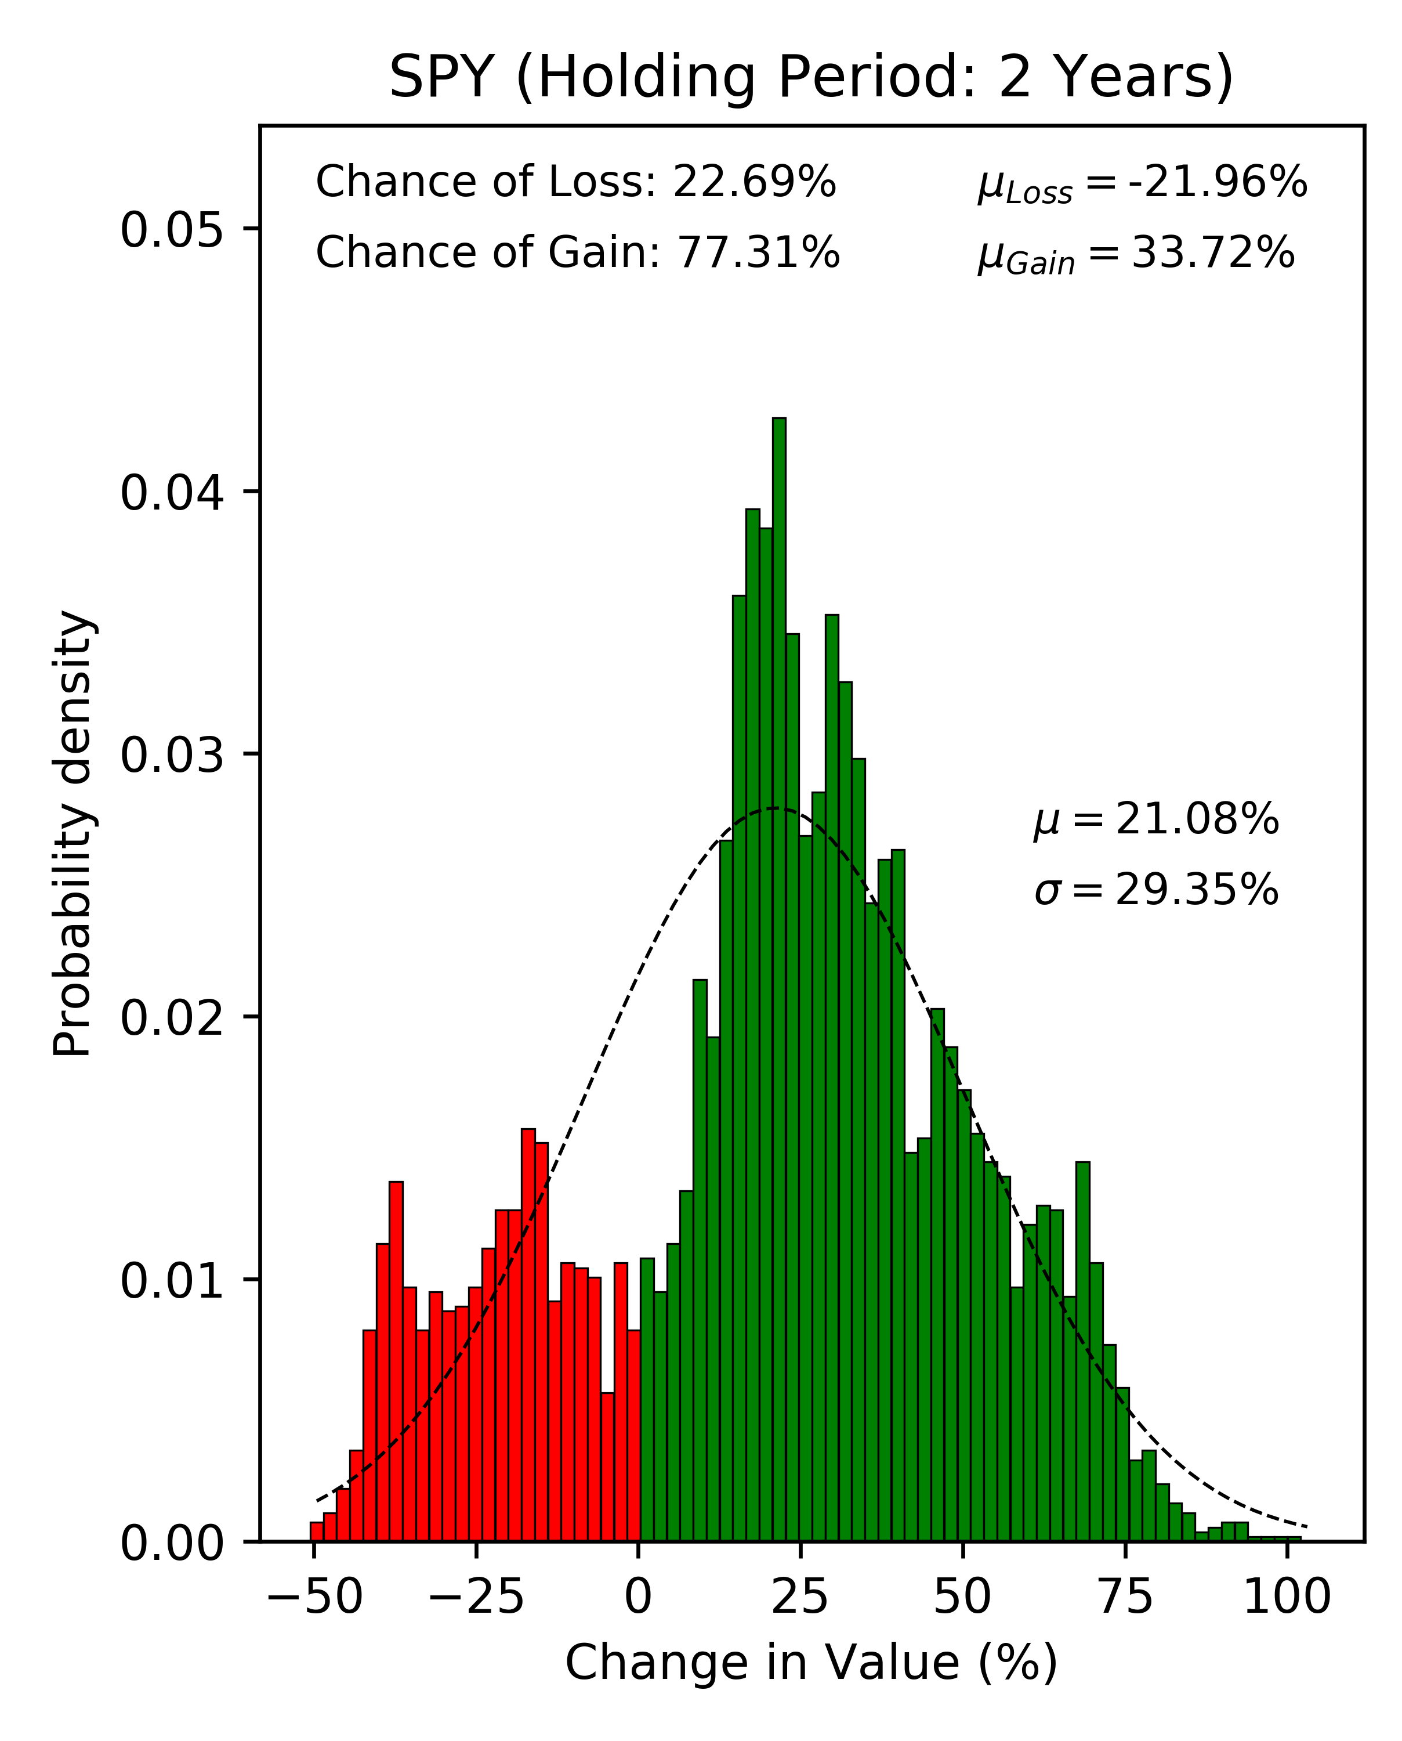
Buy and Hold: Does it Work?
An Application of Probability to the SPY ETF

Slide 40
Fourier Transforms https://en.wikipedia.org/wiki/Fourier_transform
The term Fourier transform refers to both the frequency domain representation and the mathematical operation that associates the frequency domain representation to a function of time.
The Fourier transform is not limited to functions of time, but in order to have a unified language, the domain of the original function is commonly referred to as the time domain.
For many functions of practical interest, one can define an operation that reverses this, the inverse Fourier transformation of a frequency domain representation combines the contributions of all the different frequencies to recover the original function of time.

Slide 41
Fourier Transforms https://en.wikipedia.org/wiki/Fourier_transform

Slide 42
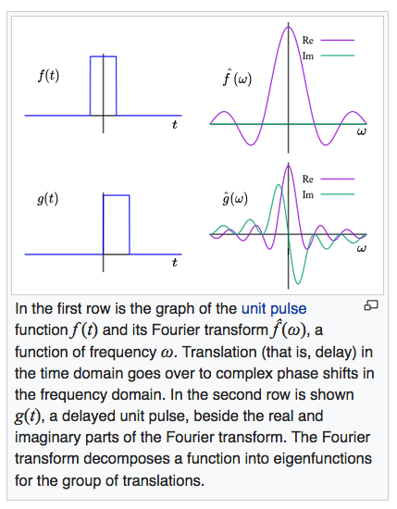
Fourier Transforms https://en.wikipedia.org/wiki/Fourier_transform

Slide 43
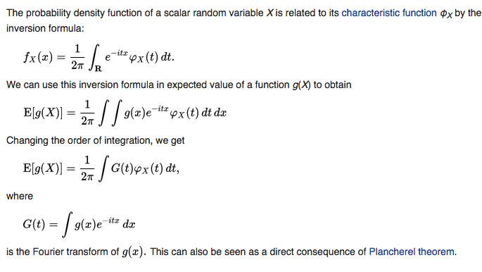
Expected Value & Characteristic Function https://en.wikipedia.org/wiki/Expected_value

