Slide 1
Lectures 4-6 (Summary)
Earthquake Science (Condensed)
John Rundle GEL/EPS 131

Slide 2
Earthquake Energy – Basic Facts
Approximately 10¹⁶ Joules/yr of radiated energy are released in earthquakes
Radiated energy (energy in waves) is only one part of the energy budget
There is also energy of heating on the fault, change in stored elastic energy, and change in gravitational potential energy
A good discussion is in H. Kanamori (Journal of Geophysical Research, 1977)

Slide 3
Charles Richter http://en.wikipedia.org/wiki/Charles_Francis_Richter
Born April 26, 1900, Overpeck Ohio
Died September 30, 1985, Pasadena, CA
Attended Stanford and Caltech
Co-Invented the idea of the Richter magnitude scale for earthquakes (with Beno Gutenberg)

Slide 4
Charles Richter http://en.wikipedia.org/wiki/Charles_Francis_Richter
Richter went to work at the Carnegie Institute in 1927 after receiving a job offer to be a research assistant there from Robert Millikan
Here he began a collaboration with Beno Gutenberg.
The Seismology Lab at the California Institute of Technology was hoping to begin publishing regular reports on earthquakes in southern California and had a pressing need to have a system of measuring the strength of earthquakes for these reports.
Together, they had devised the scale that would become known as the Richter scale to fill this need, based on measuring quantitatively the displacement of the earth due to seismic waves, as had been suggested by Kiyoo Wadati, a Japanese seismologist.
The pair designed a seismograph that measured this displacement, and developed a logarithmic scale to measure amplitude of displacement.

Slide 5
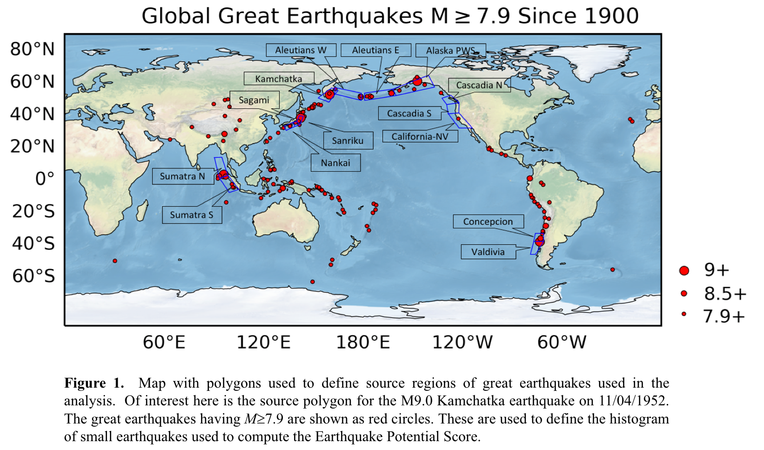
Great Global Earthquakes

Slide 6
Radiated Energy www.geology.ar.gov
~2600 Megatons

Slide 7
Seismic Waves are More Complex
This is a typical local earthquake seismogram
P waves travel faster than S waves, typically by a factor of about 5/3
The P wave arrives first
The S wave arrives second
You can tell approximately how far away the earthquake is in km from the seismometer by multiplying the P-S time by 6
Here the earthquake is about 60 km from the seismometer

Slide 8
Seismometers are of Two Types
Velocity transducers, that measure the ground velocity at the seismometer site
Strong motion instruments, that measure the ground acceleration at the seismometer
It can be shown that acceleration decays more rapidly with distance than does velocity, although the relationship is complex
Ground motion also depends on magnitude of the source earthquake, due to saturation effects
This is discussed for example in Boore and Atkinson (Earthquake Spectra, 2008)

Slide 9
An Early Seismometer was a Wood-Anderson Torsional Seismometer
http://www.eas.slu.edu/eqc/eqc_instruments/wood_and.html
eqseis.geosc.psu.edu (Chuck Ammon)

Slide 10
Seismographs and Seismometers http://en.wikipedia.org/wiki/Seismometer
A seismograph typically records the seismic wave amplitude as a function of time on a chart or graph
A seismometer measures the amplitude of the waves and records them digitally
At right, a relatively modern Kinemetrics seismograph
It is called a “…graph” since it records the waves on a cylindrical piece of paper, creating a graph

Slide 11
Seismographs and Seismometers http://en.wikipedia.org/wiki/Seismometer
Early seismoscopes could only determine that an earthquake has occurred, and from which direction the waves were traveling
At right, a seismoscope from the Han dynasty, China, AD132
The dragons held metal balls in their mouths
Seismic waves from a given direction would cause that ball to fall into the frog receptacle
The observer could then tell from which direction the waves originated

Slide 12
Earthquake Recurrence
Generally defined to be the average time interval between earthquakes on a fault
However, earthquakes on a fault do not repeat exactly
Should we use a point on a fault, or should we use some other criterion?
What to do if the earthquakes are usually different in magnitude and extent?

Slide 13
However, Nothing is Simple whipple_arrowsmith598.asu.edu/

Slide 14
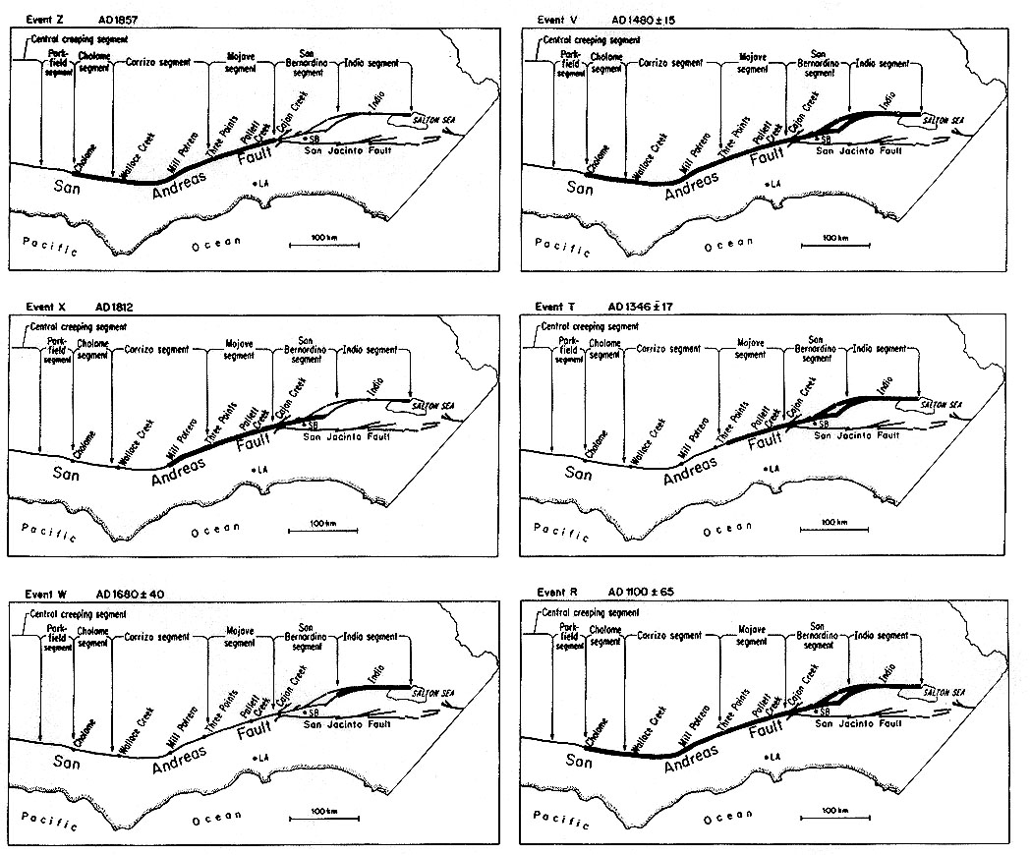
Space-Time Patterns of Historic Earthquakes in California
K. Sieh et al., JGR (1989)
A.D. 1857
1480
Major events on the San Andreas Fault
1812
1346
1680
1100

Slide 15
Recurrence and Paleoseismology whipple_arrowsmith598.asu.edu/

Slide 16
Models of Recurrence whipple_arrowsmith598.asu.edu/

Slide 17
How do We Connect the Dots? whipple_arrowsmith598.asu.edu/
(Ray Weldon)
Start here

Slide 18
North Anatolian Fault A Good Example or an Outlier? http://en.wikipedia.org/wiki/North_Anatolian_Fault

Slide 19
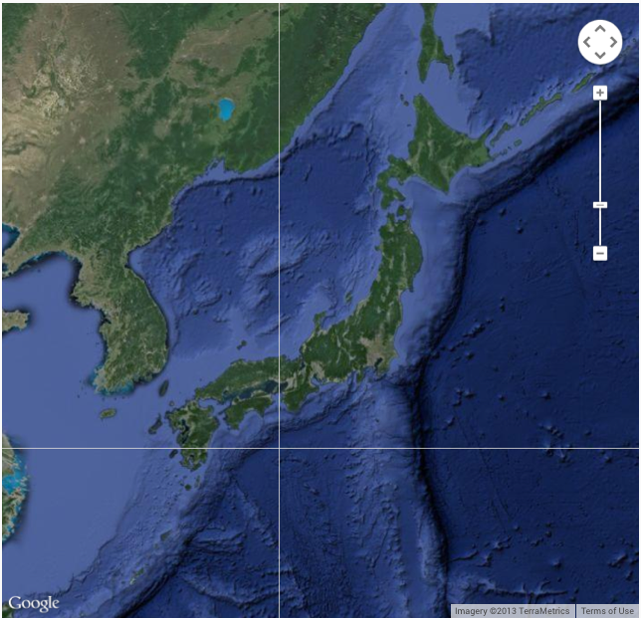
Earthquakes in Nankai Trough, Japan M Ando, Tectonophysics, v27, p112 (1975)
Data from historic writings in Japan
Basic idea of "characteristic earthquake" essentially started here

Slide 20
Two Types of Earthquake Measures
Magnitude: A measure that characterizes the earthquake source (also seen in other types of hazard phenomena)
Intensity: A measure that characterizes the effect of the earthquake on a local site (as before: seen in other types of hazard phenomena)
Definitions
Epicenter: The point, projected onto the earth’s surface, at which the fault slip starts. Typically stated in latitude and longitude.
Hypocenter: The actual point within the earth at which the fault slip starts. Typically stated in latitude, longitude, and depth.
Source region: A somewhat loose term used to describe the volume of rock encompassing the active fault

Slide 21
Giuseppe Mercalli http://en.wikipedia.org/wiki/Giuseppe_Mercalli
Italian Volcanologist
Born May 21, 1850 in Milan, Italy
Died March 19, 1914, Naples, Italy
Known for the Mercalli Intensity scale for measuring ground motion intensity

Slide 22
Mercalli Intensity ema.alabama.gov
Notice: These are all properties of the ground motion, not necessarily of the earthquake source!

Slide 23
Mercalli Intensity http://en.wikipedia.org/wiki/Mercalli_intensity_scale
Notice: These are all properties of the ground motion, not necessarily of the earthquake source!

Slide 24
Mercalli Intensity vs. Magnitude
The Mercalli scale was a big advance for its time, and we still use it to express ground motion intensity
However, it says nothing about the earthquake source or its energy release
A great earthquake far away can produce the same ground motion as a small close-by earthquake
The magnitude scale was invented to address these problems – it characterizes only the source!
Note that other intensity scales exist besides Modified Mercalli Intensity: E.g., the Japan Meteorogical Agency (JMA) intensity scale

Slide 25
Isoseismals http://en.wikipedia.org/wiki/Isoseismal_map
In seismology an isoseismal map is used to show lines of equal felt seismic intensity, generally measured on the Modified Mercalli scale.
Such maps help to identify earthquake epicenters, particularly where no instrumental records exist, such as for historical earthquakes.
They also contain important information on ground conditions at particular locations, the underlying geology, radiation pattern of the seismic waves and the response of different types of buildings.
They form an important part of the macroseismic approach, i.e. that part of seismology dealing with non-instrumental data.
The shape and size of the isoseismal regions can be used to help determine the magnitude, focal depth and focal mechanism of an earthquake.

Slide 26
Construction of Isoseismal Maps http://en.wikipedia.org/wiki/Isoseismal_map
“First, observations of the felt intensity need to be obtained for all areas affected by the tremor.
In the case of recent earthquakes news reports are augmented by sending out questionnaires or by collecting information online about the intensity of the shaking.
For a historical earthquake the procedure is much the same, except that it requires searching through contemporary accounts in newspapers, letters and diaries etc.
Once the information has been assembled and intensities assigned at the location of the individual observations, these are plotted on a map.
Isoseismal lines are then drawn to link together areas of equal shaking.’
Because of local variations in the ground conditions isoseismals will generally separate zones of broadly similar felt intensity, while containing areas of both higher and lower degrees of shaking.
To make the isoseismals less subjective, attempts have been made to use computer-based methods of contouring such as kriging, rather than relying on visual interpolation.”

Slide 27
Isoseismal Map http://earthquake.usgs.gov/earthquakes/states/historical.php
This earthquake is one of the most devastating in the history of California.
The earthquake and resulting fires caused an estimated 3,000 deaths and $524 million in property loss.
Damage in San Francisco resulting only from the earthquake was estimated at $20 million
Outside the city, it was estimated at $4 million.
The sensible duration of the shaking in San Francisco was about 1 minute.
The earthquake damaged buildings and structures in all parts of the city and county of San Francisco, although over much of the area, the damage was moderate in amount and character.

Slide 28
Isoseismal Maps http://earthquake.usgs.gov/earthquakes/states/historical.php
This destructive earthquake was associated with the Newport-Inglewood fault.
Shocks similar in magnitude and intensity to this event have occurred in this area in the past - notably July 28, 1769; December 8, 1812; and July 11, 1855.
Although only moderate in terms of magnitude, this earthquake caused serious damage to weak masonry structures on land fill from Los Angeles south to Laguna Beach.
Property damage was estimated at $40 million, and 115 people were killed.
Some thought now that this earthquake could have been related to oil drilling

Slide 29
ShakeMap Examples usgs.gov
Tohoku earthquake, March 11, 2011
Magnitude 9.1
Tsunami killed over 17,000 persons
Damage approaching $1T USD (including Fukushima meltdown)

Slide 30
Haiti Earthquake ShakeMap usgs.gov
Magnitude 7.0
January 12, 2010
21:53:09 GMT
200,000 + persons killed
Damages of ~$12B USD (about the size of their GDP)

Slide 31
Northridge ShakeMap pubs.usgs.gov
Northridge, CA earthquake, January 17, 1994 04:31 PST
PGA 1.8g
PGV 1.83 m/s
Magnitude 6.7
57 persons killed, 8700 injured
Damage in excess of $20 billion
Loss including economic losses totaled about $50 billion (loss of business, etc.)
Led to the formation of the California Earthquake Authority (public-private insurance partnership)

