Slide 1
Lecture 3
Introduction to Markets
John Rundle Econophysics PHYS 250

Slide 2
Need for Financial Markets https://en.wikipedia.org/wiki/Financial_market
Financial markets attract funds from investors and channel them to corporations—they thus allow corporations to finance their operations and achieve growth.
Without financial markets, borrowers would have difficulty finding lenders themselves. Intermediaries such as banks, Investment Banks, and Boutique Investment Banks can help in this process.
More complex transactions than a simple bank deposit require markets where lenders and their agents can meet borrowers and their agents
A good example of a financial market is a stock exchange. A company can raise money by selling shares to investors and its existing shares can be bought or sold.

Slide 3
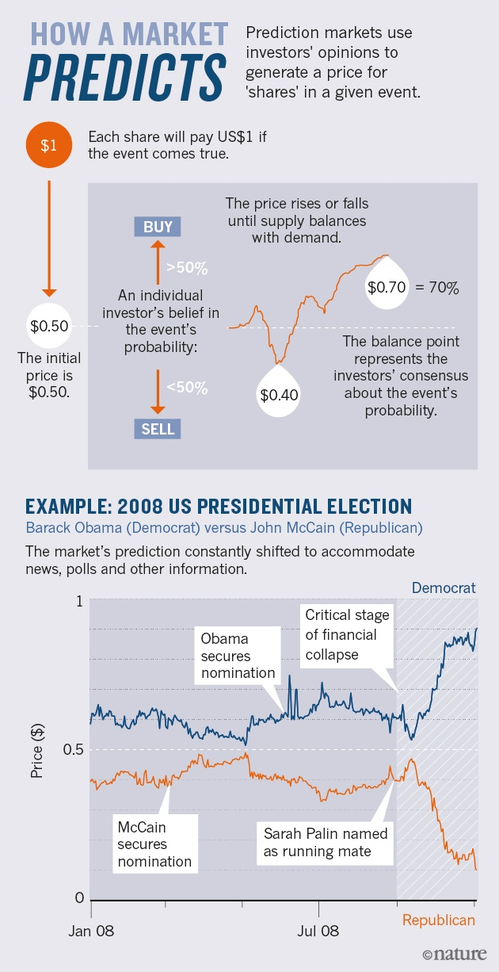
Prediction Markets
Prediction markets (also known as predictive markets, information markets, decision markets, idea futures, event derivatives, or virtual markets) are exchange-traded markets created for the purpose of trading the outcome of events.
The market prices can indicate what the crowd thinks the probability of the event is.

Slide 4
Financial Market Participants https://en.wikipedia.org/wiki/Financial_market
Agents: 1) Counterparties 2) Market Makers
The two parties in a contract agreement
The people who establish and maintain the operation of the market by supplying liquidity

Slide 5
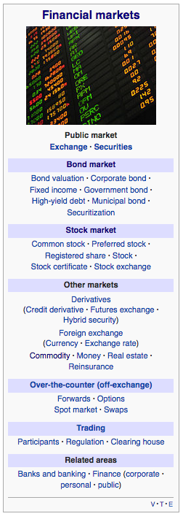
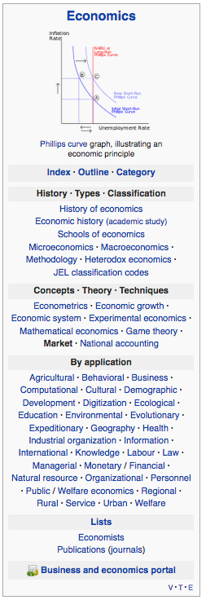

Slide 6
Types of Financial Markets https://en.wikipedia.org/wiki/Financial_market
Capital markets which to consist of:
Stock markets, which provide financing through the issuance of shares or common stock, and enable the subsequent trading thereof.
Bond markets, which provide financing through the issuance of bonds, and enable the subsequent trading thereof.
Commodity markets, which facilitate the trading of commodities.
Money markets, which provide short term debt financing and investment.
Derivatives markets, which provide instruments for the management of financial risk.
Futures markets, which provide standardized forward contracts for trading products at some future date; see also forward market.
Foreign exchange markets, which facilitate the trading of foreign exchange.
Spot market
Interbanks market
Critical role of a clearinghouse, which ensures trades proceed reliably

Slide 7
Primary and Secondary Markets https://en.wikipedia.org/wiki/Financial_market
The capital markets may also be divided into primary markets and secondary markets.
Newly formed (issued) securities are bought or sold in primary markets, such as during initial public offerings.
Secondary markets allow investors to buy and sell existing securities.
Transactions in primary markets exist between issuers and investors, while secondary market transactions exist among investors.

Slide 8
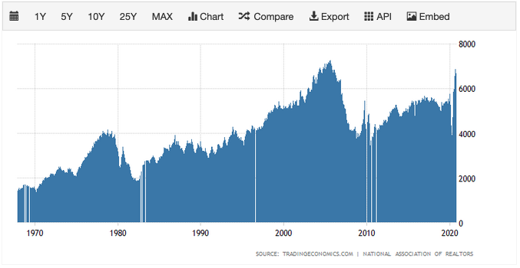
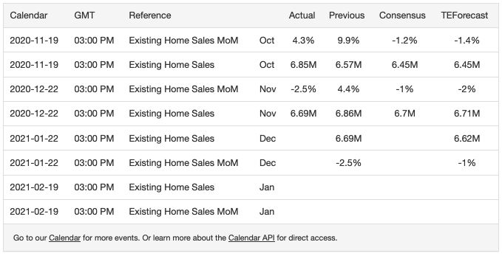
US Existing Home Sales (Thousands)
https://tradingeconomics.com/united-states/existing-home-sales

Slide 9
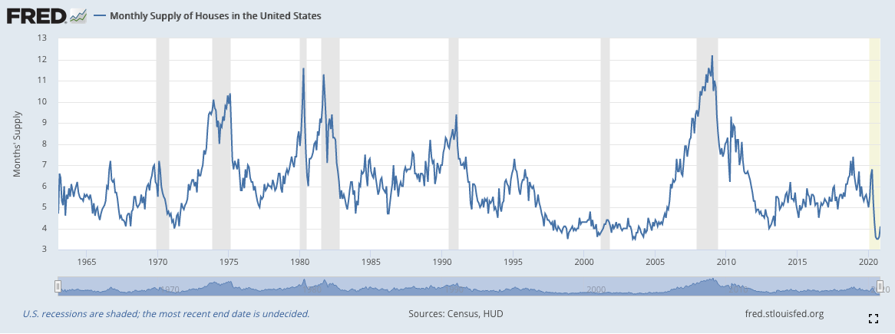
Monthly Supply of US Homes
https://fred.stlouisfed.org/series/MSACSR

Slide 10
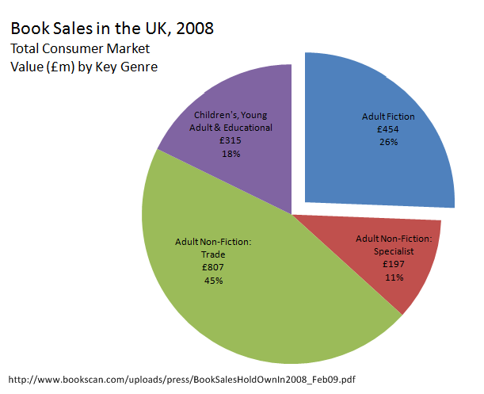

Slide 11
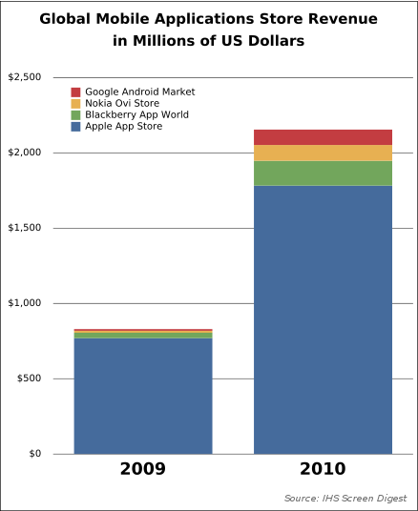

Slide 12
Liquidity https://en.wikipedia.org/wiki/Financial_market
Liquidity is a crucial aspect of securities that are traded in secondary markets.
Liquidity refers to the ease with which a security can be sold without a loss of value.
Securities with an active secondary market mean that there are many buyers and sellers at a given point in time.
Investors benefit from liquid securities because they can sell their assets whenever they want.
An illiquid security may force the seller to sell their asset at a large discount.

Slide 13
Market Liquidity General Features
Liquid Market
Illiquid Market
Buy
Buy
Sell
Sell
Number of Buyers or Sellers
Number of Buyers or Sellers
Price Gap
Spot Price
Price
Price

Slide 14
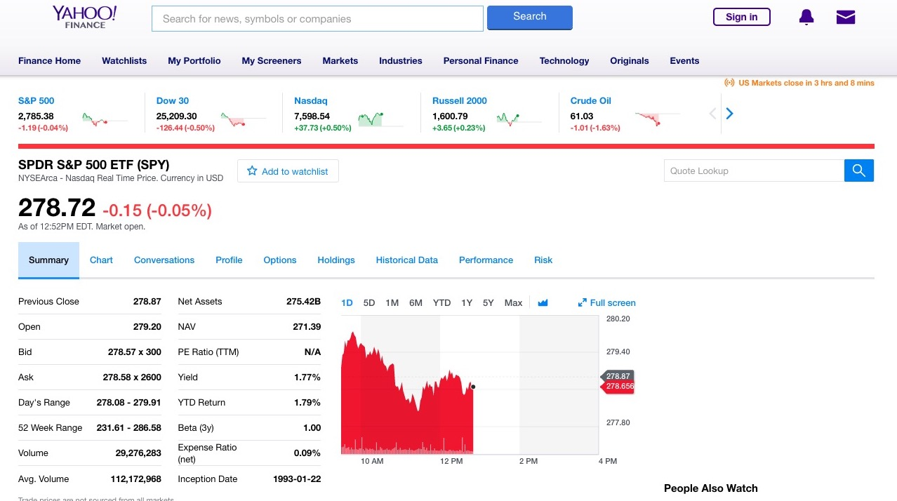
Liquidity of SPY ETF
Small difference between bid and ask means high liquidity

Slide 15
General Aspects of Market Liquidity
On the run: Current auction.
Off the run: Older but existing
http://www.zerohedge.com/sites/default/files/images/user5/imageroot/2013/08/liquidity%201.jpg

Slide 16
Stock Markets https://en.wikipedia.org/wiki/Stock_market
The total market capitalization of equity backed securities worldwide rose from US$2.5 trillion in 1980 to US$68.65 trillion at the end of 2018.
As of December 31, 2019, the total market capitalization of all stocks worldwide was approximately US$70.75 trillion.
As of 2016, there are 60 stock exchanges in the world. Of these, there are 16 exchanges with a market capitalization of $1 trillion or more, and they account for 87% of global market capitalization.
Apart from the Australian Securities Exchange, these 16 exchanges are all in either North America, Europe, or Asia.
By country, the largest stock markets as of January 2020 are in the United States of America (about 54.5%), followed by Japan (about 7.7%) and the United Kingdom (about 5.1%).

Slide 17
Standard and Poors 500 Index http://siblisresearch.com/data/total-market-cap-sp-500/

Slide 18
Standard and Poors 500 Index http://siblisresearch.com/data/total-market-cap-sp-500/

Slide 19
SPY Exchange Traded Fund An index fund that tracks the SP500

Slide 20
Standard and Poors 500 Index http://siblisresearch.com/data/total-market-cap-sp-500/

Slide 21
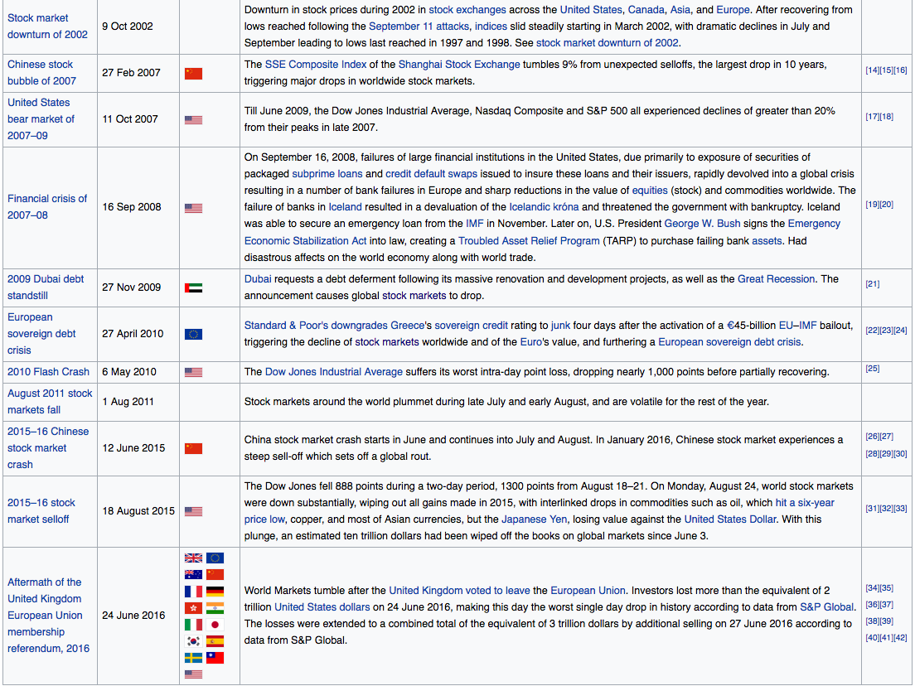
Recent Market Crashes and Bear Markets https://en.wikipedia.org/wiki/List_of_stock_market_crashes_and_bear_markets

Slide 22
Markets and Corporate Profits
The relationship appears to be breaking down somewhat. Now driven in part by FED-supplied liquidity

Slide 23
Bond (or Fixed Income) Market https://en.wikipedia.org/wiki/Bond_market
The bond market (also debt market or credit market) is a financial market where participants can issue new debt, known as the primary market.
Participants can also buy and sell debt securities, known as the secondary market.
This is usually in the form of bonds, but it may include notes, bills, and other maturities.
Its primary goal is to provide long-term funding for public and private expenditures.
The bond market has largely been dominated by the United States, which accounts for about 44% of the market.

Slide 24
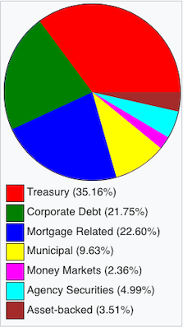
Size of Bond Market https://en.wikipedia.org/wiki/Bond_market
US debt market as of Q1 2017
As of 2009, the size of the worldwide bond market (total debt outstanding) is an estimated at $82.2 trillion
The size of the outstanding U.S. bond market debt was $39.2688 trillion as of Q1 2017 according to Securities Industry and Financial Markets Association (SIFMA).

Slide 25
Credit Markets https://en.wikipedia.org/wiki/Bond_market
The bond market is part of the credit market, with bank loans forming the other main component.
The global credit market in aggregate is about 3 times the size of the global equity market.
Bank loans are not securities under the Securities and Exchange Act, but bonds typically are and are therefore more highly regulated.
Note that a security is typically a contract that can be bought or sold by participants in a market
Bonds are typically not secured by collateral (although they can be), and are sold in relatively small denominations of around $1,000 to $10,000.

Slide 26
Bonds https://en.wikipedia.org/wiki/Bond_market
Unlike bank loans, bonds may be held by retail investors.
Bonds are more frequently traded than loans, although not as often as equity.
Nearly all of the average daily trading in the U.S. bond market takes place between broker-dealers and large institutions in a decentralized over-the-counter (OTC) market.
However, a small number of bonds, primarily corporate ones, are listed on exchanges
Bond trading prices and volumes are reported on Financial Industry Regulatory Authority’s (FINRA's) Trade Reporting and Compliance Engine

Slide 27
Government Bonds https://en.wikipedia.org/wiki/Bond_market
An important part of the bond market is the government bond market, because of its size and liquidity.
Government bonds are often used to compare to other bonds to measure credit risk.
Because of the inverse relationship between bond valuation and interest rates (or yields), the bond market is often used to indicate changes in interest rates or the shape of the yield curve, the measure of "cost of funding” (following)
Inverse relationship is because interest income is preserved when bonds are transferred from one party to another

Slide 28
Examples of Treasury Yield Curves https://en.wikipedia.org/wiki/Bond_market

Slide 29
Yield Curve (Recent, ~11/2018)
Expansionary monetary policy to stimulate the economy typically involves the central bank buying short-term government bonds to lower short-term market interest rates.
However, when short-term interest rates reach or approach zero, this method can no longer work.
In such circumstances, monetary authorities may then use quantitative easing to further stimulate the economy, by buying riskier or longer maturity assets (other than short-term government bonds), thereby lowering interest rates further out on the yield curve.

Slide 30
Risk of Government Bonds https://en.wikipedia.org/wiki/Bond_market
The yield on government bonds in low risk countries such as the United States or Germany is thought to indicate a risk-free rate of default.
Other bonds denominated in the same currencies (U.S. Dollars or Euros) will typically have higher yields, because other borrowers are more likely to default
The losses to investors in the case of default are expected to be higher for other countries.
The primary way to default is to not pay in full or not pay on time.

Slide 31
Types of Bond Markets https://en.wikipedia.org/wiki/Bond_market
The Securities Industry and Financial Markets Association (SIFMA) classifies the broader bond market into five specific bond markets.
Corporate
Government and agency
Municipal
Mortgage-backed, asset-backed, and collateralized debt obligations
Funding (a mutual fund that invests only in bonds)

Slide 32
Bond Market Participants https://en.wikipedia.org/wiki/Bond_market
Participants include:
Institutional investors
Governments
Traders
Individuals
Because of the specificity of individual bond issues, and the lack of liquidity in many smaller issues, the majority of outstanding bonds are held by institutions like pension funds, banks and mutual funds.
In the United States, approximately 10% of the market is held by private individuals.

Slide 33
Size of Global Bond Market https://en.wikipedia.org/wiki/Bond_market
Amounts outstanding on the global bond market increased by 2% in the twelve months to March 2012 to nearly $100 trillion.
Domestic bonds accounted for 70% of the total and international bonds for the remainder.
The United States was the largest market with 33% of the total followed by Japan (14%).
In March 2012 global bond market was much larger than the global equity market (which had a market capitalization of around $53 trillion)

Slide 34
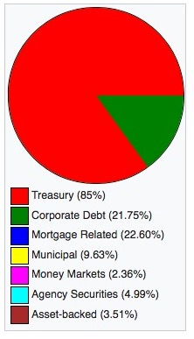
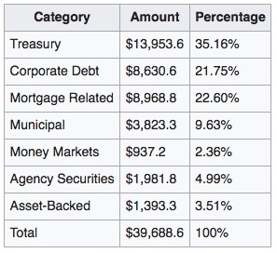
US Bond Market Size (SIFMA*) As of Q1 2017 https://screenshots.firefox.com/ScFjvZZMBmhQps2K/en.wikipedia.org
*Securities Industry and Financial Markets Association

Slide 35
Volatility and Risk https://en.wikipedia.org/wiki/Bond_market
For market participants who own a bond, collect the coupon and hold it to maturity, market volatility is irrelevant, principal and interest are received according to a pre-determined schedule.
But participants who buy and sell bonds before maturity are exposed to many risks, most importantly changes in interest rates.
When interest rates increase, the value of existing bonds falls, since new issues pay a higher yield.
Likewise, when interest rates decrease, the value of existing bonds rises, since new issues pay a lower yield.
This is because the interest payments are established at the time the bond is issued and these do not change
This is the fundamental concept of bond market volatility—changes in bond prices are inverse to changes in interest rates.
Fluctuating interest rates are part of a country's monetary policy and bond market volatility is a response to expected monetary policy and economic changes.

Slide 36
Commodity Markets https://en.wikipedia.org/wiki/Commodity_market
A commodity market is a market that trades in primary economic sector rather than manufactured products.
Soft commodities are agricultural products such as wheat, coffee, cocoa, sugar, orange juice and pork bellies.
Hard commodities are mined, such as gold and oil.
Commodies also include currencies, including crypto currencies
Investors access about 50 major commodity markets worldwide with purely financial transactions increasingly outnumbering physical trades in which goods are delivered

Slide 37
Commodities and Futures https://en.wikipedia.org/wiki/Commodity_market
Futures contracts are the oldest way of investing in commodities.
Futures are secured by physical assets.
Commodity markets can include physical trading and derivatives trading using spot prices, forwards, futures, and options on futures.
A spot price is another term for the current real time price
Farmers have used a simple form of derivative trading in the commodity market for centuries for price risk management.

Slide 38
Derivatives Markets https://en.wikipedia.org/wiki/Financial_market
During the 1980s and 1990s, a major growth sector in financial markets was the trade in so called derivative products, or derivatives for short.
In the financial markets, stock prices, bond prices, currency rates, interest rates and dividends go up and down, creating risk.
Derivative products are financial products which are used to control risk or paradoxically exploit risk.

Slide 39
Types of Derivatives https://en.wikipedia.org/wiki/Financial_market
Derivative products or instruments help the issuers to gain an unusual profit from issuing the instruments.
For using the help of these products a contract has to be agreed.
Derivative contracts are mainly 5 types:
Futures
Forwards
Options
Swaps
Exchange Traded Funds

Slide 40
Foreign Exchange (FOREX) Markets https://en.wikipedia.org/wiki/Financial_market
The most obvious buyers and sellers of currency are importers and exporters of goods.
This may have been true in the distant past, when international trade created the demand for currency markets
Now importers and exporters represent only 1/32 of foreign exchange dealing, according to the Bank for International Settlements.

Slide 41
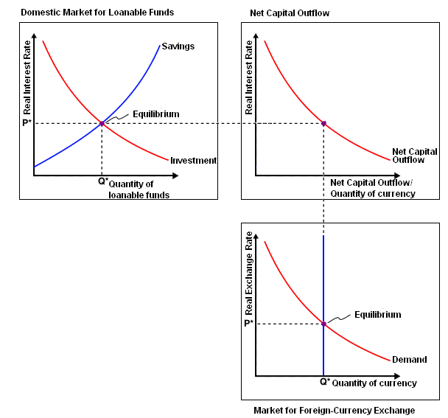
Foreign Exchange (FOREX) Markets https://en.wikipedia.org/wiki/Foreign_exchange_market
Tradeoff curves for interest rates, quantity of currencies available, and exchange rate
High interest rates attract inflows of currencies
Net capital outflow (NCO) is the net flow of funds being invested abroad by a country during a certain period of time (usually a year).
A positive NCO means that the country invests outside more than the world invests in it and vice versa.
NCO is one of two major ways of characterizing the nature of a country's financial and economic interaction with the other parts of the world (the other being the balance of trade).
For example, China has a high NCO historically
The importance of NCO. The domestic real interest rate determined in the domestic market for loanable funds moves along the NCO curve to determine the quantity of currency available for foreign exchange.
This in turn determines the real exchange rate.

Slide 42
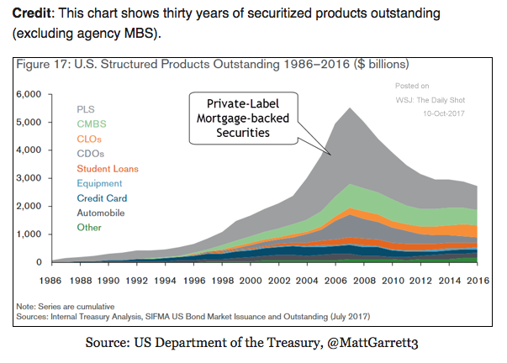
PLS: Private Label Security.
CMBS: Collateralized Mortgage Backed Security.
CLS: Collateralized Loan Obligation.
CDO: Collateralized Debt Obligation.

Slide 45
Standard and Poors 500 Index http://siblisresearch.com/data/total-market-cap-sp-500/

