Slide 1
Lecture 2
Structure of the Earth
John Rundle GEL/EPS 131

Slide 2
Topics
Origin of the earth
Internal structure
Sources of energy
Plate tectonics
Evidence for plate motions
Atmosphere
Ocean
Environment from space

Slide 3
Models for the Solar System http://abyss.uoregon.edu/~js/ast121/lectures/lec24.html
“Any model or theory for the formation of the Solar System must have a set of explanations for large-scale and small-scale properties.Large-Scale:
The planets are isolated in orderly intervals
Orbits are nearly circular
Orbits are in the same plane
All planets revolve prograde
Small-Scale:
Most planets rotate prograde (Execptions are Venus and Uranus)
The systems of moons can be divided into regular objects (spherical) with direct orbits versus irregular objects with eccentric orbits
Terrestrial planets have
high densities
thin or no atmospheres
rotate slowly
rocky, poor in ices and H/He
Jovian worlds have
low densities
thick atmospheres
rotate rapidly
many moons
fluid interiors, rich in ices, H/He
Most of outer SS objects (not just jovian worlds) are ice-rich”

Slide 4
Origin of the Sun and Planets: Models http://abyss.uoregon.edu/~js/ast121/lectures/lec24.html
Encounter hypothesis
A rogue star passes by the sun and pulls matter out from both
Gas eventually condenses into planets
Conservation of angular momentum induces rotation of the mass
Inner solar system material is more dense and forms rocky planets

Slide 5
Origin of the Sun and Planets: Models http://abyss.uoregon.edu/~js/ast121/lectures/lec24.html
Nebular hypothesis
Entire solar system starts as a cloud of gas and dust
Cools and condenses, and contracts
As it contracts, conservation of angular momentum induces rotation
Sun evolves from central mass and planets evolve from the remainder

Slide 6
Origin of the Sun and Planets: Models http://abyss.uoregon.edu/~js/ast121/lectures/lec24.html
Protoplanet hypothesis
Very similar to the nebular hypothesis
Adds additional information about physics of condensing gas clouds
“The protoplanet hypothesis suggests that about 5 billion years ago a great cloud of gas and dust rotated slowly in space. The cloud was at least 10 billion kilometers in diameter. About 10 percent of the material in the cloud formed a great plate-like disk surrounding the sun far into space. Friction within the disk caused most of its mass to collect in a number of huge whirlpools or eddies. These eddies shrank into more compact masses called protoplanets and later formed planets and moons. Some uncollected material remains even today as comets, meteoroids, and asteroids. “

Slide 7
Internal Structure of the Earth http://www.usgs.gov/science/science.php?term=292
“The earth's interior consists of several distinct regions
Crust is ~5-30 km thick (silicate rocks)
Upper mantle is from crust down to about 670 km (silicate rocks)
Lower mantle is from 670 km down to about ~2890 km depth (silicate rocks)
Outer core (liquid, mostly iron) from ~2890 km to about ~5150 km depth
Inner core (iron + nickel + sulfur) is from ~5150 km depth down to 6371 km”

Slide 8
Energy Budget http://en.wikipedia.org/wiki/File:Earth_heat_flow.jpg
“Global map of the flow of heat, in mWm-2, from Earth's interior to the surface.
Higher heat flows are observed at the locations of mid-ocean ridges, and oceanic crust has relatively higher heat flows than continental crust.”

Slide 9
Seismic Observations http://www.usgs.gov/science/science.php?term=292
“Our knowledge about the earth's interior comes primarily from seismic waves
There are many types ('phases') of waves.
P waves are longitudinal vibrations
S waves are transverse vibrations
Phases have differing designations depending on their paths”

Slide 10
Primoridal Heat http://en.wikipedia.org/wiki/Earth's_internal_heat_budget
“The flow of heat from Earth's interior to the surface is estimated at 47 terawatts and comes from two main sources:
The radiogenic heat produced by the radioactive decay of isotopes in the mantle and crust
The primordial heat left over from the formation of the Earth.
Primordial heat is the heat lost by the Earth as it continues to cool from its original formation, and this is in contrast to its still actively-produced radiogenic heat.
The Earth core's heat flow—heat leaving the core and flowing into the overlying mantle—is thought to be due to primordial heat, and is estimated at 5–15 TW.
Estimates of mantle primordial heat loss range 7–15 TW.
The early formation of the Earth's dense core could have caused superheating and rapid heat loss, and the heat loss rate would slow once the mantle solidified.
Heat flow from the core is necessary for maintaining the convecting outer core and the geodynamo and Earth's magnetic field, therefore primordial heat from the core enabled Earth's atmosphere and thus helped retain Earth's liquid water.”

Slide 11
Thickness of the Crust http://www.usgs.gov/science/science.php?term=292
“Crustal thicknesses vary from a few km at the mid-ocean ridges to perhaps 50 km or so on the interior of continents
These data are obtained from a variety of seismic measurements, including seismic refraction and reflection
Crustal thicknesses average around 30 km”

Slide 12
Convection in the Earth's Mantle http://www.usgs.gov/science/science.php?term=292
“The interior of the earth is hot and produces convective motions
Heating comes from primordial heat left over from the earth's formation, and also from radioactive decay
Radioactive elements are primarily U, K, and Th
The amount of heat escaping from the interior is about 47x10¹² Watt
About half of this is thought to come from radioactive decay
Convection also occurs in the earth's outer core and results in Taylor columns (Coriolis force balancing convection)”

Slide 13
Convection Leads to "Plumes" http://www.usgs.gov/science/science.php?term=292
“A variety of styles of convection are known
Some are in the form of "rolls"
Others are in "hexagonal" patterns
Still others are "plumes", localized regions of upwelling of hot semi-molten rock known as magma
"Magma" differs from "lava" in the chemical composition and gas content”

Slide 14
Global Patterns of Earthquakes http://www.usgs.gov/science/science.php?term=292

Slide 15
Evidence for Mantle Plumes (Koppers et al., G³, 2011)
“Hawaiian-Emperor seamount chain implies islands and seamounts at the NW end are the oldest
Hawaiian Islands are the youngest (0.4 my to ~7 my), then the Leeward Islands(~7 my to 28 my), then the Emperor Islands (~28 my to ~85my)
Loihi seamount (south of the Big Island of Hawai'i) is currently the youngest
Loihi is 1500 m below the level of the sea and will emerge in several million years as extruded lava builds it up”

Slide 16
Plate Tectonics http://www.usgs.gov/science/science.php?term=292

Slide 17
Plate Boundaries and Volcanoes http://www.usgs.gov/science/science.php?term=292

Slide 18
Evidence for Plate Tectonics http://pubs.usgs.gov/gip/dynamic/stripes.html
“One of the more remarkable pieces of evidence in favor of plate tectonics is the magnetic age stripes at mid-ocean ridges
As the plates move away from spreading centers, temperature of the hot rock falls below the Curie temperature and iron in the rock becomes magnetized with the current polarity of the earth's field
When the field changes direction (every ~450,000 years) the polarity of magnetization changes as well”

Slide 19
Global Plate Motions http://en.wikipedia.org/wiki/File:Tectonic_plates_boundaries_detailed-en.svg

Slide 20
Asia http://en.wikipedia.org/wiki/File:Tectonic_plates_boundaries_detailed-en.svg

Slide 21
Japan http://en.wikipedia.org/wiki/File:Tectonic_plates_boundaries_detailed-en.svg

Slide 22
North Pacific http://en.wikipedia.org/wiki/File:Tectonic_plates_boundaries_detailed-en.svg

Slide 23
North America-Atlantic http://en.wikipedia.org/wiki/File:Tectonic_plates_boundaries_detailed-en.svg

Slide 24
South America http://en.wikipedia.org/wiki/File:Tectonic_plates_boundaries_detailed-en.svg

Slide 25
Southern Pacific-Oceania http://en.wikipedia.org/wiki/File:Tectonic_plates_boundaries_detailed-en.svg

Slide 26
South Asia-Australia http://en.wikipedia.org/wiki/File:Tectonic_plates_boundaries_detailed-en.svg

Slide 27
Ring of Fire http://pubs.usgs.gov/gip/dynamic/understanding.html#anchor6715825
“The Pacific Ring of Fire was known long before plate tectonics was formulated
This is where most of the world's earthquakes and volcanos occur
The largest earthquakes in the world occur here, along with many of the most violent volcanic eruptions”

Slide 28
Divergent Plate Boundaries http://pubs.usgs.gov/gip/dynamic/understanding.html#anchor15343710
Lava fountains at Krafla volcano

Slide 29
Ocean-Continent Convergence http://pubs.usgs.gov/gip/dynamic/understanding.html#anchor15343710
“One of the more impressive features on the planet are the deeps, or trenches that are formed by oceanic plates subducting beneath continental lithosphere
These deep submerged valleys are 8-10 km deep
As the plates descend into the earth, they push up mountain ranges, and create volcanic arcs
Mount Fuji in Japan, and Mount St. Helens in the USA are examples”

Slide 30
Structure of a Benioff Zone - Sumatra (Images from USGS)

Slide 31
Double Benioff Zone (Hasegawa et al., 1978)
“Many Benioff zones are now known to be "double zones"
Cause is the dynamics of the bending-unbending of the plates as it descends into the earth
The plate undergoes "plastic" deformation and flow as it bends, then due to mantle flow, it "unbends"
Resulting strains lead to earthquakes at the top and bottom of the slab”

Slide 32
Oceanic-Oceanic Convergence http://pubs.usgs.gov/gip/dynamic/understanding.html#anchor15343710
“Convergence also occurs at Island Arcs
Examples include Fiji, Tonga, and other islands in the New Hebrides area
Volcanoes are produced which lead to island atolls of the south Pacific”

Slide 33
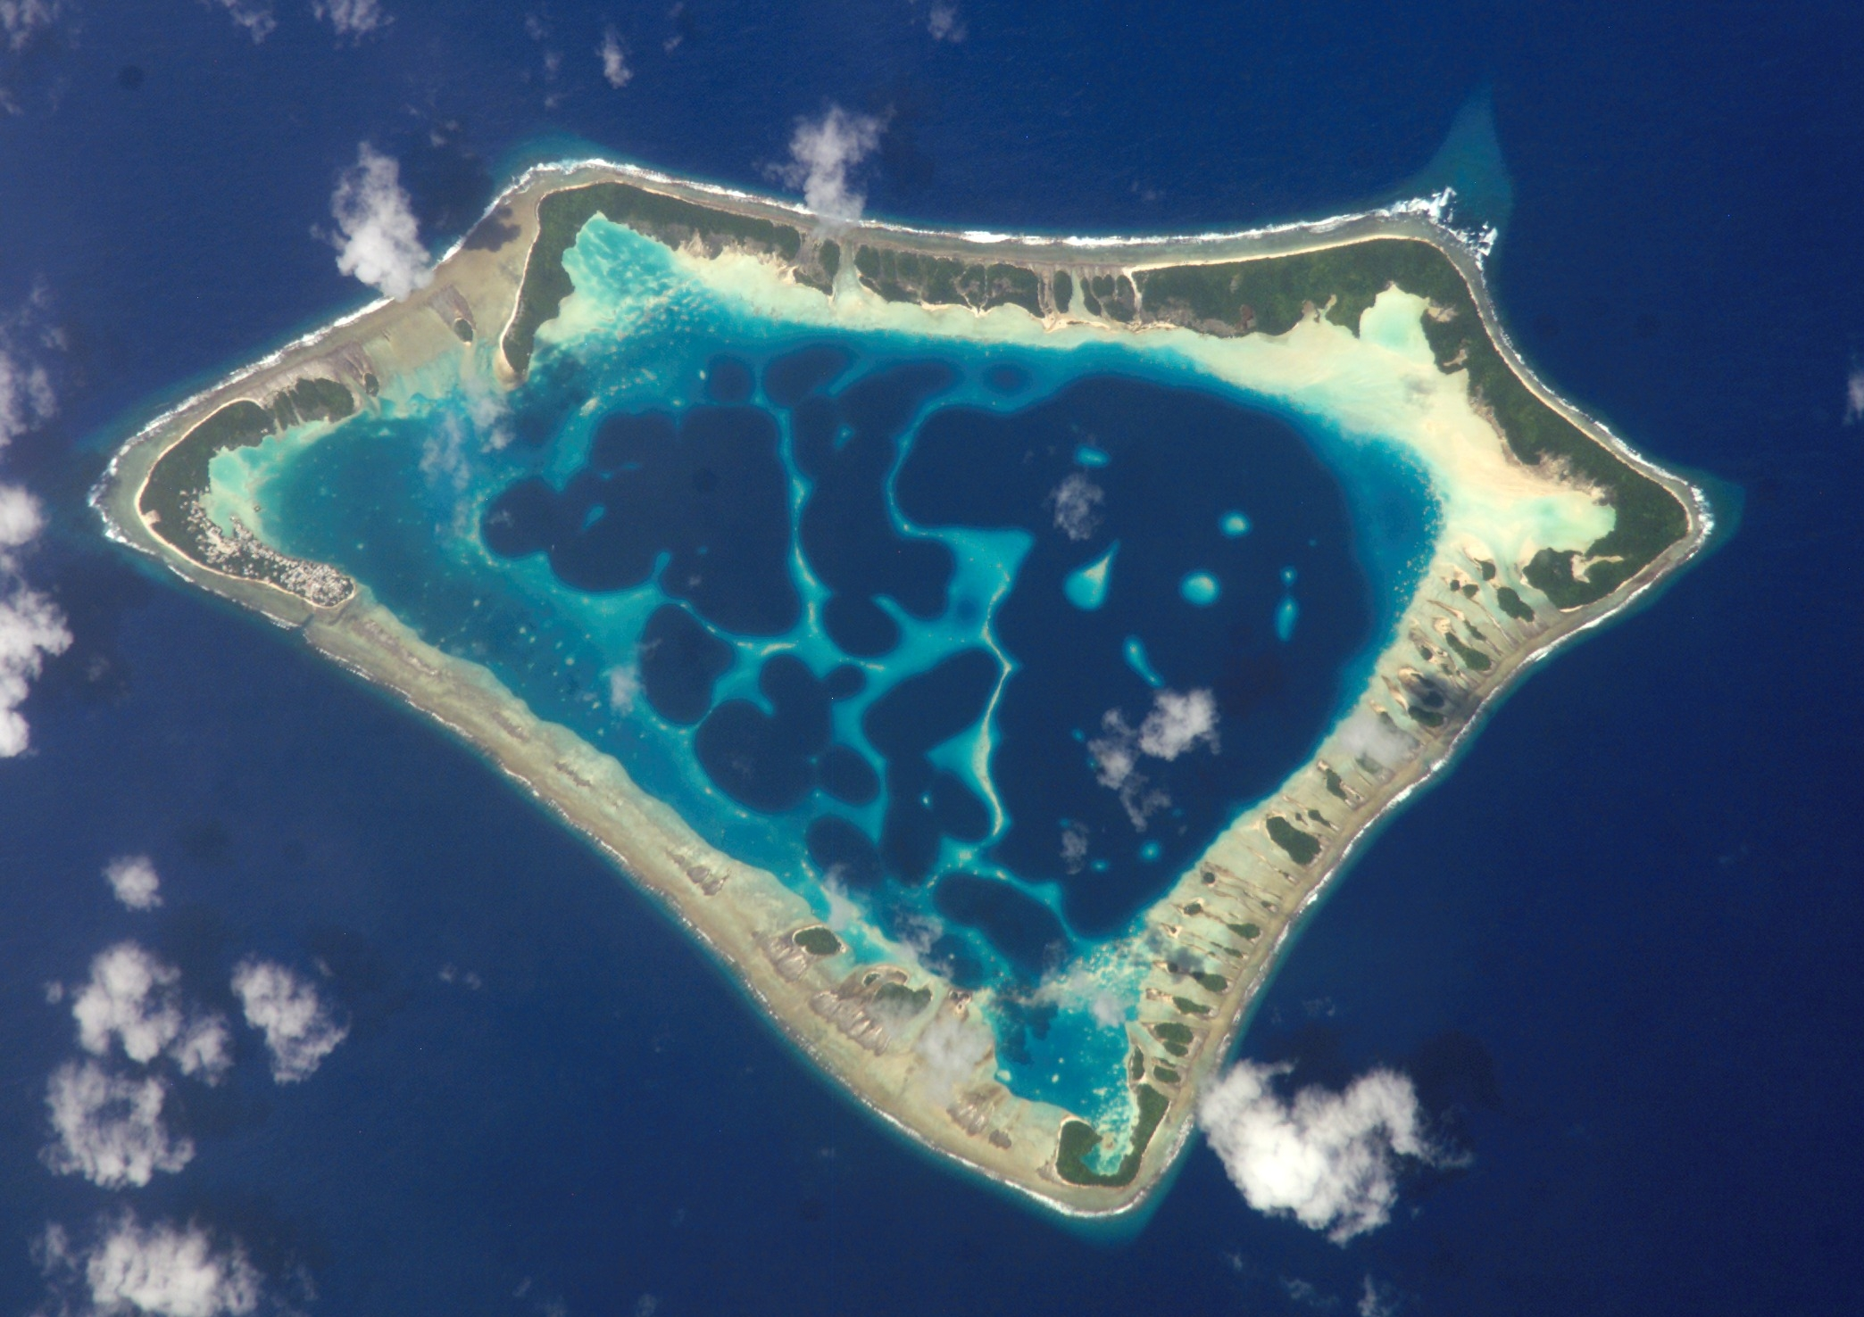
Formation of an Island Atoll http://en.wikipedia.org/wiki/Hawaii_hotspot
“Seamount-volcano is formed rapidly
Corals grow on the side of the volcano at sea level
Erosion and isostasy reduce the elevation of the volcano, but corals grow to remain at sea level
Eventually the volcano lies just at or below sea level
What remains is the coral lagoon typically seen in the south Pacific
These are very vulnerable to rising sea level”

Slide 34
Continent-Continent Collision http://pubs.usgs.gov/gip/dynamic/understanding.html#anchor15343710
“Continent-continent collisions occur with India moving north and Africa colliding with the Mediterranean plate and Eurasian plate
Collisions lead to fold and thrust belts
High mountains of the Himalayas are produced
Isostasy (adjustment of the crust by asthenospheric flow) leads to reduced gravity anomalies”

Slide 35
India Colliding with EurAsian Plate http://pubs.usgs.gov/gip/dynamic/understanding.html#anchor15343710

Slide 36
Transform Boundaries http://pubs.usgs.gov/gip/dynamic/understanding.html#anchor15343710
“Transform boundaries occur at mid-ocean ridges
They connect spreading centers in general
A classic transform boundary is the San Andreas fault system here in California
The San Andreas fault connects the spreading centers in the Gulf of Mexico with those offshore of N. California and Oregon of the Juan de Fuca ridge and plate”

Slide 37
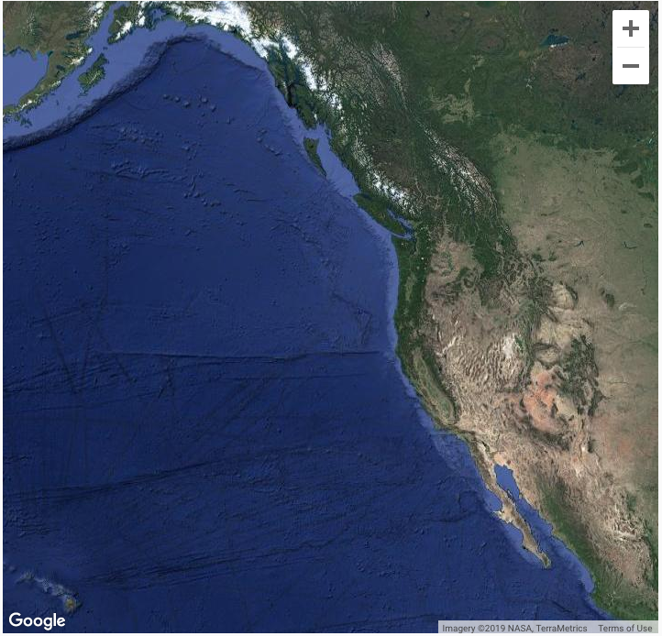
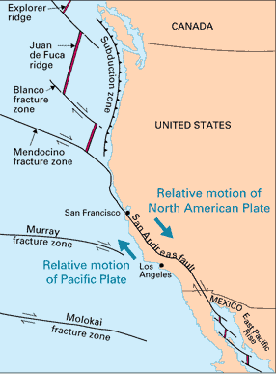
Satellite Imagery

Slide 39
Heat Transfer in Layers http://en.wikipedia.org/wiki/Earth's_internal_heat_budget
“The flow of heat from Earth's interior to the surface is estimated at 47 terawatts and comes from two main sources, the radiogenic heat produced by the radioactive decay of isotopes in the mantle and crust and the primordial heat left over from the formation of the Earth.
Earth's internal heat powers most geological processes and drives plate tectonics.
Despite its geological significance, this heat energy coming from Earth's interior is actually only 0.03% of Earth's total energy budget at the surface, which is dominated by 173,000 TW of incoming solar radiation.”

Slide 40
See the Plate Positions Through Time http://www2.nature.nps.gov/geology/usgsnps/pltec/sc152ma.html

Slide 41
Origin of the Sun and Planets: Models http://abyss.uoregon.edu/~js/ast121/lectures/lec24.html
Inner Solar System
Outer Solar System

Slide 42
Origin of the Sun and Planets: Models http://abyss.uoregon.edu/~js/ast121/lectures/lec24.html
Other problems still remain, but we will not consider these further here

Slide 43
Internal Composition of the Earth http://www.usgs.gov/science/science.php?term=292
“Chemical composition of the earth
Crust and mantle are primarily composed of silicate rocks
Outer and inner core are mostly iron, nickel, oxygen and some sulfur
Outer core is liquid and generates the earth's magnetic field
Inner core is solid and is probably a (very large) single crystal”

Slide 44
Radiogenic Heat Flow http://en.wikipedia.org/wiki/Earth's_internal_heat_budget
“The radioactive decay of elements in the Earth's mantle and crust results in production of daughter isotopes and release of particles and heat energy, or radiogenic heat.
Four radioactive isotopes are responsible for the majority of radiogenic heat, uranium-238 (238U), uranium-235 (235U), thorium-232 (232Th), and potassium-40 (40K).
Due to a lack of rock samples from below 200 km depth it is not possible to do a simple radiogenic heat estimate off of known radioactive isotope concentrations in rock throughout the whole mantle.
For the Earth's core, geochemical studies indicate that it would not be a significant source of radiogenic heat due to an expected low concentration of radioactive elements.
Radiogenic heat production in the mantle is linked to the structure of mantle convection, a topic of much debate
It is thought that the mantle may either have a layered structure with a higher concentration of radioactive heat-producing elements in the lower mantle, or small reservoirs enriched in radioactive elements dispersed throughout the whole mantle.”
“Initial results from measuring the geoneutrino products of radioactive decay from within the Earth, a proxy for radiogenic heat, yield a new estimate of half of the total Earth internal heat source being radiogenic, which is consistent with previous estimates.”

Slide 45
Heat Budget http://en.wikipedia.org/wiki/Earth's_internal_heat_budget
“Estimates of the total heat flow from Earth’s interior to surface span a range of 43 to 49 TW (TW = terawatt = 1012 watt).
The closest estimate is 47 TW, an average crust heat flow of 91.6 mW/m², and is based on more than 38,000 measurements.
The respective mean heat flows of continental and oceanic crust are 70.9 and 105.4 mW/m².
Based on this mean continental crust heat flow value, the ground beneath our feet is releasing Earth's internal heat at a rate equivalent to 709 100-watt lightbulbs per square kilometer.
While the total internal Earth heat flow to the surface is well constrained, the relative contribution of the two main sources of Earth's heat, radiogenic and primordial heat, are highly uncertain because their direct measurement is difficult.
Chemical and physical models give estimated ranges of 15–41 TW and 12–30 TW for radiogenic heat and primordial heat, respectively, and recent results indicate their contributions may be roughly equal.
The mantle convects in response to heat escaping from Earth's interior, with hotter and more buoyant mantle rising and cooler, and therefore denser, mantle sinking.
This convective flow of the mantle drives the movement of Earth's lithospheric plates; thus, an additional reservoir of heat in the lower mantle is critical for the operation of plate tectonics and one possible source is an enrichment of radioactive elements in the lower mantle.”

Slide 46
Heat Transport http://en.wikipedia.org/wiki/Earth's_internal_heat_budget
“Earth heat transport occurs by conduction, mantle convection, hydrothermal convection, and volcanic advection.
Earth's internal heat flow to the surface is thought to be 80% due to mantle convection, with the remaining heat mostly originating in the Earth's crust, with about 1% due to volcanic activity, earthquakes, and mountain building.
Thus, ~99% of Earth's internal heat loss at the surface is by conduction through the crust, and mantle convection is the dominant control on heat transport from deep within the Earth. “

Slide 47
Heat Transport http://en.wikipedia.org/wiki/Earth's_internal_heat_budget
“Most of the heat flow from the thicker continental crust is attributed to internal radiogenic sources, in contrast the thinner oceanic crust has only 2% internal radiogenic heat.
The remaining heat flow at the surface would be due to basal heating of the crust from mantle convection.
Heat fluxes are negatively correlated with rock age, with the highest heat fluxes from the youngest rock at mid-ocean ridge spreading centers (zones of mantle upwelling), as observed in the global map of Earth heat flow.”

Slide 48
Heat Flow and Plate Tectonics http://en.wikipedia.org/wiki/Earth's_internal_heat_budget
“Controversy over the exact nature of mantle convection makes the linked evolution of Earth's heat budget and the dynamics and structure of the mantle difficult to unravel.
There is evidence that plate tectonics was not active in the Earth before 3.2 billion years ago, and that early Earth's internal heat loss could have been dominated by advection via heat-pipe volcanism.
Terrestrial bodies with lower heat flows such as the Moon and Mars conduct their internal heat through a single lithospheric plate, and higher heat flows such as on Jupiter's moon Io result in advective heat transport via enhanced volcanism, while the active plate tectonics of Earth occur with an intermediate heat flow and a convecting mantle.”

Slide 49
North American Continent http://www.usgs.gov/science/science.php?term=292

Slide 50
Average Crustal P-Wave Velocities http://www.usgs.gov/science/science.php?term=292
“Crustal P-wave velocities have been measured to determine sub-surface properties
Areas of higher velocity are typically colder
Lower velocity regions are generally warmer”

