Slide 1
Lecture 22
Bitcoin and Money
John Rundle Econophysics PHYS 250

Slide 2
Cryptocurrencies https://en.wikipedia.org/wiki/Cryptocurrency
A cryptocurrency (or crypto currency) is a digital asset designed to work as a medium of exchange that uses cryptography to secure its transactions, to control the creation of additional units, and to verify the transfer of assets.
Cryptocurrencies are a type of digital currencies, alternative currencies and virtual currencies.
Cryptocurrencies use decentralized control as opposed to centralized electronic money and central banking systems.
The decentralized control of each cryptocurrency works through a blockchain, which is a public transaction database, functioning as a distributed ledger.
Bitcoin, created in 2009, was the first decentralized cryptocurrency.
Since then, numerous other cryptocurrencies have been created.
These are frequently called altcoins, as a blend of alternative coin.

Slide 3
Cryptocurrencies https://en.wikipedia.org/wiki/List_of_cryptocurrencies
The number of cryptocurrencies available over the internet as of 19 August 2018 is over 1600 and growing.
A new cryptocurrency can be created at any time.
By market capitalization, Bitcoin is currently (December 15, 2018) the largest blockchain network, followed by Ripple, Ethereum and Tether.
As of 15 December 2018, total cryptocurrencies market capitalization is $100bn and larger than GDP of 127 countries.
I am told that 99% of cryptocurrencies are actually scams!

Slide 4
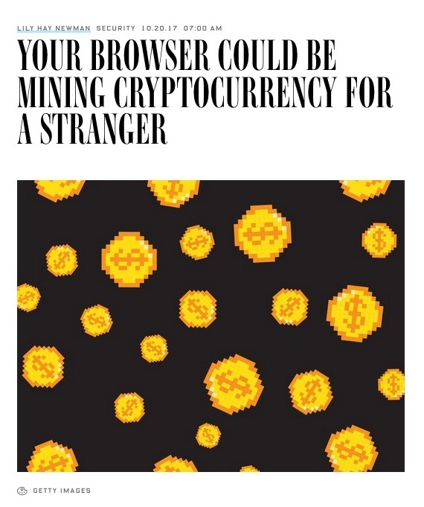
But as a result, the scammers are coming out of the woodwork
Wired October 20,2017

Slide 5
Cryptojacking https://www.wired.com/story/cryptojacking-cryptocurrency-mining-browser/
There’s something new to add to your fun mental list of invisible internet dangers.
Joining classic favorites like adware and spyware comes a new, tricky threat called “cryptojacking,” which secretly uses your laptop or mobile device to mine cryptocurrency when you visit an infected site.
Cryptojacking has exploded in popularity over the past few weeks, because it offers a clever twist.
The latest technique uses Javascript to start working instantly when you load a compromised web page.
There's no immediate way to tell that the page has a hidden mining component, and you may not even notice any impact on performance

Slide 6
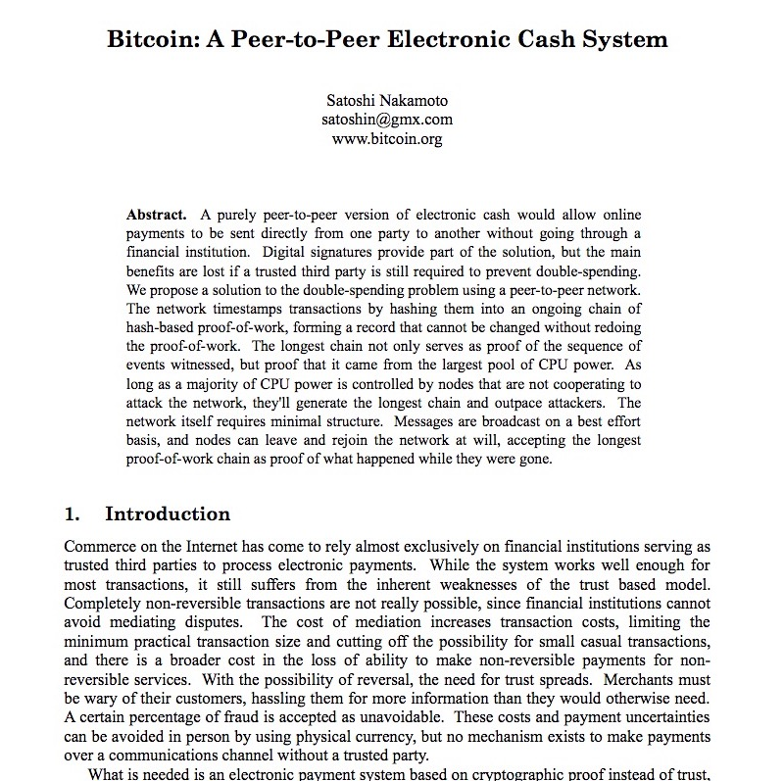
https://bitcoin.org/bitcoin.pdf

Slide 7
Bitcoin Summary https://en.wikipedia.org/wiki/Bitcoin

Slide 8
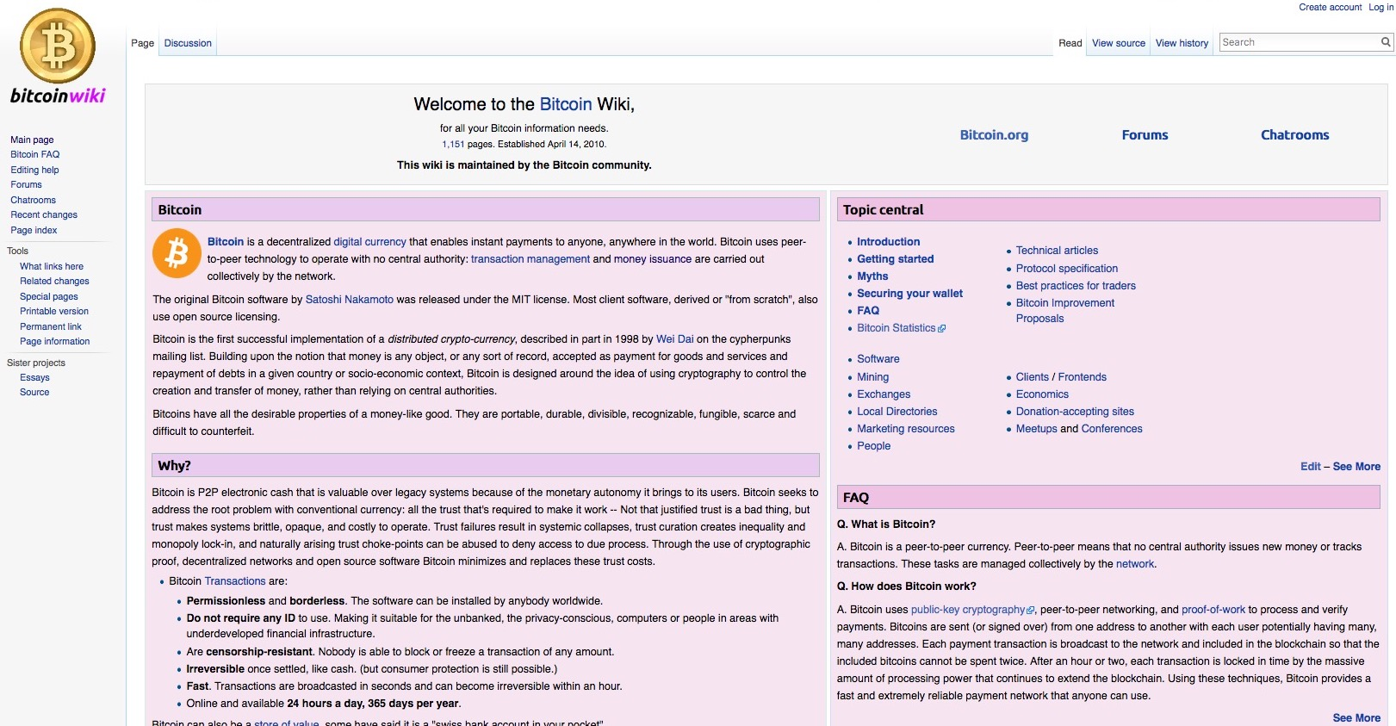
Bitcoin Wiki https://en.bitcoin.it/wiki/Main_Page

Slide 9
Bitcoin Wiki https://en.bitcoin.it/wiki/Main_Page
Edit – See More
FAQ
Q. What is Bitcoin? A. Bitcoin is a peer-to-peer currency. Peer-to-peer means that no central authority issues new money or tracks transactions. These tasks are managed collectively by the network. Q. How does Bitcoin work? A. Bitcoin uses public-key cryptography, peer-to-peer networking, and proof-of-work to process and verify payments. Bitcoins are sent (or signed over) from one address to another with each user potentially having many, many addresses. Each payment transaction is broadcast to the network and included in the blockchain so that the included bitcoins cannot be spent twice. After an hour or two, each transaction is locked in time by the massive amount of processing power that continues to extend the blockchain. Using these techniques, Bitcoin provides a fast and extremely reliable payment network that anyone can use.

Slide 10
Bitcoin Approaches a Record Value http://www.cnbc.com/2017/02/23/bitcoin-is-surging--but-that-might-not-mean-what-you-think.html
From February 23, 2017

Slide 11
Bitcoin Approaches a Record Value http://www.cnbc.com/2017/02/23/bitcoin-is-surging--but-that-might-not-mean-what-you-think.html
From February 23, 2017

Slide 12
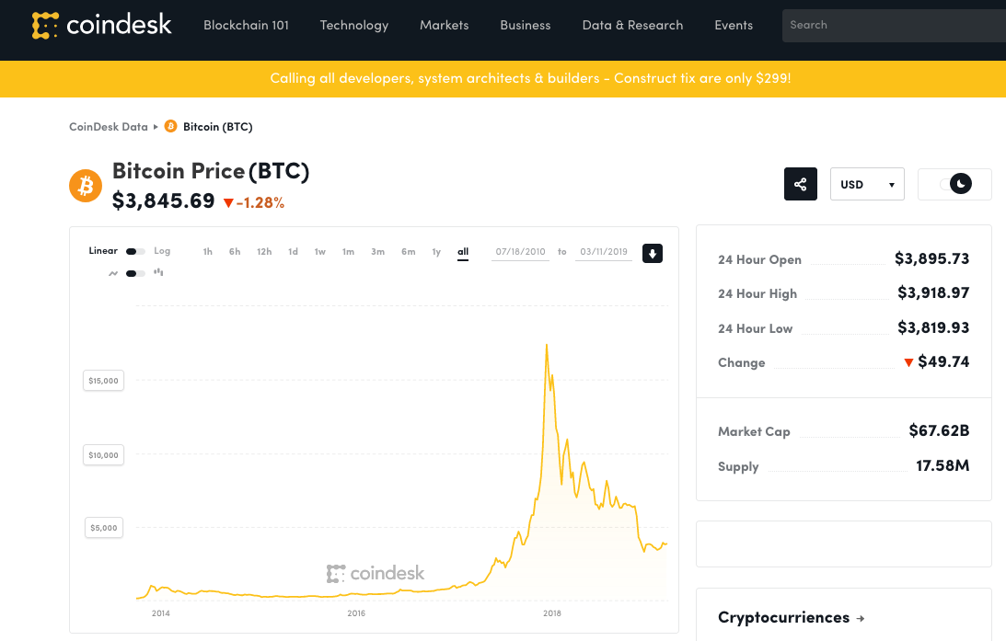
$17,394.97
On 12/11/2017
7/18/2010 – 3/11/2019

Slide 13
How Isaac Newton went Broke The South Sea Bubble
https://www.sovereignman.com/finance/how-isaac-newton-went-flat-broke-chasing-a-stock-bubble-13268/
An early example is the case of Sir Isaac Newton and the South Sea Company, which was established in the early 18th Century and granted a monopoly on trade in the South Seas in exchange for assuming England’s war debt.
It was one of the first companies whose shares were actively traded
Newton proceeded to lose £20,000, which, in 1720, amounted to almost all his life savings.
Newton died in 1727

Slide 14
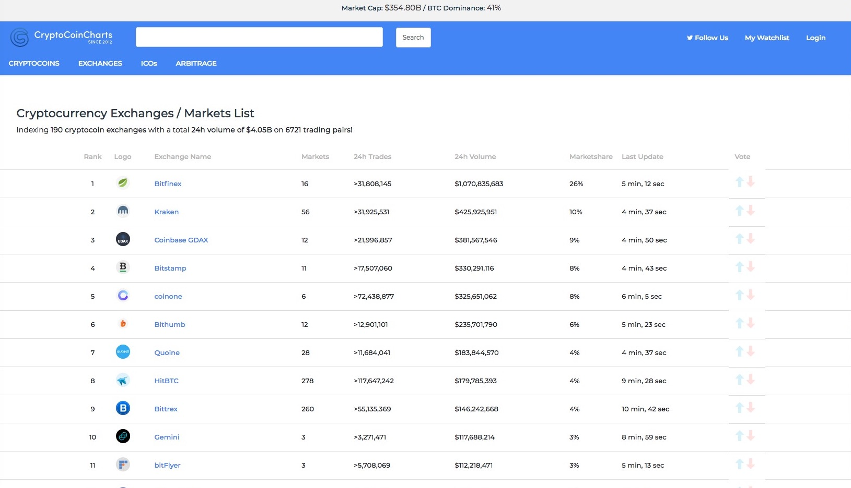
Crypto Currency Exchanges https://cryptocoincharts.info/markets/info

Slide 15
Curious Facts: Bitcoin ETF http://etfdailynews.com/2017/03/05/winklevoss-bitcoin-etf-decision-due-this-week-bitcoin-to-2000/

Slide 16
Curious Facts: First Bitcoin Transaction http://www.coindesk.com/bitcoin-pizza-day-celebrating-pizza-bought-10000-btc/

Slide 17
Bitcoin https://en.wikipedia.org/wiki/Bitcoin
Bitcoin is a cryptocurrency and a payment system invented by an unidentified programmer, or group of programmers, under the name of Satoshi Nakamoto.
Bitcoin was introduced on 31 October 2008 to a cryptography mailing list, and released as open-source software in 2009.
There have been various claims and speculation concerning the identity of Nakamoto, none of which are confirmed.
The system is peer-to-peer and transactions take place between users directly, without an intermediary.
These transactions are verified by network nodes and recorded in a public distributed ledger called the blockchain, which uses bitcoin as its unit of account.
Since the system works without a central repository or single administrator, the U.S. Treasury categorizes bitcoin as a decentralized virtual currency.

Slide 18
Bitcoin https://en.wikipedia.org/wiki/Bitcoin
Bitcoin is often called the first cryptocurrency, although prior systems existed and it is more correctly described as the first decentralized digital currency.
Bitcoin is the largest of its kind in terms of total market value.
Bitcoins are created as a reward in a competition in which users offer their computing power to verify and record bitcoin transactions into the blockchain.
This activity is referred to as mining and successful miners are rewarded with transaction fees and newly created bitcoins.
Besides being obtained by mining, bitcoins can be exchanged for other currencies, products, and services.
When sending bitcoins, users can pay an optional transaction fee to the miners.
This may expedite the transaction being confirmed.

Slide 19
Bitcoin https://en.wikipedia.org/wiki/Bitcoin
In February 2015, the number of merchants accepting bitcoin for products and services passed 100,000.
Instead of 2–3% typically imposed by credit card processors, merchants accepting bitcoins often pay fees in the range from 0% to less than 2%.
Despite the fourfold increase in the number of merchants accepting bitcoin in 2014, the cryptocurrency did not have much momentum in retail transactions.
The European Banking Authority and other sources have warned that bitcoin users are not protected by refund rights or chargebacks.
The use of bitcoin by criminals has attracted the attention of financial regulators, legislative bodies, law enforcement, and media.
Criminal activities are primarily focused on darknet markets and theft, though officials in countries such as the United States also recognize that bitcoin can provide legitimate financial services.

Slide 20
History https://en.wikipedia.org/wiki/Bitcoin
Bitcoin was created by “Satoshi Nakamoto”, who published the invention on 31 October 2008 to a cryptography mailing list in a research paper called "Bitcoin: A Peer-to-Peer Electronic Cash System”.
It was implemented as open source code and released in January 2009.
Bitcoin is often called the first cryptocurrency although prior systems existed.
Bitcoin is more correctly described as the first decentralized digital currency.
One of the first supporters, adopters, contributor to bitcoin and receiver of the first bitcoin transaction was programmer Hal Finney.
Finney downloaded the bitcoin software the day it was released, and received 10 bitcoins from Nakamoto in the world's first bitcoin transaction.

Slide 21
History https://en.wikipedia.org/wiki/Bitcoin
Other early supporters were Wei Dai, creator of bitcoin predecessor b-money, and Nick Szabo, creator of bitcoin predecessor bit gold.
In the early days, Nakamoto is estimated to have mined 1 million bitcoins
Before disappearing from any involvement in bitcoin, Nakamoto in a sense handed over the reins to developer Gavin Andresen, who then became the bitcoin lead developer at the Bitcoin Foundation, the 'anarchic' bitcoin community's closest thing to an official public face.
Other cryptocurrencies started to emerge in 2011.
In March 2013, a technical glitch caused a fork in the blockchain, with one half of the network adding blocks to one version of the chain and the other half adding to another.
For six hours two bitcoin networks operated at the same time, each with its own version of the transaction history.
The core developers called for a temporary halt to transactions, sparking a sharp sell-off.
Normal operation was restored when the majority of the network downgraded to version 0.7 of the bitcoin software.

Slide 22
History https://en.wikipedia.org/wiki/Bitcoin
In 2013 some mainstream websites began accepting bitcoins.
WordPress had started in November 2012, followed by OKCupid in April 2013, TigerDirect and Overstock.com in January 2014, Expedia in June 2014, Newegg and Dell in July 2014, and Microsoft in December 2014.
The Electronic Frontier Foundation, a non-profit group, started accepting bitcoins in January 2011, stopped accepting them in June 2011, and began again in May 2013.
In May 2013, the Department of Homeland Security seized assets belonging to the Mt. Gox exchange.
The U.S. Federal Bureau of Investigation (FBI) shut down the Silk Road website in October 2013.

Slide 23
History https://en.wikipedia.org/wiki/Bitcoin
In October 2013, Chinese internet giant Baidu had allowed clients of website security services to pay with bitcoins.
During November 2013, the China-based bitcoin exchange BTC China overtook the Japan-based Mt. Gox and the Europe-based BitStamp to become the largest bitcoin trading exchange by trade volume.
On 19 November 2013, the value of a bitcoin on the Mt. Gox exchange soared to a peak of US$900 after a United States Senate committee hearing was told by the FBI that virtual currencies are a legitimate financial service.
On the same day, one bitcoin traded for over RMB¥6780 (US$1,100) in China.
On 5 December 2013, the People's Bank of China prohibited Chinese financial institutions from using bitcoins.
Buying real-world goods with any virtual currency has been illegal in China since at least 2009.

Slide 24
History https://en.wikipedia.org/wiki/Bitcoin
The first bitcoin ATM was installed in October 2013 in Vancouver, British Columbia, Canada.
With about 12 million existing bitcoins in November 2013, the new price increased the market cap for bitcoin to at least US$7.2 billion.
By 23 November 2013, the total market capitalization of bitcoin exceeded US$10 billion for the first time.
In early February 2014, one of the largest bitcoin exchanges, Mt. Gox, suspended withdrawals citing technical issues.
By the end of the month, Mt. Gox had filed for bankruptcy protection in Japan amid reports that 744,000 bitcoins had been stolen.
Months before the filing, the popularity of Mt. Gox had waned as users experienced difficulties withdrawing funds.

Slide 25
History https://en.wikipedia.org/wiki/Bitcoin
Less than one year after the collapse of Mt. Gox, United Kingdom-based exhange Bitstamp announced that their exchange would be taken offline while they investigate a hack which resulted in about 19,000 bitcoins (equivalent to roughly US$5 million at that time) being stolen from their hot wallet.
The exchange remained offline for several days amid speculation that customers had lost their funds.
Bitstamp resumed trading on 9 January after increasing security measures and assuring customers that their account balances would not be impacted.
In August 2015 Barclays announced that they would become the first UK high street bank to start accepting bitcoin, with a plan to facilitate users to make charitable donations using the cryptocurrency outside their systems.
They partnered in April 2016 with mobile payment startup Circle Internet Financial.

Slide 26
Bitcoin Blockchain https://en.wikipedia.org/wiki/Bitcoin
The blockchain is a public ledger that records bitcoin transactions.
A novel solution accomplishes this without any trusted central authority: maintenance of the blockchain is performed by a network of communicating nodes running bitcoin software.
Transactions of the form payer X sends Y bitcoins to payee Z are broadcast to this network using readily available software applications.
Network nodes can validate transactions, add them to their copy of the ledger, and then broadcast these ledger additions to other nodes.

Slide 27
Building the Blockchain https://99bitcoins.com/bitcoin-blocks-confirmations/

Slide 28
Bitcoin Blockchain https://en.wikipedia.org/wiki/Bitcoin
The blockchain is a distributed database – to achieve independent verification of the chain of ownership of any and every bitcoin (amount), each network node stores its own copy of the blockchain.
Approximately six times per hour, a new group of accepted transactions, a block, is created, added to the blockchain, and quickly published to all nodes.
This allows bitcoin software to determine when a particular bitcoin amount has been spent, which is necessary in order to prevent double-spending in an environment without central oversight.
Whereas a conventional ledger records the transfers of actual bills or promissory notes that exist apart from it, the blockchain is the only place that bitcoins can be said to exist in the form of unspent outputs of transactions.

Slide 29
Bitcoin Units https://en.wikipedia.org/wiki/Bitcoin
The unit of account of the bitcoin system is bitcoin.
As of 2014, symbols used to represent bitcoin are BTC, XBT, and .
Small amounts of bitcoin used as alternative units are millibitcoin (mBTC), microbitcoin (µBTC, sometimes referred to as bit), and satoshi.
Named in homage to bitcoin's creator, a satoshi is the smallest amount within bitcoin representing 0.00000001 bitcoin, one hundred millionth of a bitcoin.
A millibitcoin equals to 0.001 bitcoin, one thousandth of a bitcoin.
One microbitcoin equals to 0.000001 bitcoin, one millionth of a bitcoin.
A proposal was submitted to the Unicode Consortium in October 2015 to add a codepoint for the symbol.

Slide 30
Bitcoin Transactions https://en.wikipedia.org/wiki/Bitcoin
A valid transaction must have one or more inputs.
Every input must be an unspent output of a previous transaction.
The transaction must carry the digital signature of every input owner.
The use of multiple inputs corresponds to the use of multiple coins in a cash transaction.
A transaction can also have multiple outputs, allowing one to make multiple payments in one transaction.
As in a cash transaction, the sum of inputs (coins used to pay) can exceed the intended sum of payments.
In such a case, an additional output is used, returning the change back to the payer.
Any input satoshis not accounted for in the transaction outputs become the transaction fee.

Slide 31
Bitcoin Fees https://en.wikipedia.org/wiki/Bitcoin
Paying a transaction fee is optional.
Miners can choose which transactions to process and prioritize those that pay higher fees.
Fees are based on the storage size of the transaction generated, which in turn is dependent on the number of inputs used to create the transaction.
Furthermore, priority is given to older unspent inputs.

Slide 32
Bitcoin Hash https://en.wikipedia.org/wiki/Bitcoin
A hash function is any function that can be used to map data of arbitrary size to data of fixed size.
The values returned by a hash function are called hash values, hash codes, digests, or simply hashes.
One use is a data structure called a hash table, widely used in computer software for rapid data lookup.
Hash functions accelerate table or database lookup by detecting duplicated records in a large file.
An example is finding similar stretches in DNA sequences.
They are also useful in cryptography.

Slide 33
Simple Explanation of Hash https://99bitcoins.com/what-is-bitcoin-hash/

Slide 34
Purpose of the Hash http://www.coindesk.com/information/how-bitcoin-mining-works/
When a block of transactions is created, miners put it through a process. They take the information in the block, and apply a mathematical formula to it, turning it into something else.
That something else is a far shorter, seemingly random sequence of letters and numbers known as a hash.
This hash is stored along with the block, at the end of the blockchain at that point in time.
Hashes have some interesting properties.
It’s easy to produce a hash from a collection of data like a bitcoin block, but it’s practically impossible to work out what the data was just by looking at the hash.
And while it is very easy to produce a hash from a large amount of data, each hash is unique.

Slide 35
Purpose of the Hash http://www.coindesk.com/information/how-bitcoin-mining-works/
If you change just one character in a bitcoin block, its hash will change completely.
Miners don’t just use the transactions in a block to generate a hash. Some other pieces of data are used too.
One of these pieces of data is the hash of the last block stored in the blockchain.
Because each block’s hash is produced using the hash of the block before it, it becomes a digital version of a wax seal.
It confirms that this block – and every block after it – is legitimate, because if you tampered with it, everyone would know.
If you tried to fake a transaction by changing a block that had already been stored in the blockchain, that block’s hash would change.

Slide 36
Purpose of the Hash http://www.coindesk.com/information/how-bitcoin-mining-works/
If someone checked the block’s authenticity by running the hashing function on it, they’d find that the hash was different from the one already stored along with that block in the blockchain.
The block would be instantly spotted as a fake.
Because each block’s hash is used to help produce the hash of the next block in the chain, tampering with a block would also make the subsequent block’s hash wrong too.
That would continue all the way down the chain, throwing everything out of whack.

Slide 37
Bitcoin Hash https://en.wikipedia.org/wiki/Bitcoin
Hash functions are used in hash tables, to quickly locate a data record (e.g., a dictionary definition) given its search key (the headword).
Specifically, the hash function is used to map the search key to an index; the index gives the place in the hash table where the corresponding record should be stored.
Typically, the domain of a hash function (the set of possible keys) is larger than its range (the number of different table indices), and so it will map several different keys to the same index.
Therefore, each slot of a hash table is associated with (implicitly or explicitly) a set of records, rather than a single record.
For this reason, each slot of a hash table is often called a bucket, and hash values are also called bucket indices.
Thus, the hash function only hints at the record's location — it tells where one should start looking for it. Still, in a half-full table, a good hash function will typically narrow the search down to only one or two entries.

Slide 38
Crypographic Hash https://en.wikipedia.org/wiki/Bitcoin
A cryptographic hash function is a special class of hash function that has certain properties which make it suitable for use in cryptography.
It is a mathematical algorithm that maps data of arbitrary size to a bit string of a fixed size (a hash function) which is designed to also be a one-way function, that is, a function which is infeasible to invert.
The only way to recreate the input data from an ideal cryptographic hash function's output is to attempt a brute-force search of possible inputs to see if they produce a match, or use a "rainbow table" of matched hashes.
Bruce Schneier has called one-way hash functions "the workhorses of modern cryptography”.
The input data is often called the message, and the output (the hash value or hash) is often called the message digest or simply the digest.
Block transaction data string
Note: Bitcoin uses the SHA-2 hash algorithm

Slide 39
Cryptographic Hash https://en.wikipedia.org/wiki/Cryptographic_hash_function
The ideal cryptographic hash function has five main properties:
It is deterministic so the same message always results in the same hash
It is quick to compute the hash value for any given message
It is infeasible to generate a message from its hash value except by trying all possible messages
A small change to a message should change the hash value so extensively that the new hash value appears uncorrelated with the old hash value
It is infeasible to find two different messages with the same hash value

Slide 40
Cryptographic Hash https://en.wikipedia.org/wiki/Cryptographic_hash_function
Cryptographic hash functions have many information-security applications, notably in digital signatures, message authentication codes (MACs), and other forms of authentication.
They can also be used as ordinary hash functions, to index data in hash tables, for fingerprinting, to detect duplicate data or uniquely identify files, and as checksums to detect accidental data corruption.
Indeed, in information-security contexts, cryptographic hash values are sometimes called (digital) fingerprints, checksums, or just hash values, even though all these terms stand for more general functions with rather different properties and purposes.

Slide 41
Cryptographic Hash https://en.wikipedia.org/wiki/Cryptographic_hash_function
Most cryptographic hash functions are designed to take a string of any length as input and produce a fixed-length hash value.
In theoretical cryptography, the security level of a cryptographic hash function has been defined using the following properties:
Pre-image resistance Given a hash value h it should be difficult to find any message m such that h = hash(m). This concept is related to that of one-way function. Functions that lack this property are vulnerable to preimage attacks.
Second pre-image resistance Given an input m₁ it should be difficult to find different input m₂ such that hash(m₁) = hash(m₂). Functions that lack this property are vulnerable to second-preimage attacks.
Collision resistance It should be difficult to find two different messages m₁ and m₂ such that hash(m₁) = hash(m₂). Such a pair is called a cryptographic hash collision. This property is sometimes referred to as strong collision resistance

Slide 42
Cryptographic Hash https://en.wikipedia.org/wiki/Cryptographic_hash_function
An illustration of the potential use of a cryptographic hash is as follows:
Alice poses a tough math problem to Bob and claims she has solved it.
Bob would like to try it himself, but would yet like to be sure that Alice is not bluffing.
Therefore, Alice writes down her solution, computes its hash and tells Bob the hash value (whilst keeping the solution secret).
Then, when Bob comes up with the solution himself a few days later, Alice can prove that she had the solution earlier by revealing it and having Bob hash it and check that it matches the hash value given to him before.
(This is an example of a simple commitment scheme, in actual practice, Alice and Bob will often be computer programs, and the secret would be something less easily spoofed than a claimed puzzle solution).

Slide 43
Bitcoin Mining https://en.wikipedia.org/wiki/Bitcoin
Mining is a record-keeping service.
Miners keep the blockchain consistent, complete, and unalterable by repeatedly verifying and collecting newly broadcast transactions into a new group of transactions called a block.
Each block contains a cryptographic hash of the previous block, using the SHA-256 hashing algorithm
This links it to the previous block, thus giving the blockchain its name.

Slide 44
Bitcoin Mining https://en.wikipedia.org/wiki/Bitcoin
In order to be accepted by the rest of the network, a new block must contain a so-called proof-of-work.
The proof-of-work requires miners to find a number called a nonce, such that when the block content is hashed along with the nonce, the result is numerically smaller than the network's difficulty target.
This proof is easy for any node in the network to verify, but extremely time-consuming to generate, as for a secure cryptographic hash, miners must try many different nonce values (usually the sequence of tested values is 0, 1, 2, 3, …) before meeting the difficulty target.

Slide 45
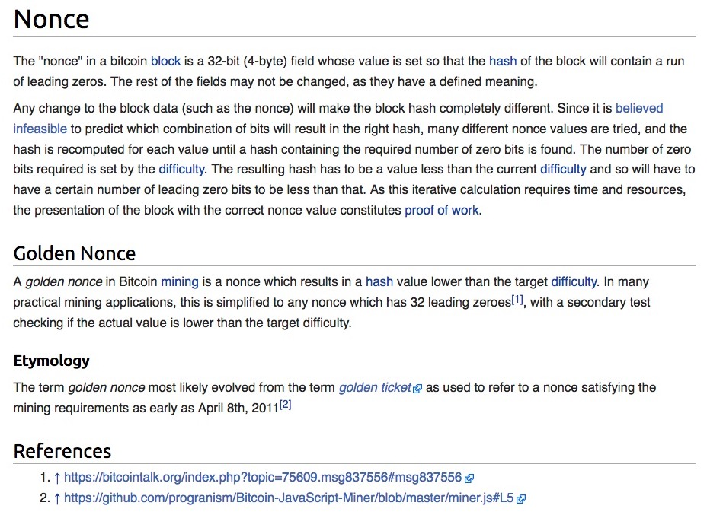
Meaning of a “Nonce” https://en.bitcoin.it/wiki/Nonce
i.e, Miners have to find the string of integers that will lead to the required number of zeros in the hash by using random trials

Slide 46
Example of a Hashed Block https://blockexplorer.com/block/00000000000000001e8d6829a8a21adc5d38d0a473b144b6765798e61f98bd1d
This is the “nonce”

Slide 47
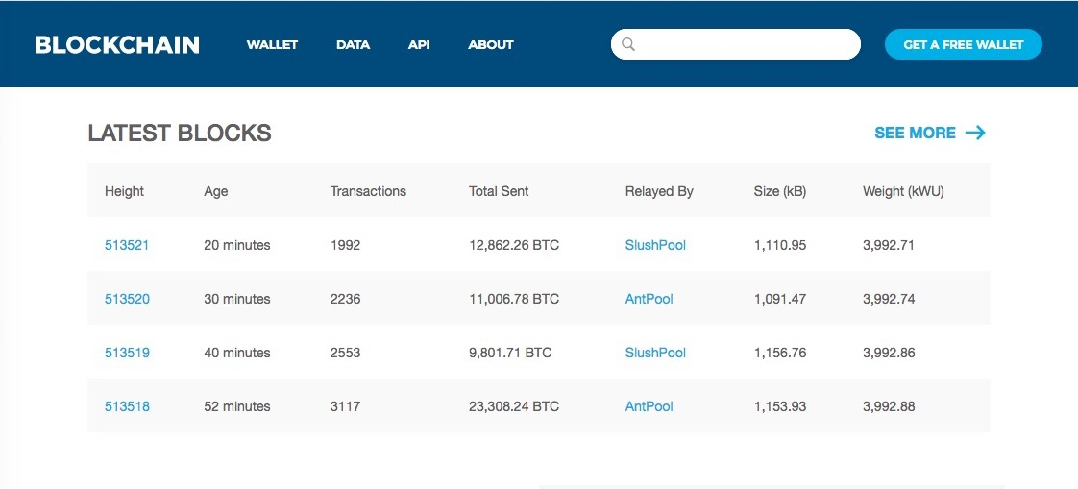
Blockchain https://www.blockchain.com/

Slide 48
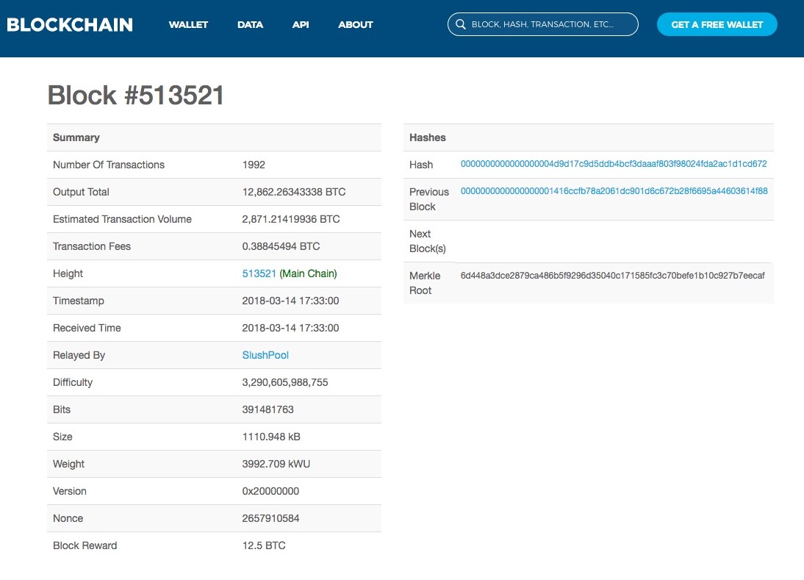

Slide 49
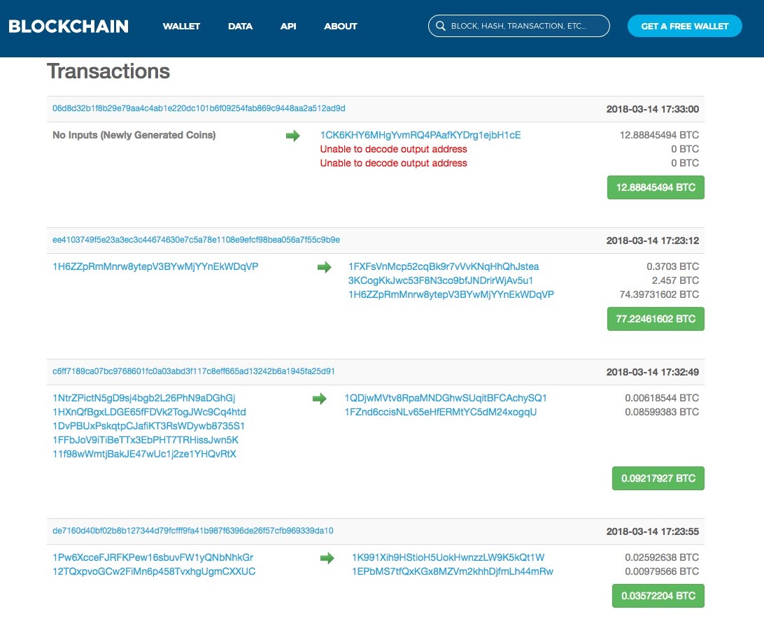
Block #513521 Transactions
…and many more

Slide 50
Example of a Hashed Block https://blockexplorer.com/block/00000000000000001e8d6829a8a21adc5d38d0a473b144b6765798e61f98bd1d

Slide 51
Bitcoin Mining https://en.wikipedia.org/wiki/Bitcoin
Every 2016 blocks (approximately 14 days), the difficulty target is adjusted based on the network's recent performance, with the aim of keeping the average time between new blocks at ten minutes.
In this way the system automatically adapts to the total amount of mining power on the network.
Between 1 March 2014 and 1 March 2015, the average number of nonces miners had to try before creating a new block increased from 16.4 quintillion to 200.5 quintillion.
The proof-of-work system, alongside the chaining of blocks, makes modifications of the blockchain extremely hard, as an attacker must modify all subsequent blocks in order for the modifications of one block to be accepted.
As new blocks are mined all the time, the difficulty of modifying a block increases as time passes and the number of subsequent blocks (also called confirmations of the given block) increases.

Slide 52
Bitcoin Mining Practicalities https://en.wikipedia.org/wiki/Bitcoin
It has become common for miners to join mining pools which combine the computational resources of their members in order to increase the frequency of generating new blocks.
The reward for each block is then split proportionately among the members, creating a more predictable stream of income for each miner without necessarily changing their long-term average income, although a fee may be charged for the service.
The competitive nature of mining has led to ever-more-specialized technology being utilized.
The most efficient mining hardware makes use of custom designed application-specific integrated circuits, which outperform general-purpose CPUs while using less power.
As of 2015, a miner who is not using purpose-built hardware is unlikely to earn enough to cover the cost of the electricity used in their efforts, even if they are a member of a pool.

Slide 53
Bitcoin Energy Consumption https://en.wikipedia.org/wiki/Bitcoin
In 2013, Mark Gimein estimated electricity use to be about 40.9 megawatts (982 megawatt-hours a day).
In 2014, Hass McCook estimated 80.7 megawatts (80,666 kW).
As of 2015, The Economist estimated that even if all miners used modern facilities, the combined electricity consumption would be 166.7 megawatts (1.46 terawatt-hours per year).
Journalist Matt O'Brien opined that it is not obvious whether bitcoin is lowering transaction costs, since the costs are transformed into pollution costs, which he characterizes as "environmental spillovers on everyone else, or what economists call negative externalities.”
To lower the costs, bitcoin miners have set up in places like Iceland where geothermal energy is cheap and cooling Arctic air is free.
Chinese bitcoin miners are known to use hydroelectric power in Tibet to reduce electricity costs.

Slide 54
Bitcoin Supply https://en.wikipedia.org/wiki/Bitcoin
The successful miner finding the new block is rewarded with newly created bitcoins and transaction fees.
As of 9 July 2016, the reward amounted to 12.5 newly created bitcoins per block added to the blockchain.
To claim the reward, a special transaction called a coinbase is included with the processed payments.
All bitcoins in existence have been created in such coinbase transactions.
The bitcoin protocol specifies that the reward for adding a block will be halved every 210,000 blocks (approximately every four years).
Eventually, the reward will decrease to zero, and the limit of 21 million bitcoins will be reached ca. 2140
The record keeping will then be rewarded by transaction fees solely.
In other words, bitcoin's inventor Nakamoto set a monetary policy based on artificial scarcity at bitcoin's inception that there would only ever be 21 million bitcoins in total.
Their numbers are being released roughly every ten minutes and the rate at which they are generated would drop by half every four years until all were in circulation.

Slide 55
Wallets https://en.wikipedia.org/wiki/Bitcoin
A wallet stores the information necessary to transact bitcoins.
While wallets are often described as a place to hold or store bitcoins,due to the nature of the system, bitcoins are inseparable from the blockchain transaction ledger.
A better way to describe a wallet is something that "stores the digital credentials for your bitcoin holdings”[ and allows you to access (and spend) them.
Bitcoin uses public-key cryptography, in which two cryptographic keys, one public and one private, are generated.
At its most basic, a wallet is a collection of these keys.

Slide 56
Wallets https://en.wikipedia.org/wiki/Bitcoin
There are several types of wallets.
Software wallets connect to the network and allow spending bitcoins in addition to holding the credentials that prove ownership.
Software wallets can be split further in two categories: full clients and lightweight clients:
Full clients verify transactions directly on a local copy of the blockchain (over 80 GB as of November 2016, or a subset of the blockchain (around 2 GB).
Because of its size / complexity, the entire blockchain is not suitable for all computing devices.

Slide 57
Wallets https://en.wikipedia.org/wiki/Bitcoin
Lightweight clients on the other hand consult a full client to send and receive transactions without requiring a local copy of the entire blockchain (see simplified payment verification – SPV).
This makes lightweight clients much faster to setup and allows them to be used on low-power, low-bandwidth devices such as smartphones.
When using a lightweight wallet however, the user must trust the server to a certain degree.
When using a lightweight client, the server can not steal bitcoins, but it can report faulty values back to the user.
With both types of software wallets, the users are responsible for keeping their private keys in a secure place.

Slide 58
Wallets https://en.wikipedia.org/wiki/Bitcoin
Besides software wallets, Internet services called online wallets offer similar functionality but may be easier to use.
In this case, credentials to access funds are stored with the online wallet provider rather than on the user's hardware.
As a result, the user must have complete trust in the wallet provider.
A malicious provider or a breach in server security may cause entrusted bitcoins to be stolen.
An example of such security breach occurred with Mt. Gox in 2011.
Physical wallets store the credentials necessary to spend bitcoins offline.
Examples combine a novelty coin with these credentials printed on metal

Slide 59
Ownership https://en.wikipedia.org/wiki/Bitcoin
Ownership of bitcoins implies that a user can spend bitcoins associated with a specific address.
To do so, a payer must digitally sign the transaction using the corresponding private key.
Without knowledge of the private key, the transaction cannot be signed and bitcoins cannot be spent.
The network verifies the signature using the public key.
If the private key is lost, the bitcoin network will not recognize any other evidence of ownership
The coins are then unusable, and thus effectively lost.
For example, in 2013 one user claimed to have lost 7,500 bitcoins, worth $7.5 million at the time, when he accidentally discarded a hard drive containing his private key.

Slide 60
Governance https://en.wikipedia.org/wiki/Bitcoin
Bitcoin is an open source software which was initially led by “Satoshi Nakamoto”.
Nakamoto stepped back in 2010 and handed the network alert key to Gavin Andresen.
Andresen stated he subsequently sought to decentralize control stating:
"As soon as Satoshi stepped back and threw the project onto my shoulders, one of the first things I did was try to decentralize that. So, if I get hit by a bus, it would be clear that the project would go on.”
This left opportunity for controversy to develop over the future development path of bitcoin.
The reference implementation of the bitcoin protocol called Bitcoin Core obtained competing versions that propose to solve various governance and blocksize debates
The alternatives are called Bitcoin XT, Bitcoin Classic, and Bitcoin Unlimited.

Slide 61
Governance https://en.wikipedia.org/wiki/Bitcoin
Bitcoin is pseudonymous, meaning that funds are not tied to real-world entities but rather bitcoin addresses.
Owners of bitcoin addresses are not explicitly identified, but all transactions on the blockchain are public.
In addition, transactions can be linked to individuals and companies through "idioms of use" (e.g., transactions that spend coins from multiple inputs indicate that the inputs may have a common owner) and corroborating public transaction data with known information on owners of certain addresses.
Additionally, bitcoin exchanges, where bitcoins are traded for traditional currencies, may be required by law to collect personal information.
According to Dan Blystone, "Ultimately, bitcoin resembles cash as much as it does credit cards.”

Slide 62
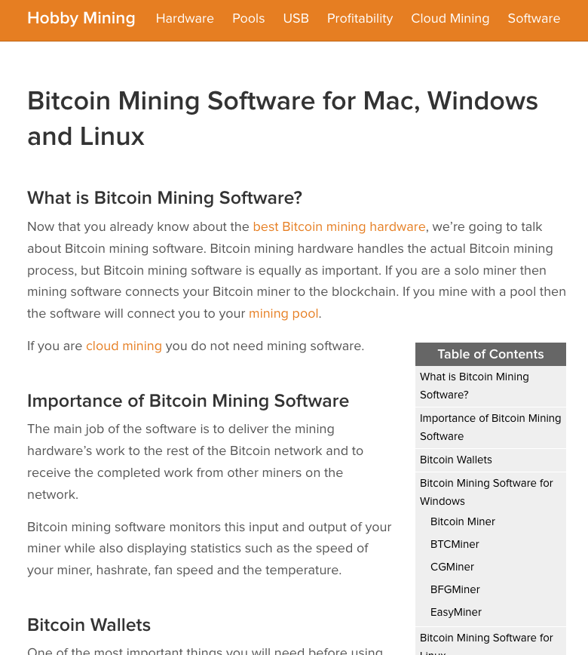
https://www.hobbymining.com/bitcoin-mining-software/

Slide 63
Applications of Blockchain https://www.nytimes.com/2017/03/04/business/dealbook/blockchain-ibm-bitcoin.html?hp&action=click&pgtype=Homepage&clickSource=story-heading&module=second-column-region&region=top-news&WT.nav=top-news

