Slide 1
Lecture 21
Market Stability and Phase Transitions
John Rundle Econophysics PHYS 250

Slide 2
Physics of the Markets
Financial securities and markets have thresholds. Examples include:
  No transactions occur until buyer and seller agree on the price
  Bond defaults leading to cascade of defaults
  Strike price must be reached before an option can be exercised
  Concept of “support” and “resistance” in markets
  These all lead to changes in state of the system, for example from a bull market to a bear market
  In physics, thresholds and changes of state are encountered in phase transitions

Slide 3
Phase Transitions
Universality of Landau-Ginzburg-Wilson field theories encourage us to model novel systems
Long range interactions fundamentally alter the physics
Scaling (power laws) are characteristic features
Nucleation processes (first-order transitions) are seen in many applications
Metastability and hysteresis are important for the dynamics of nucleation processes

Slide 4
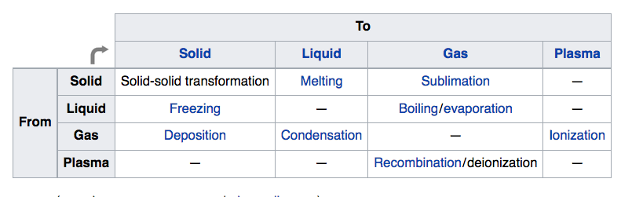
Thermal Phase Transitions https://en.wikipedia.org/wiki/Phase_transition

Slide 5
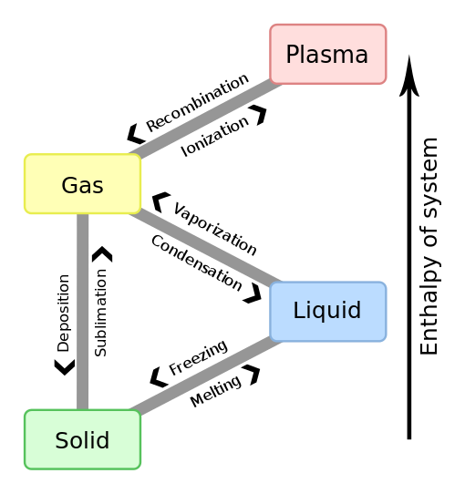
Phase Transitions https://en.wikipedia.org/wiki/Phase_transition

Slide 6
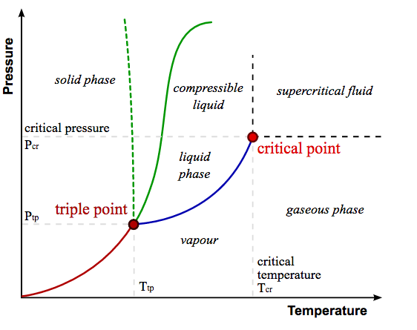
Thermal Phase Diagram (Classical) https://en.wikipedia.org/wiki/Phase_transition

Slide 7
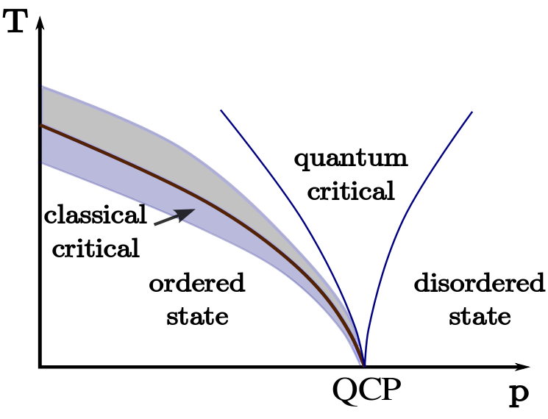
Thermal Phase Diagram(Quantum) https://en.wikipedia.org/wiki/Phase_transition

Slide 8
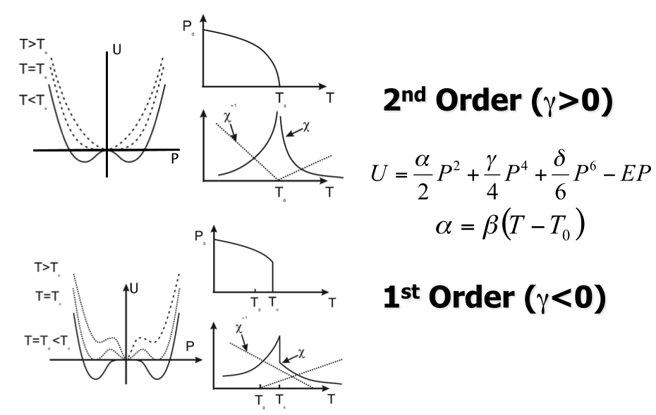
Landau-Ginzburg-Wilson Theory http://mini.physics.sunysb.edu/~mdawber/research.htm

Slide 9
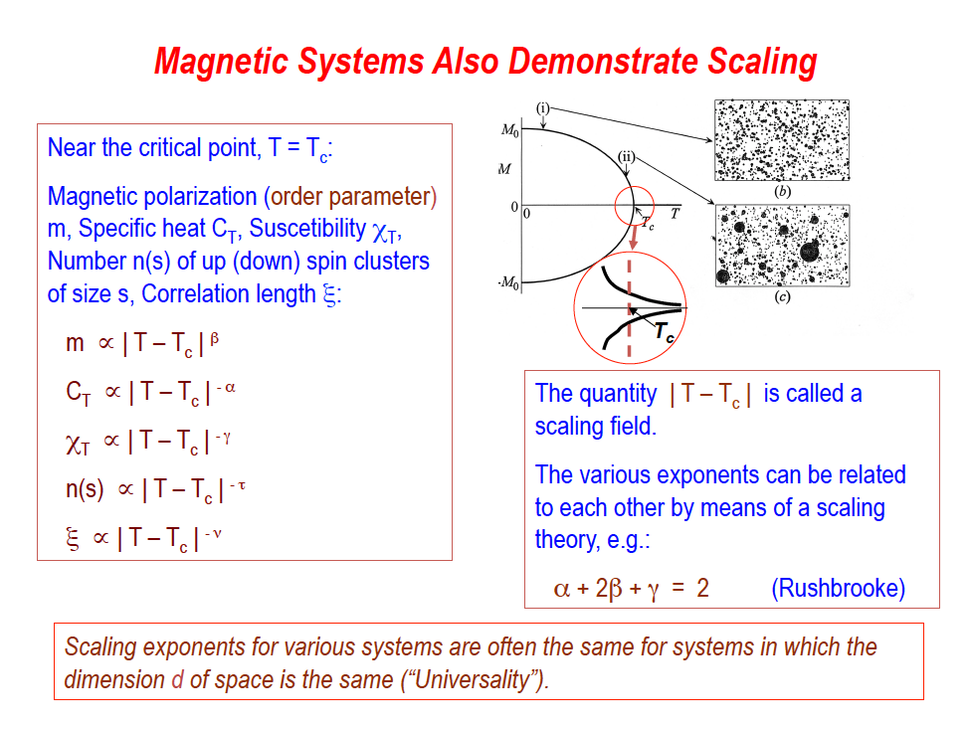
Scaling in Magnetic Systems

Slide 10
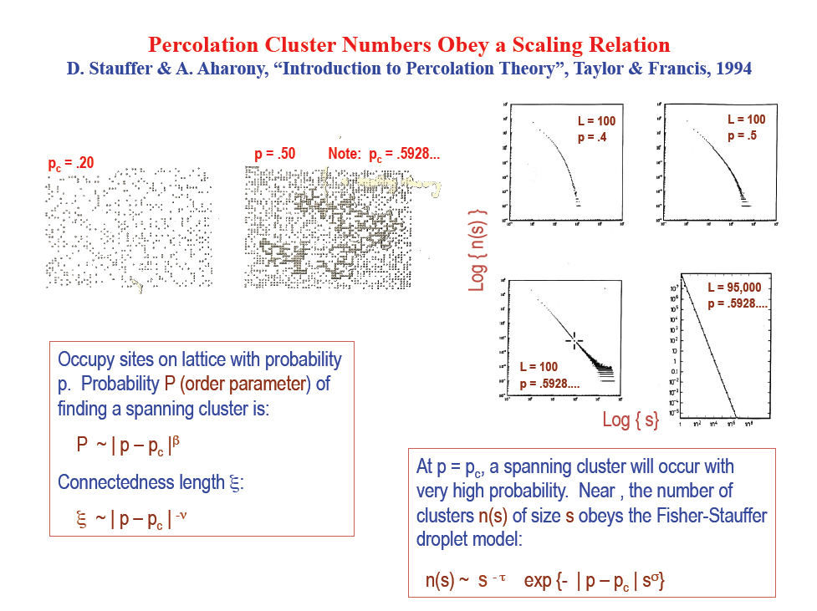
Scaling in Percolation Systems
D. Stauffer and A. Aharony, Introduction to Percolation theory, Taylor and Frnacis, 1994

Slide 11
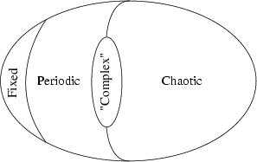
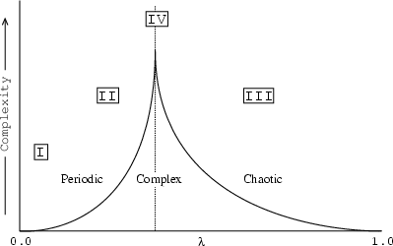
Phase Transitions in Complex Systems https://theory.org/complexity/cdpt/html/node5.html

Slide 12
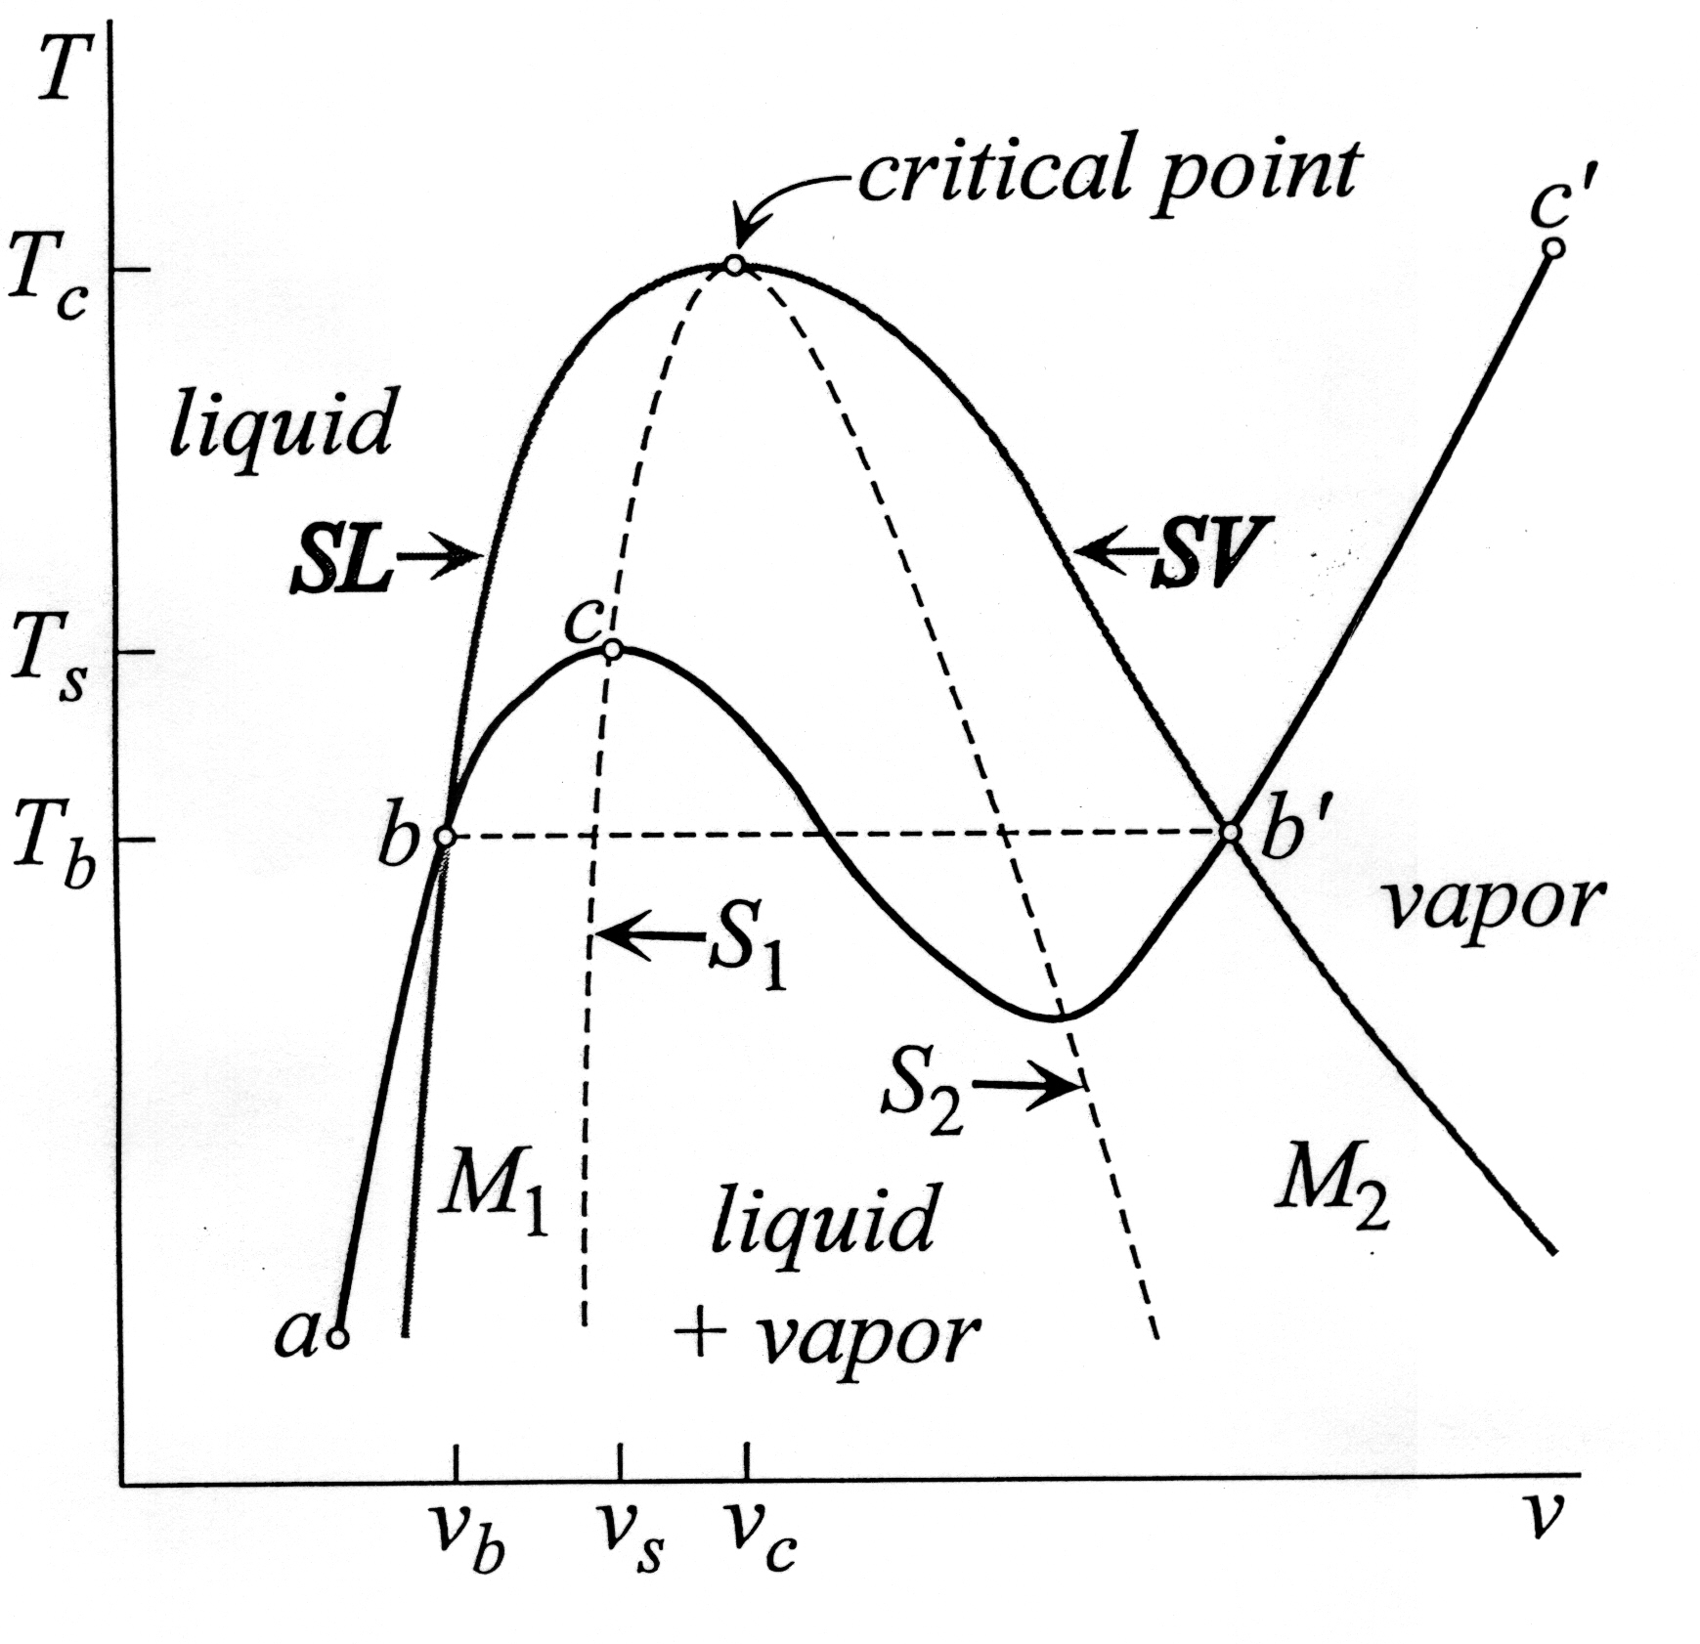
Ehrenfest Classification https://en.wikipedia.org/wiki/Phase_transition
Density is the order parameter field for thermal phase transitions
The order parameter is the first derivative of the free energy with respect to the external field
First-order phase transitions exhibit a discontinuity in the first derivative of the free energy with respect to pressure.
Second-order phase transitions are continuous in the first derivative but exhibit discontinuity in a second derivative of the free energy.
Coexistence Curve
Temperature
Volume
Spinodal Lines

Slide 13
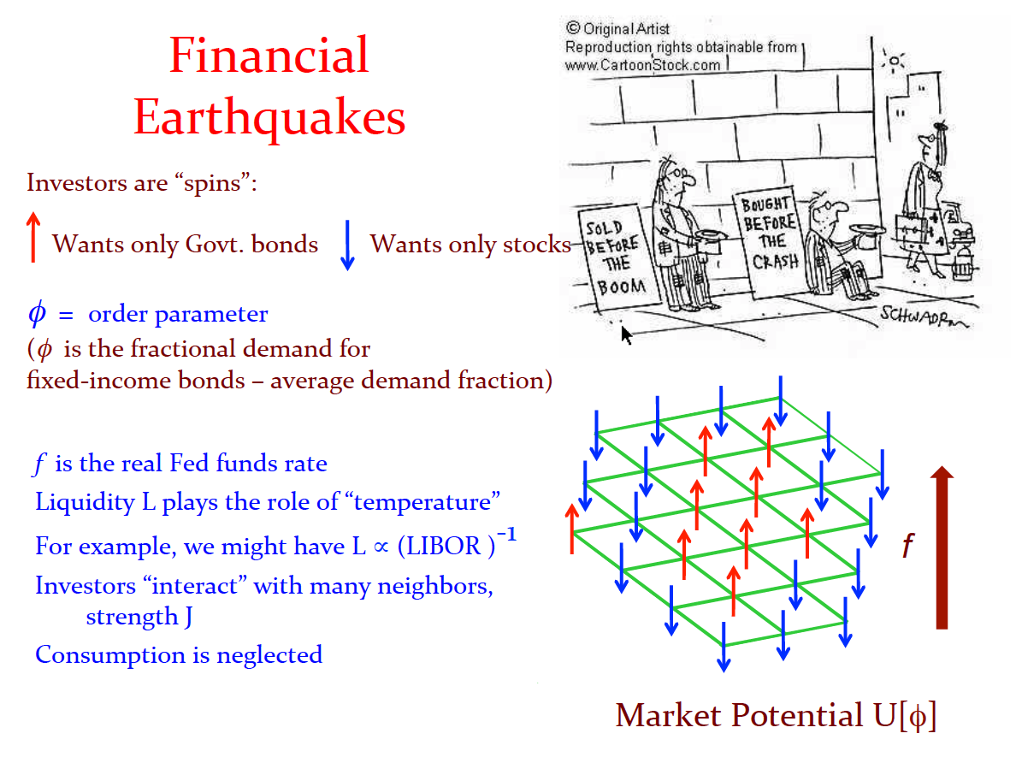
Simple Model of Investor Dynamics

Slide 14
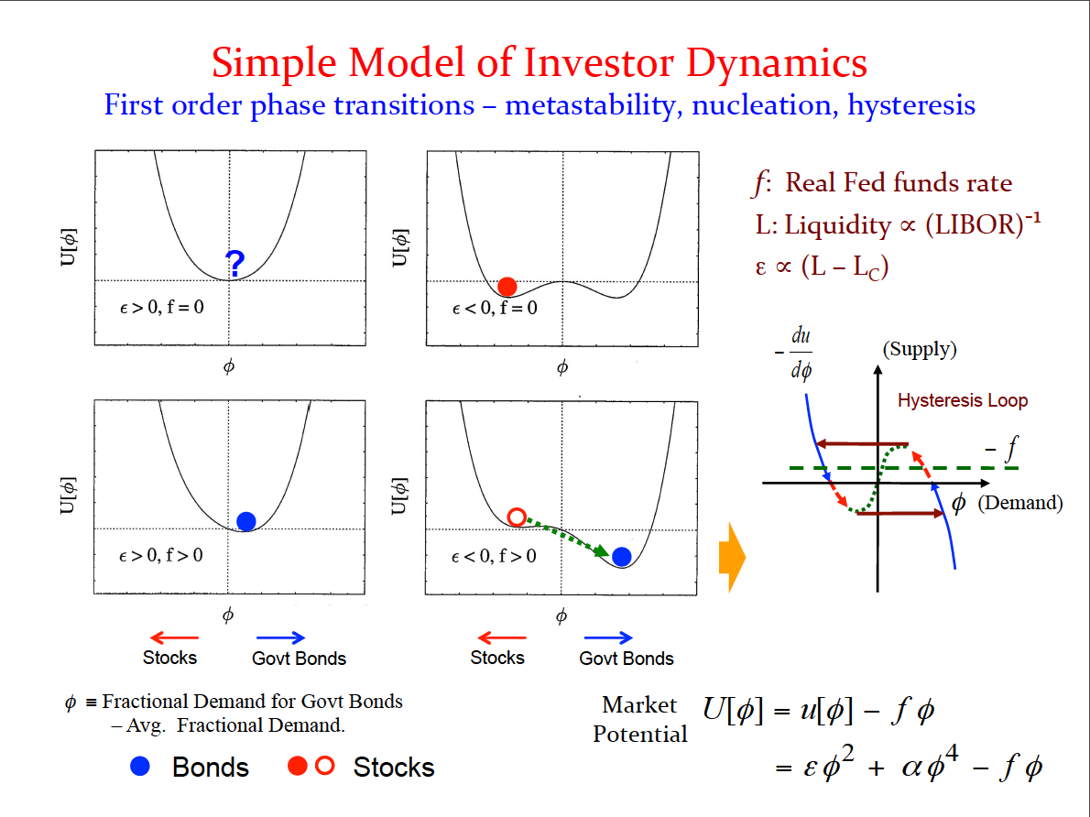
Landau-Ginzburg-Wilson model

Slide 15
Driven Systems
In addition to thresholds, markets are also driven systems
They are driven by the increase or decrease in the number of buyers/sellers, and by the increase in the money supply and the GDP
A well-developed example of a driven threshold system is an earthquake fault system
Faults are subjected to steadily increasing tectonic stresses (forces)
When the stresses exceed the frictional strength threshold, the fault slips (earthquake)
Then the cycle repeats
We will consider an earthquake as a model of a market crash or shock

Slide 16
Features Common to Earthquakes, Markets and the Economy
Scaling (power laws)
Hysteresis
Sudden changes in state:
  Stable fault state to slipped fault state (earthquake)
  Bull to Bear state (markets)

Slide 17
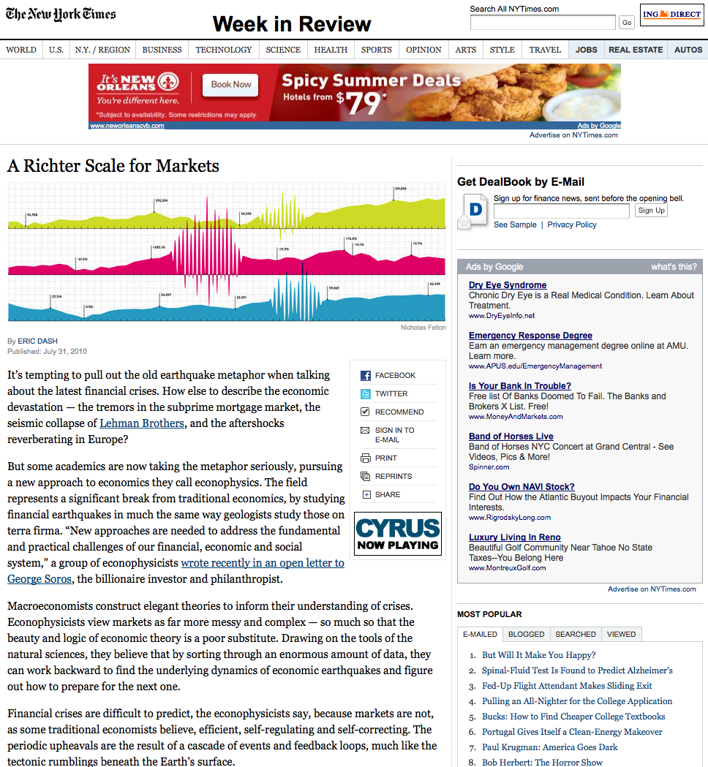
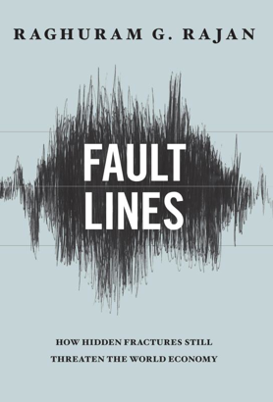
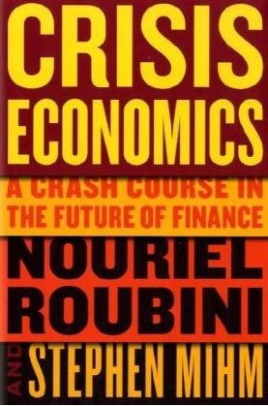


Slide 18
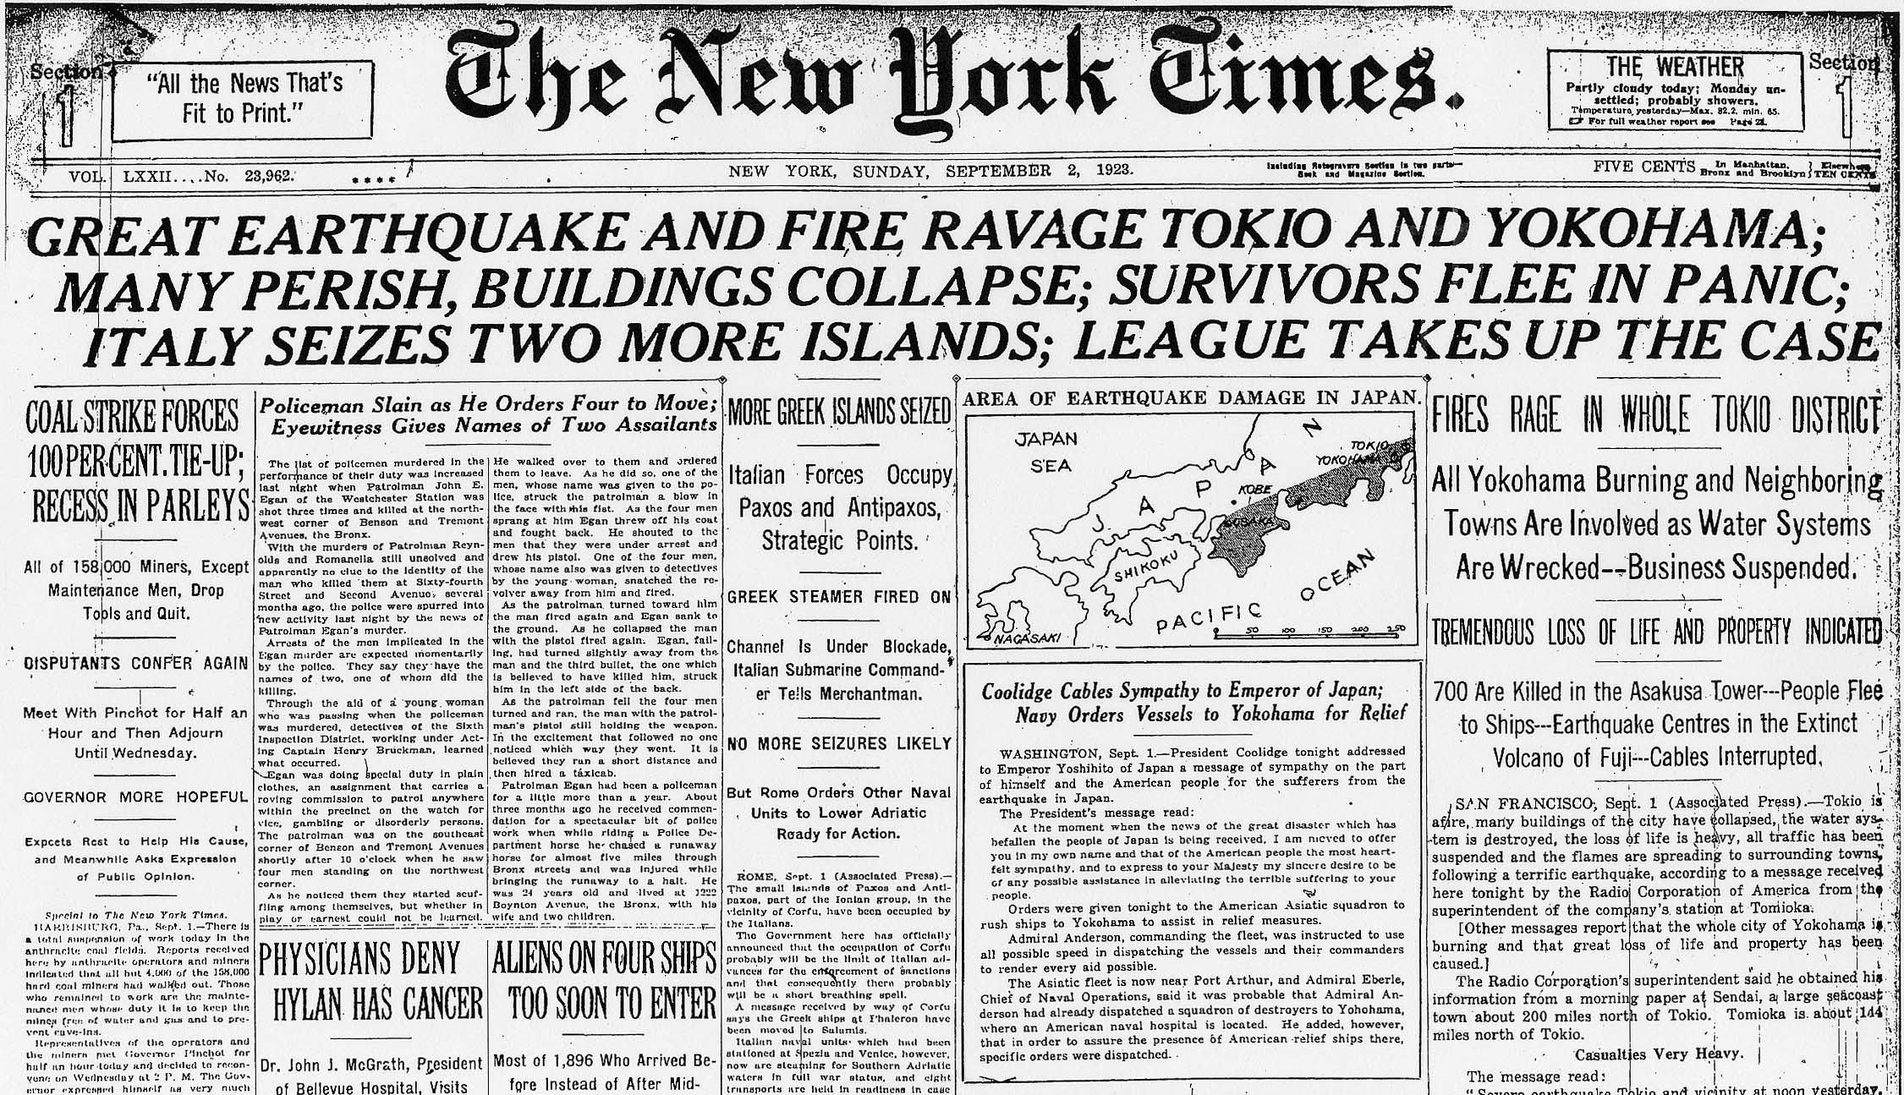

Slide 19
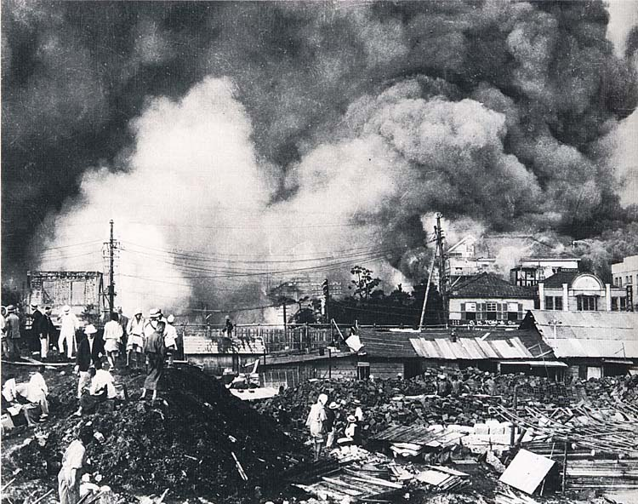

Slide 20
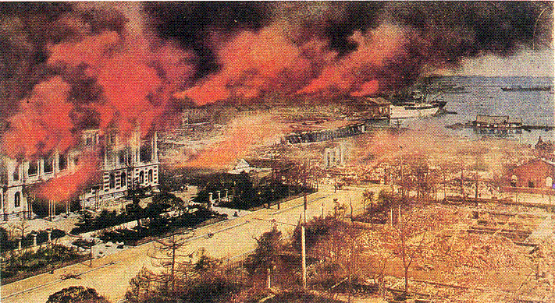

Slide 21
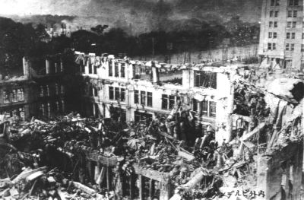

Slide 22
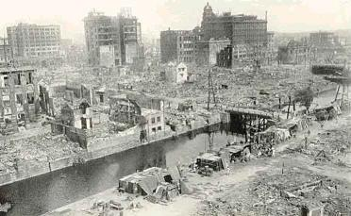

Slide 23
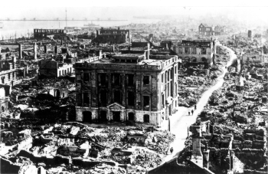

Slide 24
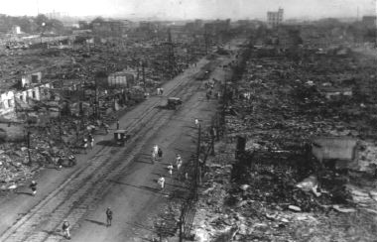

Slide 25
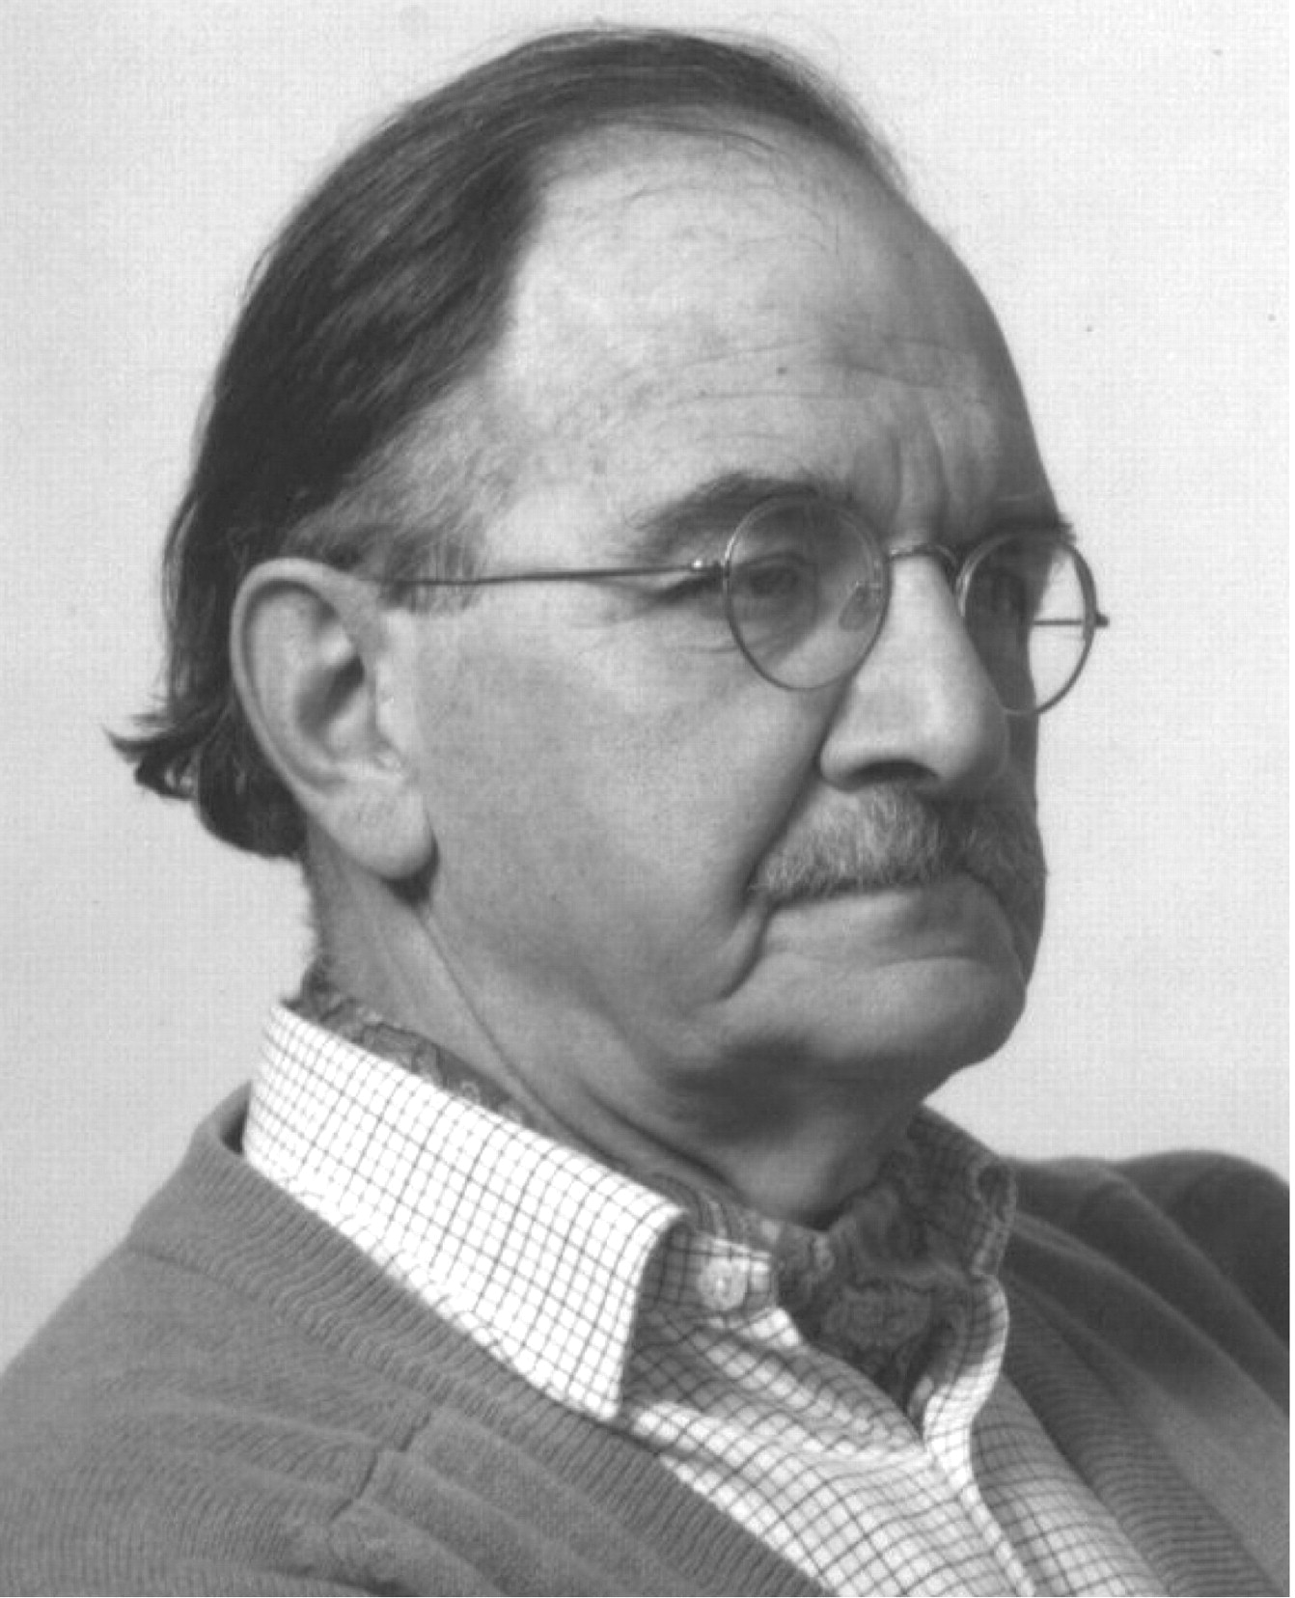
Idealized Model of Elastic Rebound on a Fault
Report of the 1906 Earthquake Investigation (1910)
Fault Stress σ
Time, t
T
Fault Slip
t₁
t₂
Time, t
Harry Fielding Reid (1859-1944)

Slide 26
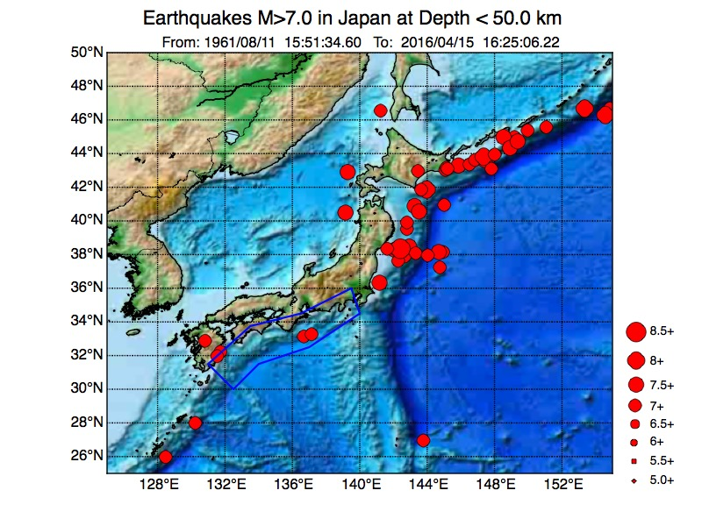

Slide 27
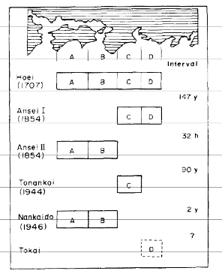
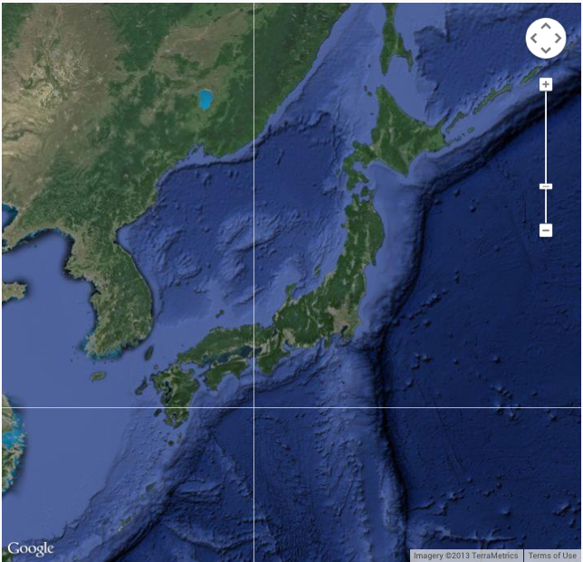
Earthquakes in Nankai Trough, Japan
M Ando, Tectonophysics, v27, p112 (1975)
Data from historic writings in Japan
Basic ideas of the earthquake “cycle” essentially started here

Slide 28
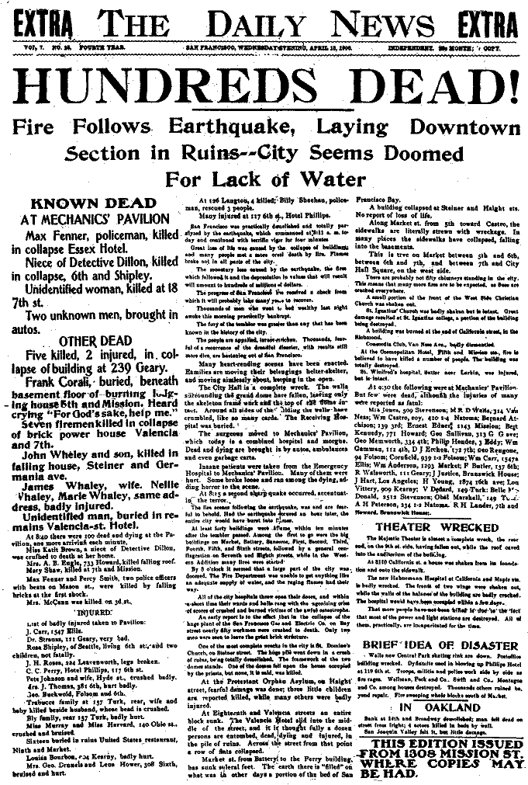
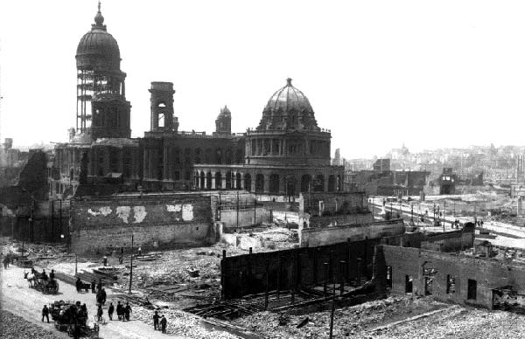
The 1906 Earthquake and Fire
It is now known that the M ~ 7.9 San Francisco earthquake and fire of April 18, 1906 killed well in excess of 3000 persons.
Wreckage of City Hall
and the Hall of Records
Photos courtesy of the Museum of the City of San Francisco; the Steinbrugge Collection of UC Berkeley; and the Bancroft Library, UC Berkeley

Slide 29
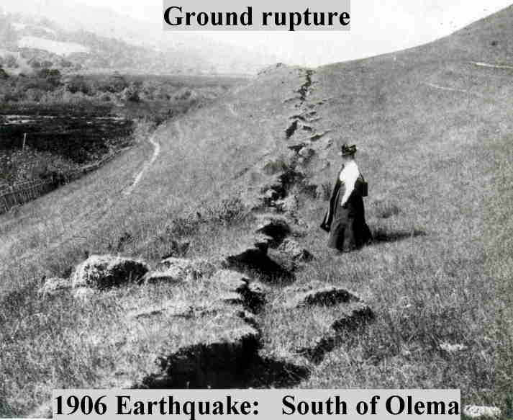
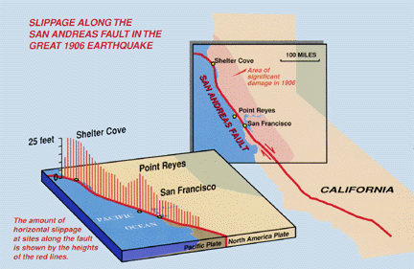
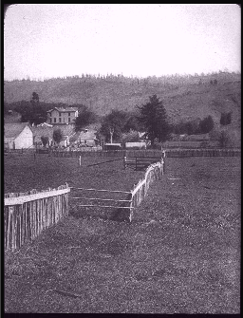
The Great 1906 San Francisco Earthquake Extended for ~ 350 km Along the San Andreas Fault in Northern California.
Horizontal offsets of as much as 8 meters were observed.
Wayne Thatcher, US Geological Survey
Three coupled spatial scales visible: 1. Fault length (~430 km); 2. Slip (~m); 3. Rupture thickness (~cm)

Slide 30
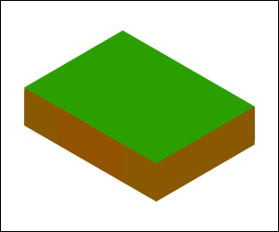
The Earthquake ”Cycle”
(Courtesy P.B. Rundle)
“Strike-slip” Earthquakes (mainly horizontal motion)

Slide 31
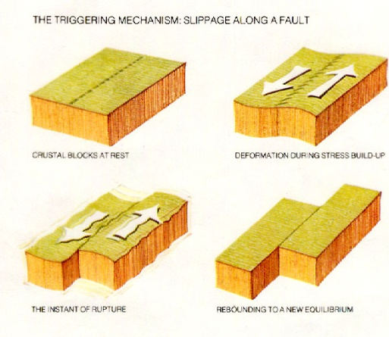
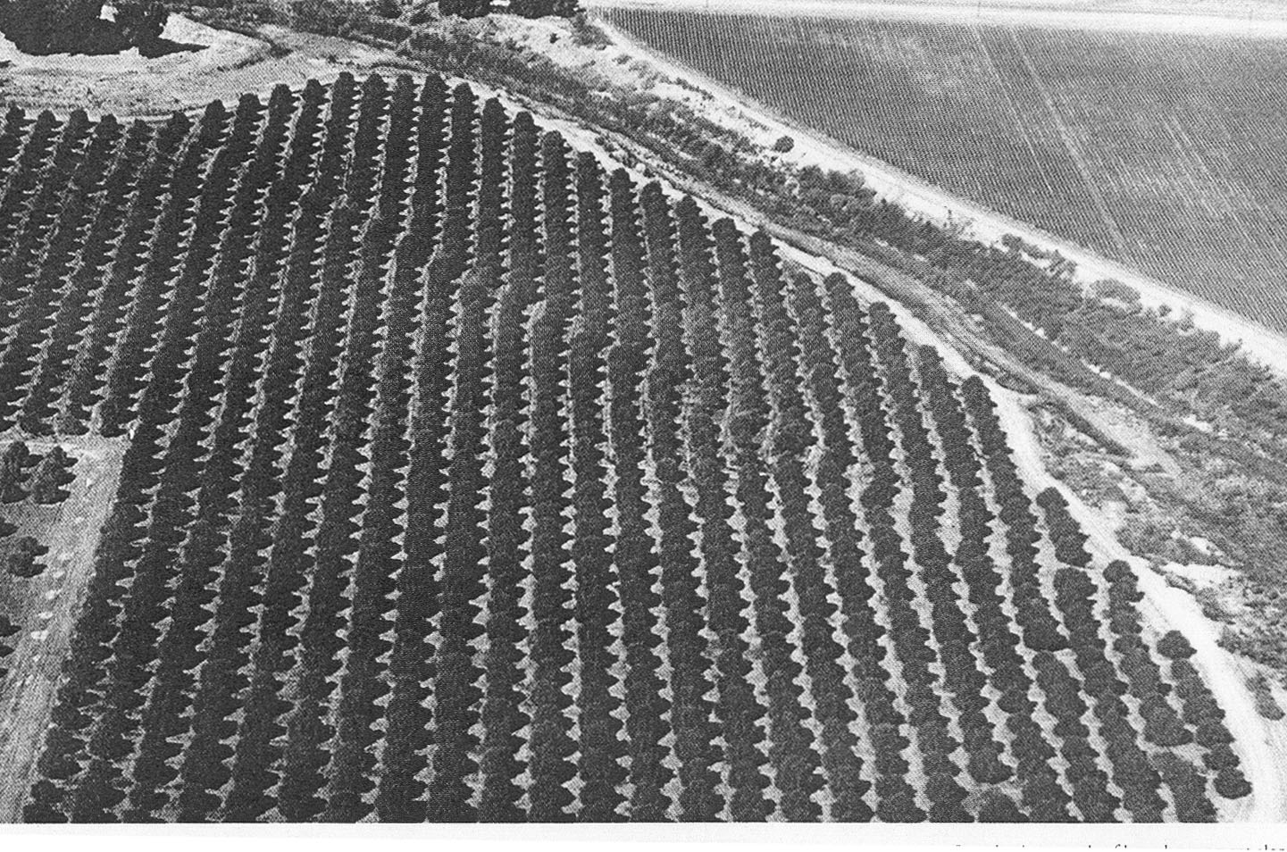
Earthquake Observations & Forecasting
Earthquakes occur on the fault systems of southern California. One of the most active branches of the San Andreas fault system is the Imperial Valley fault.
Earthquake Cycle

Slide 32
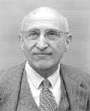
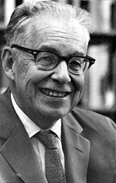
Gutenberg-Richter Relation (1942)(Frequency-Magnitude Relation)
Beno Gutenberg (1889-1960)
Charles Richter (1900-1985)

Slide 33
Small: 4 < M_{S} < 6
Large: 6 < M_{L}

Slide 34
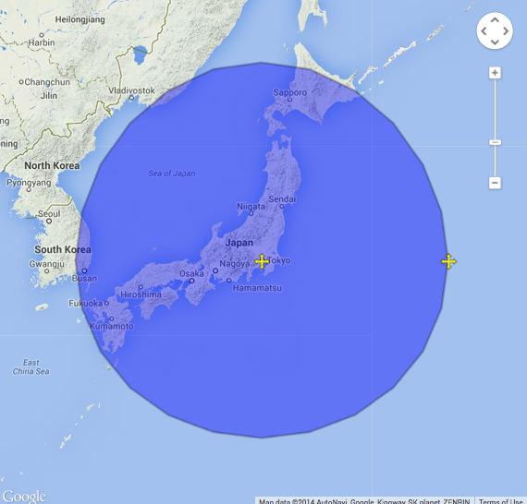
Gutenberg-Richter Relation
Statistics Before and After 3/11/2011
Radius of 1000 km Around Tokyo (Accessed Dec 2, 2016)
b=1.01 +/- 0.01
Log₁₀ (Number of EQs)
Log₁₀ (Number of EQs)
Magnitude
Magnitude
All events prior to M9.1 on 3/11/2011 (“Normal” statistics)
All events after M7.7 on 3/11/2011 (Deficit of large events)

Slide 35
Idealized Model of the Earthquake Cycle
Cumulative Number
of Small Earthquakes
between Large Earthquakes
Time, t
If we count the number of small earthquakes since the last large earthquake, we expect it to increase with time (Gutenberg-Richter relation)
So the count of small earthquakes can be viewed as a marker for the increase of stress and consequently the hazard level

Slide 36
Small: 4 < M_{S} < 6
Large: 6 < M_{L}

Slide 37
Scaling in Earthquakes and Financial Markets
Earthquakes
Moment (Richter) Magnitude
S&P 500 Quakes
M=4 means ~ 4% move in SPX (either up or down)
W = Seismic Moment
= Energy Released
P_{i} = Closing Price, Day i
California-NV Region
b ~ 0.9
S&P 500
b ~ 0.25
Slope = - b
Slope = - b

Slide 38
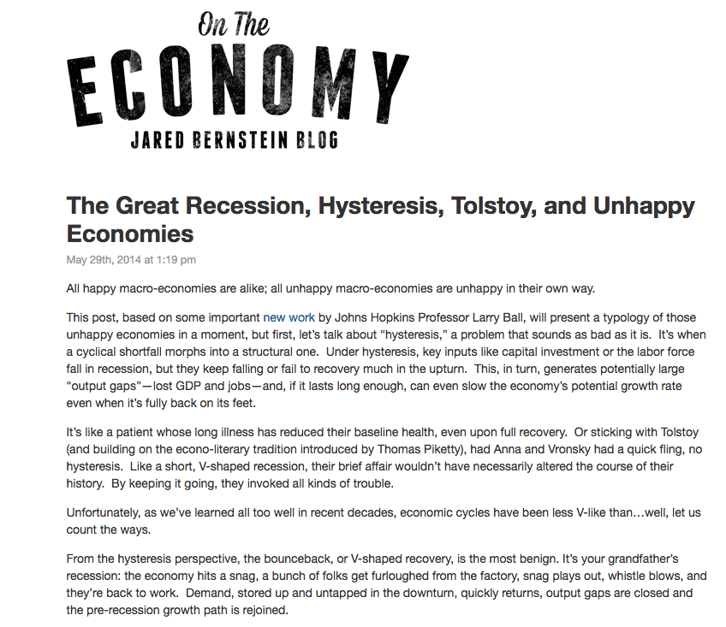
Hysteresis in the Economy http://jaredbernsteinblog.com/the-great-recession-hysteresis-tolstoy-and-unhappy-economies/

Slide 39
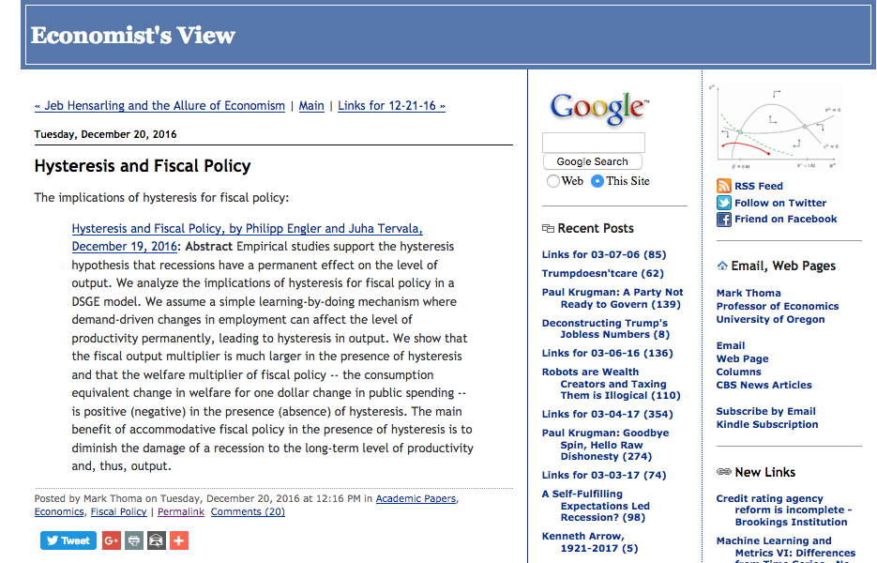
Hysteresis in Fiscal Policy http://economistsview.typepad.com/economistsview/2016/12/hysteresis-and-fiscal-policy.html

Slide 40
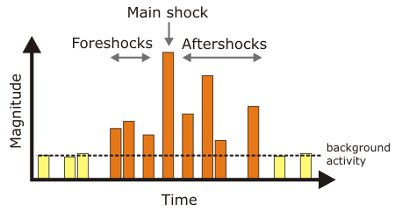
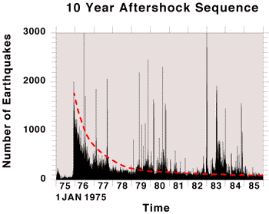
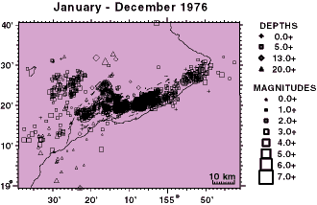
Earthquake Aftershocks https://hvo.wr.usgs.gov/earthquakes/destruct/1975Nov29/aftershock.html
November 1975 Aftershock Sequence:
The M7.7 earthquake is the largest local earthquake ever to be instrumentally recorded by the Hawaiian Volcano Observatory. Although most were too small to be felt, an intense period of aftershocks continued for several months, where thousands of earthquakes were recorded.

Slide 41
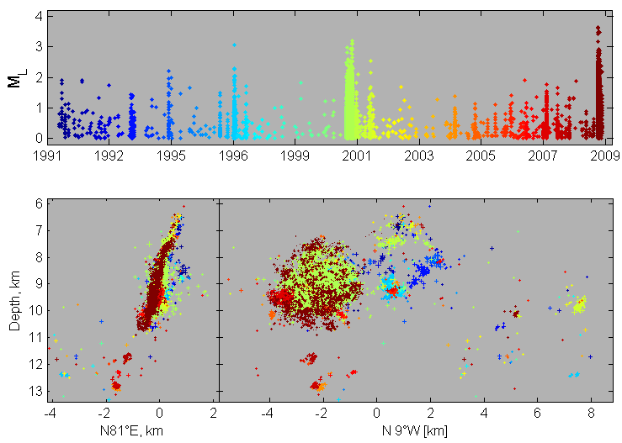
Time History of Earthquake Sequences in Western Bohemia
http://www.ig.cas.cz/en/structure/observatories/west-bohemia-seismic-network-webnet/recent-information-about-earthquake-swar

Slide 42
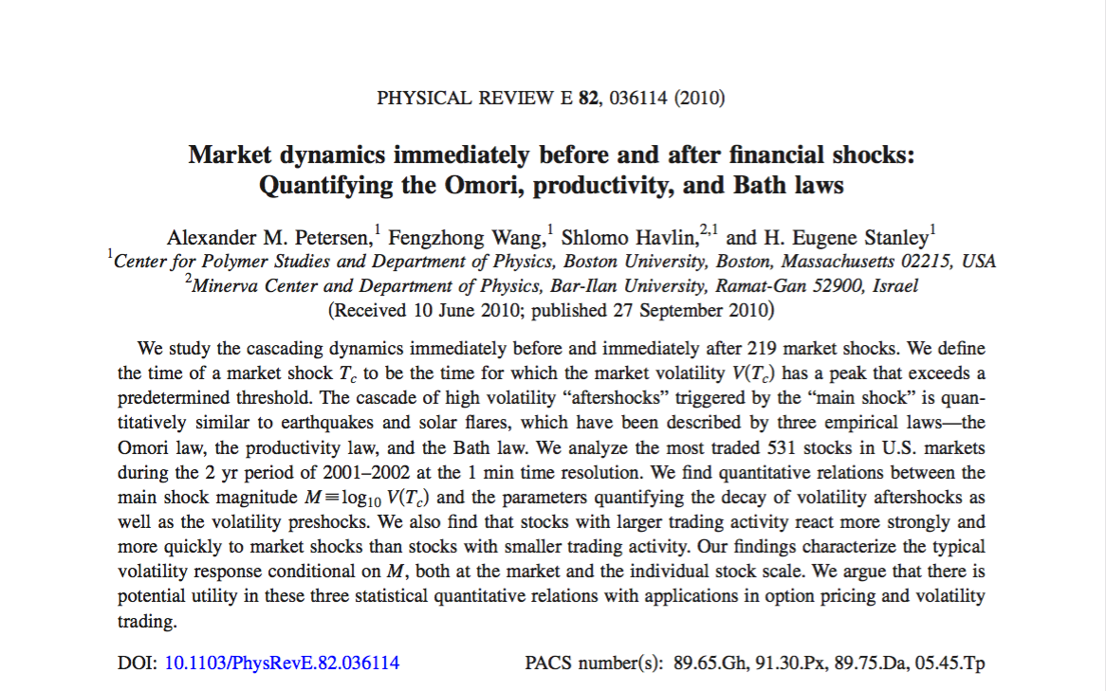

Slide 43
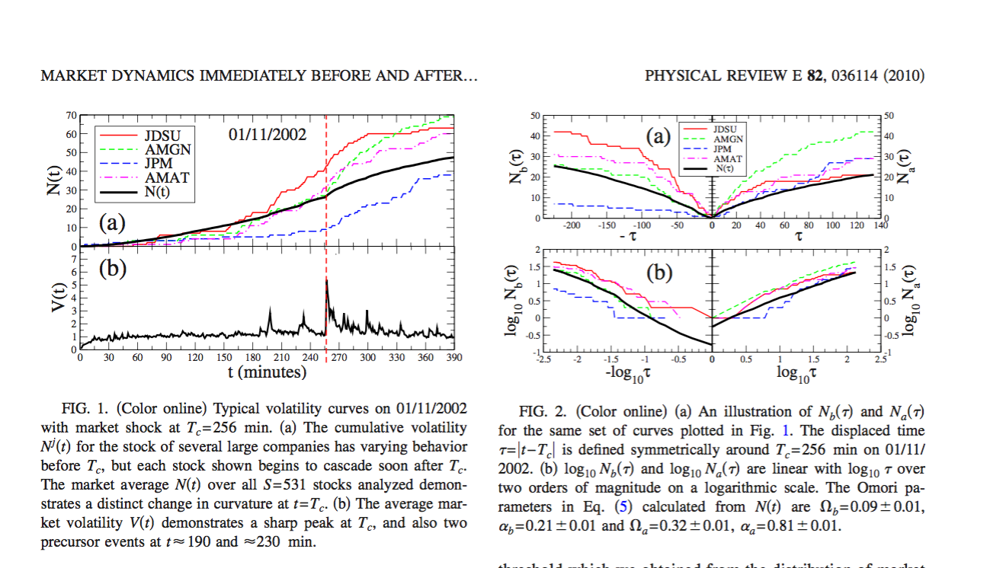

Slide 44
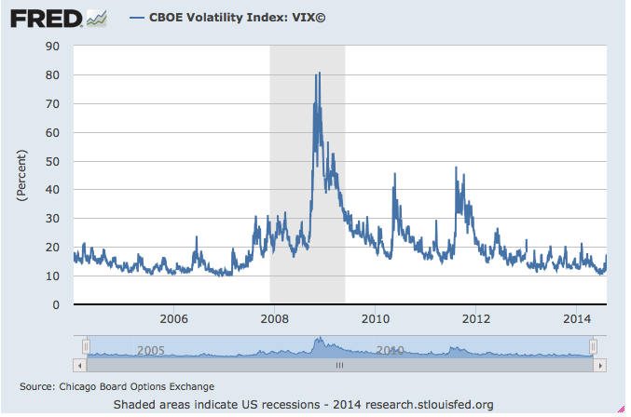
These look like earthquakes!
Volatility (VIX)
AM Petersen et al., Phys. Rev. E, 82, 036114 (2010)

Slide 45
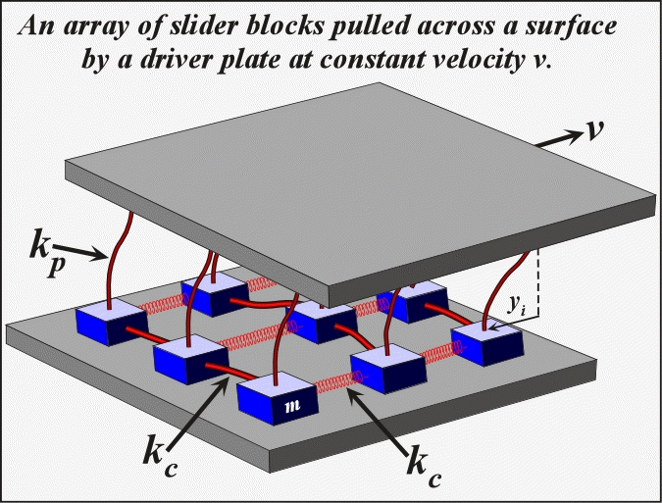
A Simple Earthquake Fault Model
A simple model of an earthquake fault ( R Burridge and L Knopoff, BSSA, 1967; JBR & DD Jackson, BSSA, 1977)

Slide 46
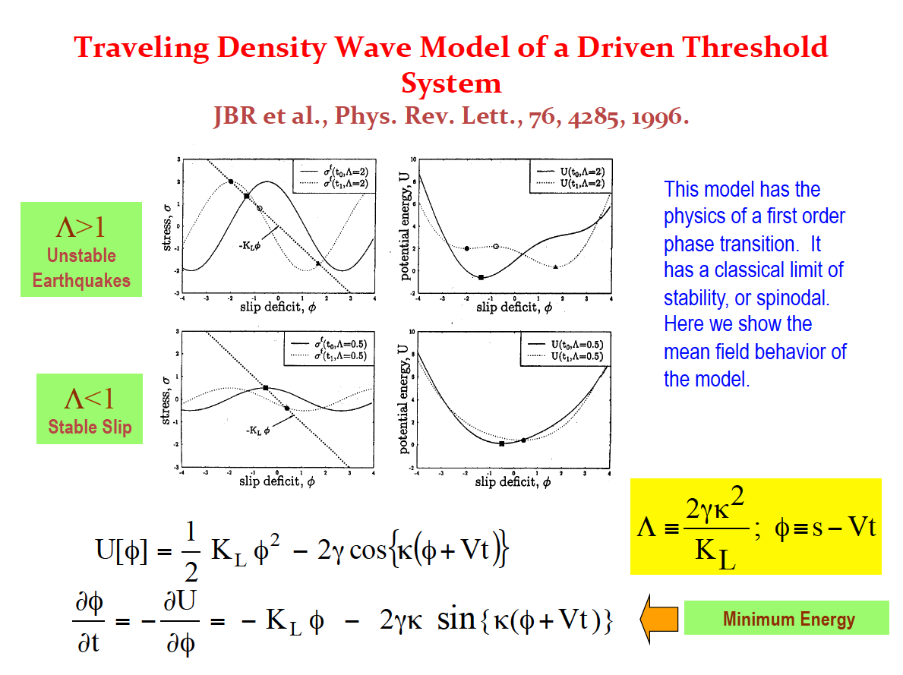

Slide 47
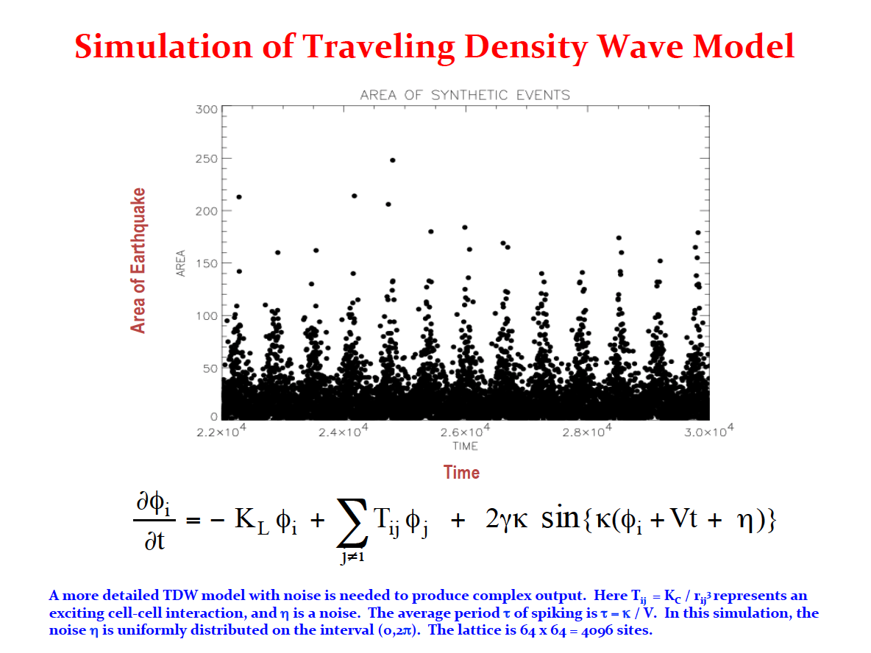

Slide 48
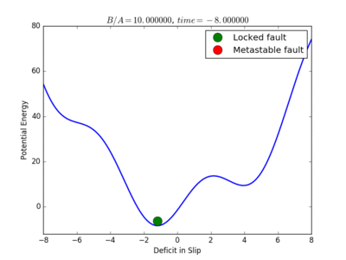

Physics Model of the Earthquake Cycle
Nucleation as First Order Phase Transition
(Courtesy Mark Yoder)
Metastability: System state is no longer minimum energy

Slide 49


Slide 50


Physics Model of the Market Cycle
Nucleation as First Order Phase Transition
(Courtesy Mark Yoder)
Metastability: System state is no longer minimum energy

Slide 51


Slide 52


Slide 53


Slide 54


