Slide 1
Lecture 21
Dynamical Atmospheric Modes;
ENSO, PDO, MJO
John Rundle GEL/EPS 131

Slide 2
Atmospheric Modes http://en.wikipedia.org/wiki/Climatology
“Atmospheric modes are examples of patterns or “coherent structures” in the climate system
These are modes that have certain recognizable characteristics
Knowledge of these modes is often used in weather forecasting
These modes include:
El Niño – Southern Oscillation (ENSO)
Madden-Julian Oscillation (MJO)
North Atlantic Oscillation (NAO)
Northern Annualar Mode (NAM) which is also known as the Arctic oscillation (AO)
Northern Pacific (NP) Index
Pacific Decadal Oscillation (PDO)
Interdecadal Pacific Oscillation (IPO)”

Slide 3
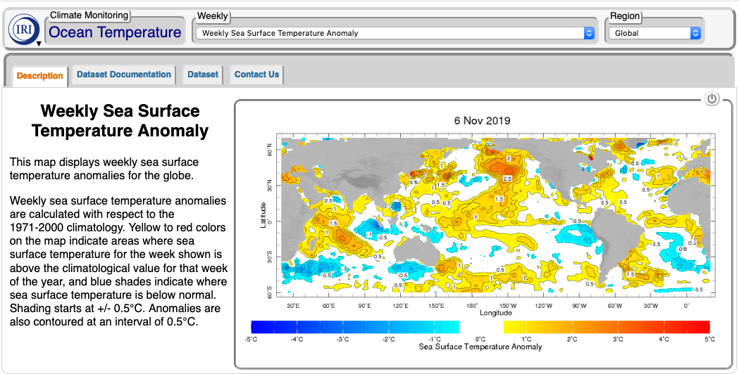
Weekly Sea Temperature Anomalies 6 November 2019
https://iridl.ldeo.columbia.edu/maproom/Global/Ocean_Temp/Weekly_Anomaly.html?T=3-9%20Nov%202019

Slide 4
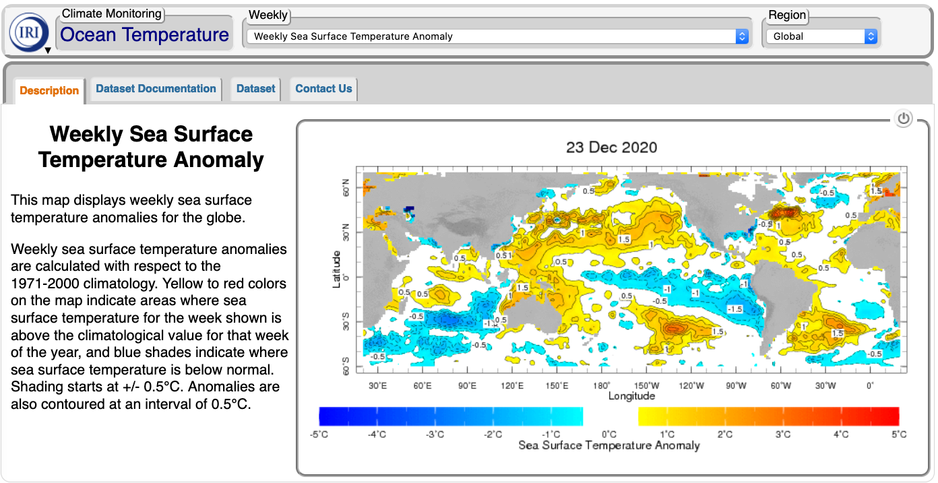
Weekly Sea Temperature Anomalies 23 December 2020
https://iridl.ldeo.columbia.edu/maproom/Global/Ocean_Temp/Weekly_Anomaly.html?T=20-26%20Dec%202020

Slide 5
Dynamical Modes and Patterns
“The atmosphere can be considered to be a combination (superposition) of dynamical modes
These modes can be shown to arise from the equations of motion (Navier-Stokes equations)
The modes correspond to characteristic patterns or regularities
Examples of this type of “mode decomposition” for other systems include:
Harmonics for waves in music and mathematics
Principal Component Analysis which is used for fingerprint identification by the FBI and in biometric analysis of “Eigenfaces”
Basis vectors or Eigenvectors
For the atmosphere, these modes are defined by characteristic wind speeds, atmosphere and ocean temperatures, and other features
Both spatial and temporal patterns are seen in the mode decompositions
Often the equations of motion of the atmosphere can be written as an infinite series of equations, each of which describes the evolution of a particular mode
ENSO, the PDO, the Madden-Julian oscillation are examples of atmospheric modes”

Slide 6
ENSO: El Nino-Southern Oscillation http://en.wikipedia.org/wiki/El_Nino
“El Niño (/ɛlˈniːnjoʊ/, /-ˈnɪn-/, Spanish pronunciation: [el ˈniɲo]) is a band of anomalously warm ocean water temperatures that periodically develops off the western coast of South America and can cause climatic changes across the Pacific Ocean.
There is a phase of 'El Niño–Southern Oscillation' (ENSO), which refers to variations in the temperature of the surface of the tropical eastern Pacific Ocean (El Niño and La Niña) and in air surface pressure in the tropical western Pacific.
The two variations are coupled: the warm oceanic phase, El Niño, accompanies high air surface pressure in the western Pacific, which forces the water eastward
The cold phase, La Niña, accompanies low air surface pressure in the western Pacific, which forces the water westward.
Mechanisms that cause the oscillation remain under study.
The extremes of this climate pattern's oscillations cause extreme weather (such as floods and droughts) in many regions of the world.
Developing countries dependent upon agriculture and fishing, particularly those bordering the Pacific Ocean, are the most affected.
El niño is Spanish for "the boy", and the capitalized term El Niño refers to the Christ child, Jesus, because periodic warming in the Pacific near South America is usually noticed around Christmas.”

Slide 7
Normal Conditions http://en.wikipedia.org/wiki/El_Nino
“Normal Pacific pattern: Equatorial winds gather warm water pool toward the west. Cold water upwells along South American coast. (NOAA / PMEL / TAO)”

Slide 8
Or in Other Words… https://en.wikipedia.org/wiki/Walker_circulation

Slide 9
El Nino Conditions http://en.wikipedia.org/wiki/El_Nino
“El Niño conditions: Warm water pool approaches the South American coast. The absence of cold upwelling increases warming.”

Slide 10
La Nina Conditions http://en.wikipedia.org/wiki/El_Nino
“La Niña conditions: Warm water is farther west than usual.”

Slide 11
ENSO: El Nino and La Nina http://www.climate.gov

Slide 12
ENSO Characteristics
“El Niño is defined by prolonged warming in the eastern Pacific Ocean sea surface temperatures when compared with the average value.
The accepted definition is a warming of at least 0.5°C (0.9°F) averaged over the east-central tropical Pacific Ocean.
Typically, this anomaly happens at irregular intervals of two to seven years, and lasts nine months to two years.
The average period length is five years.
When this warming occurs for only seven to nine months, it is classified as El Niño "conditions”
When it occurs for more than that period, it is classified as El Niño "episodes”.
Similarly, La Niña conditions and episodes are defined for cooling.”

Slide 13
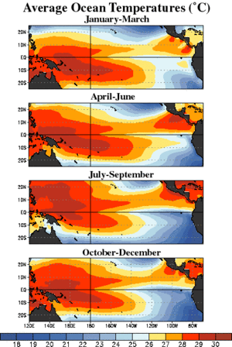
Sea Surface Temperature Anomalies https://en.wikipedia.org/wiki/El_Nino
Time loop of Sea Surface Temperature anomalies for week centered on July 12, 2006

Slide 14
ENSO: Time Series http://en.wikipedia.org/wiki/El_Nino
SOI = Air pressure at Tahiti – Air pressure at Darwin, Australia

Slide 15
Onset of El Nino http://en.wikipedia.org/wiki/El_
“The first signs of an El Niño are:
Rise in surface pressure over the Indian Ocean, Indonesia, and Australia
Fall in air pressure over Tahiti and the rest of the central and eastern Pacific Ocean
Trade winds in the south Pacific weaken or head east
Warm air rises near Peru, causing rain in the northern Peruvian deserts
Then warm water spreads from the west Pacific and the Indian Ocean to the east Pacific.
The warm water takes the rain with it, causing extensive drought in the western Pacific and rainfall in the normally dry eastern Pacific (failure of the monsoon).
El Niño's warm rush of nutrient-poor water heated by its eastward passage in the Equatorial Current, replaces the cold, nutrient-rich surface water of the Humboldt Current.
When El Niño conditions last for many months, extensive ocean warming and the reduction in easterly trade winds limits upwelling of cold nutrient-rich deep water, and its economic impact to local fishing for an international market can be serious.”
Notes:
Start here 2017-11-17

Slide 16
To Repeat: Normal & El Nino Conditions http://spaceplace.nasa.gov/el-nino/en/

Slide 17
Southern Oscillation http://en.wikipedia.org/wiki/El_Nino
“The Southern Oscillation is the atmospheric component of El Niño.
This component is an oscillation in surface air pressure between the tropical eastern and the western Pacific Ocean waters.
The strength of the Southern Oscillation is measured by the Southern Oscillation Index (SOI).
The SOI is computed from fluctuations in the surface air pressure difference between Tahiti and Darwin, Australia.
El Niño episodes are associated with negative values of the SOI, meaning there is below normal pressure over Tahiti and above normal pressure of Darwin, Australia – SOI is negative during an El Nino
Low atmospheric pressure tends to occur over warm water and high pressure occurs over cold water, in part because of deep convection over the warm water.
El Niño episodes are defined as sustained warming of the central and eastern tropical Pacific Ocean.
This results in a decrease in the strength of the Pacific trade winds, and a reduction in rainfall over eastern and northern Australia.”

Slide 18
Walker Circulation http://en.wikipedia.org/wiki/El_Nino
“During non-El Niño conditions, the Walker circulation is seen at the surface as easterly trade winds that move water and air warmed by the sun toward the west.
This also creates ocean upwelling off the coasts of Peru and Ecuador and brings nutrient-rich cold water to the surface, increasing fishing stocks.
The western side of the equatorial Pacific is characterized by warm, wet, low-pressure weather as the collected moisture is dumped in the form of typhoons and thunderstorms.
The ocean is some 60 cm (24 in) higher in the western Pacific as the result of this motion.”

Slide 19
Impacts of ENSO Warm Phase: South America http://en.wikipedia.org/wiki/El_Nino
“Because El Niño's warm pool feeds thunderstorms above, it creates increased rainfall across the east-central and eastern Pacific Ocean, including several portions of the South American west coast.
The effects of El Niño in South America are direct and stronger than in North America.
An El Niño is associated with warm and very wet weather months in April–October along the coasts of northern Peru and Ecuador, causing major flooding whenever the event is strong or extreme.
The effects during the months of February, March, and April may become critical.
Along the west coast of South America, El Niño reduces the upwelling of cold, nutrient-rich water that sustains large fish populations, which in turn sustain abundant sea birds, whose droppings support the fertilizer industry.
The reduction in upwelling leads to fish kills off the shore of Peru.
The local fishing industry along the affected coastline can suffer during long-lasting El Niño events.
The world's largest fishery collapsed due to overfishing during the 1972 El Niño Peruvian anchoveta reduction.
During the 1982–83 event, some catches decreased while others increased.”

Slide 20
Impacts of ENSO Warm Phase: South America http://en.wikipedia.org/wiki/El_Nino
“Horse mackerel have increased in the region during warm events. Shifting locations and types of fish due to changing conditions provide challenges for fishing industries.
Other conditions provide further complications, such as the government of Chile in 1991 creating restrictions on the fishing areas for self-employed fishermen and industrial fleets.
The ENSO variability may contribute to the great success of small, fast-growing species along the Peruvian coast, as periods of low population removes predators in the area.
Similar effects benefit migratory birds that travel each spring from predator-rich tropical areas to distant winter-stressed nesting areas.
Southern Brazil and northern Argentina also experience wetter than normal conditions, but mainly during the spring and early summer. Central Chile receives a mild winter with large rainfall, and the Peruvian-Bolivian Altiplano is sometimes exposed to unusual winter snowfall events.
Drier and hotter weather occurs in parts of the Amazon River Basin, Colombia, and Central America.”

Slide 21
Impacts on the United States http://en.wikipedia.org/wiki/El_Nino
“During El Niño, the northern tier of the lower 48, as well as southern Alaska, exhibits above normal temperatures during the fall and winter, while the Gulf coast experiences below normal temperatures during the winter season.
During El Niño events, increased precipitation is expected in California due to a more southerly, zonal, storm track.
During La Niña, increased precipitation is diverted into the Pacific Northwest due to a more northerly storm track.
During La Niña events, the storm track shifts far enough northward to bring wetter than normal winter conditions (in the form of increased snowfall) to the Midwestern states, as well as hot and dry summers.”

Slide 22
Impacts on the United States http://en.wikipedia.org/wiki/El_Nino
“During the El Niño portion of ENSO, increased precipitation falls along the Gulf coast and Southeast due to a stronger than normal, and more southerly, polar jet stream.
In the late winter and spring during El Niño events, drier than average conditions can be expected in Hawaii.
On Guam during El Niño years, dry season precipitation averages below normal.
However, the threat of a tropical cyclone is over triple what is normal during El Niño years, so extreme shorter duration rainfall events are possible.
On American Samoa during El Niño events, precipitation averages about 10 percent above normal, while La Niña events lead to precipitation amounts which average close to 10 percent below normal.
ENSO is linked to increased rainfall over Puerto Rico. “

Slide 23
Other Impacts http://en.wikipedia.org/wiki/El_Nino
“Snowfall:
During an El Niño, snowfall is greater than average across the southern Rockies and Sierra Nevada mountain range, and is well-below normal across the Upper Midwest and Great Lakes states.
During a La Niña, snowfall is above normal across the Pacific Northwest and western Great Lakes.
Severe weather:
During El Niño, the jet stream is oriented from west to east across the southern portion of the United States, making the region more susceptible to severe weather outbreaks.
During La Niña, the jet stream and severe weather is likely to be farther north than normal.
Tropical cyclones:
Due to changes in upper level winds caused by variations in the ENSO cycle, the likelihood of a North Atlantic hurricane hitting the Continental United States is increased during La Niña conditions
Hurricane likelihood decreases during El Niño conditions.”

Slide 24
Global Tropical Cyclone Impacts http://en.wikipedia.org/wiki/El_Nino
“Most tropical cyclones form on the side of the subtropical ridge closer to the equator, then move poleward past the ridge axis before recurving into the main belt of the Westerlies.
When the subtropical ridge position shifts due to El Niño, so will the preferred tropical cyclone tracks.
Areas west of Japan and Korea tend to experience many fewer September–November tropical cyclone impacts during El Niño and neutral years.
During El Niño years, the break in the subtropical ridge tends to lie near 130°E, which would favor the Japanese archipelago.
During El Niño years, Guam's chance of a tropical cyclone impact is one-third of the long-term average.
The tropical Atlantic ocean experiences depressed hurricane activity due to increased vertical wind shear across the region during El Niño years.
On the flip side, however, the tropical Pacific Ocean east of the dateline has above-normal activity during El Niño years due to water temperatures well above average and decreased windshear.
Most of the recorded East Pacific category 5 hurricanes occur during El Niño years in clusters.”

Slide 25
Impacts of La Nina http://en.wikipedia.org/wiki/El_Nino
“La Niña causes mostly the opposite effects of El Niño, above-average precipitation across the northern Midwest, the northern Rockies, Northern California, and the Pacific Northwest's southern and eastern regions.
Meanwhile, precipitation in the southwestern and southeastern states is below average.
This also allows way above average hurricanes in the Atlantic and fewer in the Pacific.
In Canada, La Niña will, in general, cause a cooler, snowier winter, such as the near-record-breaking amounts of snow recorded in the La Niña winter of 2007/2008 in Eastern Canada.
2010-2011 La Niña was one of the strongest ever observed. ”
La Niñas occurred in 1904, 1908, 1910, 1916, 1924, 1928, 1938, 1950, 1955, 1964, 1970, 1973, 1975, 1988, 1995, 1998, 2010, and 2011.

Slide 26
Health and Social Impacts http://en.wikipedia.org/wiki/El_Nino
“Extreme weather conditions related to the El Niño cycle correlate with changes in the incidence of epidemic diseases.
For example, the El Niño cycle is associated with increased risks of some of the diseases transmitted by mosquitoes, such as malaria, dengue, and Rift Valley fever.
Cycles of malaria in India, Venezuela, Brazil, and Colombia have now been linked to El Niño.
Outbreaks of another mosquito-transmitted disease, Australian encephalitis (Murray Valley encephalitis—MVE), occur in temperate south-east Australia after heavy rainfall and flooding, which are associated with La Niña events.
A severe outbreak of Rift Valley fever occurred after extreme rainfall in north-eastern Kenya and southern Somalia during the 1997–98 El Niño.
ENSO conditions have also been related to Kawasaki disease incidence in Japan and the west coast of the United States, via the linkage to tropospheric winds across the north Pacific Ocean.
Scientists at The Earth Institute of Columbia University, having analyzed data from 1950 to 2004, suggest ENSO may have had a role in 21% of all civil conflicts since 1950, with the risk of annual civil conflict doubling from 3% to 6% in countries affected by ENSO during El Niño years relative to La Niña years.”

Slide 27
Global Warming and ENSO http://en.wikipedia.org/wiki/El_Nino
“During the last several decades, the number of El Niño events increased, and the number of La Niña events decreased, although observation of ENSO for much longer is needed to detect robust changes.
The question is whether this is a random fluctuation or a normal instance of variation for that phenomenon or the result of global climate changes toward global warming.
The studies of historical data show the recent El Niño variation is most likely linked to global warming.
For example, even after subtracting the positive influence of decadal variation, the amplitude of the ENSO variability in the observed data still increases, by as much as 60% in the last 50 years.
The exact changes happening to ENSO in the future is uncertain
Different models make different predictions.
The ENSO is considered to be a potential tipping element in Earth's climate.”

Slide 28
Pacific Decadal Oscillation (PDO) http://research.jisao.washington.edu/pdo/
The "Pacific Decadal Oscillation" (PDO) is a long-lived El Niño-like pattern of Pacific climate variability.
While the two climate oscillations have similar spatial climate fingerprints, they have very different behavior in time.
Fisheries scientist Steven Hare coined the term "Pacific Decadal Oscillation" (PDO) in 1996 while researching connections between Alaska salmon production cycles and Pacific climate (his dissertation topic with advisor Robert Francis).
Two main characteristics distinguish PDO from El Niño/Southern Oscillation (ENSO): -- First, 20th century PDO "events" persisted for 20-to-30 years, while typical ENSO events persisted for 6 to 18 months
-- Second, the climatic fingerprints of the PDO are most visible in the North Pacific/North American sector, while secondary signatures exist in the tropics - the opposite is true for ENSO.
Several independent studies find evidence for just two full PDO cycles in the past century: "cool" PDO regimes prevailed from 1890-1924 and again from 1947-1976, while "warm" PDO regimes dominated from 1925-1946 and from 1977 through (at least) the mid-1990’s

Slide 29
PDO http://cses.washington.edu

Slide 30
PDO Time Series http://research.jisao.washington.edu/pdo/

Slide 31
Pacific Decadal Oscillation (PDO) http://research.jisao.washington.edu/pdo/
Major changes in northeast Pacific marine ecosystems have been correlated with phase changes in the PDO
Warm eras have seen enhanced coastal ocean biological productivity in Alaska and inhibited productivity off the west coast of the contiguous United States, while cold PDO eras have seen the opposite north-south pattern of marine ecosystem productivity.
Causes for the PDO are not currently known.
Likewise, the potential predictability for this climate oscillation are not known.
Some climate simulation models produce PDO-like oscillations, although often for different reasons.
The mechanisms giving rise to PDO will determine whether skillful decades-long PDO climate predictions are possible.
From a societal impacts perspective, recognition of PDO is important because it shows that "normal" climate conditions can vary over time periods comparable to the length of a human's lifetime .

Slide 32
Possible Mechanisms for PDO http://en.wikipedia.org/wiki/Pacific_decadal_oscillation
“Several studies have indicated that the PDO index can be reconstructed as the superposition of tropical forcing and extra-tropical processes.
Thus, unlike ENSO, the PDO is not a single physical mode of ocean variability, but rather the sum of several processes with different dynamic origins.
The PDO index is reconstructed as the sum of:
Random and ENSO induced variability in the Aleutian low, on decadal timescales
ENSO teleconnections
Stochastic atmospheric forcing, and
Changes in the North Pacific oceanic gyre circulation
All of these contribute approximately equally
Additionally, sea surface temperature anomalies have some winter to winter persistence.”
Positive phase PDO spatial pattern

Slide 33
Temperature and Precipitation http://en.wikipedia.org/wiki/Pacific_decadal_oscillation
Temperature
Precipitation
“The IPO/PDO spatial pattern and impacts are similar to those associated with ENSO events.
During the positive phase the wintertime Aleutian low is deepened and shifted southward, warm/humid air moves along the North American west coast and temperatures are higher than usual from the Pacific Northwest to Alaska but below normal in Mexico and the Southeastern United States.
Winter precipitations are higher than usual in the Alaska Coast Range, Mexico and the Southwestern United States but reduced over Canada, Eastern Siberia and Australia”

Slide 34
Anomalous Events http://en.wikipedia.org/wiki/Pacific_decadal_oscillation

Slide 35
Comparison of ENSO with PDO http://cses.washington.edu

Slide 36
Other Comparisons http://cses.washington.edu

Slide 37
Madden-Julian Oscillation http://en.wikipedia.org/wiki/Madden-Julian_oscillation
“The Madden–Julian oscillation (MJO) is the largest element of the intraseasonal (30–90 days) variability in the tropical atmosphere.
It is a large-scale coupling between atmospheric circulation and tropical deep convection.
Rather than being a standing pattern (like ENSO) it is a traveling pattern, propagating eastwards at approximately 4 to 8 m/s (9 to 18 mph), through the atmosphere above the warm parts of the Indian and Pacific oceans.
This overall circulation pattern manifests itself in various ways, most clearly as anomalous rainfall.
This was discovered by Roland Madden and Paul Julian (again the comparison with ENSO is instructive, since their local effects on Peruvian fisheries were discovered long before the global structure of the pattern was recognized).”

Slide 38
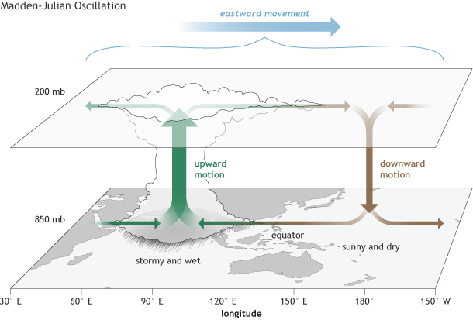
Madden-Julian Oscillation https://www.climate.gov/news-features/blogs/enso/what-mjo-and-why-do-we-care

Slide 39
Madden-Julian Oscillation https://www.climate.gov/news-features/blogs/enso/what-mjo-and-why-do-we-care

Slide 40
MJO Progression http://en.wikipedia.org/wiki/Madden-Julian_oscillation
“The MJO is characterized by an eastward progression of large regions of both enhanced and suppressed tropical rainfall, observed mainly over the Indian Ocean and Pacific Ocean.
The anomalous rainfall is usually first evident over the western Indian Ocean, and remains evident as it propagates over the very warm ocean waters of the western and central tropical Pacific.
The wet phase of enhanced convection and precipitation is followed by a dry phase where thunderstorm activity is suppressed.
Each cycle lasts approximately 30–90 days.
Because of this pattern, The MJO is also known as the 30–90 day oscillation, 30–90 day wave, or intraseasonal oscillation”
Date Line
A Hovmöller diagram of the 5-day running mean of outgoing longwave radiation showing the MJO. Time increases from top to bottom in the figure, so contours that are oriented from upper-left to lower-right represent movement from west to east.

Slide 41
Connection to Indian Monsoon http://en.wikipedia.org/wiki/Madden-Julian_oscillation
“During the Northern Hemisphere summer season the MJO-related effects on the Indian summer monsoon are well documented.
A period of warming sea surface temperatures are found five to ten days prior to a strengthening of MJO-related precipitation across southern Asia.
A break in the Asian monsoon, normally during the month of July, has been attributed to the Madden–Julian oscillation, after its enhanced phase moves off to the east of the region into the open tropical Pacific ocean.
MJO-related effects on the North American summer monsoon also occur, though they are relatively weaker.
MJO-related impacts on the North American summer precipitation patterns are strongly linked to meridional (i.e. north–south) adjustments of the precipitation pattern in the eastern tropical Pacific. “

Slide 42
MJO Influence http://en.wikipedia.org/wiki/Madden-Julian_oscillation
“There is evidence that the MJO modulates activity particularly for the strongest storms by providing a large-scale environment that is favorable (or unfavorable) for development
As the MJO progresses east, the favored region for tropical cyclone activity shifts eastward from the western Pacific to the eastern Pacific and finally to the Atlantic basin.
There is an inverse relationship between tropical cyclone activity in the western north Pacific basin and the north Atlantic basin, however.
When one basin is active, the other is normally quiet, and vice versa.
The main reason for this appears to be the phase of the MJO, which is normally in opposite modes between the two basins at any given time.
Sea surface temperatures (SST) must be sufficiently warm and vertical wind shear must be sufficiently weak for tropical disturbances to form and persist.
The MJO is monitored routinely by both the USA National Hurricane Center and the USA Climate Prediction Center during the Atlantic hurricane (tropical cyclone) season to aid in anticipating periods of relative activity or inactivity.”

Slide 43
Links of MJO to ENSO http://en.wikipedia.org/wiki/Madden-Julian_oscillation
“There is strong year-to-year (interannual) variability in MJO activity, with long periods of strong activity followed by periods in which the oscillation is weak or absent.
This interannual variability of the MJO is partly linked to the El Niño-Southern Oscillation (ENSO) cycle.
In the Pacific, strong MJO activity is often observed 6 – 12 months prior to the onset of an El Niño episode, but is virtually absent during the maxima of some El Niño episodes, while MJO activity is typically greater during a La Niña episode.
Strong events in the Madden–Julian oscillation over a series of months in the western Pacific can speed the development of an El Niño or La Niña but usually do not in themselves lead to the onset of a warm or cold ENSO event.
Changes in the structure of the MJO with the seasonal cycle and ENSO might facilitate more substantial impacts of the MJO on ENSO.
For example, the surface westerly winds associated with active MJO convection are stronger during advancement toward El Niño and the surface easterly winds associated with the suppressed convective phase are stronger during advancement toward La Nina.”

