Slide 1
Lecture 1
Introduction to Econophysics
John Rundle Econophysics PHYS 255

Slide 2
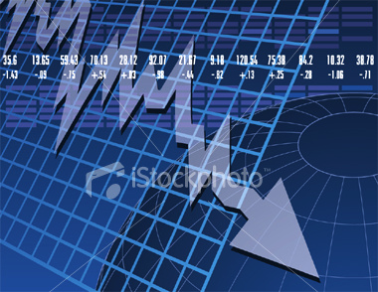
Econophysics
Statistical Physics and Data Science of Financial Markets
Physics 255: Winter Quarter 2021
Instructor: John Rundle, Departments of Physics & Earth/Planetary Science
http://rundle.physics.ucdavis.edu/PHYS_150-250_ECONOPHYSICS/index.html
Topics:
Introduction
Markets and arbitrage
Statistical distributions
Random walks
Time series analysis
Financial data
Tail risk and volatility
Risk management and the Kelly criterion
Valuing and pricing models for assets
Black-Scholes model for option pricing
Machine Learning with Applications

Slide 3
The Main Idea
Philosophical Question: What is the value of a thing? It could be:
An object
A stock or bond
A contract such as a future, a forward or any kind of legal agreement
A service
A cryptocurrency (bitcoin, Ethereum)
A regular currency

Slide 4
How Value is Assigned
Society has found a method of assigning value through “markets”
Examples include:
The financial markets: stocks, bonds, foreign exchange
Auctions (really the same thing as a market)
eBay
Political ideas (more popular ideas are more valuable and longer lasting)
Scientific ideas (citations)
Google backlinks (also basically citations)

Slide 5
The Point of This Course
As we move through life, we need to acquire assets to fund our lifestyle, our retirements, and other needs
Investing is basically gambling, but with better odds, it is an example of applied probability
We need to understand how to build models so that we can invest our resources intelligently, to encourage them to grow through compounding
We basically want to learn to “make money while we sleep” as someone once said
For physicists, one of the attractions of the financial markets is the huge amount of interesting data that is available for analysis

Slide 6
About Econophysics
Econophysics is a heterodox interdisciplinary research field, applying theories and methods originally developed by physicists in order to solve problems in economics, usually those including uncertainty or stochastic processes and nonlinear dynamics.
Some of its application to the study of financial markets has also been termed statistical finance referring to its roots in statistical physics.
Econophysics is closely related to social physics.

Slide 7
About Me
Teaching for 27 years at the university level
50% physics department 50% Earth and Planetary Science
Research on statistical physics and complexity of earth system processes
Member of the Santa Fe Institute for 30 years
Interested in Econophysics since 2008
Have since worked with investment professionals that manage many billions of $USD
Have published blogs on similarities between systems undergoing phase transitions and markets

Slide 8
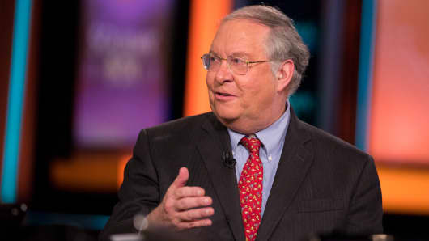
Bill Miller

Slide 9
Blogs on the MVP site

Slide 10
Econophysics: History
Physicists' interest in the social sciences is not new
Daniel Bernoulli, as an example, was the originator of utility-based preferences.
One of the founders of neoclassical economic theory, former Yale University Professor of Economics Irving Fisher, was originally trained under the Yale physicist, Josiah Willard Gibbs.
Likewise, Jan Tinbergen, who won the first Nobel Memorial Prize in Economic Sciences in 1969 for having developed and applied dynamic models for the analysis of economic processes, studied physics with Paul Ehrenfest at Leiden University.
In particular, Tinbergen developed the gravity model of international trade that has become the workhorse of international economics.

Slide 11
History (Continued)
Econophysics was started in the mid-1990s by several physicists working in the subfield of statistical mechanics.
Unsatisfied with the traditional explanations and approaches of economists
Which usually prioritized simplified approaches for the sake of soluble theoretical models over agreement with empirical data
They applied tools and methods from physics, first to try to match financial data sets, and then to explain more general economic phenomena.

Slide 12
History (Continued)
One driving force behind Econophysics arising at this time was the sudden availability of large amounts of financial data, starting in the 1980s and growing in the 1990’s with the advent of the World Wide Web.
It became apparent that traditional methods of analysis were insufficient
Standard economic methods dealt with homogeneous agents and equilibrium, while many of the more interesting phenomena in financial markets fundamentally depended on heterogeneous agents and far-from-equilibrium situations.

Slide 13
History (Continued)
The term ”Econophysics" was coined by H. Eugene Stanley, to describe the large number of papers written by physicists in the problems of (stock and other) markets, in a conference on statistical physics in Kolkata (Calcutta) in 1995
The term first appeared in its proceedings publication in Physica A 1996.
The inaugural meeting on Econophysics was organised in 1998 in Budapest by János Kertész and Imre Kondor.
The first book on econophysics was by R. N. Mantegna & H. E. Stanley in 2000.

Slide 14
History (Continued)
In recent years network science, heavily reliant on analogies from statistical mechanics, has been applied to the study of productive systems.
That is the case with the works done at the Santa Fe Institute in European Funded Research Projects as Forecasting Financial Crises and the Harvard-MIT Observatory of Economic Complexity

Slide 15
History (Continued)
If ”Econophysics" is taken to denote the principle of applying statistical mechanics to economic analysis, as opposed to a particular literature or network, priority of innovation is probably due to Emmanuel Farjoun and Moshé Machover (1983)
On the other hand, if ”Econophysics" is taken to denote the application of physics to economics, one can consider the works of Léon Walras and Vilfredo Pareto as part of it.
As shown by Bruna Ingrao and Giorgio Israel, general equilibrium theory in economics is based on the physical concept of mechanical equilibrium that we know from physics
More recently, the idea of meta-stable equilibrium and hysteresis has become more widely accepted

Slide 17
Santa Fe Institute
The Santa Fe Institute (SFI) is an independent, nonprofit theoretical research institute located in Santa Fe (New Mexico, United States) and dedicated to the multidisciplinary study of the fundamental principles of complex adaptive systems, including physical, computational, biological, and social systems.
Founded in 1984
The Institute is ranked 25th among the world's "Top Science and Technology Think Tanks" and 25th among the world's "Best Transdisciplinary Research Think Tanks" according to the 2018 edition of the Global Go To Think Tank Index Reports, published annually by the University of Pennsylvania.

Slide 18
Santa Fe Institute
The Institute consists of a small number of resident faculty and postdoctoral researchers, a large group of external faculty whose primary appointments are at other institutions, and a number of visiting scholars.
The Institute is advised by a group of eminent scholars, including several Nobel Prize-winning scientists.
Theoretical scientific research is the Institute's primary focus
It also runs several popular summer schools on complex systems, along with other educational and outreach programs aimed at students ranging from middle school up through graduate school.
The Santa Fe Institute was founded in 1984 by scientists George Cowan, David Pines, Stirling Colgate, Murray Gell-Mann, Nick Metropolis, Herb Anderson, Peter A. Carruthers, and Richard Slansky.
All but Pines and Gell-Mann were scientists with Los Alamos National Laboratory.
In conceiving of the Institute, the scientists sought a forum to conduct theoretical research outside the traditional disciplinary boundaries of academic departments and government agency science budgets.
Note: SFI has REU programs, as well as a graduate summer school

Slide 19
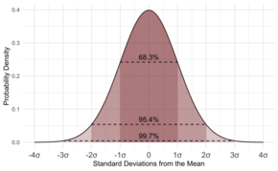
Basic Tools of Econophysics
Basic tools of Econophysics are probabilistic and statistical methods taken from statistical physics
Physics models that have been applied in economics include the kinetic theory of gases, percolation models, chaotic models developed to study cardiac arrest, and models with self-organizing criticality as well as other models developed for earthquake prediction.
Moreover, there have been attempts to use the mathematical theory of complexity and information theory, as developed by many scientists among whom are Murray Gell-Mann and Claude E. Shannon, respectively.

Slide 20
Main Results
Presently, one of the main results of econophysics comprises the explanation of the "fat tails" in the distribution of many kinds of financial data
Fat tails are a universal self-similar scaling property (i.e. scale invariant over many orders of magnitude in the data),arising from the tendency of individual market competitors, or of aggregates of them, to exploit systematically and optimally the prevailing "microtrends" (e.g., rising or falling prices).

Slide 21
Fat Tails and Scaling Laws
These "fat tails" (scaling laws) are mathematically important, because they comprise the risks
These may be on the one hand very small such that one may tend to neglect them
But usually they are not negligible at all
They can never be made exponentially tiny, but instead follow a measurable algebraically decreasing power law, for example with a failure probability P ~ x⁻⁴, as an example
Here x is an increasingly large variable in the tail region of the distribution considered (i.e. a price statistics with much more than 10⁸ data)
The events considered are not simply "outliers" but must really be taken into account and cannot be "insured away”
Example of such a risk: A global pandemic!

Slide 22
Fat Tails
Fat tails are a characteristic of “critical points”, a type of mathematical structure seen in second order phase transitions, and in some circumstances, in first order phase transitions
These have been studied in many contexts, and their properties have been elucidated by Fisher, Kadanoff, Wilson, Stanley, Klein, Leibowitz, and many others

Slide 24
Data

Slide 25
Fat Tails (Continued)
Scaling also plays a role near a change of tendency (e.g. from falling to rising prices)
Here "panic reactions" are typically seen in the selling or buying of assets
The "fat tails" are also observed in commodity markets.
Much of this type of behavior was first observed by Louis Bachelier in analyzing prices on the Paris Bourse.
Bachelier recognized that prices under go Brownian (random) walks, just like the molecules in a gas
His PhD dissertation was on stochastic processes, and was titled “The Theory of Speculation” (1900)

Slide 26
Fat Tails (Continued)
As in quantum field theory the "fat tails" can be obtained by complicated methods, mainly by numerical ones, since they contain the deviations from the usual Gaussian approximations
For example, the Black–Scholes theory.
Fat tails can, however, also be due to other phenomena, such as a random number of terms in the central-limit theorem, or any number of other, non-econophysics models.
Due to the difficulty in testing such models, they have received less attention in traditional economic analysis
A difference is that these fat tail distributions have a finite mean and infinite (or at least very large) variance
Compare that to a Gaussian normal distribution which has finite mean and variance

Slide 27
What is this Course About (2)?
Not a course in economics, accounting or finance
It is a course in:
Applying statistical mechanics models to markets
Analyzing financial time series and building models
Statistics of markets and financial time series

Slide 28
Note
Investing is basically gambling, but with better odds
Aided by the idea that over long times, prices of financial assets tend to increase (positive drift of a stochastic process)
Success or failure are defined by an understanding of probability and statistics, as well as the ability to control ones’ emotions
A huge advantage is the idea of building models
In gambling, this approach was pioneered by Ed Thorp, who extended his models to markets and invented the method of statistical arbitrage

Slide 29
Ed Thorp
Edward Oakley Thorp (born August 14, 1932) is an American mathematics professor, author, hedge fund manager, and blackjack researcher.
He pioneered the modern applications of probability theory, including the harnessing of very small correlations for reliable financial gain.
Thorp is the author of Beat the Dealer, which mathematically proved that the house advantage in blackjack could be overcome by card counting.
He also developed and applied effective hedge fund techniques in the financial markets, and collaborated with Claude Shannon in creating the first wearable computer.
They demonstrated this computer (in a hidden way) in Las Vegas at the roulette tables
Thorp is also the author of Beat the Market, A Scientific Stock Market System, a book on investing

Slide 30
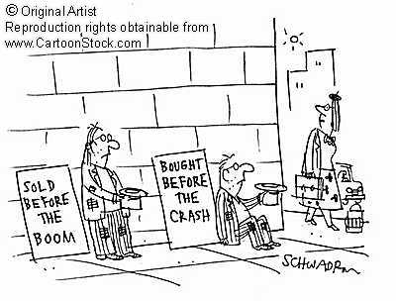
A Simple Model for the Dynamics of Financial Markets
(“Ising Model”)
Investors are spins :
Owns only stocks Owns only govt. bonds
(“Boom” phase) (“Bust” phase)
is the fraction of total money
invested in Govt bonds
Normally, stocks are anticorrelated with bonds
f is the real Fed funds rate
Volatility V plays the role of “temperature”
(V ∝ VIX)
Investors “interact” with neighbors, strength J
f
Market Potential U[φ]

Slide 31
Transitions in Financial Markets
First order phase transitions – metastability, nucleation, hysteresis
?
f: Real Fed funds rate
V: Volatility ∝ (VIX)
ε ∝ (V – V_{C})
φ
Hysteresis Loop
Fraction of Stocks
Fraction of
Govt Bonds
Fraction of Stocks
Fraction of
Govt Bonds
Market
Potential
Bonds
Stocks

Slide 32
Phase Transitions and Markets
Before a 1st Order Phase Transition
Transition occurs via nucleation and growth of bubbles
Classical: Correlation lengths and times are small
Nonclassical: Correlation lengths and times → ∞
Large fluctuations (volatility is high) – measured by the Ginzburg Criterion
Risk function (of bubble formation):
Related to nucleation rate of bubbles,
Lifetime in the metastable state is inverse of nucleation rate
Scaling (fat tail) exponents can be calculated: (Prob $∝x^{−α})$

Slide 33
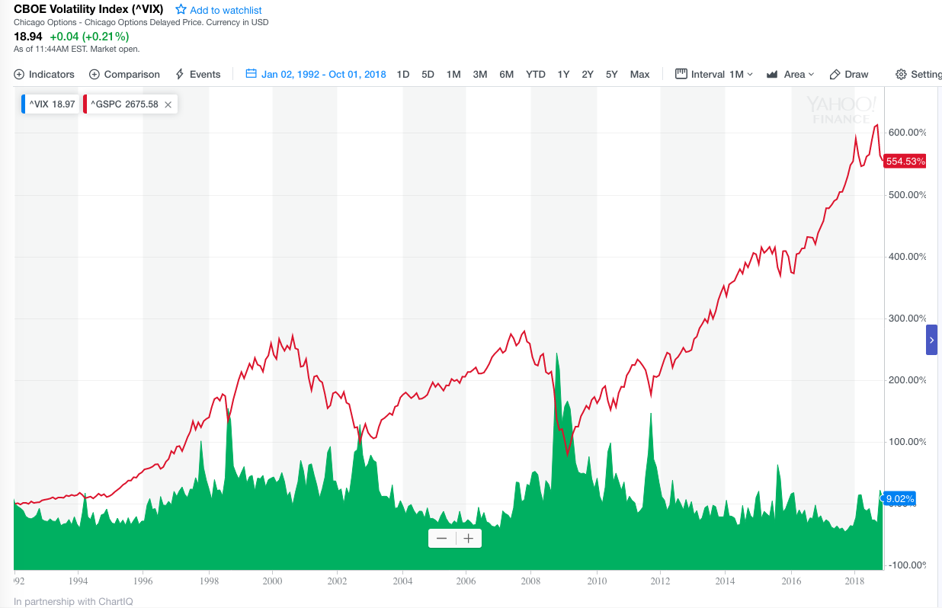
The VIX Index: Plays the role of “Temperature”
SP500
VIX

Slide 34
Simple Phase Diagram for the Markets
Low V
f < 0
Low V
f > 0
V
Low
“Boom”
“Metastable (?) Boom”
V_{C}
Volatility
Market Cycle
“Metastable(?) Bust”
“Bust”
High
High V
f < 0
High V
f > 0
Boom: Stocks are preferred.
Bust: Govt bonds are preferred
f
Stimulative Monetary Policy
Easier Credit – Higher Liquidity
Restrictive Monetary Policy
Tighter Credit – Lower Liquidity

Slide 35
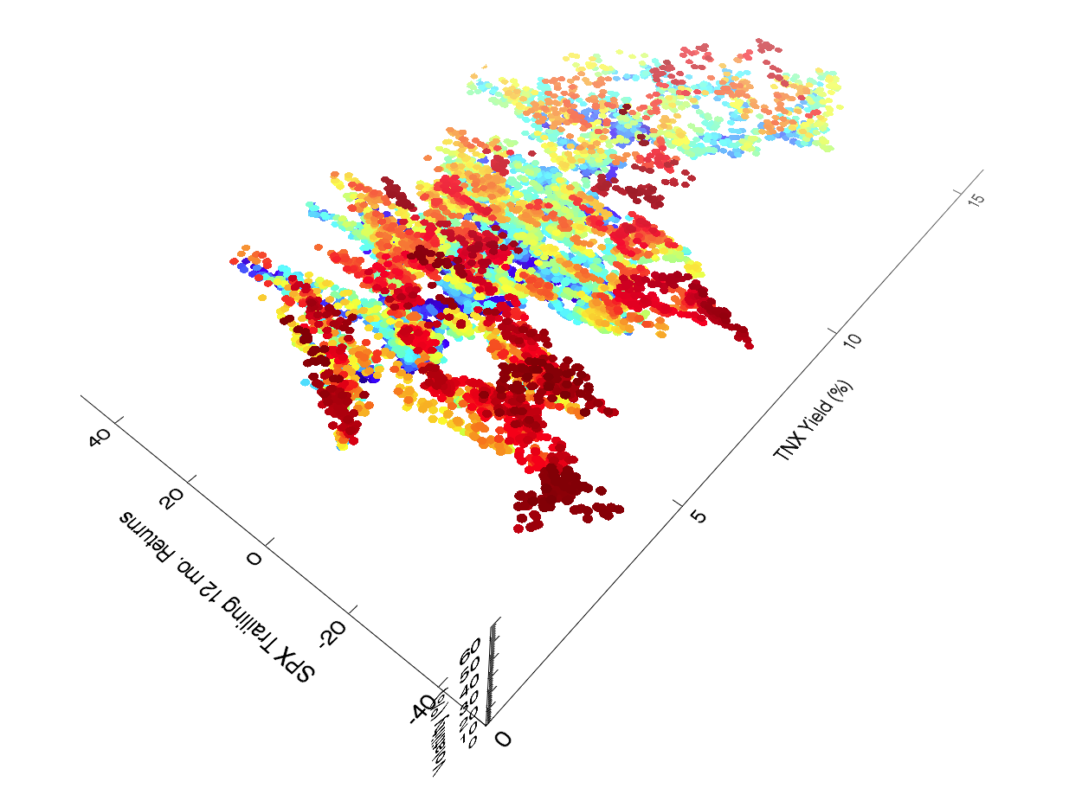
Attractor for the S&P 500:
The dynamics are a bit more complex than a simple Ising model!
This is not random – there is structure here. Time interval = 1970-2012

Slide 36
Working with Financial Data A brief tutorial

Slide 37
Downloading Yahoo Financial Data Sets
History:
In the past, Yahoo Finance allowed users to automate downloads of stock data freely.
With the advent of paid data services (Quandl, Intrinio), Yahoo has unfortunately decided to disable automated downloads.
However, manual downloads of individual data sets are still possible, and the files in this folder can be used to accomplish this task.
This README file illustrates the steps
Note that “ETF” means “Exchange Traded Fund”, which is an investment vehicle that trades like a stock
Example is the SPY, an index fund that tracks the Standards and Poors 500 index of stocks in real time

Slide 38
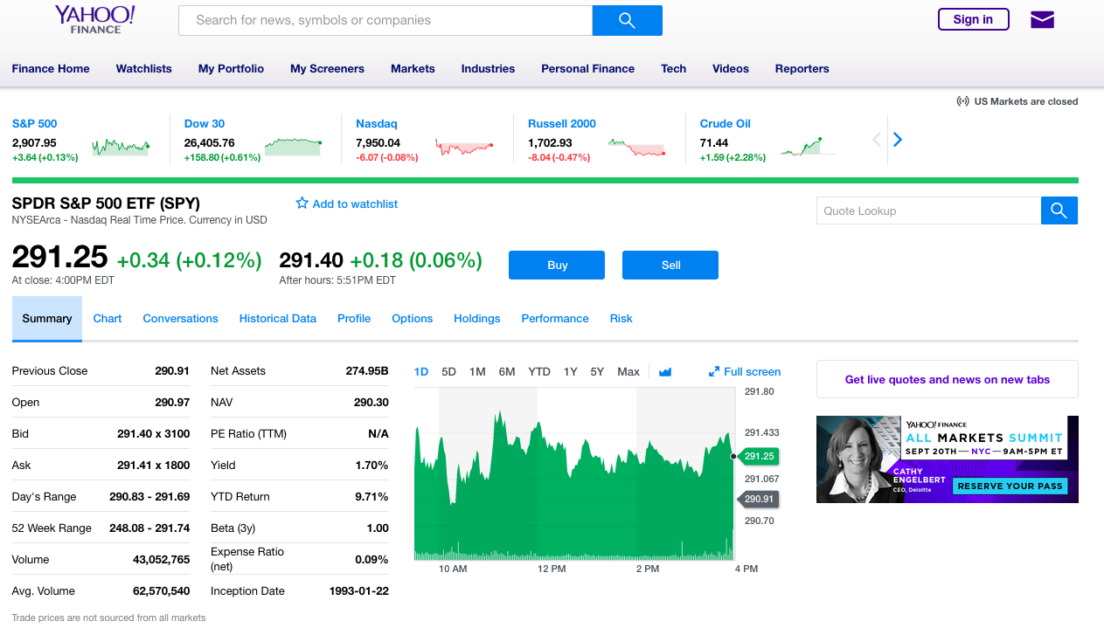
Yahoo Finance (Illustrated with SPY ETF) https://finance.yahoo.com/quote/SPY?ltr=1
Click Here

Slide 39
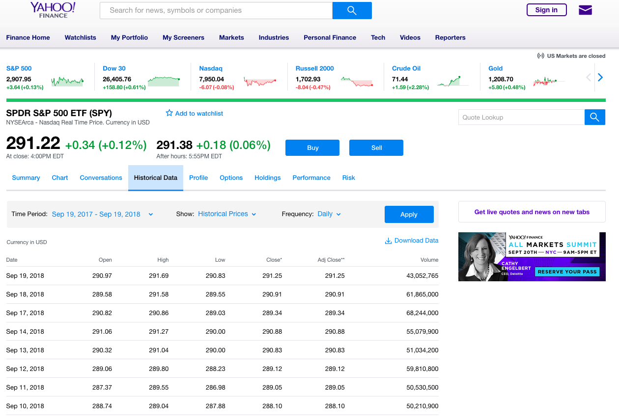
Set the date range here
Next, click on “Apply”
Finally, click on “Download Data”

Slide 40
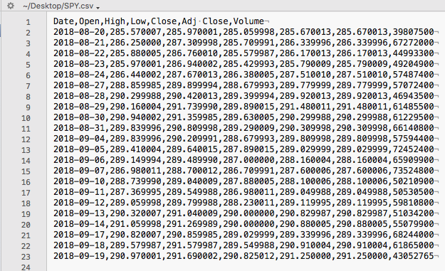
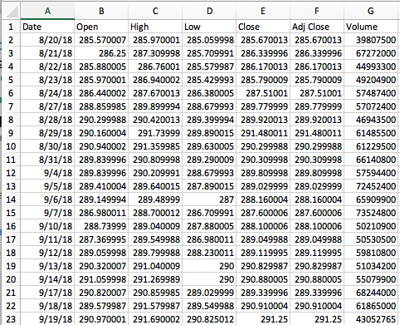
In a text editor, the file looks like this:
In Excel, the file looks like this:

Slide 41
Workflow for Homeworks
Download the stock/ETF data files that you want to use
Example: SPY.csv is the SPY Exchange Traded Fund
Pick 10 total Stocks or ETFs that you want to analyze (include the SPY as one of these)
Download these .csv files
Put the names of these stocks or ETFs into a file Stocks_List.txt
Place the .csv files into the same folder as the Stocks_List.txt file and the python codes
For plotting and analysis, either use the .csv files directly, or run the python code Convert_Stock_Data.py to convert the data into a text file format (if desired)

Slide 42
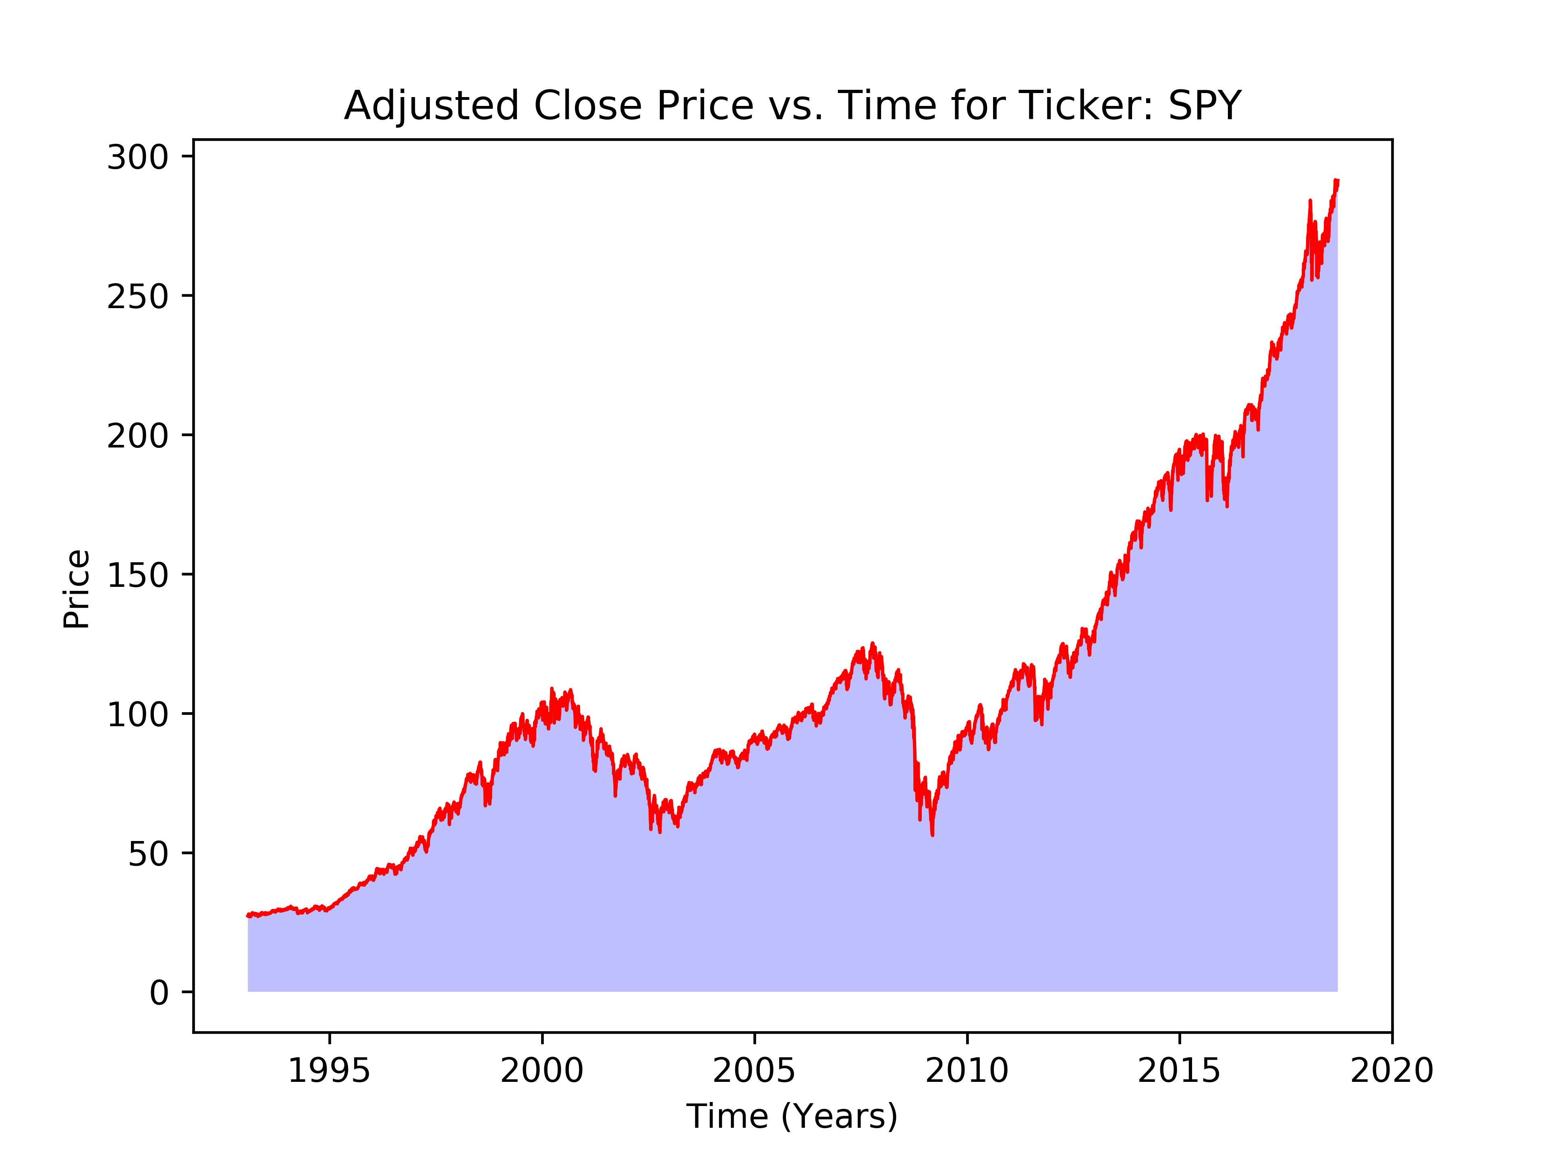
Example of a Time Series Plot

Slide 43
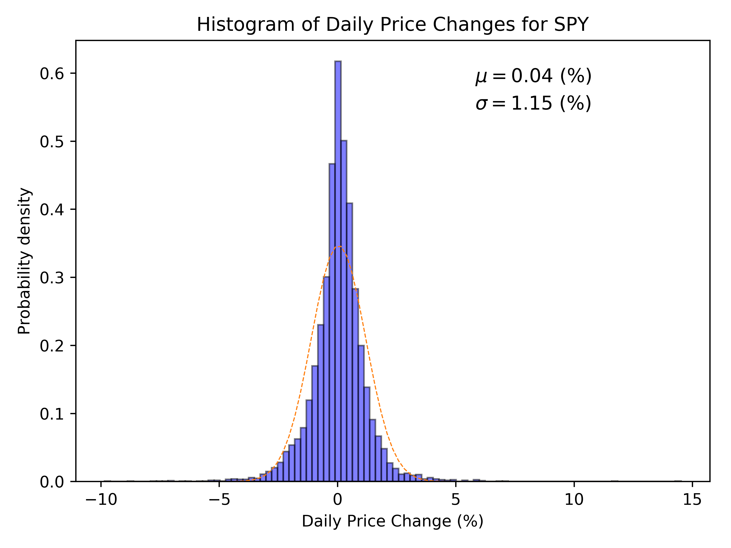
Example of a Daily Price Change Plot
Mean $μ$
Standard deviation $σ$
Gaussian with same $μ$ and $σ$
Later lectures include a discussion of statistical distributions and their moments, including mean and standard deviation

