Slide 1
Lecture 10
Introduction to
Probability - II
John Rundle Econophysics PHYS 250

Slide 2
Cumulative Distribution Function https://en.wikipedia.org/wiki/Cumulative_distribution_function
In probability theory and statistics, the cumulative distribution function (CDF) of a real-valued random variable X, or just distribution function of X, evaluated at x, is the probability that X will take a value less than or equal to x.
In the case of a continuous distribution, it gives the area under the probability density function from minus infinity to x.

Slide 3
Cumulative Distribution Function https://en.wikipedia.org/wiki/Cumulative_distribution_function

Slide 4
Cumulative Distribution Function https://en.wikipedia.org/wiki/Cumulative_distribution_function

Slide 5
Cumulative Distribution Function https://en.wikipedia.org/wiki/Cumulative_distribution_function

Slide 6
Survival Function https://en.wikipedia.org/wiki/Cumulative_distribution_function

Slide 7
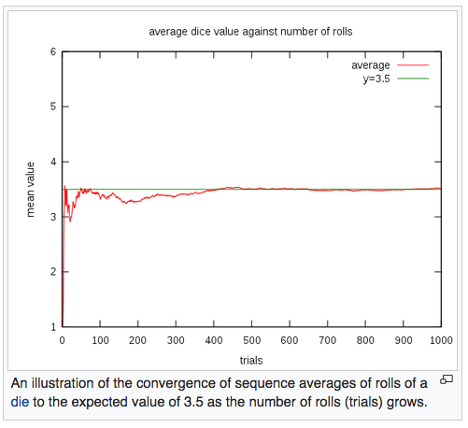
Expected Value (Sample Mean) https://en.wikipedia.org/wiki/Experiment_(probability_theory)
The rate of convergence can be roughly quantified by Chebyshev's inequality and the Berry–Esseen theorem.

Slide 8
Chebyshev’s Inequality https://en.wikipedia.org/wiki/Chebyshev's_inequality
In probability theory, Chebyshev’s rule guarantees that, for a wide class of probability distributions, "nearly all" values are close to the mean—the precise statement being that no more than 1/k2 of the distribution's values can be more than k standard deviations away from the mean.
The rule is often called Chebyshev's theorem, about the range of standard deviations around the mean, in statistics.
The inequality has great utility because it can be applied to any probability distribution in which the mean and variance are defined.
For example, it can be used to prove the weak law of large numbers.

Slide 9
Berry-Esseen Convergence https://en.wikipedia.org/wiki/Berry%E2%80%93Esseen_theorem
In probability theory, the central limit theorem states that, under certain circumstances, the probability distribution of the scaled mean of a random sample converges to a normal distribution as the sample size increases to infinity.
Under stronger assumptions, the Berry–Esseen theorem, or Berry–Esseen inequality, gives a more quantitative result
It also specifies the rate at which this convergence takes place by giving a bound on the maximal error of approximation between the normal distribution and the true distribution of the scaled sample mean.

Slide 10
Berry-Esseen Convergence https://en.wikipedia.org/wiki/Berry%E2%80%93Esseen_theorem

Slide 11
Expected Value (Discrete Random Variables) https://en.wikipedia.org/wiki/Experiment_(probability_theory)

Slide 12
Variance https://en.wikipedia.org/wiki/Variance

Slide 13
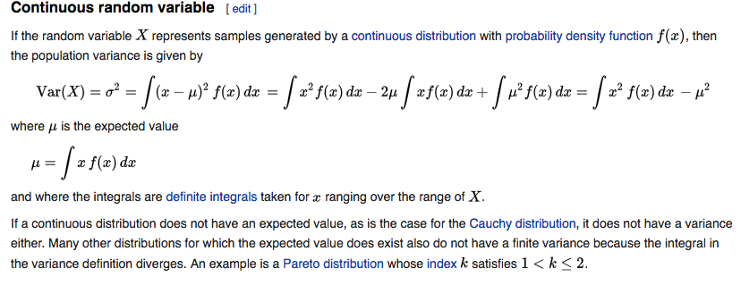
Variance https://en.wikipedia.org/wiki/Variance

Slide 14
Variance https://en.wikipedia.org/wiki/Variance

Slide 15
Variance https://en.wikipedia.org/wiki/Variance

Slide 16
CoVariance https://en.wikipedia.org/wiki/Covariance
In probability theory and statistics, covariance is a measure of the joint variability of two random variables.
If the greater values of one variable mainly correspond with the greater values of the other variable, and the same holds for the lesser values, (i.e., the variables tend to show similar behavior), the covariance is positive.
In the opposite case, when the greater values of one variable mainly correspond to the lesser values of the other, (i.e., the variables tend to show opposite behavior), the covariance is negative.
The sign of the covariance therefore shows the tendency in the linear relationship between the variables.
The magnitude of the covariance is not easy to interpret because it is not normalized and hence depends on the magnitudes of the variables.
The normalized version of the covariance, the correlation coefficient, however, shows by its magnitude the strength of the linear relation.

Slide 17
CoVariance https://en.wikipedia.org/wiki/Covariance

Slide 18
Variance: Properties https://en.wikipedia.org/wiki/Variance

Slide 19
Variance: Properties https://en.wikipedia.org/wiki/Variance

Slide 20
Variance: Properties https://en.wikipedia.org/wiki/Variance

Slide 21
Standard Deviation https://en.wikipedia.org/wiki/Standard_deviation

Slide 22
Standard Deviation https://en.wikipedia.org/wiki/Standard_deviation

Slide 23
Skewness https://en.wikipedia.org/wiki/Skewness
Skewness is a measure of the asymmetry of the probability distribution about its mean.
The skewness value can be positive or negative, or even undefined.
The qualitative interpretation of the skew is complicated.
For a unimodal distribution, negative skew indicates that the tail on the left side of the probability density function is longer or fatter than the right side
Conversely, positive skew indicates that the tail on the right side is longer or fatter than the left side.

Slide 24
Skewness https://en.wikipedia.org/wiki/Skewness

Slide 25
Skewness https://en.wikipedia.org/wiki/Skewness

Slide 26
Kurtosis https://en.wikipedia.org/wiki/Kurtosis
In probability theory and statistics, kurtosis (is a measure of the "tailedness" of the probability distribution of a real-valued random variable.
In a similar way to the concept of skewness, kurtosis is a descriptor of the shape of a probability distribution
Just as for skewness, there are different ways of quantifying it for a theoretical distribution and corresponding ways of estimating it from a sample from a population.
Depending on the particular measure of kurtosis that is used, there are various interpretations of kurtosis, and of how particular measures should be interpreted.

Slide 27
Kurtosis http://www.value-at-risk.net/leptokurtosis-conditional-heteroskedasticity/
Leptokurtotic distribution with same mean and variance
Data
Normal distribution with same mean and variance

Slide 28
Kurtosis https://en.wikipedia.org/wiki/Kurtosis
The standard measure of kurtosis, originating with Karl Pearson, is based on a scaled version of the fourth moment of the data or population.
This number measures heavy tails, and not peaked-ness
Thus the historical "peaked-ness" definition is wrong.
For this measure, higher kurtosis means more of the variance is the result of infrequent extreme deviations, as opposed to frequent modestly sized deviations.

Slide 29
Platykurtosis and Leptokurtosis https://en.wikipedia.org/wiki/Kurtosis
The kurtosis of any univariate normal distribution is 3.
It is common to compare the kurtosis of a distribution to this value.
The term “Excess Kurtosis” is used when the value of kurtosis is greater than 3
Distributions with kurtosis less than 3 are said to be platykurtic, although this does not imply the distribution is "flat-topped" as sometimes reported.
Rather, it means the distribution produces fewer and less extreme outliers than does the normal distribution.
An example of a platykurtic distribution is the uniform distribution, which does not produce outliers.
Distributions with kurtosis greater than 3 are said to be leptokurtic.
An example of a leptokurtic distribution is the Laplace distribution, or the Lorentz distribution, both of which have tails that asymptotically approach zero more slowly than a Gaussian, and therefore produce more outliers than the normal distribution.

Slide 30
Kurtosis: Definition https://en.wikipedia.org/wiki/Kurtosis

Slide 31
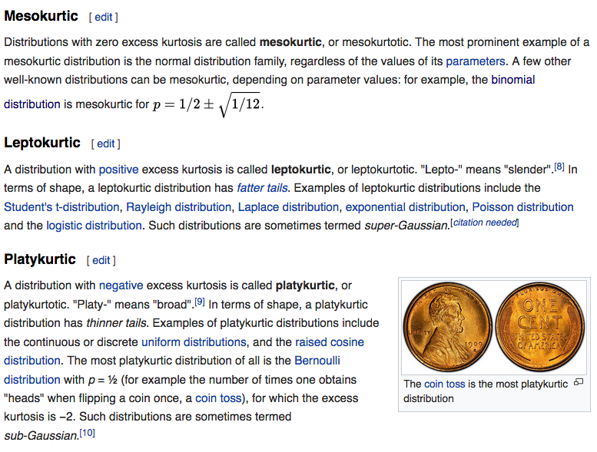
https://en.wikipedia.org/wiki/Kurtosis

Slide 32
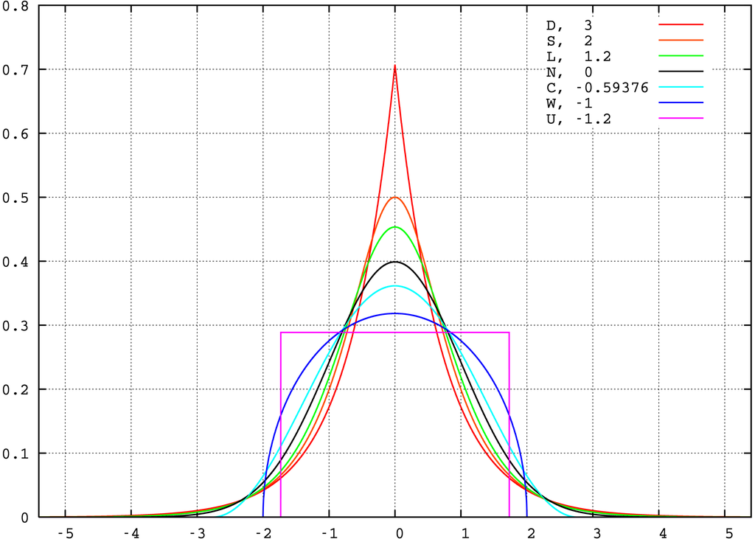
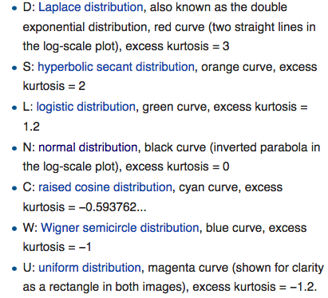
Kurtosis: Examples https://en.wikipedia.org/wiki/Kurtosis

Slide 33
Definition of Median https://en.wikipedia.org/wiki/Median
The median is the value separating the higher half of a data sample, a population, or a probability distribution, from the lower half.
In simple terms, it may be thought of as the "middle" value of a data set.
For example, in the data set {1, 3, 3, 6, 7, 8, 9}, the median is 6, the fourth number in the sample.

Slide 34
Definition of Mode https://en.wikipedia.org/wiki/Mode_(statistics)
The mode is the value that appears most often in a set of data.
The mode of a discrete probability distribution is the value x at which its probability mass function takes its maximum value.
In other words, it is the value that is most likely to be sampled.
Like the statistical mean and median, the mode is a way of expressing, in a (usually) single number, important information about a random variable or a population.
The numerical value of the mode is the same as that of the mean and median in a normal distribution, and it may be very different in highly skewed distributions.

Slide 35
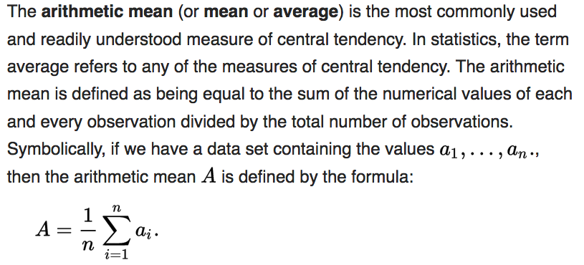
Arithmetic Mean vs. Geometric Mean https://en.wikipedia.org/wiki/Arithmetic_mean

Slide 36
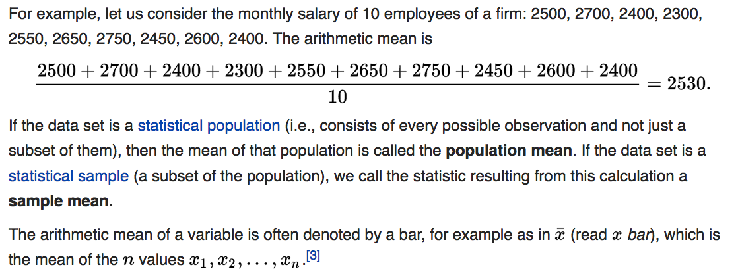
Arithmetic Mean vs. Geometric Mean https://en.wikipedia.org/wiki/Arithmetic_mean
Arithmetic Mean Example:

Slide 37
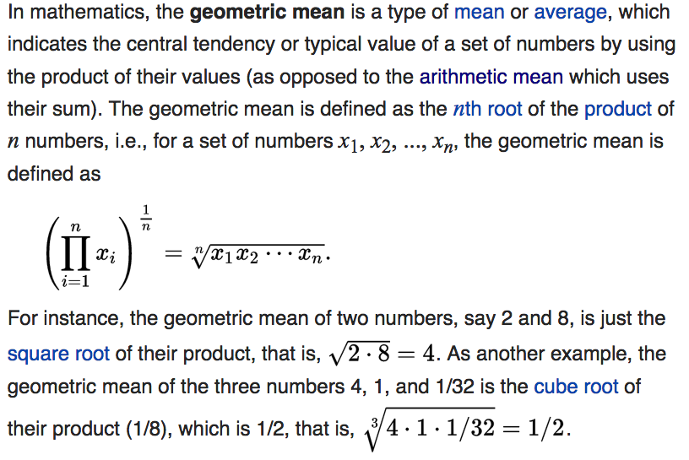
Arithmetic Mean vs. Geometric Mean https://en.wikipedia.org/wiki/Arithmetic_mean

Slide 38
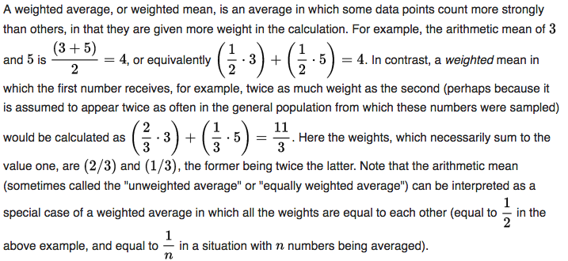
Weighted Arithmetic Average https://en.wikipedia.org/wiki/Arithmetic_mean
Arithmetic Mean - Weighted Average:
Data points are often weighted by the inverse of the variance

