Slide 1
Lecture 8
Earthquakes: Case Studies
John Rundle GEL/EPS 131

Slide 2
Topics
Important historic earthquakes
Lisbon, 1755
Cape Ann, MA, USA 1755
New Madrid, MO, USA 1811-1812
Charleston, SC, USA 1886
San Francisco, CA, USA 1906
Great Kanto Earthquake (Tokyo, Japan) 1923
Cascadia, Pacific NW USA 1700

Slide 3
Historic Earthquakes: Lisbon, 1755 http://en.wikipedia.org/wiki/1755_Lisbon_earthquake
1755 Copper Engraving
200 km WSW of Cape St Vincent

Slide 4
Historic Earthquakes: Lisbon, 1755 http://en.wikipedia.org/wiki/1755_Lisbon_earthquake
1 November 1755 (All Souls Day)
M8.5 – 9.0 (estimated)
10,000-100,000 deaths
Occurred on the Azores-Gilbert transform fault
Earthquake lasted 3-6 minutes in duration
Opened 5 meter wide fissures in city center
Shocks felt as far away as Greenland
Led to the beginning of seismically resistant construction techniques
Tsunami affected countries across the Atlantic Ocean

Slide 5
Cape Ann, MA Earthquake 1755 http://en.wikipedia.org/wiki/1755_Cape_Ann_Earthquake
Occurred just 17 days after the Lisbon earthquake
Remote aftershock?
Other research puts the magnitude at about 6.0-6.3
A very destructive earthquake – Boston at the time had major tidal flats that are subject to severe shaking amplification and liquefaction
May have produced a tsunami that was observed in the Leeward islands 1600 km south

Slide 6
New Madrid, Missouri, 1811-1812 http://en.wikipedia.org/wiki/1811%E2%80%931812_New_Madrid_earthquakes
Trees in Reelfoot Lake, TN, submerged at the time of the Dec 16, 1811 NE Arkansas earthquake. Photo taken approx. 100 years later by ML Fuller
New Madrid Seismic Zone
http://earthquake.usgs.gov/earthquakes/states/events/1811-1812_pics.php

Slide 7
New Madrid, Missouri, 1811-1812 http://en.wikipedia.org/wiki/1811%E2%80%931812_New_Madrid_earthquakes
A series of 4 intense earthquakes rocked the region near St Louis, MO
Dec 16, 1811 M~7.2-8.1, 0215am, epicenter NE Arkansas
Dec 16, 1811 M~7.2-8.1, 0815am, epicenter NE Arkansas
Jan 23, 1812, M7-7.8, 0900 am, epicenter in Missouri bootheel
Feb 7, 1812, M7.4-8, 0445am, epicenter near New Madrid
However, S. Hough (USGS) estimates magnitudes at M<7.5

Slide 8
New Madrid, Missouri, 1811-1812 http://en.wikipedia.org/wiki/1811%E2%80%931812_New_Madrid_earthquakes
Sand blows were common throughout the area, these can still be seen from the air in cultivated fields.
The shockwaves propagated easily through the cold crust
Residents as far away as Pittsburgh, Pennsylvania, and Norfolk, Virginia, were awakened by intense shaking.
Church bells were rung as far as Boston, Massachusetts and York, Ontario (now Toronto)
Sidewalks were reported to have been cracked and broken in Washington, D.C.
http://www.eas.slu.edu/eqc/eqc_publ/Flyers/PDFs/1811-12_Intensities.pdf

Slide 9
New Madrid, Missouri, 1811-1812 http://en.wikipedia.org/wiki/1811%E2%80%931812_New_Madrid_earthquakes
An M6.8 earthquake in 1895 caused major damage over the eastern US. Comparison to the M6.7 1994 Northridge event
Area at risk today

Slide 10
Charleston, SC Earthquake, 1886 http://en.wikipedia.org/wiki/1886_Charleston_earthquake
Earthquake occurred at about 2150 pm, Aug 31, 1886
Shaking lasted just under a minute.
Event caused severe damage in Charleston, SC
2,000 buildings and $6 million in damage (over $141 million in 2009 dollars)
In the entire city the buildings were only valued at approx. $24 million.
Between 60 and 110 lives were lost.
Some of the damage is still seen today.
Showed that earthquakes can happen anywhere in the continental US

Slide 11
Charleston, SC Earthquake, 1886 http://en.wikipedia.org/wiki/1886_Charleston_earthquake
Major damage occurred as far away as Tybee Island, Georgia, (more than 60 miles away)
Structural damage was reported several hundred miles from Charleston (including central Alabama, central Ohio, eastern Kentucky, southern Virginia and western West Virginia).
Event was felt as far away as Boston to the north, Chicago and Milwaukee to the northwest, as far west as New Orleans, as far south as Cuba, and as far east as Bermuda

Slide 12
San Francisco, CA Earthquake 1906 http://en.wikipedia.org/wiki/1906_San_Francisco_earthquake
Began at 0512 am PDT on April 18, 1906
Rupture length approx. 400 km, from San Juan Bautista in the south to Mendocino in the north
Right lateral strike slip faulting with maximum slip approx 6 m
Initially thought that only ~700 persons had died, later found that >3000 persons died
Many died from the fire, which was exacerbated by the Army under command of Brigadier F. Funston
Start here 1/25/2019

Slide 13
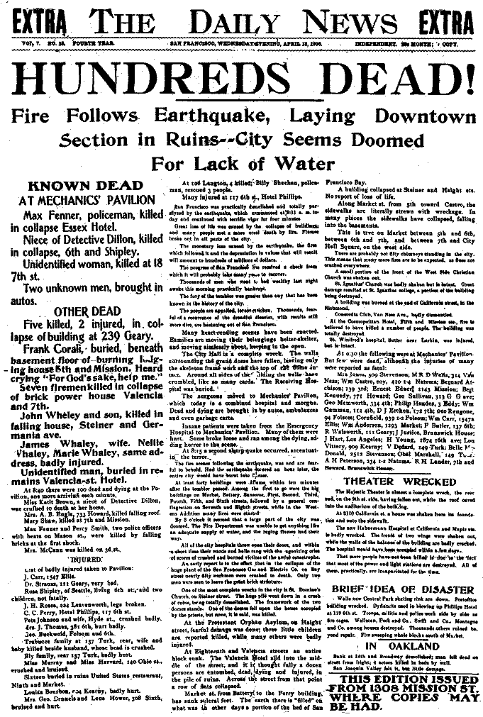
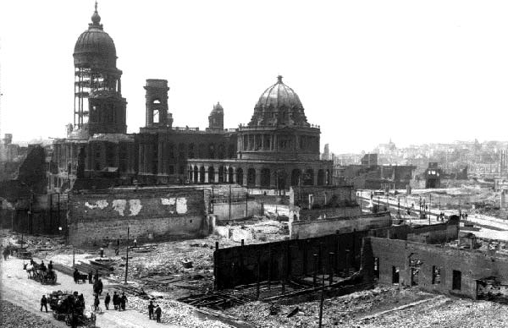
Wreckage of City Hall
and the Hall of Records
Photos courtesy of the Museum of the City of San Francisco; the Steinbrugge Collection of UC Berkeley; and the Bancroft Library, UC Berkeley

Slide 14
Arnold Genthe photo. “Looking down Sacramento Street, San Francisco, April 18, 1906”

Slide 15
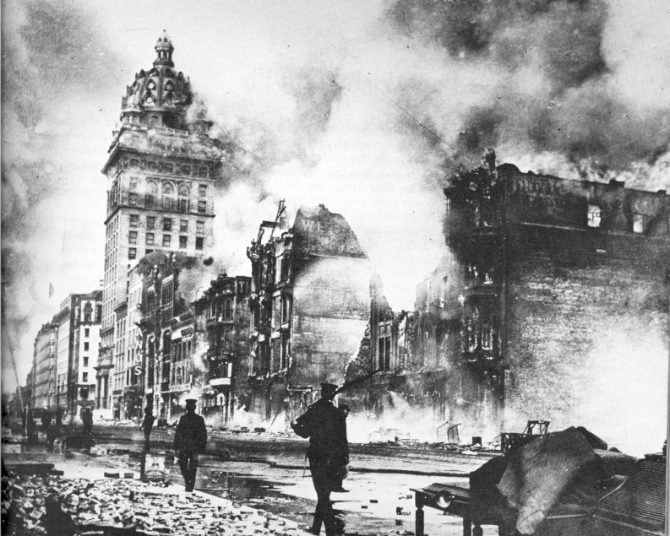

Slide 16
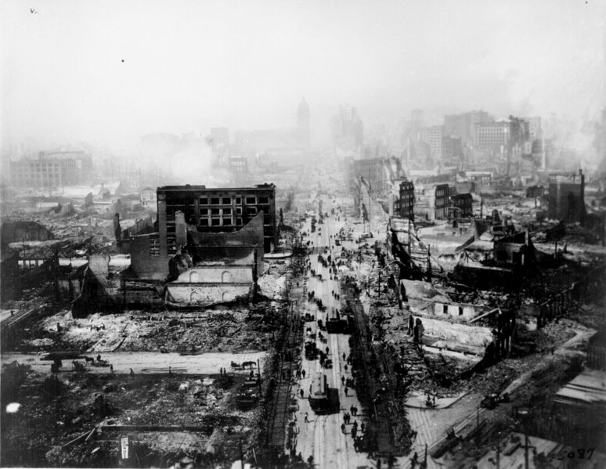

Slide 17
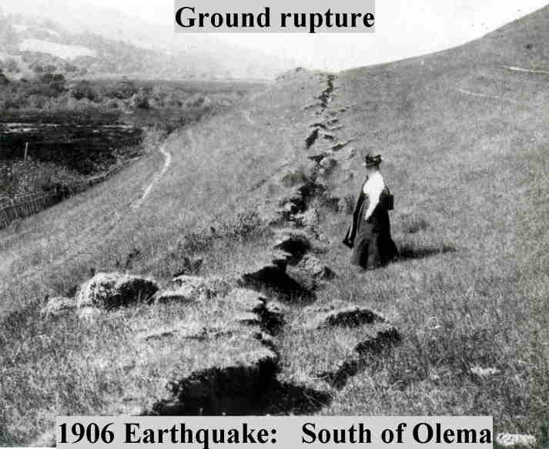
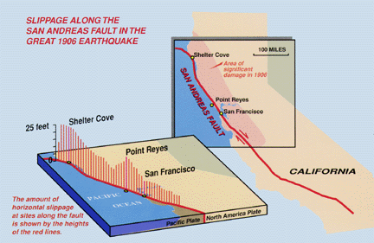
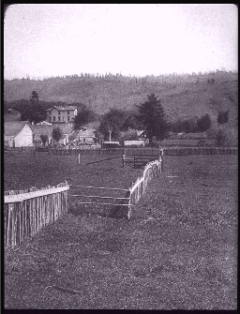
The Great 1906 San Francisco Earthquake Extended for ~ 350 km Along the San Andreas Fault in Northern California.
Horizontal offsets of as much as 8 meters were observed.
Wayne Thatcher, US Geological Survey
Three coupled spatial scales visible: 1. Fault length (~430 km); 2. Slip (~m); 3. Rupture thickness (~cm)

Slide 18
San Francisco, CA Earthquake 1906 http://en.wikipedia.org/wiki/1906_San_Francisco_earthquake
"At the time, San Francisco had been the ninth-largest city in the United States and the largest on the West Coast, with a population of about 410,000.
Over a period of 60 years, the city had become the financial, trade and cultural center of the West
It operated the busiest port on the West Coast; and was the "gateway to the Pacific", through which growing US economic and military power was projected into the Pacific and Asia.
Over 80% of the city was destroyed by the earthquake and fire. "

Slide 19
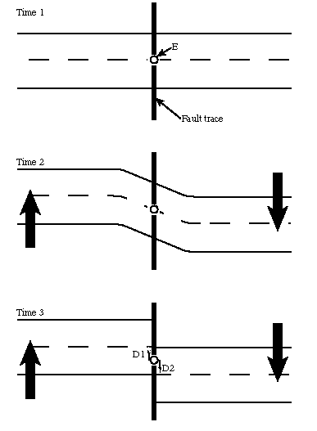
San Francisco, CA Earthquake 1906 http://en.wikipedia.org/wiki/1906_San_Francisco_earthquake
"The 1908 Lawson Report, a study of the 1906 quake led and edited by Professor Andrew Lawson of the University of California, showed that the same San Andreas Fault which had caused the disaster in San Francisco ran close to Los Angeles as well.
HF Reid, a member of the Lawson commission, proposed the elastic rebound theory of earthquakes, a model that we still use today
The earthquake was the first natural disaster of its magnitude to be documented by photography and motion picture footage and occurred at a time when the science of seismology was blossoming.
The overall cost of the damage from the earthquake was estimated at the time to be around US$400 million ($8.2 billion in 2009 dollars)."
Soldiers looting during the fire
Elastic Rebound Theory of earthquakes as proposed by HF Reid

Slide 20
San Francisco, CA Earthquake 1906 http://en.wikipedia.org/wiki/1906_San_Francisco_earthquake
Photograph taken by kite photography, approximately 600m
above San Francisco Bay showing the city in ruins

Slide 21
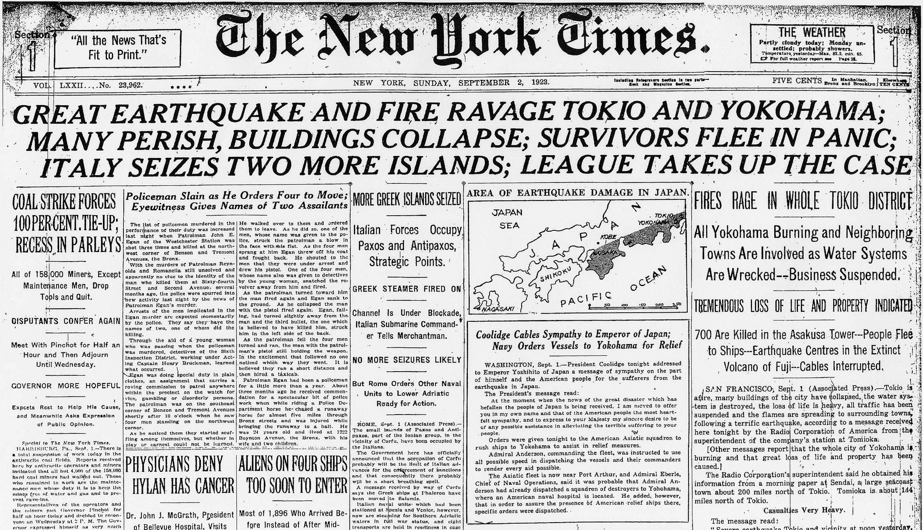

Slide 22
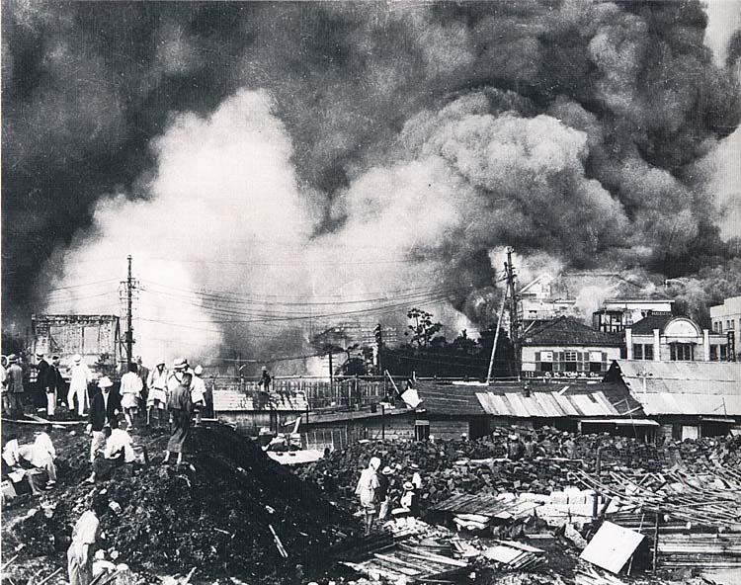

Slide 23
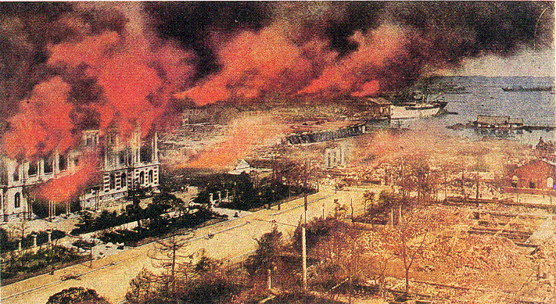

Slide 24
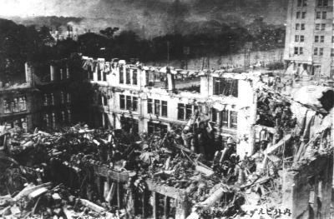

Slide 25
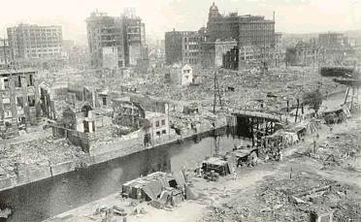

Slide 26
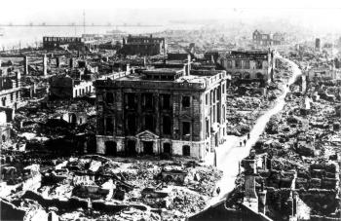

Slide 27
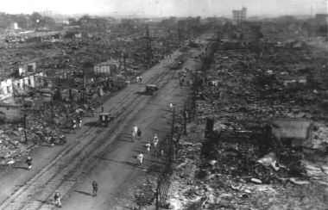

Slide 28
Cascadia M~9 January 26, 1700 AD ~2100 pm http://en.wikipedia.org/wiki/1700_Cascadia_earthquake
"The earthquake involved the Juan de Fuca Plate underlying the Pacific Ocean, from mid-Vancouver Island in British Columbia, Canada, south along the Pacific Northwest coast as far as northern California, USA.
The length of the fault rupture was about 1,000 kilometers (620 miles) with an average slip of 20 meters (22 yards).
Evidence supporting the occurrence of the 1700 earthquake has been gathered into the 2005 book The Orphan Tsunami of 1700, by geologist Brian Atwater and others."

Slide 29
Cascadia M~9 January 26, 1700 AD ~2100 pm http://en.wikipedia.org/wiki/1700_Cascadia_earthquake

Slide 30
Cascadia M~9 How do We Know About the Earthquake?
"Although there were no written records in the region at the time, the earthquake's precise time is known from Japanese records of a tsunami that has not been tied to any other Pacific Rim earthquake.
The most important clue linking the tsunami in Japan and the earthquake in the Pacific Northwest comes from studies of tree rings (dendrochronology)
These show that red cedar trees killed by lowering of coastal forests into the tidal zone by the earthquake have outermost growth rings that formed in 1699, the last growing season before the tsunami.
Local Indigenous American oral traditions describing a large quake also exist, although these do not specify the date.
There are many areas in the Pacific Northwest with drowned groves of trees that also show evidence of the earthquake."

Slide 31
Cascadia M~9 Tsunami Simulation: Kenji Satake

Slide 32
Another Simulation S. Ward (Youtube: “Ingomar200”)

Slide 33
Cascadia M~9: Simulation
Simulation of slip in a Cascadia earthquake
Simulation by Kim Olson, San Diego State University

Slide 34
Cascadia M~9 Drowned Forest skywalker.cochise.edu

Slide 35
Ghost Forests from Cascadia http://www.pnsn.org/outreach/earthquakesources/csz/landlevelchange

Slide 36
Cascadia M~9 Field Evidence http://en.wikipedia.org/wiki/cascadia
Trees killed by Cascadia earthquake 1700 AD
Tsunami deposits overlying native American firepits

Slide 37
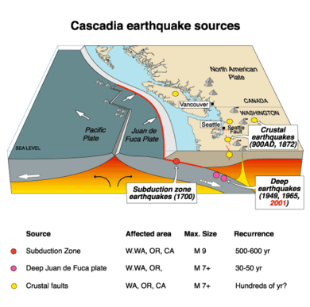
Next Cascadia M9: When? http://www.nrcan.gc.ca/earth-sciences/energy-mineral/geology/geodynamics/earthquake-processes/7047
Great earthquakes occur every 300-500 years on average
Episodic Tremor and Slip (ETS) was discovered during the past decade
ETS are small earthquakes and deep episodic slip that occurs every 14 months in the subduction zone
Are these precursors?

