Slide 1
Lecture 29
Extraterrestrial (Bolide) Impacts
John Rundle EPS 131

Slide 2
Impacts http://en.wikipedia.org/wiki/Impact_event
Impact events have physical consequences and have been found to regularly occur in planetary systems, though the most frequent involve asteroids, comets or meteoroids and have minimal impact.
When large objects impact terrestrial planets like the Earth, there can be significant physical and biospheric consequences, though atmospheres mitigate many surface impacts through atmospheric entry.
Impact structures are dominant landforms on many of the System's solid objects and present the strongest empirical evidence for their frequency and scale.
Impact events appear to have played a significant role in the evolution of the Solar System since its formation.
Very early impact events include the Late Heavy Bombardment, which occurred early in history of the Earth–Moon.

Slide 3
Significant Impacts http://en.wikipedia.org/wiki/Impact_event
Major impact events have significantly shaped Earth's history, have been implicated in the formation of the Earth–Moon system, the evolutionary history of life, the origin of water on Earth and several mass extinctions.
Impact structures are the result of impact events on solid objects and, as the dominant landforms on many of the System's solid objects, present the most solid evidence of prehistoric events.
Notable impact events include the the Chicxulub impact, 66 million years ago, believed to be the cause of the Cretaceous–Paleogene extinction event
One of the best-known recorded impacts in modern times was the Tunguska event, which occurred in Siberia, Russia, in 1908.
The 2013 Chelyabinsk meteor event is the only known such event to result in a large number of injuries, and the Chelyabinsk meteor is the largest recorded object to have encountered the Earth since the Tunguska event.
The most notable non-terrestrial event is the Comet Shoemaker–Levy 9 impact, which provided the first direct observation of an extraterrestrial collision of Solar System objects, when the comet broke apart and collided with Jupiter in July 1994.
Impact events have been a plot and background element in science fiction since knowledge of real impacts became established in the scientific mainstream.

Slide 4
Frequency http://en.wikipedia.org/wiki/Impact_event
Small objects frequently collide with Earth.
The lunar cratering record shows that the frequency of impacts decreases as approximately the cube of the resulting crater's diameter, which is on average proportional to the diameter of the impactor.
Asteroids with a 1 km (0.62 mi) diameter strike Earth every 500,000 years on average.
Large collisions – with 5 km (3 mi) objects – happen approximately once every twenty million years.
The last known impact of an object of 10 km (6 mi) or more in diameter was at the Cretaceous–Paleogene extinction event 66 million years ago.
The energy released by an impactor depends on diameter, density, velocity, and angle.
The diameter of most near-Earth asteroids that have not been studied by radar or infrared can generally only be estimated within about a factor of 2 based on the asteroid brightness.
Airburst Frequency
At least one known asteroid with a diameter of over 1 km (0.62 mi), (29075) 1950 DA, has a possibility of colliding with Earth on March 16, 2880.
The table above uses a density of 2600 kg/m3, velocity of 17 km/s, and an angle of 45 degrees

Slide 5
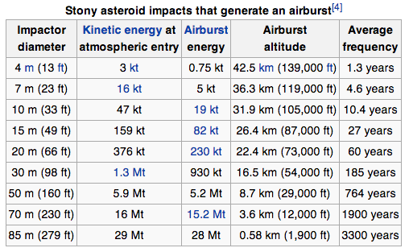
Frequency http://en.wikipedia.org/wiki/Impact_event
The minimum impact velocity on Earth is 11 km/s with asteroid impacts averaging around 17 km/s, with most probable impact angle of 45 degrees
Stony asteroids with a diameter of 4 meters (13 ft) impact Earth approximately once per year.
Asteroids with a diameter of 7 meters enter Earth's atmosphere with as much kinetic energy as Little Boy (the atomic bomb dropped on Hiroshima, approximately 16 kilotons of TNT) about every 5 years, but the air burst only generates a much reduced 5 kilotons of TNT.
These ordinarily explode in the upper atmosphere, and most or all of the solids are vaporized.
Objects with a diameter of roughly 50 m (164 ft) strike Earth approximately once every thousand years, producing explosions comparable to the one known to have detonated roughly 8.5 kilometers (28,000 ft) above Tunguska in 1908.
Airburst Frequency
At least one known asteroid with a diameter of over 1 km (0.62 mi), (29075) 1950 DA, has a possibility of colliding with Earth on March 16, 2880.
The table above uses a density of 2600 kg/m3, velocity of 17 km/s, and an angle of 45 degrees

Slide 6
Frequency http://en.wikipedia.org/wiki/Impact_event
Objects with a diameter less than 1 m (3.3 ft) are called meteoroids and seldom make it to the ground to become meteorites.
An estimated 500 meteorites reach the surface each year, but only 5 or 6 of these typically create a weather radar signature with a strewn field large enough to be recovered and be made known to scientists.
Although no human is known to have been killed directly by an impact, over one thousand people were injured by the Chelyabinsk meteor airburst event over Russia in 2013.
In 2005 it was estimated that the chance of a person born today dying due to an impact is around 1 in 200 000.
The 4-meter-sized asteroid 2008 TC3 is the only known object to be detected before impacting the Earth.
An impact event is commonly seen as a scenario that would bring about the end of civilization. In 2000, Discover Magazine published a list of 20 possible sudden doomsday scenarios with an impact event listed as the most likely to occur.
NASA artist depiction of K/T event

Slide 7
Historical Developments http://en.wikipedia.org/wiki/Impact_event
Impacts have had a significant geological and climatic influence.
The Moon is widely attributed to at least 2 huge impacts early in Earth's history.
Impact events earlier in the history of Earth have been credited with creative as well as destructive events
It has been proposed that impacting comets delivered the Earth's water, and some have suggested that the origins of life may have been influenced by impacting objects by bringing organic chemicals or lifeforms to the Earth's surface, a theory known as exogenesis.
Eugene Shoemaker was first to prove that meteorite impacts have affected the Earth.
Large-scale terrestrial impacts of the sort that produced the Barringer Crater, locally known as Meteor Crater, northeast of Flagstaff, Arizona, are rare.
Instead, it was widely thought that cratering was the result of volcanism
The Barringer Crater, for example, was originally ascribed to a prehistoric volcanic explosion (not an unreasonable hypothesis, given that the volcanic San Francisco Peaks stand only 30 miles (48 km) to the west).

Slide 8
Historical Developments http://en.wikipedia.org/wiki/Impact_event
The findings of late 20th-century space exploration and the work of scientists such as Shoemaker demonstrated that impact cratering was by far the most widespread geological process at work on the solar system's solid bodies.
Every surveyed solid body in the solar system was found to be cratered, and there was no reason to believe that the Earth had somehow escaped bombardment from space.
In the last few decades of the twentieth century, a large number of highly modified impact craters began to be identified.
The largest of these include Vredefort Crater, Sudbury Crater, Chicxulub Crater, and Manicouagan Crater.
The first observation of a major impact event occurred in 1994, the collision of the comet Shoemaker-Levy 9 with Jupiter
To date, no such events have been observed on Earth.
Based on crater formation rates determined from the Earth's closest celestial partner, the Moon, astrogeologists have determined that during the last 600 million years, the Earth has been struck by 60 objects of a diameter of 5 km (3 mi) or more.
The smallest of these impactors would release the equivalent of ten million megatons of TNT and leave a crater 95 km (60 mi) across.
For comparison, the largest nuclear weapon ever detonated, the Tsar Bomba, had a yield of 50 megatons.

Slide 9
Impact Examples

Slide 10
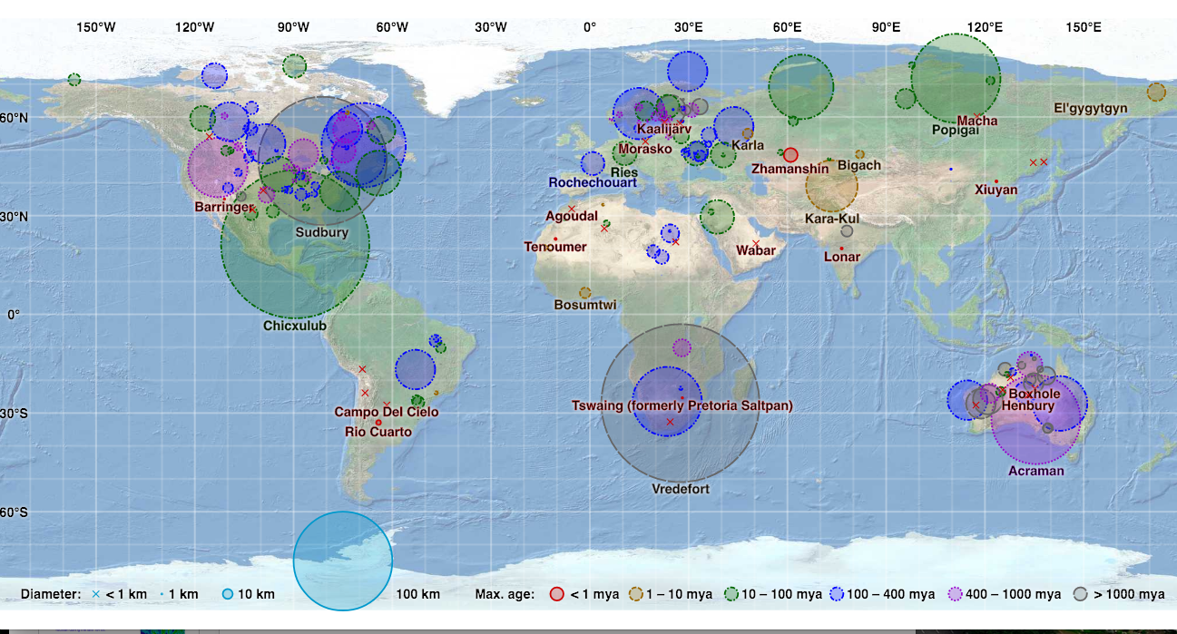
Mapped Impact Craters
https://upload.wikimedia.org/wikipedia/commons/c/cc/Earth_Impact_Database_world_map.svg

Slide 11
Death of the Dinosaurs https://en.wikipedia.org/wiki/Chicxulub_crater
In 1980, geologist Walter Alvarez and his father, Nobel Prize-winning scientist Luis Walter Alvarez, put forth his hypothesis that a large extraterrestrial body had struck Earth and led to the death of many of the mega fauna (dinosaurs) present at that time
In 1981 University of Arizona graduate student Alan R. Hildebrand and faculty adviser William V. Boynton published a draft Earth-impact theory and sought a candidate crater.
Their evidence included greenish-brown clay with surplus iridium containing shocked quartz grains and small weathered glass beads that looked to be tektites.
Thick, jumbled deposits of coarse rock fragments were also present, thought to have been scoured from one place and deposited elsewhere by a megatsunami resulting from an Earth impact.
Such deposits occur in many locations but seem concentrated in the Caribbean basin at the Cretaceous-Paleogene (K–Pg) boundary
When Haitian professor Florentine Morás discovered what he thought to be evidence of an ancient volcano on Haiti, Hildebrand suggested it could be a telltale feature of a nearby impact
Tests on samples retrieved from the K–Pg boundary revealed more tektite glass, as well as a world-wide iridium anomaly, formed only in the heat of asteroid impacts and high-yield nuclear detonations.

Slide 12
Evidence for Bolide Impact: Iridium https://en.wikipedia.org/wiki/Iridium_anomaly
The iridium anomaly refers to an unusual abundance of the chemical element iridium in a layer of rock strata at the Cretaceous–Paleogene (K-Pg) boundary.
The unusually high concentration of a rare metal like iridium is often taken as evidence for an extraterrestrial impact event.
Iridium is a very rare element in the Earth's crust, but is found in anomalously high concentrations (around 100 times greater than normal) in a thin worldwide layer of clay marking the boundary between the Cretaceous and Paleogene periods, 66 million years ago.
This boundary is marked by a major extinction event, including that of the dinosaurs along with about 70% of all other species.
The physicist Luis Alvarez and his coworkers were the first to link the extinction to an extraterrestrial impact event based on the observation that iridium is much more abundant in meteorites than it is on Earth.
This theory was later substantiated by other evidence, including the eventual discovery of the impact crater, known as Chicxulub, on the Yucatan Peninsula in Mexico.

Slide 13
Chicxulub crater https://en.wikipedia.org/wiki/Chicxulub_crater
The Chicxulub crater is an impact crater buried underneath the Yucatán Peninsula in Mexico.
Its center is located near the town of Chicxulub, after which the crater is named
It was formed by a large asteroid or comet about 10 kilometres (6 miles) in diameter, the Chicxulub impactor, striking the Earth, the date of the impact coinciding precisely with the Cretaceous–Paleogene boundary (K–Pg boundary), around 66 million years ago
This event is a widely accepted extinction level event (ELE), a mass extinction in which 75% of plant and animal species on Earth suddenly became extinct, including all non-avian dinosaurs.
The crater is more than 180 kilometers (110 miles) in diameter and 20 km (12 mi) in depth, well into the continental crust of the region of about 10–30 km depth.
It makes the feature the third of the largest confirmed impact structures on Earth.

Slide 14
Chicxulub crater https://en.wikipedia.org/wiki/Chicxulub_crater
A massive bolide struck the earth 66 million years ago

Slide 15
Chicxulub crater https://en.wikipedia.org/wiki/Chicxulub_crater
The crater was discovered by Antonio Camargo and Glen Penfield, geophysicists who had been looking for petroleum in the Yucatán during the late 1970s.
Penfield was initially unable to obtain evidence that the geological feature was a crater and gave up his search.
Later, through contact with Alan Hildebrand in 1990, Penfield obtained samples that suggested it was an impact feature.
Evidence for the impact origin of the crater includes shocked quartz, a gravity anomaly, and tektites in surrounding areas.

Slide 16
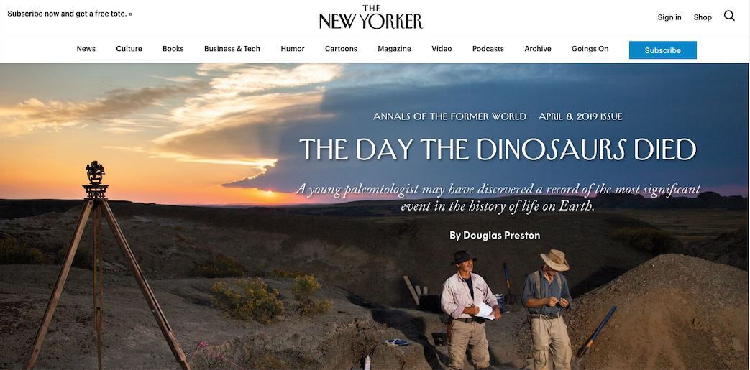
https://www.newyorker.com/magazine/2019/04/08/the-day-the-dinosaurs-died
Robert DePalma has discovered what may be evidence of the catastrophic phenomena that occurred in the hours just after the Chicxulub bolide struck Earth

Slide 17
From the New Yorker
https://www.newyorker.com/magazine/2019/04/08/the-day-the-dinosaurs-died

Slide 18
From the New Yorker
https://www.newyorker.com/magazine/2019/04/08/the-day-the-dinosaurs-died

Slide 19
From the New Yorker
https://www.newyorker.com/magazine/2019/04/08/the-day-the-dinosaurs-died

Slide 20
From the New Yorker
https://www.newyorker.com/magazine/2019/04/08/the-day-the-dinosaurs-died

Slide 21
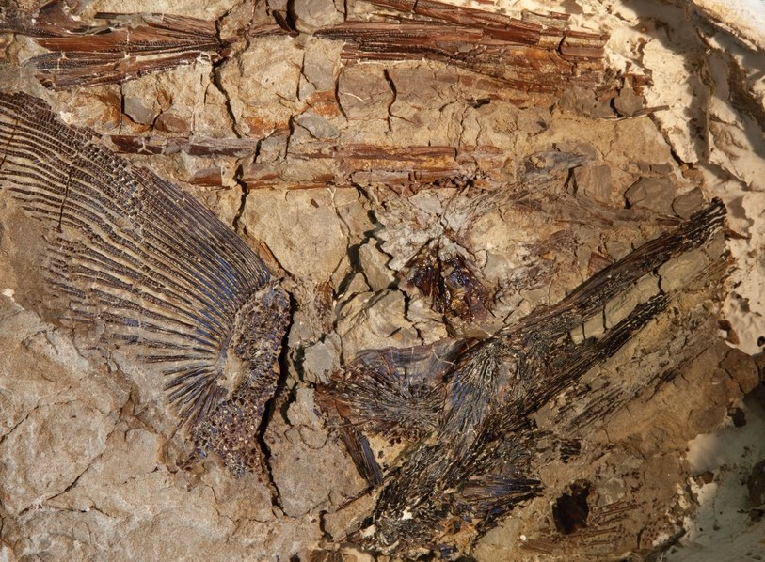
Fossils of fish were found with microtektites embedded in their gills. The circumstances of their conditions indicated almost instantaneous death.

Slide 22
Images from Hell Creek Site, Montana
https://www.newyorker.com/magazine/2019/04/08/the-day-the-dinosaurs-died

Slide 23
Images from Hell Creek Site, Montana
https://www.newyorker.com/magazine/2019/04/08/the-day-the-dinosaurs-died

Slide 24
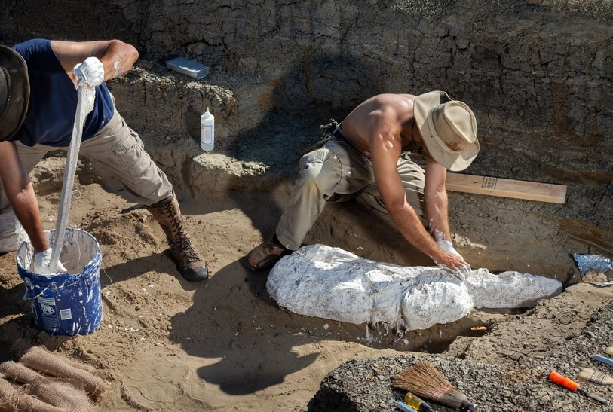
https://www.newyorker.com/magazine/2019/04/08/the-day-the-dinosaurs-died

Slide 25
Deccan Traps https://en.wikipedia.org/wiki/Deccan_Traps
Another possible (but now considered unlikely) cause of the extinction level event at the K/Pg boundary is the Deccan Traps, a massive ancient eruption sequence
The Deccan Traps began forming 66.25 million years ago, at the end of the Cretaceous period.
The bulk of the volcanic eruption occurred at the Western Ghats some 66 million years ago. This series of eruptions may have lasted less than 30,000 years in total.
The original area covered by the lava flows is estimated to have been as large as 1.5 million km², approximately half the size of modern India.
The Deccan Traps region was reduced to its current size by erosion and plate tectonics; the present area of directly observable lava flows is around 500,000 km² (200,000 sq mi).

Slide 26
Deccan Traps https://en.wikipedia.org/wiki/Deccan_Traps
Work published in 2014 by geologist Gerta Keller and others on the timing of the Deccan volcanism suggests the extinction may have been caused by both the volcanism and the impact event
Another possibility is that the impact event led to the Deccan volcanism, since they are on antipodes of each other
Because of its magnitude, scientists formerly speculated that the gases released during the formation of the Deccan Traps played a role in the Cretaceous–Paleogene (K–Pg) extinction event (also known as the Cretaceous–Tertiary extinction).

Slide 27
Tunguska Impact, 1908 http://en.wikipedia.org/wiki/Tunguska_event
The Tunguska event was a large explosion caused by the impact of a small asteroid or comet on June 30, 1908.
The explosion occurred at an altitude of 5–10 kilometres (3–6 mi) at 60.886°N, 101.894°E.
Different studies have yielded widely varying estimates of the impacting object's size, on the order of 60 m (200 ft) to 190 m (620 ft).
It is the largest impact event on or near Earth in recorded history.
It is classified as an impact even though the asteroid or comet is believed to have been an airburst ather than hitting the surface.
In 2013, a team of researchers led by Victor Kvasnytsya of the National Academy of Sciences of Ukraine published analysis results of micro-samples from a peat bog near the blast epicenter showing fragments that may be of meteoric origin.

Slide 28
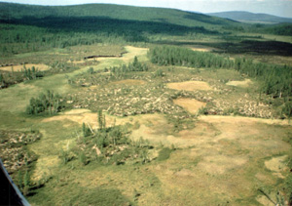
Energetics http://en.wikipedia.org/wiki/Tunguska_event
Estimates of the energy of the blast range from as low as three to as high as 30 megatons of TNT (between 13 and 130 PJ).
Most likely it was between 10–15 megatons of TNT (42–63 PJ).)
The energy of the explosion was about 1,000 times greater than that of the atomic bomb dropped on Hiroshima, Japan:
Roughly equal to that of the United States' Castle Bravo ground-based thermonuclear test detonation on March 1, 1954
About two-fifths that of the Soviet Union's later Tsar Bomba (the largest nuclear weapon ever detonated).[11]
It is estimated that the Tunguska explosion knocked down some 80 million trees over an area of 2,150 square kilometres (830 sq mi)
1927
2008

Slide 29
Field Investigations http://en.wikipedia.org/wiki/Tunguska_event
There was little scientific curiosity about the impact at the time, possibly due to the isolation of the Tunguska region.
If there were any early expeditions to the site, the records were likely to have been lost during the subsequent chaotic years—World War I, the Russian Revolution of 1917 and the Russian Civil War.
The first recorded expedition arrived at the scene more than a decade after the event.
In 1921, the Russian mineralogist Leonid Kulik, visiting the Podkamennaya Tunguska River basin as part of a survey for the Soviet Academy of Sciences, deduced from local accounts that the explosion had been caused by a giant meteorite impact.
He persuaded the Soviet government to fund an expedition to the Tunguska region, based on the prospect of meteoric iron that could be salvaged to aid Soviet industry, and Kulik's party eventually undertook an expedition in 1927.
The spectacle that confronted Kulik as he stood on a ridge overlooking the devastated area was overwhelming.
To the explorers' surprise, no crater was to be found. There was instead around ground zero a vast zone (8 kilometres [5.0 mi] across) of trees scorched and devoid of branches, but standing upright.
Those farther away had been partly scorched and knocked down in a direction away from the center.
Much later, in the 1960s, it was established that the zone of leveled forest occupied an area of some 2,150 square kilometres (830 sq mi), its shape resembling a gigantic spread-eagled butterfly with a "wingspan" of 70 kilometres (43 mi) and a "body length" of 55 kilometres (34 mi)

Slide 30
Evidence for Meteorite http://en.wikipedia.org/wiki/Tunguska_event
It is also estimated that the shock wave from the blast would have measured 5.0 on the Richter scale.
Expeditions sent to the area in the 1950s and 1960s found microscopic silicate and magnetite spheres in siftings of the soil.
Similar spheres were predicted to exist in the felled trees, although they could not be detected by contemporary means.
Later expeditions did identify such spheres in the resin of the trees.
Chemical analysis showed that the spheres contained high proportions of nickel relative to iron, which is also found in meteorites, leading to the conclusion they were of extraterrestrial origin.
The concentration of the spheres in different regions of the soil was also found to be consistent with the expected distribution of debris from a meteorite air burst.
Later studies of the spheres found unusual ratios of numerous other metals relative to the surrounding environment, which was taken as further evidence of their extraterrestrial origin.
Photograph from Kulik's 1929 expedition taken near the Hushmo river.

Slide 31
Comet Shoemaker-Levy Impact http://en.wikipedia.org/wiki/Comet_Shoemaker%E2%80%93Levy_9
Comet Shoemaker–Levy 9 (formally designated D/1993 F2) was a comet that broke apart in July 1992 and collided with Jupiter in July 1994, providing the first direct observation of an extraterrestrial collision of Solar System objects.
Brown spots mark impact sites on Jupiter's southern hemisphere

Slide 32
Collision with Jupiter http://en.wikipedia.org/wiki/Comet_Shoemaker%E2%80%93Levy_9
Comet Shoemaker–Levy 9 (formally designated D/1993 F2) was a comet that broke apart and collided with Jupiter in July 1994, providing the first direct observation of an extraterrestrial collision of Solar System objects.
The collision provided new information about Jupiter and highlighted its role in reducing space debris in the inner Solar System.
The comet was discovered by astronomers Carolyn and Eugene M. Shoemaker and David Levy. Shoemaker–Levy 9, at the time captured by, and then orbiting, Jupiter, was located on the night of March 24, 1993, in a photograph taken with the 40 cm (16 in) Schmidt telescope at the Palomar Observatory in California.
It was the first comet observed to be orbiting a planet, and had probably been captured by the planet around 20 – 30 years earlier.
Calculations showed that its unusual fragmented form was due to a previous closer approach to Jupiter in July 1992.
At that time, the orbit of Shoemaker–Levy 9 passed within Jupiter's Roche limit, and Jupiter's tidal forces had acted to pull the comet apart.
The comet was later observed as a series of fragments ranging up to 2 km (1.2 mi) in diameter.
These fragments collided with Jupiter's southern hemisphere between July 16 and July 22, 1994, at a speed of approximately 60 km/s (37 mi/s) or 216,000 km/h (134,000 mph).
The prominent scars from the impacts were more easily visible than the Great Red Spot and persisted for many months.

Slide 33
Other Observations http://en.wikipedia.org/wiki/Comet_Shoemaker%E2%80%93Levy_9
Anticipation grew as the predicted date for the collisions approached, and astronomers trained terrestrial telescopes on Jupiter.
Several space observatories did the same, including the Hubble Space Telescope, the ROSAT X-ray observing satellite, and significantly the Galileo spacecraft, then on its way to a rendezvous with Jupiter scheduled for 1995.
While the impacts took place on the side of Jupiter hidden from Earth, Galileo, then at a distance of 1.6 AU from the planet, was able to see the impacts as they occurred.
Jupiter's rapid rotation brought the impact sites into view for terrestrial observers a few minutes after the collisions.
Two other satellites made observations at the time of the impact
The Ulysses spacecraft, primarily designed for solar observations, was pointed towards Jupiter from its location 2.6 AU away, and the distant Voyager 2 probe, some 44 AU from was programmed to look for radio emission in the 1–390 kHz range.
Jupiter in Ultraviolet (about 2.5 hours after R's impact). The black dot near the top is a Galilean moon transiting Jupiter.

Slide 34
Other Observations http://en.wikipedia.org/wiki/Comet_Shoemaker%E2%80%93Levy_9
Astronomers had expected to see the fireballs from the impacts, but did not have any idea in advance how visible the atmospheric effects of the impacts would be from Earth.
Observers soon saw a huge dark spot after the first impact.
The spot was visible even in very small telescopes, and was about 6,000 km (3,700 mi) (one Earth radius) across.
This and subsequent dark spots were thought to have been caused by debris from the impacts, and were markedly asymmetric, forming crescent shapes in front of the direction of impact
Over the next 6 days, 21 distinct impacts were observed, with the largest coming on July 18 at 07:33 UTC when fragment G struck Jupiter.
This impact created a giant dark spot over 12,000 km across, and was estimated to have released an energy equivalent to 6,000,000 megatons of TNT (600 times the world's nuclear arsenal).
Two impacts 12 hours apart on July 19 created impact marks of similar size to that caused by fragment G, and impacts continued until July 22, when fragment W struck the planet.
HST images of a fireball from the first impact appearing over the limb of the planet

Slide 35
Chelyabinsk Impact, 2013 http://en.wikipedia.org/wiki/Chelyabinsk_meteor
The Tunguska event is the strongest, but not the only, example of bolide air-bursts in recent history.
A much smaller air burst occurred over a populated area in Russia on February 15, 2013, at 7:25:00 Moscow time at Chelyabinsk in the Ural district of Russia,.
It inflicted over 1,200 injuries, mainly from broken glass falling from windows shattered by the meteor's shock wave.
The Chelyabinsk meteor was a near-Earth asteroid that entered Earth's atmosphere over Russia on 15 February 2013 at about 09:20 YEKT (03:20 UTC), with an estimated speed of 18.6 km/s (over 41,000 mph or 66,960 km/h), almost 60 times the speed of sound.
It quickly became a brilliant superbolide meteor over the southern Ural region.
The light from the meteor was brighter than the sun.
It was observed over a wide area of the region and in neighboring republics.
Eyewitnesses also felt intense heat from the fireball.

Slide 36
Chelyabinsk Effects http://en.wikipedia.org/wiki/Chelyabinsk_meteor
Due to its enormous velocity and shallow atmospheric entry angle, the object exploded in an air burst over Chelyabinsk Oblast, at a height of around 23.3 km (14.5 miles, 76,000 feet).
The explosion generated a bright flash, producing many small fragmentary meteorites and a powerful shock wave.
The atmosphere absorbed most of the object's energy, with a total kinetic energy before atmospheric impact equivalent to approximately 500 kilotons of TNT (about 1.8 PJ), 20–30 times more energy than was released from the atomic bomb detonated at Hiroshima.
The object was undetected before its atmospheric entry and its explosion created panic among local residents.
About 1,500 people were injured seriously enough to seek medical treatment.
All of the injuries were due to indirect effects rather than the meteor itself, mainly from broken glass from windows that were blown in when the shock wave arrived, minutes after the superbolide's flash.
Some 7,200 buildings in six cities across the region were damaged by the explosion's shock wave, and authorities scrambled to help repair the structures in sub-zero (°C) temperatures.

Slide 37
Flight Path http://en.wikipedia.org/wiki/Chelyabinsk_meteor
Illustrating all "phases", from atmospheric entry to explosion.
The meteorite's path in relation to the ground.

Slide 38
Injuries and Damage http://en.wikipedia.org/wiki/Chelyabinsk_meteor
The meteor's unpredicted arrival and air burst resulted in considerable injuries. Russian authorities stated that 1,491 people, including 311 children, sought medical attention in Chelyabinsk Oblast within the first few days.
Health officials said 112 people had been hospitalised, with two in serious condition. A 52-year-old woman with a broken spine was flown to Moscow for treatment.
Most people were hurt by shattered, falling or blown-in glass.
The intense light from the meteor, momentarily 30 times brighter than the Sun, led to over 180 cases of eye pain, and 70 people subsequently reported temporary flash blindness.
Twenty people reported ultraviolet burns similar to sunburn, possibly intensified by the presence of snow on the ground.
A fourth-grade teacher in Chelyabinsk, Yulia Karbysheva, saved 44 children from potentially life threatening imploding window glass cuts.
Despite not knowing the origin of the intense flash of light, Karbysheva thought it prudent to take precautionary measures by ordering her students to stay away from the room's windows and to perform a duck and cover maneuver.
Karbysheva, who remained standing, was seriously lacerated when the air blast arrived and window glass severed a tendon in one of her arms
However, not one of her students, who she ordered to hide under their desks, suffered a cut.

Slide 39
Injuries and Damage http://en.wikipedia.org/wiki/Chelyabinsk_meteor
Shattered windows in the foyer of the Chelyabinsk Drama Theatre
The collapsed roof over the warehouse section of a zinc factory in Chelyabinsk

Slide 40
Injuries and Damage http://en.wikipedia.org/wiki/Chelyabinsk_meteor
By 5 March 2013 the number of damaged buildings was tallied at over 7,200, which included some 6,040 apartment blocks, 293 medical facilities, 718 schools and universities, 100 cultural organizations, and 43 sport facilities, of which only about one and a half percent had not yet been repaired.
The oblast's governor estimated the damage to buildings at more than 1 billion rubles (approximately US$33 million).
Chelyabinsk authorities said that broken windows of apartment homes, but not the glazing of enclosed balconies, would be replaced at the state's expense.
Discussion on social media sites started almost immediately after the event (including initial skepticism, given the sophistication of modern computer-generated imagery), and heavy coverage by the international media had begun by the time the Associated Press put out a brief report with the Russian government's confirmation less than two hours afterwards.
Less than 15 hours after the meteor impact, videos of the meteor and its aftermath had been viewed millions of times.

Slide 41
Origin of Chelyabinsk Meteorite http://en.wikipedia.org/wiki/Chelyabinsk_meteor
Preliminary calculations showed the object was not related to 15 February close approach of what was at the time known as asteroid 2012 DA14 (later named 367943 Duende) that passed the Earth 16 hours later at a distance of 27,700 km.
The Sodankylä Geophysical Observatory, Russian sources, the European Space Agency, NASA and the Royal Astronomical Society all indicated the two objects could not have been related because the two asteroids had widely different trajectories.
However, further analysis revealed that before its intersection with the Earth, the orbit of the Chelyabinsk meteor around the sun was similar to a larger asteroid, the 2 km object (86039) 1999 NC43, suggesting that the two bodies may once have been part of the same object.
Note the elliptical orbit
Comparison of the former orbit of the Chelyabinsk meteor (larger elliptical blue orbit) and asteroid 2012 DA14 (smaller circular blue orbit), showing that they are dissimilar.

Slide 42
Chelyabinsk Video https://www.youtube.com/watch?v=DsIqw60c9Hs

Slide 43
NASA Video https://www.youtube.com/watch?v=l_MfWQ36Zl0

Slide 44
Interstellar Objects: Oumuamua

Slide 45
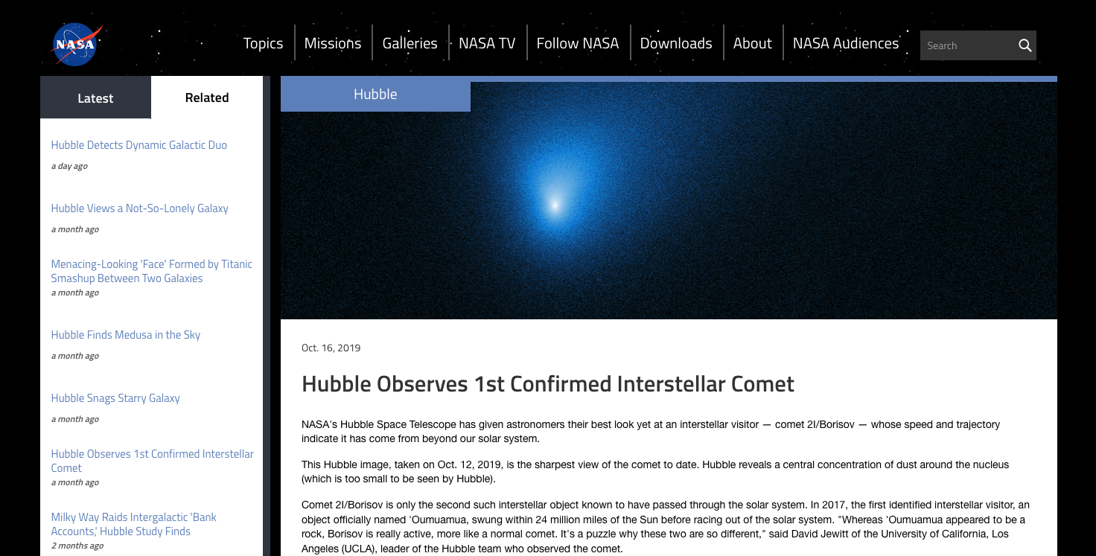
Second Confirmed Interstellar Object: 2I/Borisov

