Slide 1
Lecture 24
Tornadoes
John Rundle GEL/EPS 131

Slide 2
Tornadoes http://en.wikipedia.org/wiki/Tornado
“A tornado near Anadarko, Oklahoma.
The funnel is the thin tube reaching from the cloud to the ground.
The lower part of this tornado is surrounded by a translucent dust cloud, kicked up by the tornado's strong winds at the surface.
The wind of the tornado has a much wider radius than the funnel itself.”

Slide 3
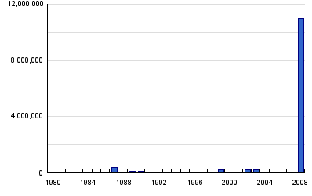
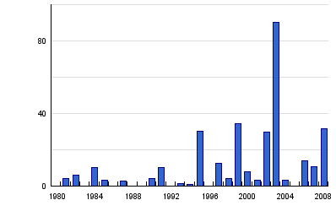
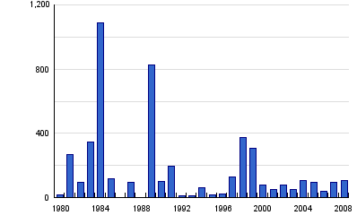
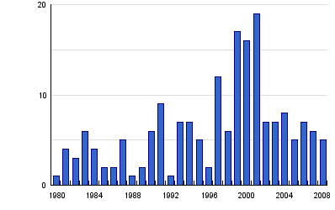
Global Tornado Statistics, 1980-2008 http://www.preventionweb.net/english/hazards/statistics/?hid=70
Persons Affected
Economic Damage (USD in B$)
Persons Killed
Number of Reported Events

Slide 4
Global Tornadoes Summary Statistics, 1980-2008 http://www.preventionweb.net/english/hazards/statistics/?hid=70

Slide 5
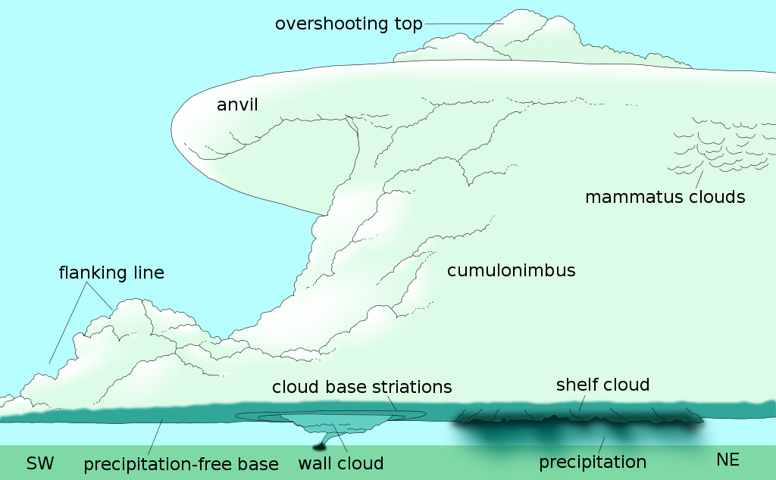
Anatomy of a Thunderstorm https://en.wikipedia.org/wiki/Supercell

Slide 6
Supercells and Mesocyclones https://en.wikipedia.org/wiki/Supercell
A supercell is a thunderstorm characterized by the presence of a mesocyclone: a deep, persistently rotating updraft.
For this reason, these storms are sometimes referred to as rotating thunderstorms.
Of the four classifications of thunderstorms (supercell, squall line, multi-cell, and single-cell), supercells are the overall least common and have the potential to be the most severe.
Supercells are often isolated from other thunderstorms, and can dominate the local weather up to 32 kilometres (20 mi) away.

Slide 7
Supercells https://en.wikipedia.org/wiki/Supercell
Supercells are often put into classification types: Low-precipitation (LP), and High-precipitation (HP).
LP supercells are usually found in climates that are more arid, such as the high plains of the United States, and HP supercells are most often found in moist climates.
Supercells can occur anywhere in the world under the right pre-existing weather conditions, but they are most common in the Great Plains of the United States in an area known as Tornado Alley and in the Tornado Corridor of Argentina, Uruguay and southern Brazil.
Supercells are usually found isolated from other thunderstorms,

Slide 8
Tornadoes http://en.wikipedia.org/wiki/Tornado
“A tornado is "a violently rotating column of air, in contact with the ground, either pendant from a cumuliform cloud or underneath a cumuliform cloud, and often (but not always) visible as a funnel cloud”.
For a vortex to be classified as a tornado, it must be in contact with both the ground and the cloud base. Scientists have not yet created a complete definition of the word
For example, there is disagreement as to whether separate touchdowns of the same funnel constitute separate tornadoes.
Tornado refers to the vortex of wind, not the condensation cloud.
A tornado is also commonly referred to as a "twister", and is also sometimes referred to by the old-fashioned colloquial term cyclone.
The term "cyclone" is used as a synonym for "tornado" in the often-aired 1939 film The Wizard of Oz.
The term "twister" is also used in that film, along with being the title of the 1996 tornado-related film Twister
Tornadoes can be detected before or as they occur through the use of Pulse-Doppler radar by recognizing patterns in velocity and reflectivity data, such as hook echoes or debris balls, as well as by the efforts of storm spotters”

Slide 9
Basics http://en.wikipedia.org/wiki/Tornado
“Tornadoes come in many shapes and sizes, but they are typically in the form of a visible condensation funnel, whose narrow end touches the earth and is often encircled by a cloud of debris and dust.
Most tornadoes have wind speeds less than 110 miles per hour (177 km/h), are about 250 feet (76 m) across, and travel a few miles (several kilometers) before dissipating.
The most extreme tornadoes can attain wind speeds of more than 300 miles per hour (483 km/h), stretch more than two miles (3.2 km) across, and stay on the ground for dozens of miles (more than 100 km).
At right, is shown a sequence of images illustrating the birth of a tornado.
First, the rotating cloud base lowers.
This lowering becomes a funnel, which continues descending while winds build near the surface, kicking up dust and other debris.
Finally, the visible funnel extends to the ground, and the tornado begins causing major damage.
This tornado, near Dimmitt, Texas, was one of the best-observed violent tornadoes in history”

Slide 10
Types of Tornadoes http://en.wikipedia.org/wiki/Tornado http://www.srh.noaa.gov/mfl/?n=waterspouts
“Various types of tornadoes include the landspout, multiple vortex tornado, and waterspout.
Waterspouts are characterized by a spiraling funnel-shaped wind current, connecting to a large cumulus or cumulonimbus cloud.
They are generally classified as non-supercellular tornadoes that develop over bodies of water, but there is disagreement over whether to classify them as true tornadoes.
These spiraling columns of air frequently develop in tropical areas close to the equator, and are less common at high latitudes.
Other tornado-like phenomena that exist in nature include the gustnado, dust devil, fire whirls, and steam devil
South Florida

Slide 11
Other Small Scale Circulations http://en.wikipedia.org/wiki/Tornado
“A dust devil resembles a tornado in that it is a vertical swirling column of air.
However, they form under clear skies and are no stronger than the weakest tornadoes.
They form when a strong convective updraft is formed near the ground on a hot day.
If there is enough low level wind shear, the column of hot, rising air can develop a small cyclonic motion that can be seen near the ground.
They are not considered tornadoes because they form during fair weather and are not associated with any clouds.
However, they can, on occasion, result in major damage in arid areas.
Other types of small scale circulations are gustnados, fire whirls and steam devils “
A dust devil in Arizona

Slide 12
Multiple Vortex Tornadoes http://en.wikipedia.org/wiki/Tornado
“A multiple-vortex tornado is a type of tornado in which two or more columns of spinning air rotate around a common center.
A multi-vortex structure can occur in almost any circulation, but is very often observed in intense tornadoes.
These vortices often create small areas of heavier damage along the main tornado path.
This is a distinct phenomenon from a satellite tornado, which is a weaker tornado which forms very near a large, strong tornado contained within the same mesocyclone.
The satellite tornado may appear to "orbit" the larger tornado (hence the name), giving the appearance of one, large multi-vortex tornado.
However, a satellite tornado is a distinct circulation, and is much smaller than the main funnel.”

Slide 13
Formation of Tornadoes http://en.wikipedia.org/wiki/Tornado
A “wall cloud”, precursor to a tornado

Slide 14
Storm Spotting http://en.wikipedia.org/wiki/Tornado
“In the mid-1970s, the U.S. National Weather Service (NWS) increased its efforts to train storm spotters to spot key features of storms which indicate severe hail, damaging winds, and tornadoes, as well as damage itself and flash flooding.
The program was called Skywarn, and the spotters were local sheriff's deputies, state troopers, firefighters, ambulance drivers, amateur radio operators, civil defense (now emergency management) spotters, storm chasers, and ordinary citizens.
When severe weather is anticipated, local weather service offices request that these spotters look out for severe weather, and report any tornadoes immediately, so that the office can warn of the hazard.
The organizations activate public warning systems such as sirens and the Emergency Alert System, and forward the report to the NWS.
There are more than 230,000 trained Skywarn weather spotters across the United States.

Slide 15
Spotting Wall Clounds http://en.wikipedia.org
“In Europe, several nations are organizing spotter networks under the auspices of Skywarn Europe and the Tornado and Storm Research Organisation (TORRO) has maintained a network of spotters in the United Kingdom since 1974.
Storm spotters are needed because radar systems such as NEXRAD do not detect a tornado; merely signatures which hint at the presence of tornadoes.
Radar may give a warning before there is any visual evidence of a tornado or imminent tornado, but ground truth from an observer can either verify the threat or determine that a tornado is not imminent.
The spotter's ability to see what radar cannot is especially important as distance from the radar site increases, because the radar beam becomes progressively higher in altitude further away from the radar, chiefly due to curvature of Earth, and the beam also spreads out.”

Slide 16
Wall Cloud http://en.wikipedia.org/wiki/Tornado
“Only wall clouds that rotate spawn tornadoes, and usually precede the tornado by five to thirty minutes.
Rotating wall clouds are the visual manifestation of a mesocyclone.
Barring a low-level boundary, tornadogenesis is highly unlikely unless a rear flank downdraft occurs, which is usually visibly evidenced by evaporation of cloud adjacent to a corner of a wall cloud.
A tornado often occurs as this happens or shortly after
First, a funnel cloud dips and in nearly all cases by the time it reaches halfway down, a surface swirl has already developed, signifying a tornado is on the ground before condensation connects the surface circulation to the storm.
Tornadoes may also occur without wall clouds, under flanking lines, and on the leading edge. Spotters watch all areas of a storm, and the cloud base and surface”

Slide 17
Tornado Genesis
“Storm spotters are trained to discern whether a storm seen from a distance is a supercell.
They typically look to its rear, the main region of updraft and inflow.
Under the updraft is a rain-free base, and the next step of tornadogenesis is the formation of a rotating wall cloud.
The vast majority of intense tornadoes occur with a wall cloud on the backside of a supercell.
Evidence of a supercell comes from the storm's shape and structure, and cloud tower features such as a hard and vigorous updraft tower, a persistent, large overshooting top, a hard anvil (especially when sheared against strong upper level winds), and a corkscrew look or striations.
Tornadogenesis is most likely at the interface of the updraft and rear flank downdraft, and requires a balance between the outflow and inflow.

Slide 18
Detecting Tornadoes http://en.wikipedia.org/wiki/Tornado
“Path of a tornado across Wisconsin on August 21, 1857”
“Rigorous attempts to warn of tornadoes began in the United States in the mid-20th century.
Before the 1950s, the only method of detecting a tornado was by someone seeing it on the ground.
Often, news of a tornado would reach a local weather office after the storm.
However, with the advent of weather radar, areas near a local office could get advance warning of severe weather.
The first public tornado warnings were issued in 1950 and the first tornado watches and convective outlooks in 1952.
In 1953 it was confirmed that hook echoes are associated with tornadoes.
By recognizing these radar signatures, meteorologists could detect thunderstorms probably producing tornadoes from dozens of miles away.”

Slide 19
Research http://en.wikipedia.org/wiki/Tornado
“Meteorology is a relatively young science and the study of tornadoes is newer still.
Although researched for about 140 years and intensively for around 60 years, there are still aspects of tornadoes which remain a mystery.
Scientists have a fairly good understanding of the development of thunderstorms and mesocyclones, and the meteorological conditions conducive to their formation.
However, the step from supercell, a large rotating, violent cloud structure (or other respective formative processes) to tornadogenesis and predicting tornadic vs. non-tornadic mesocyclones is not yet well known and is the focus of much research.
Also under study are the low-level mesocyclone and the stretching of low-level vorticity which tightens into a tornado, namely, what are the processes and what is the relationship of the environment and the convective storm. “
“Mesocyclone: a cyclonic air mass associated with a supercell
Its presence is a condition for a tornado warning.
Intense tornadoes have been observed forming simultaneously with a mesocyclone aloft (rather than succeeding mesocyclogenesis) and some intense tornadoes have occurred without a mid-level mesocyclone.”

Slide 20
Doppler on Wheels and Other Research Programs http://en.wikipedia.org/wiki/Tornado
“Scientists still do not know the exact mechanisms by which most tornadoes form, and occasional tornadoes still strike without a tornado warning being issued.
Analysis of observations including both stationary and mobile (surface and aerial) in-situ and remote sensing (passive and active) instruments generates new ideas and refines existing notions.
Numerical modeling also provides new insights as observations and new discoveries are integrated into our physical understanding and then tested in computer simulations
Development of new observation technologies and installation of finer spatial and temporal resolution observation networks have aided increased understanding and better predictions.
Research programs, including field projects such as the VORTEX projects (Verification of the Origins of Rotation in Tornadoes Experiment), deployment of TOTO (the TOtable Tornado Observatory), Doppler On Wheels (DOW), and dozens of other programs, hope to solve many questions that still plague meteorologists.
Universities, government agencies such as the National Severe Storms Laboratory, private-sector meteorologists, and the National Center for Atmospheric Research are some of the organizations very active in research; with various sources of funding, both private and public, a chief entity being the National Science Foundation.”

Slide 21
NEXRAD http://en.wikipedia.org/wiki/NEXRAD
“Today, most developed countries have a network of weather radars, which remains the main method of detecting signatures probably associated with tornadoes.
In the United States and a few other countries, Doppler weather radar stations are used.
These devices measure the velocity and radial direction (towards or away from the radar) of the winds in a storm, and so can spot evidence of rotation in storms from more than a hundred miles (160 km) away.
When storms are distant from a radar, only areas high within the storm are observed and the important areas below are not sampled.
Also, most populated areas on Earth are now visible from the Geostationary Operational Environmental Satellites (GOES), which aid in the forecasting of tornadic storms.”

Slide 22
NEXRAD Images http://en.wikipedia.org/wiki/NEXRAD

Slide 23
NEXRAD Improvements http://en.wikipedia.org/wiki/NEXRAD
“NEXRAD sites across the nation are currently being upgraded to polarimetric radar, which adds vertical polarization to the current horizontal radar waves, in order to more accurately discern what is reflecting the signal.
This so-called dual polarization allows the radar to distinguish between rain, hail and snow, something the horizontally polarized radars cannot accurately do.
Early trials have shown that rain, ice pellets, snow, hail, birds, insects, and ground clutter all have different signatures with dual-polarization, which could mark a significant improvement in forecasting winter storms and severe thunderstorms.
The deployment of the dual polarization capability (Build 12) to NEXRAD sites began in 2010 and will be complete by the summer of 2013. “

Slide 24
Anatomy of a Supercell from NEXRAD http://en.wikipedia.org/wiki/Tornado
“A radar image of a violently tornadic classic supercell near Oklahoma City, Oklahoma, USA on May 3, 1999”

Slide 25
Sounds http://en.wikipedia.org/wiki/Tornado
“Tornadoes emit widely on the acoustics spectrum and the sounds are caused by multiple mechanisms.
Various sounds of tornadoes have been reported, mostly related to familiar sounds for the witness and generally some variation of a whooshing roar.
Popularly reported sounds include a freight train, rushing rapids or waterfall, a nearby jet engine, or combinations of these.
Many tornadoes are not audible from much distance
The nature and propagation distance of the audible sound depends on atmospheric conditions and topography.
The winds of the tornado vortex and of constituent turbulent eddies, as well as airflow interaction with the surface and debris, contribute to the sounds. “
“An illustration of generation of infrasound in tornadoes by the NOAA Earth System Research Laboratory's Infrasound Program”

Slide 26
Sounds and Seismology http://en.wikipedia.org/wiki/Tornado
“Funnel clouds also produce sounds.
Funnel clouds and small tornadoes are reported as whistling, whining, humming, or the buzzing of innumerable bees or electricity, or more or less harmonic, whereas many tornadoes are reported as a continuous, deep rumbling, or an irregular sound of "noise”.
Tornadoes also produce identifiable inaudible infrasonic signatures
Unlike audible signatures, tornadic signatures have been isolated
Due to the long distance propagation of low-frequency sound, efforts are ongoing to develop tornado prediction and detection devices with additional value in understanding tornado morphology, dynamics, and creation.
Tornadoes also produce a detectable seismic signature, and research continues on isolating it and understanding the process.”
“An illustration of generation of infrasound in tornadoes by the NOAA Earth System Research Laboratory's Infrasound Program”

Slide 27
Fujita Scale http://en.wikipedia.org/wiki/Fujita_scale
“The original scale as derived by Fujita was a theoretical 13-level scale (F0–F12) designed to smoothly connect the Beaufort scale and the Mach number scale.
F1 corresponds to the twelfth level of the Beaufort scale, and F12 corresponds to Mach number 1.0.
F0 was placed at a position specifying no damage (approximately the eighth level of the Beaufort scale), in analogy to how the Beaufort's zeroth level specifies little to no wind.
From these wind speed numbers, qualitative descriptions of damage were made for each category of the Fujita scale, and then these descriptions were used to classify tornadoes.
The diagram on the right illustrates the relationship between the Beaufort, Fujita, and Mach number scales.”

Slide 28
Fujita Scale http://en.wikipedia.org/wiki/Fujita_scale
“At the time Fujita derived the scale, little information was available on damage caused by wind, so the original scale presented little more than educated guesses at wind speed ranges for specific tiers of damage.
Fujita intended that only F0–F5 be used in practice, as this covered all possible levels of damage to frame homes as well as the expected estimated bounds of wind speeds.
He did, however, add a description for F6, which he phrased as "inconceivable tornado", to allow for wind speeds exceeding F5 and for possible future advancements in damage analysis which might show it.”

Slide 29
Fujita Scale http://en.wikipedia.org/wiki/Fujita_scale
“The Fujita scale (F-Scale), or Fujita–Pearson scale, is a scale for rating tornado intensity, based primarily on the damage tornadoes inflict on human-built structures and vegetation.
The official Fujita scale category is determined by meteorologists and engineers after a ground or aerial damage survey, or both.
Depending on the circumstances, ground-swirl patterns (cycloidal marks), radar tracking, eyewitness testimonies, media reports and damage imagery, as well as photogrammetry or videogrammetry if motion picture recording is available can also be used.
The F-Scale was replaced with the Enhanced Fujita Scale (EF-Scale) in the United States in February 2007.”

Slide 30
Fujita Scale: Relation to Damage http://en.wikipedia.org/wiki/Fujita_scale

Slide 31
Enhanced Fujita Scale http://en.wikipedia.org/wiki/Enhanced_Fujita_scale
“The Enhanced Fujita Scale (EF scale) rates the strength of tornadoes in the United States and Canada based on the damage they cause.
Implemented in place of the Fujita scale introduced in 1971 by Tetsuya Theodore Fujita, it began operational use in the United States on February 1, 2007, followed by Canada on April 1, 2013.
The scale has the same basic design as the original Fujita scale—six categories from zero to five, representing increasing degrees of damage.
It was revised to reflect better examinations of tornado damage surveys, so as to align wind speeds more closely with associated storm damage; the new scale was publicly unveiled by the National Weather Service on February 2, 2006.
As with the Fujita scale, the Enhanced Fujita scale remains a damage scale and only a proxy for actual wind speeds.
In addition to damage to structures and vegetation, radar data, photogrammetry, and cycloidal marks (ground swirl patterns) may be utilized when available.”

Slide 32
Enhanced Fujita Scale

Slide 33
Enhanced Fujita Scale

Slide 34
Locations http://en.wikipedia.org/wiki/Tornado_climatology
“Tornadoes have been observed on every continent except Antarctica.
However, the vast majority of tornadoes occur in the Tornado Alley region of the United States, although they can occur nearly anywhere in North America.
They also occasionally occur in south-central and eastern Asia, northern and east-central South America, Southern Africa, northwestern and southeast Europe, western and southeastern Australia, and New Zealand.”

Slide 35
Relationship (?) to Climate Change http://en.wikipedia.org/wiki/Tornado
“Associations to various climate and environmental trends may exist.
An increase in the sea surface temperature of a source region (e.g. Gulf of Mexico and Mediterranean Sea) increases atmospheric moisture content.
Increased moisture can fuel an increase in severe weather and tornado activity, particularly in the cool season.
Some evidence does suggest that the Southern Oscillation is weakly correlated with changes in tornado activity, which vary by season and region, as well as whether the ENSO phase is that of El Niño or La Niña.
Climatic shifts may affect tornadoes via teleconnections in shifting the jet stream and the larger weather patterns.
The climate-tornado link is confounded by the forces affecting larger patterns and by the local, nuanced nature of tornadoes.
Although it is reasonable to suspect that global warming may affect trends in tornado activity, any such effect is not yet identifiable due to the complexity, local nature of the storms, and database quality issues.
Any effect would vary by region.”

Slide 36
Spatial Distribution http://www.ncdc.noaa.gov/climate-information/extreme-events/us-tornado-climatology

Slide 37
Detrended Tornado Counts http://www.spc.noaa.gov/wcm/

Slide 38
Tornado Activity: Fine Grained http://www.spc.noaa.gov http://en.wikipedia.org/wiki/Tornado

Slide 39
Tornado Activity: Coarse Grained http://en.wikipedia.org/wiki/Tornado_climatology

Slide 40
Tornado Alley http://en.wikipedia.org/wiki/Tornado_Alley
A diagram of tornado alley based on 1 tornado or more per decade. Rough location (red), and its contributing weather systems

Slide 41
Tornado Alley http://en.wikipedia.org/wiki/Tornado_Alley
“Over the years, the location(s) of Tornado Alley have not been clearly defined.
No official definition of 'tornado alley' or the geographical area of tornado alley has ever been designated by the National Weather Service.
According to the National Severe Storms Laboratory "Tornado Alley" is a term used by the media as a reference to areas that have higher numbers of tornadoes.
A study of 1921-1995 tornadoes concluded almost one-fourth of all significant tornadoes occur in this area.
Though no state is entirely free of tornadoes, they occur more frequently in the Central United States, between the Rocky Mountains and Appalachian Mountains.
Per square mile, Kansas and Oklahoma rank first and second respectively in the number of tornadoes
Regionally, the frequency of tornadoes in the United States is closely tied with the progression of the warm season when warm and cold air masses often clash.”

Slide 42
Tornado Myths http://en.wikipedia.org/wiki/Tornado
It is often thought that opening windows will lessen the damage caused by the tornado.
While there is a large drop in atmospheric pressure inside a strong tornado, it is unlikely that the pressure drop would be enough to cause the house to explode.
Some research indicates that opening windows may actually increase the severity of the tornado's damage.
A violent tornado can destroy a house whether its windows are open or closed.
An old belief is that the southwest corner of a basement provides the most protection during a tornado.
The safest place is the side or corner of an underground room opposite the tornado's direction of approach (usually the northeast corner), or the central-most room on the lowest floor.
Taking shelter in a basement, under a staircase, or under a sturdy piece of furniture such as a workbench further increases chances of survival.”
“The 1999 Salt Lake City tornado disproved several misconceptions, including the idea that tornadoes cannot occur in areas like Utah or in cities “

Slide 43
Myths and Misconceptions http://en.wikipedia.org/wiki/Tornado
“A commonly held misconception is that highway overpasses provide adequate shelter from tornadoes.
This belief is partly inspired by widely circulated video captured during the 1991 tornado outbreak near Andover, Kansas, where a news crew and several other people take shelter under an overpass on the Kansas Turnpike and safely ride out a tornado as it passes by.
However, a highway overpass is a dangerous place during a tornado: the subjects of the video remained safe due to an unlikely combination of events
The storm in question was a weak tornado, did not directly strike the overpass, and the overpass itself was of a unique design.
Due to the Venturi effect, tornadic winds are accelerated in the confined space of an overpass.
By comparison, during the same tornado outbreak, more than 2000 homes were completely destroyed, with another 7000 damaged, and yet only a few dozen people died in their homes.

Slide 44
Tornadoes: Case Studies
April 3-4, 1974
148 Tornadoes
23 F4 Events
7 F5 Events
April 25-26, 2011
358 Tornadoes
11 EF4 Events
4 EF5 Events

Slide 45
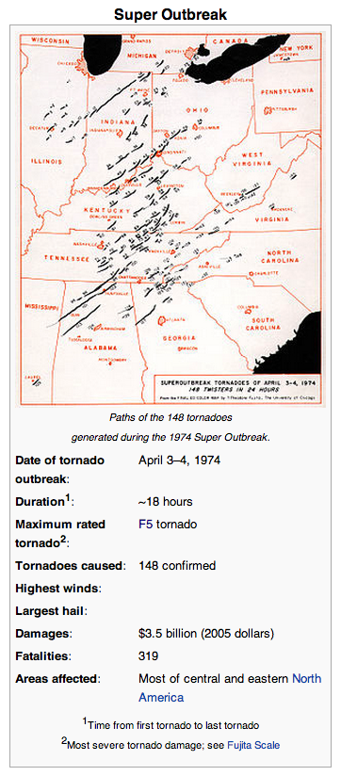
April 3-4, 1974 http://en.wikipedia.org/wiki/Super_Outbreak
The Super Outbreak was the most violent tornado outbreak ever recorded, with 30 F4/F5 tornadoes reported.
From April 3 to April 4, 1974, there were 148 tornadoes confirmed in 13 U.S. states, including Illinois, Indiana, Michigan, Ohio, Kentucky, Tennessee, Alabama, Mississippi, Georgia, North Carolina, Virginia, West Virginia, and New York; and the Canadian province of Ontario.
It extensively damaged approximately 900 square miles (2,330 square kilometers) along a total combined path length of 2,600 miles (4,200 km).”

Slide 46
April 3-4, 1974 http://en.wikipedia.org/wiki/Super_Outbreak
The outbreak far surpassed previous and succeeding events in severity, longevity and extent, with the notable exception of the April 2011 Super Outbreak.
With a death toll of over 300, this outbreak was the deadliest since the 1936 Tupelo-Gainesville tornado outbreak.
Its death toll would also not be surpassed until the April 25–28, 2011 tornado outbreak killed 324 people.”

Slide 47
Meteorology: Details http://en.wikipedia.org/wiki/Super_Outbreak
“A powerful spring-time low pressure system developed across the North American Interior Plains on April 1.
While moving into the Mississippi and Ohio Valley areas, a surge of very moist air intensified the storm further while there were sharp temperature contrasts between both sides of the system.
NOAA officials were expecting a severe weather outbreak on April 3, but not of the extent which ultimately occurred.
Several F2 and F3 tornadoes had struck portions of the Ohio Valley and the South in a separate, earlier outbreak on April 1 and 2, and this earlier storm system included three killer tornadoes in Kentucky, Alabama, and Tennessee.
The town of Campbellsburg, northeast of Louisville, was hard-hit in this earlier outbreak, with a large portion of the town destroyed by an F3.
Between the two outbreaks, an additional tornado was reported in Indiana in the early morning hours of April 3, several hours before the official start of the outbreak.”

Slide 48
Meteorology: Details http://en.wikipedia.org/wiki/Super_Outbreak
“By the early afternoon, numerous supercells and clusters of thunderstorms developed and the outbreak began quickly, with storms developing in central Illinois and a secondary zone developing near the Appalachians across eastern Tennessee, central Alabama, and northern Georgia.
The worst of the outbreak shifted towards the Ohio Valley between 4:30 pm and 6:30 pm EDT where it produced four of the seven F5s over a span of just two hours
Three powerful supercells traveled across the area—one in central and southern Ohio, a second one across southern Indiana and Ohio, and a third one in northern Kentucky.
Additional supercells developed across northern Indiana and southern Michigan producing additional violent and/or killer tornadoes between 6:00 pm and 10:00 pm EDT including the Windsor, Ontario tornado.
Thunderstorm downpours caused flash floods, and north of the warm front in the Upper Peninsula, heavy snowfall was reported.”

Slide 49
Meteorology http://en.wikipedia.org/wiki/Super_Outbreak
“Activity in the south moved towards the Appalachians during the overnight hours and produced the final tornadoes across the southeast during the morning of April 4.
A 2004 survey for Risk Management Solutions, citing an earlier Dr. Ted Fujita study, found that three-quarters of all tornadoes in the 1974 Super Outbreak were produced by 30 'families' of tornadoes -- multiple tornadoes spawned in succession by a single thunderstorm cell.
Note that most of these tornadoes were not associated with squall lines. These were long-lived and long-tracked supercells.”
Satellite image of weather system responsible for super outbreak 1974

Slide 50
Damage in Xenia, Ohio http://en.wikipedia.org/wiki/Super_Outbreak
“The tornado that struck the city of Xenia, Ohio stands as the deadliest individual tornado of the Super Outbreak, killing 32 and destroying a significant portion of the town.
The tornado formed near Bellbrook, Ohio, southwest of Xenia, at about 4:30pm EDT.
It began as a moderate-sized tornado, then intensified while moving northeast at about 50 mph (80 km/h).
The tornado exhibited multiple-vortex structure and became very large as it approached town. Gil Whitney, the weather specialist for WHIO-TV in Dayton, alerted viewers in Montgomery and Greene County (where Xenia is located) about the possible tornado, broadcasting the radar image of the supercell several minutes before it actually struck.
The massive tornado slammed into the western part of Xenia, completely flattening the Windsor Park and Arrowhead subdivisions, and sweeping away entire rows of brick homes.”
“The tornado as it enters the Arrowhead subdivision, in the southwestern part of Xenia.
This photo was taken by Homer G. Ramby at Royal Woods Lane and Wilmington Pike, 8.3 miles from Arrowhead.”

Slide 51
Damage in Xenia, Ohio http://en.wikipedia.org/wiki/Super_Outbreak
“When the storm reached central Xenia at 4:40pm, apartment buildings, homes, businesses, churches, and schools including Xenia High School were destroyed.
Students in the school, practicing for a play, took cover in the main hallway seconds before a direct hit from the tornado.
A school bus dropped on top of the stage the students were practicing on.
The steel-reinforced high school building suffered extensive structural damage.
Several railroad cars were lifted and blown over as the tornado passed over a moving Penn Central freight train in the center of town.
It toppled gravestones in Cherry Grove Cemetery, then moved through the length of the downtown business district, passing west of the courthouse, and into the Pinecrest Garden district, which was extensively affected.”
The tornado as it is hitting downtown Xenia moving toward the old Xenia high school. This photo was taken by Kitty Marchant on Murray Hill Dr.
The houses in the foreground are on Eavey St. and the large red brick structure is a house on S. Columbus St.

Slide 52
Tornado Tracks in Indiana http://en.wikipedia.org/wiki/Super_Outbreak

Slide 53
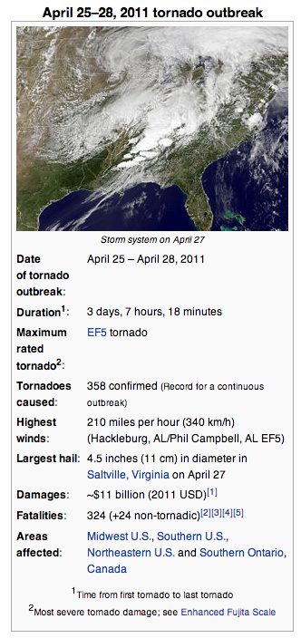
April 25-28, 2011 http://en.wikipedia.org/wiki/April_25%E2%80%9328,_2011_tornado_outbreak#April_27_event
“The April 25–28, 2011 tornado outbreak was the largest and one of the deadliest tornado outbreaks ever recorded, affecting the Southern, Midwestern, and Northeastern United States and leaving catastrophic destruction in its wake.
While the hardest-hit states were Alabama and Mississippi, the outbreak also produced destructive tornadoes in Arkansas, Georgia, Tennessee, and Virginia, and affected many other areas throughout the Southern and Eastern United States.
In total, 358 tornadoes were confirmed by the National Weather Service (NWS) and Environment Canada in 21 states from Texas to New York to southern Canada.
Widespread and destructive tornadoes occurred on each day of the outbreak, with April 27 being the most active day with a record of 211 tornadoes touching down that day from midnight to midnight CDT (0500 – 0500 UTC).
Four of the tornadoes were destructive enough to be rated EF5 on the Enhanced Fujita scale, which is the highest ranking possible
Typically these tornadoes are only recorded about once each year or less.”

Slide 54
Damage and Deaths http://en.wikipedia.org/wiki/April_25%E2%80%9328,_2011_tornado_outbreak
“In total, 348 people were killed as a result of the outbreak, which includes 324 tornado-related deaths across six states.
In addition, 24 fatalities were not caused by tornadoes, but were confirmed to be as a result of other thunderstorm-related events such as straight-line winds, hail, flash flooding or lightning.
In Alabama alone, 238 tornado-related deaths were confirmed by the Storm Prediction Center (SPC) and the state's Emergency Management Agency.
April 27 had the most tornado-related fatalities in the United States in a single day since the 1925 "Tri-State" outbreak on March 18, 1925, when at least 747 people were killed.
Nearly 500 preliminary local storm reports were received for tornadoes over four days, including 292 in 16 states on April 27 alone.
This outbreak was the costliest tornado outbreak and one of the costliest natural disasters in United States history (even after adjustments for inflation), with total damages of approximately $11 billion (2011 USD).”
Map of all tornado (red), severe thunderstorm (yellow), and flood (green) warnings issued on April 27.

Slide 55
Meteorology http://en.wikipedia.org/wiki/April_25%E2%80%9328,_2011_tornado_outbreak
“The outbreak was caused by a vigorous upper-level trough that moved into the Southern Plains states on April 25.
An extratropical cyclone developed ahead of this upper-level trough between northeast Oklahoma and western Missouri, which moved northeast.
Conditions were similar on April 26, with a predicted likelihood of severe thunderstorms, including an extended threat of strong to violent long-track tornadoes during the afternoon and evening hours
The storm mode on April 26 was predicted to consist of mostly discrete supercells during the afternoon and early evening, shifting over to a mesoscale convective complex, with more of a threat of damaging winds and hail during the nighttime hours.
As the storm system moved eastward toward the Ohio, Mississippi and Tennessee Valleys on April 27, a very powerful 80–100 knot mid-level jet stream moved into the Ohio and Tennessee Valleys, behind the trough, creating strong wind shear, with a low pressure center moving quickly northeastward across those areas on the 27th.
Temperatures across the southeastern United States ranged from the 70s °F (mid-20s °C) to the lower 90s °F (near 35 °C).
In total, 56 severe weather watches were issued by the Storm Prediction Center (SPC) over those four days in the outbreak area, including 41 tornado watches (10 of which were PDS watches) and 15 severe thunderstorm watches.”

Slide 56
Rainfall http://en.wikipedia.org/wiki/April_25%E2%80%9328,_2011_tornado_outbreak
“Rainfall totals within the United States for the week ending during the morning of April 29, 2011, which shows the extent of the heavy rain event this cyclone produced.”

