Slide 1
Lecture 23c
Catastrophic Cyclones
John Rundle GEL/EPS 131

Slide 2
Hurricane Harvey August 17- September 3, 2017 https://en.wikipedia.org/wiki/Hurricane_Harvey
Hurricane Harvey was the costliest tropical cyclone on record, inflicting nearly $200 billion in damage, primarily from widespread flooding in the Houston metropolitan area, breaking the previous record set by Hurricane Katrina.
It was the first major hurricane to make landfall in the United States since Wilma in 2005, ending a record 12-year span in which no hurricanes made landfall at such an intensity in the country.
In a four-day period, many areas received more than 40 inches (100 cm) of rain as the system slowly meandered over eastern Texas and adjacent waters, causing catastrophic flooding.
With peak accumulations of 64.58 inches (164.0 cm), Harvey was the wettest tropical cyclone on record in the United States.
The resulting floods inundated hundreds of thousands of homes, displaced more than 30,000 people, and prompted more than 17,000 rescues

Slide 3
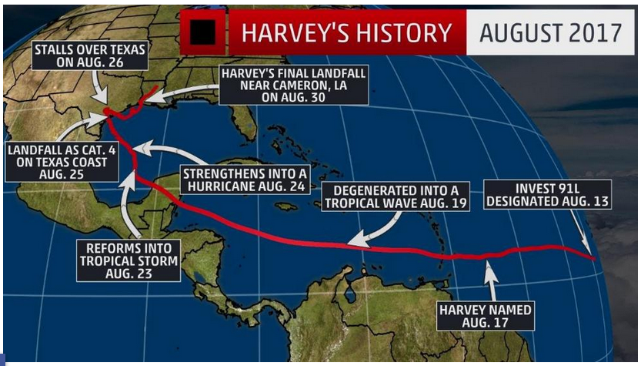
Hurricane Harvey 2017 https://weather.com/storms/hurricane/news/tropical-storm-harvey-forecast-texas-louisiana-arkansas
Harvey was a catastrophic flood disaster in southeast Texas.
Harvey made landfall as a Category 4 Hurricane with winds of 130 mph near Rockport, Texas.
Harvey meandered around southern Texas for days as a weakening hurricane and tropical storm.
As a tropical storm, Harvey dropped 40-61 inches of rainfall in southeast Texas and southwest Louisiana.
All-time U.S. tropical cyclone rain records were broken.
Harvey triggered flash flooding in parts of Arkansas, Kentucky, and Tennessee from Aug. 31-Sept. 1.
Harvey's long-lived odyssey has come to an end but its catastrophic impacts will be felt for weeks and months

Slide 4
Harvey Storm Track
After striking land, the storm moved over the Copano Bay and made a second landfall in Texas just north of Holiday Beach at 06:00 UTC on August 26 as a Category 3 hurricane.
Harvey weakened to a tropical storm at 18:00 UTC on August 26.
For about two days the storm stalled just inland, dropping very heavy rainfall and causing widespread flash flooding.
Harvey's center drifted back towards the southeast, positioning itself near or just off the Texas coast at Matagorda on August 28.
Once offshore, convection blossomed and allowed the once-exposed low-level circulation to become obscured.
An Air Force reconnaissance plane investigating the system during the afternoon of August 29 found that maximum winds had increased to 50 mph (85 km/h).
Around 09:00 UTC the next morning, Harvey made its third and final landfall just west of Cameron, Louisiana, with winds of 45 mph (75 km/h).

Slide 5
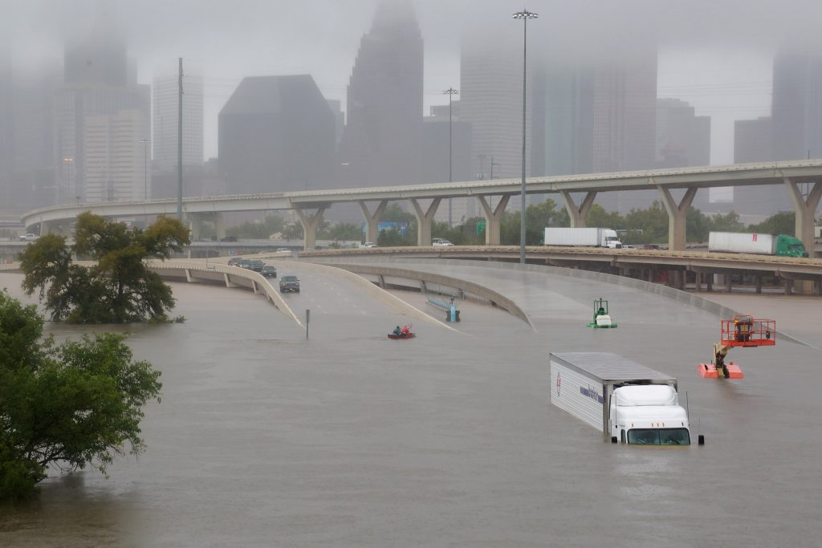
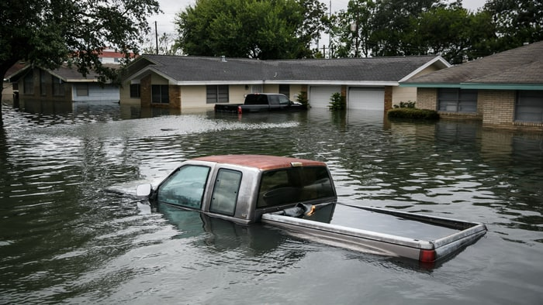
Harvey Caused Widespread Flooding in the Houston Metro Area

Slide 6
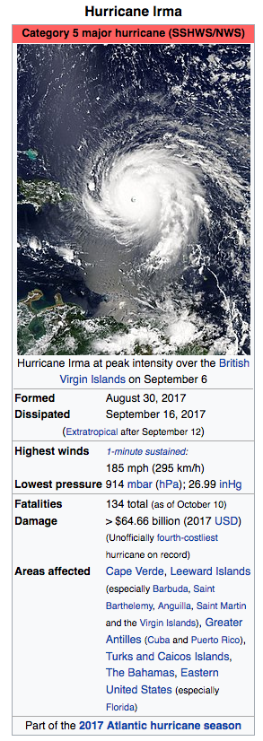
Hurricane Irma 2017 August 30-September 16, 2017 https://en.wikipedia.org/wiki/Hurricane_Irma
Hurricane Irma was an extremely powerful and catastrophic Cape Verde-type hurricane, the strongest observed in the Atlantic since Wilma in 2005 in terms of maximum sustained winds.
It was the first Category 5 hurricane to strike the Leeward Islands on record, followed by Hurricane Maria two weeks later, and the costliest Caribbean hurricane.
It was also the most intense Atlantic hurricane to strike the United States since Katrina in 2005, and the first major hurricane to make landfall in Florida since Wilma in 2005.
The ninth named storm, fourth hurricane, second major hurricane, and first Category 5 hurricane of the 2017 Atlantic hurricane season, Irma caused widespread and catastrophic damage throughout its long lifetime, particularly in parts of the northeastern Caribbean and the Florida Keys.

Slide 7
Irma Storm Track and Infrared Loop
On September 4, Florida Governor Rick Scott declared a state of emergency for Florida, and placed 100 members of the Florida National Guard on duty to assist in preparations.
All 7,000 troops were ordered to be on duty by September 8.
Officials advised residents to stock their hurricane kits.[68] Governor Scott suspended tolls on all toll roads in Florida, including Florida's Turnpike, starting at 5:00 p.m. on September 5.
All state offices in Florida were closed on September 8.
All schools in the Florida Keys were ordered closed from September 6 until further notice.
Mandatory evacuations for the islands were expected, with tourists to leave on September 6 and residents the following day; an estimated 25% of residents stayed.
Schools and colleges were closed in 44 of the state's 67 counties, before Governor Scott ordered all state colleges, universities, schools, and offices to be closed from September 8 to 11.

Slide 8
Effect of Low Pressure in a Tropical Cyclone
http://www.telegraph.co.uk/news/2017/09/10/force-hurricane-irma-displayed-sucks-water-bahamas-beach/

Slide 9
Impacts of Irma
Operational Land Imager imagery by Landsat 8 of the Virgin Islands from before Hurricane Irma's impact on August 25, 2017, and after on September 10, 2017, depicting a "browning" of the landscape and vegetation.[180]

Slide 10
Records
When Irma reached Category 5 intensity with winds of 175 mph (280 km/h) at 11:45 UTC on September 5 at 57.7°W, it became the easternmost Atlantic hurricane of this strength on record, surpassing Hurricane David of 1979.
By 00:15 UTC on September 6, Irma reached peak intensity with 185 mph (295 km/h) winds and a minimum pressure of 914 mbar (914 hPa; 27.0 inHg).
This ties it as the second-strongest Atlantic hurricane by wind speed, surpassed only by Allen of 1980 which reached wind speeds of 190 mph (305 km/h).
Irma achieved one of the longest durations of Category 5 strength winds, and the third-highest accumulated cyclone energy (ACE) index for a tropical cyclone in the Atlantic basin, with a value of 66.6 units

Slide 11
Hurricane Maria September 16 – October 3, 2017 https://en.wikipedia.org/wiki/Hurricane_Maria
Hurricane Maria is regarded as the worst natural disaster on record in Dominica and caused catastrophic damage and a major humanitarian crisis in Puerto Rico.
The tenth-most intense Atlantic hurricane on record, Maria was the thirteenth named storm, seventh consecutive hurricane, fourth major hurricane, and the second Category 5 hurricane of the hyperactive 2017 Atlantic hurricane season.
At its peak, the hurricane caused catastrophic damage and numerous fatalities across the northeastern Caribbean, compounding recovery efforts in the areas of the Leeward Islands already struck by Hurricane Irma just two weeks prior.
Maria was the third consecutive major hurricane to threaten the Leeward Islands in two weeks, after Irma made landfall in several of the islands two weeks prior and Hurricane Jose passed dangerously close, bringing tropical storm force winds to Barbuda.

Slide 12
Impacts
As of November 13, at least 129 people are confirmed to have been killed by the hurricane: 55 in Puerto Rico, 57 in Dominica, 5 in the Dominican Republic, 4 in the contiguous United States, 3 in Haiti, 2 in Guadeloupe, and 3 in the United States Virgin Islands.
Dozens of others, mostly in Dominica and Puerto Rico, are still missing. San Juan Mayor Yulín Cruz claimed that the actual death toll in Puerto Rico may actually be as high as 500.
Maria wrought catastrophic damage to the entirety of Dominica, which suffered an island-wide communication blackout. Much of the housing stock and infrastructure were left beyond repair, while the island's lush vegetation had been practically eradicated.
Total losses from the hurricane are estimated at between $15.9 and $95 billion (2017 USD), mostly in Puerto Rico, making Maria's cost comparable to that of previous Hurricanes Irma and Harvey.
Infrared loop of Hurricane Maria passing St. Croix, Vieques, and landfalling on Puerto Rico on the morning of September 20

Slide 13
Damage and Destruction in the Lesser Antilles

Slide 14
US Government Response
San Juan Mayor Carmen Yulín Cruz, called the disaster a "terrifying humanitarian crisis" and pleaded for relief efforts to be sped up on September 26.
The White House contested claims that the administration was not responding effectively.
General Joseph L. Lengyel, Chief of the National Guard Bureau, defended the Trump Administration's response, and reiterated that relief efforts were hampered by Puerto Rico being an island rather than on the mainland.
President Donald Trump responded to accusations that he does not care about Puerto Rico: "Puerto Rico is very important to me, and Puerto Rico -- the people are fantastic people.
Frustrated with the federal government's "slow and inadequate response", relief group Oxfam announced on October 2 that it plans to get involved in the humanitarian aid effort, sending a team to "assess a targeted and effective response" and support its local partners' on-the-ground efforts.
San Juan Mayor Carmen Yulín Cruz (pictured) harshly criticized the federal response to Maria in Puerto Rico as inadequate.

Slide 15
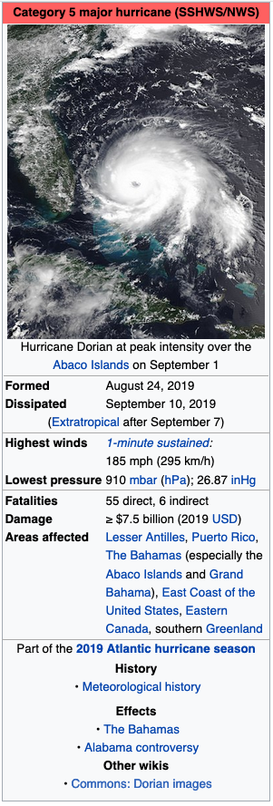
Hurricane Dorian 9/2019 https://en.wikipedia.org/wiki/Hurricane_Dorian
Hurricane Dorian was the most powerful tropical cyclone on record to strike the Bahamas, and is regarded as the worst natural disaster in the country's history.
It was the fourth named storm, second hurricane, and the first major hurricane of the 2019 Atlantic hurricane season.
Dorian struck the Abaco Islands on September 1 with maximum sustained winds of 185 mph (295 km/h), tying with the Labor Day hurricane of 1935 for the highest winds of an Atlantic hurricane ever recorded at landfall.
Dorian went on to strike Grand Bahama at similar intensity, stalling just north of the territory with unrelenting winds for at least 24 hours.
The resultant damage to these islands was catastrophic; most structures were destroyed or swept out to sea, and at least 70,000 people were left homeless.
The hurricane proceeded along the coasts of the Southeastern United States and Atlantic Canada, leaving behind considerable damage and economic losses throughout those regions.

Slide 16
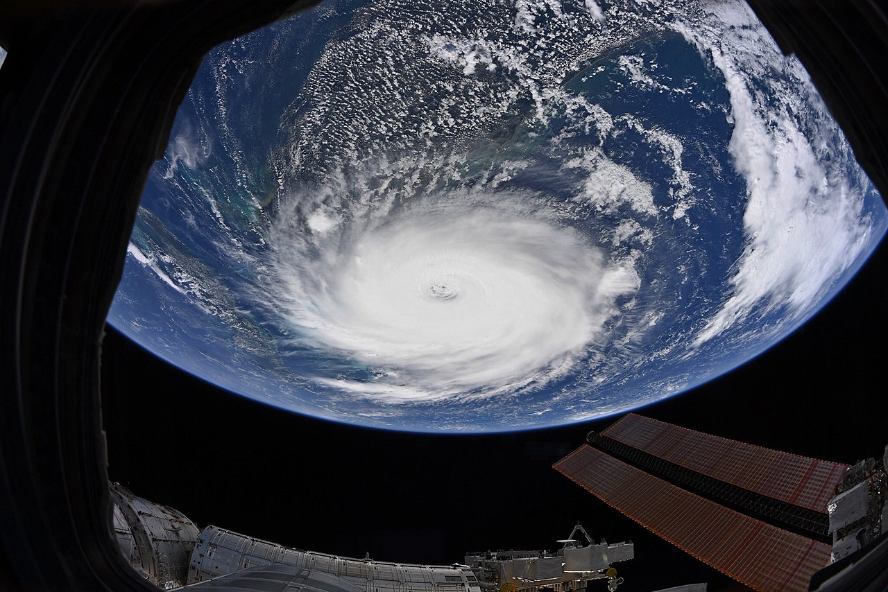
Dorian from the International Space Station

Slide 17
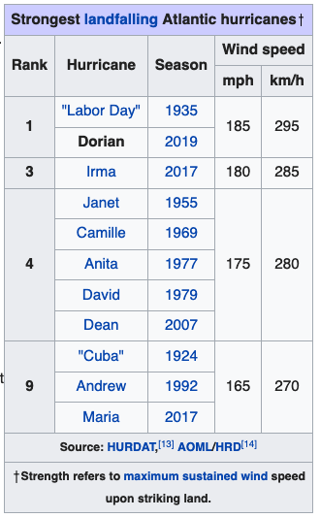
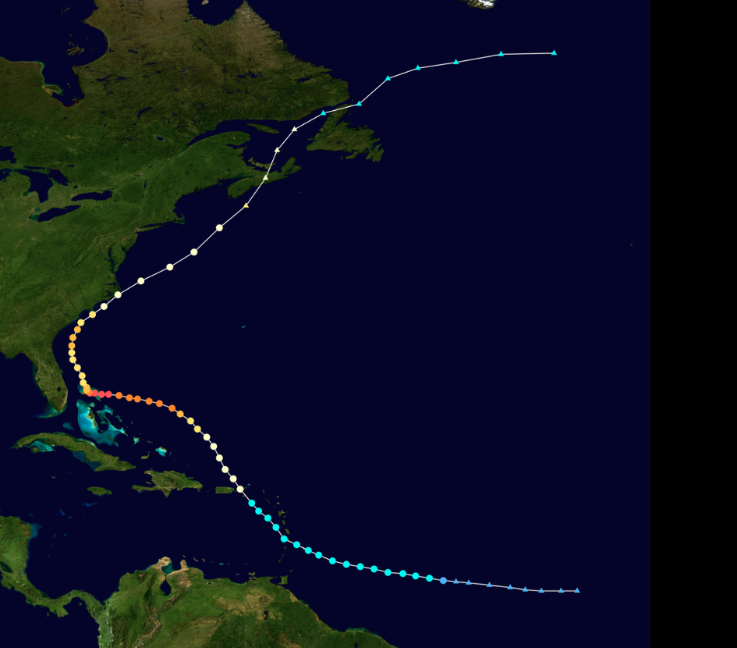
Statistics and Storm Track

Slide 18
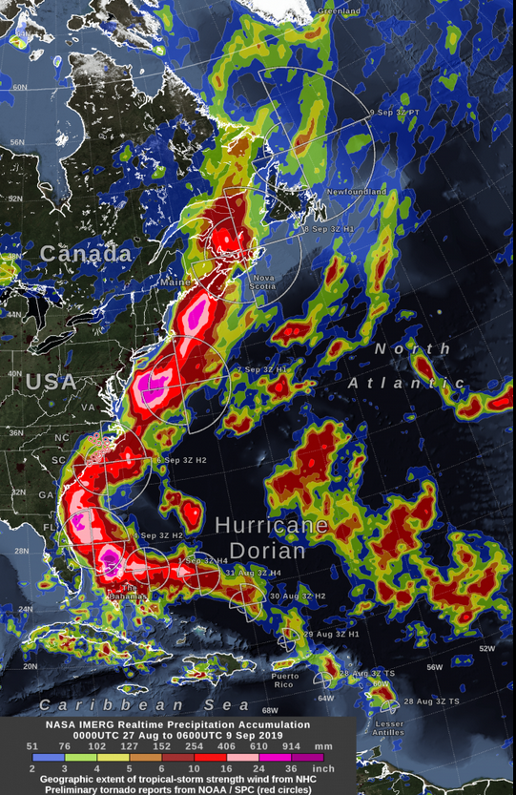
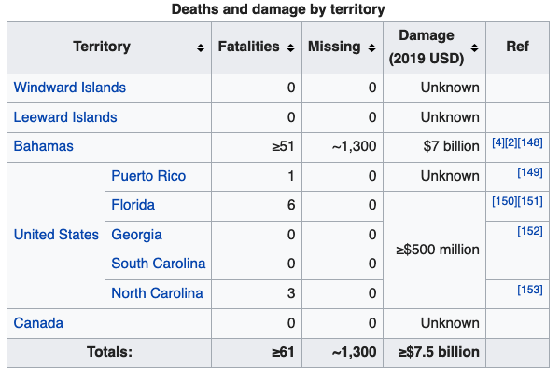
Precipitation & Impacts

Slide 19
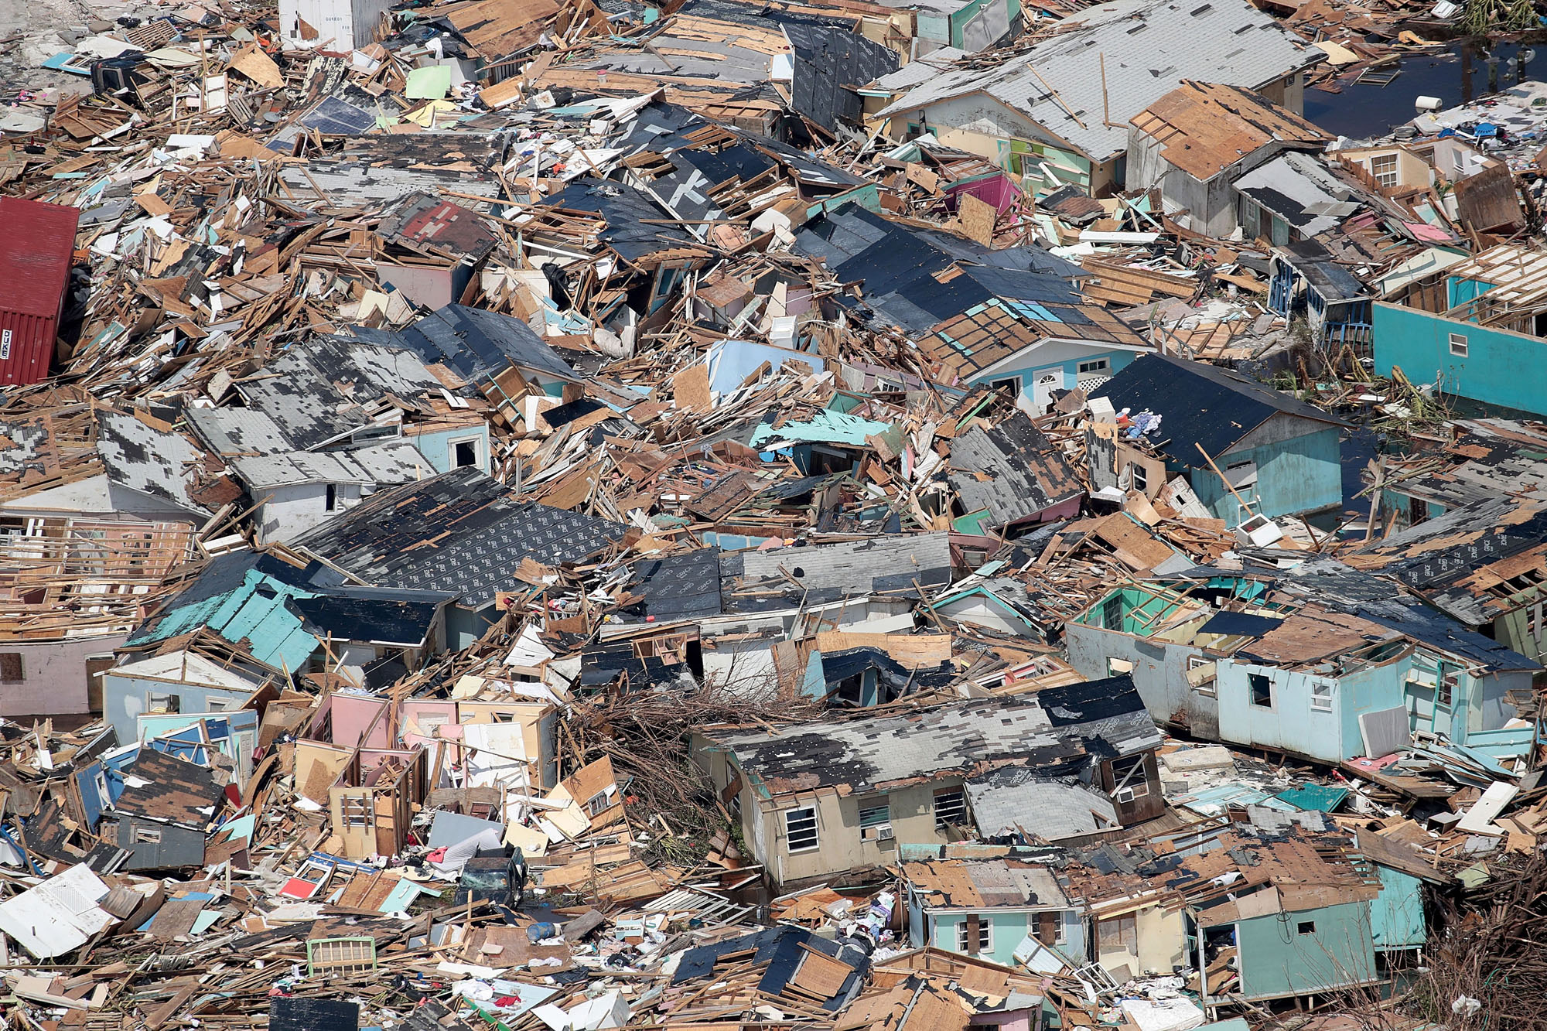
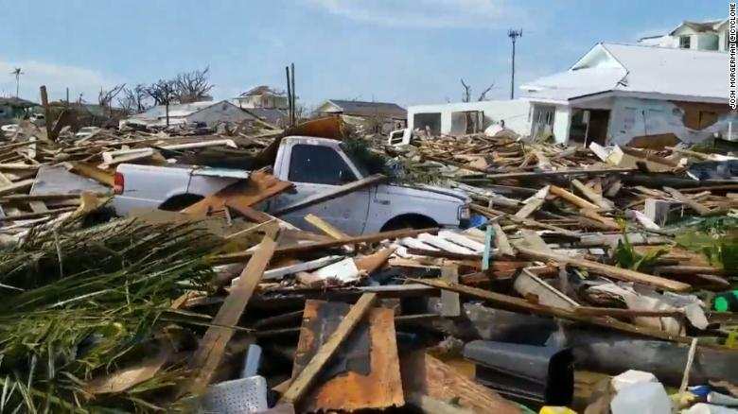
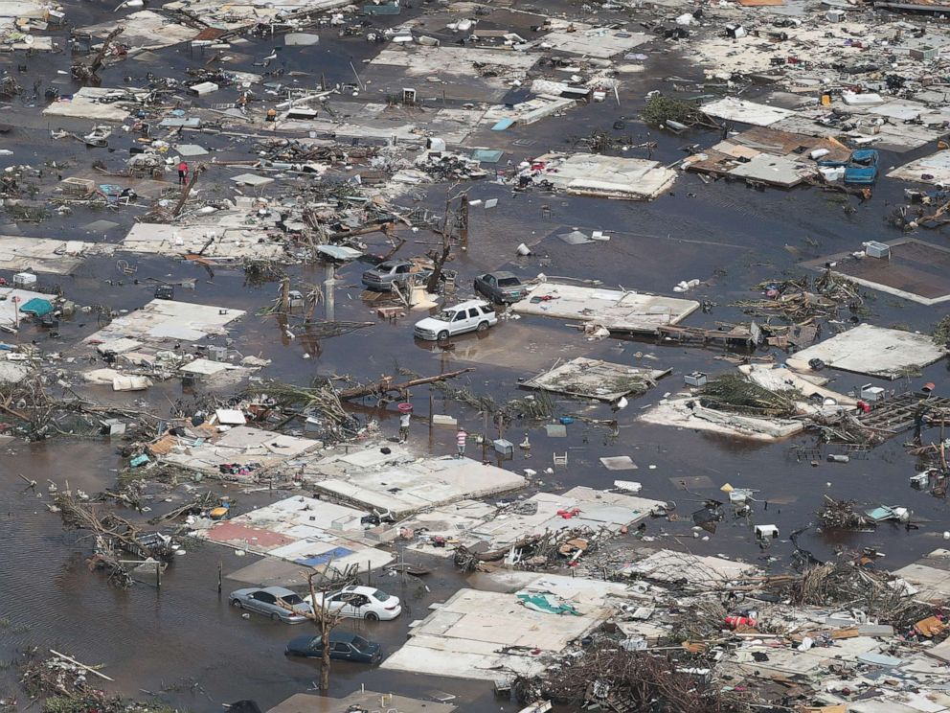
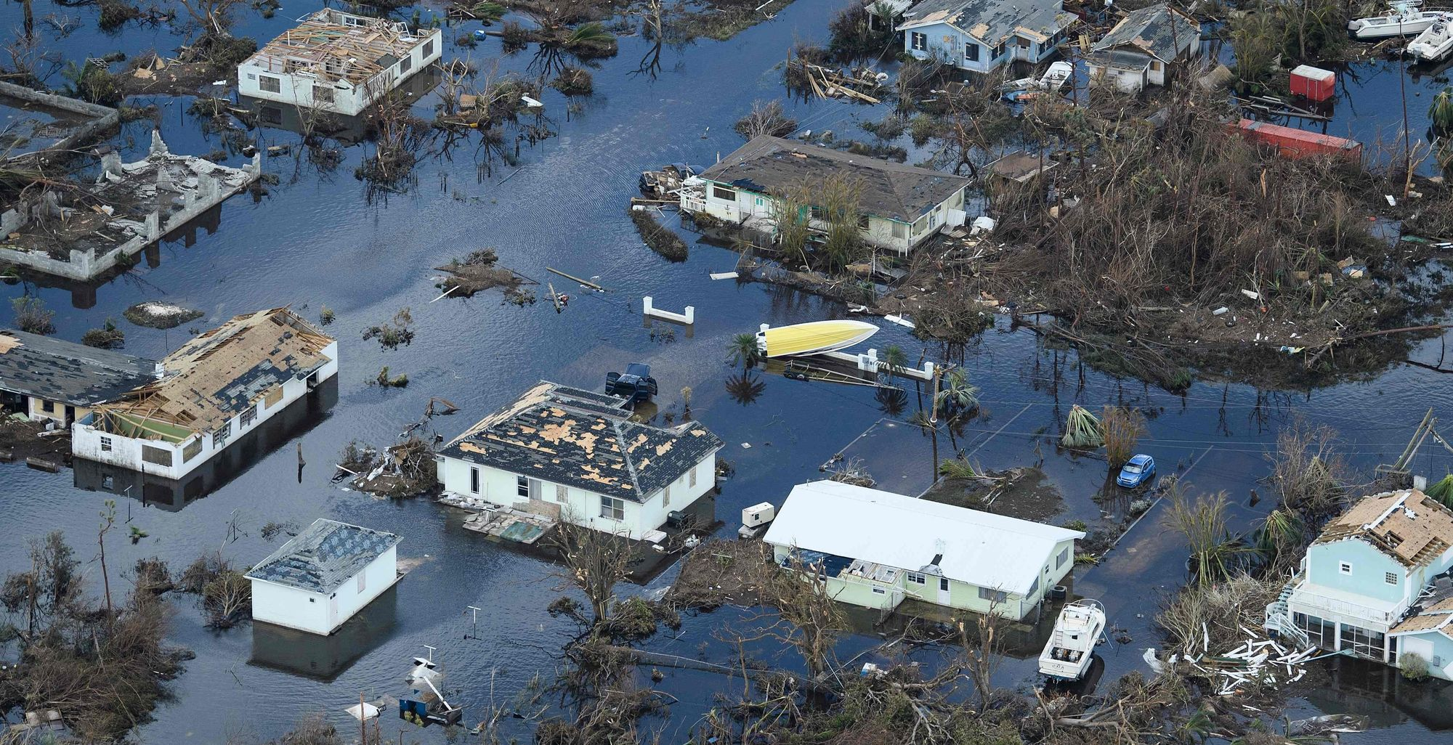

Slide 20
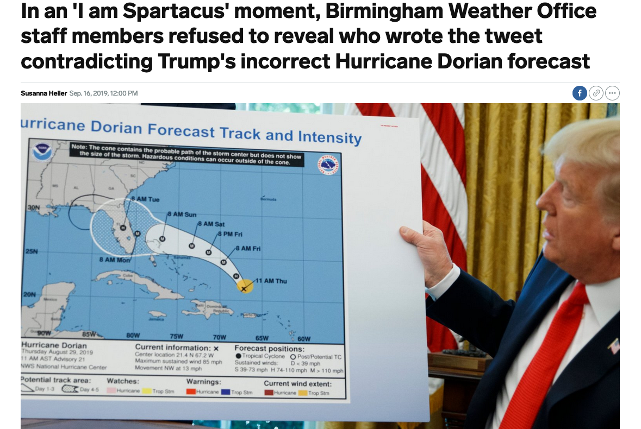
Controversy

Slide 21
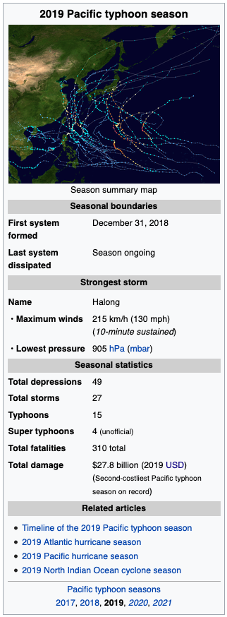
Pacific Typhoons 2019
The 2019 Pacific typhoon season is currently the second-costliest Pacific typhoon season on record, only behind the previous year.
The season runs throughout most of the year, though most tropical cyclones typically develop between May and October.
The season was an average, but notable season.
A notable storm, Typhoon Lekima, became the second costliest typhoon in Chinese history, behind Typhoon Fitow of 2013.
Typhoon Hagibis became one of the costliest tropical cyclones in Japanese history.

Slide 22
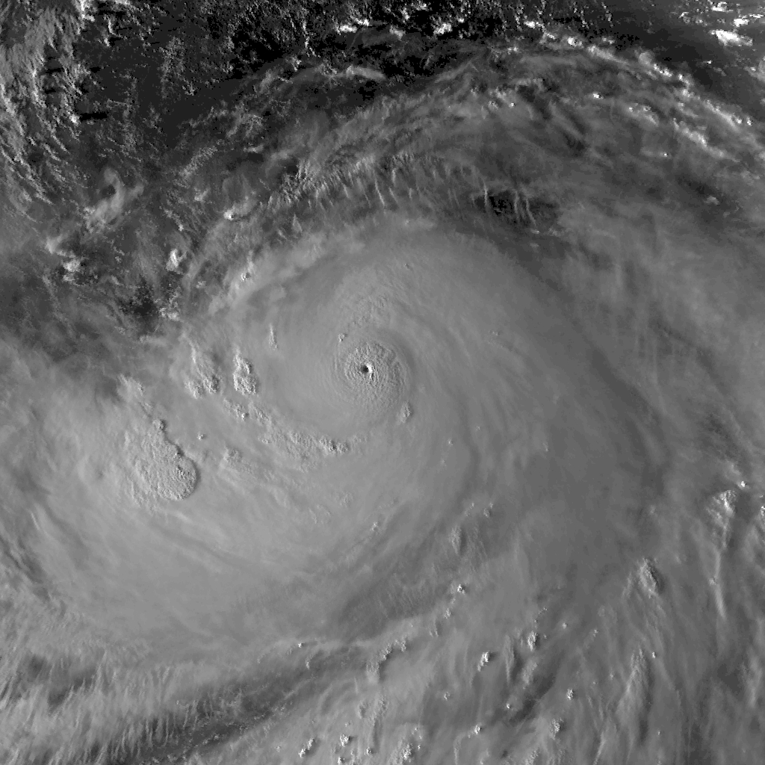
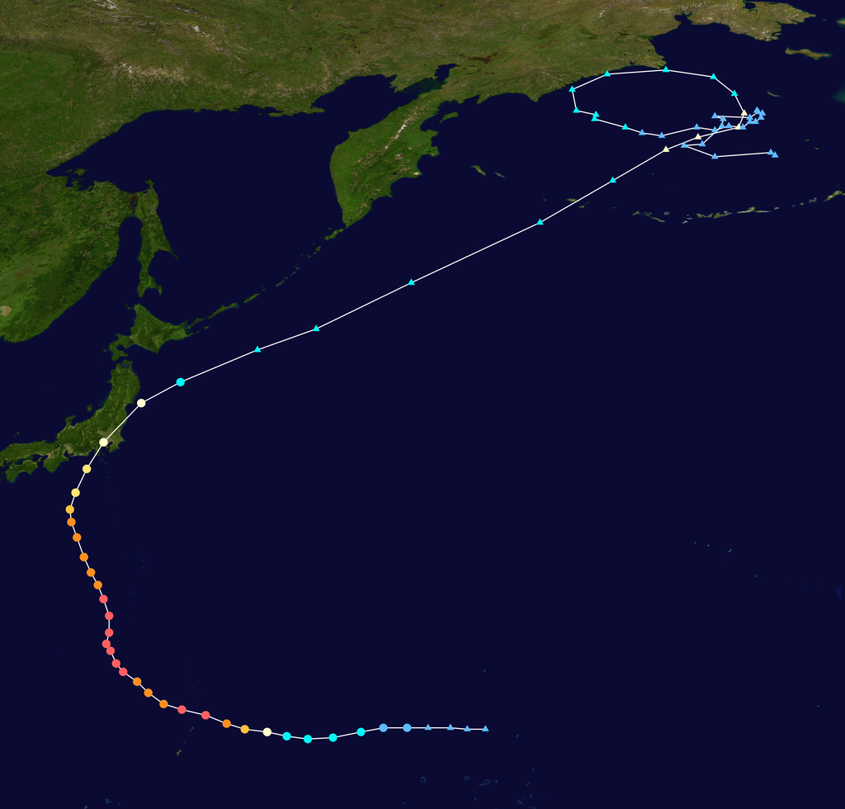
Super Typhoon Hagabis, 2019

Slide 23
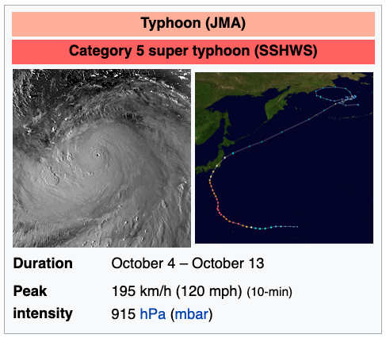
Super Typhoon Hagabis, 2019
On October 7, while continuing to move west, Hagibis explosively intensified and became a super typhoon in the space of only a few hours, developing a pinhole eye.
As it approached the uninhabited areas of the Mariana Islands, strong convective activity as a result of extremely favourable conditions saw Hagibis became a very powerful Category 5-equivalent super typhoon on the Saffir-Simpson hurricane wind scale, with one-minute sustained wind speeds of 260 km/h (160 mph).
The National Weather Service also began issuing advisories for its areas of responsibility, with a typhoon warning issued for Garapan and Tinian, and tropical storm advisories issued for Sinapalo and Hagåtña.
Hagibis passed over the Mariana Islands at 15:30 UTC on October 7 at peak intensity, with 10-minute sustained winds of 195 km/h (120 mph) and a central pressure of 915 hPa (27.02 inHg).

Slide 24
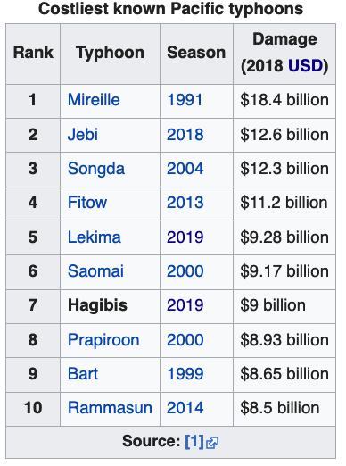
Impacts
In the afternoon, some areas of Japan suffered heavy flooding, with tens of thousands of homes lacking power.
The Japan Meteorological Agency warned that high winds could cause further flooding and landslides, and issued evacuation advisories in high-risk areas.
Over 30 inches (76 cm) of rain fell in parts of Japan. Japan's Fire and Disaster Management Agency stated that at least 95 people have been confirmed dead, 7 people are missing, with 346 people injured by the storm
More than 270,000 households have lost power across the country.
Ten trains of the Hokuriku Shinkansen Line in Nagano City were inundated by flood waters, leading to a loss of ¥32.8 billion (US$300 million).
Insured losses throughout the country are estimated as greater than US$9 billion.
At around 6:22 p.m. JST on 12 October, a magnitude 5.7 earthquake occurred off the coast of Chiba Prefecture, worsening the dangerous conditions already created by Hagibis.
Hagibis also led to the cancellation of several sporting events, such as qualifying for the Japanese Grand Prix and three world cup rugby matches.

