Slide 1
Lecture 23b
Catastrophic Cyclones
John Rundle GEL/EPS 131 WQ2014

Slide 2
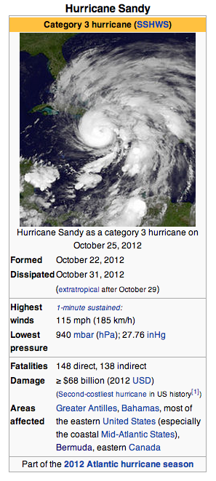
Hurricane Sandy http://en.wikipedia.org/wiki/Hurricane_Sandy
“Hurricane Sandy (unofficially known as "Superstorm Sandy") was the deadliest and most destructive hurricane of the 2012 Atlantic hurricane season, as well as the second-costliest hurricane in United States history.
Sandy was a Category 3 storm at its peak intensity when it made landfall in Cuba.
While it was a Category 2 storm off the coast of the Northeastern United States, the storm became the largest Atlantic hurricane on record (as measured by diameter, with winds spanning 1,100 miles (1,800 km)).
Estimates as of June 2013 assess damage to have been over $68 billion (2013 USD), a total surpassed only by Hurricane Katrina.
At least 286 people were killed along the path of the storm in seven countries.
In the United States, Hurricane Sandy affected 24 states, including the entire eastern seaboard from Florida to Maine and west across the Appalachian Mountains to Michigan and Wisconsin, with particularly severe damage in New Jersey and New York.
Its storm surge hit New York City on October 29, flooding streets, tunnels and subway lines and cutting power in and around the city.
Damage in the United States amounted to $65 billion (2013 USD).”

Slide 3
Hurricane Sandy http://en.wikipedia.org/wiki/Hurricane_Sandy
“Sandy developed from a tropical wave in the western Caribbean Sea on October 22, quickly strengthened, and was upgraded to Tropical Storm Sandy six hours later.
Sandy moved slowly northward toward the Greater Antilles and gradually intensified.
On October 24, Sandy became a hurricane, made landfall near Kingston, Jamaica, re-emerged a few hours later into the Caribbean Sea and strengthened into a Category 2 hurricane.
On October 25, Sandy hit Cuba as a Category 3 hurricane, then weakened to a Category 1 hurricane.
On October 27, Sandy briefly weakened to a tropical storm and then restrengthened to a Category 1 hurricane.
Early on October 29, Sandy curved north-northwest and then moved ashore near Brigantine, New Jersey, just to the northeast of Atlantic City, as a post-tropical cyclone with hurricane-force winds.”

Slide 4
Relation to Global Warming http://en.wikipedia.org/wiki/Hurricane_Sandy
“As they move north, Atlantic hurricanes typically are forced east and out to sea by the Prevailing Westerlies.
In Sandy's case, this typical pattern was blocked by a ridge of high pressure over Greenland resulting in a negative North Atlantic Oscillation, forming a kink in the jet stream, causing it to double back on itself off the East Coast.
Sandy was caught up in this northwesterly flow.
The blocking pattern over Greenland also stalled an arctic front which combined with the cyclone.[36]
Kevin Trenberth of NCAR said that while a negative North Atlantic Oscillation and a blocking anticyclone were in place, the null hypothesis remained that this was just the natural variability of weather (and not due to global warming)
Sea level at New York and along the New Jersey coast has increased by nearly a foot over the last hundred years, which contributed to the storm surge.
Harvard geologist Daniel P. Schrag calls Hurricane Sandy's 13-foot storm surge an example of what will, by mid-century, be the "new norm on the Eastern seaboard”.”

Slide 5
Sandy: Impact on New Jersey http://en.wikipedia.org/wiki/Hurricane_Sandy
“Preparations began on October 26, when officials in Cape May County advised residents on barrier islands to evacuate.
Governor of New Jersey Chris Christie ordered all residents of barrier islands from Sandy Hook to Cape May to evacuate and closed Atlantic City casinos.
President Obama signed an emergency declaration for New Jersey, allowing the state to request federal funding and other assistance for actions taken before Sandy's landfall.[96]
On October 28, Mayor of Hoboken Dawn Zimmer ordered residents of basement and street-level residential units to evacuate, due to possible flooding.
On October 29, residents of Logan Township were ordered to evacuate. Jersey Central Power & Light told employees to prepare to work extended shifts.
Most schools, colleges and universities were closed October 29 while at least 509 out of 580 school districts were closed October 30.
Although tropical storm conditions were inevitable and hurricane force winds were likely, the National Hurricane Center did not issue any tropical cyclone watches or warnings for New Jersey, because Sandy was forecast to become extratropical before landfall and thus would not be a tropical cyclone.”

Slide 6
Sandy: Impact on New York http://en.wikipedia.org/wiki/Hurricane_Sandy
“The New York Stock Exchange was closed for trading for two days, the first weather closure of the exchange since 1985.
It was also the first two-day weather closure since the Great Blizzard of 1888.
The East River overflowed its banks, flooding large sections of Lower Manhattan. Battery Park had a water surge of 13.88 ft.
Seven subway tunnels under the East River were flooded.
The Metropolitan Transportation Authority said that the destruction caused by the storm was the worst disaster in the 108-year history of the New York City subway system.
Sea water flooded the Ground Zero construction site.
Over 10 billion gallons of raw and partially treated sewage were released by the storm, 94% of which went into waters in and around New York and New Jersey.
In addition, a four story Chelsea building's facade crumbled and collapsed, leaving the interior on full display; however, no one was hurt by the falling masonry.
On November 26, Governor Cuomo called Sandy "more impactful" than Hurricane Katrina, and estimated costs to New York at $42 billion.
The storm severely damaged or destroyed around 100,000 homes on Long Island with more than 2,000 homes deemed uninhabitable there.”

Slide 7
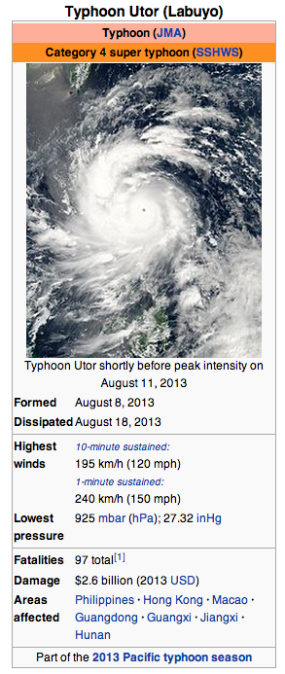
Super Typhoon Utor http://en.wikipedia.org/wiki/Typhoon_Utor_(2013)
“Typhoon Utor(international designation: 1311, JTWC designation: 11W, PAGASA name: Labuyo VNCHMF designation: Bão số 7 ), is the 15th depression and the 2nd typhoon in the 2013 typhoon season.
It was a powerful tropical cyclone which struck the Philippines and southern China.
Developing into a tropical storm on August 9, Utor soon underwent explosive intensification and became a typhoon within a half of day.
After making landfall over Luzon late on August 11, the typhoon re-emerged in the South China Sea, and it ultimately made its second landfall over Guangdong, China on August 14.
On August 11, under the influence of low vertical wind shear, very favorable poleward and westward outflow, and warm sea surface temperature, Utor began to intensify more and formed a clear eye.
At 12:00 UTC, Typhoon Utor attained peak intensity by the ten-minute maximum sustained winds reaching 105 knots (195 km/h, 105 mph) and the atmospheric pressure decreasing to 925 hPa (27.3 inHg). “

Slide 8
Inside Super Typhoon Utor http://earthobservatory.nasa.gov/NaturalHazards/view.php?id=81909
“CloudSat samples the atmosphere, taking the tiniest vertical slices of clouds and haze and dust and smoke and creating a profile of all that stands between us and space.
This vertical sampling is possible because the satellite carries a radar instrument similar to those used to track storms on the ground, but more than 1,000 times more sensitive.
The profiles reveal the hidden structure of clouds and their distribution and abundance.
It is rare, however, for the satellite to fly directly over the center of a tropical cyclone.
On August 11, 2013, CloudSat did exactly that, capturing a perfect profile of the category 4 Super Typhoon Utor approaching the Philippines.
Since its launch in April 2006, CloudSat has directly intersected the eye of a storm of this intensity and size only a handful of times.”
“NASA's Cloudsat flew directly over super typhoon Utor as it passed over the Philippines.
Using the radar instrument to analyze the cloud structure, NASA scientists reconstructed a side view that reveals the structure of the storm.
The top image was acquired by the MODIS instrument on the Aqua satellite.
Red line is the track of the Cloudsat satellite.”

Slide 9
Inside a Super Typhoon http://earthobservatory.nasa.gov/NaturalHazards/view.php?id=81909
“The view of the storm at the top of this page comes from the Moderate Resolution Imaging Spectroradiometer (MODIS) on NASA’s Aqua satellite, which flies in formation with CloudSat and acquired this image a few minutes before the CloudSat overpass.
The red line shows the footprint of the CloudSat radar observation displayed in the lower image.
The CloudSat observation is about 10 kilometers east of the center of the storm, taking in the structure of the eye and eye wall.
At the time, Utor had winds estimated at 115 knots (132 mph) and a minimum pressure of 937 millibars.
This overpass reveals many unique features of a well-defined and intense typhoon, including a distinct eye, bands of rain separated by cloud-free areas, and extremely heavy rain.
The dip in the center of the profile shows an outward sloping eye and strong eyewall.
The lack of a data signal below five kilometers (ten kilometers close to the eye) is due to heavy precipitation, since the radar pulse loses power traveling through intense rain.
The strong signal elsewhere points to large amounts of ice and liquid water spread throughout the storm. “
Dark stripes are rain bands, and these are separated by moats (cloud-free areas) beneath the cirrus canopy.

Slide 10
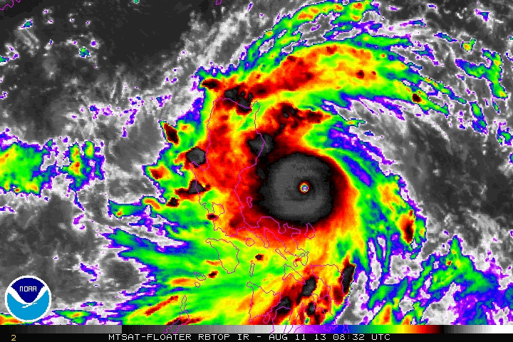
Utor Track and Animation http://en.wikipedia.org/wiki/Typhoon_Utor_(2013)
“As it tracked westward, Utor became exceptionally symmetrical, as the convective bands had further deepened and wrapped tighter around a 13 nautical miles (24 km; 15 mi) pin-hole eye
This development prompted JTWC to upgrade Utor to a super typhoon.
Due to land interaction with Luzon, the pin-hole eye filled in quickly
As a result, JTWC downgraded Utor to a typhoon at 18:00 UTC.
Tracking along the southern periphery of a subtropical ridge to the north, Utor made landfall over northern Luzon around 19:00 UTC (03:00 PHT on August 12).”
Infrared image loop: Philippines landfall
http://www.nhc.noaa.gov

Slide 11
Impact on China http://en.wikipedia.org/wiki/Typhoon_Utor_(2013)
“On August 14, Utor made landfall over Yangjiang in Guangdong, China as a minimal typhoon.
At 12:00 UTC, JMA downgraded Utor to a severe tropical storm, shortly before JTWC issued a final warning to the rapidly weakening system due to land interaction.
Utor weakened into a tropical storm overland, and JMA downgraded the system into a tropical depression at noon on August 15.
The remnants began tracking very slowly in Guangxi, until the tropical depression finally dissipated on August 18.
Widespread damage took place in Guangdong Province where at least four people were killed and four others were listed missing.
An estimated 109 million people were affected, 16.15 million of whom were temporarily relocated due to the threat of flooding. Six people were killed in Guangxi Province while nearly 100 million were affected. Losses in the province reached ¥382 million (US$62.4 million).
Prolonged heavy rains in Hunan Province triggered widespread flooding that caused substantial damage. “

Slide 12
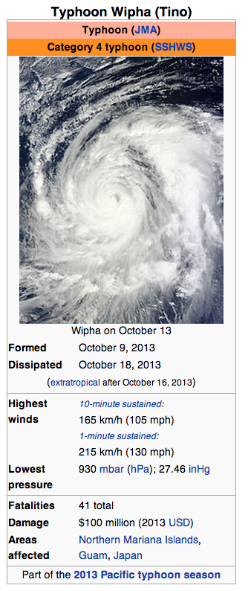
Typhoon Wipha, October 9-18, 2013 http://en.wikipedia.org/wiki/Typhoon_Wipha_(2013)
“Typhoon Wipha, (international designation: 1326, JTWC designation: 25W, PAGASA name: Tino) was a large typhoon that caused extensive damage in Japan in mid-October 2013.
The system originated from a tropical depression well to the east of Guam on October 8, and reached typhoon status on October 12.
Moving northwestward, Wipha grew into a very large system and ultimately attained its peak intensity on October 14 with winds of 165 km/h (105 mph) and an atmospheric pressure of 930 mbar (hPa; 27.46 inHg).
Accelerating and turning more northerly, the typhoon weakened as conditions became less conducive for tropical cyclones.
Wipha dramatically accelerated northeastward on October 15 as it interacted with a stalled out front over Japan.
Simultaneously, the storm began transitioning into an extratropical cyclone, a process which it completed early on October 16.
Upon doing so, gale-force winds spanned an area 2,220 km (1,380 mi) in diameter. It is said that the storm caused over 100 million dollars of damage. “

Slide 13
Typhoon Wipha, October 9-18, 2013 http://en.wikipedia.org/wiki/Typhoon_Wipha_(2013) http://www.usno.navy.mil/JTWC/
“In anticipation of heavy rains at the debilitated Fukushima Daiichi Nuclear Power Plant, the Tokyo Electric Power Company (TEPCO) placed sandbags around a drainage ditch holding back radioactive water.[10]
Regarded as a "once in a decade storm" by the JMA, schools throughout Tokyo were closed on October 16.
Significant disruptions to transportation took place, with over 60,000 people having their flights canceled and train service in parts of the city was suspended.
Typhoon Wipha weakened as it skirted Japan's eastern coastline on October 15. Though the storm caused only limited damage on the mainland, it spawned a massive landslide on the island of Izu Ōshima, killing at least 31 and leaving 13 others missing.”

Slide 14
Typhoon Wipha, October 9-18, 2013 http://en.wikipedia.org/wiki/Typhoon_Wipha_(2013) http://gdacs.org/
“At the Fukushima Daiichi plant, 12 water storage tanks overflowed from the typhoon's heavy rains.
Beta radiation levels skyrocketed to 400,000 becquerels in the wake of the storm, 6,500 times greater than prior to Wipha.
The overflow was blamed on TEPCO's inadequate preparation and not heeding warnings of the storm.
On October 24, it was announced that radiation levels in water near the Fukushima nuclear plant reached an all-time high of 140,000 becquerels, greatly surpassing the previous peak of 59,000 becquerels.
The spike in radiation is at least partially attributed to torrential rains from Typhoon Wipha.”

Slide 15
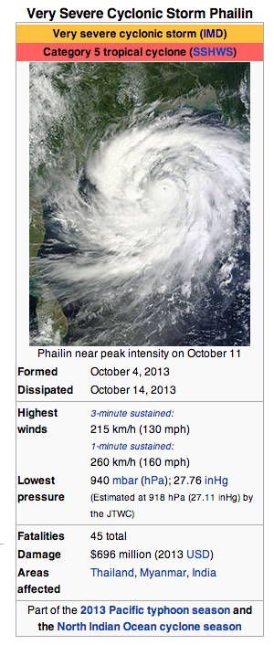
Super Typhoon Phailin http://en.wikipedia.org/wiki/Cyclone_Phailin
“Very Severe Cyclonic Storm Phailin was the second-strongest tropical cyclone ever to make landfall in India, behind only the 1999 Odisha cyclone.
The system was first noted as a tropical depression on October 4, 2013 within the Gulf of Thailand, to the west of Pnom Penh in Cambodia.
Over the next few days, it moved westwards within an area of low to moderate vertical wind shear, before as it passed over the Malay Peninsula, it moved out of the Western Pacific Basin on October 6.
Phailin intensified rapidly and became a category 5 hurricane on the Saffir Simpson scale before it started to weaken during the next day as it approached the Indian state of Odisha.
It made landfall later that day, near Gopalpur in Odisha coast at around 2130 IST (1600 UTC).
It subsequently weakened over land as a result of frictional forces, before it was last noted on October 14, as it degenerated into a well marked area of low pressure.
The cyclone prompted India's biggest evacuation in 23 years with more than 550,000 people moved up from the coastline in Odisha and Andhra Pradesh to safer places.”

Slide 16
Typhoon Phailin http://en.wikipedia.org/wiki/Cyclone_Phailin
“On October 4, the Japan Meteorological Agency started to monitor a tropical depression that had developed in the Gulf of Thailand, about 400 km (250 mi) west of Ho Chi Minh City in Vietnam.
Over the next couple of days the system moved westward within an area of low to moderate vertical wind shear before it passed over the Malay Peninsula and moved out of the Western Pacific Basin on October 6.
The system then subsequently emerged into the Andaman Sea during the next day, before the India Meteorological Department (IMD) started to monitor the system as Depression BOB 04 early on October 8.
During that day the system moved towards the west-northwest into an environment for more development before the IMD reported that the system had become a deep depression early on October 9 as it intensified and consolidated further.
The United States Joint Typhoon Warning Center (JTWC) subsequently initiated advisories on the depression and designated it as Tropical Cyclone 02B, before the system slightly weakened, as it passed near to Mayabunder in the Andaman Islands and moved into the Bay of Bengal.”
After moving into the Bay of Bengal, the system quickly reorganized as it moved along the southern edge of a subtropical ridge of high pressure.
The IMD reported that the system had intensified into a cyclonic storm and named it Phailin.

Slide 17
Phailin Landfall http://en.wikipedia.org/wiki/Cyclone_Phailin
“In Odisha, the government issued a high
Food and relief materials were stocked-up at storm shelters across the state.
The Chief Minister of Odisha wrote to the Union Defence Minister seeking support from defence personnel, particularly the Air Force and Navy, for rescue and relief operations.
Odisha government had made arrangements for over 1,000,560 food packets for relief.
Indian Air Force helicopters were kept on standby in West Bengal to move in for help at short notice.
A total of 1,154,725 people were evacuated in the wake of the storm and the following floods in the state.
It was also reported that due to high winds, nine people were killed in Odisha.
In a period of 24 hours ending on 13 October, Banki and Balimundali in Odisha received heavy rainfall of 381 mm and 305 mm respectively.
As the storm moved inland, wind speeds picked up from 100 km/h (62 mph) to 200 km/h (120 mph) within 30 minutes]
As of 18 October, 44 people have been reported dead from Odisha.
Losses across Odisha amounted to 42.4 billion rupees (US$688 million).”
The system made landfall on October 11 near Gopalpur in Odisha, at around 22:30 IST (17:00 UTC) on as a very severe cyclonic storm.[12]
After the system made landfall, the JTWC issued their final advisory on Phailin, before during the next day the India Meteorological Department (IMD) reported that the system had weakened into a cyclonic storm.

Slide 18
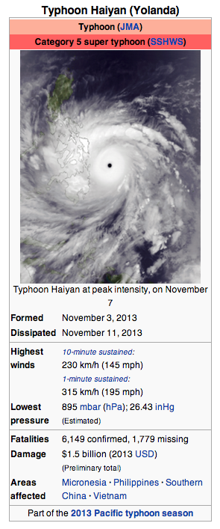
Super Typhoon Haiyan http://en.wikipedia.org/wiki/Typhoon_Haiyan
“Typhoon Haiyan, known as Typhoon Yolanda in the Philippines, was an exceptionally powerful tropical cyclone that devastated portions of Southeast Asia, particularly the Philippines, in early November 2013.
It is the deadliest Philippine typhoon on record, killing at least 6,109 people in that country alone.
Haiyan is also the strongest storm recorded at landfall, and unofficially the strongest typhoon ever recorded in terms of wind speed.
The thirtieth named storm of the 2013 Pacific typhoon season, Haiyan originated from an area of low pressure several hundred kilometers east-southeast of Pohnpei in the Federated States of Micronesia on November 2, 2013.
Tracking generally westward, environmental conditions favored tropical cyclogenesis and the system developed into a tropical depression the following day.
After becoming a tropical storm and attaining the name Haiyan at 0000 UTC on November 4, the system began a period of rapid intensification that brought it to typhoon intensity by 1800 UTC on November 5.
By November 6, the Joint Typhoon Warning Centre (JTWC) assessed the system as a Category 5-equivalent super typhoon on the Saffir-Simpson hurricane wind scale
The storm passed over the island of Kayangel in Palau shortly after attaining this strength.”

Slide 19
Haiyan http://en.wikipedia.org/wiki/Typhoon_Haiyan
“At 1200 UTC on November 7, the Japan Meteorological Agency (JMA) upgraded the storm's maximum ten-minute sustained winds to 235 km/h (145 mph), the highest in relation to the cyclone.
The Hong Kong Observatory put the storm's maximum ten-minute sustained winds at 260 km/h (160 mph) prior to landfall in the central Philippines, while the China Meteorological Administration estimated the maximum ten-minute sustained winds at the time to be around 75 m/s (270 km/h or 167 mph).
At 1800 UTC, the JTWC estimated the system's one-minute sustained winds to 315 km/h (196 mph), unofficially making Haiyan the fourth most intense tropical cyclone ever observed.
Several hours later, the eye of the cyclone made its first landfall in the Philippines at Guiuan, Eastern Samar, without any change in intensity
If verified, this would make Haiyan the strongest tropical cyclone to make a landfall on record, surpassing the old record of 305 km/h (190 mph) set by Atlantic Hurricane Camille in 1969. “
Typhoon Haiyan of 2013 was estimated from satellite imagery by NOAA to have a pressure possibly as low as 858 mbar though it is uncertain without direct obsevation.
So far, due to lack of direct observations, it is unknown if Typhoon Tip maintains the world record

Slide 20
Haiyan & Climate http://en.wikipedia.org/wiki/Typhoon_Haiyan
“Gradually weakening, the storm made five additional landfalls in the country before emerging over the South China Sea.
The cyclone caused catastrophic destruction in the Visayas, particularly on Samar and Leyte.
According to UN officials, about 11 million people have been affected and many have been left homeless.
Both political leaders and climatologists have connected the typhoon to climate change.
Climatologists have consequently published analyses correlating the increasing intensity of storms with the progression of global warming.
As Yeb Saño continued his hunger strike (box at right), several delegates, including American delegate Collin Reese, joined him in fasting.
Sixty people from Climate Action Network, an umbrella group of environmental non-governmental organisations, also joined the hunger strike.”
During the 2013 United Nations Climate Change Conference (which was coincidentally held concurrently with the typhoon), Yeb Saño, the lead negotiator of the Philippines delegation, received a standing ovation when he declared a hunger strike in solidarity with his country.

Slide 21
Impacts http://en.wikipedia.org/wiki/Typhoon_Haiyan
“Typhoon Haiyan caused catastrophic damage throughout much of Leyte and Samar islands, where cities and towns were largely destroyed.
As of 6:00 a.m. local time on December 16, the National Disaster Risk Reduction and Management Council (NDRRMC) confirmed 6,069 fatalities across the country, 5,715 of those taking place in the Eastern Visayas.
The actual death toll remains unclear, with the total loss of life estimated as low as 2,500 by President Benigno Aquino III.
As of November 13, Red Cross estimated that 22,000 people were missing while approximately 65,500 people were listed as such through Google Person Finder.
Google, however, cautioned that this value is not to be read into, as shown during the 2011 Tōhoku earthquake and tsunami when more than 600,000 names were listed in contrast to the final death toll of roughly 20,000.”

Slide 22
Steve Ward
Video

Slide 23
Impacts http://en.wikipedia.org/wiki/Typhoon_Haiyan
“In Surigao City, 281.9 mm (11.10 in) of rainfall was recorded, much of which fell in under 12 hours.
Storm surges were also recorded in many places. In the island of Leyte and Samar, PAGASA measured 5–6 meter (15–19 ft) waves.
In Tacloban, Leyte, the terminal building of Tacloban Airport was destroyed by a 5.2 m (17 ft) storm surge up to the height of the second story.
Along the airport, a storm surge of 4 m (13 ft) was estimated.
Waves of 4.6 m (15 ft) were also estimated.
On the western coast of Samar, the storm surge was not as significant.
Guiuan in Eastern Samar was the point of Haiyan's first landfall, and was severely affected due to the typhoon's impacts.
Nearly all structures in the township suffered at least partial damage, many of which were completely flattened.
For several days following Haiyan's first landfall, the damage situation in the fishing town remained unclear due to lack of communication.
However, the damage could finally be assessed after Philippine Air Force staff arrived in Guiuan on November 10.”

Slide 24
Impacts http://en.wikipedia.org/wiki/Typhoon_Haiyan
“There was widespread devastation from the storm surge in Tacloban City especially in San Jose, with many buildings being destroyed, trees knocked over or broken, and cars piled up.
The low-lying areas on the eastern side of Tacloban city were hardest hit, with some areas completely washed away.
Flooding also extended for 1 km (0.62 mi) inland on the east coast of the province.
City administrator Tecson John Lim stated that roughly 90 percent of the city had been destroyed.
Journalists on the ground have described the devastation as, "off the scale, and apocalyptic”.
Most families in Samar and Leyte lost some family members or relatives; families came in from outlying provinces looking for relatives, especially children, who may have been washed away.
The entire first floor of the Tacloban City Convention Center, which was serving as an evacuation shelter, was submerged by storm surge.
Many residents in the building were caught off-guard by the fast rising waters and subsequently drowned or were injured in the buildings.”

Slide 25
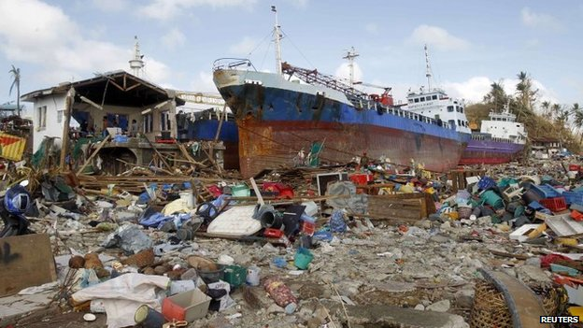
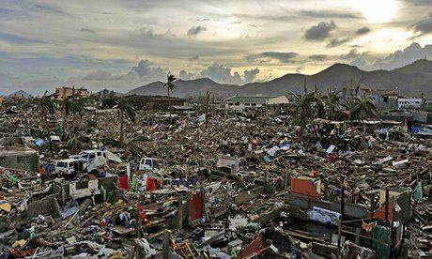
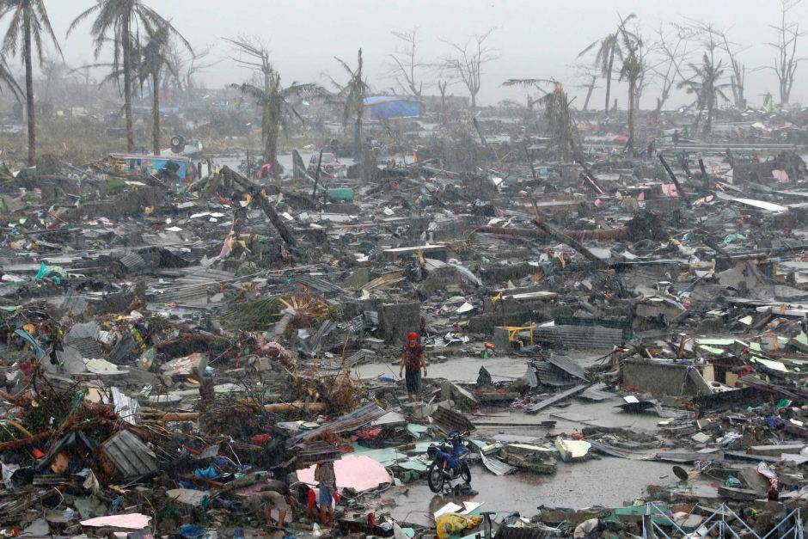
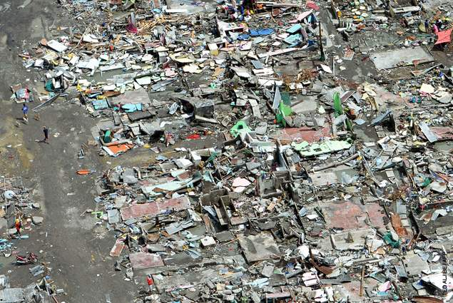
Images of Tacloban (Various Sources as Listed)
http://www.bbc.co.uk
http://www.theguardian.com
http://www.abc.net.au
http://www.usaid.gov

Slide 26
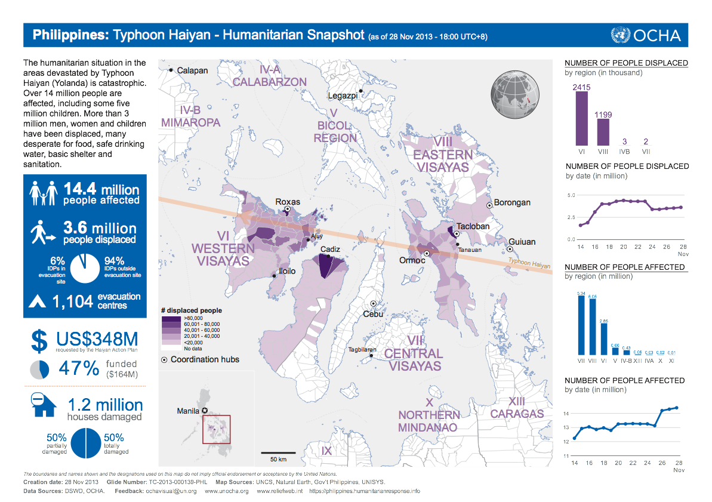
http://reliefweb.int/report/philippines/philippines-typhoon-haiyan-humanitarian-snapshot-28-nov-2013-1800-utc8

Slide 27
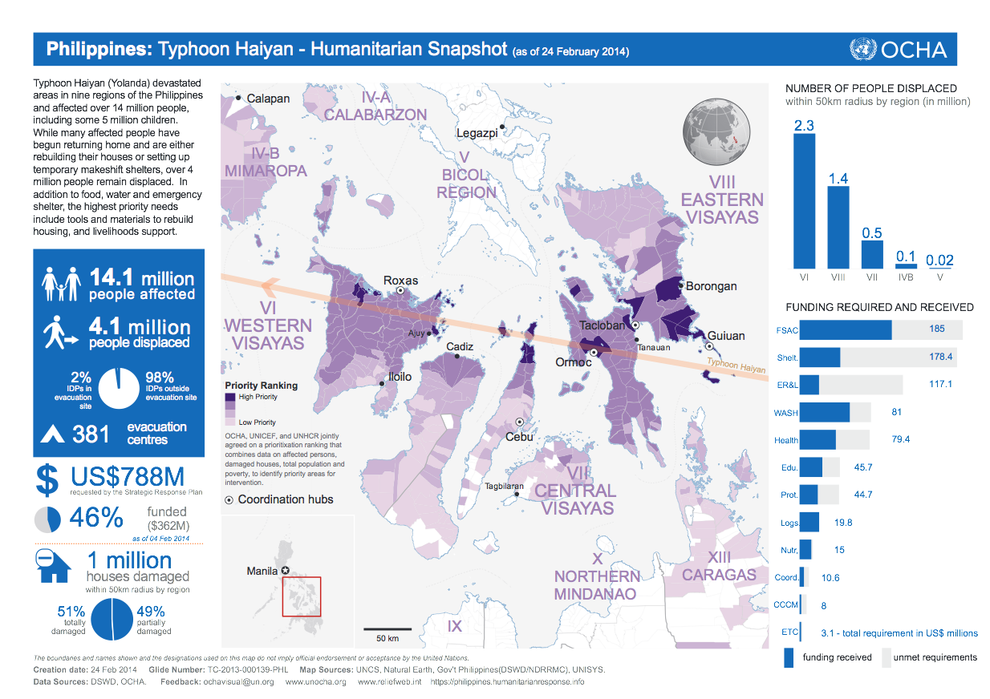
http://reliefweb.int/report/philippines/philippines-typhoon-haiyan-humanitarian-snapshot-24-february-2014

