Slide 1
Lecture 22
Tropical Cyclones, Hurricanes, Typhoons
John Rundle GEL/EPS 131

Slide 2
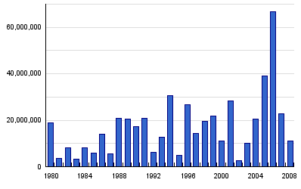
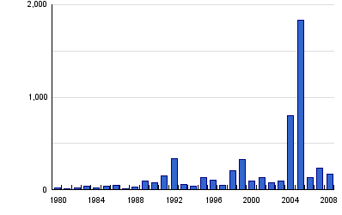
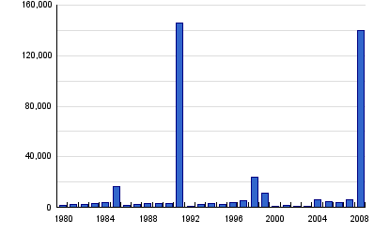
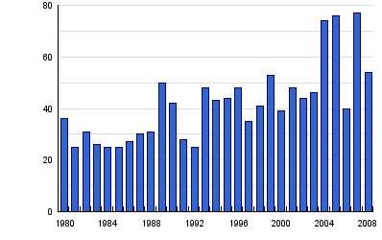
Global Cyclone Statistics, 1980-2008 http://www.preventionweb.net/english/hazards/statistics/?hid=58
Persons Affected
Economic Damage (USD in B$)
Persons Killed
Number of Reported Events

Slide 3
Global Cyclones Summary Statistics, 1980-2008 http://www.preventionweb.net/english/hazards/statistics/?hid=58

Slide 4
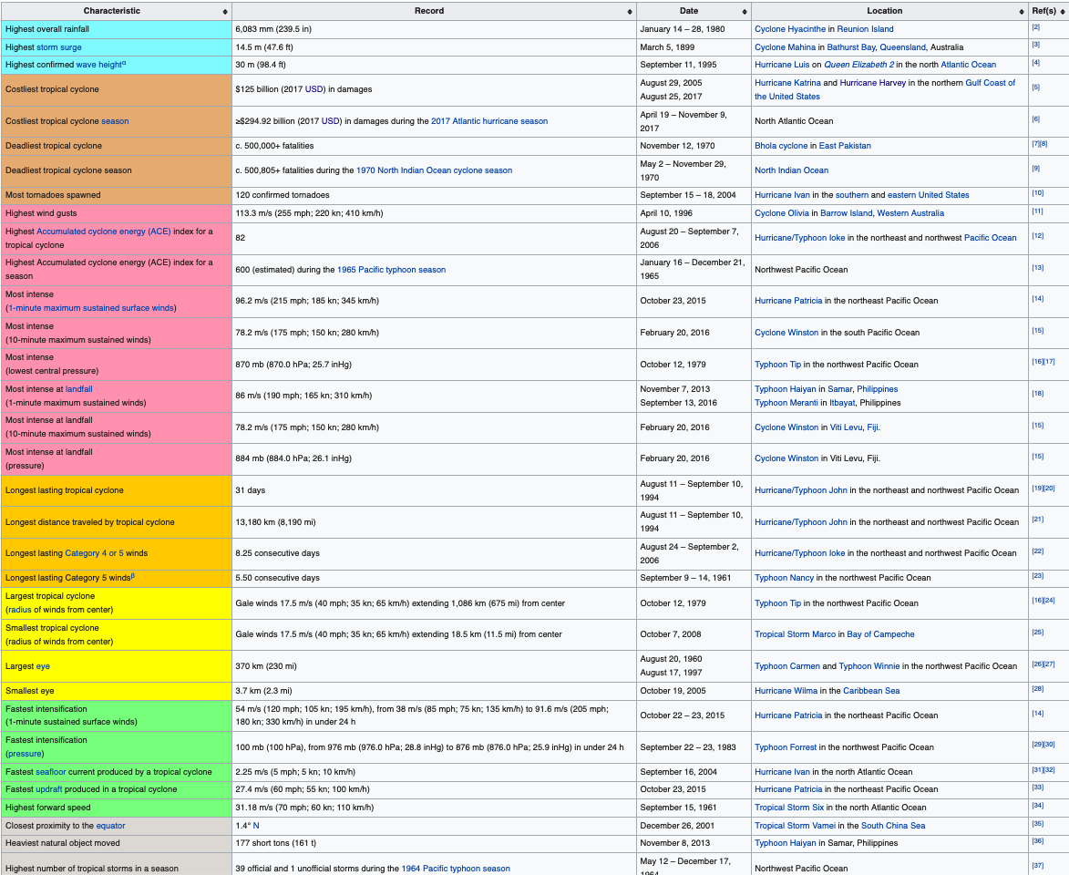
Records http://en.wikipedia.org/wiki/List_of_tropical_cyclone_records

Slide 5
Tropical Cyclones http://en.wikipedia.org/wiki/Tropical_cyclone
“A tropical cyclone is a rapidly-rotating storm system characterized by a low-pressure center, strong winds, and a spiral arrangement of thunderstorms that produce heavy rain.
Depending on its location and strength, a tropical cyclone is referred to by names such as hurricane (/ˈhʌrɨkeɪn/ or /ˈhʌrɨkən/), typhoon /taɪˈfuːn/, tropical storm, cyclonic storm, tropical depression, and simply cyclone.
Tropical cyclones typically form over large bodies of relatively warm water.
They derive their energy from the evaporation of water from the ocean surface, which ultimately re-condenses into clouds and rain when moist air rises and cools to saturation.
This energy source differs from that of mid-latitude cyclonic storms, such as nor'easters and European windstorms, which are fueled primarily by horizontal temperature contrasts.
The strong rotating winds of a tropical cyclone are a result of the (partial) conservation of angular momentum imparted by the Earth's rotation as air flows inwards toward the axis of rotation.
As a result, they rarely form within 5° of the equator.
Tropical cyclones are typically between 100 and 4,000 km (62 and 2,500 mi) in diameter.”

Slide 6
Tropical Cyclones http://en.wikipedia.org/wiki/Tropical_cyclone
Hurricane Isabel (2003) as seen from orbit during Expedition 7 of the International Space Station. The eye, eyewall, and surrounding rainbands, characteristics of tropical cyclones, are clearly visible in this view from space.

Slide 7
History of Hurricane/Cyclone Names http://www.nhc.noaa.gov/aboutnames_history.shtml
“For several hundred years many hurricanes in the West Indies were named after the particular saint's day on which the hurricane occurred.
Ivan R. Tannehill describes in his book "Hurricanes" the major tropical storms of recorded history and mentions many hurricanes named after saints.
For example, there was "Hurricane Santa Ana" which struck Puerto Rico with exceptional violence on July 26, 1825, and "San Felipe" (the first) and "San Felipe" (the second) which hit Puerto Rico on September 13 in both 1876 and 1928.
Tannehill also tells of Clement Wragge, an Australian meteorologist who began giving women's names to tropical storms before the end of the 19th century.
During World War II this practice became widespread in weather map discussions among forecasters, especially Army and Navy meteorologists who plotted the movements of storms over the wide expanses of the Pacific Ocean.
In 1953, the United States abandoned a confusing two-year old plan to name storms by a phonetic alphabet (Able, Baker, Charlie) when a new, international phonetic alphabet was introduced.
That year, the United States began using female names for storms.
The practice of naming hurricanes solely after women came to an end in 1978 when men's and women's names were included in the Eastern North Pacific storm lists.
In 1979, male and female names were included in lists for the Atlantic and Gulf of Mexico.”

Slide 8
Tropical Cyclones http://en.wikipedia.org/wiki/Tropical_cyclone
“The term "tropical" refers to the geographical origin of these systems, which usually form over the tropical oceans.
The term "cyclone" refers to their cyclonic nature, with wind blowing counterclockwise in the Northern Hemisphere and clockwise in the Southern Hemisphere. The opposite direction of circulation is due to the Coriolis force.
In addition to strong winds and rain, tropical cyclones are capable of generating high waves, damaging storm surge, and tornadoes.
They typically weaken rapidly over land where they are cut off from their primary energy source.
For this reason, coastal regions are particularly vulnerable to damage from a tropical cyclone as compared to inland regions.
Heavy rains, however, can cause significant flooding inland, and storm surges can produce extensive coastal flooding up to 40 kilometres (25 mi) from the coastline.
Though their effects on human populations are often devastating, tropical cyclones can relieve drought conditions.
They also carry heat energy away from the tropics and transport it toward temperate latitudes, which may play an important role in modulating regional and global climate “

Slide 9
Structure of a Tropical Cyclone http://en.wikipedia.org/wiki/Tropical_cyclone
“Tropical cyclones are areas of relatively low pressure in the troposphere, with the largest pressure perturbations occurring at low altitudes near the surface.
On Earth, the pressures recorded at the centers of tropical cyclones are among the lowest ever observed at sea level.
The environment near the center of tropical cyclones is warmer than the surroundings at all altitudes, thus they are characterized as "warm core" systems.”

Slide 10
Wind Field http://en.wikipedia.org/wiki/Tropical_cyclone
“The near-surface wind field of a tropical cyclone is characterized by air rotating rapidly around a center of circulation while also flowing radially inwards.
At the outer edge of the storm, air may be nearly calm; however, due to the Earth's rotation, the air has non-zero angular momentum.
As air flows radially inward, it begins to rotate cyclonically (counter-clockwise in the Northern Hemisphere, and clockwise in the Southern Hemisphere) in order to conserve angular momentum.
At an inner radius, air begins to ascend to the top of the troposphere.
This radius is typically coincident with the inner radius of the eyewall, and has the strongest near-surface winds of the storm, consequently, it is known as the radius of maximum winds.
Once aloft, air flows away from the storm's center, producing a shield of cirrus clouds.
These processes result in a wind field that is nearly axisymmetric: Wind speeds are low at the center, increase rapidly moving outwards to the radius of maximum winds, and then decay more gradually with radius to large radii.
However, the wind field often exhibits additional spatial and temporal variability due to the effects of localized processes, such as thunderstorm activity and horizontal flow instabilities.
In the vertical direction, winds are strongest near the surface and decay with height within the troposphere.”

Slide 11
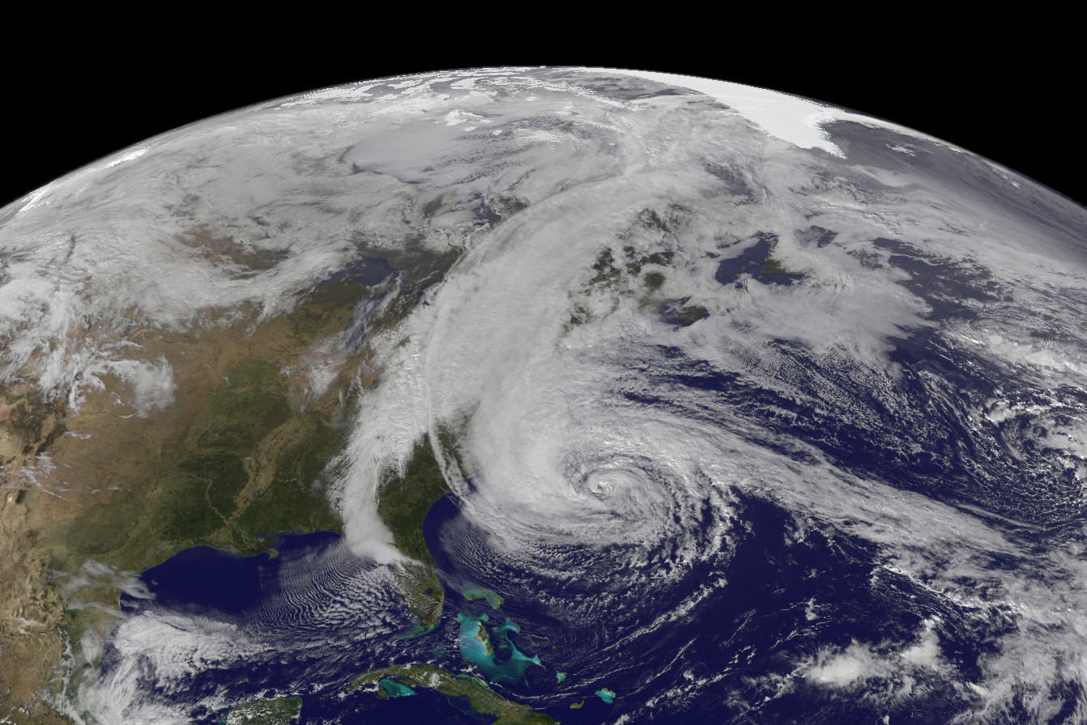
Eye and Eyewall http://en.wikipedia.org/wiki/Tropical_cyclone
“At the center of a mature tropical cyclone, air sinks rather than rises.
For a sufficiently strong storm, air may sink over a layer deep enough to suppress cloud formation, thereby creating a clear "eye".
Weather in the eye is normally calm and free of clouds, although the sea may be extremely violent.
The eye is normally circular in shape, and is typically 30–65 km in diameter, though eyes as small as 3 km and as large as 370 km (230 mi) have been observed.
The cloudy outer edge of the eye is called the "eyewall".
The eyewall typically expands outward with height, resembling an arena football stadium; this phenomenon is sometimes referred to as the stadium effect.
The eyewall is where the greatest wind speeds are found, air rises most rapidly, clouds reach to their highest altitude, and precipitation is the heaviest. “
Hurricane Sandy

Slide 12
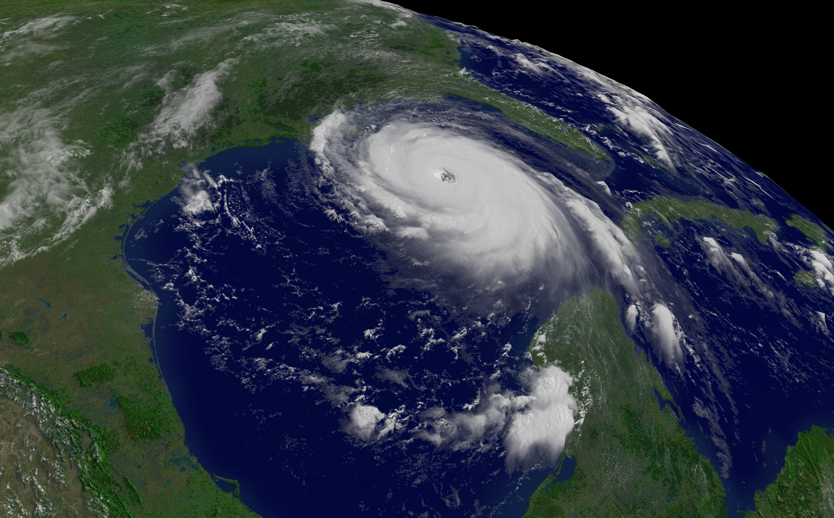
Eye and Eyewall http://en.wikipedia.org/wiki/Tropical_cyclone
“The heaviest wind damage occurs where a tropical cyclone's eyewall passes over land.
In a weaker storm, the eye may be obscured by the central dense overcast, which is the upper-level cirrus shield that is associated with a concentrated area of strong thunderstorm activity near the center of a tropical cyclone.
The eyewall may vary over time in the form of eyewall replacement cycles, particularly in intense tropical cyclones.
Outer rainbands can organize into an outer ring of thunderstorms that slowly moves inward, which is believed to rob the primary eyewall of moisture and angular momentum.
When the primary eyewall weakens, the tropical cyclone weakens temporarily. The outer eyewall eventually replaces the primary one at the end of the cycle, at which time the storm may return to its original intensity.”
Hurricane Katrina

Slide 13
Cyclone Warning Centers http://en.wikipedia.org/wiki/Tropical_cyclone
“There are six Regional Specialized Meteorological Centers (RSMCs) worldwide.
These organizations are designated by the World Meteorological Organization and are responsible for tracking and issuing bulletins, warnings, and advisories about tropical cyclones in their designated areas of responsibility.
In addition, there are six Tropical Cyclone Warning Centers (TCWCs) that provide information to smaller regions.
The RSMCs and TCWCs are not the only organizations that provide information about tropical cyclones to the public.
The Joint Typhoon Warning Center (JTWC) of the US Navy issues advisories in all basins except the Northern Atlantic for the purposes of the United States Government.
The Philippine Atmospheric, Geophysical and Astronomical Services Administration (PAGASA) issues advisories and names for tropical cyclones that approach the Philippines in the Northwestern Pacific to protect the life and property of its citizens.
The Canadian Hurricane Center (CHC) issues advisories on hurricanes and their remnants for Canadian citizens when they affect Canada.”
“On 26 March 2004, Cyclone Catarina became the first recorded South Atlantic cyclone and subsequently struck southern Brazil with winds equivalent to Category 2 on the Saffir-Simpson Hurricane Scale.
As the cyclone formed outside the authority of another warning center, Brazilian meteorologists initially treated the system as an extratropical cyclone, but later on classified it as tropical.”

Slide 14
Cyclone Intensity http://en.wikipedia.org/wiki/Tropical_cyclone
“Storm "intensity" is defined as the maximum wind speed in the storm.
This speed is taken as either a 1-minute or a 10-minute average at the standard reference height of 10 meters.
The choice of averaging period, as well as the naming convention for classifying storms, differs across forecast centers and ocean basins.
There are a variety of metrics commonly used to measure storm size.
The most common metrics include the radius of maximum wind, the radius of 34-knot wind (i.e. gale force), the radius of outermost closed isobar (ROCI), and the radius of vanishing wind.
An additional metric is the radius at which the cyclone's relative vorticity field decreases to 1×10⁻⁵ s⁻¹.”

Slide 15
Saffir Simpson Scale http://en.wikipedia.org/wiki/Tropical_cyclone_scales
“The Saffir-Simpson Hurricane Scale is the classification system used for tropical cyclones in the Atlantic Ocean and in the Pacific Ocean east of the anti-meridian.
The Saffir-Simpson Scale is based on 1-minute maximum sustained wind speeds.
In these oceanic basins, tropical cyclones with maximum sustained winds below 34 kn (39 mph; 63 km/h) are labelled as tropical depressions by either the National Hurricane Center (if it is in the North Atlantic or North-east Pacific Basin) or the Central Pacific Hurricane Center (if located in the North Central Pacific Ocean).
Should a tropical depression reach 35 kn (40 mph; 65 km/h), it will receive a name and will be classified as a tropical storm.
If the tropical storm continues to intensify and reaches maximum sustained winds of 64 kn (74 mph; 119 km/h) then the tropical storm will be designated as a hurricane.”

Slide 16
Western Pacific http://en.wikipedia.org/wiki/Tropical_cyclone_scales
“Any tropical cyclone that develops within the Northern Hemisphere between 180° and 100°E is monitored by the Japan Meteorological Agency's Regional Specialized Meteorological Center in Tokyo, Japan, on behalf of the WMO/ESCAP's Typhoon Committee.
Other warning centres such as the Philippine Atmospheric, Geophysical and Astronomical Services Administration (PAGASA), the China Meteorological Agency (CMA) and the Hong Kong Observatory (HKO) also monitor tropical cyclones developing within the basin.
Both the Joint Typhoon Warning Center (JTWC) and the PAGASA merge the severe tropical storm into the tropical storm category, yet the JTWC has the super typhoon category when wind speed reaches 130 kn (150 mph; 240 km/h).
In addition, the Central Weather Bureau (CWB) has its own scale in Chinese but uses the Typhoon Committee scale in English.”
Although most of agencies use 10-minute maximum sustained wind speed, the JTWC uses 1-minute maximum sustained wind speed and the CMA uses 2-minute maximum sustained wind speed.

Slide 17
Australia & Fiji http://en.wikipedia.org/wiki/Tropical_cyclone_scales
“Any tropical cyclone that forms to the east of 90°E in the Southern Hemisphere is monitored by either the Australian Bureau of Meteorology and/or the Regional Specialized Meteorological Center in Nadi, Fiji.
Both warning centers use the Australian tropical cyclone intensity scale, which measures tropical cyclones using a six category system.
It is based on estimated maximum wind gusts, which are a further 30-40% stronger than the 10-minute average sustained winds.
This is different from the Saffir-Simpson Hurricane Scale, which uses 1-minute maximum sustained winds.
When a tropical cyclone that has wind speeds below 35 knots (65 km/h, 40 mph) forms east of 160°E it is labelled as either a tropical disturbance or a tropical depression by RSMC Nadi.
If it forms to the west of 160°E it is labelled as a tropical low by the Australian Bureau of Meteorology.”

Slide 18
Indian Ocean http://en.wikipedia.org/wiki/Tropical_cyclone_scales

Slide 19
Cyclone Size http://en.wikipedia.org/wiki/Tropical_cyclone
“On Earth, tropical cyclones span a large range of sizes, from 100–2000 km as measured by the radius of vanishing wind.
They are largest on average in the northwest Pacific Ocean basin and smallest in the eastern Pacific Ocean basin.
If the radius of outermost closed isobar is less than two degrees of latitude (222 km (138 mi)), then the cyclone is "very small" or a "midget".
A radius of 3–6 latitude degrees (333–670 km (207–420 mi)) is considered "average sized".
"Very large" tropical cyclones have a radius of greater than 8 degrees (888 km (552 mi)).
Observations indicate that size is only weakly correlated to variables such as storm intensity (i.e. maximum wind speed), radius of maximum wind, latitude, and maximum potential intensity.”
“Size plays an important role in modulating damage caused by a storm.
All else equal, a larger storm will impact a larger area for a longer period of time.
For example, Hurricane Sandy, which struck the eastern U.S. in 2012, barely attained hurricane intensity prior to landfall yet was one of the costliest landfalling hurricanes in U.S. history because of its extremely large size.
The upper circulation of strong hurricanes extends into the tropopause of the atmosphere, which at low latitudes is 50,000-60,000 ft.”

Slide 20
Physics and Energetics http://en.wikipedia.org/wiki/Tropical_cyclone
“The three-dimensional wind field in a tropical cyclone can be separated into two components: a "primary circulation" and a "secondary circulation".
The primary circulation is the rotational part of the flow; it is purely circular.
The secondary circulation is the overturning (in-up-out-down) part of the flow; it is in the radial and vertical directions.
The primary circulation has the strongest winds and is responsible for the majority of the damage a storm causes, while the secondary circulation is slower but governs the energetics of the storm.”
“Scientists estimate that a tropical cyclone releases heat energy at the rate of 50 to 200 exajoules (1018 J) per day, equivalent to about 1 PW (1015 watt).
This rate of energy release is equivalent to 70 times the world energy consumption of humans and 200 times the worldwide electrical generating capacity, or to exploding a 10-megaton nuclear bomb every 20 minutes.”

Slide 21
Carnot Heat Engine http://en.wikipedia.org/wiki/Tropical_cyclone
“A tropical cyclone's primary energy source is the evaporation of water from the ocean surface, which ultimately recondenses into clouds and rain when moist air rises and cools to saturation.
The energetics of the system may be idealized as an atmospheric Carnot heat engine.
First, inflowing air near the surface acquires heat primarily via evaporation of water (i.e. latent heat) at the temperature of the warm ocean surface.
Second, air rises and cools within the eyewall while conserving total heat content (latent heat is simply converted to sensible heat during condensation).
Third, air outflows and loses heat via infrared radiation to space at the temperature of the cold tropopause.
Finally, air subsides and warms at the outer edge of the storm while conserving total heat content. “
“The first and third legs are nearly isothermal, while the second and fourth legs are nearly isentropic (constant entropy)
This in-up-out-down overturning flow is known as the secondary circulation.
The Carnot perspective provides an upper bound on the maximum wind speed that a storm can attain.”

Slide 22
Inside Super Typhoon Utor http://earthobservatory.nasa.gov/NaturalHazards/view.php?id=81909
“CloudSat samples the atmosphere, taking the tiniest vertical slices of clouds and haze and dust and smoke and creating a profile of all that stands between us and space.
This vertical sampling is possible because the satellite carries a radar instrument similar to those used to track storms on the ground, but more than 1,000 times more sensitive.
The profiles reveal the hidden structure of clouds and their distribution and abundance.
It is rare, however, for the satellite to fly directly over the center of a tropical cyclone.
On August 11, 2013, CloudSat did exactly that, capturing a perfect profile of the category 4 Super Typhoon Utor approaching the Philippines.
Since its launch in April 2006, CloudSat has directly intersected the eye of a storm of this intensity and size only a handful of times.”
“NASA's Cloudsat flew directly over super typhoon Utor as it passed over the Philippines.
Using the radar instrument to analyze the cloud structure, NASA scientists reconstructed a side view that reveals the structure of the storm.
The top image was acquired by the MODIS instrument on the Aqua satellite.
Red line is the track of the Cloudsat satellite.”

Slide 23
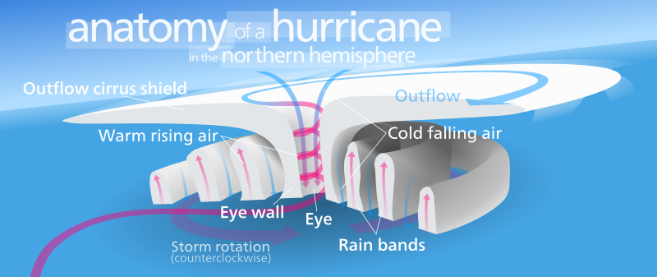
Physics of Cyclones (CAPE)
“In meteorology, convective available potential energy (CAPE), sometimes, simply, available potential energy (APE), is the amount of energy a parcel of air would have if lifted a certain distance vertically through the atmosphere.
CAPE is effectively the positive buoyancy of an air parcel and is an indicator of atmospheric instability, which makes it very valuable in predicting severe weather.
It is a form of fluid instability found in thermally stratified atmospheres in which a colder fluid overlies a warmer one.
When an air mass is unstable, the element of the air mass that is displaced upwards is accelerated by the pressure differential between the displaced air and the ambient air at the (higher) altitude to which it was displaced.
This usually creates vertically developed clouds from convection, due to the rising motion, which can eventually lead to thunderstorms.
It could also be created in other phenomenon, such as a cold front.
Even if the air is cooler on the surface, there is still warmer air in the mid-levels, that can rise into the upper-levels.
However, if there is not enough water vapor present, there is no ability for condensation, thus storms, clouds, and rain will not form.”

Slide 24
Maximum Wind Speed http://en.wikipedia.org/wiki/Tropical_cyclone
“Due to surface friction, the inflow only partially conserves angular momentum.
Thus, the sea surface lower boundary acts as both a source (evaporation) and sink (friction) of energy for the system.
This fact leads to the existence of a theoretical upper bound on the strongest wind speed that a tropical cyclone can attain.
Because evaporation increases linearly with wind speed (just as climbing out of a pool feels much colder on a windy day), there is a positive feedback on energy input into the system known as the Wind-Induced Surface Heat Exchange (WISHE) feedback.
This feedback is offset when frictional dissipation, which increases with the cube of the wind speed, becomes sufficiently large.
For wind speeds above this upper bound, energy loss due to frictional dissipation is larger than energy input due to evaporation, and the storm weakens.”

Slide 25
Interaction with the Oceans http://en.wikipedia.org/wiki/Tropical_cyclone
“The passage of a tropical cyclone over the ocean causes the upper layers of the ocean to cool substantially, which can influence subsequent cyclone development.
This cooling is primarily caused by wind-driven mixing of cold water from deeper in the ocean with the warm surface waters.
This effect results in a negative feedback process that can inhibit further development or lead to weakening.
Additional cooling may come in the form of cold water from falling raindrops (this is because the atmosphere is cooler at higher altitudes).
Cloud cover may also play a role in cooling the ocean, by shielding the ocean surface from direct sunlight before and slightly after the storm passage.
All these effects can combine to produce a dramatic drop in sea surface temperature over a large area in just a few days.”
“Chart displaying the drop in surface temperature in the Gulf of Mexico as Hurricanes Katrina and Rita passed over.”

Slide 26
Tropical Cyclogenesis http://en.wikipedia.org/wiki/Tropical_cyclone
“Worldwide, tropical cyclone activity peaks in late summer, when the difference between temperatures aloft and sea surface temperatures is the greatest.
However, each particular basin has its own seasonal patterns.
On a worldwide scale, May is the least active month, while September is the most active month.
November is the only month in which all the tropical cyclone basins are active.”
11/20/2019

Slide 27
Formation of Tropical Cyclones http://en.wikipedia.org/wiki/Tropical_cyclone
“The formation of tropical cyclones is the topic of extensive ongoing research and is still not fully understood.
While several factors appear to be generally necessary, tropical cyclones may occasionally form without meeting all of the following conditions.
In most situations, water temperatures of at least 26.5 °C (79.7 °F) are needed down to a depth of at least 50 m (160 ft) -- waters of this temperature cause the overlying atmosphere to be unstable enough to sustain convection and thunderstorms.
Another factor is rapid cooling with height, which allows the release of the heat of condensation that powers a tropical cyclone.
High humidity is needed, especially in the lower-to-mid troposphere -- when there is a great deal of moisture in the atmosphere, conditions are more favorable for disturbances to develop.
Low amounts of wind shear are needed, as high shear is disruptive to the storm's circulation.
Tropical cyclones generally need to form more than 555 km (345 mi) or five degrees of latitude away from the equator, allowing the Coriolis effect to deflect winds blowing towards the low pressure center and creating a circulation.”

Slide 28
Role of Disturbed Weather http://en.wikipedia.org/wiki/Tropical_cyclone
“A formative tropical cyclone needs a pre-existing system of disturbed weather.
Tropical cyclones will not form spontaneously.
Low-latitude and low-level westerly wind bursts associated with the Madden-Julian oscillation can create favorable conditions for tropical cyclogenesis by initiating tropical disturbances.
Also, waves in the trade winds in the Atlantic Ocean—areas of converging winds that move along the same track as the prevailing wind—create instabilities in the atmosphere that may lead to the formation of hurricanes”

Slide 29
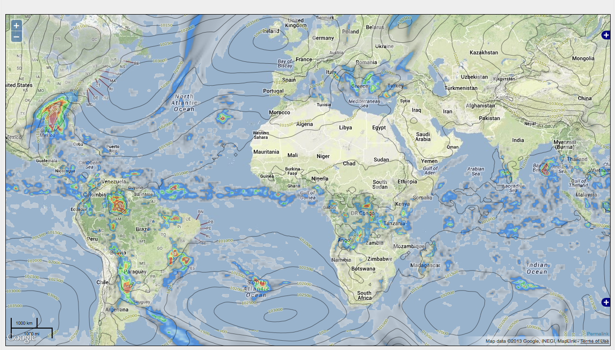
Formation of Cyclones http://en.wikipedia.org/wiki/Tropical_cyclone http://social.openhazards.com http://www.openweathermap.com
“Most tropical cyclones form in a worldwide band of thunderstorm activity near the equator, referred to as the Intertropical Front (ITF), the Intertropical Convergence Zone (ITCZ), or the Monsoon rough.
Another important source of atmospheric instability is found in tropical waves, which contribute to the development of about 85% of intense tropical cyclones in the Atlantic ocean and become most of the tropical cyclones in the Eastern Pacific.
The majority forms between 10 and 30 degrees of latitude away of the equator, and 87% forms no farther away than 20 degrees north or south.
Because the Coriolis effect initiates and maintains their rotation, tropical cyclones rarely form or move within 5 degrees of the equator, where the effect is weakest.
However, it is still possible for tropical systems to form within this boundary as Cyclone Agni and Tropical Storm Vamei did in 2004 and 2010, respectively.”
ICTZ on November 26, 2013

Slide 30
Coriolis Effect http://en.wikipedia.org/wiki/Tropical_
“The Coriolis effect or Coriolis acceleration causes cyclonic systems to turn towards the poles in the absence of strong steering currents.
The poleward portion of a tropical cyclone contains easterly winds, and the Coriolis effect pulls them slightly more poleward.
The westerly winds on the equatorial portion of the cyclone pull slightly towards the equator, but, because the Coriolis effect weakens toward the equator, the net drag on the cyclone is poleward.
Tropical cyclones in the Northern Hemisphere usually turn north (before being blown east), and tropical cyclones in the Southern Hemisphere usually turn south (before being blown east) when no other effects counteract the Coriolis effect.
The Coriolis effect also initiates cyclonic rotation, but unlike the heat of condensation it is not a driving force in bringing this rotation to high speeds.”
“Infrared image of a powerful southern hemisphere cyclone, Monica, near peak intensity, showing clockwise rotation due to the Coriolis effect”

Slide 31
http://en.wikipedia.org/wiki/Tropical_cyclone

Slide 32
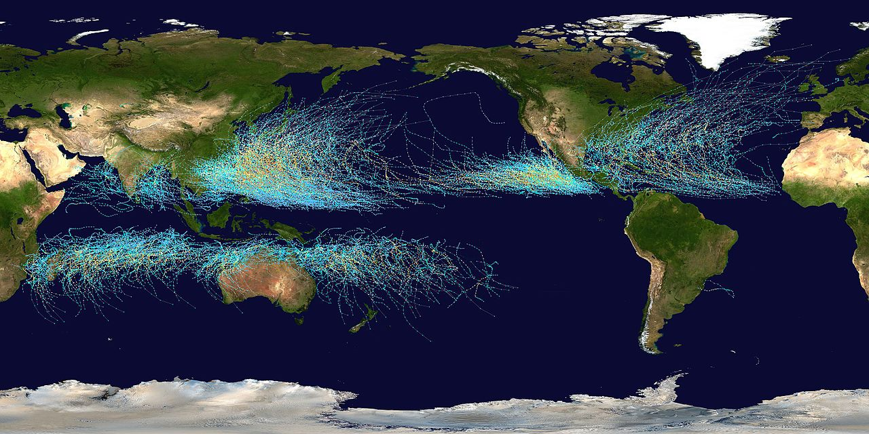
Storm Tracks, 1985-2005 https://en.wikipedia.org/wiki/Tropical_cyclone
Map of the cumulative tracks of all tropical cyclones during the 1985–2005 time period.

Slide 33
“Recurvature” http://en.wikipedia.org/wiki/Tropical_cyclone
“When the cyclone track becomes strongly poleward with an easterly component, the cyclone has begun recurvature.
A typhoon moving through the Pacific Ocean towards Asia, for example, will recurve offshore of Japan to the north, and then to the northeast, if the typhoon encounters southwesterly winds (blowing northeastward) around a low-pressure system passing over China or Siberia.
Many tropical cyclones are eventually forced toward the northeast by extratropical cyclones in this manner, which move from west to east to the north of the subtropical ridge.
This is due to interaction with mid-latitude westerlies”
“Many examples of recurvature can be seen in the record of historic storm tracks”

Slide 34
2013 Pacific Typhoon Season Showing Recurvature http://en.wikipedia.org/wiki/Tropical_cyclone

Slide 35
But Then There was Hurricane Ivan (9/2/2004) http://en.wikipedia.org/wiki/Hurricane_Ivan

Slide 36
Landfall http://en.wikipedia.org/wiki/Tropical_cyclone http://www.usno.navy.mil/JTWC/
“Officially, landfall is when a storm's center (the center of its circulation, not its edge) crosses the coastline.
Storm conditions may be experienced on the coast and inland hours before landfall; in fact, a tropical cyclone can launch its strongest winds over land, yet not make landfall
If this occurs, then it is said that the storm made a direct hit on the coast.
As a result of the narrowness of this definition, the landfall area experiences half of a land-bound storm by the time the actual landfall occurs.
For emergency preparedness, actions should be timed from when a certain wind speed or intensity of rainfall will reach land, not from when landfall will occur.”
“Typhoon USAGI, September 20, 2013
USAGI was a Cat-5 Storm with maximum wind speeds of 150 mph
(Joint Typhoon Warning Center Graphic)”

Slide 37
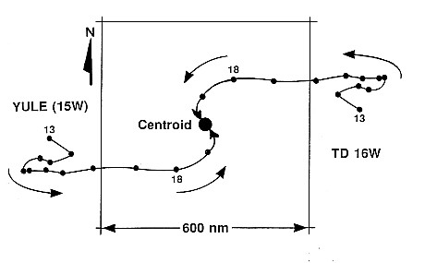
Multiple Storm Interactions http://en.wikipedia.org/wiki/Fujiwhara_effect
Severe Tropical Storm Parma and Typhoon Melor on 10/6/2009
“When two cyclones approach one another, their centers will begin orbiting cyclonically about a point between the two systems.
The two vortices will be attracted to each other, and eventually spiral into the center point and merge.
When the two vortices are of unequal size, the larger vortex will tend to dominate the interaction, and the smaller vortex will orbit around it.
This phenomenon is called the Fujiwhara effect, after Sakuhei Fujiwhara”
Fujiwhara diagram of interacting storms

Slide 38
Dissipation of Cyclones http://en.wikipedia.org/wiki/Tropical_cyclone
“A tropical cyclone can cease to have tropical characteristics in several different ways.
One such way is if it moves over land, thus depriving it of the warm water it needs to power itself, quickly losing strength.
Most strong storms lose their strength very rapidly after landfall and become disorganized areas of low pressure within a day or two, or evolve into extratropical cyclones.
There is a chance a tropical cyclone could regenerate if it managed to get back over open warm water, such as with Hurricane Ivan.
Without warm surface water, the storm cannot survive.
A tropical cyclone can dissipate when it moves over waters significantly below 26.5 °C (79.7 °F).
This will cause the storm to lose its tropical characteristics, such as a warm core with thunderstorms near the center, and become a remnant low-pressure area.
These remnant systems may persist for up to several days before losing their identity. This dissipation mechanism is most common in the eastern North Pacific.”

Slide 39
Shear Dissipation http://en.wikipedia.org/wiki/Tropical_cyclone
“Weakening or dissipation can occur if it experiences vertical wind shear, causing the convection and heat engine to move away from the center
Wind shear is higher during El Nino years in the Atlantic basin
This normally ends the development of a tropical cyclone.
In addition, its interaction with the main belt of the Westerlies, by means of merging with a nearby frontal zone, can cause tropical cyclones to evolve into extratropical cyclones.
This transition can take 1–3 days.
Even after a tropical cyclone is said to be extratropical or dissipated, it can still have tropical storm force (or occasionally hurricane/typhoon force) winds and drop several inches of rainfall.
In the Pacific Ocean and Atlantic Ocean, such tropical-derived cyclones of higher latitudes can be violent and may occasionally remain at hurricane or typhoon-force wind speeds when they reach the west coast of North America. “
“Tropical Storm Franklin, an example of a strongly sheared tropical cyclone in the North Atlantic hurricane basin during 2005”

Slide 40
Hurricane Wind Speeds and Power Law Statistics http://pubs.usgs.gov/fs/natural-disasters/
“106 years of storm data for Tampa Bay region, Florida provides the basis for establishing scaling laws for wind speed and time intervals between storms.
The insight provided by a log-log plot of data is shown (above) for maximum wind speed (on left) and for time intervals between storms (on right).
Traditionally, data are plotted on a histogram plot (A and D).
Structure in the data becomes apparent when data are replotted on logarithmic scales where two populations become clear (B) and scaling is revealed (E).
Axes on the plot are converted to probability in (C and F) which permits extrapolation to forecast the probability of greater wind speeds and time intervals between storms. (Data from NOAA).”
Analysis by C. Barton and S. Nishenko

Slide 41
Hurricane Frequency http://pubs.usgs.gov/fs/natural-disasters/
“The frequency of Florida hurricanes with wind speeds greater than or equal to 100 knots is mapped in terms of the probability of occurrence during a 20 year exposure window.
These probabilistic estimates, based on 106 years of observations, illustrate that hurricanes with 100 knot winds occur more frequently in southern Florida, and gradually decrease in frequency towards northern Florida.”

Slide 42
Forecast Accuracy http://en.wikipedia.org/wiki/Tropical_cyclone
“Because of the forces that affect tropical cyclone tracks, accurate track predictions depend on determining the position and strength of high- and low-pressure areas, and predicting how those areas will change during the life of a tropical system.
The deep layer mean flow, or average wind through the depth of the troposphere, is considered the best tool in determining track direction and speed.
If storms are significantly sheared, use of wind speed measurements at a lower altitude, such as at the 70 kPa pressure surface (3,000 metres or 9,800 feet above sea level) will produce better predictions.
Tropical forecasters also consider smoothing out short-term wobbles of the storm as it allows them to determine a more accurate long-term trajectory.
High-speed computers and sophisticated simulation software allow forecasters to produce computer models that predict tropical cyclone tracks based on the future position and strength of high- and low-pressure systems. “
“Combining forecast models with a wealth of data from Earth-orbiting satellites and other sensors, scientists have increased the accuracy of track forecasts over recent decades.
However, scientists are not as skillful at predicting the intensity of tropical cyclones.
The lack of improvement in intensity forecasting is attributed to the complexity of tropical systems and an incomplete understanding of factors that affect their development.”

Slide 43
Long Term Activity Trends http://en.wikipedia.org/wiki/Tropical_cyclone
“The number and strength of Atlantic hurricanes may undergo a 50–70 year cycle, also known as the Atlantic Multidecadal Oscillation.
Nyberg et al. reconstructed Atlantic major hurricane activity back to the early 18th century and found five periods averaging 3–5 major hurricanes per year and lasting 40–60 years, and six other averaging 1.5–2.5 major hurricanes per year and lasting 10–20 years.
These periods are associated with the Atlantic multidecadal oscillation.
Throughout, a decadal oscillation related to solar irradiance was responsible for enhancing/dampening the number of major hurricanes by 1–2 per year.”
Atlantic Multidecadal Oscillation Timeseries, 1856–2009
“The combined effects of ship destruction and remote landfall severely limit the number of intense hurricanes in the official record before the era of hurricane reconnaissance aircraft and satellite meteorology.
Although the record shows a distinct increase in the number and strength of intense hurricanes, therefore, experts regard the early data as suspect.”

Slide 44
Recent Activity Trends http://en.wikipedia.org/wiki/Tropical_cyclone
“While the number of storms in the Atlantic has increased since 1995, there is no obvious global trend
the annual number of tropical cyclones worldwide remains about 87 ± 10 (Between 77 and 97 tropical cyclones annually).
However, the ability of climatologists to make long-term data analysis in certain basins is limited by the lack of reliable historical data in some basins, primarily in the Southern Hemisphere.
In spite of that, there is some evidence that the intensity of hurricanes is increasing.
Kerry Emanuel stated, ‘Records of hurricane activity worldwide show an upswing of both the maximum wind speed in and the duration of hurricanes.’
Furthermore, ‘the energy released by the average hurricane (again considering all hurricanes worldwide) seems to have increased by around 70% in the past 30 years or so, corresponding to about a 15% increase in the maximum wind speed and a 60% increase in storm lifetime.’”
“Atlantic Multidecadal Cycle since 1950, using accumulated cyclone energy (ACE)”
“Atlantic storms are becoming more destructive financially, as evidenced by the fact that five of the ten most expensive storms in United States history have occurred since 1990.
According to the World Meteorological Organization, "recent increase in societal impact from tropical cyclones has been caused largely by rising concentrations of population and infrastructure in coastal regions.”

Slide 45
Influence of Global Warming (controversial) http://en.wikipedia.org/wiki/Tropical_cyclone
According to IPCC 2012, "attribution of single extreme events to anthropogenic climate change is challenging”.
On one hand, the report said that there is "medium evidence" that long-term trends in normalized losses have not been attributed to tropical and extratropical [winter] storms.
On the other hand, the report also noted that much more research is needed in part due to "confounding factors" that might have increased losses, such as increased population and development in at-risk areas, and those that might have decreased losses, such as better forecasting, emergency alert systems, emergency management, building codes, and near-instantaneous media coverage of weather emergencies.
The report also noted that storm surges are already worse due to sea level rise, and that windspeed of tropical cyclones will likely increase, as will total rainfall in extreme events.
Other reports indicate that there is evidence for a causal connection.
The U.S. National Oceanic and Atmospheric Administration Geophysical Fluid Dynamics Laboratory performed a simulation to determine if there is a statistical trend in the frequency or strength of tropical cyclones over time.
The simulation concluded "the strongest hurricanes in the present climate may be upstaged by even more intense hurricanes over the next century as the earth's climate is warmed by increasing levels of greenhouse gases in the atmosphere”.

Slide 46
Remote Observations
“Intense tropical cyclones pose a particular observation challenge, as they are a dangerous oceanic phenomenon, and weather stations, being relatively sparse, are rarely available on the site of the storm itself.
In general, surface observations are available only if the storm is passing over an island or a coastal area, or if there is a nearby ship.
Real-time measurements are usually taken in the periphery of the cyclone, where conditions are less catastrophic and its true strength cannot be evaluated.
For this reason, there are teams of meteorologists that move into the path of tropical cyclones to help evaluate their strength at the point of landfall.
Tropical cyclones far from land are tracked by weather satellites capturing visible and infrared images from space, usually at half-hour to quarter-hour intervals.
As a storm approaches land, it can be observed by land-based Doppler weather radar.
Radar plays a crucial role around landfall by showing a storm's location and intensity every several minutes.”

Slide 47
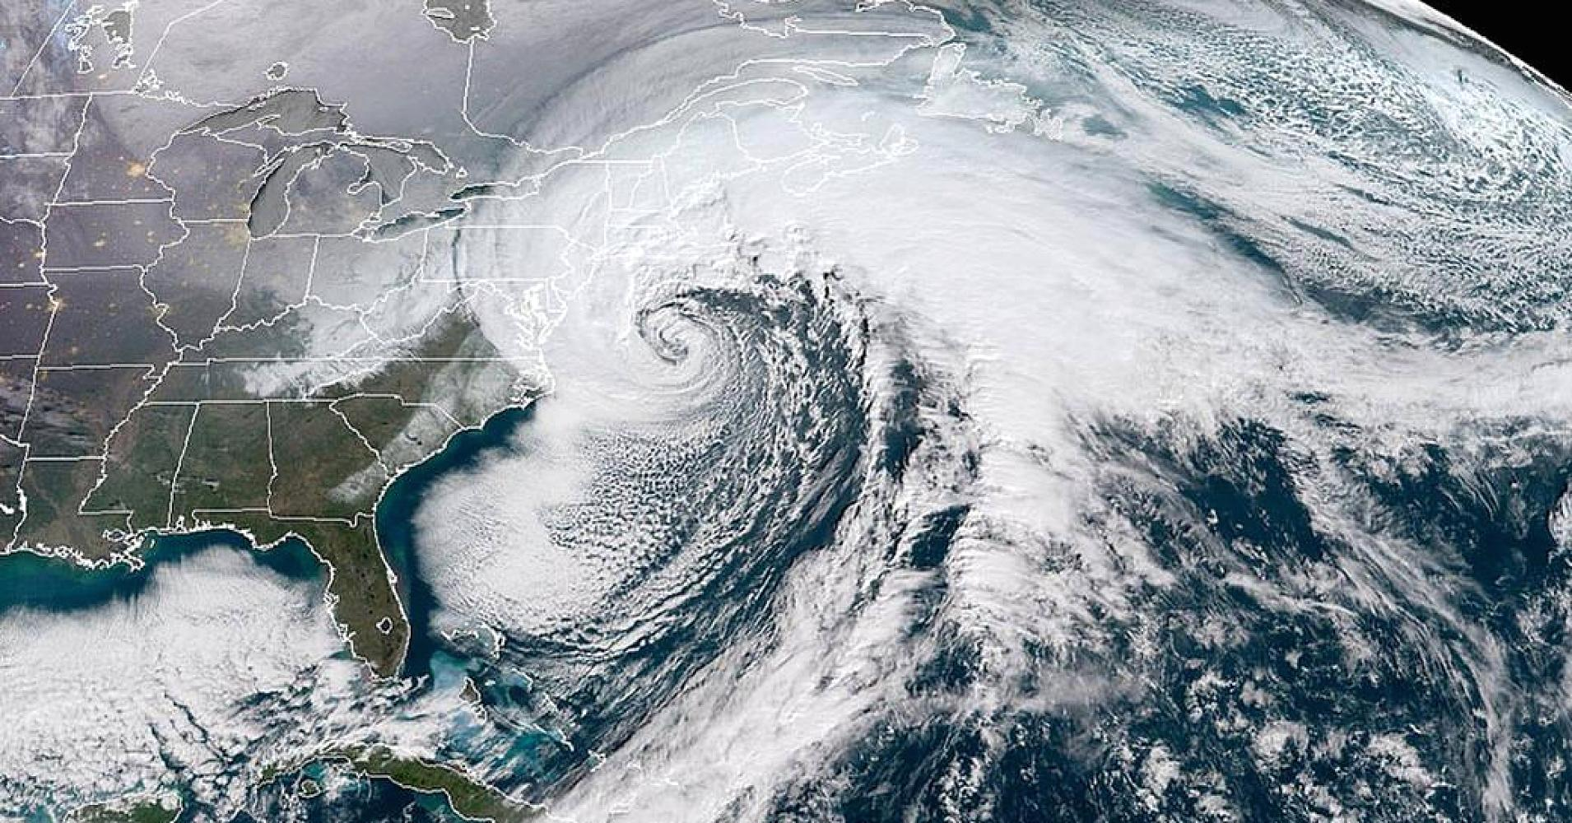
The East Coast “Bomb Cyclone” January 4, 2018 A different kind of cold weather vortex

Slide 48
Bomb Cyclone Details
The National Oceanic and Atmospheric Administration (NOAA) GOES-16 satellite caught a dramatic view of the bomb cyclone moving up the East Coast on Jan. 4, 2017.
The powerful nor'easter struck coastal areas with heavy snow and strong winds, from Florida to Maine.
Notice the long line of clouds stretching over a thousand miles south of the storm, which is drawing moisture all the way from deep in the Caribbean.
Why is it called a "bomb cyclone"? Meteorologists say that a storm undergoes "bombogenesis" when it rapidly intensifies over a short period.
More precisely, it's a mid-latitude cyclone that sees its central pressure drop 24 millibars or more within 24 hours, in this case to about 950 hPa.
Storms like this typically bring heavy precipitation, strong winds, and coastal storm surge and are common along the East Coast during the winter months.
The Geostationary Operational Environmental Satellite (GOES) – R Series is a collaborative development and acquisition effort between NOAA and NASA.
Image Credit: NOAA/CIRA

Slide 49
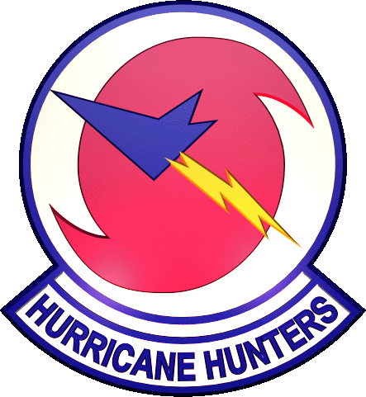
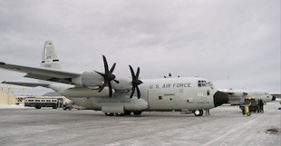
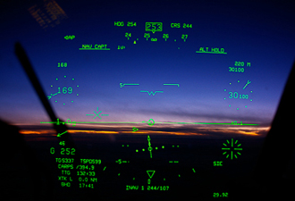
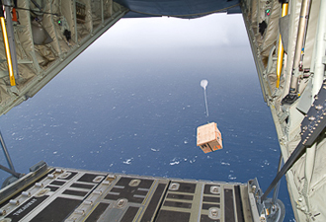
Hurricane Hunters
“In situ measurements, in real-time, can be taken by sending specially equipped reconnaissance flights into the cyclone.
In the Atlantic basin, these flights are regularly flown by United States government hurricane hunters.
The aircraft used are WC-130 Hercules and WP-3D Orions, both four-engine turboprop cargo aircraft.
These aircraft fly directly into the cyclone and take direct and remote-sensing measurements.
The aircraft also launch GPS dropsondes inside the cyclone.
These sondes measure temperature, humidity, pressure, and especially winds between flight level and the ocean's surface.
A new era in hurricane observation began when a remotely piloted Aerosonde, a small drone aircraft, was flown through Tropical Storm Ophelia as it passed Virginia's Eastern Shore during the 2005 hurricane season.
A similar mission was also completed successfully in the western Pacific ocean.
This demonstrated a new way to probe the storms at low altitudes that human pilots seldom dare.”

Slide 50
History of the Hurricane Hunters 53rd Weather Reconaissance Squadron (USAF)
“The 1943 Surprise Hurricane, which struck Houston, Texas, during World War II, marked the first intentional meteorological flight into a hurricane.
It started with a bet.
That summer, British pilots were being trained in instrument flying at Bryan Field.
When they saw that the Americans were evacuating their AT-6 Texan trainers in the face of the storm, they began questioning the construction of the aircraft.
Colonel Joe Duckworth took one of the trainers out and flew it straight into the eye of the storm.
After he returned safely with navigator Lt. Ralph O'Hair, the base's weather officer, Lt. William Jones-Burdick, took over the navigator's seat and Duckworth flew into the storm a second time.
This flight showed that hurricane reconnaissance flights were possible, and further flights continued occasionally.
In 1946, the moniker "Hurricane Hunters" was first used, and the Air Force and now Air Force Reserve have used it ever since.”
WB-29 on approach to Kindley Field, Bermuda, ca. 1952
(Rundle Family Archives)
http://en.wikipedia.org/wiki/Hurricane_Hunters

Slide 51
History of the Hurricane Hunters 53rd Weather Reconaissance Squadron (USAF), ca. 1952
Capt. Russ Vernoy (L, pilot), Capt. David Rundle (C, weather officer), and Capt. Les Vohses (R, co-pilot) conferring in flight
Capt. David Rundle

Slide 52
Life with the Hurricane Hunters (1953)
Ladies fashion show, officers club, Kindley Field (ca. 1953)

Slide 53
Bermuda http://en.wikipedia.org/wiki/Bermuda
Queen of Bermuda in Hamilton Harbor,
ca. December1952/January1953

Slide 54
RAF Burtonwood http://en.wikipedia.org/wiki/RAF_Burtonwood
“On 7 November 1953 the USAF 53rd Weather Reconnaissance Squadron was transferred to RAF Burtonwood airbase from Bermuda
The squadron flew WB-29 then WB-50D Superfortresses.
The squadron was assigned to collecting weather data that was transmitted to weather stations for use in preparing forecasts required for the Air Force Military Air Transport Service (MATS) and the US Weather Bureau.
Burtonwood airfield was opened on 1 January 1940 as a servicing and storage centre for the modification of British aircraft.
Burtonwood was the largest airfield in Europe during the war with the most USAAF personnel and aircraft maintenance facilities.
The roar of the engines in the test beds could be heard for miles around, especially at night.
By the end of the war 18,000 servicemen were stationed at Burtonwood.”
“We left Bermuda for Burtonwood Airfield on the USS General Hodges, a converted troop ship in 1953
The Atlantic crossing was rough and many of us were seasick
RAF Burtonwood was the staging area for most of the allied bombing raids on Nazi Germany during WWII”

Slide 55
RAF Burtonwood Airfield Today http://en.wikipedia.org/wiki/RAF_Burtonwood
The old runways are overgrown with weeds
The hangers are now used as storage bunkers

Slide 56
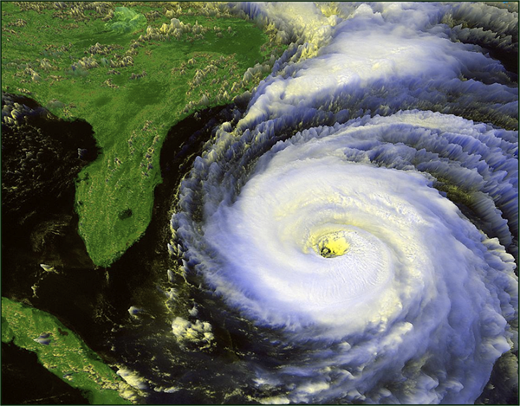
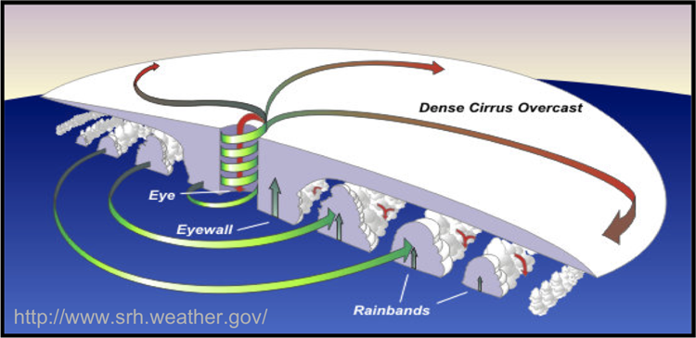
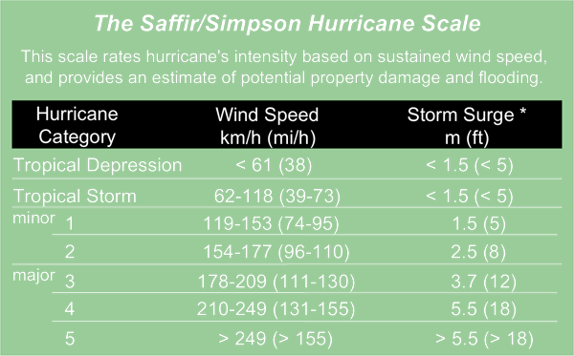
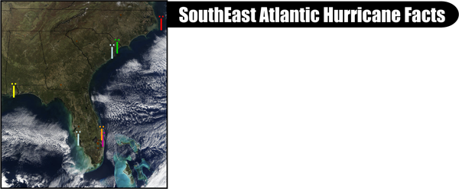
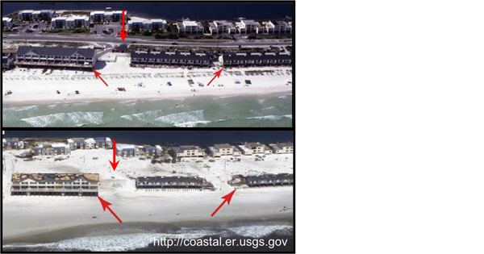
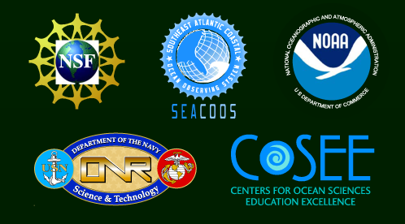
FORMING HURRICANES
What is a Hurricane ?
What causes Hurricanes ?
A hurricane is the most intense form of a tropical cyclone with sustained winds exceeding 120 kilometers per hour (74 mph) that rotate around a strong atmospheric low-pressure system. Hurricanes are accompanied by several hazards (below). North of the equator, hurricanes spin counterclockwise; south of the equator, clockwise. The word comes from the Carib for strong wind, Huracan.
Atlantic hurricanes form from atmospheric disturbances, usually off the west coast of Africa but also in the Caribbean Sea and Gulf of Mexico. Hurricanes also form in the tropical Pacific, where they are called typhoons. Hurricanes are fueled by water vapor rising from warm ocean water (27°C, 80°F). These vapors form clouds and rain that warm the surrounding air. If upper level winds are light and unchanging, the system intensifies causing warm wind to move toward the low-pressure center. The air spins under the action of the rotating Earth (Coriolis) causing the storm to grow. The energy organizes into bands of thunderstorms that expand upward and outward of the low-pressure center encircling the eye. Hurricanes can last two weeks over warm ocean waters, but will subside over cooler waters or land. Ocean observing systems provide vital data to scientists indicating when and where hurricanes form, intensify and move. This information is used for hurricane preparedness (evacuations) and research.
Anatomy of a Hurricane
Eye: The hurricane’s center can be amazingly clear and calm enough for people to see blue skies above. It can be as large as 65 kilometers (40 miles) across.
Eyewall (also called the Wall Cloud): The dense wall of thunderclouds that define the eye holds the highest wind speeds and controls the size of the eye.
Rainbands: The outer and less severe bands of thunderstorms can range in size from 80 to 500 kilometers (50-300 miles).
Hurricane Fran, 16 September 1996
http://rsd.gsfc.nasa.gov
Hazards of a Hurricane
* Could be less or significantly larger depending on direction and speed of approach, point of landfall and storm radius.
High Winds: The hazard most associated with hurricanes are defined under the Saffir-Simpson scale (to the far right). Hurricane-force winds can easily destroy poorly constructed buildings.
Storm Surge: A rapid rise in sea level forced on land by high winds that cause flooding. Storm surges are the worst of hurricane hazards, claiming the most fatalities.
Heavy Rains: Rainfall levels of 15-30 centimeters (6-12 inches) are common, but can reach 115 centimeters (45 inches). Heavy rainfall can lead to significant flooding in low-lying areas.
Tornadoes: Over half of the hurricanes that reach land produce at least one tornado. These tornadoes tend to be less intense than those occurring in the Great Plains.
For Hurricane Safety and Preparedness Guides, please visit http://www.nws.noaa.gov/om/brochures/hurr.pdf and
http://www.fema.gov/areyouready/
The official Atlantic hurricane season begins on June 1 and ends November 30, but peak season is from mid-August until October.
The naming of hurricanes using alternating male and female names and moving through the alphabet began in 1979. There are 6 lists of names (reused every 6 years) that are used by the National Hurricane Center. These have been endorsed by the World Meteorological Organization.
On average, 5 hurricanes make landfall from Maine to Texas every 3 years. However in 2004, 6 hurricanes came onshore from North Carolina to Florida alone (to the left). A record level of activity has been noted during the first two months of the 2005 Atlantic hurricane season.
Since 1950, 48 hurricanes have made landfall from North Carolina to Florida. Of those, 16 were major (Categories 3-5). Hurricanes in 2004 caused 117 deaths and $42 billion in damage in the U.S. alone.
Storms bringing hurricane conditions onshore from North Carolina to Florida. Symbols ( Ï ) define areas where hurricanes were over land and water. The Hurricanes were: Alex, Charley, Frances, Gaston, Ivan and Jeanne.
Poster Credits: Poster Design: David Palandro, USF
Poster Template: Patty Snow, SCSGC
For Classroom lessons and hurricane information: www.seacoos.org SouthEast Atlantic Coastal Ocean Observing System

Slide 57
Physics of CAPE http://en.wikipedia.org/wiki/Convective_Available_Potential_Energy
A skew-T plot showing a morning sounding with a large hydrolapse followed by an afternoon sounding showing the cooling (red curve moving to the left) which occurred in the mid-levels resulting in an unstable atmosphere as surface parcels have now become negatively buoyant. The red line is temperature, the green line is the dew point, and the yellow line is the air parcel lifted.
“Hydrolapse” = change in moisture content

