Slide 1
Lecture 18
Atmospheric Science (Overview)
John Rundle GEL/EPS 131

Slide 2
Atmospheric Composition http://en.wikipedia.org/wiki/Atmospheric_sciences
The composition and chemistry of the atmosphere is of importance because of the interactions between the atmosphere and living organisms.
The composition of the atmosphere has been changed by human activity and some of these changes are harmful to human health, crops and ecosystems.
Examples of problems which have been addressed by atmospheric chemistry include acid rain, photochemical smog and global warming.

Slide 3
Atmospheric Physics http://en.wikipedia.org/wiki/Atmospheric_sciences
Atmospheric physicists model Earth's atmosphere and the atmospheres of the other planets using fluid flow equations, chemical models, radiation balancing, and energy transfer processes in the atmosphere (as well as how these tie into other systems such as the oceans).
In order to model weather systems, atmospheric physicists employ elements of scattering theory, wave propagation models, cloud physics, statistical mechanics and spatial statistics.
It has close links to meteorology and climatology and also covers the design and construction of instruments for studying the atmosphere and the interpretation of the data they provide, including remote sensing instruments.

Slide 4
Remote Sensing http://en.wikipedia.org/wiki/Atmospheric_sciences
Remote sensing is the small or large-scale acquisition of information of an object or phenomenon, by the use of either recording or real-time sensing device(s) that is not in physical or intimate contact with the object (such as by way of aircraft, spacecraft, satellite, buoy, or ship).
Earth observation or weather satellite collection platforms, ocean and atmospheric observing weather buoy platforms, monitoring of a pregnancy via ultrasound, Magnetic Resonance Imaging (MRI), Positron Emission Tomography (PET), and space probes are all examples of remote sensing.
In modern usage, the term generally refers to the use of imaging sensor technologies including but not limited to the use of instruments aboard aircraft and spacecraft.
Weather radar image of Hurricane Abby, 1960

Slide 5
Types of Remote Sensing http://en.wikipedia.org/wiki/Atmospheric_sciences
There are two kinds of remote sensing.
Passive sensors detect natural radiation that is emitted or reflected by the object or surrounding area being observed.
Reflected sunlight is the most common source of radiation measured by passive sensors.
Examples of passive remote sensors include film photography, infra-red, charge-coupled devices, and radiometers.
Active collection, on the other hand, emits energy in order to scan objects and areas whereupon a passive sensor then detects and measures the radiation that is reflected or backscattered from the target.
Radar is an example of active remote sensing where the time delay between emission and return is measured, establishing the location, height, speed and direction of an object.

Slide 6
Uses of Remote Sensing http://en.wikipedia.org/wiki/Atmospheric_sciences
Remote sensing makes it possible to collect data on dangerous or inaccessible areas.
Applications include monitoring deforestation in areas such as the Amazon Basin, the effects of climate change on glaciers and Arctic and Antarctic regions, and depth sounding of coastal and ocean depths.
Remote sensing also replaces costly and slow data collection on the ground, ensuring in the process that areas or objects are not disturbed.
Orbital platforms collect and transmit data from different parts of the electromagnetic spectrum
Researchers use remote sensing to monitor trends such as El Niño and other natural long and short term phenomena.
Other uses include different areas of the earth sciences such as natural resource management, agricultural fields such as land usage and conservation, and national security and overhead, ground-based and stand-off collection on border areas.

Slide 7
Example: Tacloban, Philippines Before and After Super Typhoon Haiyan/Yolanda of November 8, 2013 http://earthobservatory.nasa.gov/IOTD/view.php?id=82420&eocn=home&eoci=iotd_image Images acquired by the ASTER instrument on NASA’s Terra Satellite (ASTER: Advanced Spaceborne Thermal Emission and Reflection Radiometer)
April 3, 2004
November 15, 2013
Vegetation is red, urban areas are white and silver, and bare ground is tan in these images.
Notes:
Start here 2017/11/08

Slide 8
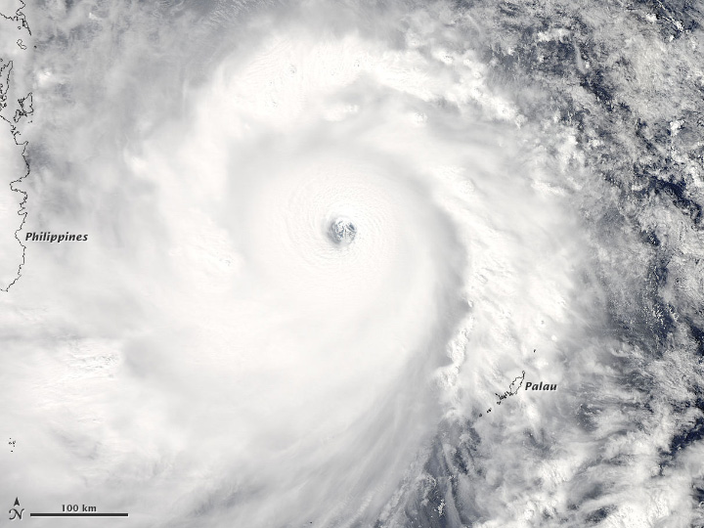
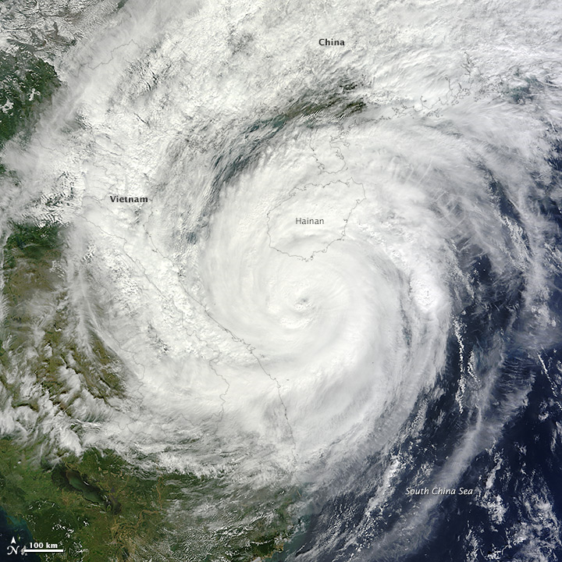
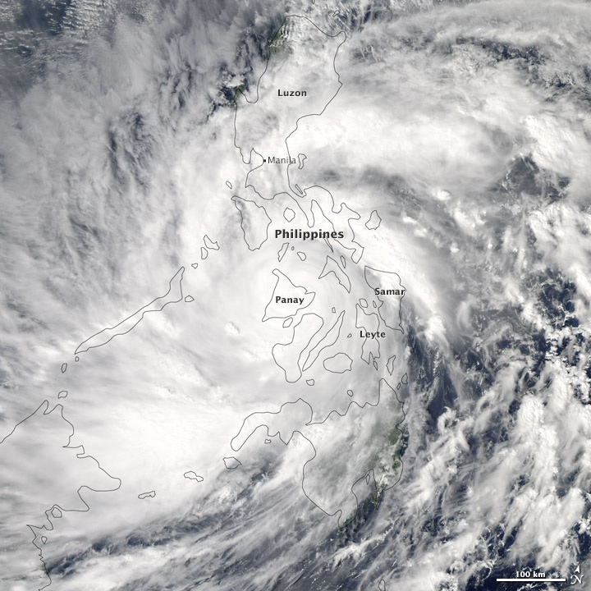
Images of Super Typhoon Haiyan/Yolanda Acquired by NASA’s MODIS instrument on the Aqua Satellite
Approaching the Philippines
Over the
Philippines
Making landfall over Vietnam
MODIS: Moderate Resolution Imaging SpectroRadiometer

Slide 9
Atmospheric Electricity http://en.wikipedia.org/wiki/Atmospheric_sciences
“Atmospheric electricity is the regular diurnal variations of the Earth's atmospheric electromagnetic network (or, more broadly, any planet's electrical system in its layer of gases).
The Earth's surface, the ionosphere, and the atmosphere is known as the global atmospheric electrical circuit.
Lightning discharges 30,000 amperes, at up to 100 million volts, and emits light, radio waves, x-rays and even gamma rays.
Plasma temperatures in lightning can approach 28,000 kelvins and electron densities may exceed 1024/m³.
Lightning is a massive electrostatic discharge between the electrically charged regions within clouds or between a cloud and the Earth's surface.
The charged regions within the atmosphere temporarily equalize themselves through a lightning flash, commonly referred to as a strike if it hits an object on the ground.
There are three primary types of lightning; from a cloud to itself (intra-cloud or IC); from one cloud to another cloud (CC) and between a cloud and the ground (CG).
Although lightning is always accompanied by the sound of thunder, distant lightning may be seen but be too far away for the thunder to be heard.
Lightning occurs approximately 40–50 times a second worldwide, resulting in nearly 1.4 billion flashes per year.”

Slide 10
Global Intensity of Lightning Strikes http://en.wikipedia.org/wiki/Lightning

Slide 11
Lightning Discharges http://en.wikipedia.org/wiki/Lightning
“A typical cloud to ground lightning flash culminates in the formation of an electrically conducting plasma channel through the air in excess of 5 kilometres tall, from within the cloud to the ground's surface.
The actual discharge is the final stage of a very complex process.
At its peak, a typical thunderstorm produces three or more strikes to the Earth per minute.
Lightning primarily occurs when warm air is mixed with colder air masses, resulting in atmospheric disturbances necessary for polarizing the atmosphere.
However, it can also occur during dust storms, forest fires, tornadoes, volcanic eruptions, and even in the cold of winter, where the lightning is known as thundersnow.
Hurricanes typically generate some lightning, mainly in the rainbands as much as 160 kilometres (99 mi) from the center.
The science of lightning is called fulminology, and the fear of lightning is called astraphobia.”
Four-second video of a lightning strike, Island in the Sky, Canyonlands National Park, Utah, United States.

Slide 12
Physics of Lightning http://en.wikipedia.org/wiki/Lightning
“About 70% of lightning occurs over land in the tropics where atmospheric convection is the greatest.
This occurs from both the mixture of warmer and colder air masses, as well as differences in moisture concentrations, and it generally happens at the boundaries between them.
The flow of warm ocean currents past drier land masses, such as the Gulf Stream, partially explains the elevated frequency of lightning in the Southeast United States.
Because the influence of small or absent land masses in the vast stretches of the world's oceans limits the differences between these variants in the atmosphere, lightning is notably less frequent there than over larger landforms.
The North and South Poles are limited in their coverage of thunderstorms and therefore result in areas with the least amount of lightning.
In general, cloud-to-ground (CG) lightning flashes account for only 25% of all total lightning flashes worldwide.
Since the base of a thunderstorm is usually negatively charged, this is where most CG lightning originates, and this region is typically at the elevation where freezing occurs within the cloud.
Freezing, combined with collisions between ice and water, appears to be a critical part of the initial charge development and separation process.
During wind-driven collisions, ice crystals tend to develop a positive charge, while a heavier, slushy mixture of ice and water (called graupel) develops a negative charge.
Updrafts within a storm cloud separate the lighter ice crystals from the heavier graupel, causing the top region of the cloud to accumulate a positive space charge while the lower level accumulates a negative space charge.”

Slide 13
Atmospheric Circulation http://en.wikipedia.org/wiki/Atmospheric_circulation
“Atmospheric circulation is the large-scale movement of air, and the means (together with the smaller ocean circulation) by which thermal energy is distributed on the surface of the Earth.
The large-scale structure of the atmospheric circulation varies from year to year, but the basic climatological structure remains fairly constant.
Individual weather systems – mid-latitude depressions, or tropical convective cells – occur "randomly”
It is accepted that weather cannot be predicted beyond a fairly short limit: perhaps a month in theory, or (currently) about ten days in practice (see Chaos theory and Butterfly effect).
Nonetheless, as the climate is the average of these systems and patterns – where and when they tend to occur again and again – it is stable over longer periods of time.”

Slide 14
Atmospheric Circulation http://en.wikipedia.org/wiki/Atmospheric_circulation
“As a rule, the "cells" of Earth's atmosphere shift polewards in warmer climate periods (e.g. interglacials compared to glacials), but remain largely constant even due to continental drift
They are, fundamentally, a property of the Earth's size, rotation rate, heating and atmospheric depth, all of which change little.
Tectonic uplift can significantly alter major elements of the circulation patterns, i.e., the jet stream.
Plate tectonics shift ocean currents.
In the extremely hot climates of the Mesozoic, indications of a third desert belt at the Equator has been found; it was perhaps caused by convection.
But even then, the overall latitudinal pattern of Earth's climate was not much different from the one today.”

Slide 15
Hadley Cell http://en.wikipedia.org/wiki/Atmospheric_circulation
“The Hadley cell mechanism is well understood.
The atmospheric circulation pattern that George Hadley described to provide an explanation for the trade winds matches observations very well.
It is a closed circulation loop, which begins at the equator with warm, moist air lifted aloft in equatorial low pressure areas (the Intertropical Convergence Zone, ITCZ) to the tropopause and carried poleward.
At about 30°N/S latitude, it descends in a high pressure area.
Some of the descending air travels equatorially along the surface, closing the loop of the Hadley cell and creating the Trade Winds.
Though the Hadley cell is described as lying on the equator, it is more accurate to describe it as following the sun’s zenith point, or what is termed the "thermal equator," which undergoes a semiannual north-south migration.”

Slide 16
Polar Cell http://en.wikipedia.org/wiki/Atmospheric_circulation
“The Polar cell is also a simple system.
Though cool and dry relative to equatorial air, air masses at the 60th parallel are still sufficiently warm and moist to undergo convection and drive a thermal loop.
Air circulates within the troposphere, limited vertically by the tropopause at about 8 km.
Warm air rises at lower latitudes and moves poleward through the upper troposphere at both the north and south poles.
When the air reaches the polar areas, it has cooled considerably, and descends as a cold, dry high pressure area, moving away from the pole along the surface but twisting westward as a result of the Coriolis effect to produce the Polar easterlies.
The outflow from the cell creates harmonic waves in the atmosphere known as Rossby waves.
These ultra-long waves play an important role in determining the path of the jet stream, which travels within the transitional zone between the tropopause and the Ferrel cell.
By acting as a heat sink, the Polar cell also balances the Hadley cell in the Earth’s energy equation.”

Slide 17
Hadley and Polar Cells http://en.wikipedia.org/wiki/Atmospheric_circulation
“It can be argued that the Polar cell is the primary weathermaker for regions above the middle northern latitudes.
It is the polar high which is responsible for generating the coldest temperature recorded on Earth: -89.2°C at Vostok Station in 1983 in Antarctica.
The Hadley cell and the Polar cell are similar in that they are thermally direct; in other words, they exist as a direct consequence of surface temperatures; their thermal characteristics override the effects of weather in their domain.
The sheer volume of energy the Hadley cell transports, and the depth of the heat sink that is the Polar cell, ensures that the effects of transient weather phenomena are not only not felt by the system as a whole, but — except under unusual circumstances — are not even permitted to form.
The endless chain of passing highs and lows which is part of everyday life for mid-latitude dwellers is unknown above the 60th and below the 30th parallels.
These atmospheric features are also stable, so even though they may strengthen or weaken regionally or over time, they do not vanish entirely.”
2/27/2019

Slide 18
Ferrel Cell http://en.wikipedia.org/wiki/Atmospheric_circulation
“The Ferrel cell, theorized by William Ferrel (1817–1891), is a secondary circulation feature, dependent for its existence upon the Hadley cell and the Polar cell.
It behaves much as an atmospheric ball bearing between the Hadley cell and the Polar cell, and comes about as a result of the eddy circulations (the high and low pressure areas) of the mid-latitudes.
For this reason it is sometimes known as the "zone of mixing."
At its southern extent (in the Northern hemisphere), it overrides the Hadley cell, and at its northern extent, it overrides the Polar cell.
Just as the Trade Winds can be found below the Hadley cell, the Westerlies can be found beneath the Ferrel cell.

Slide 19
Mid Latitude Circulations http://en.wikipedia.org/wiki/Atmospheric_circulation
While the Hadley and Polar cells are truly closed loops, the Ferrel cell is not, and the result is in Westerlies, which are more formally known as "the Prevailing Westerlies."
Upper-level winds are essentially westerly, but surface winds can vary sharply and abruptly in direction.
A low pressure region moving pole-wards or a high pressure region moving equator-wards maintains or even accelerates a westerly flow
The local passage of a cold front may change that in a matter of minutes, and frequently does.
A strong high moving pole-wards may bring easterly winds for days.
The base of the Ferrel cell is characterized by the movement of air masses, and the location of these air masses is influenced in part by the location of the Jet stream
The Jet acts as a collector for the air carried aloft by surface lows - a look at a weather map will show that surface lows follow the jet stream.
The overall movement of surface air is from the 30th latitude to the 60th.
However, the upper flow of the Ferrel cell is not well defined, in part because it is intermediary between the Hadley and Polar cells, with neither a strong heat source nor a strong cold sink to drive convection and in part because of the effects on the upper atmosphere of surface eddies, which act as destabilizing influences.

Slide 20
Vertical velocity at 500 hPa, July average (Sea level pressure is about 1000 hPa) http://en.wikipedia.org/wiki/Atmospheric_circulation
“Ascent (negative values) is concentrated close to the solar equator; descent (positive values) is more diffuse but also occurs mainly in the Hadley cell.”

Slide 21
Global Precipitation and Sea Level Isobars Pacific Basin Showing ITCZ: From Open Hazards and Open Weather Map
November 26, 2013, 10:00 am PST: A large storm is moving up the US Eastern seaboard

Slide 22
Global Precipitation and Sea Level Isobars Atlantic Basin – Indian Ocean Showing ITCZ: From Open Hazards and Open Weather Map
November 26, 2013, 10:00 am PST: A large storm is moving up the US Eastern seaboard
Note that the ICTZ is much better organized in the Atlantic than in the Indian Ocean

Slide 23
Longitudinal Circulations http://en.wikipedia.org/wiki/Atmospheric_circulation
“While the Hadley, Ferrel, and Polar cells are major factors in global heat transport, they do not act alone.
Disparities in temperature also drive a set of longitudinal circulation cells, and the overall atmospheric motion is known as the zonal overturning circulation.
Latitudinal circulation is the consequence of the fact that incident solar radiation per unit area is highest at the heat equator, and decreases as the latitude increases, reaching its minimum at the poles.
Longitudinal circulation, on the other hand, comes about because water has a higher specific heat capacity than land and thereby absorbs and releases more heat, but the temperature changes less than land.”

Slide 24
Longitudinal Circulations http://en.wikipedia.org/wiki/Atmospheric_circulation
Onshore Breeze
Offshore Breeze
“Even at mesoscales (a horizontal range of 5 to several hundred kilometres), longitudinal circulations are noticeable
It is what brings the sea breeze, air cooled by the water, ashore in the day, and carries the land breeze, air cooled by contact with the ground, out to sea during the night.”

Slide 25
Effect of the Pacific Ocean http://en.wikipedia.org/wiki/Atmospheric_circulation
“On a larger scale, this effect ceases to be diurnal (daily), and instead is seasonal or even decadal in its effects.
Warm air rises over the equatorial, continental, and western Pacific Ocean regions, flows eastward or westward, depending on its location, when it reaches the tropopause, and subsides in the Atlantic and Indian Oceans, and in the eastern Pacific.
The Pacific Ocean cell plays a particularly important role in Earth's weather.
This entirely ocean-based cell comes about as the result of a marked difference in the surface temperatures of the western and eastern Pacific.
Under ordinary circumstances, the western Pacific waters are warm and the eastern waters are cool.
The process begins when strong convective activity over equatorial East Asia and subsiding cool air off South America's west coast creates a wind pattern which pushes Pacific water westward and piles it up in the western Pacific.
Water levels in the western Pacific are about 60 cm higher than in the eastern Pacific, a difference due entirely to the force of moving air.”

Slide 26
Temperature Patterns in the Pacific Basin Showing warmer in the Western Pacific, Cooler in the Eastern Pacific This is the “normal” pattern of temperatures in the Pacific (Open Hazards and Open Weather Map)
November 26, 2013, 10:30 am PST

Slide 27
Walker Circulation
“The Pacific cell is of such importance that it has been named the Walker circulation after Sir Gilbert Walker, an early-20th-century director of British observatories in India, who sought a means of predicting when the monsoon winds would fail.
While he was never successful in doing so, his work led him to the discovery of an indisputable link between periodic pressure variations in the Indian Ocean and the Pacific, which he termed the "Southern Oscillation".
The movement of air in the Walker circulation affects the loops on either side. Under "normal" circumstances, the weather behaves as expected.
But every few years, the winters become unusually warm or unusually cold, or the frequency of hurricanes increases or decreases, and the pattern sets in for an indeterminate period.
The behavior of the Walker cell is the key to the riddle, and leads to an understanding of the El Niño (more accurately, ENSO or El Niño – Southern Oscillation) phenomenon”

Slide 28
Sea Level Pressure Patterns in the Pacific Basin Showing High and Low Pressure Zones on a Normal Day (Open Hazards and Open Weather Map)
November 26, 2013, 11:00 am PST

Slide 29
Sea Level Pressure Patterns in the Atlantic, Europe and Asia Showing High and Low Pressure Zones on a Normal Day (Open Hazards and Open Weather Map)
November 26, 2013, 11:00 am PST

Slide 30
Pineapple Express: Precipitation in California Showing Precipitation Patterns for the Pineapple Express (Open Hazards and Open Weather Map)
February 8, 2014, 19:30 am PST

Slide 31
Pineapple Express: Isobars in California Showing Isobars and Pressure Patterns for the Pineapple Express (Open Hazards and Open Weather Map)
L
H
February 8, 2014, 19:30 am PST

Slide 32
Circulation “Dominoes” http://en.wikipedia.org/wiki/Atmospheric_circulation
“If convective activity slows in the Western Pacific for some reason (this reason is not currently known), the climate dominoes next to it begin to topple.
First, the upper-level westerly winds fail
This cuts off the source of cool subsiding air, and therefore the surface Easterlies cease.
The consequence of this is twofold:
In the eastern Pacific, warm water surges in from the west since there is no longer a surface wind to constrain it.
This and the corresponding effects of the Southern Oscillation result in long-term unseasonable temperatures and precipitation patterns in North and South America, Australia, and Southeast Africa, and disruption of ocean currents.
Meanwhile in the Atlantic, high-level, fast-blowing Westerlies form
These would ordinarily be blocked by the Walker circulation and would then be unable to reach such intensities
These winds tear apart the tops of nascent hurricanes and greatly diminish the number which are able to reach full strength.”

Slide 33
Surface Winds in the Pacific Basin (Open Hazards and Open Weather Map)
November 26, 2013, 11:20 am PST

Slide 34
Surface Winds and Isobars in the Pacific Basin (Open Hazards and Open Weather Map)
November 26, 2013, 11:20 am PST

Slide 35
Winds in the Pacific and Atlantic Basins Are coupled in complex ways (Open Hazards and Open Weather Map)
November 26, 2013, 11:20 am PST

Slide 36
Winds in the Pacific and Atlantic Basins A few hours later, a major winter storm eastern seaboard of US (Precipitation and Isobars: Open Hazards and Open Weather Map)
November 26, 2013, 17:00 am PST

Slide 37
Winds in the Pacific and Atlantic Basins A few hours later, a major winter storm eastern seaboard of US (Surface winds and Isobars: Open Hazards and Open Weather Map)
November 26, 2013, 17:00 am PST

Slide 38
ENSO: El Nino – Southern Oscillation Brief Introduction http://en.wikipedia.org/wiki/Atmospheric_circulation
El Niño and La Niña are two opposite surface temperature anomalies in the Southern Pacific, which heavily influence the weather on a large scale.
In the case of El Niño warm water approaches the coasts of South America which results in blocking the upwelling of nutrient-rich deep water. This has serious impacts on the fish populations.
In the La Niña case, the convective cell over the western Pacific strengthens inordinately, resulting in colder than normal winters in North America, and a more robust cyclone season in South-East Asia and Eastern Australia.
For La Niñas, there is increased upwelling of deep cold ocean waters and more intense upwellings of surface air near South America, resulting in increasing numbers of drought occurrence, although it is often argued that fishermen reap benefits from the more nutrient-filled eastern Pacific waters.
The neutral part of the cycle – the "normal" component – has been referred to humorously by some as "La Nada", which means "the nothing" in Spanish.

Slide 39
A Current Ensemble Weather Forecast (2/26/2019) https://www.washingtonpost.com/weather/2019/02/26/one-strongest-arctic-outbreaks-winter-is-ready-surge-into-lower-early-march/?utm_term=.dacf40df8230

