Slide 1
Lecture 17
Structure of the Atmosphere
John Rundle GEL/EPS 131WQ2016

Slide 2
Topics
Parts of the atmosphere
Layers
Composition
Physical properties
Lapse rate
Stratification
Circulation
Human effects

Slide 3
Composition of the Atmosphere http://en.wikipedia.org/wiki/Atmosphere_of_Earth

Slide 4
Composition http://en.wikipedia.org/wiki/Atmosphere_of_Earth
“Air is mainly composed of nitrogen, oxygen, and argon, which together constitute the major gases of the atmosphere.
Water vapor accounts for roughly 0.25% of the atmosphere by mass.
The concentration of water vapor (a greenhouse gas) varies significantly from around 10 ppmv in the coldest portions of the atmosphere to as much as 5% by volume in hot, humid air masses, and concentrations of other atmospheric gases are typically provided for dry air without any water vapor.
The remaining gases are often referred to as trace gases, among which are the greenhouse gases such as carbon dioxide, methane, nitrous oxide, and ozone.
Many substances of natural origin may be present in locally and seasonally variable small amounts as aerosol in an unfiltered air sample, including dust of mineral and organic composition, pollen and spores, sea spray, and volcanic ash.
Various industrial pollutants also may be present as gases or aerosol, such as chlorine (elemental or in compounds), fluorine compounds and elemental mercury vapor.
Sulfur compounds such as hydrogen sulfide and sulfur dioxide (SO₂) may be derived from natural sources or from industrial air pollution.”

Slide 5
Structure of the Atmosphere http://en.wikipedia.org/wiki/Atmosphere_of_Earth http://www.kowoma.de/en/gps/additional/atmosphere.htm
“In general, air pressure and density decrease with altitude in the atmosphere.
Temperature has a more complicated profile with altitude, and may remain relatively constant or even increase with altitude in some regions (see the temperature section, below).
Because the general pattern of the temperature/altitude profile is constant and recognizable through means such as balloon soundings, the temperature behavior provides a useful metric to distinguish between atmospheric layers.
In this way, Earth's atmosphere can be divided (called atmospheric stratification) into five main layers.
These layers are:
Exosphere: >700 km (>440 miles
Thermosphere: 80 to 700 km (50 to 440 miles)
Mesosphere: 50 to 80 km (31 to 50 miles)
Stratosphere: 12 to 50 km (7 to 31 miles)
Troposphere: 0 to 12 km (0 to 7 miles)”

Slide 6
Exosphere en.wikipedia.org/wiki/Atmosphere_of_Earth http://www.kowoma.de/en/gps/additional/atmosphere.htm
“The exosphere is the outermost layer of Earth's atmosphere, ranging from the exobase at an altitude of about 700 km above sea level to about half way to the Moon.
It is mainly composed of hydrogen, helium and some heavier molecules such as nitrogen, oxygen and carbon dioxide
Closer to the exobase, the top of the atmosphere, the atoms and molecules are so far apart that they can travel hundreds of kilometers without colliding with one another, so the atmosphere no longer behaves like a gas.
These free-moving particles follow ballistic trajectories and may migrate in and out of the magnetosphere or the solar wind.”

Slide 7
Thermosphere en.wikipedia.org/wiki/Atmosphere_of_Earth http://www.kowoma.de/en/gps/additional/atmosphere.htm
“Temperature increases with height in the thermosphere from the mesopause at an altitude of about 80 km (50 mi; 260,000 ft) up to the thermopause
Then temperature is constant with height entering the exosphere up to the exobase
Exobase height averages about 700 km above Earth but actually varies with solar activity and ranges from about 500–1,000 km (310–620 mi; 1,600,000 – 3,300,000 ft).
Unlike the stratosphere, where a temperature inversion is caused by absorption of radiation by ozone, the inversion in the thermosphere is a result of the extremely low density of molecules.
The temperature of this layer can rise to 1,500 °C (2,700 °F)
The International Space Station orbits in this layer, between 320 and 380 km (200 and 240 mi).
The aurora borealis and aurora australis are occasionally seen in the thermosphere and the lower part of the exosphere.”

Slide 8
Mesosphere en.wikipedia.org/wiki/Atmosphere_of_Earth http://www.kowoma.de/en/gps/additional/atmosphere.htm
“The mesosphere extends from the stratopause at an altitude of about 50 km to the mesopause at 80–85 km above sea level.
It is the layer where most meteors burn up upon entering the atmosphere.
Temperature decreases with height in the mesosphere.
The mesopause, the temperature minimum that marks the top of the mesosphere, is the coldest place on Earth and has an average temperature around −85 °C (−120 °F; 190 K).
At this altitude, temperatures may drop to −100 °C (−150 °F; 170 K).
Due to the cold temperature of this layer, water vapor is frozen, occasionally forming polar-mesospheric noctilucent clouds which are the highest water-based aerosols in the atmosphere.
A type of lightning referred to as either sprites or ELVES, occasionally form far above tropospheric thunderclouds.”

Slide 9
Stratosphere en.wikipedia.org/wiki/Atmosphere_of_Earth http://www.kowoma.de/en/gps/additional/atmosphere.htm
“The stratosphere ranges from the tropopause at about 12 km above Earth to the stratopause at an altitude of 50 to 55 km
The atmospheric pressure at the top of the stratosphere is roughly 1/1000 the pressure at sea level.
Temperature increases with height due to increased absorption of ultraviolet radiation by the ozone layer, which restricts turbulence and mixing.
While the temperature may be −60 °C (−76 °F; 210 K) at the tropopause, the top of the stratosphere is much warmer, and may be near freezing.
Polar stratospheric or nacreous clouds are occasionally seen in this layer of the atmosphere.”

Slide 10
Troposphere en.wikipedia.org/wiki/Atmosphere_of_Earth http://www.kowoma.de/en/gps/additional/atmosphere.htm
“The troposphere begins at Earth's surface and extends to the tropopause at an average height of about 12 km, although this altitude actually varies from about 9 km at the poles and 17 km at the equator, with some variation due to weather.
The troposphere is mostly heated by transfer of energy from the surface, so on average the lowest part of the troposphere is warmest and temperature decreases with altitude.
This promotes vertical mixing (hence the origin of its name in the Greek word τρόπος, tropos, meaning "turn").
The troposphere contains roughly 80% of the mass of the atmosphere and basically all the weather-associated cloud genus types (very tall cumulonimbus thunder clouds can penetrate the stratosphere from below).
The tropopause is the boundary between the troposphere and stratosphere.”

Slide 11
Other Layers: Ozone Layer en.wikipedia.org/wiki/Atmosphere_of_Earth http://www.kowoma.de/en/gps/additional/atmosphere.htm
“The ozone layer is contained within the stratosphere.
In this layer ozone concentrations are about 2 to 8 parts per million, which is much higher than in the lower atmosphere but still very small compared to the main components of the atmosphere.
It is mainly located in the lower portion of the stratosphere from about 15–35 km, though the thickness varies seasonally and geographically.
About 90% of the ozone in our atmosphere is contained in the stratosphere.”

Slide 12
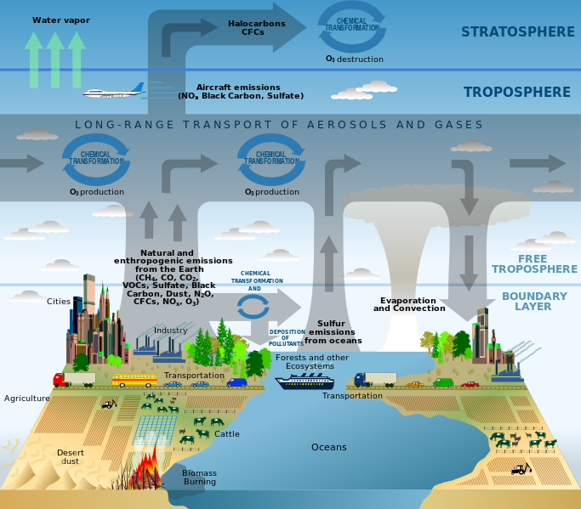
Composition + Structure http://en.wikipedia.org/wiki/Atmospheric_sciences

Slide 13
Other Layers: Ionosphere en.wikipedia.org/wiki/ionosphere
“The ionosphere is a region of the atmosphere that is ionized by solar radiation.
It is responsible for aurorae.
During daytime hours, it stretches from 50 to 1,000 km and includes the mesosphere, thermosphere, and parts of the exosphere.
However, ionization in the mesosphere largely ceases during the night, so auroras are normally seen only in the themosphere and lower exosphere.
The ionosphere forms the inner edge of the magnetosphere. It has practical importance because it influences, for example, radio propagation on Earth.”

Slide 14
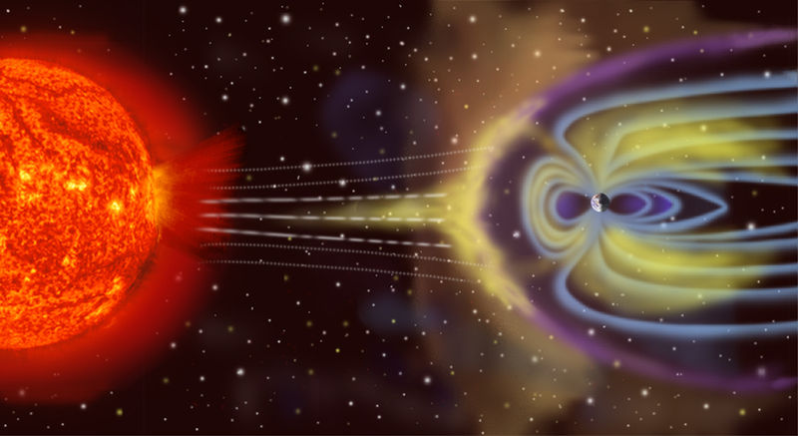
Other Layers: Magnetosphere en.wikipedia.org/wiki/magnetosphere
“Over the Earth's equator, the magnetic field lines become almost horizontal, then return to connect back again at high latitudes.
On the dayside of the Earth, the magnetic field is significantly compressed by the solar wind to a distance of approximately 65,000 km.
The Earth's bow shock is about 17 kilometers thick and located about 90,000 km from the Earth.
The magnetopause exists at a distance of several hundred km off the surface of the earth.
The Earth's magnetopause has been compared to a sieve, as it allows particles from the solar wind to enter.
On the nightside of the earth, the magnetic field extends in the magnetotail, which is over 6,300,000 km in length.
The Earth's magnetotail is the primary source of the polar aurora borealis/australis”

Slide 15
Other Layers: Parts of the Magnetosphere en.wikipedia.org/wiki/magnetosphere
“The rounded, bullet-like shape represents the bow shock as the magnetosphere confronts solar winds.
The area represented in gray, between the magnetosphere and the bow shock, is called the magnetosheath, while the magnetopause is the boundary between the magnetosphere and the magnetosheath.
The Earth's magnetosphere extends about 10 Earth radii toward the Sun and perhaps similar distances outward on the flanks.
The magnetotail is thought to extend as far as 1,000 Earth radii away from the Sun.
1 : Bow shock
2 : Magnetosheath
3 : Magnetopause
4 : Magnetosphere
5 : Northern tail lobe
6 : Southern tail lobe
7 : Plasmasphere”

Slide 16
Aurorae Borealis / Australis en.wikipedia.org/wiki/Aurora_(astronomy)
“An aurora (plural: aurorae or auroras; from the Latin word aurora, "sunrise" or the Roman goddess of dawn) is a natural light display in the sky particularly in the high latitude (Arctic and Antarctic) regions, caused by the collision of energetic charged particles with atoms in the high altitude atmosphere (thermosphere).
The charged particles originate in the magnetosphere and solar wind and, on Earth, are directed by the Earth's magnetic field into the atmosphere.
Most aurorae occur in a band known as the auroral oval, which is typically 3° to 6° in latitudinal extent and at all local times or longitudes.
The auroral zone is typically 10° to 20° from the magnetic pole defined by the axis of the Earth's magnetic dipole.
During a geomagnetic storm, the auroral zone expands to lower latitudes.
In northern latitudes, the effect is known as the aurora borealis (or the northern lights)
Its southern counterpart is the aurora australis (or the southern lights) “

Slide 17
Other Layers: Planetary Boundary Layer en.wikipedia.org/wiki/Atmosphere_of_Earth
“The planetary boundary layer (PBL) is the part of the troposphere that is closest to Earth's surface and is directly affected by it, mainly through turbulent diffusion.
During the day the planetary boundary layer usually is well-mixed, whereas at night it becomes stably stratified with weak or intermittent mixing.
The depth of the planetary boundary layer ranges from as little as about 100 meters on clear, calm nights to 3000 m or more during the afternoon in dry regions.
In the PBL, physical quantities such as flow velocity, temperature, moisture, etc., display rapid fluctuations (turbulence) and vertical mixing is strong.
Above the PBL is the "free atmosphere" where the wind is approximately geostrophic (parallel to the isobars) while within the PBL the wind is affected by surface drag and turns across the isobars.
The free atmosphere is usually nonturbulent, or only intermittently turbulent.”
Depiction of the location of the PBL on a sunny day

Slide 18
Parts of the Atmosphere-I http://en.wikipedia.org/wiki/Atmosphere_of_Earth
“The average atmospheric pressure at sea level is 1 standard atmosphere (atm)=101.3 kPa (kilopascals)=14.7 psi (pounds per square inch)=760 torr=29.92 inches of Hg.
The mass of Earth's atmosphere is distributed approximately as follows:
50% is below 5.6 km
90% is below 16 km
9.99997% is below 100 km), the Kármán line (By international convention, this marks the beginning of space)
If the atmosphere had a uniform density, it would terminate abruptly at an altitude of 8.50 km
It actually decreases exponentially with altitude, dropping by half every 5.6 km or by a factor of 1/e every 7.64 km, the average scale height of the atmosphere below 70 km.
However, the atmosphere is more accurately modeled with a customized equation for each layer that takes gradients of temperature, molecular composition, solar radiation and gravity into account.”

Slide 19
Parts of the Atmosphere-II http://en.wikipedia.org/wiki/Atmosphere_of_Earth
Temperature and speed of sound
“Temperature decreases with altitude starting at sea level through the troposphere
In the stratosphere starting above about 20 km after an initial isothermal layer, the temperature increases with height
This is due to heating within the ozone layer caused by capture of significant ultraviolet radiation from the Sun by the dioxygen and ozone gas in this region.
Still another region of increasing temperature with altitude occurs at very high altitudes, in the aptly-named thermosphere above 90 km.
In an ideal gas of constant composition the speed of sound depends only on temperature and not on the gas pressure or density
As a result, the speed of sound in the atmosphere with altitude takes on the form of a complicated temperature profile, and does not mirror altitude changes in density or pressure.”

Slide 20
Density and Mass http://en.wikipedia.org/wiki/Atmosphere_of_Earth
“The density of air at sea level is about 1.2 kg/m3 (1.2 g/L).
Density is not measured directly but is calculated from measurements of temperature, pressure and humidity using the equation of state for air (a form of the ideal gas law).
Atmospheric density decreases as the altitude increases.
This variation can be approximately modeled using the barometric formula. More sophisticated models are used to predict orbital decay of satellites.
According to NCAR, "The total mean mass of the atmosphere is 5.1480×1018 kg or about 1/1,200,000 the mass of the Earth
The mean mass of water vapor is estimated as 1.27×1016 kg and the dry air mass as 5.1352 ±0.0003×1018 kg."

Slide 21
Opacity of the Atmosphere to Radiation en.wikipedia.org/wiki/Atmosphere_of_Earth
Important to consider with regards to greenhouse gases and global warming

Slide 22
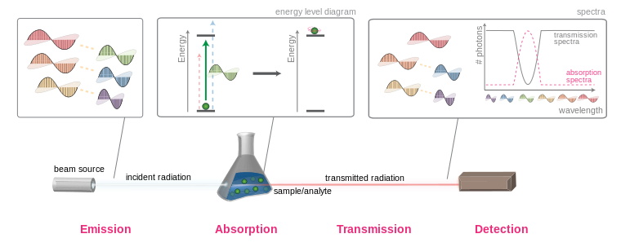
Absorption en.wikipedia.org/wiki/Atmosphere_of_Earth
“Different molecules absorb different wavelengths of radiation.
For example, O₂ and O₃ absorb almost all wavelengths shorter than 300 nanometers.
Water (H₂O) absorbs many wavelengths above 700 nm.
The combined absorption spectra of the gases in the atmosphere leave "windows" of low opacity, allowing the transmission of only certain bands of light.
The optical window runs from around 300 nm (ultraviolet-C) up into the range humans can see, the visible spectrum (commonly called light), at roughly 400–700 nm and continues to the infrared to around 1100 nm.
There are also infrared and radio windows that transmit some infrared and radio waves at longer wavelengths.”

Slide 23
Emission en.wikipedia.org/wiki/Atmosphere_of_Earth
“Emission is the opposite of absorption, it is when an object emits radiation.
Objects tend to emit amounts and wavelengths of radiation depending on their "black body" emission curves, therefore hotter objects tend to emit more radiation, with shorter wavelengths.
Because of its temperature, the atmosphere emits infrared radiation.
For example, on clear nights the Earth's surface cools down faster than on cloudy nights.
This is because clouds (H₂O) are strong absorbers and emitters of infrared radiation.
This is also why it becomes colder at night at higher elevations.
The greenhouse effect is directly related to this absorption and emission effect.
Some gases in the atmosphere absorb and emit infrared radiation, but do not interact with sunlight in the visible spectrum, common examples of these are CO₂ and H₂O.”
Black body radiation theory

Slide 24
Scattering en.wikipedia.org/wiki/Atmosphere_of_Earth
“When light passes through our atmosphere, photons interact with it through scattering.
If the light does not interact with the atmosphere, it is called direct radiation and is what you see if you were to look directly at the Sun.
Indirect radiation is light that has been scattered in the atmosphere.
Due to a phenomenon called Rayleigh scattering, shorter (blue) wavelengths scatter more easily than longer (red) wavelengths.
The sky looks blue since blue light is scattered more than red light.
This is also why sunsets are red -- because the Sun is close to the horizon, the Sun's rays pass through more atmosphere than normal to reach your eye.
Much of the blue light has been scattered out, leaving the red light in a sunset.”

Slide 25
http://www.jpl.nasa.gov/video/index.php?id=1163

