Slide 1
Lecture 15
Earthquake Forecasting
John Rundle GEL/EPS 131

Slide 2


Slide 3
Challenges in Web-Based Forecasting
Data & Models | Information Delivery | Meaning
Acquiring & validating data | Automation | What is probability?
Model building | Web-based integration | Visual presentation
Efficient algorithms | UI | GIS
Validating/verifying models | Tools | Correlations
Error reporting, correction, model steering | Collaboration/social networks | Expert guidance/blogs

Slide 4
Risk Management
Systemic-level risk is growing exponentially from a variety of natural hazards
Currently, risk management is done by big corporations for big corporations
Modern social networking technology together with web-based information and tools has enabled a new era of Personal Risk Management

Slide 5
Risk Management as Currently Practiced
Oriented at selling earthquake insurance & financial products
California earthquake insurance:
15% deductable
Often expensive
Only 8-10% of California residents carry it
Pricing of insurance & financial securities
Earthquake forecast model
Ground shaking model
Economic loss model
Poisson
Log Normal
BPT
Fault models
Pattern Analysis
AMR
ETAS
RIPI
Etc.
Attenuation
PGA
Surface geology
Basin structure
Etc.
LEP curves
Building damage
Socioeconomic data
Supply chain disruption
Lost income
Lifelines
Etc.
CAT Bonds
SPVs
Warrants
Traders
Hedge Funds
Options
Muni Bonds
Equities
Etc.

Slide 6
NTW Regional Earthquake Forecast
Assumes Infinite Correlation Length
JBR et al., Physical Review E, 86, 021106 (2012)
Pattern recognition methods
Data from ANSS catalog + other feeds
Based on “filling in” the Gutenberg-Richter magnitude-frequency relation (Example: for every ~1000 M>3 earthquakes there is 1 M>6 earthquake)
Fully automated
Backtested and optimized
Updated in real time (at least nightly)
Accounts for statistical correlations of earthquake interactions
Probabilities can change rapidly in time

Slide 7
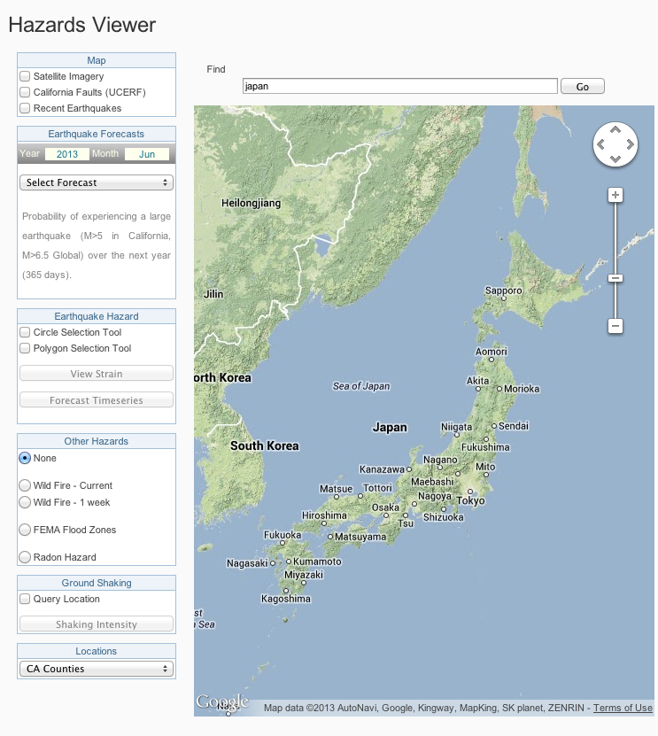
Hazard Viewer
Japan Region

Slide 8
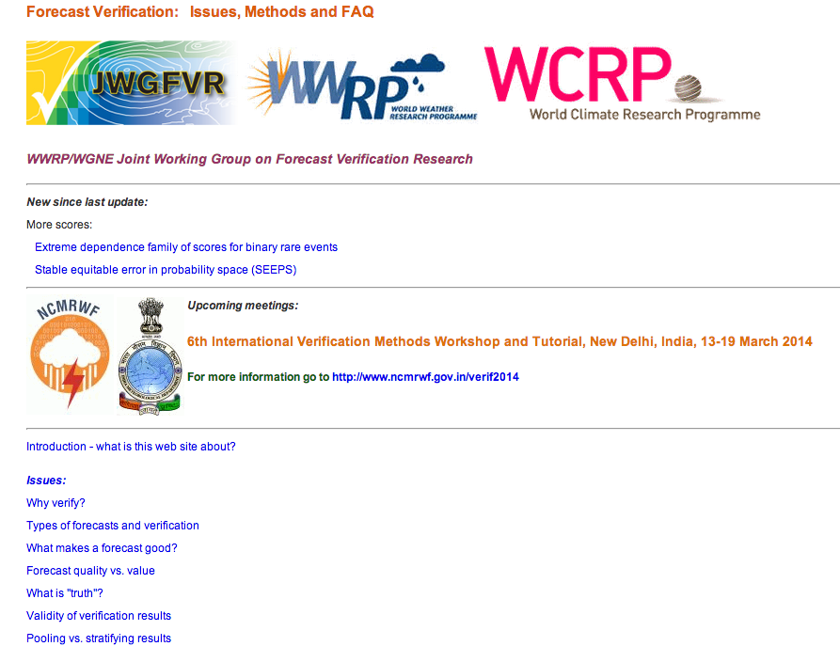
Verification and Validation http://www.cawcr.gov.au/projects/verification/
Australian site for weather and more general validation and verification of forecasts
Common methods are Reliability/Attributes diagrams, ROC diagrams, Briar Scores, etc.

Slide 9
Optimized 48 month Japan forecast:
Probabilities (%) vs. Time for Magnitude ≥ 7.25 & Depth < 40 KM
Japan NTW Forecast
Assumes Infinite Correlation Length
Optimal forecasts via backtesting, using
common validation and verification testing procedures.
Forecast Date: 2013/04/10
Scatter Plot
1980-present
Observed Frequency vs. Computed Probability
Temporal Receiver Operating Characteristic
1980-present

Slide 10
Hazard Viewer
Japan Region

Slide 11
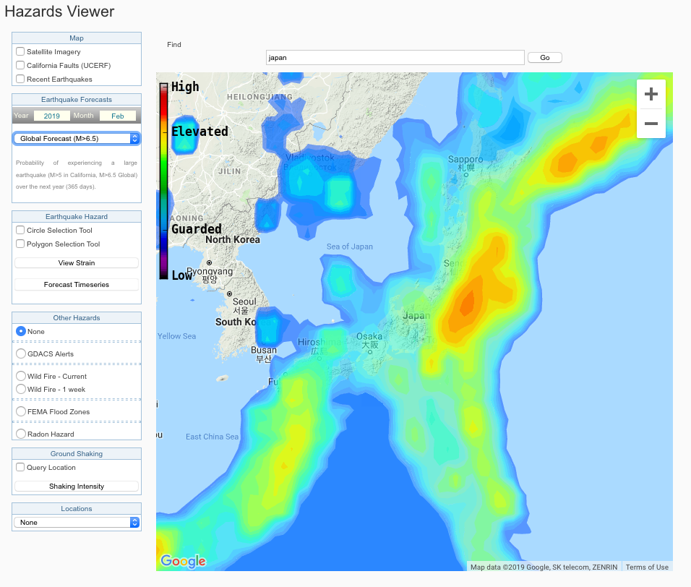
Spatial Contours of Forecast Probabilities in the Japan Region
M>6.5 for the Next 1 Year
Beginning Feb 11, 2019

Slide 12
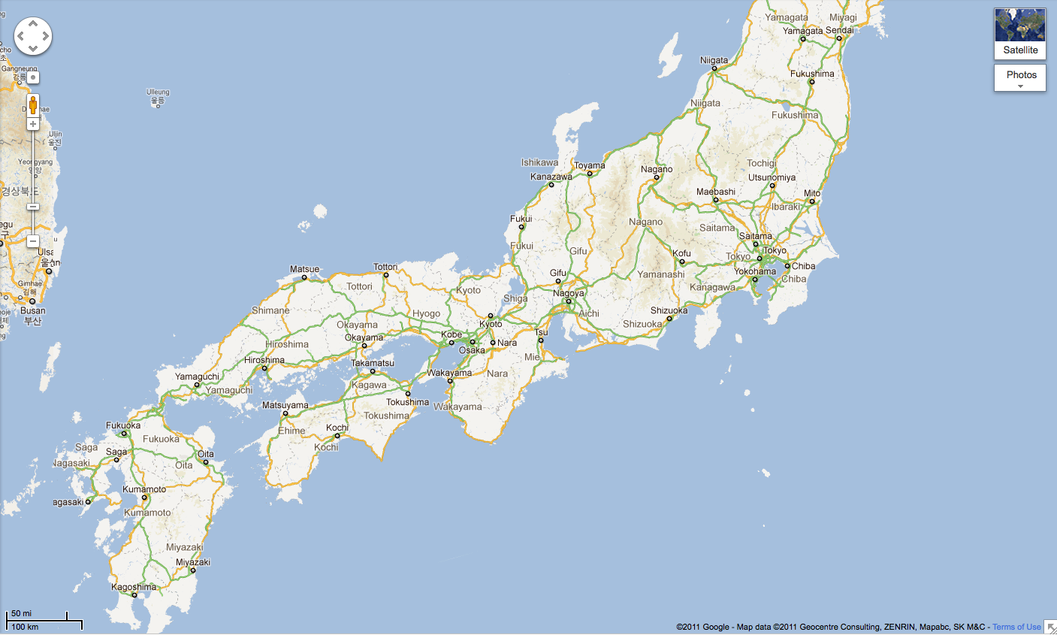
NTW Earthquake Forecasts (Probability in %): Eight Cities
Probability of Magnitude ≥ 7 -- Within 1 Year and Within 100 miles
6/26/2013
Niigata
23%
Sendai
79%
Kyoto
18%
Tokyo
58%
Nagasaki
11%
Shizuoka
38%
Osaka
18%
On October 25, 2015, a M7.3 earthquake ocurred off the coast of Fukushima, Japan
Miyazaki
24%

Slide 13
NTW Earthquake Forecasts (Probability in %): Eight Cities
Probability of Magnitude ≥ 7 -- Within 1 Year and Within 100 miles
2/9/2014
Niigata
3%
Sendai
33%
Kyoto
1%
Tokyo
11%
Nagasaki
1%
Shizuoka
3%
Osaka
1%
Following that event, by February 9, 2014, the earthquake probabilities had declined significantly
Miyazaki
3%

Slide 14
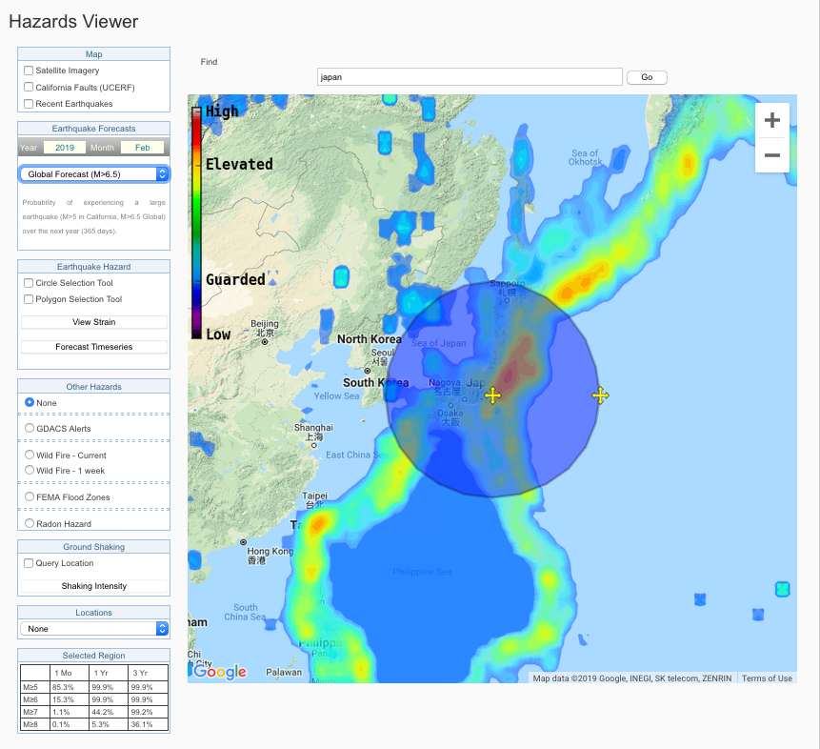
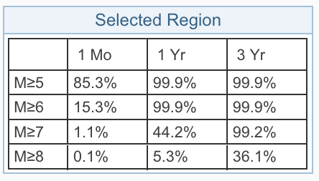
Chance of a Another Major or Great Earthquake in
Japan Region in the Near Future is High
Accessed 2/11/2019
1000 km Radius Circle Around Tokyo

Slide 15
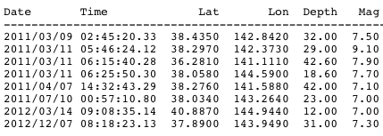
Chance of a Another Major or Great Earthquake in
Japan Region in the Near Future is High
Accessed 2/11/2019
All Aftershocks Since M7.9 on March 11, 2011
1000 km Radius Circle Around Tokyo

Slide 16
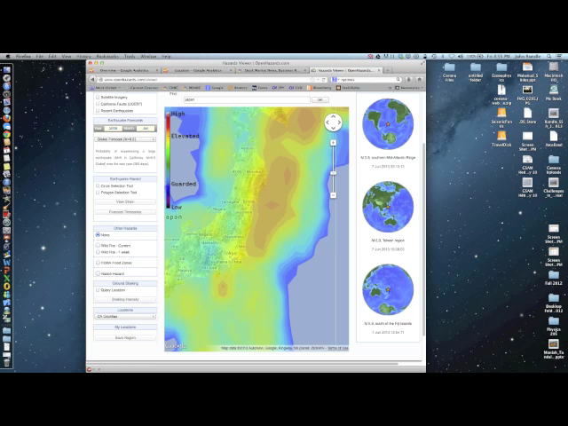
Forecast Movie
Contours for M>6.5 Over Next 1 Year
June, 2008 through June, 2013: Monthly Intervals

Slide 17
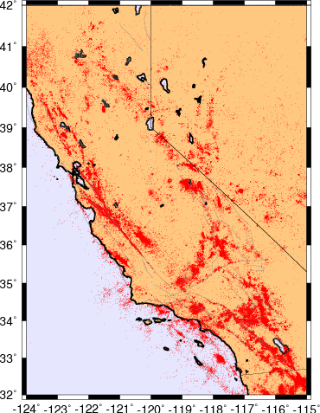
Optimized 12 month California-Nevada forecast:
Probabilities (%) vs. Time for Magnitude ≥ 6
California EQ Forecast Advanced Technology
(Open Hazards Group)
Optimal forecasts via backtesting, using
common validation and verification testing procedures.
Forecast Date: 2012/07/28
Scatter Plot
1980-present
Observed Frequency vs. Computed Probability
Hit Rate
Temporal Receiver Operating Characteristic
1980-present
False Alarm Rate

Slide 18
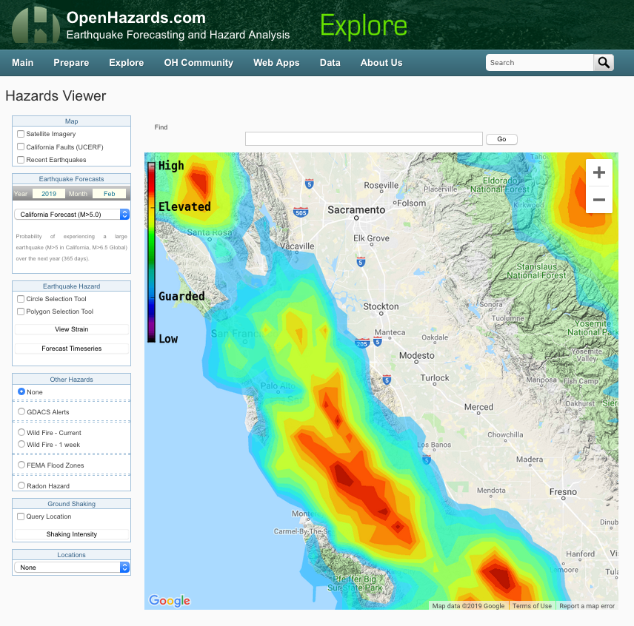
Accessed 2/11/2019
www.openhazards.com

Slide 19
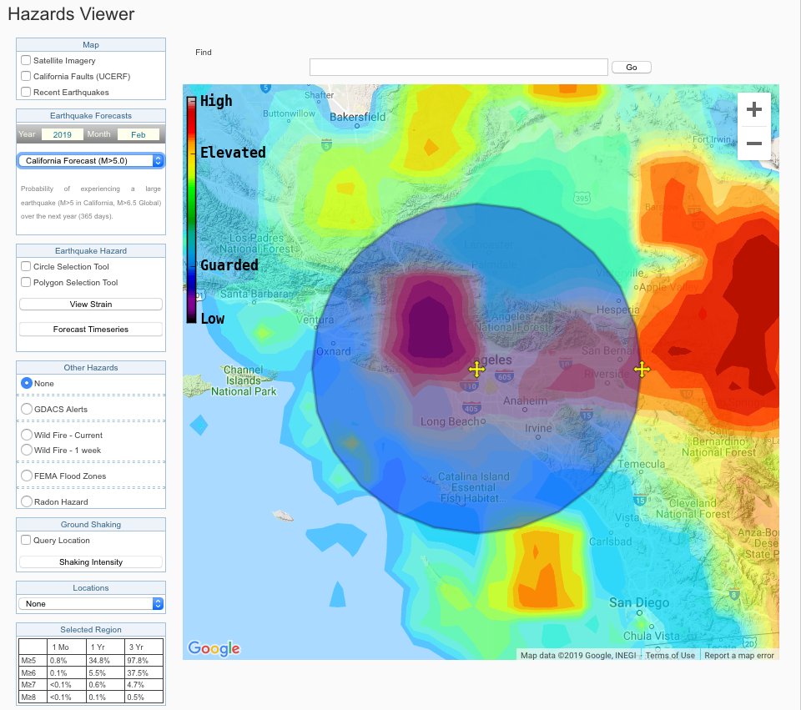
www.openhazards.com
100 km of Los Angeles. 2/9112019

Slide 20
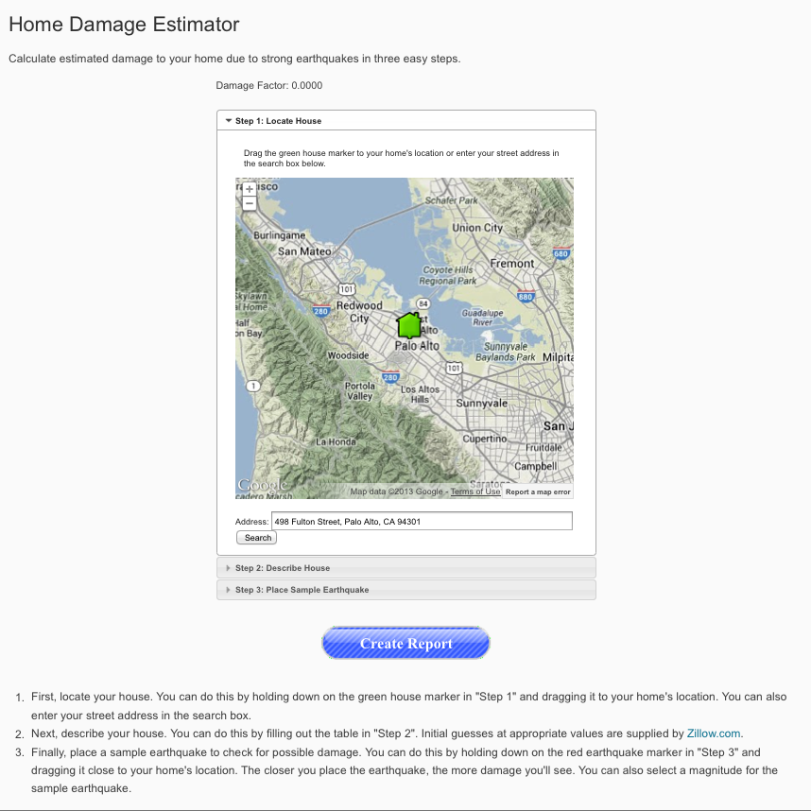

Slide 21
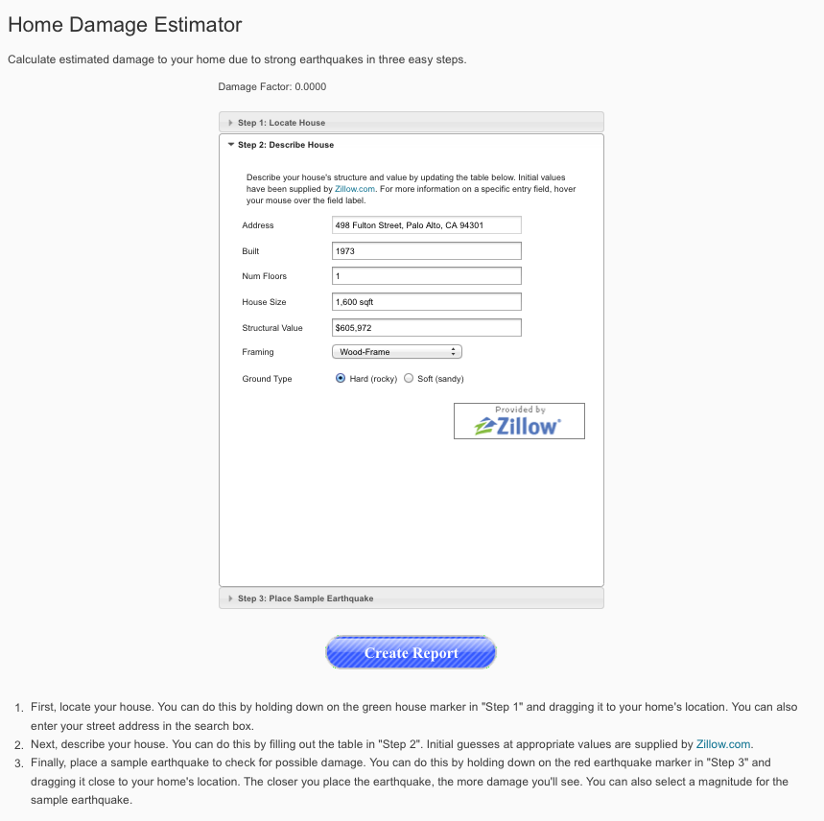

Slide 22
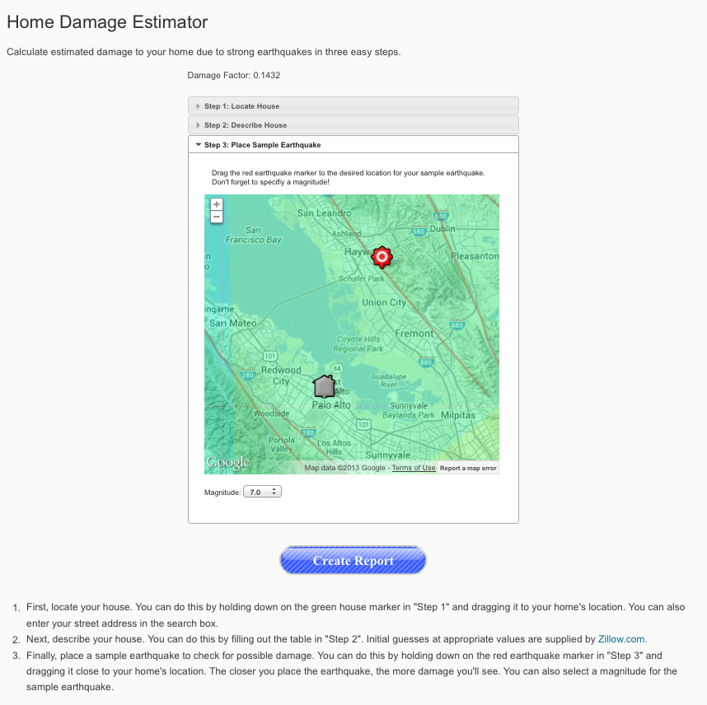

Slide 23
