Slide 1
Lecture 14b
Earthquake Simulations
John Rundle GEL/EPS 131

Slide 2
Forecasting vs. Prediction
Context | Characteristic
Prediction | A statement that can be validated or falsified with 1 observation
Forecast | A statement for which multiple observations are required to determine a confidence level

Slide 3
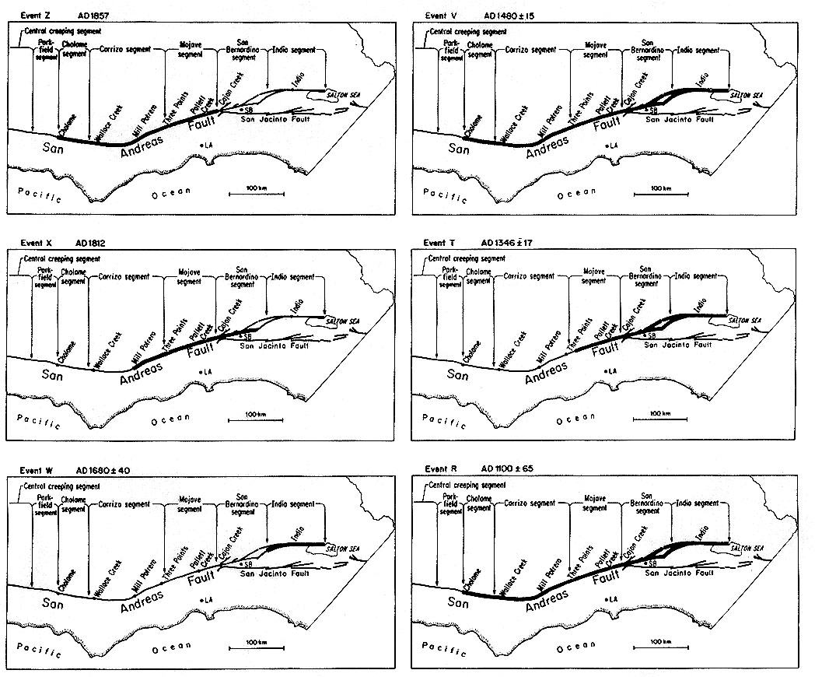
Space-Time Patterns of Historic Earthquakes
Large earthquakes on major faults occur irregularly in time
A.D. 1857
1480
Major events on the San Andreas Fault
1812
1346
1680
1100
From K. Sieh et al., JGR, 94, 603 (1989)

Slide 4
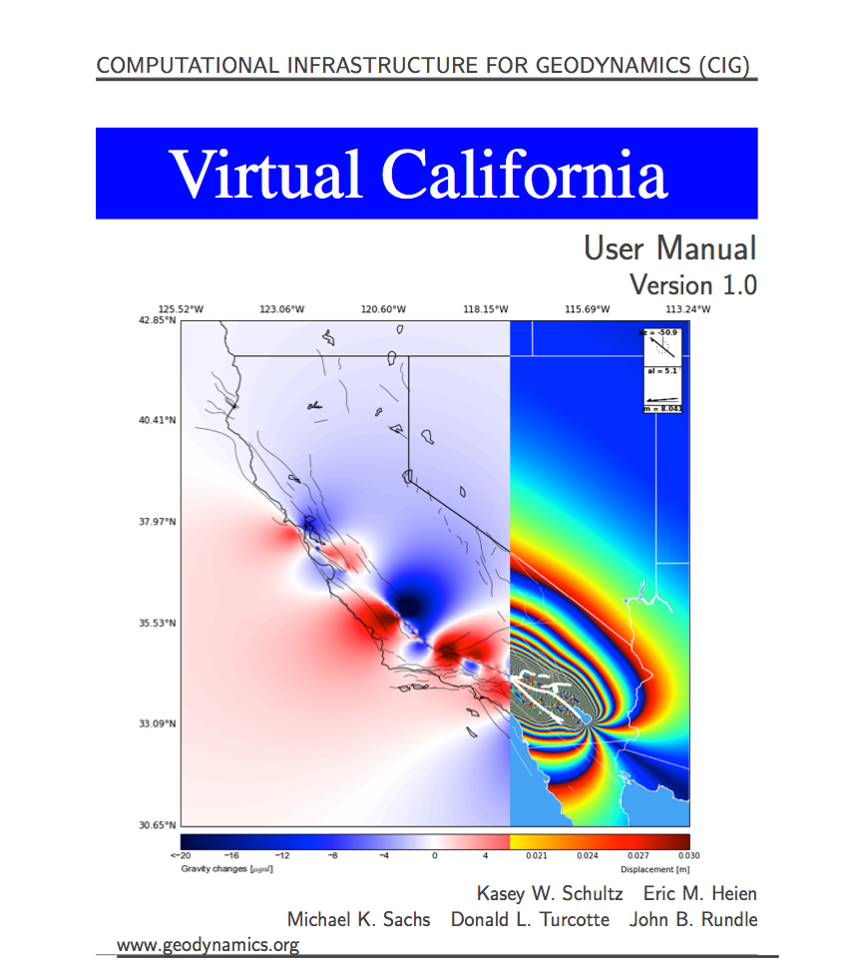
Available at:
http://geodynamics.org/cig/software/vc/

Slide 5
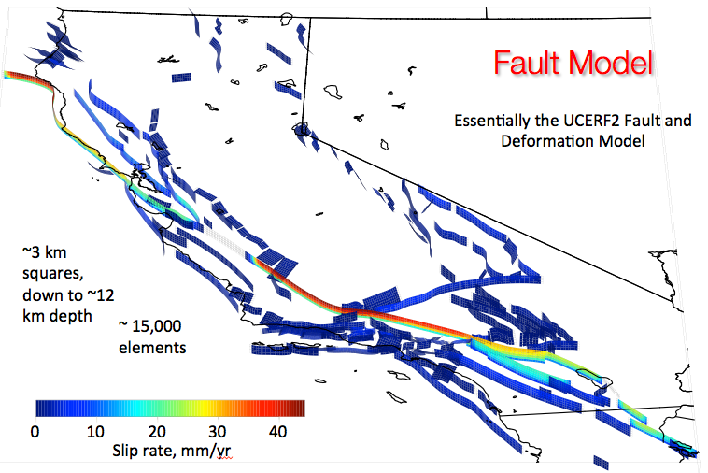

Slide 6
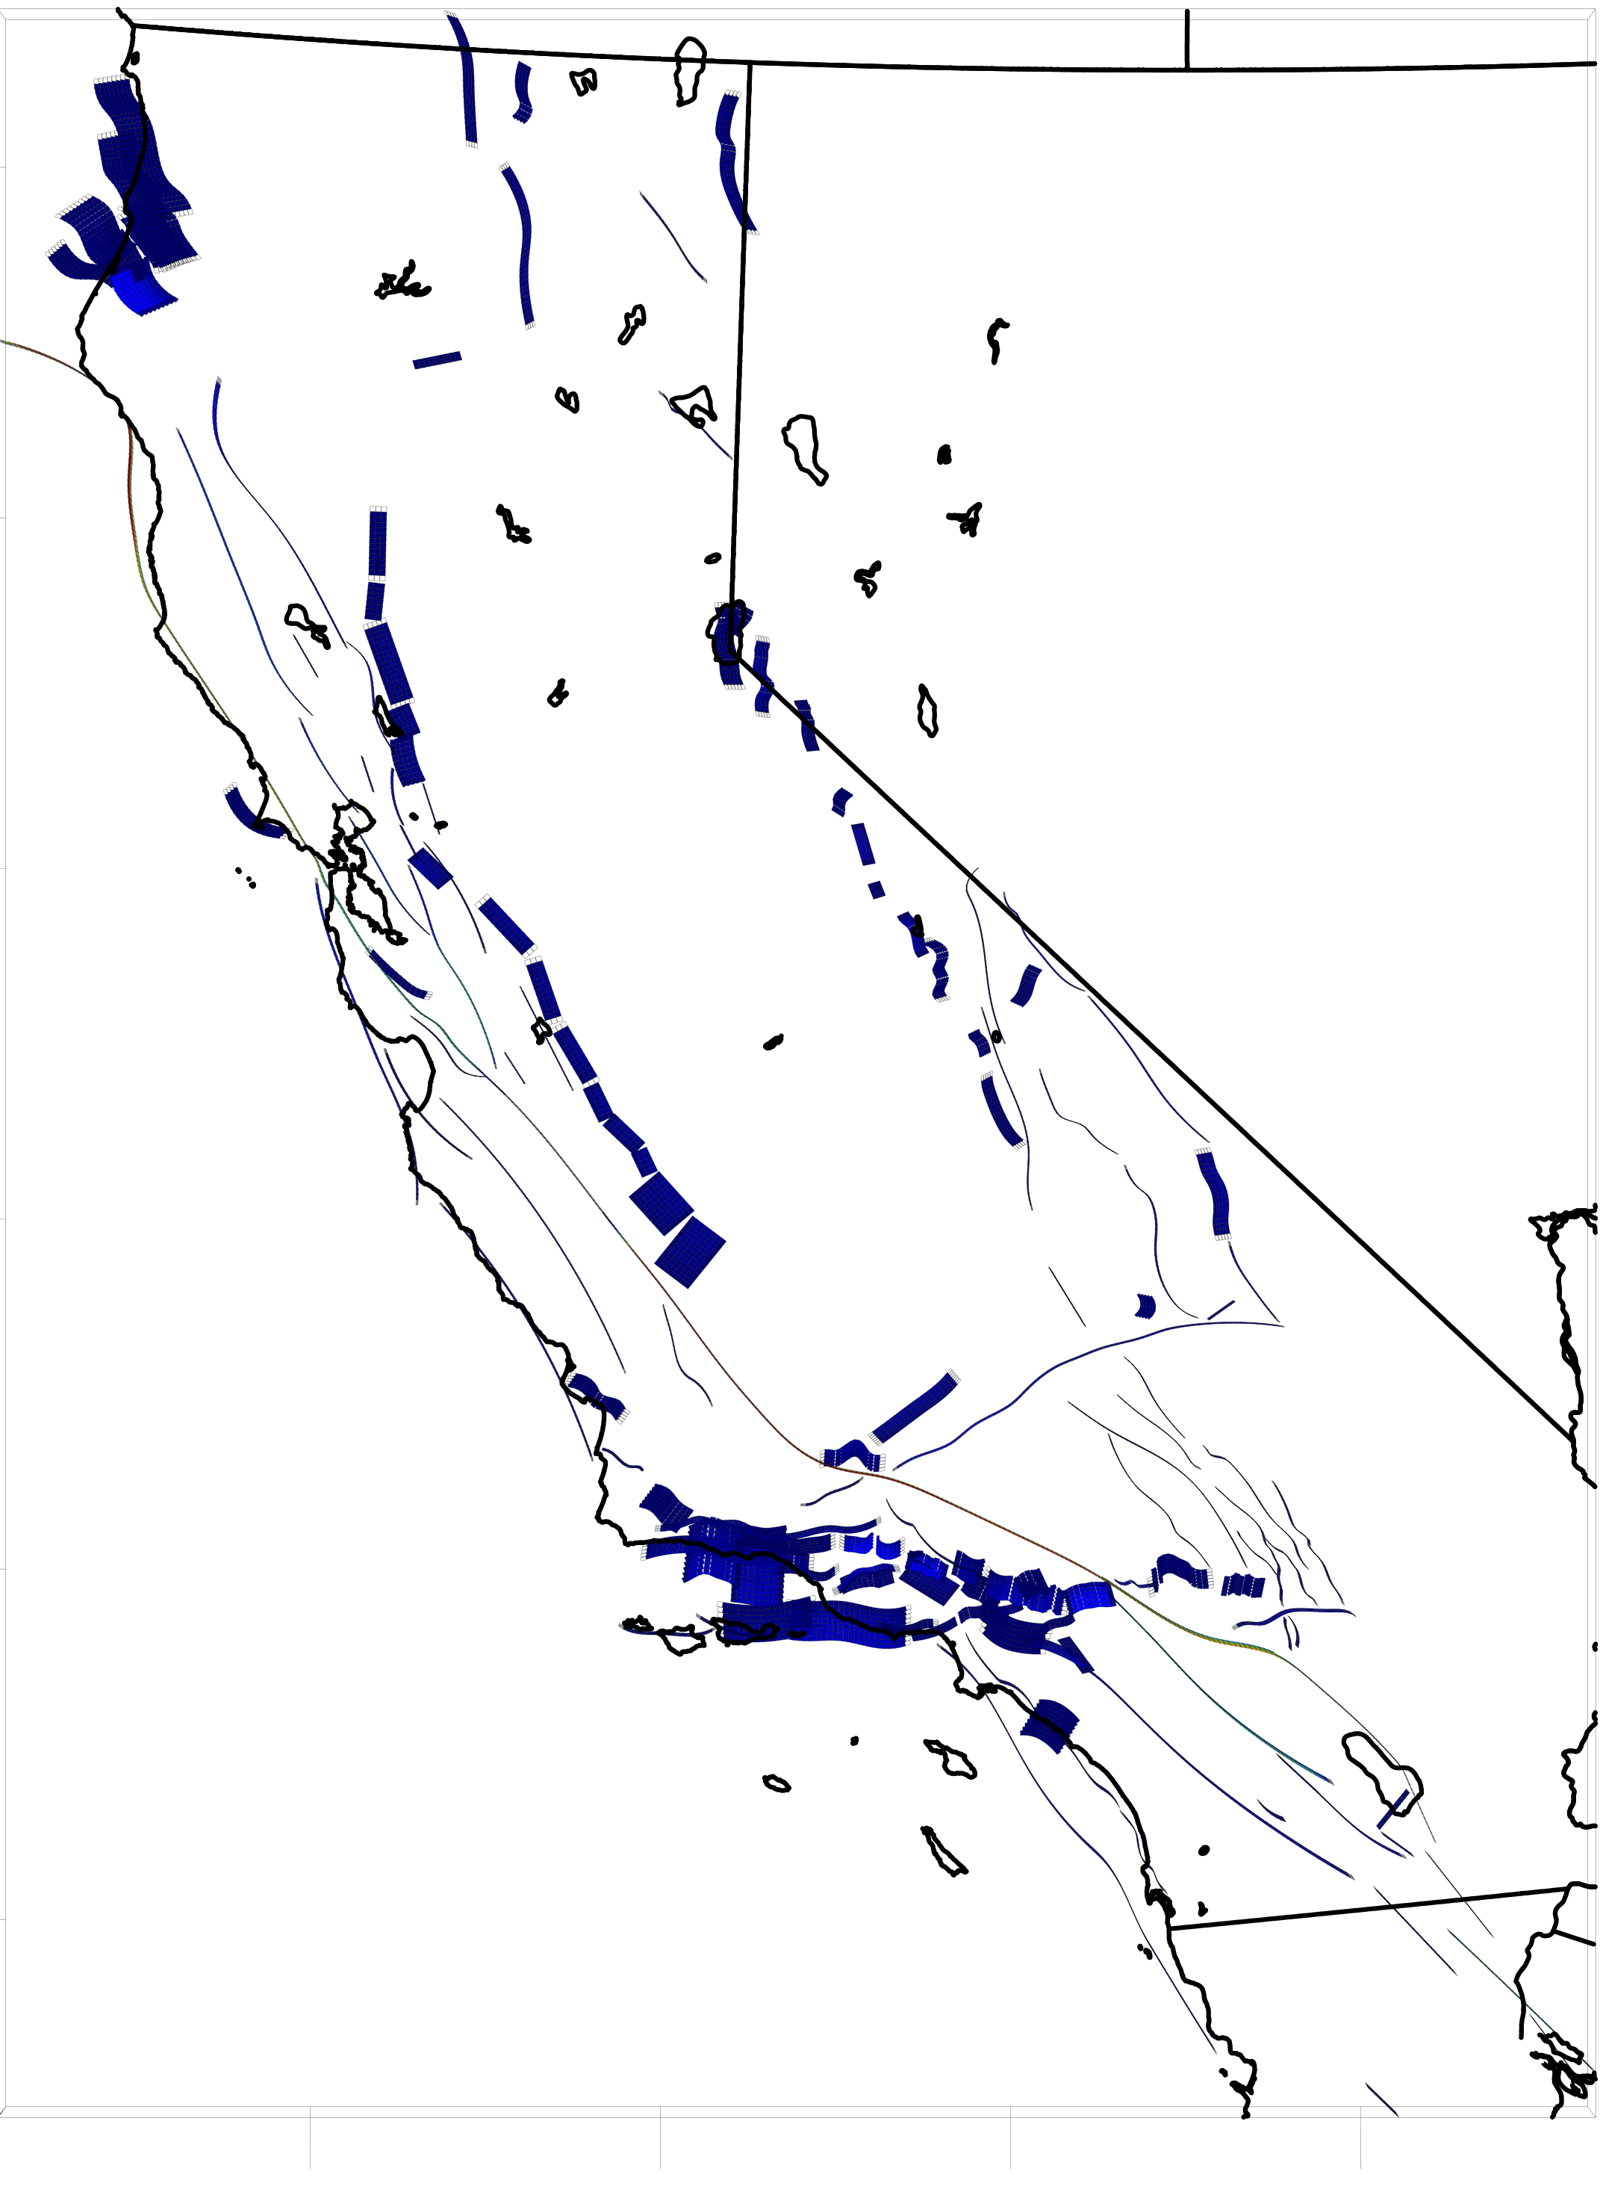
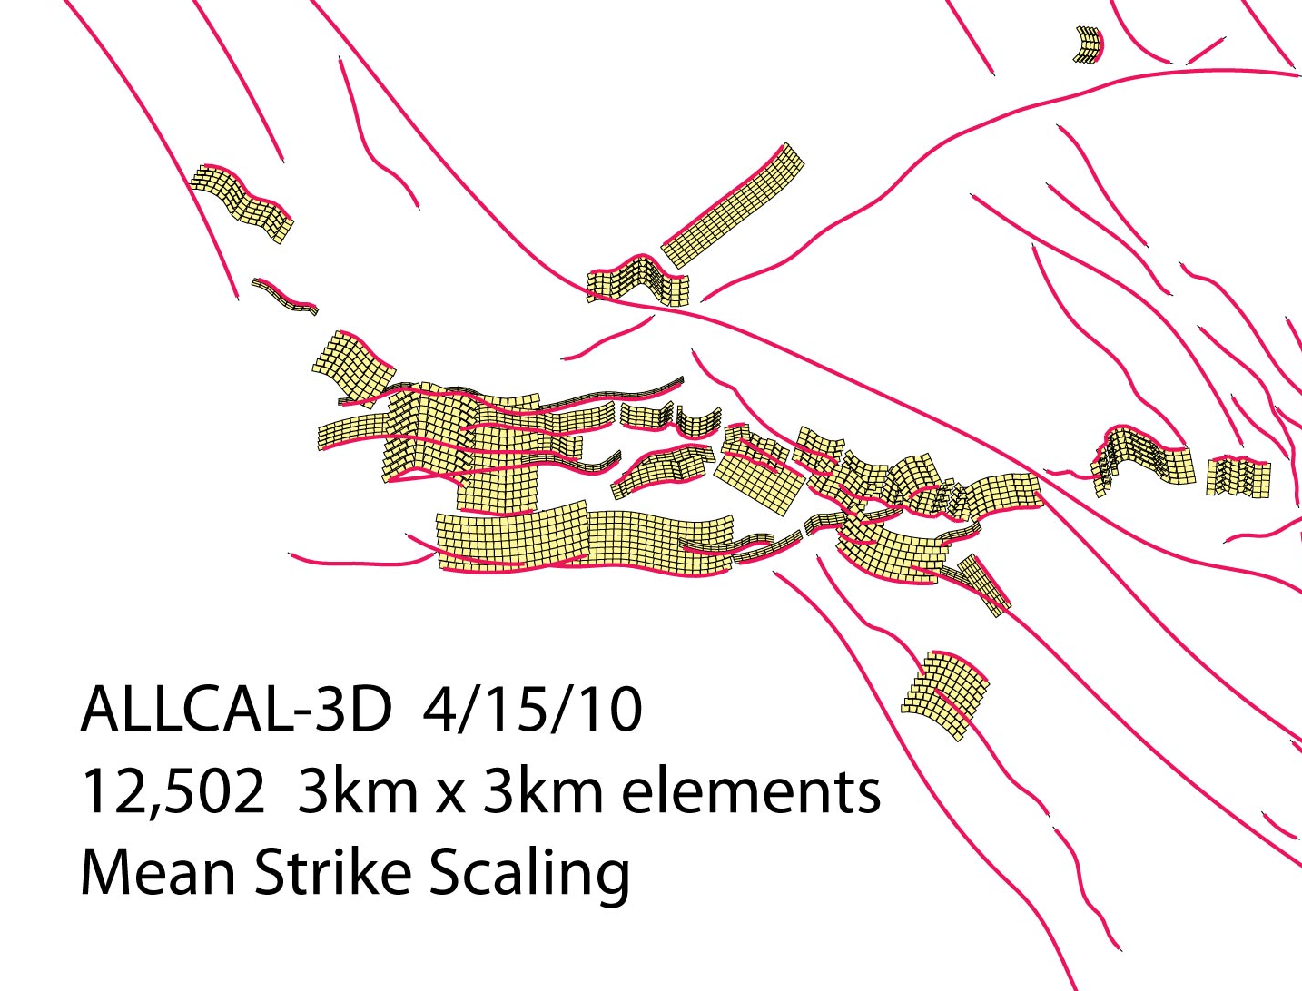
Fault Model
~3 km squares, down to ~12 km depth
Essentially the UCERF2 Fault and Deformation Model
~ 15,000 elements
Details of Southern CA
Few rips and tears down dip, since using rectangles rather than triangles to fit curved surfaces
0
10
20
30
40
Slip rate, mm/yr

Slide 8
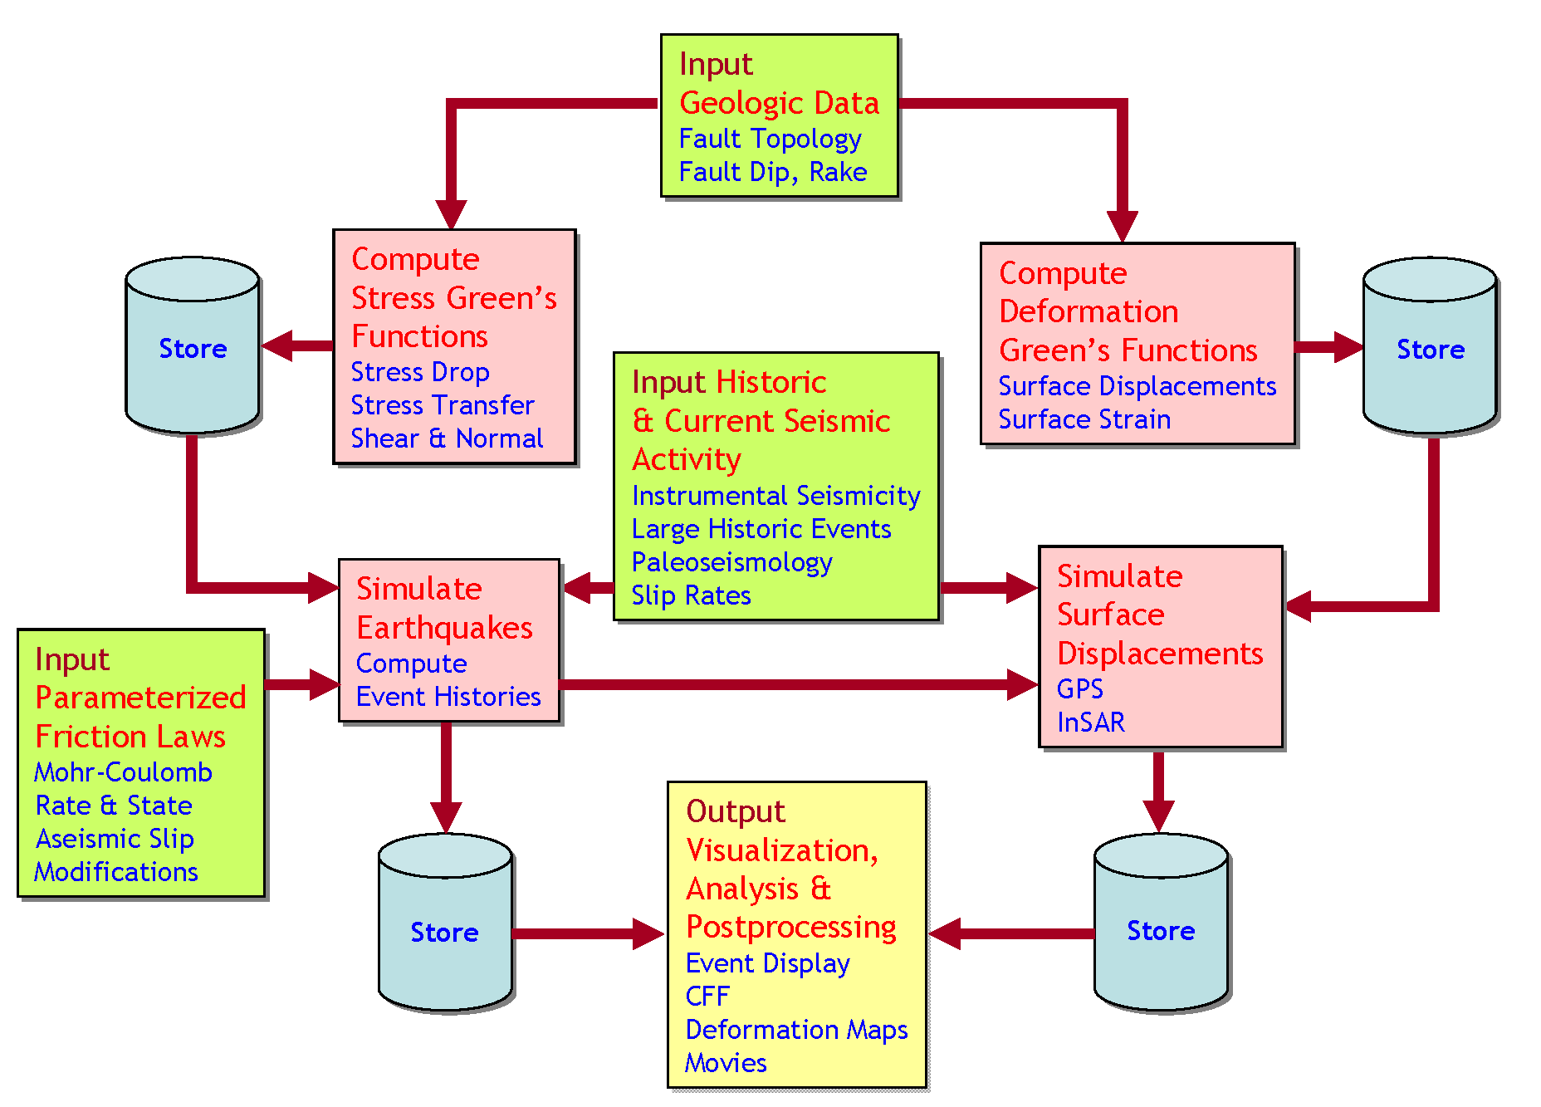
Structure of Virtual California Family of Codes
JPL QuakeSim Project: http://quakesim.jpl.nasa.gov
Data Assimilation
The structure of a backslip code such as Virtual California uses boundary elements or finite elements only to compute the stress Green’s functions. The dynamics are computed, analyzed and visualized with codes of considerable generality. The advantage of a backslip model is that all faults are guaranteed to have an average slip rate equal to the observed long-term rate.

Slide 9
Earthquake Simulations for Earthquake Fault Systems
Any observable geophysical quantity can be computed and displayed from simulations
Includes earthquake histories, aftershock patterns, surface deformation, InSAR, and gravity changes
Virtual California simulations are in reasonable agreement with the aggregate of data
We are reaching an era of big data (at least in the simulation sense)

Slide 10
Memory
Requirements

Slide 11
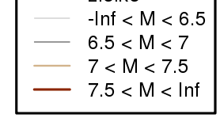
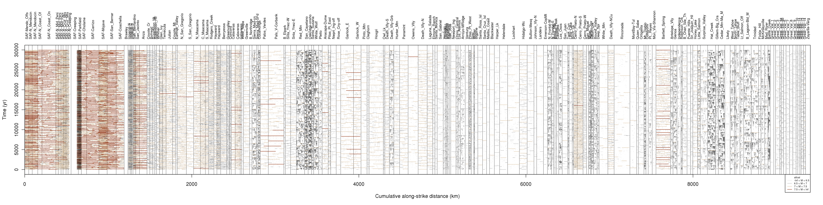
Space - Time Plots
ALLCAL
(Steve Ward)
VIRTCAL
(UC Davis)

Slide 12
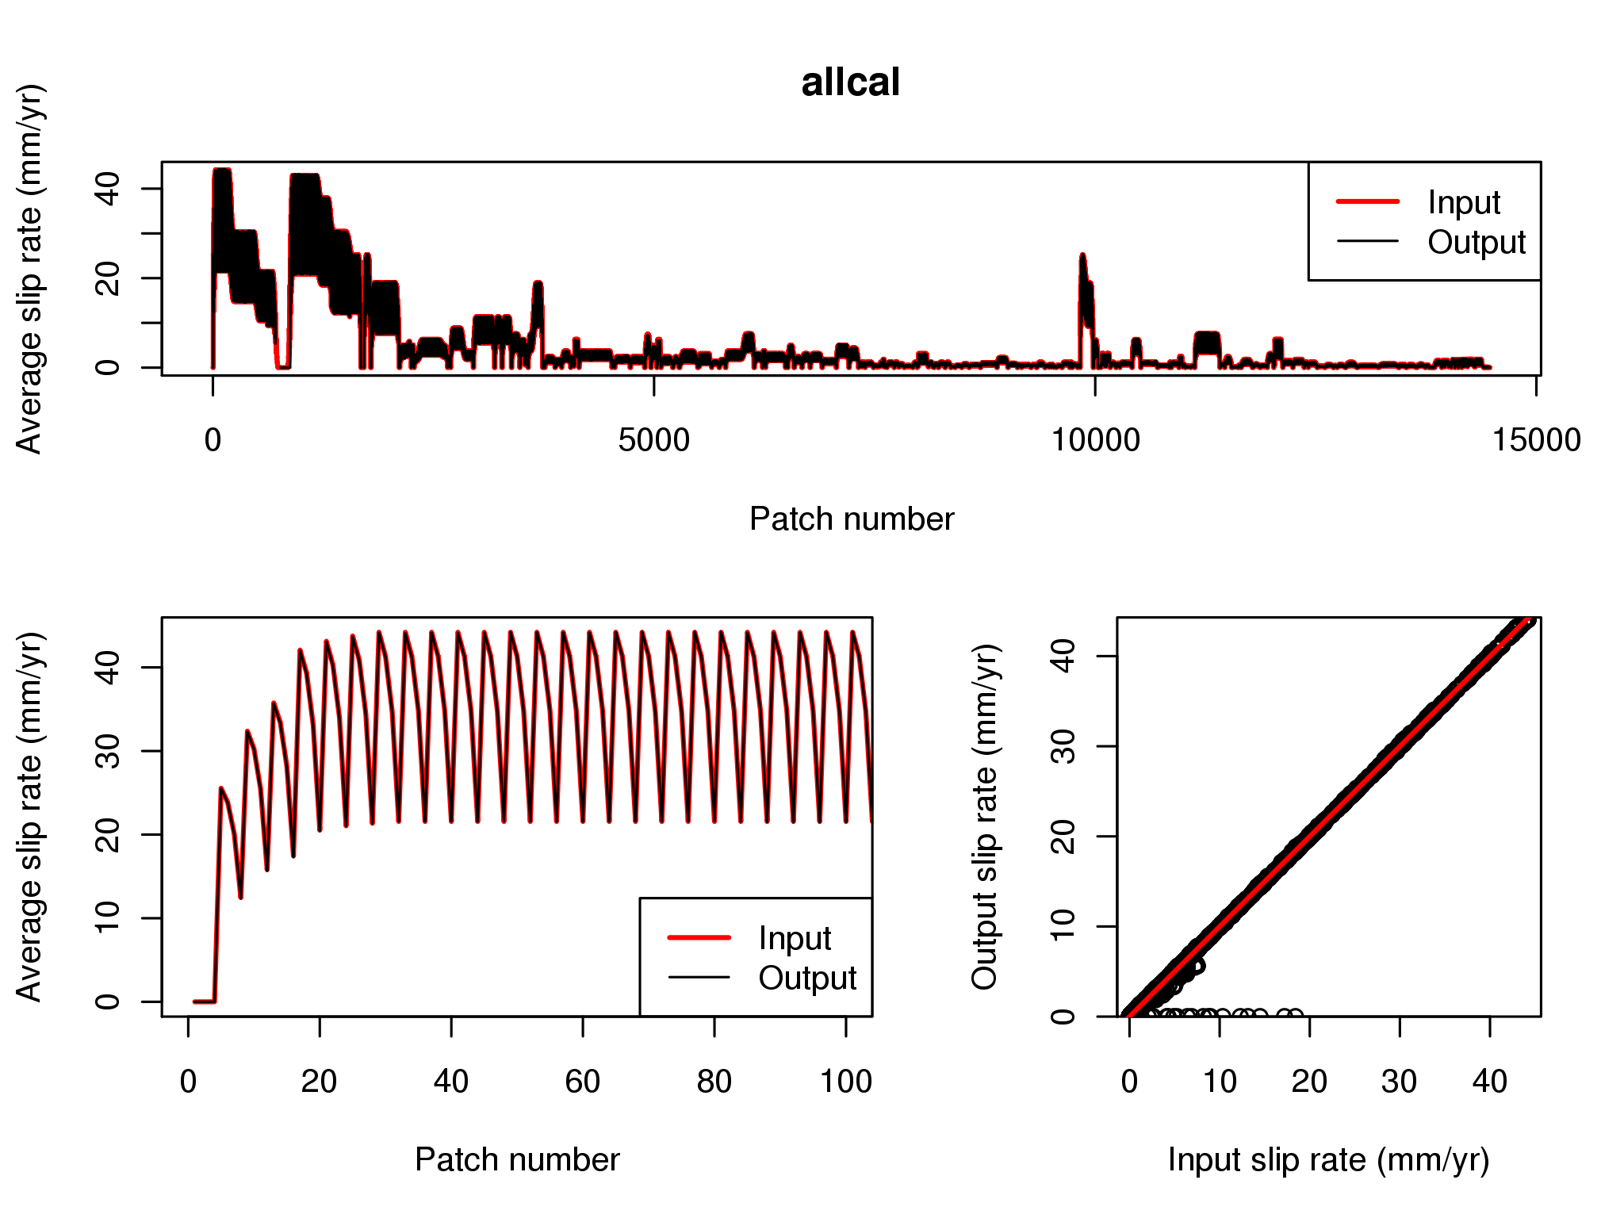
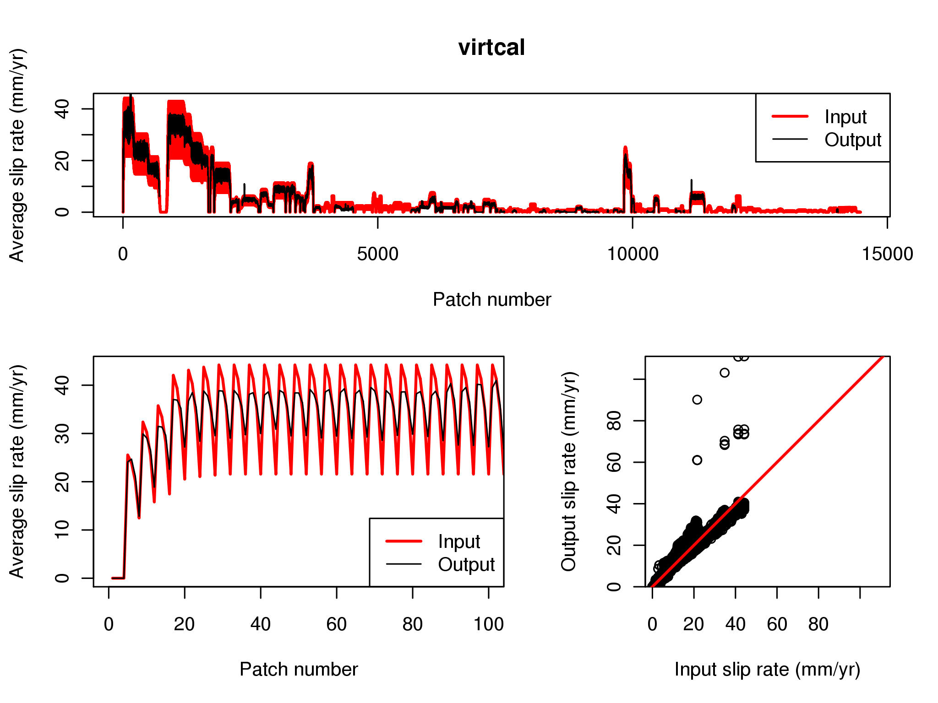

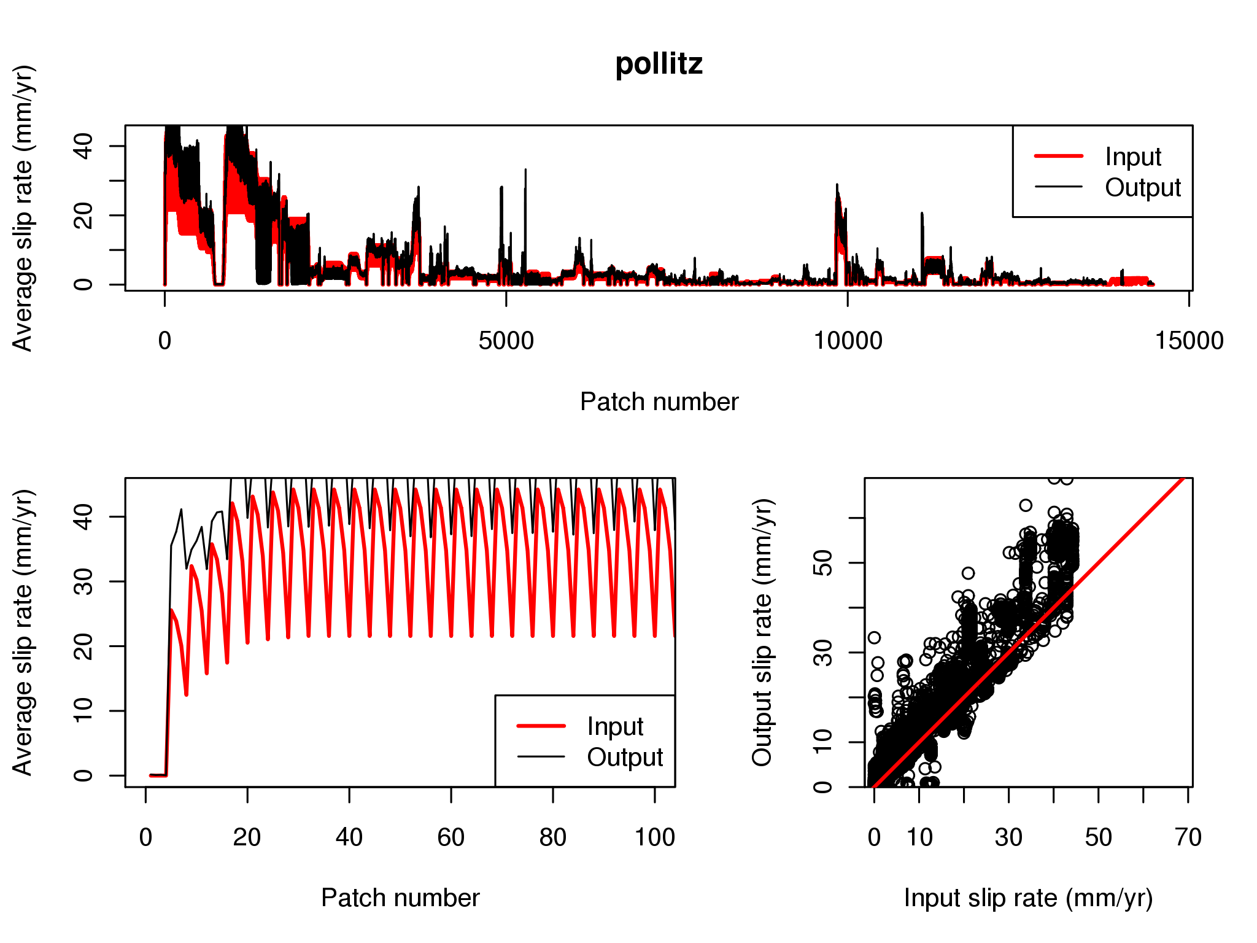
Output Slip Rate Compared to Input Slip Rate
ALLCAL
VIRTCAL
The few points along input axis are pinned to zero slip due to their elements being problematic
RSQSim
ViscoSim
Note: Output slip is correct, but ViscoSim is sometimes over-reporting it for these plots

Slide 13
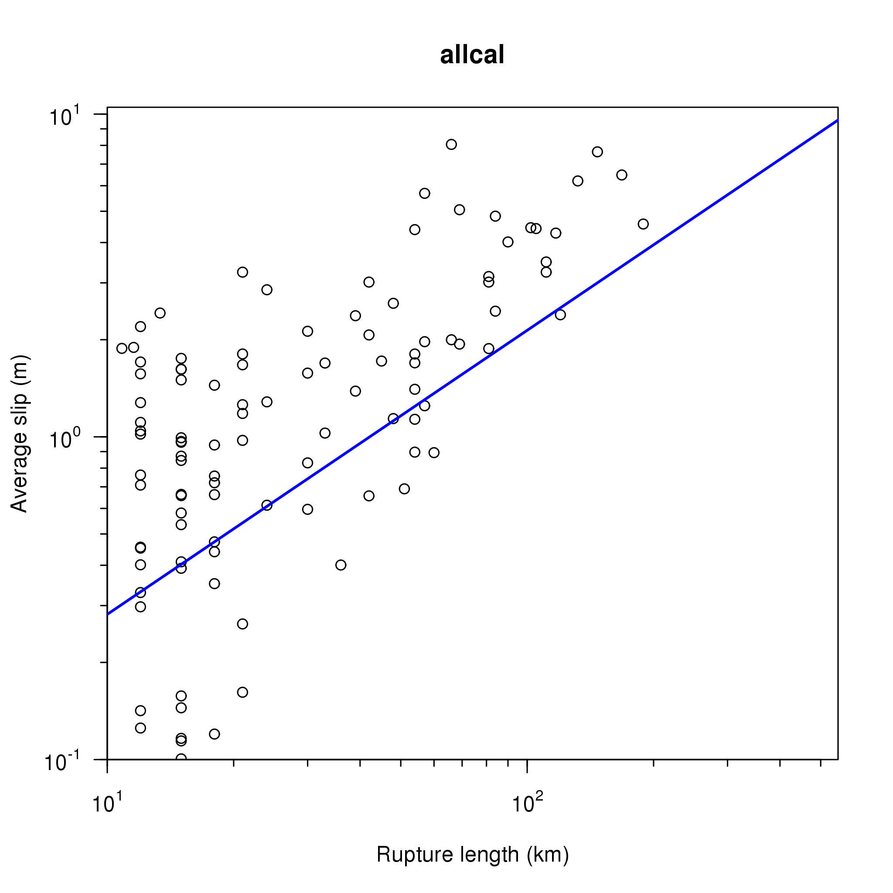
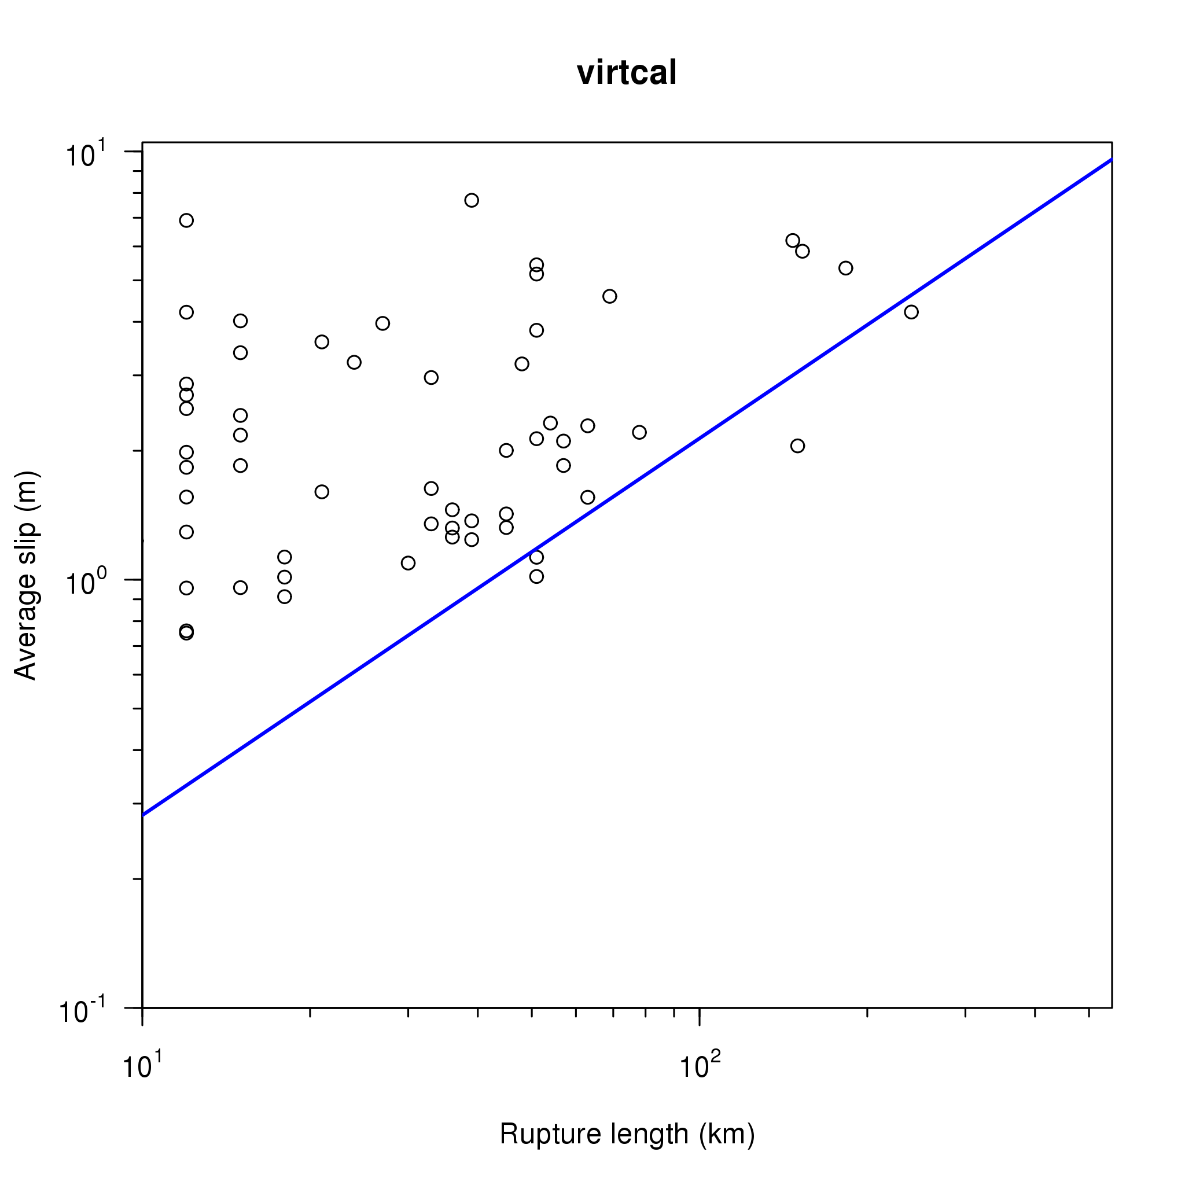

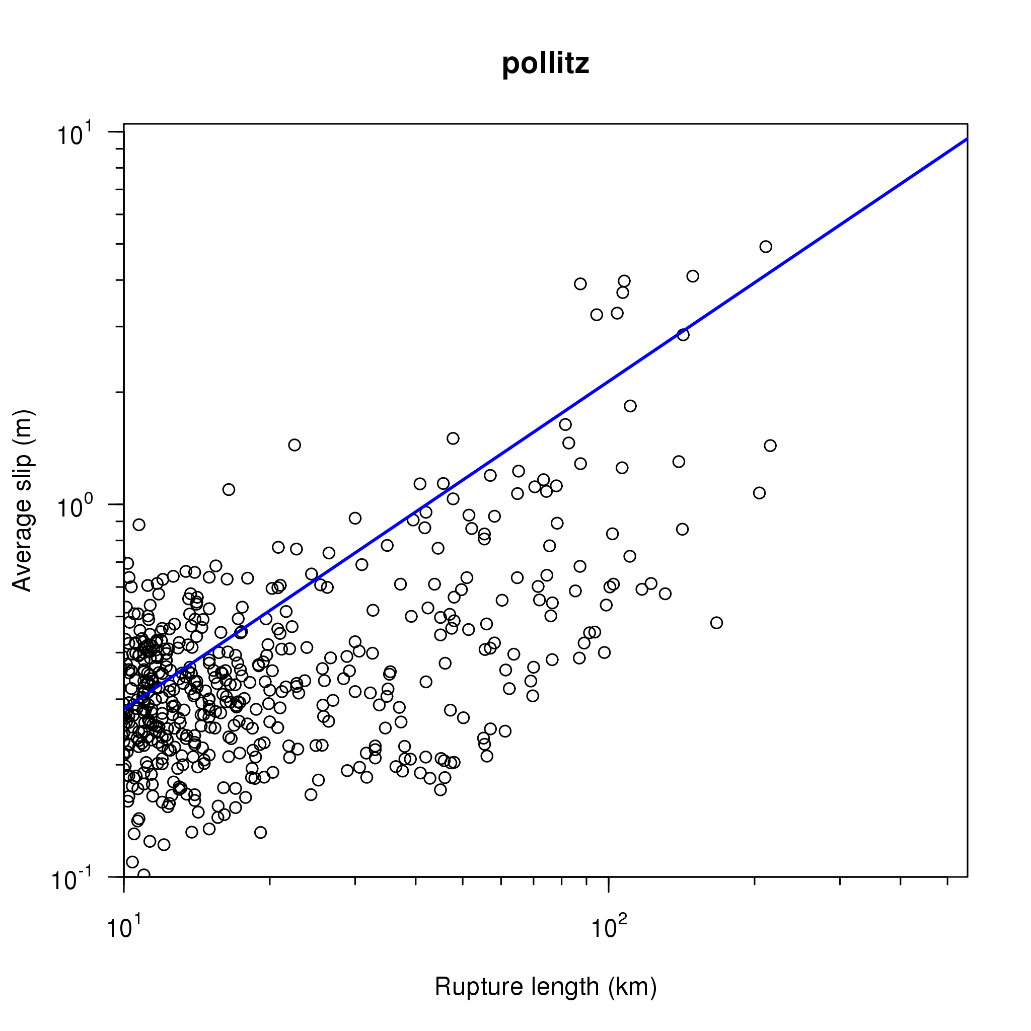
Slip - Length Scaling – Showing only 200 years of Simulated Events
ALLCAL
VIRTCAL
Blue line and symbols are from
Wells and Coppersmith
Green symbols from WG02 Appendix D, Table D4
Red symbols are from Wesnousky modified by Bruce Shaw
RSQSim
ViscoSim

Slide 14
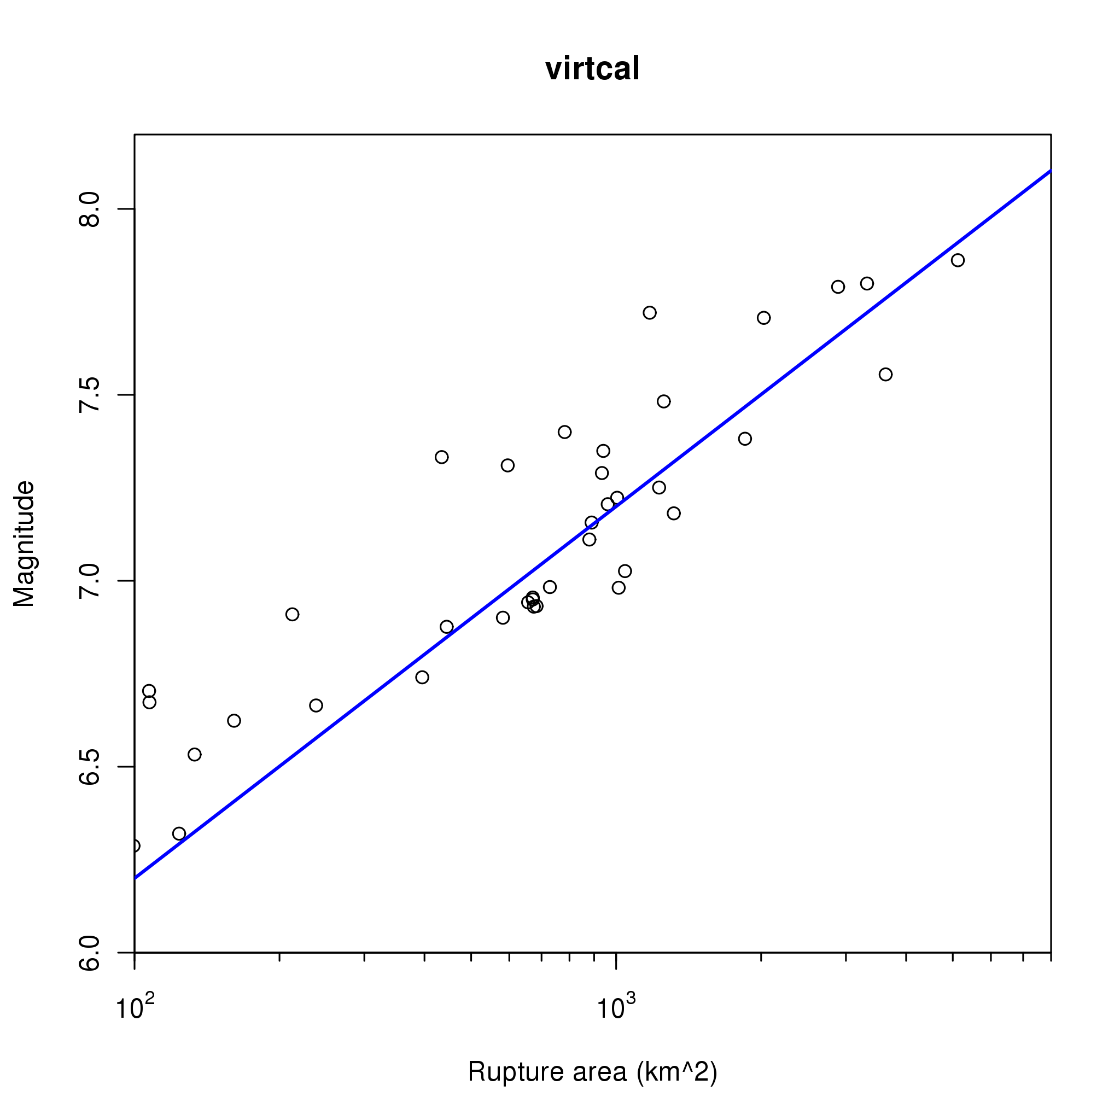
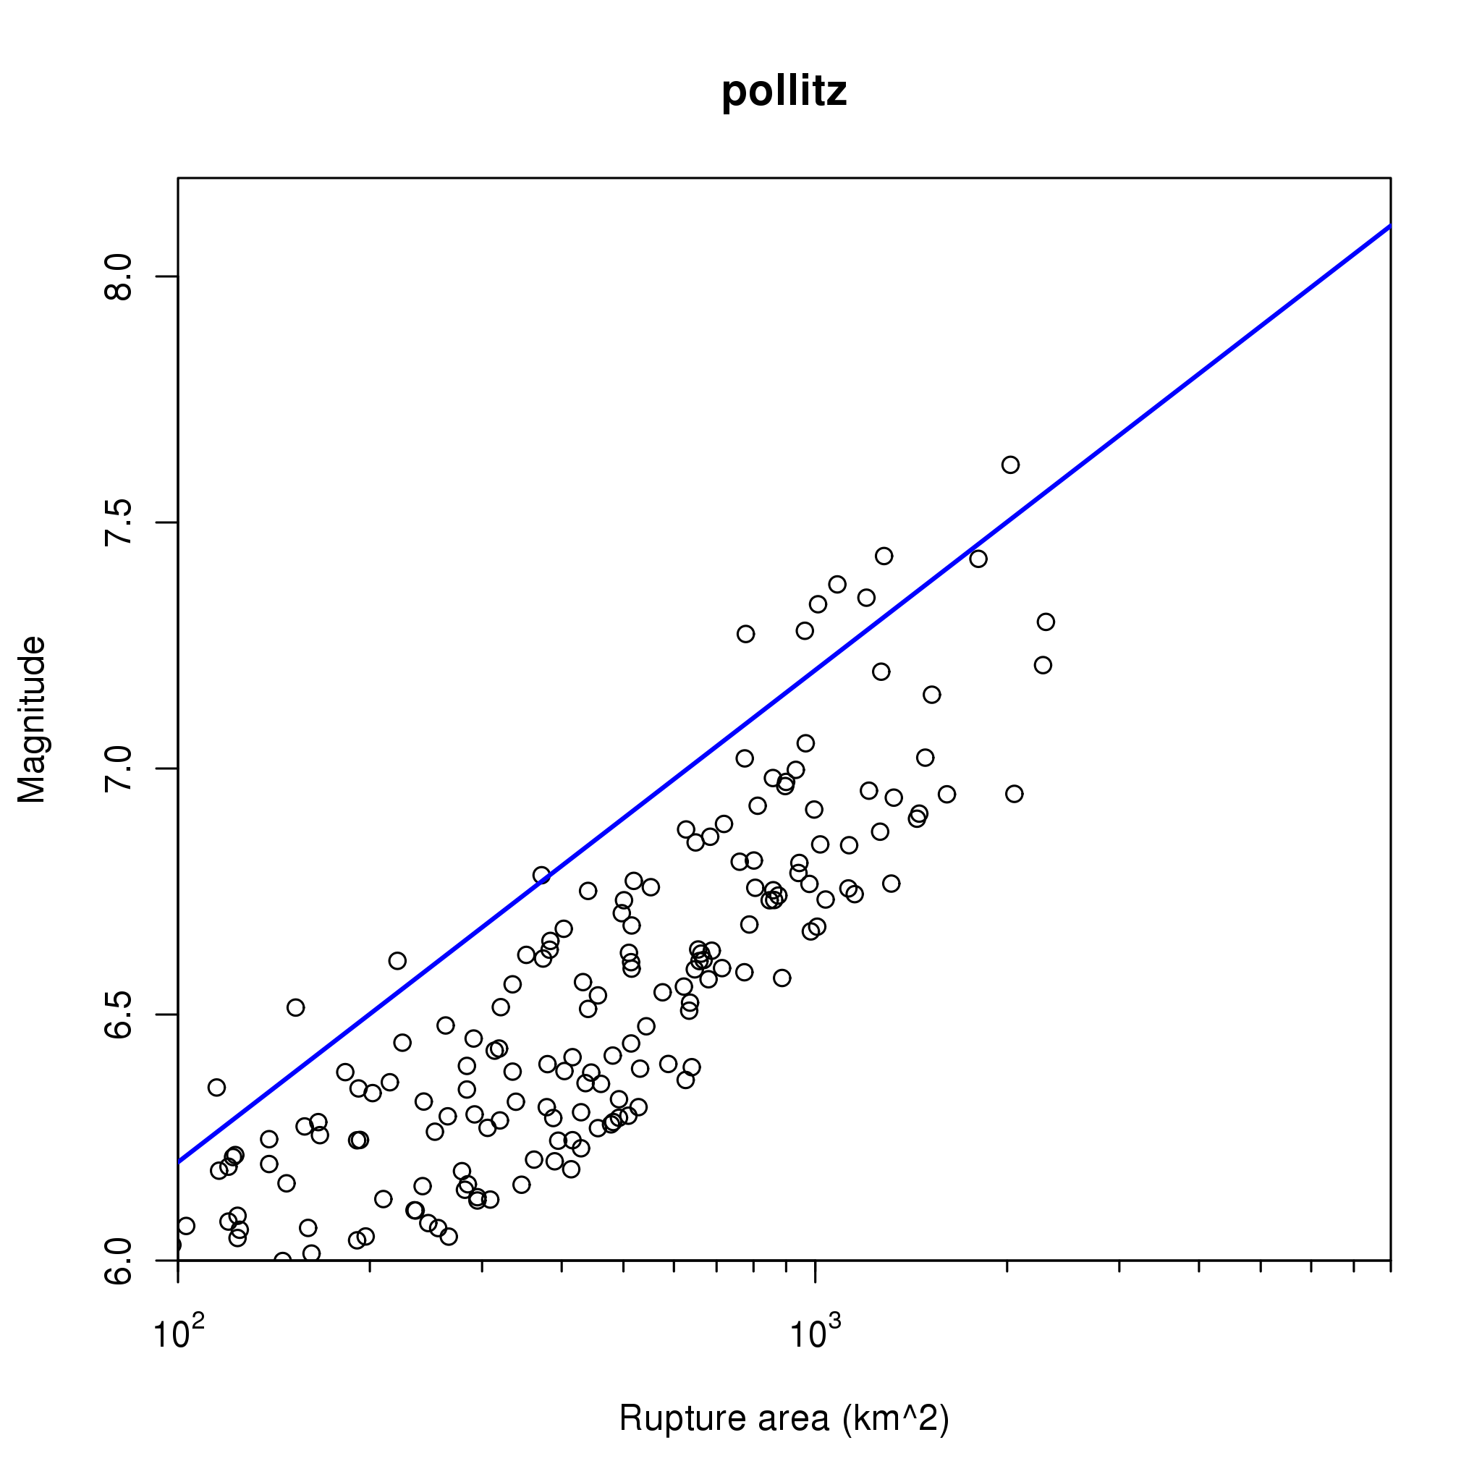
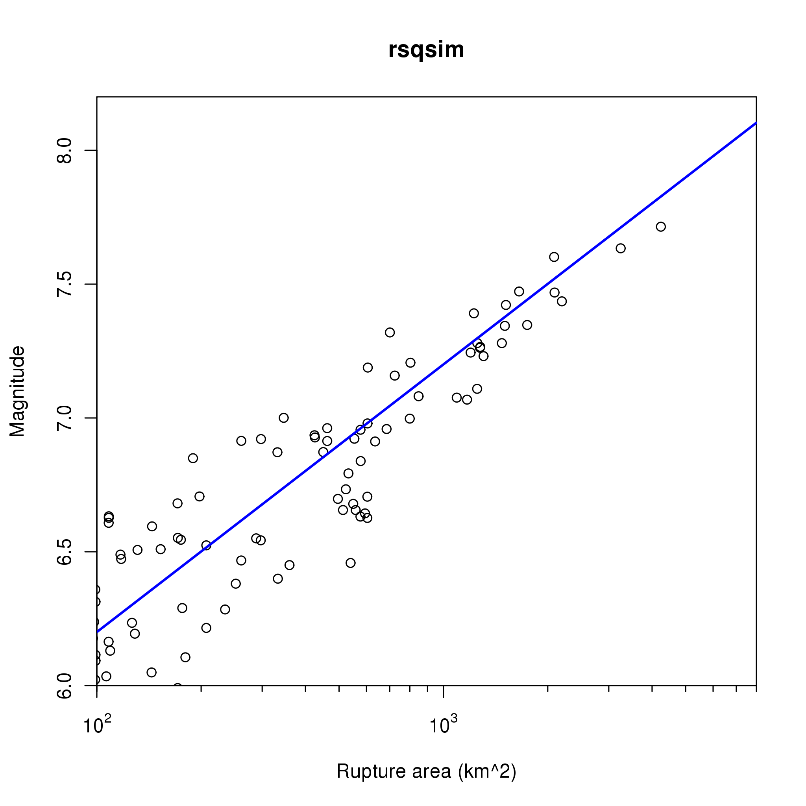
Comparison of 4 Simulators
Magnitude-Area Scaling – Showing 200 years of Simulated Events
ALLCAL
VIRTCAL
Blue line and symbols from
Wells and Coppersmith
Green symbols from WG02 Appendix D, Table D4
Red symbols from Hanks and Bakun (2007) via Bruce Shaw
RSQSim
ViscoSim

Slide 15
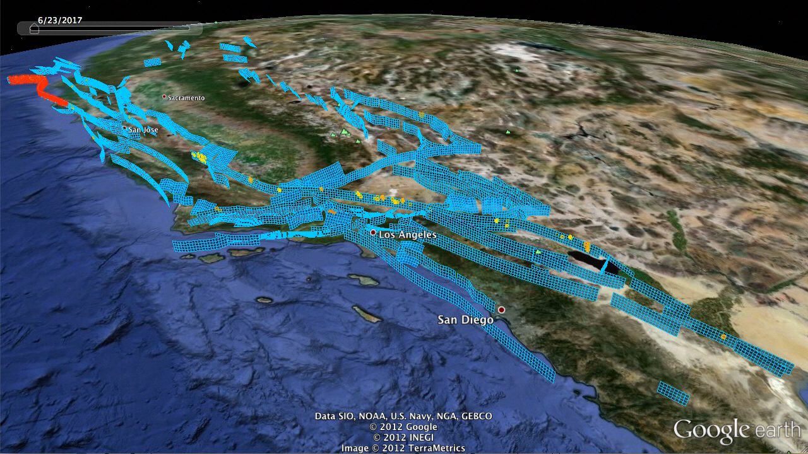

Slide 16
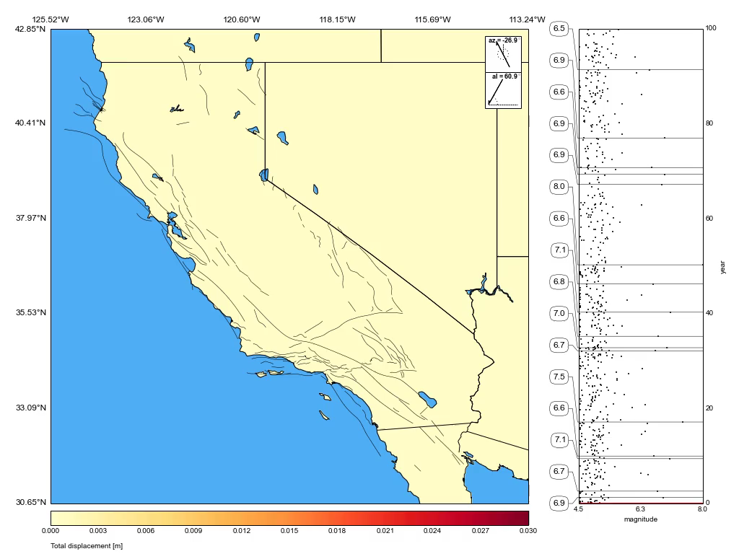
Displacement (m)

Slide 17
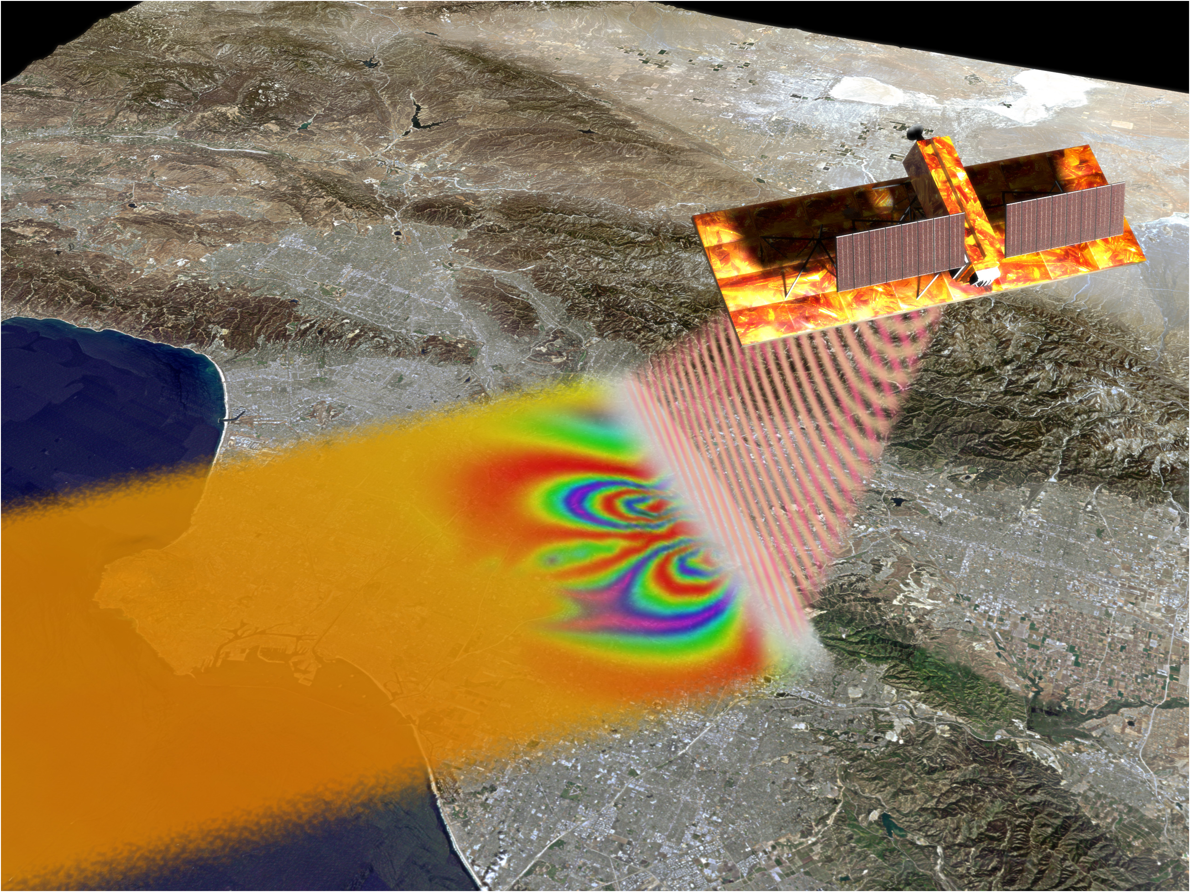

Slide 18
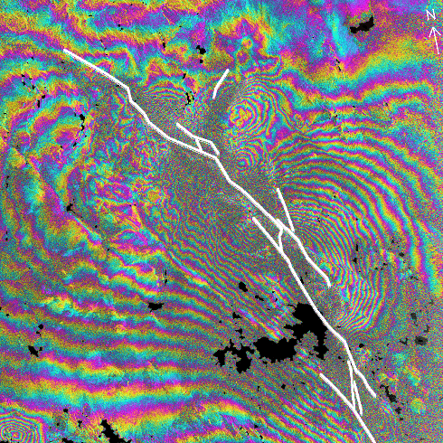
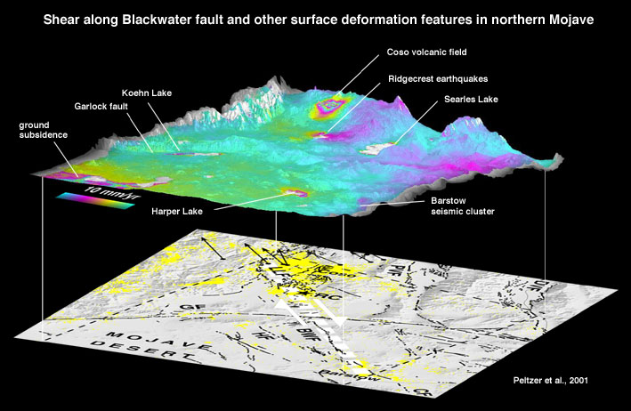
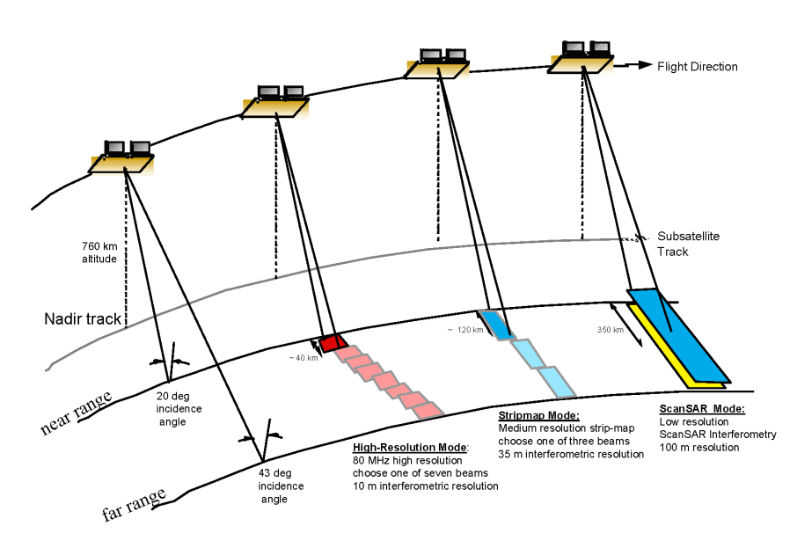
Synthetic Aperture Radar Interferometry (InSAR) can detect changes (both large and small) in surface deformation of the earth’s crust over synoptic scales.
At present we are limited to isolated, static images.
Deformation in the Eastern Mojave Shear Zone
(Courtesy G. Peltzer)
1992 Landers, California Earthquake
(Courtesy H. Zebker)
Courtesy Y. Kim

Slide 19
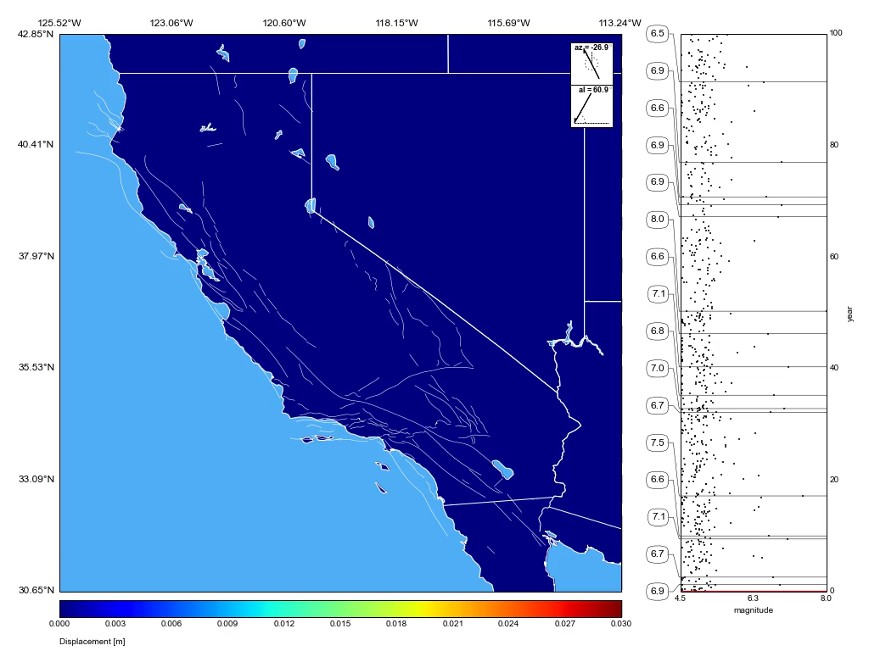
InSAR

Slide 20
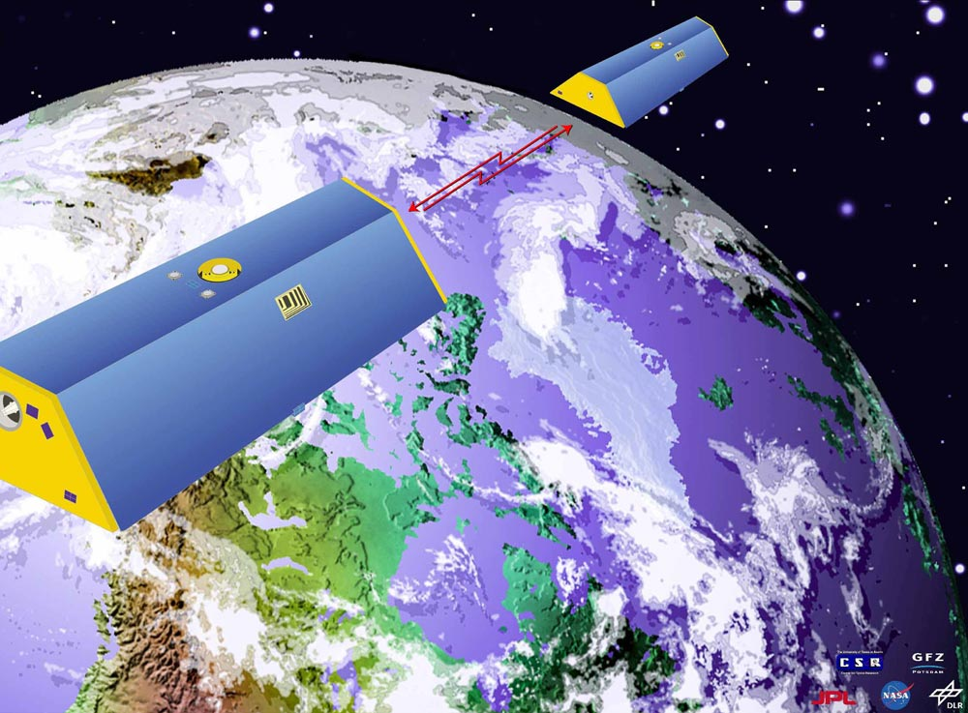
NASA Grace

Slide 21
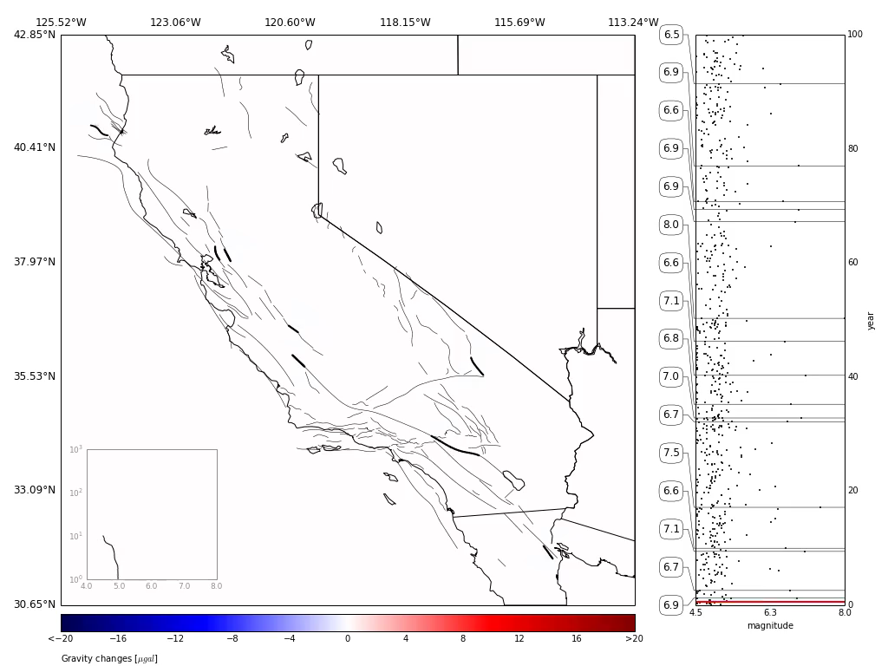
Gravity
(A Movie Not Starring Sandra Bullock and George Clooney)

Slide 22
Challenges in Web-Based Forecasting
Data & Models | Information Delivery | Meaning
Acquiring & validating data | Automation | What is probability?
Model building | Web-based integration | Visual presentation
Efficient algorithms | UI | GIS
Validating/verifying models | Tools | Correlations
Error reporting, correction, model steering | Collaboration/social networks | Expert guidance/blogs

