Slide 1
Lecture 14a
Earthquake Prediction and Forecasting
John Rundle GEL/EPS 131

Slide 2
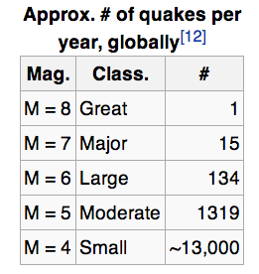
Topics
Haicheng: A Success Story
Prediction vs. Forecasting
Precursors
Probability
Validation and Verification
Examples

Slide 3
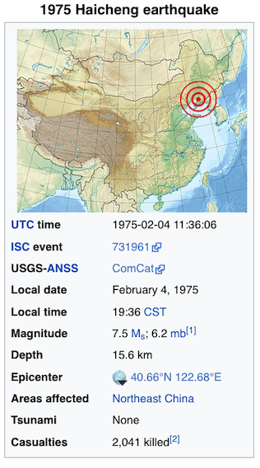
A Successful Earthquake Prediction:
The Haicheng, China Earthquake of 2/4/1975
The 1975 Haicheng earthquake hit Haicheng, Liaoning in China at 19:36 CST on February 4.
This earthquake had an Ms magnitude of 7.5, which is associated with total destruction of infrastructure and property.
Haicheng had approximately 1 million residents at the time of the earthquake, which is known for being one of the few earthquakes to be successfully predicted throughout history.
https://en.wikipedia.org/wiki/1975_Haicheng_earthquake

Slide 4
Details of the Haicheng Prediction
Early in the morning of February 4, 1975, Chinese officials ordered that the city of Haicheng be evacuated, believing there to be a large chance of an earthquake occurring.
The prediction was allegedly based on reports of changes in groundwater and soil elevations over the past several months as well as widespread accounts of unusual animal behavior, such as snakes crawling out of their holes in the middle of winter
A low-level alert was triggered by regional increases in seismicity (later recognized as foreshocks).
Both authorities and citizens were finally placed on high alert and an evacuation order was issued due to an increase in foreshocks.
The evacuation, despite successfully saving most of Haicheng's population, did not prevent deaths in its entirety.
When the main quake struck at 7:36 pm, 2,041 people died, over 27,000 were injured and thousands of buildings collapsed.
However, the death toll was much lower than the estimate of over 150,000 dead which is believed to have resulted if the evacuation had not taken place.
This was the only successful evacuation of a potentially affected population before a devastating earthquake in history.

Slide 5
Forecasting vs. Prediction
Context | Characteristic | Alternatively
Prediction | A statement that can be validated or falsified with 1 observation | Prediction is characterized by a search for reliable precursors
Forecast | A statement for which multiple observations are required to determine a confidence level | Forecasting is characterized by a computation of probabilities

Slide 6
Definitions http://en.wikipedia.org/wiki/Earthquake_prediction#CITEREFICEF2011
“Earthquake prediction "is usually defined as the specification of the time, location, and magnitude of a future earthquake within stated limits”, and particularly of "the next strong earthquake to occur in a region.”
This can be distinguished from earthquake forecasting, which is the probabilistic assessment of general earthquake hazard, including the frequency and magnitude of damaging earthquakes, in a given area over periods of years or decades.
This can be further distinguished from real-time earthquake warning systems, which, upon detection of a severe earthquake, can provide neighboring regions a few seconds warning of potentially significant shaking
To be useful, an earthquake prediction must be precise enough to warrant the cost of increased precautions, including disruption of ordinary activities and commerce, and timely enough that preparation can be made.
Predictions must also be reliable, as false alarms and cancelled alarms are not only economically costly, but seriously undermine confidence in, and thereby the effectiveness of, any kind of warning.”

Slide 7
Precursors http://en.wikipedia.org/wiki/Earthquake_prediction#CITEREFICEF2011
“An earthquake precursor could be any anomalous phenomena that can give effective warning of the imminence or severity of an impending earthquake in a given area.
Reports of premonitory phenomena – though generally recognized as such only after the event – number in the thousands, some dating back to antiquity.
In the scientific literature there have been around 400 reports of possible precursors, of roughly twenty different types, running the gamut "from aeronomy to zoology”.
The search for reliable precursors has yet to have a convincing success.
When (early 1990s) the IASPEI solicited nominations for a "Preliminary List of Significant Precursors" 40 nominations were made
Five were selected as possible significant precursors, with two of those based on a single observation each.”

Slide 8
Precursor Examples http://en.wikipedia.org/wiki/Earthquake_prediction#CITEREFICEF2011
Changes in V_{P}/V_{S} Velocity ratio
“Small-scale laboratory experiments have shown that the ratio of these two velocities – represented as Vp/Vs – changes when rock is near the point of fracturing. In the 1970s it was considered a significant success and likely breakthrough when Russian seismologists reported observing such changes in the region of a subsequent earthquake.
This effect, as well as other possible precursors, has been attributed to dilatancy, where rock stressed to near its breaking point expands (dilates) slightly.
Study of this phenomena near Blue Mountain Lake (New York) led to a successful prediction in 1973.
However, additional successes there have not followed, and it has been suggested that the prediction was only a lucky fluke.
A Vp/Vs anomaly was the basis of James Whitcomb's 1976 prediction of a M 5.5 to 6.5 earthquake near Los Angeles, which failed to occur.”

Slide 9
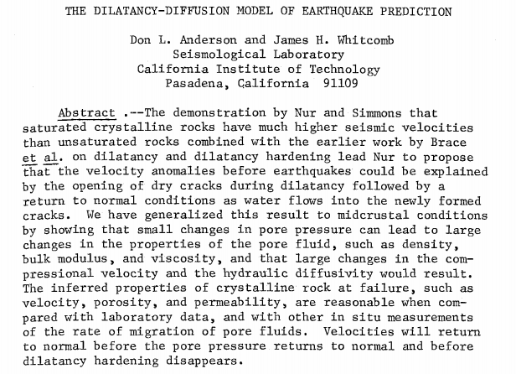
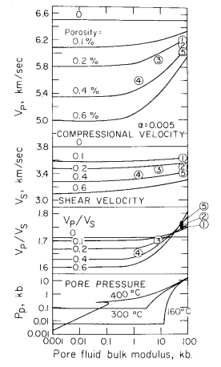
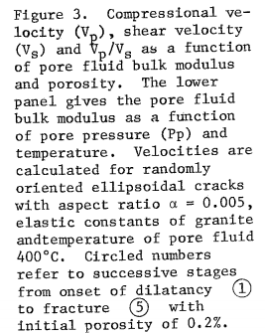
Dilatancy Diffusion Model http://www.gps.caltech.edu/uploads/File/People/dla/DLAtpsaf73.pdf

Slide 10
Precursor Examples http://en.wikipedia.org/wiki/Earthquake_prediction#CITEREFICEF2011
Radon Emissions
Most rock contains small amount of gases that can be isotopically distinguished from the normal atmospheric gases. There are reports of spikes in the concentrations of such gases prior to a major earthquake; this has been attributed to release due to pre-seismic stress or fracturing of the rock.
One of these gases is radon, produced by radioactive decay of the trace amounts of uranium present in most rock active as a potential earthquake predictor because being radioactive it is easily detected, and its short half-life (3.8 days) makes it sensitive to short-term fluctuations.
A 2009 review found 125 reports of changes in radon emissions prior to 86 earthquakes since 1966. But the earthquakes with which these changes are supposedly linked were up to a thousand kilometers away, months later, and at all magnitudes.
In some cases the anomalies were observed at a distant site, but not at closer sites.
Another review concluded that in some cases changes in radon levels preceded an earthquake, but a correlation is not yet firmly established.

Slide 11
Precursor Examples http://en.wikipedia.org/wiki/Earthquake_prediction#CITEREFICEF2011
Electromagnetic Variations
“Various attempts have been made to identify possible pre-seismic variations in various electrical, electric-resistive, or magnetic phenomena.
The most visible, and most criticized, is the VAN method of professors P. Varotsos, K. Alexopoulos and K. Nomicos – "VAN" – of the National and Capodistrian University of Athens.
Objections have been raised that the physics of the claimed process is not possible.
An analysis of the wave propagation properties of SES in the Earth’s crust showed that it would have been impossible for signals with the amplitude reported by VAN to have been generated by small earthquakes and transmitted over the several hundred kilometers distances from the epicenter to the monitoring station.
Several authors have pointed out that VAN’s publications are characterized by not accounting for (identifying and eliminating) the possible sources of electromagnetic interference (EMI) to their measuring system.”

Slide 12
Precursor Examples http://en.wikipedia.org/wiki/Earthquake_prediction#CITEREFICEF2011
Space-Time Patterns of Earthquake Seismicity
Seismic Gaps:
At the contact where two tectonic plates slip past each other every section must eventually slip, as (in the long-term) none get left behind.. In the seismic gap model the "next big quake" should be expected not in the segments where recent seismicity has relieved the strain, but in the intervening gaps where the unrelieved strain is the greatest.
This method is based on the Characteristic Earthquake model
This model has an intuitive appeal; it is used in long-term forecasting, and was the basis of a series of circum-Pacific (Pacific Rim) forecasts in 1979 and 1989—1991.
However, systematic testing has shown that this pattern is not very predictive of the time or location of the next large earthquake

Slide 13
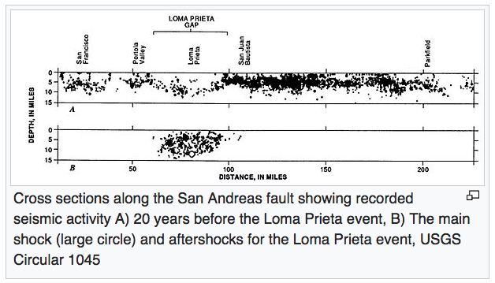
Seismic Gaps https://en.wikipedia.org/wiki/Seismic_gap

Slide 14
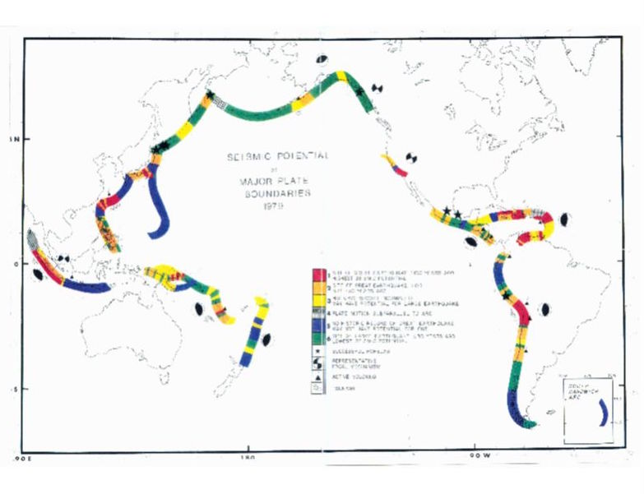
Seismic Gaps
McCann et al (1991)

Slide 15
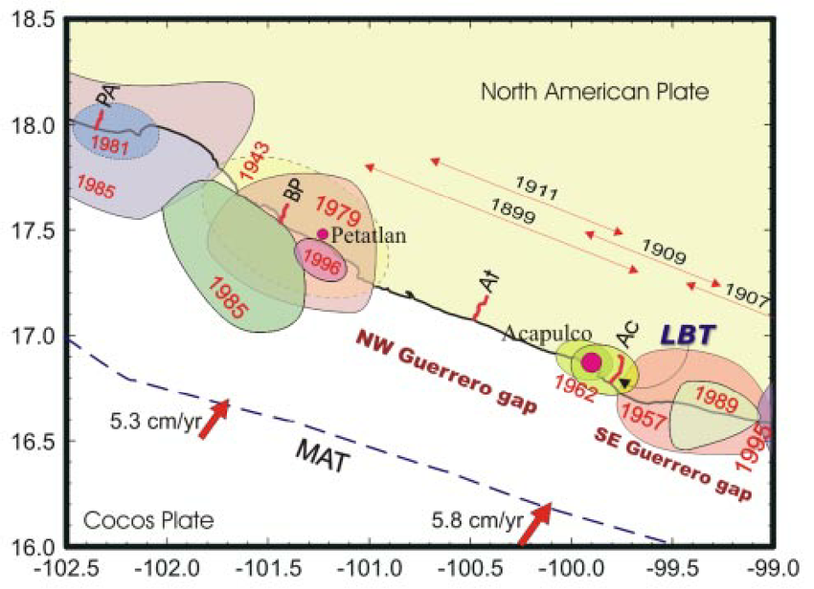
Seismic Gaps https://www.researchgate.net/figure/26490475_fig1_Fig-1-Major-seismic-gaps-along-the-Pacific-coast-of-Mexico-Shaded-areas-annotated-with
Fig. 1. Major seismic gaps along the Pacific coast of Mexico. Shaded areas annotated with a year are rupture zones of recent large thrust earthquakes. Thin arrows indicate the approximate rupture length of large earthquakes in 1899, 1907, 1909, and 1911. Solid arrows are vectors of the Cocos – NA convergence velocities according to the NUVEL 1A model (DeMets et al., 1994). MAT – Middle America trench. LBT mark with a thin arrow show a location of the tiltmeter. Annotated short lines (PA, BP, At, and Ac) are leveling profiles.

Slide 16
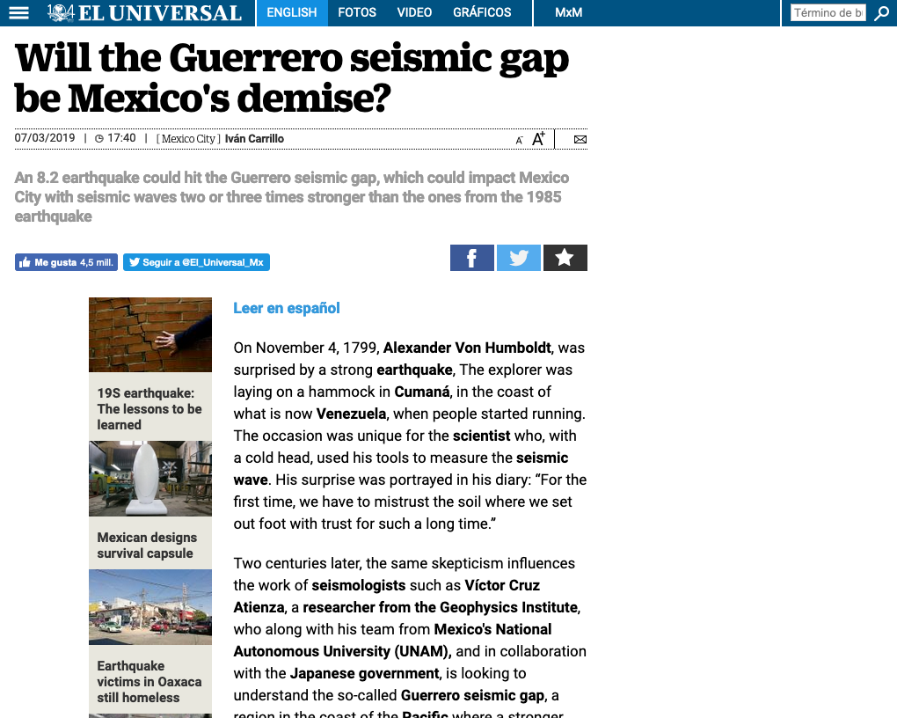

Slide 17
Seismicity Patterns http://en.wikipedia.org/wiki/Earthquake_prediction#CITEREFICEF2011
M8:
“Various pattern analysis algorithms have been developed for predicting earthquakes.
The most widely known is the M8 family of algorithms (including the RTP method) developed under the leadership of Vladimir Keilis-Borok of Russia. M8 issues a "Time of Increased Probability" (TIP) alarms for a large earthquake of a specified magnitude upon observing certain patterns of smaller earthquakes.
TIPs generally cover large areas (up to a thousand kilometers across) for up to five years.
Such large parameters have made M8 controversial, as it is hard to determine whether any hits that happen were skillfully predicted, or only the result of chance.”
AMR:
“Accelerating moment release (AMR, "moment" being a measurement of seismic energy) is based on some observations that foreshock activity prior to a major earthquake not only increased, but increased at an exponential rate.
Testing has shown that apparent AMR trends likely result from how data fitting is done[ and failing to account for spatiotemporal clustering of earthquakes.
The AMR trends have generally not been found to be statistically significant. “

Slide 18
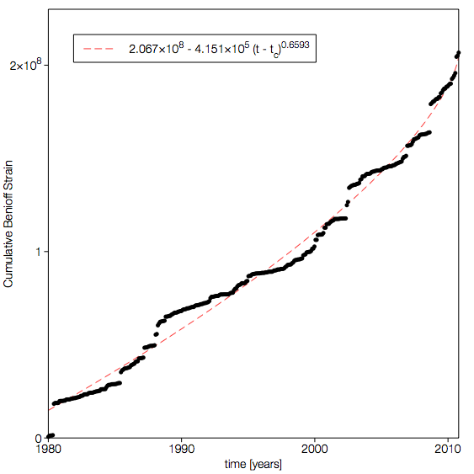

Seismicity Patterns:
Accelerating moment release (AMR)
Cumulative Benioff strain prior to the El Mayor-Cucapah earthquake in a circular region of radius 100km centered on the epicenter.
The dashed line is the best fit AMR correlation with:

Slide 19
Notable Predictions: Haicheng-Tangshan http://en.wikipedia.org/wiki/Earthquake_prediction#CITEREFICEF2011
“The M 7.3 Haicheng (China) earthquake of 4 February 1975 is the most widely cited "success" of earthquake prediction
The Chinese authorities issued both a medium-term prediction in June, 1974, and, following a number of foreshocks up to M 4.7 the previous day, a short-term prediction on February 4 that large earthquake might occur within one to two days.
Various measures were taken, including enforced evacuation of homes, construction of "simple outdoor structures", and showing of movies out of doors.
Although the quake, striking at 19:36, was powerful enough to destroy or badly damage about half of the homes, the "effective preventative measures taken" were said to have kept the death toll under 300.
This in a population of about 1.6 million, where otherwise tens of thousands of fatalities might have been expected.”
“The M7.8 Tangshan earthquake occurred on Wednesday, July 28, 1976, and is believed to be the largest earthquake of the 20th century by death toll.
The epicenter of the earthquake was near Tangshan in Hebei, People's Republic of China, an industrial city with approximately one million inhabitants.
The number of deaths initially reported by the Chinese government was 655,000, but this number has since been stated to be around 240,000 to 255,000.
A further 164,000 people were recorded as being severely injured.
The earthquake occurred between a series of political events involving the Communist Party of China, ultimately leading to the expulsion of the ruling Gang of Four by Mao's chosen successor Hua Guofeng.
In traditional Chinese thought, natural disasters are seen as a precursor of dynastic change.”

Slide 20
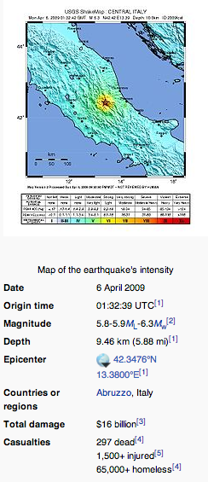
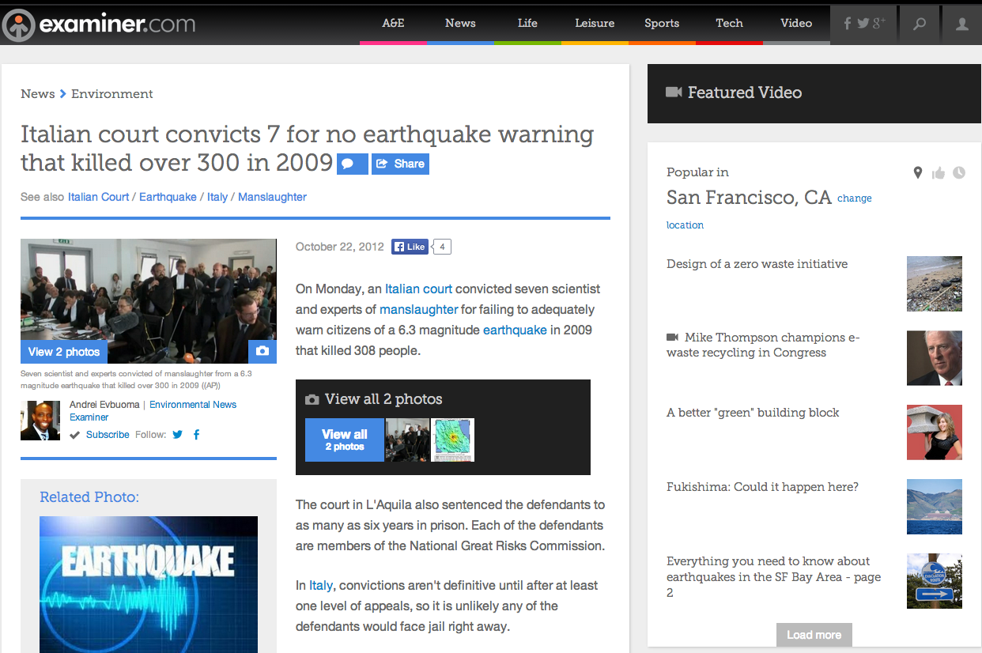
The L’Aquila Earthquake http://en.wikipedia.org/wiki/Earthquake_prediction#CITEREFICEF2011
It has been claimed that this conviction casts a cold chill over earthquake prediction/forecast research and that the 7 were convicted of failing to predict earthquakes
The countervailing view is that the 7 were convicted of failing to convey the possible risk
On appeal, 6 of the 7 had the convictions reversed

Slide 21
Hazards of Prediction: The Italian Situation http://en.wikipedia.org/wiki/Earthquake_prediction#CITEREFICEF2011
On 6 April 2009, the L’Aquila, Italy region was shaken by a M6.3 earthquake that collapsed many historic unreinforced buildings in the town and killed 308 persons and left 67,000 others homeless
This event had been preceeded by many swarms of small earthquakes in the months before the mainshock
That area of Italy has had significant historic earthquakes, and the tradition in the town was that the public would sleep outside when the activity became intense
Soon after the mainshock came the further information that a laboratory technician, Giampaolo Giuliani, had not only predicted this earthquake, but had tried to warn the public, and had been muzzled by the Italian government.
He was arrested, tried, and convicted for disturbing the peace
In addition, a government commission had investigated the claims, thought them to be baseless, and dismissed the prediction
In fact, one of the 7 commissioners had even gone so far as to suggest to a reporter outside the meeting room at the press conference, that citizens in the region should relax and have a bottle of wine
The 7 commissioners were themselves tried for failing in their duty to warn the public of a possible disaster, they were convicted and sentenced to 6 years in prison
The case caused an international outcry and sensation, and their sentences were appealed.
6 of the 7 were eventually exonerated, the last had his sentence reduced

Slide 22
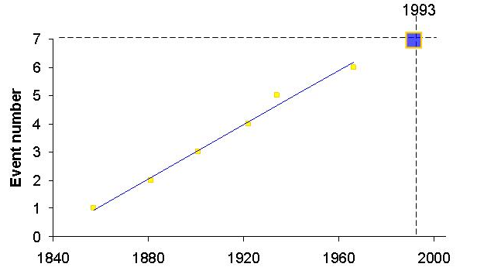
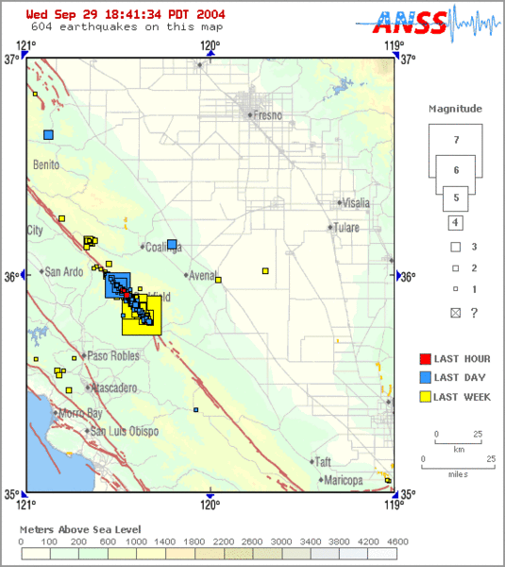
Notable Predictions: Parkfield http://en.wikipedia.org/wiki/Earthquake_prediction#CITEREFICEF2011
Most recent event occurred on September 28, 2004
Previous Events in:
1857, 1881, 1901, 1922, 1934, and 1966
2/8/2019

Slide 23

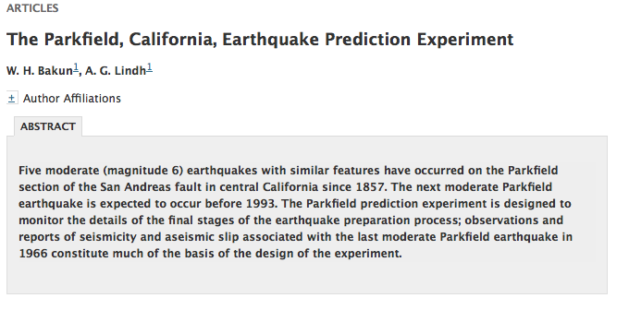
USGS Forecasts
Previous Forecasts
A “consensus” prediction at the time
Earthquake originally predicted for 1988 +/- 5 years

Slide 24
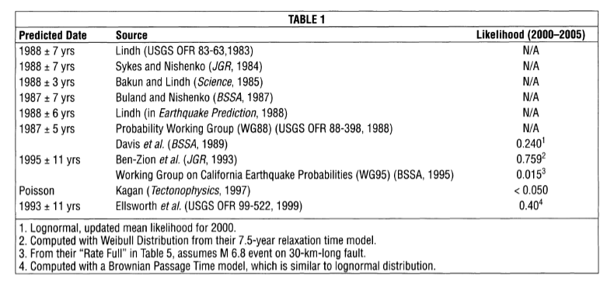
Predicted Time of Occurrence (A. Lindh, SRL, 2005)
Actual Occurrence: 28 September, 2004
Various precursors predicted
Precursors observed: Depends on your interpretation of events

Slide 25
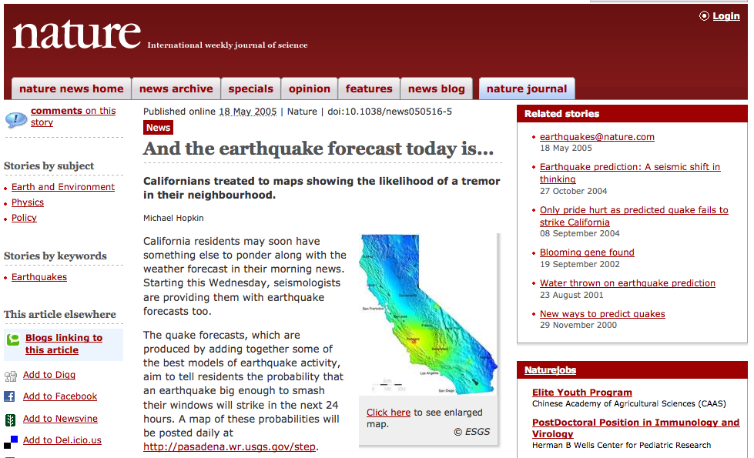
STEP: A “consensus” forecast at the time. Approved by CEPEC and NEPEC
Web site was built to make 24-hour forecasts of aftershocks using the STEP method

Slide 26
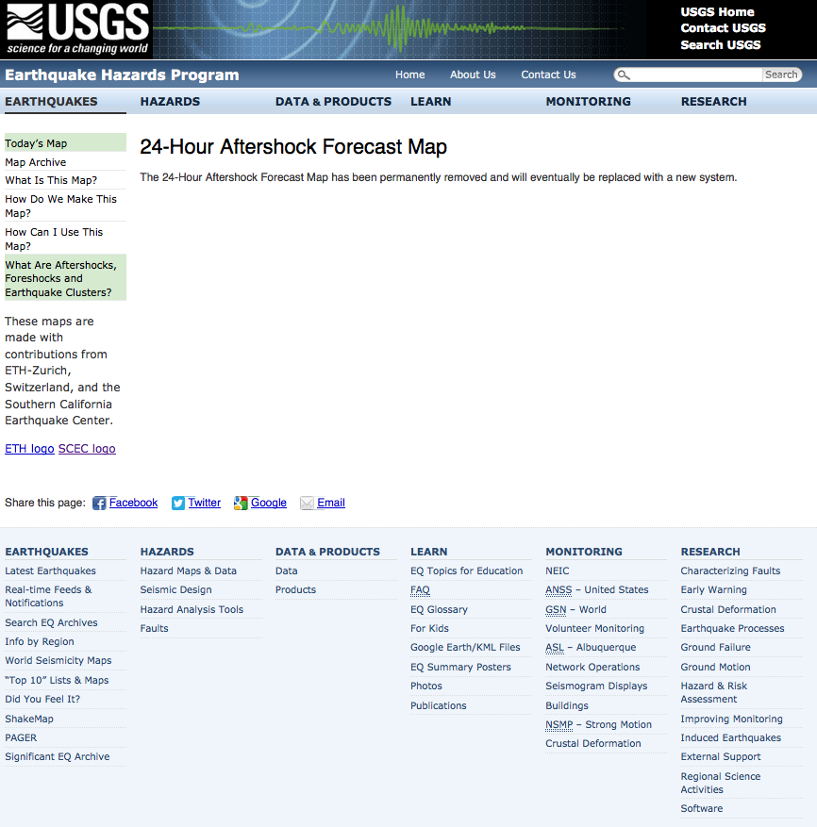
Current state of STEP web site

Slide 27
Forecast for Nepal Aftershocks Made on May 8, 2015
A “consensus” method using
Reasenberg and Jones 1989
Forecast made by USGS on May 8, 2015 at the request of USAID
99.6% probability of non-occurrence for M>7 during the week of May 8-14
M7.3 aftershock occurred on May 12
280 deaths, 3500+ injuries
(per wikipedia)
Notes:
Start here 2017-10-27

Slide 28
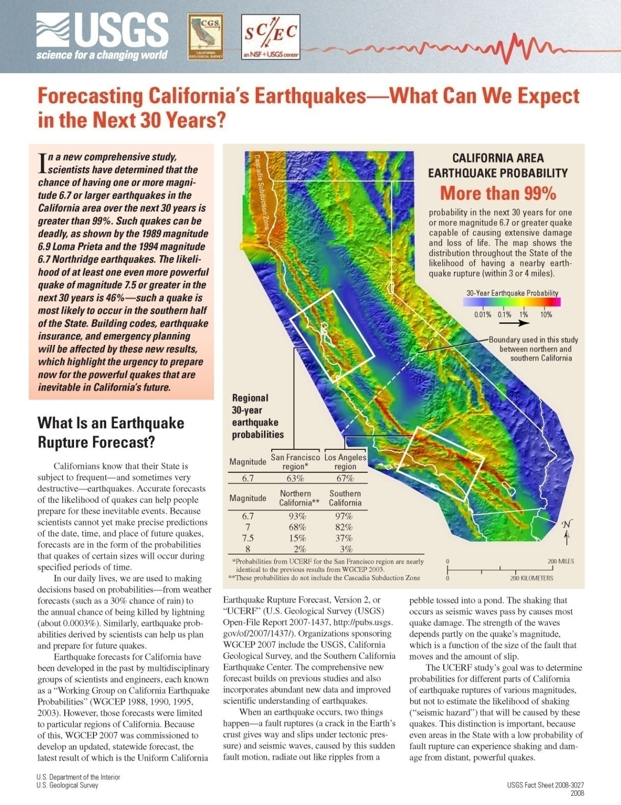
California:
The Official Forecast
http://wgcep.org/
Working Group on California Earthquake Probabilities 2007
Method requires many tens of scientists over ~4 years to produce a single 30 year forecast.
Approx. 2000 model parameters whose values are set using “expert opinion”.
Method cannot be automated (because it uses expert opinion) so the forecast cannot be backtested.

Slide 29
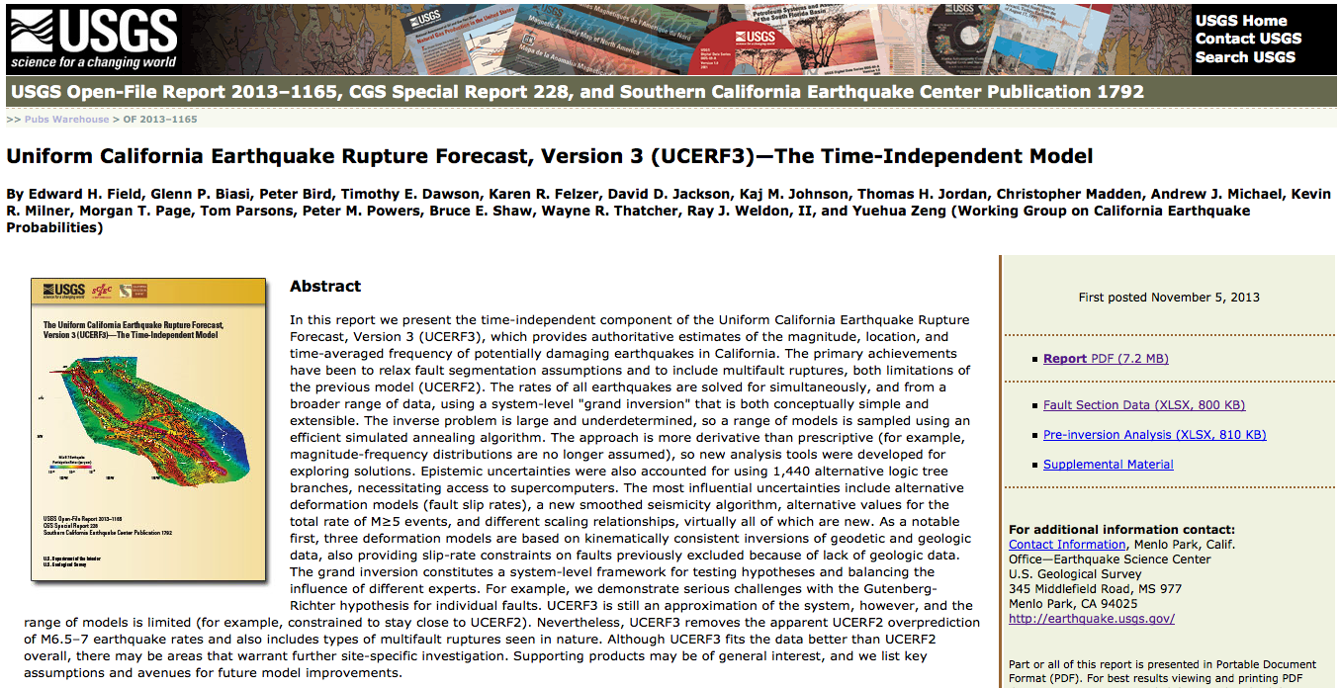
The New “Consensus” Forecast
18 Authors. Official California forecast. Not tested in CSEP.

Slide 30
Fault Model for Earthquake Simulators
Input Data: Paleoseismic and Statistical Rupture Data
Essentially the UCERF2 Fault and Deformation Model
~3 km squares, down to ~12 km depth
~ 15,000 elements
0
10
20
30
40
Slip rate, mm/yr

Slide 31
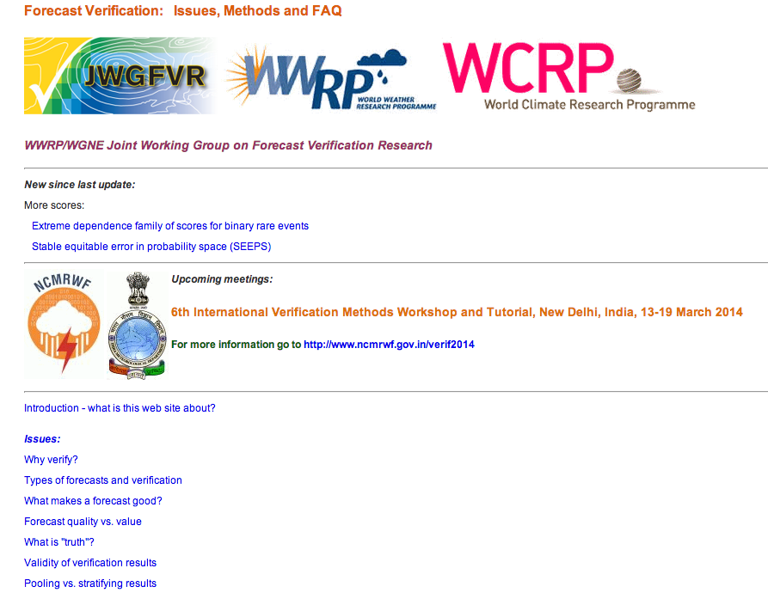
Verification and Validation http://www.cawcr.gov.au/projects/verification/
Australian site for weather and more general validation and verification of forecasts
Common methods are Reliability/Attributes diagrams, ROC diagrams, Briar Scores, etc.

Slide 32
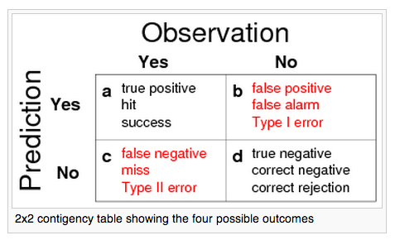
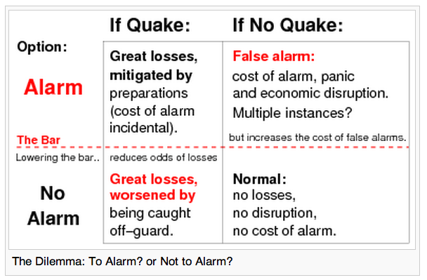
Testing: Contingency Tables http://en.wikipedia.org/wiki/Earthquake_prediction#CITEREFICEF2011

Slide 33
RELM forecast comparison test
January 1, 2006 – December 31, 2010

Slide 34
No. | Origin Time (UTC) | Lat. | Long. | M
1 | 2006/05/24 04:20:26.01 | 32.3067 | -115.2278 | 5.37 | A
2 | 2006/07/19 11:41:43.46 | 40.2807 | -124.4332 | 5.00
3 | 2007/02/26 12:19:54.48 | 40.6428 | -124.8662 | 5.40
4 | 2007/05/09 07:50:03.83 | 40.3745 | -125.0162 | 5.20
5 | 2007/06/25 02:32:24.62 | 41.1155 | -124.8245 | 5.00
6 | 2007/10/31 03:04:54.81 | 37.4337 | -121.7743 | 5.45
7 | 2008/02/09 07:12:04.55 | 32.3595 | -115.2773 | 5.10 | A
8 | 2008/02/11 18:29:30.53 | 32.3272 | -115.2568 | 5.10 | A
9 | 2008/02/12 04:32:39.24 | 32.4475 | -115.3175 | 4.97 | A
10 | 2008/02/19 22:41:29.66 | 32.4325 | -115.3130 | 5.01 | A
11 | 2008/04/26 06:40:10.60 | 39.5253 | -119.9289 | 5.00
12 | 2008/04/30 03:03:06.90 | 40.8358 | -123.4968 | 5.40
13 | 2008/07/29 18:42:15.71 | 33.9530 | -117.7613 | 5.39
14 | 2008/11/20 19:23:00.19 | 32.3288 | -115.3318 | 4.98 | A
15 | 2008/12/06 04:18:42.85 | 34.8133 | -116.4188 | 5.06
16 | 2009/09/19 22:55:17.84 | 32.3707 | -115.2612 | 5.08
17 | 2009/10/01 10:01:24.67 | 36.3878 | -117.8587 | 5.00 | FS
18 | 2009/10/03 01:16:00.31 | 36.3910 | -117.8608 | 5.19
19 | 2009/12/30 18:48:57.33 | 32.4640 | -115.1892 | 5.80
20 | 2010/01/10 00:27:39.32 | 40.6520 | -124.6925 | 6.50
21 | 2010/02/04 20:20:21.97 | 40.4123 | -124.9613 | 5.88
22 | 2010/04/04 22:40:42.15 | 32.2587 | -115.2872 | 7.20
23 | 2010/04/04 22:50:17.08 | 32.0972 | -115.0467 | 5.51 | AS
24 | 2010/04/04 23:15:14.24 | 32.3000 | -115.2595 | 5.43 | AS
25 | 2010/04/04 23:25:06.95 | 32.2462 | -115.2978 | 5.38 | AS
26 | 2010/04/05 00:07:09.07 | 32.0180 | -115.0172 | 5.32 | AS
27 | 2010/04/05 03:15:24.46 | 32.6282 | -115.8062 | 4.97 | AS
28 | 2010/04/08 16:44:25.92 | 32.2198 | -115.2760 | 5.29 | AS
29 | 2010/06/15 04:26:58.48 | 32.7002 | -115.9213 | 5.72 | AS
30 | 2010/07/07 23:53:33.53 | 33.4205 | -116.4887 | 5.43
31 | 2010/09/14 10:52:18.00 | 32.0485 | -115.1982 | 4.96 | AS
The Earthquakes
Times of occurrence, locations, and magnitudes of the 31 earthquakes in the test region with M ≥ 4.95 from 1 January 2006 until 31 December 2010. The M = 7.2 El Mayor-Cucapah earthquake is in red.
A - activation(6)
FS - foreshock(1) AS - aftershock (8)

Slide 35
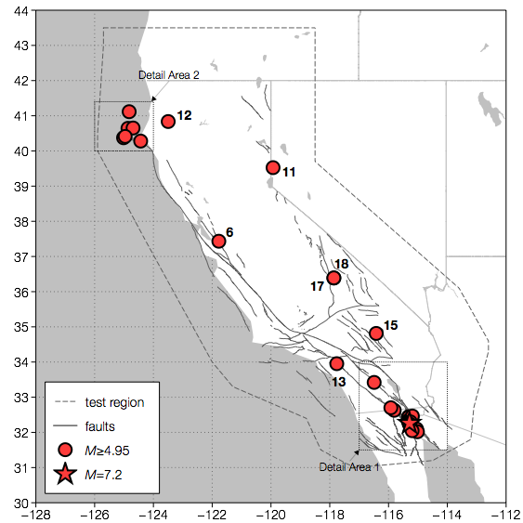
Test Region
Map of the test region, the coast of California, major faults, and the 31 earthquakes with M ≥ 4.95 that occurred in the test region. Also shown are the square regions where large scale maps are given in subsequent slides.

Slide 36
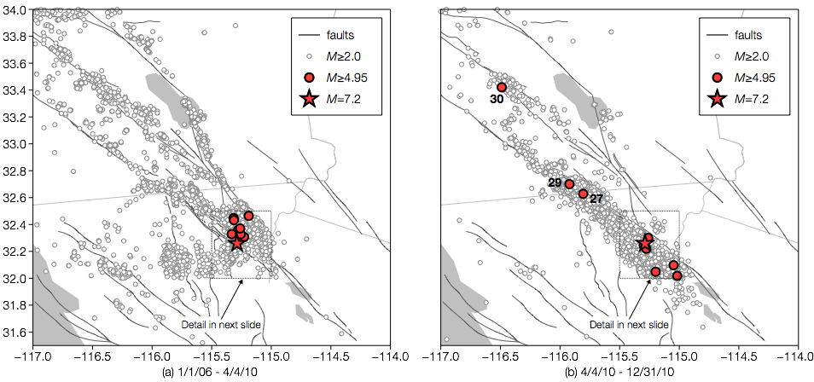
detail area 1
Map of the southeast region around the epicenter of the M = 7.2 El Mayor-Cucapah earthquake that occurred on 4 April 2010 (shown as a star). (a) Earthquakes during the period 1 January 2006 through 4 April 2010. (b) Earthquakes during the period 4 April 2010 through 31 December 2010 (includes aftershocks). Included are the test earthquakes as well as background earthquakes with M ≥ 2.0.
Map of the southeast region around the epicenter of the M = 7.2 El Mayor-Cucapah earthquake that occurred on 4 April 2010 (shown as a star). (a) Earthquakes during the period 1 January 2006 through 4 April 2010. (b) Earthquakes during the period 4 April 2010 through 31 December 2010 (includes aftershocks). Included are the test earthquakes as well as background earthquakes with M ≥ 2.0.

Slide 37
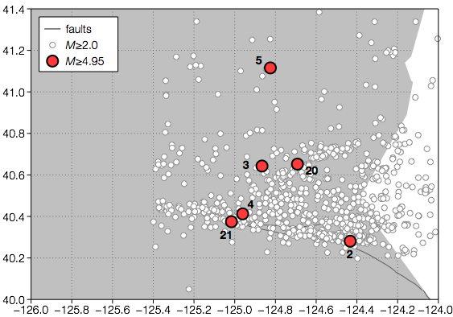
Detail Area 2
Map of the northwest region near Cape Mendocino. Test earthquakes are shown as well as background earthquakes with M ≥ 2.0.

Slide 38
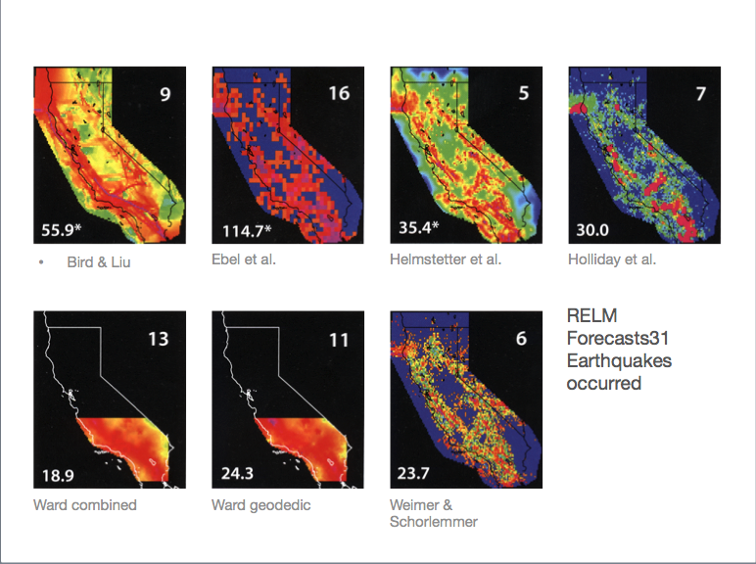

Slide 39
Cell ID | EQ ID | B and L | Ebel | Helm. | Holl. | W-C | W-G | W and S
- A - | 1,7,8,16,24 | 1.99E-02 | 2.20E-02 | 1.17E-01 | 3.32E-02 | 1.87E-02 | 1.28E-02 | 1.24E-01
- B - | 2 | 1.41E-02 | 3.40E-02 | 7.20E-02 | 3.32E-02 | 1.08E-03 | 1.86E-03 | 4.99E-02
- C - | 3 | 7.40E-03 | 6.59E-03 | 7.41E-03 | 3.32E-02 | 8.93E-04 | 1.54E-03 | 7.91E-03
- D - | 4 | 3.54E-02 | 3.29E-02 | 6.97E-02 | 3.32E-02 | 9.50E-04 | 1.64E-03 | 3.59E-02
- E - | 5 | 7.23E-03 | 1.10E-03 | 2.29E-03 | 9.72E-05 | 9.25E-04 | 1.59E-03 | 1.58E-07
- F - | 6 | 9.37E-03 | 2.85E-02 | 3.07E-02 | 3.32E-02 | 5.29E-03 | 8.12E-03 | 4.55E-02
- G - | 9,10 | 9.11E-03 | 5.49E-03 | 2.55E-02 | 3.32E-02 | 2.25E-02 | 1.27E-02 | 2.38E-02
- H - | 11 | 3.42E-04 | 5.49E-03 | 9.15E-04 | 1.62E-04 | 3.77E-04 | 6.49E-04 | 2.06E-04
- I - | 12 | 2.14E-03 | 1.10E-03 | 3.65E-03 | 2.05E-04 | 1.14E-03 | 1.96E-03 | 9.89E-03
- J - | 13 | 1.68E-03 | 8.78E-03 | 1.11E-02 | 3.32E-02 | 8.11E-03 | 5.12E-03 | 1.13E-02
- K - | 14 | 3.12E-02 | 2.20E-02 | 3.30E-02 | 3.32E-02 | 1.93E-02 | 1.17E-02 | 5.90E-02
- L - | 15 | 2.07E-03 | 5.49E-03 | 6.93E-03 | 3.32E-03 | 4.80E-03 | 5.45E-03 | 2.64E-03
- M - | 17,18 | 1.74E-03 | 2.20E-03 | 5.78E-03 | 3.32E-02 | 3.88E-03 | 4.61E-03 | 5.38E-04
- N - | 19 | 5.83E-02 | 6.59E-03 | 1.49E-02 | 3.32E-02 | 1.65E-02 | 1.23E-02 | 7.44E-03
- O - | 20 | 1.25E-02 | 1.43E-02 | 9.45E-03 | 3.32E-02 | 9.30E-04 | 1.60E-03 | 1.62E-02
- P - | 21 | 6.48E-03 | 3.29E-02 | 2.71E-02 | 3.32E-02 | 9.03E-04 | 1.55E-03 | 7.46E-03
- Q - | 22,25,28 | 2.88E-02 | 2.20E-02 | 2.84E-02 | 3.32E-02 | 1.66E-02 | 1.30E-02 | 5.23E-02
- R - | 23,26 | 3.06E-02 | 1.54E-02 | 1.43E-02 | 1.73E-04 | 1.78E-02 | 1.38E-02 | 1.58E-02
- S - | 27 | 2.13E-02 | 5.49E-03 | 1.26E-02 | 3.32E-02 | 9.55E-03 | 7.93E-03 | 1.19E-02
- T - | 29 | 1.83E-02 | 1.32E-02 | 2.43E-02 | 3.32E-02 | 6.35E-03 | 3.90E-03 | 4.99E-02
- U - | 30 | 1.26E-02 | 3.07E-02 | 1.03E-01 | 3.32E-03 | 1.61E-02 | 5.47E-03 | 5.16E-02
- V - | 31 | 6.76E-03 | 1.54E-02 | 5.55E-03 | 3.32E-02 | 1.54E-02 | 1.43E-02 | 2.64E-03
  Normalized probabilities of occurrence λin of an earthquake with M ≥ 4.95 for the 22 cells in which earthquakes occurred during the test period. Seven submitted forecasts are given: (1) Bird and Liu (B and L), (2) Ebel et al. (Ebel), (3) Helmstetter et al. (Helm.), (4) Holliday et al. (Holl.), (5) Ward combined (W-C), (6) Ward geodetic (W-G), (7) Wiemer and Schorlemmer (W and S). The highest (best) probabilities are in red. Perfect skill λin = 1.00, No skill λin = 22/7682 = 2.86×10⁻³.

Slide 41
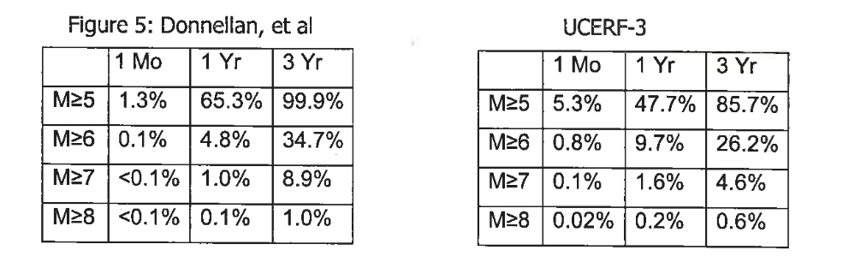
Comparison of Forecasts
100 km radius circle centered on La Habra, CA
32 M≥5 events in ANSS catalog since 1933 = 0.39 yr⁻¹
Forecasts from approximately June, 2015
Based on counting small earthquakes and Weibull statistics
Based on a 30-year forecast scaled to short term forecasts using Poisson statistics
β=1.4, has memory
Avg. rate of M≥5 = 0.39 yr⁻¹
β=1.0, has no memory
Avg. rate of M≥5 = 0.65 yr⁻¹
(implies 53 M≥5 earthquakes since 1933)
Source: Letter from John Parrish, CGS, to Andrea Donnellan, JPL, dated November 4, 2015

Slide 42
RELM test rules
Test region: California plus adjacent regions
Test region divided into Nc = 7682, 0.1˚ x 0.1˚ cells
Magnitude range M ≥ 5
Time period: 5 years 1/1/06 - 12/31/10
Participants submitted the probability λim of the occurrence of an earthquake in cell i, probabilities were submitted for 41 magnitude bins with ΔM = 0.1

Slide 43
discussion
The general RELM test worked well. The magnitude minimum, cell size and time period were appropriate
It would be best to separate the forecasts of number of events from the forecasts of the locations of the events.
The relative values of alarm based versus continuous forecasts should be considered. Continuous forecasts are best for insurance purposes.
There is no unique scoring that determines the best forecasts.
Forecasts can provide about a two order of magnitude range of earthquake probabilities (M > 5) in California.

Slide 44
 | | Nλmax | | | λin | | Ltest
Bird and Liu | 3 | 1.53×10⁻⁰² | -126
Ebel et al. | 1 | 1.51×10⁻⁰² | -123
Helmstetter et al. | 4 | 2.84×10⁻⁰² | -114
Holliday et al. | 8 | 2.45×10⁻⁰² | -123
Ward combined | 0 | 8.55×10⁻⁰³ | -141
Ward geodetic | 0 | 6.53×10⁻⁰³ | -141
Wiemer and Schor. | 6 | 2.66×10⁻⁰² | -129
Comparisons of the forecasts: Column 1: The number of maximum cell probabilities Nλmax. Column2: The mean cell probabilities forecast λin. Column 3: The maximum likelihood scores. The best scores in each category are red.
Perfect skill λin = 1.00, No skill λin = 22/7682 = 2.86×10⁻³.

Slide 45



Our Approach
Remove magnitude dependence:
λi is the probability of occurrence of a M ≥ 4.95 earthquake in cell i
Remove dependence on total number of earthquakes forecast (normalize all forecasts over area to the same value:
Consider only the 22 cells in which earthquakes occurred,and neglect the multiple occurrence of earthquakes in a cell: Nce
Introduce a normalized probability λin (skill score) for the occurrence of an earthquake in cell i
λin = 1 for a perfect skill forecast, λin = Nce/Nc = 22/7682 = 2.86 x 10⁻³ for a random, no skill forecast

Slide 46

demonstration that MS λin are equal to MS+AS λin
Consider earthquake #1 (cell A)
 |  | λi | Ne
Ebel et al. | MS | 2.81×10⁻² | 28.2 | 2.19×10⁻²
 | MS+AS | 1.15×10⁻¹ | 114.7 | 2.20×10⁻²
Helmstetter et al. | MS | 1.12×10⁻¹ | 21.1 | 1.17×10⁻¹
 | MS+AS | 1.88×10⁻¹ | 35.4 | 1.17×10⁻¹
Notes:
memphis

Slide 47
Testing: Contingency Tables http://en.wikipedia.org/wiki/Earthquake_prediction#CITEREFICEF2011

