Slide 1
Lecture 13
Tsunamis
John Rundle GEL/EPS 131

Slide 2
Topics
Tsunamis
Generation
Propagation
Runup
Tsunami Animation Links:
http://serc.carleton.edu/NAGTWorkshops/hazards/visualizations/tsunami.html

Slide 3
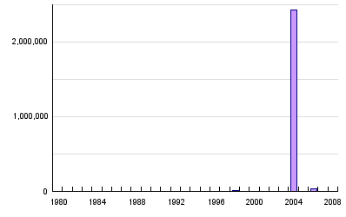
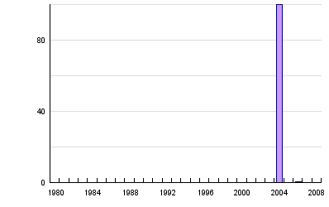
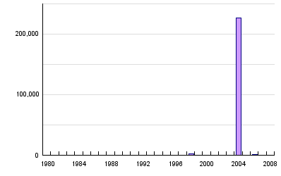
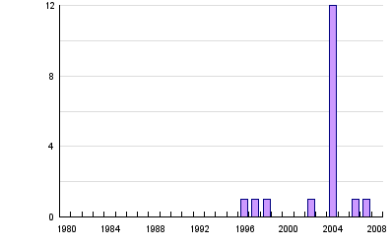
Global Tsunami Statistics, 1980-2008 http://www.preventionweb.net/english/hazards/statistics/?hid=71
Persons Affected
Economic Damage (USD in B$)
Persons Killed
Number of Reported Events

Slide 4
Global Tsunamis Summary Statistics, 1980-2008 http://www.preventionweb.net/english/hazards/statistics/?hid=71

Slide 5
Tsunamis: General Facts http://en.wikipedia.org/wiki/Tsunami
“Tsunami = Japanese for “Harbor Wave”
About 80% of tsunamis occur in the Pacific Ocean, but they are possible wherever there are large bodies of water, including lakes.
They are caused by earthquakes, landslides, volcanic explosions, glacier calvings, and bolides.
Tsunamis cause damage by two mechanisms:
The smashing force of a wall of water travelling at high speed
And the destructive power of a large volume of water draining off the land and carrying a large amount of debris with it, even with waves that do not look large.”
In the March 11, 2011 tsunami, victims died from “sandblasting”, being battered to death by water-borne debris, drowning, and hyperthermia

Slide 6
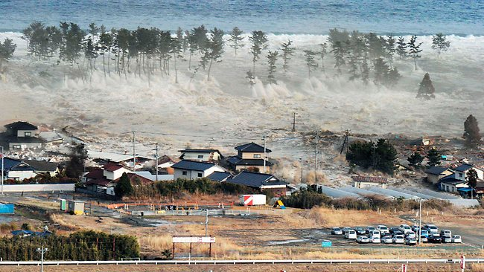
Near Sendai Airport, Japan The Largest Earthquake Since 869 AD in this Region
Image Courtesy NHK

Slide 7
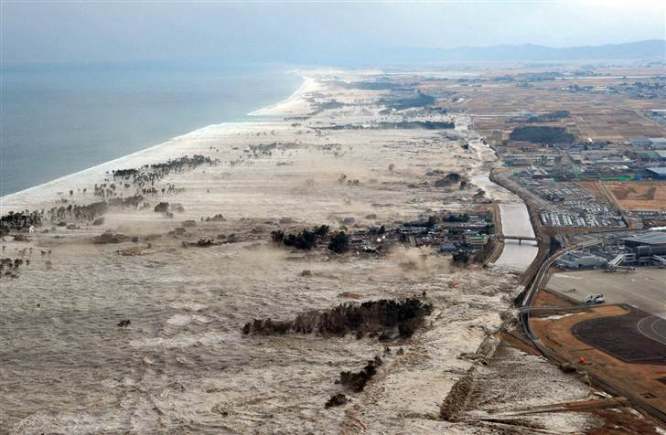
View of the Tohoku Coastline
Sendai Airport at Right
Image Courtesy NHK

Slide 8
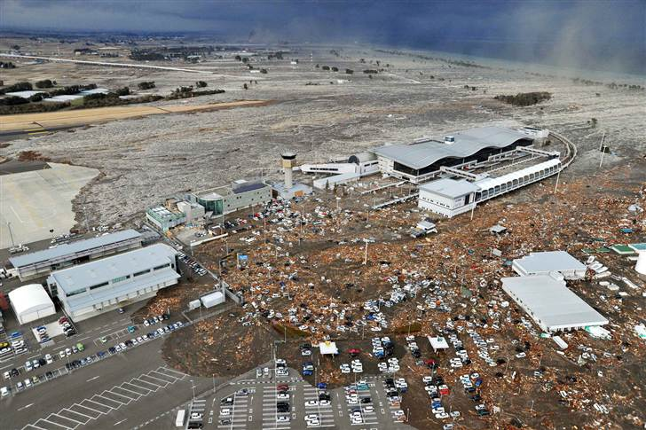
Sendai Airport
Image Courtesy NHK

Slide 9
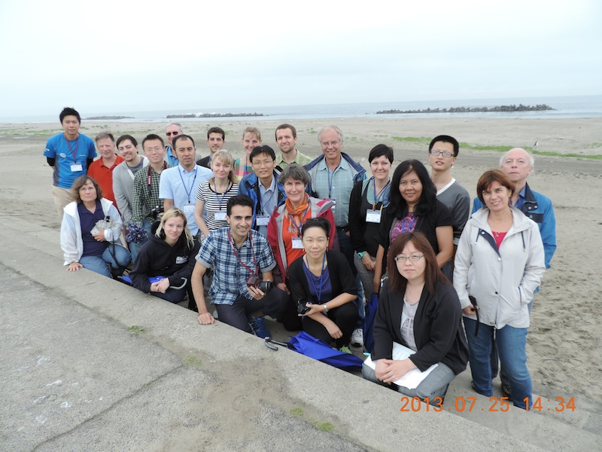
July, 2013: Field Trip to Tohoku Coastline
On the 4 Meter Seawall Tsunami Barrier

Slide 10
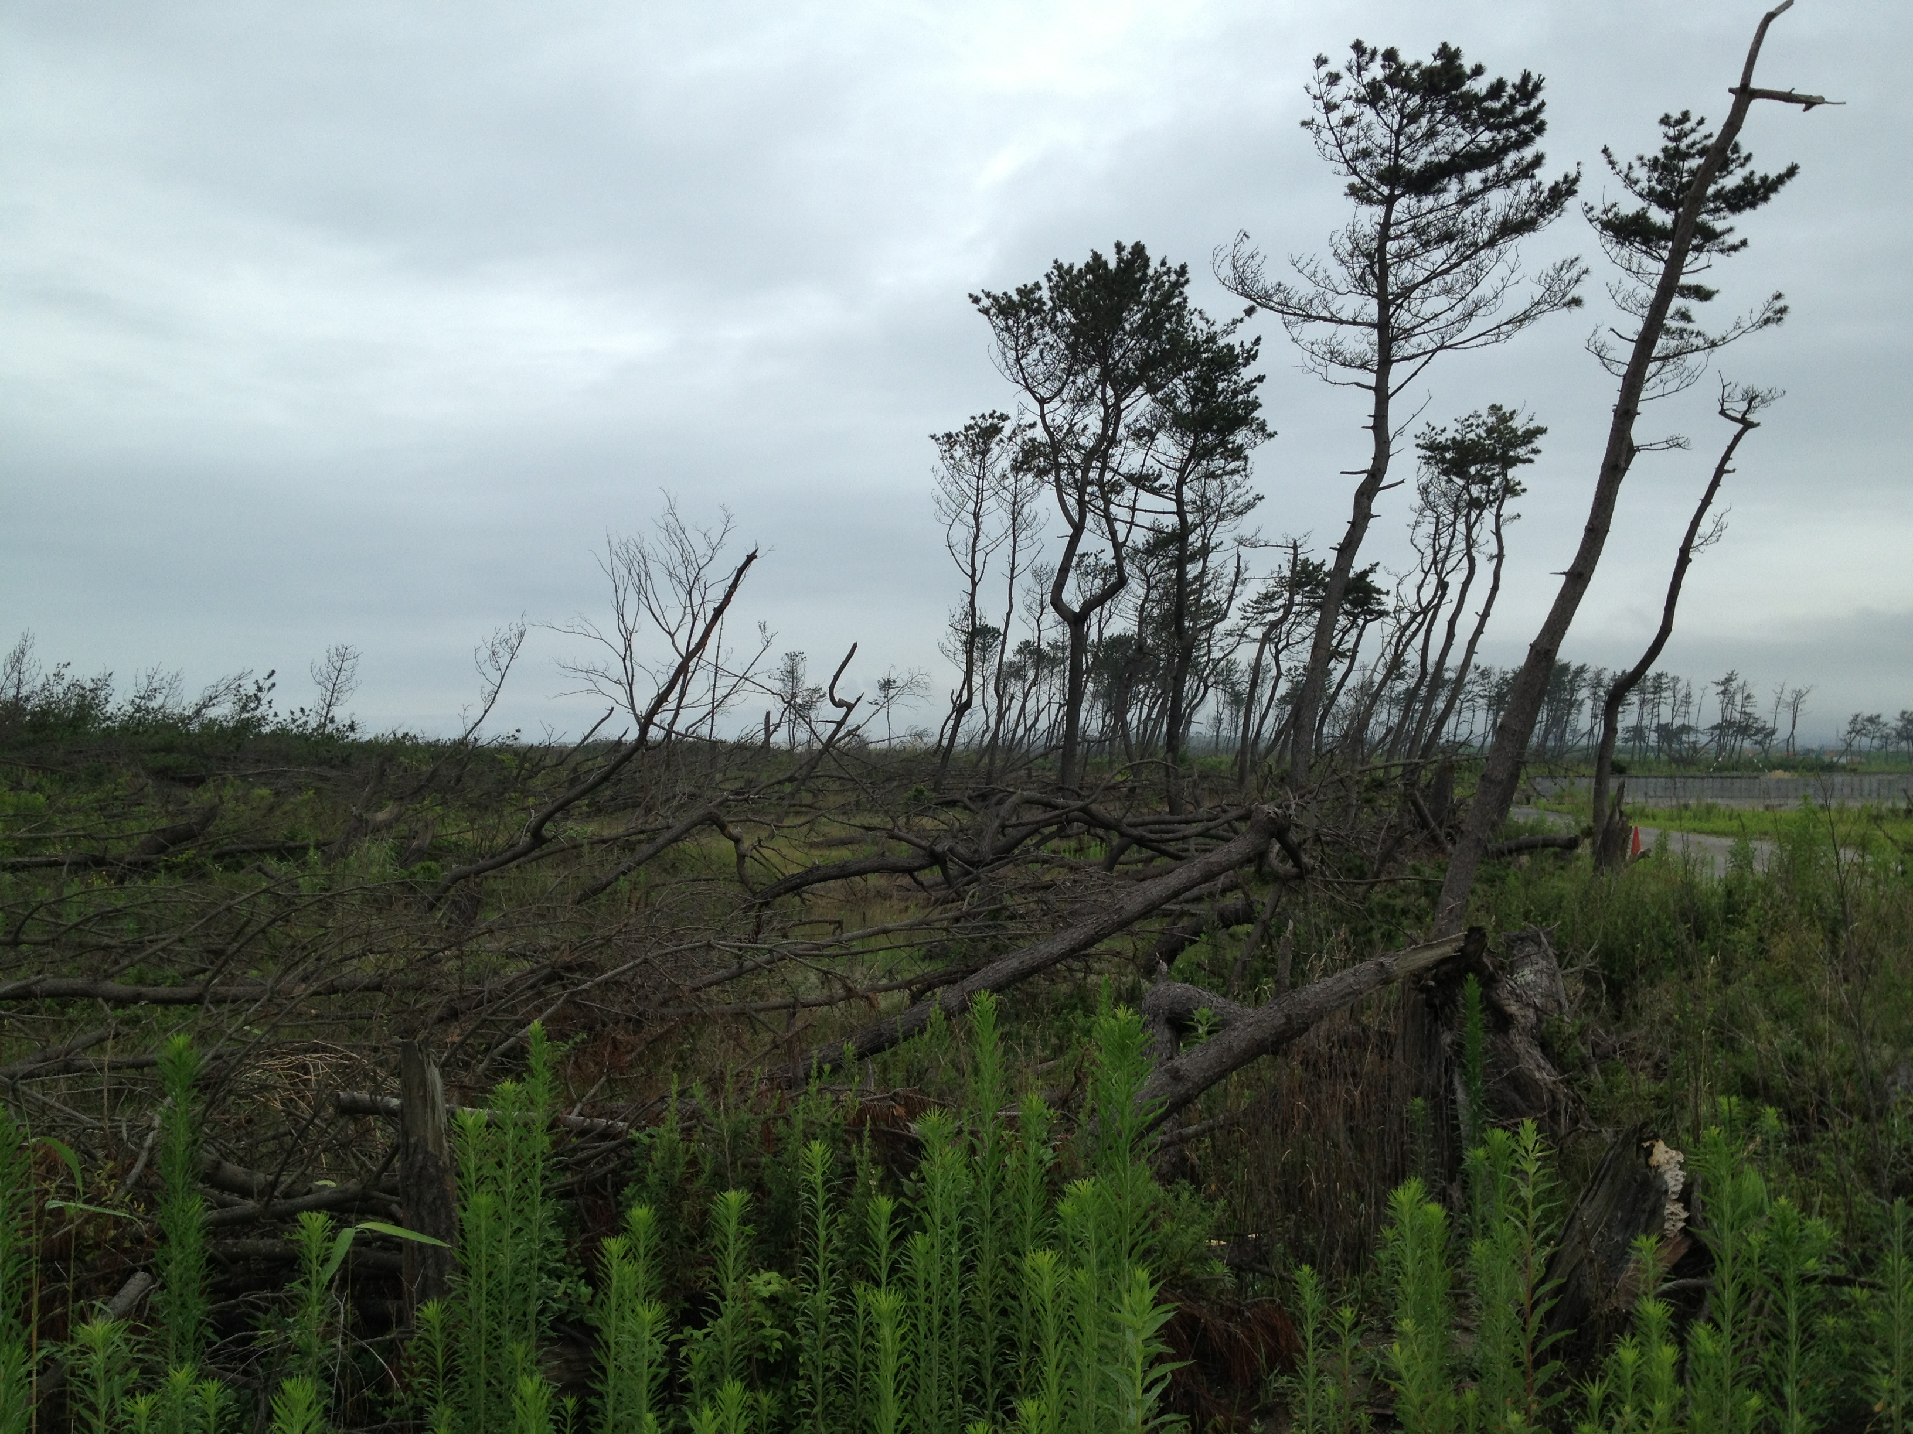
July, 2013: Field Trip to Tohoku Coastline
Remains of the Treeline Barrier

Slide 11
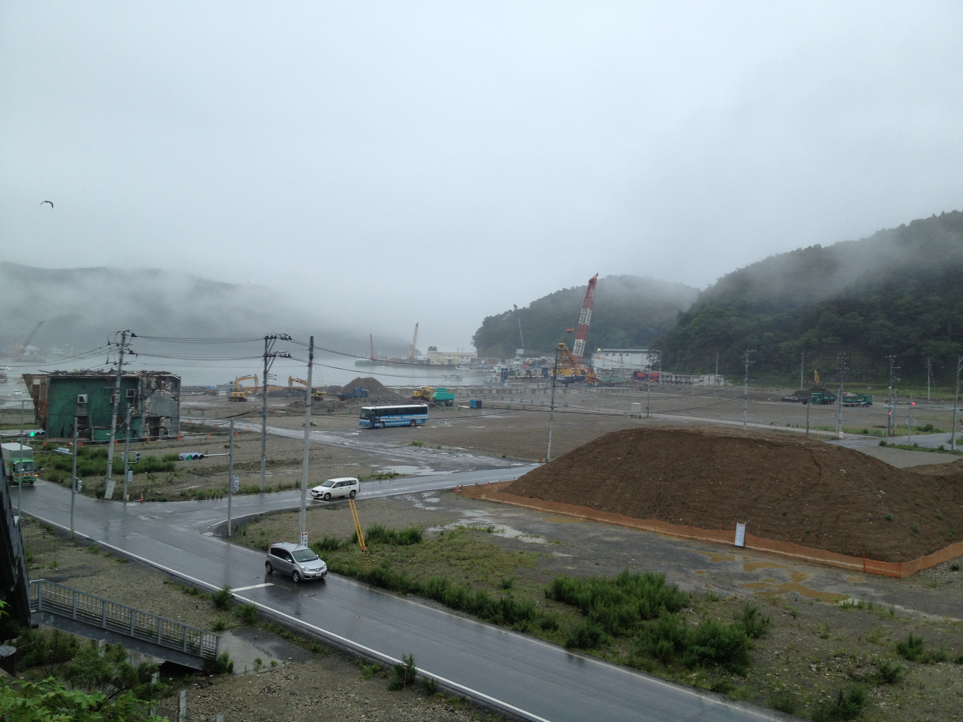
July, 2013: Field Trip at Onegawa Town Harbor
Looking Down on Harbor Area from Hospital Parking Lot
(17 Meters above the harbor)
Destroyed
building
Our tour bus

Slide 12
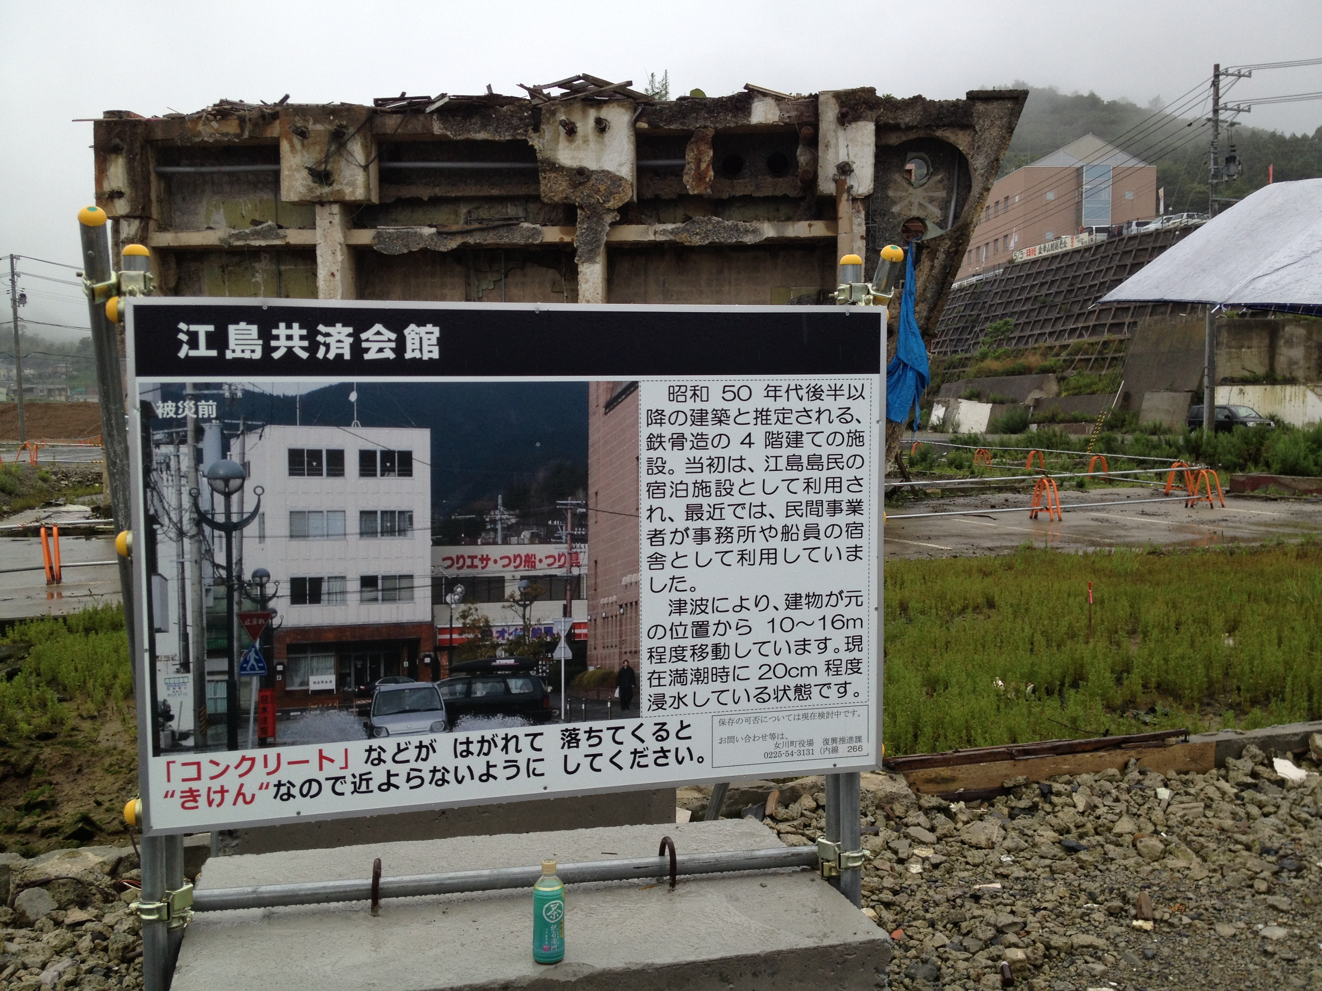
Onegawa Town
Destroyed Building from Ground Level, Hospital at Top Right
Hospital parking lot is 17 meters above the harbor

Slide 13
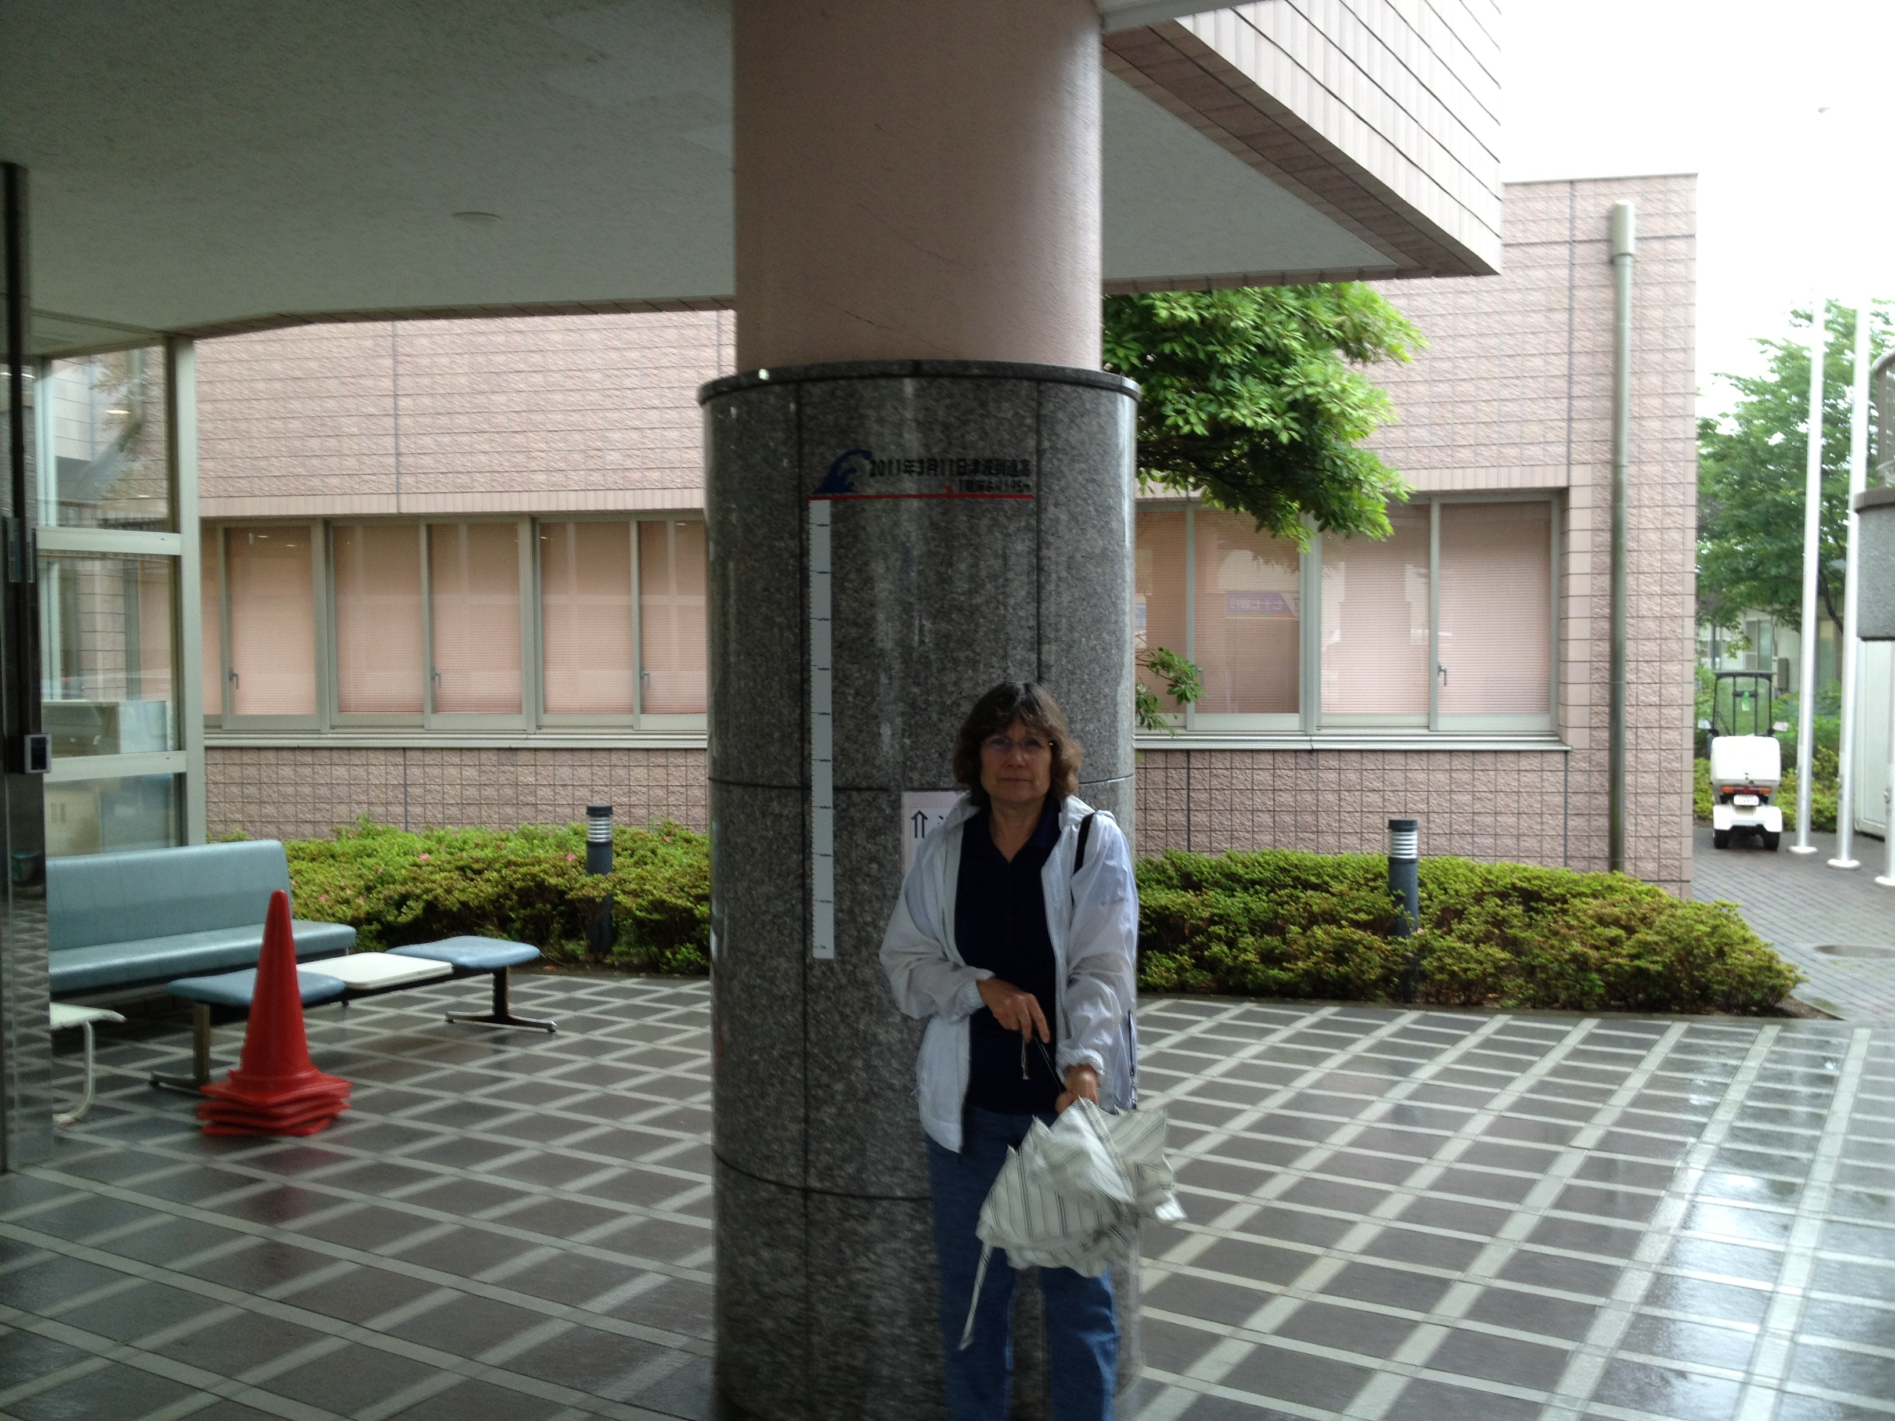
Onegawa Town Hospital Entrance
The Water was 2 Meters High at the Hospital Entrance (19 meters above the Harbor)

Slide 14
September 22, 2012, Takenoura, Japan Mr. Shigeo Suzuki and Me

Slide 15
Mr. Suzuki’s Dock is Now Underwater The Entire NorthEast Coast of Japan has Subsided ~1 to 2 Meters

Slide 16
Takenoura Wonders Whether to Rebuild

Slide 17
The Human Cost was Staggering September 22, 2012 Fresh Grave Markers Dot the Landscape (Ishinomaki Town)

Slide 18
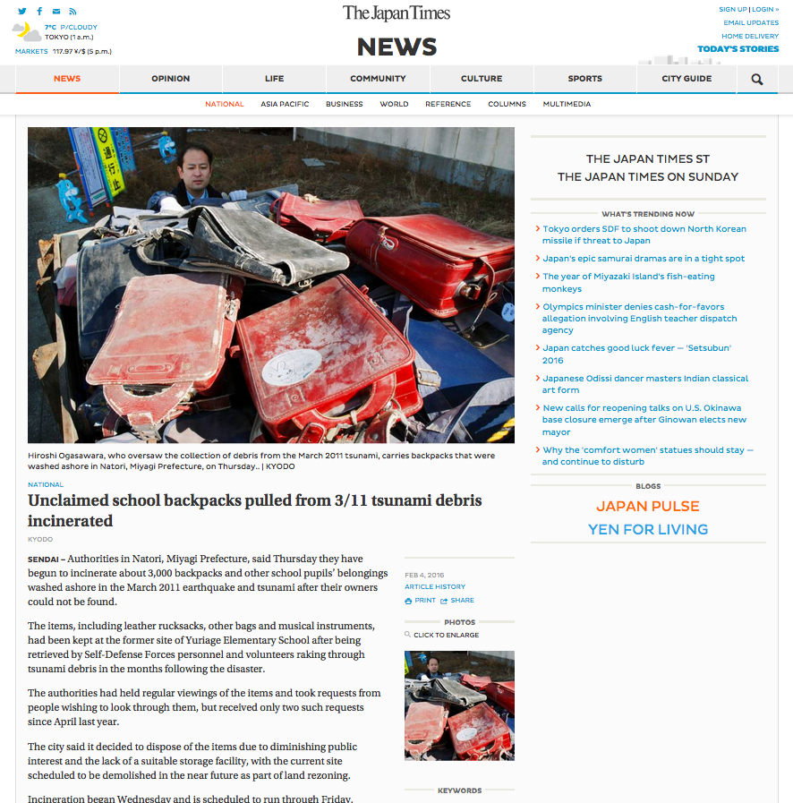

Slide 19
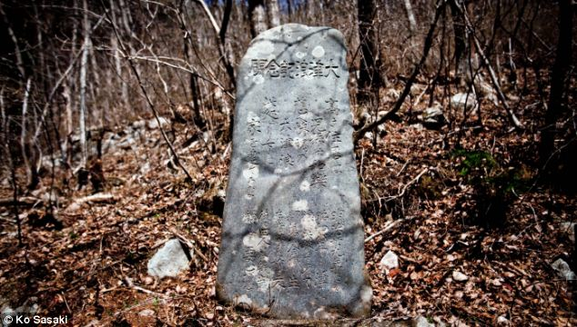
A warning from history. Tsunami stone near Aneyoshi, Japan. Carved into its weather-worn rock is a warning - 'Do not build your homes below this point!' - because they would be at risk from floods in a tsunami. The villagers obeyed the ancient warning and the tiny community of just 11 houses and 34 residents were rewarded with survival at a key geographical point. Some of these stones are more than 600 years old
(UK Daily Mail Online)

Slide 20
Tohoku Earthquake (Energy Map) http://en.wikipedia.org/wiki/2011_T%C5%8Dhoku_earthquake_and_tsunami

Slide 21
Sumatra-Andaman Tsunami, December 26, 2004 http://en.wikipedia.org/wiki/File:2004-tsunami.jpg

Slide 22
Tsunamis Focus Energy http://walrus.wr.usgs.gov

Slide 23
27 February 2010 Chile Earthquake http://en.wikipedia.org/wiki/2010_Chile_earthquake
Energy Propagation
http://nctr.pmel.noaa.gov/chile20100227/chile20100227-modeldata.html

Slide 24
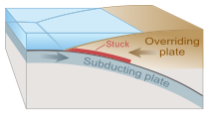
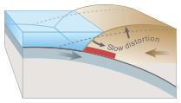
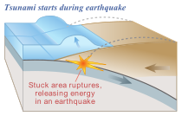
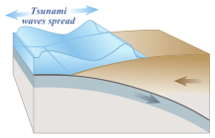
Tsunami Generation from Thrust Earthquakes http://en.wikipedia.org/wiki/Tsunami

Slide 25
Model for Tsunami Generation http://www.ga.gov.au/hazards/our-techniques/modelling/how-do-we-model-hazard.html#

Slide 26
Tsunami Waves in the Open Ocean http://en.wikipedia.org/wiki/Tsun
“Everyday wind waves have a wavelength (from crest to crest) of about 100 metres (330 ft) and a height of roughly 2 metres (6.6 ft).
However, a tsunami in the deep ocean has a much larger wavelength of up to 200 kilometres (120 mi).
Such a wave travels at well over 800 kilometres per hour (500 mph)
Owing to the enormous wavelength, the wave oscillation at any given point takes 20 or 30 minutes to complete a cycle and has an amplitude of only about 1 metre (3.3 ft)
This makes tsunamis difficult to detect over deep water, where ships are unable to feel their passage.”

Slide 27
Tsunami Propagation near Shore http://en.wikipedia.org/wiki/Tsunami
“As the tsunami approaches the coast and the waters become shallow, wave shoaling compresses the wave and its speed decreases below 80 kilometres per hour (50 mph).
Its wavelength diminishes to less than 20 kilometres (12 mi) and its amplitude grows enormously.
Since the wave still has the same very long period, the tsunami may take minutes to reach full height.
Except for the very largest tsunamis, the approaching wave does not break
Rather it appears like a fast-moving tidal bore.”
“Some meteorological conditions, such as deep depressions that cause tropical cyclones, can generate a storm surge, called a meteotsunami
These can raise tides several metres above normal levels.
The displacement comes from low atmospheric pressure within the centre of the depression.
As these storm surges reach shore, they may resemble (though are not) tsunamis, inundating vast areas of land.”

Slide 28
Tsunami “Runup” http://en.wikipedia.org/wiki/Tsunami
“When the tsunami's wave peak reaches the shore, the resulting temporary rise in sea level, the inundation, is termed ‘run up’.
Run up is measured in meters above a reference sea level.
Run up is the height reached by the wave on shore above sea level
A large tsunami may feature multiple waves arriving over a period of hours, with significant time between the wave crests.
The first wave to reach the shore may not have the highest run up.”

Slide 29
Tsunami Speed and Runup http://en.wikipedia.org/wiki/Tsunami
Tsunami speed c depends upon ocean depth as:
$$c=\sqrt{gH}$$
where c is speed, g is surface acceleration of gravity, and H is ocean depth
Tsunamis are detected in the open ocean by DART buoys (next slide)
Tsunami wave heights in shallow and deep water are related by:
$\frac{h_{s}}{h_{d}} = {\left(\frac{H_{d}}{H_{s}}\right)}^{1/4}$
where H is water depth, and h is wave height, d denotes deep water and s denotes shallow water.

Slide 30
Tsunami “Drawback” http://en.wikipedia.org/wiki/Tsunami
“All waves have a positive and negative peak, i.e. a ridge and a trough.
In the case of a propagating wave like a tsunami, either may be the first to arrive.
If the first part to arrive at shore is the ridge, a massive breaking wave or sudden flooding will be the first effect noticed on land.
However if the first part to arrive is a trough, a drawback will occur as the shoreline recedes dramatically, exposing normally submerged areas.
Drawback can exceed hundreds of meters, and people unaware of the danger sometimes remain near the shore to satisfy their curiosity or to collect fish from the exposed seabed.”
“A typical wave period for a damaging tsunami is about 12 (to 20) minutes.
This means that if the drawback phase is the first part of the wave to arrive, the sea will recede, with areas well below sea level exposed after 3-10 minutes.
During the next 6-10 minutes the tsunami wave trough builds into a ridge, and during this time the sea is filled in and destruction occurs on land.
During the next 6-10 minutes, the tsunami wave changes from a ridge to a trough, causing flood waters to drain and drawback to occur again.
This may sweep victims and debris some distance from land. The process repeats as the next wave arrives.”

Slide 31
Other Tsunami Mechanisms http://en.wikipedia.org/wiki/Tsunami
“In the 1950s, it was discovered that larger tsunamis than had previously been believed possible could be caused by giant submarine landslides.
These rapidly displace large water volumes, as energy transfers to the water at a rate faster than the water can absorb.
Their existence was confirmed in 1958, when a giant landslide in Lituya Bay, Alaska, caused the highest wave ever recorded, which had a height of 524 metres (over 1700 feet).
The wave didn't travel far, as it struck land almost immediately.
Two people fishing in the bay were killed, but another boat amazingly managed to ride the wave.
Scientists named these waves megatsunami.
Scientists discovered that extremely large landslides from volcanic island collapses can generate megatsunamis that can cross oceans.”
Another example of a landslide-generated tsunami was the Anak Krakatau tsunami of December 22, 2018 in the Sunda Strait

Slide 32
Tsunamis are Quantified by Intensity and Magnitude http://en.wikipedia.org/wiki/Tsunami
Intensity scales are used routinely to measure the intensity of tsunami.
They were first proposed by Sieberg and Ambraseys scale, and used in the Mediterranean Sea, and by Imamura and Iida, used in the Pacific Ocean, later modified by Soloviev
The intensity is specified mathematically by the average wave height along the coast for each specified location
This scale, known as the Soloviev-Imamura tsunami intensity scale, is used in the global tsunami catalogues compiled by the NGDC/NOAA
Magnitude scales, as in earthquakes, measure the energy of the tsunami rather than its local effects
The first scale that genuinely calculated a magnitude for a tsunami, rather than an intensity at a particular location was proposed by Murty & Loomis based on the potential energy.
Abe introduced the tsunami magnitude M_{T} scale which depends on the maximum tsunami-wave amplitude (in m) measured by a tide gauge at a distance R from the epicentre.
The equation has constants a, b & D that are used to make the M_{T} scale match as closely as possible with the moment magnitude scale.[30]

Slide 33
Cascadia Earthquake and Tsunami January 26, 1700 AD ~2100 hrs http://en.wikipedia.org/wiki/1700_Cascadia_earthquake
The 1700 Cascadia earthquake was a magnitude 8.7 to 9.2 megathrust earthquake that occurred in the Cascadia subduction zone on January 26, 1700.
The earthquake involved the Juan de Fuca Plate underlying the Pacific Ocean, from mid-Vancouver Island in British Columbia, Canada, south along the Pacific Northwest coast as far as northern California, USA.
The length of the fault rupture was about 1,000 kilometers with an average slip of 20 meters.
The earthquake caused a tsunami that struck the coast of Japan, and may also be linked to the Bonneville Slide.

Slide 34
Great Earthquakes in the Pacific NW http://en.wikipedia.org/wiki/1700_Cascadia_earthquake

Slide 35
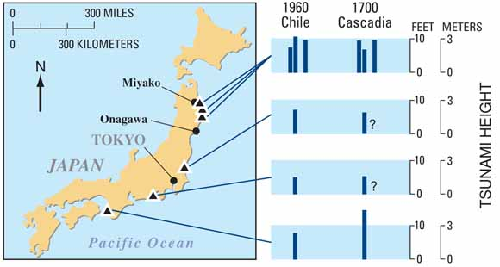
Evidence for M9 Cascadia Earthquake http://en.wikipedia.org/wiki/1700_Cascadia_earthquake http://www.usgs.gov
Suddenly drowned Cascadia forests, sometime between end growing season 1699 AD, and beginning of growing season 1700 AD
An “Orphan Tsunami” in Japan

Slide 36
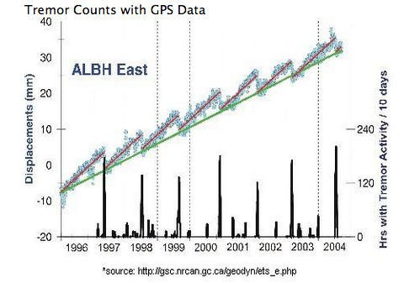
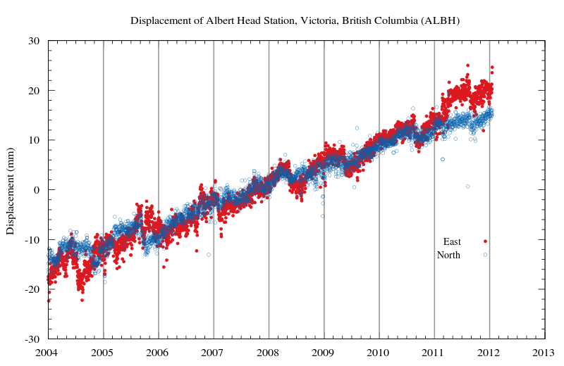
The Clock May be Ticking… http://en.wikipedia.org/wiki/Episodic_tremor_and_slip
Episodic tremor and slip (ETS) events are characterized by non-earthquake seismic rumbling, or tremor, and slow slip along the plate interface.
Nonvolcanic, episodic tremor was first identified in southwest Japan in 2002.
The Geological Survey of Canada coined the term "episodic tremor and slip" to characterize observations of GPS measurements in the Vancouver Island area.
Slow slip and tremor have been detected in other subduction zones around the world, including Japan and Mexico, but not in the Hikurangi Subduction Zone.
Every five years a year-long quake of this type occurs beneath the New Zealand capital, Wellington. It was first measured in 2003, and has reappeared in 2008 and 2013.

Slide 37
Cascadia (Simulation) http://serc.carleton.edu/NAGTWorkshops/hazards/visualizations/tsunami.html

Slide 38
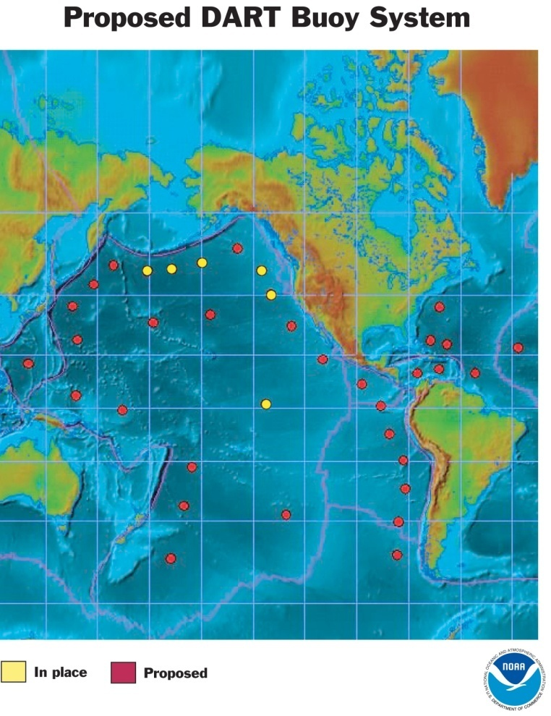
Earthquake-Magnitude-Based Tsunami Warnings DART: Deep ocean Assessment and Reporting of Tsunamis (NOAA’s PTWC)
Current Tsunami Warning System
Unfortunately,
Earthquake magnitude is not a good indicator of a resulting tsunami;
DART system has inherent delays of as long as 60 minutes
Seismic Mww estimates require at 20 minutes or more from the W phase

Slide 39
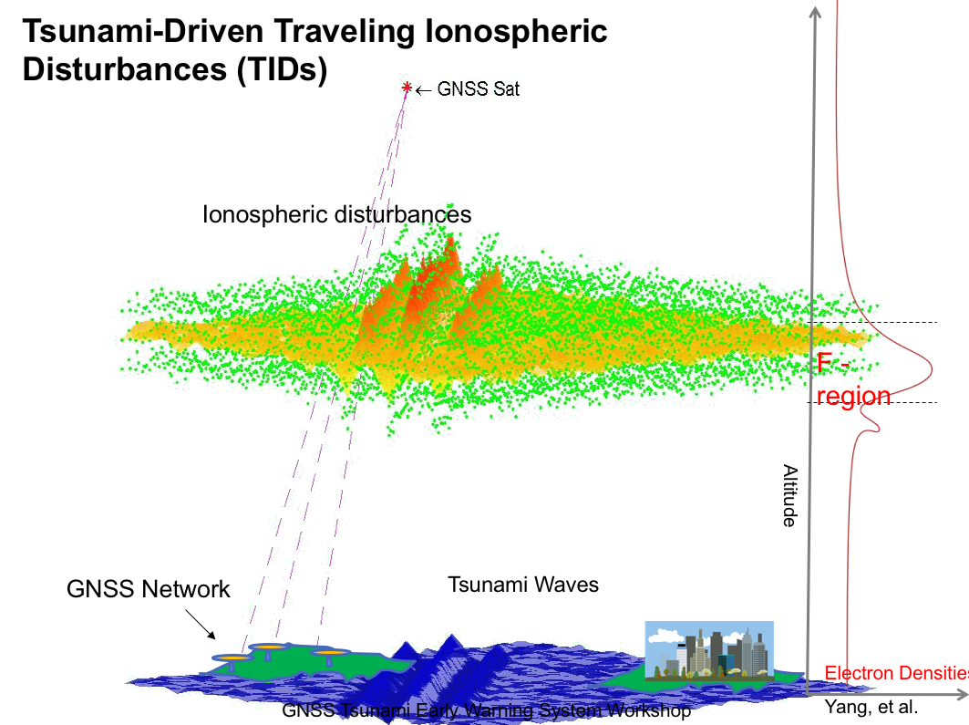
Tsunami Early Warning Data Science, Simulators, Workshops
John B Rundle, David Grzan, John Wilson, Steve Ward, (UC),
Andrea Donnellan, Tony Song, Attila Komjathy, Panagiotis Vergados (JPL), John Labrecque (UT), Yehuda Bock (UCSD), Tim Melbourne (CWU), and Yuichi Ono, Shunichi Koshimura, Fumihiko Imamura, Takako Izumi (APRU-Tohoku U)
Courtesy Yang et al.
Ionospheric Response to Mw9.0 Tohoku Earthquake and Tsunami in Japan on March 11, 2011, A.Komjathy, D.A.Galvan, M.P Hickey, P.Stephens, Mark Butala, and A.Mannucci, (http://visibleearth.nasa.gov/view.php?id=77377)

Slide 40
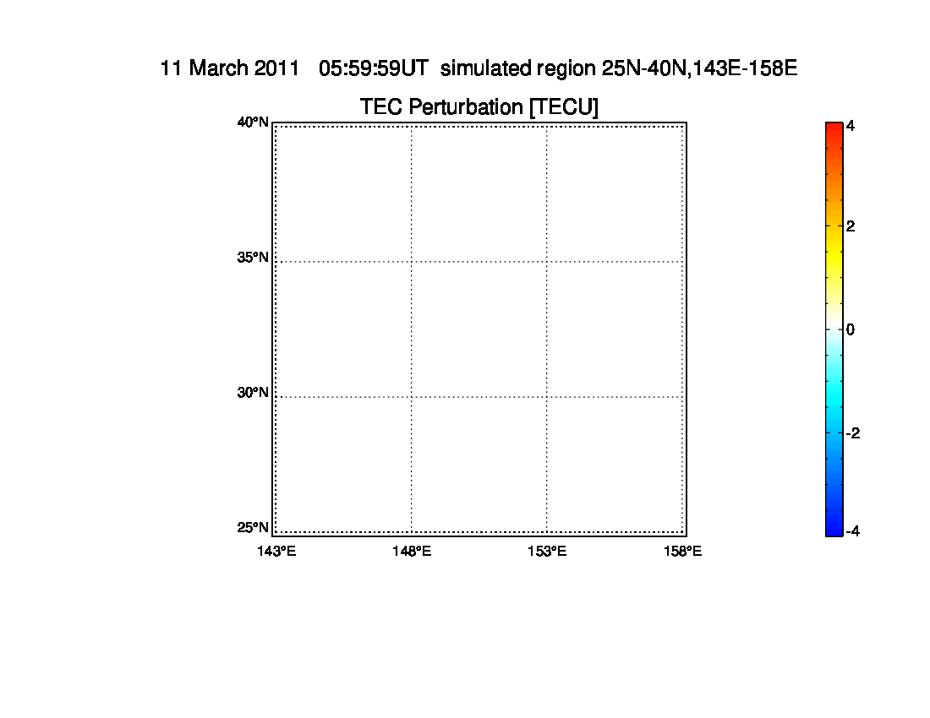
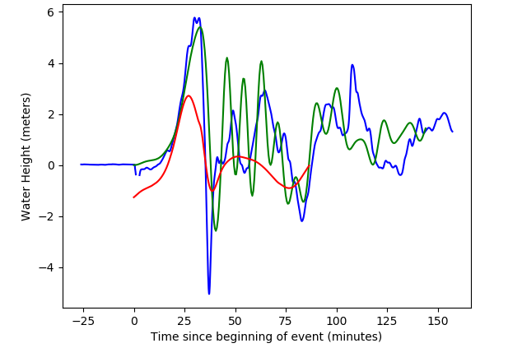
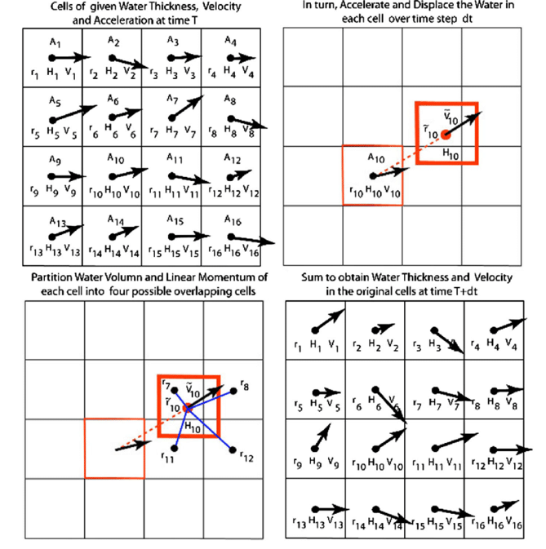
Building a Coupled Earthquake-Tsunami-TEC Simulator in a Parallel HPC Environment
At left we show TEC perturbations computed by the JPL group driven by waves from a Tsunami Squares simulation
Simulations by David Grzan and John Wilson with help from Steve Ward
Tsunami Squares was originally proposed by Steve Ward to model a variety of mass transfer phenomena. It is a central component of our integrated earthquake-tsunami-TID simulator technology (under development).
Verification
Red: TS
Green: ROMS*
Blue: Data
TS can easily compute coastal runup and inundation, unlike purely hydrodynamic models. We verify results of the simulations with buoy data and runup data. As part of the simulation, we conserve mass, momentum and energy.
Basic Method
*ROMS: Regional Ocean Modeling System (Finite Difference)

Slide 41
First GNSS GTEWs Workshop Held July 25-28, 2017
We pursue the goals of the UN Conference on Disaster Risk Reduction Sendai (2015) Framework for action, focusing on the seven targets for risk reduction outlined there, particularly Target g:
Substantially increase the availability of and access to multi-hazard early warning systems and disaster risk information and assessments to the people by 2030
First Workshop was jointly organized with the APRU Multihazards Hub at Tohoku U., Sendai, Japan, funded by NASA. It was focused on developing a science plan for a GNSS TEWS system.
Workshop report available at:
https://apru.org/gnss-tsunami-early-warning-system-report/
Second workshop to be hosted by the APRU Multihazards Hub
during June 1-5, 2020
To focus on developing a GNSS TEWS implementation plan

