Slide 1
Introduction to Neural Networks
Physics 255 Econophysics
Material Used in this Presentation comes from:
https://towardsdatascience.com/build-an-artificial-neural-network-ann-from-scratch-part-1-a21988497962
https://towardsdatascience.com/simple-introduction-to-neural-networks-ac1d7c3d7a2c
https://towardsdatascience.com/introduction-to-artificial-neural-networks-ann-1aea15775ef9

Slide 2
Machine Learning
Machine learning is a general method of using a computer to extract meaning from data
Usually this involves identifying patterns in training set of data and then using those patterns to predict features of a future data
Machine learning depends on two basic operations
Classification (typically using decision trees)
Optimization (often using an algorithm called logistic regression)
Here we will discuss the increasing use of Artificial Neural Networks
These were popularized by the work of John J Hopfield beginning in 1982
Earlier work was by McCulloch and Pitts (1943) and Hodgekin and Huxley (1952)

Slide 3
A Biological Neuron
The way an actual neuron works involves the accumulation of electric charge, which when exceeding a particular value causes the pre-synaptic neuron to discharge across the axon and stimulate the post-synaptic neuron.
Humans have billions of neurons (10¹⁰ to 10¹¹) which are interconnected and can produce incredibly complex firing patterns.
A typical neuron is connected to 10,000 others by means of synaptic junctions
The capabilities of the human brain are incredible compared to what we can do even with state-of-the-art neural networks.
We will likely not see neural networks mimicking the function of the human brain anytime soon.
Axon Terminal
Current Flow

Slide 4
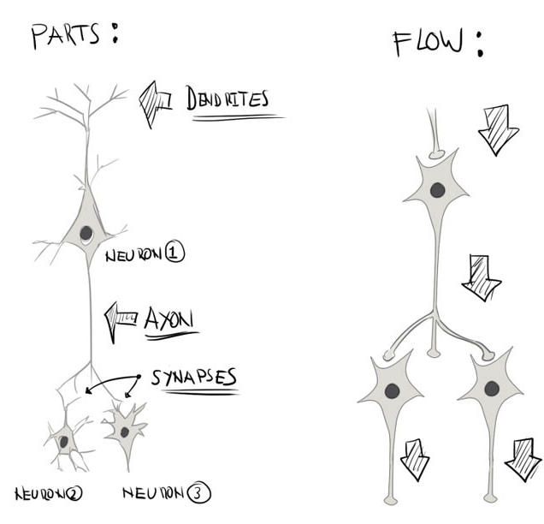
In More Detail
The Neuron is the basic unit of computation in the brain, it receives and integrates chemical signals from other neurons and depending on a number of factors it either does nothing or generates an electrical signal or Action Potential which in turn signals other connected neurons via synapses.

Slide 5
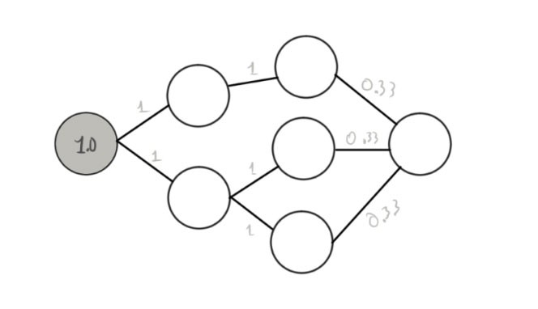
Minimal Biological Network
Generally described in a formal way with a graph.

Slide 6
Neurons
This simple graph represents a neural element
Flow of electric current in real neurons
Mathematical model of a single neuron

Slide 7
An Artificial Neuron
We can draw a diagram that makes the analogy between the neuron structure and the artificial neurons in a neural network.
Given the capabilities of the human brain, it should be apparent that the capabilities of artificial neural networks are fairly limitless in scope.

Slide 8
Motivation for Artificial Neural Networks
Algorithms experience the world through data — by training a neural network on a relevant dataset, we seek to decrease its ignorance. The way we measure progress is by monitoring the error produced by the network.
Before delving into the world of neural networks, it is important to get an understanding of the motivation behind these networks and why they work.
We will see that neural networks are arranged in feedforward layers, called perceptrons

Slide 9
“Perceptron” is a Layer of Neurons
The trick is to design a network architecture such that we are able to achieve high accuracy using relatively little computational power, with minimal data.
What is even more impressive is that one hidden layer is enough to represent an approximation of any function to an arbitrary degree of accuracy.
So why do people use multilayer neural networks if one layer is enough?
“Perceptrons”

Slide 10
Perceptrons (continued)
The answer is simple.
This network would need to have a neural architecture that is very wide since shallow networks require (exponentially) more width than a deep network.
Furthermore, shallow networks have a higher affinity for overfitting.
This is the stimulus behind why the field of deep learning exists (deep referring to the multiple layers of a neural network)
Deep learning dominates contemporary research literature in machine learning and most fields involving data classification and prediction.
Perceptrons

Slide 11
Theory of ANN
An artificial neural network is a supervised learning algorithm which means that we provide it the input data containing the independent variables and the output data that contains the dependent variable.
For instance, in our example our independent variables are X1, X2 and X3. The dependent variable is Y.
Thus X -> Y, where X is a vector of data or features, and Y is a label
In the beginning, the ANN makes some random predictions, these predictions are compared with the correct output and the error(the difference between the predicted values and the actual values) is calculated.

Slide 12
Theory of ANN
Feed Forward Direction
The function that finds the difference between the actual value and the propagated values is called the cost function.
The cost here refers to the error.
Our objective is to minimize the cost function.
Training a neural network basically refers to minimizing the cost function.
We will see how we can perform this task.
A neural network executes in two phases: Feed Forward phase and Back Propagation phase.
Back Propagation Direction

Slide 13
Theory of ANN
Feed Forward Direction
In the feed-forward phase of ANN, predictions are made based on the values in the input nodes and the weights.
If you look at the neural network in the figure, you will see that we have three features in the dataset: X1, X2, and X3, therefore we have three nodes in the first layer, also known as the input layer.
The weights of a neural network are basically the wires that we have to adjust in order to be able to correctly predict our output.
For now, just remember that for each input feature, we have one weight.
Back Propagation Direction

Slide 14
Feedforward Phase of ANN
Feed Forward Direction
Step 1: Calculate the dot product between inputs and weights
The nodes in the input layer are connected with the output layer via three weights.
In the output layer, the values in the input nodes are multiplied by the corresponding weights and are added together.
Finally, the bias term or threshold term b is added to the sum.
Mathematically, the summation of the dot product is:
X*W=x1*w1 + x2*w2 + x3*w3 + b
Back Propagation Direction

Slide 15
Bias Term b
Suppose if we have a person who has input values (0,0,0), the sum of the products of input nodes and weights will be zero.
In that case, the output will always be zero no matter how much we train the algorithms.
Therefore, in order to be able to make predictions, even if we do not have any non-zero information about the person, we need a bias term.
The bias term is necessary to make a robust neural network.
X*W=x1*w1 + x2*w2 + x3*w3 + b

Slide 16
Activation Term
Step 2: Pass the summation of dot products (X.W) through an activation function
The dot product XW can produce any set of values.
However, in our output, we have the values in the form of 1 and 0.
We want our output to be in the same format.
To do so we need an Activation Function, which restricts the input values between 0 and 1.
So of course we’ll go ahead with Sigmoid activation function.

Slide 17
Activation Function: Sigmoid
The sigmoid function returns 0.5 when the input is 0.
It returns a value close to 1 if the input is a large positive number.
In the case of negative input, the sigmoid function outputs a value close to zero.

Slide 18
Sigmoid Function
A sigmoid function is especially used for models where we have to predict the probability as an output.
Since probability of anything exists only between the range of 0 and 1, a sigmoid is the right choice for our problem.
In the figure z is the summation of dot product X*W

Slide 19
Training the ANN
Basic Methods:
Gradient Descent
Back Propagation

Slide 20
Classification
Let us consider a binary classification problem.
The goal is to attempt to classify each observation into a category (such as a class or cluster) defined by Y, based on a set of feature variables X.
Let’s say that we would like to predict whether a patient has heart disease based on features about the patient.
The response variable here is categorical (binary), i.e., there are finite outcomes since there are only two categories (yes/no).

Slide 21
Example of heart disease: A categorical problem

Slide 22
The Idea Behind Training an ANN for this problem
The first thing we do is set randomly selected weights.
Most likely it will perform horribly — in our heart data, the model will give us the wrong answer.
We then ‘train’ the network by essentially punishing it for performing poorly.

Slide 23
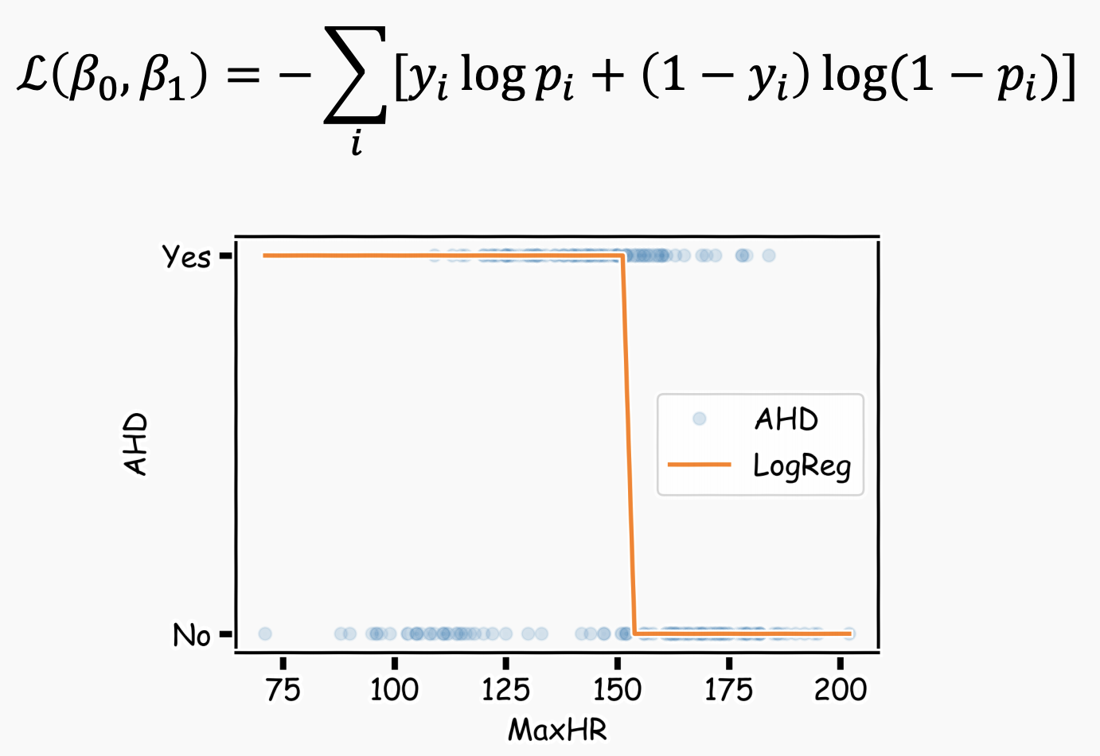
Neural Networks are Often Trained by Gradient Descent
Gradient descent is basically Newtons’ method
Likelihood Function:
Learning rate
A likelihood function is combination of probabilities
Here we assume only 1 parameter is important

Slide 24
General Features of the Optimization Problem
Regression assigns a label to the data
Regression is a kind of
optimization, it fits a function to some data

Slide 25
What about Multiparameter ANNs?
So what is the point of what we just did? How does this relate to neural networks?
Actually, what we are using essentially the same procedure that is performed by neural network algorithms.
In our example, we only used one feature for our model.
We can take multiple features and illustrate these in a network format.
We have weights for each of the features and we also have a bias term, which together makes up our regression parameters.
Depending on whether the problem is a classification or regression problem, the formulation will be slightly different.

Slide 26
Back Propagation is the General Training Method
In the beginning, before you do any training, the neural network makes random predictions which are of course incorrect.
We start by letting the network make random output predictions.
We then compare the predicted output of the neural network with the actual output.
We then calculate the error or loss function
Next, we update the weights and the bias in such a manner that our predicted output comes closer to the actual output.
In this phase, we can train our algorithm via backpropgation.
Let’s take a look at the steps involved in the backpropagation phase.

Slide 27
Training an ANN by Backpropagation

Slide 28
Backpropagation to Adjust Weights
There are basically 2 ways to adjust weights: 1. Brute-force method 2. Batch-Gradient descent

Slide 29
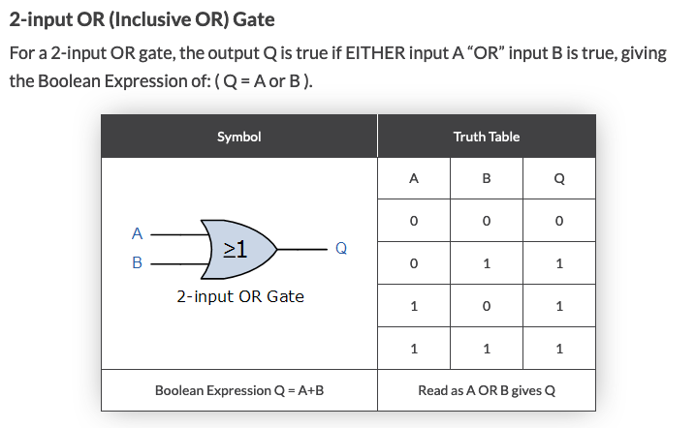
Simple Example of Back Propagation (Truth Table) https://www.electronics-tutorials.ws/boolean/bool_7.html
A Truth Table is a mathematical table used in logic—specifically in connection with Boolean algebra and Boolean functions
It sets out the functional values of logical expressions on each of their functional arguments
In particular, truth tables can be used to show whether a propositional expression is true for all legitimate input values, that is, logically valid.
Truth tables are encoded in computers as logic gates

Slide 30
Truth Table Example of Backpropagation https://users.math.yale.edu/public_html/People/frame/Fractals/
Consider an OR statement (OR gate)
If x₁ OR x₂ = 1, then z₁ = 1
We can set this problem up as a neural network.
Initial (random) weights are as shown in the figure at right
Using a threshold function with a threshold value of 0, we see y₁ = 1 and y₂ = 1.
Now the weighted input for the output neuron is:
For y₁ the input is: 2.5*X₁ + 1.2*X₂ = 2.5*0 + 1.2*1 = 1.2
For y₂ the input is: -1.4*X₁ + 2.1*X₂ = -1.4*0 + 2.1*1 = 2.1
-1.6*Y₁ + 1.4*Y₂ = -1.6*1 + 1.4*1 = -0.2
Consequently, upon applying the threshold function, the output value is z₁ = 0 when it should be 1
Threshold function $Θ(x)$: If x < 0, $Θ\left(x\right)=0$. If x $≥0$, $Θ\left(x\right)=1$.

Slide 31
Training the Neural Net for the OR Gate
“W” weights
“V” weights
For example, suppose the training set for the net pictured above contains the input-output pair:
x₁ = 0
x₂ = 1
The net pictured at right is not trained for this input-output pair.
As we showed in the previous slide, the output error is:
e_{z1} = 1 - 0 = 1
=> Z₁ = 1
Nomenclature:
The 4 weights connecting an x_{i} node and the y_{j} node are designated by “w”.
The 2 weights connecting a y_{j} node with output node z is designated by ”v”

Slide 32
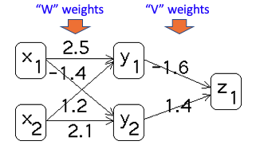
Training (continued)
∆v_{1,1} = e_{z1}*y₁ = 1*1 = 1
∆v_{2,1} = e_{z1}*y₂ = 1*1 = 1
∆w_{1,1} = e_{y1}*x₁ = -1.6*0 = 0
∆w_{2,1} = e_{y1}*x₂ = -1.6*1 = -1.6
∆w_{1,2} = e_{y2}*x₁ = 1.4*0 = 0
∆w_{2,2} = e_{y2}*x₁ = 1.4*1 = 1.4
The weight between v_{1,1} gives the error at y₁:
e_{y1} = e_{z1}*v_{1,1} = 1*(-1.6) = -1.6
Similarly:
e_{y2} = e_{z1}*v_{2,1} = 1*1.4 = 1.4
With these error values, we compute the changes in the weights at right.
Now new weights are computed.
v_{1,1} -> v_{1,1} + ∆v_{1,1} = -1.6 + 1 = -0.6
v_{2,1} -> v_{2,1} + ∆v_{2,1} = 1.4 + 1 = 2.4
w_{1,1} -> w_{1,1} + ∆w_{1,1} = 2.5 + 0 = 2.5
w_{2,1} -> w_{2,1} + ∆w_{2,1} = 1.2 + (-1.6) = -0.4
w_{1,2} -> w_{1,2} + ∆w_{1,2} = -1.4 + 0 = -1.4
w_{2,2} -> w_{2,2} + ∆w_{2,2} = 2.1 + 1.4 = 3.5
error = 1

Slide 33
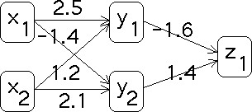
Training (continued)
Original Net
Here is the new neural net.
It is easy to verify that the output is equal to z₁ = 1 as needed, given inputs of:
x₁ = 0
x₂ = 1
Trained Net
Note that in back propagation, the error is "propagated back" through the net, using the weights to compute errors at the hidden neurons, and ultimately to adjust the weights.

Slide 34
More General Discussion of Back Propagation: Step 1: Define the Cost Function
The first step in this phase is to find the cost of the predictions.
The cost of the prediction can be calculated by finding the difference between the predicted output values and the actual output values.
If the difference is large then cost will also be large.
We will use the mean squared error or MSE cost function.
A cost function is a function that finds the cost of the given output predictions.
Alternatively, we could use a Likelihood function to define the cost function as discussed in a previous slide

Slide 35
Back Propagation Step 2: Minimize the Cost
Our ultimate goal is to fine-tune the weights of our neural network in such a way that the cost is minimized.
Note that we can only control the weights and the bias.
Everything else is beyond our control.
We cannot control the inputs, we cannot control the dot products, and we cannot manipulate the sigmoid function.
In order to minimize the cost, we need to find the weight and bias values for which the cost function returns the smallest value possible.
The smaller the cost, the more correct our predictions are.

Slide 36
Gradient descent
GD is a first-order iterative optimization algorithm
Its finds the minimum cost value (loss) in the process of training the model with different weights or updating weights.
In Gradient Descent, instead of going through every weight one at a time, and ticking every wrong weight off as you go, we instead look at the angle of the function line.
If slope → Negative, means you go down the curve to the right. If slope → Positive, means you go down the curve to the left.

Slide 37
Gradient descent using cost function
To find the minima of a function, we can use the gradient descent algorithm.
The gradient descent can be mathematically represented as in the figure at right
𝛛 Error is the cost function. The equation tells us to find the partial derivative of the cost function with respect to each weight and bias and subtract the result from the existing weights to get new weights.

Slide 38
Gradient descent
The derivative of a function gives us its slope at any given point.
To find if the cost increases or decreases, given the weight value, we can find the derivative of the function at that particular weight value.
If the cost increases with the increase in weight, the derivative will return a positive value which will then be subtracted from the existing value.
On the other hand, if the cost is decreasing with an increase in weight, a negative value will be returned, which will be added to the existing weight value since negative into negative is positive.

Slide 39
Gradient descent
In the equation, a is called the learning rate, which is multiplied by the derivative.
The learning rate decides how fast our algorithm learns.
We need to repeat the execution of gradient descent for all the weights and biases until the cost is minimized and for which the cost function returns a value close to zero.
Using these ideas, a simple neural network with one input and one output layer in Python can be created

Slide 40
Stochastic Gradient descent
Gradient descent works fine when we have a convex curve just like in the above figure.
But if we don't have a convex curve, Gradient descent fails.
The word ‘stochastic‘ means a system or a process that is linked with a random probability.
Hence, in Stochastic Gradient descent, a few samples are selected randomly instead of the whole data set for each iteration.
In SGD, we take one row of data at a time, run it through the neural network then adjust the weights. For the second row, we run it, then compare the Cost function and then again adjusting weights. And so on…
SGD helps us to avoid the problem of local minima. It is much faster than Gradient descent because it is running each row at a time and it doesn’t have to load the whole data in memory for doing computation.

Slide 41
Training with Stochastic Gradient descent
Step-1 → Randomly initialize the weights to small numbers close to 0 but not 0.
Step-2 → Input the first observation of your dataset in the input layer, each feature in one node.
Step-3 → Forward-Propagation: From left to right, the neurons are activated in a way that the impact of each neuron's activation is limited by the weights. Propagate the activations until getting the predicted value.
Step-4 → Compare the predicted result to the actual result and measure the generated error (Cost function).

Slide 42
Training with Stochastic Gradient descent
Step-5 → Back-Propagation: from right to left, the error is backpropagated.
Update the weights according to how much they are responsible for the error.
The learning rate decides how much we update weights.
Step-6 → Repeat step-1 to 5 and update the weights after each observation (Reinforcement Learning)
Step-7 → When the whole training set passed through the ANN, that makes an epoch. Redo more epochs.

Slide 43
Summary

Slide 44
Uses of Artificial Neural Networks
Deep Learning models can be used for a variety of complex tasks:
Artificial Neural Networks(ANN) for Regression and classification
Convolutional Neural Networks(CNN) for Computer Vision
Recurrent Neural Networks(RNN) for Time Series analysis
Self-organizing maps for Feature extraction
Deep Boltzmann machines for Recommendation systems
Auto Encoders for Recommendation systems
A typical example is Google Translate
Refer to the TensorFlow playground on the web that allows one to experiment with ANNs in an interactive setting

Slide 45
Tensor Flow
https://playground.tensorflow.org

Slide 46
Tensor Flow Playground https://towardsdatascience.com/emulating-logical-gates-with-a-neural-network-75c229ec4cc9
XNOR logic gate
https://playground.tensorflow.org

