Slide 1
Lecture 16
Volcanoes
John Rundle GEL/EPS 131

Slide 2
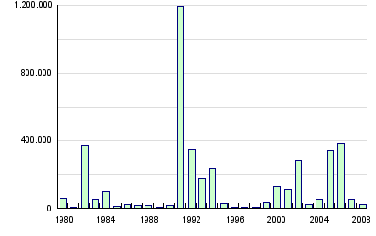
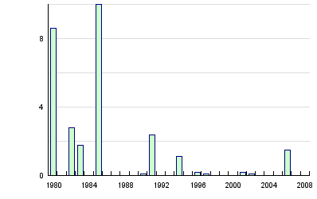
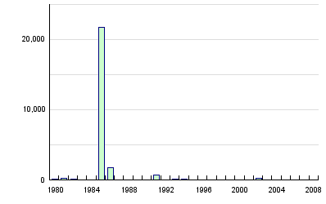
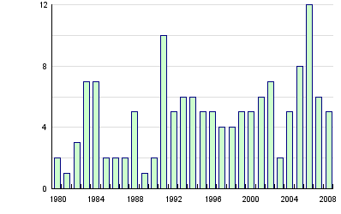
Global Volcano Statistics, 1980-2008 http://www.preventionweb.net/english/hazards/statistics/?hid=72
Persons Affected
Economic Damage (USD in B$)
Persons Killed
Number of Reported Events

Slide 3
Global Volcanoes Summary Statistics, 1980-2008 http://www.preventionweb.net/english/hazards/statistics/?hid=72

Slide 4
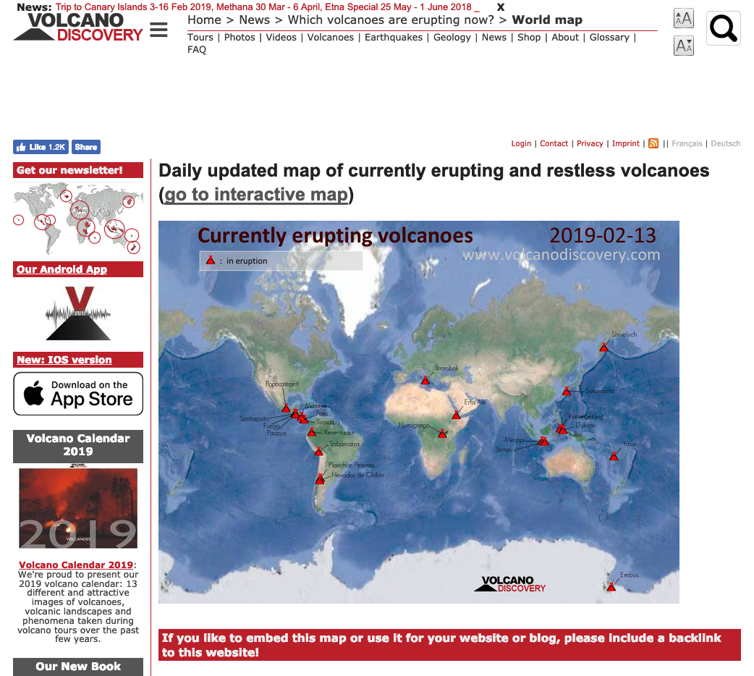
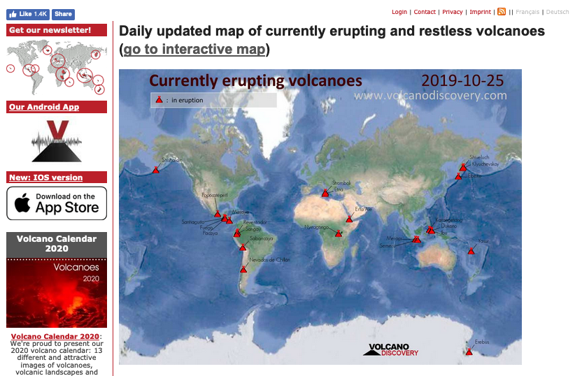
https://www.volcanodiscovery.com/daily-map-of-active-volcanoes.html

Slide 5
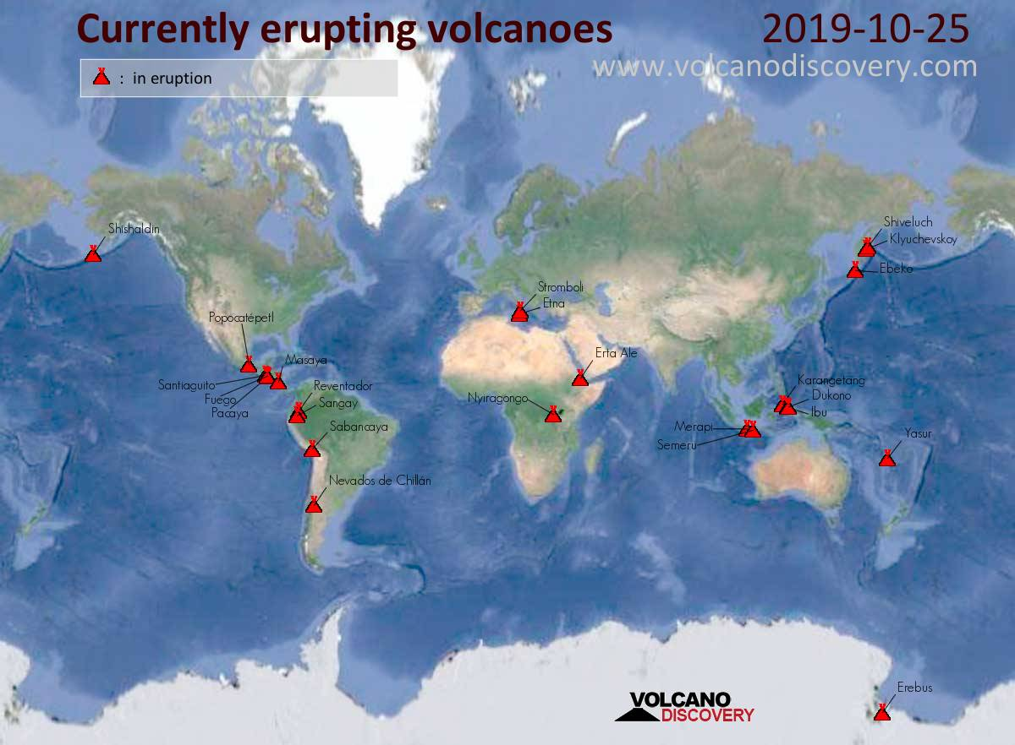

Slide 6
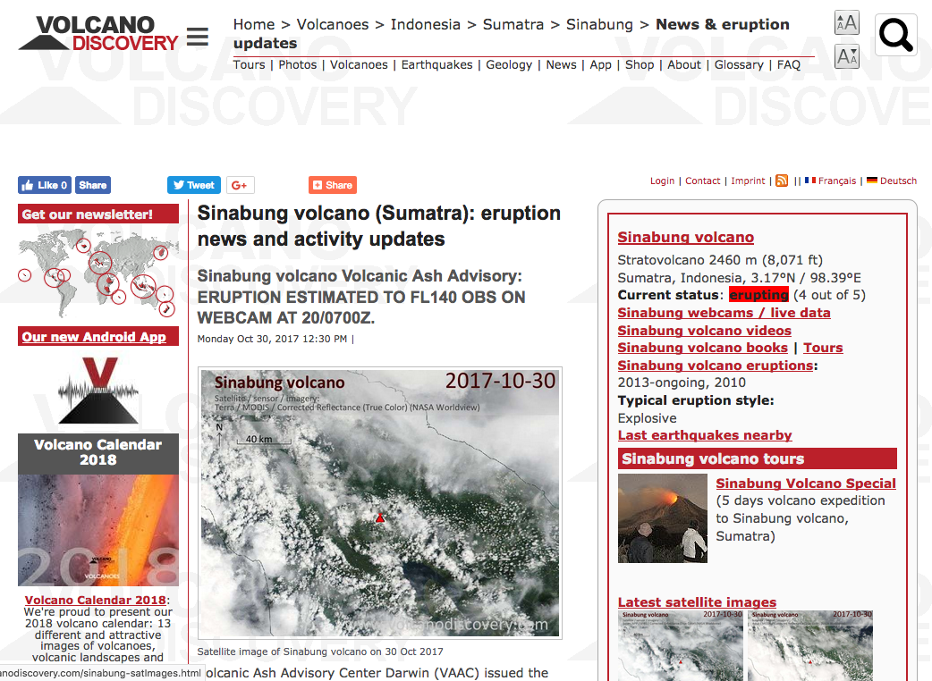

Slide 7
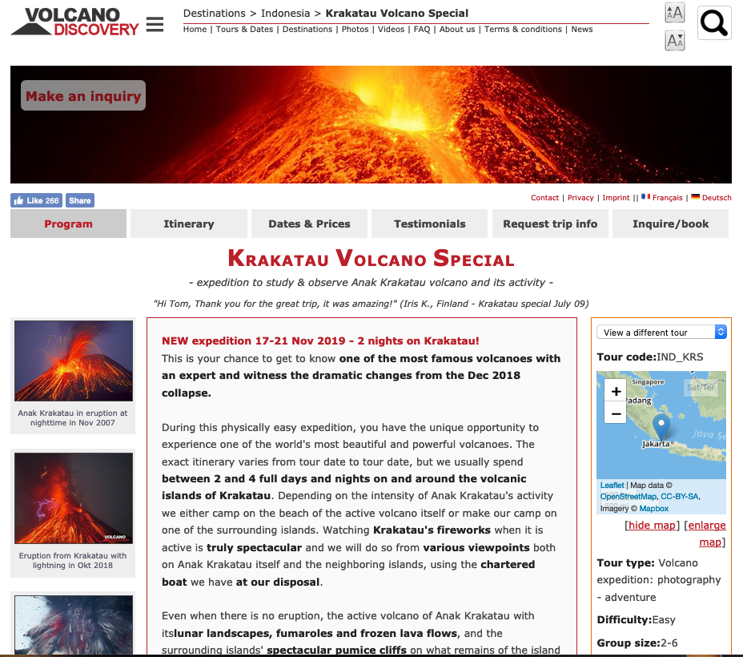

Slide 8
Volcanoes http://en.wikipedia.org/wiki/Volcano
“On Earth, volcanoes are generally found where tectonic plates are diverging or converging.
A mid-oceanic ridge, for example the Mid-Atlantic Ridge, has examples of volcanoes caused by divergent tectonic plates pulling apart
The Pacific Ring of Fire has examples of volcanoes caused by convergent tectonic plates coming together.
By contrast, volcanoes do not usually occur where two tectonic plates slide past one another (transform fault)
Volcanoes can also form where there is stretching and thinning of the Earth's crust in the interiors of plates, e.g., in the East African Rift, the Wells Gray-Clearwater volcanic field and the Rio Grande Rift in North America.
This type of volcanism falls under the umbrella of ‘Plate hypothesis’ volcanism.”

Slide 9
Recent* Sub Aerial Volcanism http://en.wikipedia.org/wiki/Volcano
*Recent = Past ~10,000 years

Slide 10
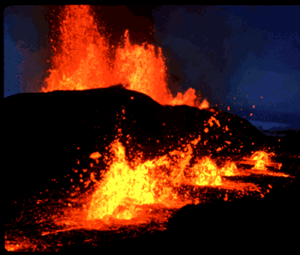
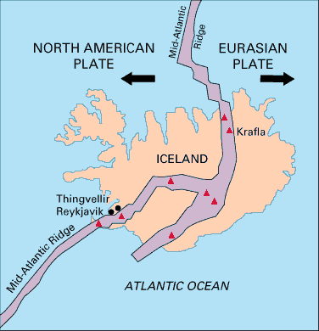
Divergent Plate Boundaries http://en.wikipedia.org/wiki/Volcano
“At the mid-oceanic ridges, two tectonic plates diverge from one another.
New oceanic crust is being formed by hot molten rock slowly cooling and solidifying. The crust is very thin at mid-oceanic ridges due to the pull of the tectonic plates.
The release of pressure due to the thinning of the crust leads to adiabatic expansion, and the partial melting of the mantle causing volcanism and creating new oceanic crust.
Most divergent plate boundaries are at the bottom of the oceans, therefore most volcanic activity is submarine, forming new seafloor.
Black smokers or deep sea vents are an example of this kind of volcanic activity.
Where the mid-oceanic ridge is above sea-level, volcanic islands are formed, for example, Iceland. ”
Krafla Volcano (USGS Photo)

Slide 11
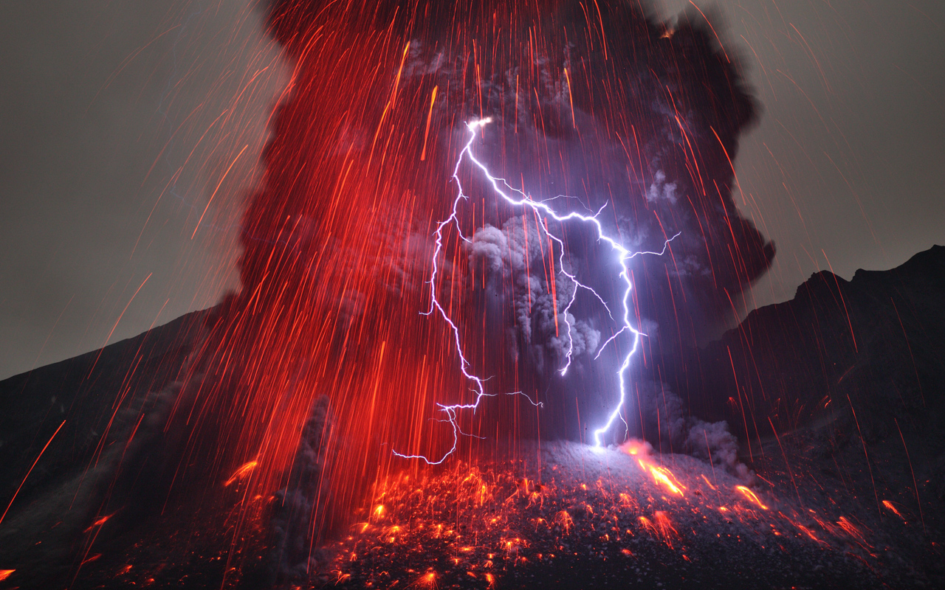
Convergent Plate Boundaries http://en.wikipedia.org/wiki/Volcano
“Subduction zones are places where two plates, usually an oceanic plate and a continental plate, collide.
In this case, the oceanic plate subducts, or submerges under the continental plate forming a deep ocean trench just offshore.
In a process called flux melting, water released from the subducting plate lowers the melting temperature of the overlying mantle wedge, creating magma.
This magma tends to be very viscous due to its high silica content, so often does not reach the surface and cools at depth.
When it does reach the surface, a volcano is formed.
Typical examples for this kind of volcano are Mount Etna and the volcanoes in the Pacific Ring of Fire.”
Sakurajima Volcano, Japan
Photo: http://apod.nasa.gov

Slide 12
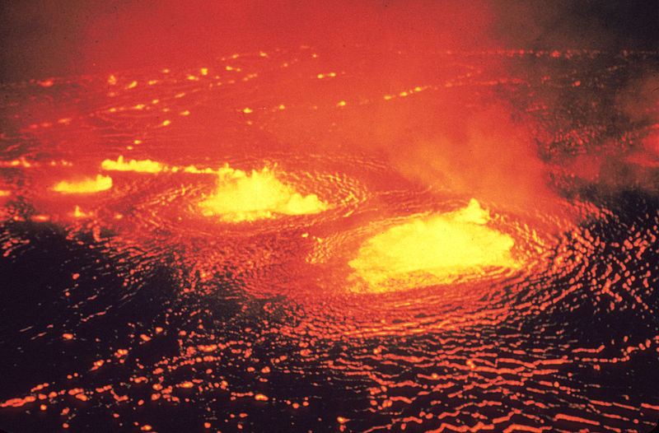
Hotspots http://en.wikipedia.org/wiki/Volcano
“‘Hotspots’ is the name given to volcanic provinces postulated to be formed by mantle plumes.
These are postulated to comprise columns of hot material that rise from the core-mantle boundary.
They are suggested to be hot, causing large-volume melting, and to be fixed in space.
Because the tectonic plates move across them, each volcano becomes dormant after a while and a new volcano is then formed as the plate shifts over the postulated plume.
The Hawaiian Islands have been suggested to have been formed in such a manner, as well as the Snake River Plain, with the Yellowstone Caldera being the part of the North American plate currently above the hot spot.
This theory is currently under criticism, however.”
Kilauea Lava Lake, Hawaii
Photo: http://usgs.gov
(Lava Lake no Longer Exists)

Slide 13
Passive Volcanism http://en.wikipedia.org/wiki/Hawai%CA%BBi_Volcanoes_National_Park
“Volcanism away from plate boundaries has also been explained as mantle plumes.
These "hotspots” are postulated to arise from upwelling diapirs with magma from the core–mantle boundary, 3,000 km deep in the Earth.
Passive volcanism can also arise at mid-ocean ridges
The lava at these volcanoes is richer in alkalai metals and poorer in silica content
It also has a much lower gas content, which is the source of the explosive nature of andesitic volcanoes”
Image showing Pahoehoe and Aa lava flows, Hawaii Volcanoes National Park
https://www.youtube.com/watch?v=Q98LcoaD5Xw

Slide 14
LAVA http://en.wikipedia.org/wiki/Volcano
“Lava refers both to molten rock expelled by a volcano during an eruption and the resulting rock after solidification and cooling.
Molten rock within the earth is more typically called magma
This molten rock is formed in the interior of some planets, including Earth, and some of their satellites.
The source of the heat that liquifies the rock within the earth is geothermal energy.
When first erupted from a volcanic vent, lava is a liquid at temperatures from 700 to 1,200 °C (1,292 to 2,192 °F).
Up to 100,000 times as viscous as water, lava can flow great distances before cooling and solidifying because of its thixotropic and shear thinning properties.
A lava flow is a moving outpouring of lava, which is created during a non-explosive effusive eruption.
When it has stopped moving, lava solidifies to form igneous rock.
The term lava flow is commonly shortened to lava.
Explosive eruptions produce a mixture of volcanic ash and other fragments called tephra, rather than lava flows. “
“The word "lava" comes from Italian, and is probably derived from the Latin word labes which means a fall or slide.
The first use in connection with extruded magma (molten rock below the Earth's surface) was apparently in a short account written by Francesco Serao on the eruption of Vesuvius between May 14 and June 4, 1737.
Serao described "a flow of fiery lava" as an analogy to the flow of water and mud down the flanks of the volcano following heavy rain”

Slide 15
Explosive Volcanoes http://en.wikipedia.org/wiki/Volcano
“Erupting volcanoes can pose many hazards, not only in the immediate vicinity of the eruption.
Volcanic ash can be a threat to aircraft, in particular those with jet engines where ash particles can be melted by the high operating temperature
The melted particles then adhere to the turbine blades and alter their shape, disrupting the operation of the turbine.
Large eruptions can affect temperature as ash and droplets of sulfuric acid obscure the sun and cool the Earth's lower atmosphere or troposphere
However, they also absorb heat radiated up from the Earth, thereby warming the stratosphere.
Historically, so-called volcanic winters have caused catastrophic famines.”
Ash plumes reached a height of 19 km during the climactic explosive eruption at Mount Pinatubo, Philippines June 15, 1991.

Slide 16
Volcanic Explosivity Index (VEI) http://en.wikipedia.org/wiki/Volcanic_Explosivity_Index
“The Volcanic Explosivity Index (VEI) was devised to provide a relative measure of the explosiveness of volcanic eruptions.
Volume of products, eruption cloud height, and qualitative observations are used to determine the explosivity value.
The scale is open-ended with the largest volcanoes in history given magnitude 8, which represents a huge eruption of 1.0×10¹² m3 (3.5×10¹³ cu ft) of tephra and have a cloud column height of over 50 km (31 mi).
A value of 0 is given for non-explosive eruptions, defined as less than 10,000 m³ (350,000 cu ft) of tephra ejected
A weakness of the VEI is that it does not take into account the power output of an eruption, which makes it extremely difficult to determine with prehistoric or unobserved eruptions.”

Slide 17
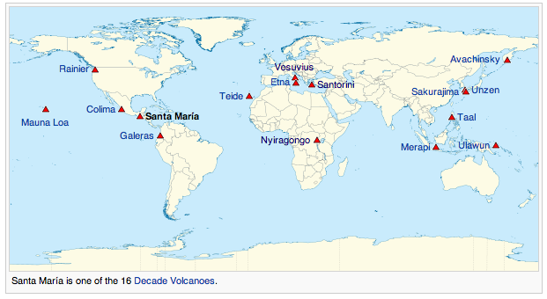
VEI – Examples http://en.wikipedia.org/wiki/Volcanic_Explosivity_Index
Right: A map showing some of the major volcanoes of the world

Slide 18
Types of Volcanoes http://library.thinkquest.org

Slide 19
Shield Volcanoes http://en.wikipedia.org/wiki/Shield_volcano
“Shield volcanoes are one of the four major types of volcanoes, distinguished from the three other major volcanic types, stratovolcanoes, lava domes, and cinder cones, by distinct differences in structure and composition.
Shield volcanoes are commonly products of hotspot volcanism, but can form at rift and subduction zones as well
The types of eruptions that occur at the majority of shield volcanoes have been named Hawaiian eruptions, after the Hawaiian chain in which they are most prominent.
Hawaiian eruptions are characterized by the effusive emission of fluid lavas.
The mobile nature of these lavas allows shield volcano flows to travel a longer distance than those of other volcanic types, resulting in larger and thinner sheets of lava, often just 1 m (3 ft) thick.
Over long periods of time, the gradual buildup of thousands of these flows slowly constructs the characteristically low, broad profile of a mature shield volcano.”
“Diagram of a Hawaiian eruption. (key: 1. Ash plume 2. Lava fountain 3. Crater 4. Lava lake 5. Fumaroles 6. Lava flow 7. Layers of lava and ash 8. Stratum 9. Sill 10. Magma conduit 11. Magma chamber 12. Dike) “

Slide 20
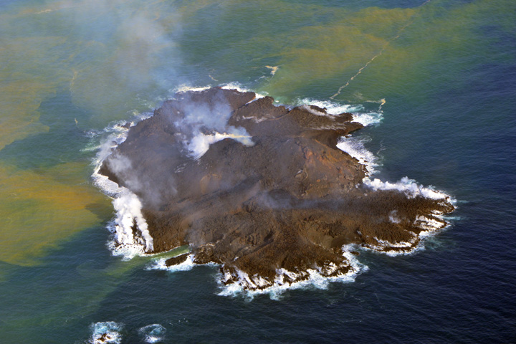
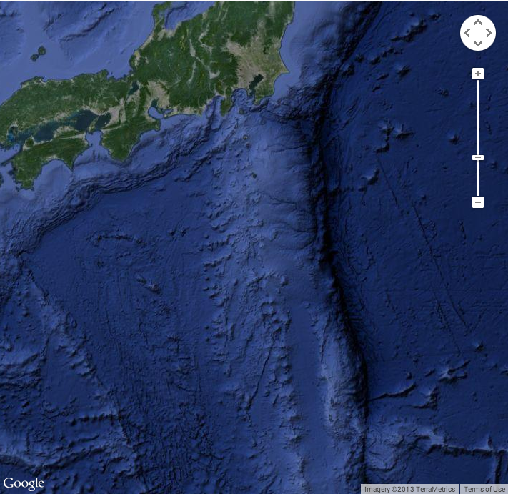
Shield Volcanoes http://earthobservatory.nasa.gov/NaturalHazards
Volcanic activity along the western edge of the Pacific “Ring of Fire” gave rise to a tiny island in late November 2013.
Located in the Ogasawara Islands, part of the Volcano Island arc, the new islet sits about 1,000 kilometers (600 miles) south of Tokyo in waters considered part of Japanese territory.
It was still erupting and growing in mid-December 2013.
The Advanced Land Imager (ALI) on NASA’s Earth Observing-1 (EO-1) satellite captured this natural-color image on December 8, 2013.
The water around the island is discolored by volcanic minerals and gases and by seafloor sediment stirred up by the ongoing volcanic eruption.
The new island, named Niijima, rose up out of the sea during a volcanic eruption first reported on November 20, 2013.
Niijima sits about 500 meters from Nishino-shima, another volcanic island that last erupted and expanded in 1973–74.
The two islands are located at approximately 27°14’ North latitude and 140°52’ East longitude, about 130 kilometers (80 miles) from the nearest inhabited island

Slide 21
Anatomy of a StratoVolcano http://en.wikipedia.org/wiki/Volcano
Cross-section through a stratovolcano
(vertical scale is exaggerated):
1. Large magma chamber
2. Bedrock
3. Conduit (pipe)
4. Base
5. Sill
6. Dike
7. Layers of ash emitted by the volcano
8. Flank
9. Layers of lava emitted by the volcano
10. Throat
11. Parasitic cone
12. Lava flow
13. Vent
14. Crater
15. Ash cloud

Slide 22
Caldera Formation Illustrated by Mt. Mazama, Oregon (Crater Lake) http://en.wikipedia.org/wiki/Mount_Mazama
“Mount Mazama is a destroyed stratovolcano in the Oregon part of the Cascade Volcanic Arc and the Cascade Range located in the United States.
The volcano's collapsed caldera holds Crater Lake, and the entire mountain is located within Crater Lake National Park.
Mazama was destroyed by a volcanic eruption that occurred around 5,677 (± 150) BC.
The eruption reduced Mazama's approximate 12,000-foot (3,700 m) height by around a mile (1600 m). Much of the volcano fell into the volcano's partially emptied neck and magma chamber. “

Slide 23
Types of Volcanic Hazards http://www.usgs.gov
Gases Cause Volcanic Explosions
“Magma contains dissolved gases that are released into the atmosphere during eruptions.
Gases are also released from magma that either remains below ground (for example, as an intrusion) or is rising toward the surface.
At high pressures deep beneath the earth's surface, volcanic gases are dissolved in molten rock.
But as magma rises toward the surface where the pressure is lower, gases held in the melt begin to form tiny bubbles.
The increasing volume taken up by gas bubbles makes the magma less dense than the surrounding rock, which may allow the magma to continue its upward journey.
Closer to the surface, the bubbles increase in number and size so that the gas volume may exceed the melt volume in the magma, creating a magma foam.
The rapidly expanding gas bubbles of the foam can lead to explosive eruptions in which the melt is fragmented into pieces of volcanic rock, known as tephra.
If the molten rock is not fragmented by explosive activity, a lava flow will be generated.”
“The most abundant gas typically released into the atmosphere from volcanic systems is water vapor (H₂O), followed by carbon dioxide (CO₂) and sulfur dioxide (SO₂). Volcanoes also release smaller amounts of others gases, including hydrogen sulfide (H₂S), hydrogen (H₂), carbon monoxide (CO), hydrogen chloride (HCL), hydrogen fluoride (HF), and helium (He)”

Slide 24
Climate Change http://www.usgs.gov
Gases and Climate Change
“During major explosive eruptions huge amounts of volcanic gas, aerosol droplets, and ash are injected into the stratosphere.
Injected ash falls rapidly from the stratosphere -- most of it is removed within several days to weeks -- and has little impact on climate change.
But volcanic gases like sulfur dioxide can cause global cooling, while volcanic carbon dioxide, a greenhouse gas, has the potential to promote global warming.
The most significant climate impacts from volcanic injections into the stratosphere come from the conversion of sulfur dioxide to sulfuric acid, which condenses rapidly in the stratosphere to form fine sulfate aerosols.
The aerosols increase the reflection of radiation from the Sun back into space, cooling the Earth's lower atmosphere or troposphere. “

Slide 25
Climate Change http://www.usgs.gov
Gases and Climate Change
“Several eruptions during the past century have caused a decline in the average temperature at the Earth's surface of up to half a degree (Fahrenheit scale) for periods of one to three years.
The climactic eruption of Mount Pinatubo on June 15, 1991, was one of the largest eruptions of the twentieth century and injected a 20-million ton (metric scale) sulfur dioxide cloud into the stratosphere at an altitude of more than 20 miles.
The Pinatubo cloud was the largest sulfur dioxide cloud ever observed in the stratosphere since the beginning of such observations by satellites in 1978.
It caused what is believed to be the largest aerosol disturbance of the stratosphere in the twentieth century, though probably smaller than the disturbances from eruptions of Krakatau in 1883 and Tambora in 1815.
Consequently, it was a standout in its climate impact and cooled the Earth's surface for three years following the eruption, by as much as 1.3 degrees at the height of the impact. “
“Sulfur dioxide from the large 1783-1784 Laki fissure eruption in Iceland caused regional cooling of Europe and North America by about 1 degree C for several years.”

Slide 26
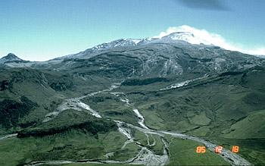
Lahars http://www.usgs.gov
“Lahar is an Indonesian term that describes a hot or cold mixture of water and rock fragments flowing down the slopes of a volcano and (or) river valleys.
When moving, a lahar looks like a mass of wet concrete that carries rock debris ranging in size from clay to boulders more than 10 m in diameter.
Lahars vary in size and speed. Small lahars less than a few meters wide and several centimeters deep may flow a few meters per second.
Large lahars hundreds of meters wide and tens of meters deep can flow several tens of meters per second--much too fast for people to outrun.
As a lahar rushes downstream from a volcano, its size, speed, and the amount of water and rock debris it carries constantly change.
The beginning surge of water and rock debris often erodes rocks and vegetation from the side of a volcano and along the river valley it enters. This initial flow can also incorporate water from melting snow and ice (if present) and the river it overruns. “
Lahars from Nevado del Ruiz Eruption, 1985
“By eroding rock debris and incorporating additional water, lahars can easily grow to more than 10 times their initial size. But as a lahar moves farther away from a volcano, it will eventually begin to lose its heavy load of sediment and decrease in size.”

Slide 27
Pyroclastic Flows http://www.usgs.gov
“Pyroclastic flows are high-density mixtures of hot, dry rock fragments and hot gases that move away from the vent that erupted them at high speeds.
They may result from the explosive eruption of molten or solid rock fragments, or both.
They may also result from the non-explosive eruption of lava when parts of dome or a thick lava flow collapses down a steep slope.
Most pyroclastic flows consist of two parts: a basal flow of coarse fragments that moves along the ground, and a turbulent cloud of ash that rises above the basal flow.
Ash may fall from this cloud over a wide area downwind from the pyroclastic flow.
A pyroclastic flow will destroy nearly everything in its path. “
“With rock fragments ranging in size from ash to boulders traveling across the ground at speeds typically greater than 80 km per hour, pyroclastic flows knock down, shatter, bury or carry away nearly all objects and structures in their way.”

Slide 28
Pyroclastic Flows http://www.usgs.gov
“Pyroclastic flows vary considerably in size and speed, but even relatively small flows that move less than 5 km from a volcano can destroy buildings, forests, and farmland.
And on the margins of pyroclastic flows, death and serious injury to people and animals may result from burns and inhalation of hot ash and gases.
Pyroclastic flows generally follow valleys or other low-lying areas and, depending on the volume of rock debris carried by the flow, they can deposit layers of loose rock fragments to depths ranging from less than one meter to more than 200 m.
Such loose layers of ash and volcanic rock debris in valleys and on hill slopes can lead to lahars indirectly.”

Slide 29
Famous and Recent Volcanic Eruptions
Stratovolcanoes
Vesuvius AD 79 (Pompeii, Italy)
Pele, 1902 (Martinique)
St. Helens, 1980 (Washington)
Pinatubo,1991 (Philippines)
Eyjafjallajökull, 2010 (Iceland)
Nevado del Ruiz, 1985 (Colombia)
Caldera Forming Eruptions
Santorini, BC 1613 +/- 7 (Greece)
Tambora, 1815 (Indonesia)
Krakatau, 1883 (Indonesia)
Supervolcanoes
Long Valley, 600,000 BC?
Yellowstone, 700,000 BC? (3 mega-eruptions in 2.1 million years)
Deccan Traps, 100 million BC?

Slide 30
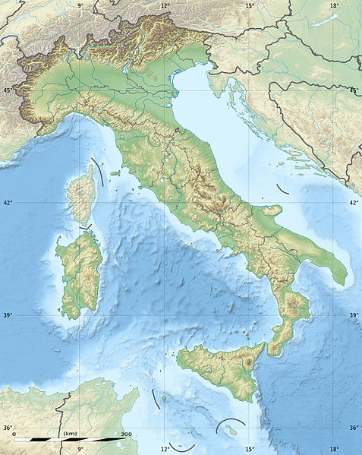
Mt Vesuvius http://en.wikipedia.org/wiki/Mount_Vesuvius
“Mount Vesuvius (Italian: Monte Vesuvio, Latin: Mons Vesuvius) is a stratovolcano in the Gulf of Naples, Italy, about 9 kilometres (5.6 mi) east of Naples and a short distance from the shore.
It is one of several volcanoes which form the Campanian volcanic arc.
Vesuvius consists of a large cone partially encircled by the steep rim of a summit caldera caused by the collapse of an earlier and originally much higher structure.”
Mt. Vesuvius

Slide 31
Eruption of 79 AD http://en.wikipedia.org/wiki/Mount_Vesuvius
“Mount Vesuvius is best known for its eruption in AD 79 that led to the burying and destruction of the Roman cities of Pompeii and Herculaneum.
That eruption ejected a cloud of stones, ash and fumes to a height of 20.5 miles, spewing molten rock and pulverized pumice at the rate of 1.5 million tons per second, ultimately releasing a hundred thousand times the thermal energy released by the Hiroshima bombing.
An estimated 16,000 people died due to hydrothermal pyroclastic flows.
The only surviving eyewitness account consists of two letters by Pliny the Younger to the historian Tacitus.
Vesuvius has erupted many times since and is the only volcano on the European mainland to have erupted within the last hundred years. “
“Today, it is regarded as one of the most dangerous volcanoes in the world because of the population of 3,000,000 people living nearby and its tendency towards explosive (Plinian) eruptions.
It is the most densely populated volcanic region in the world.”

Slide 32
Was at a Theater Near You, Feb 21, 2014 (Often shown on TV Movie Channels)

Slide 33
Campei Flegrei is Becoming Active Again http://www.nature.com/articles/ncomms13712

Slide 34
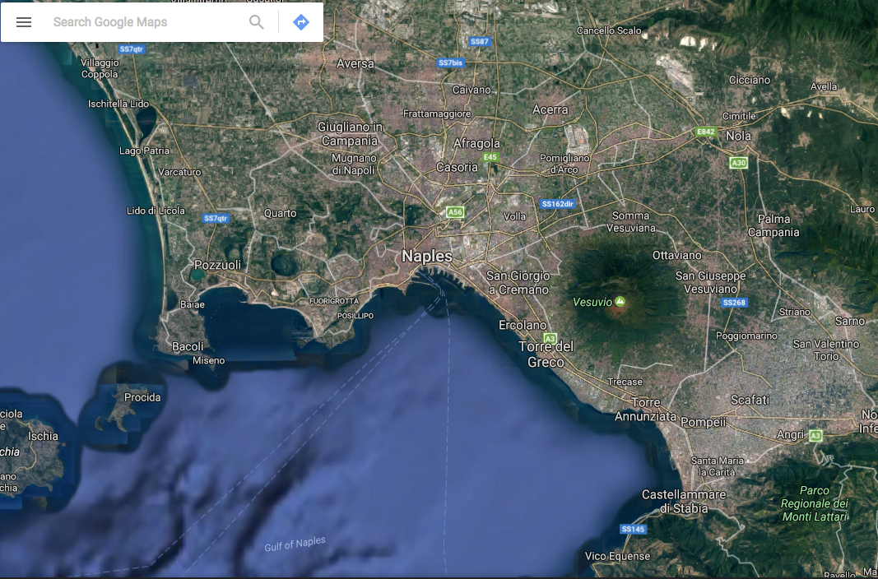

Slide 35
Campei Flegrei https://en.wikipedia.org/wiki/Phlegraean_Fields

Slide 36
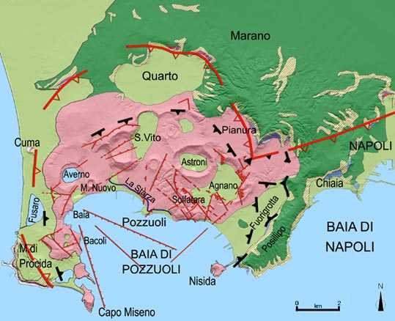
Geologic Map of Campei Flegrei http://www.meteoweb.eu/foto/terremoto-e-vulcani-adesso-occhi-puntati-sui-campi-flegrei-la-direttrice-dellosservatorio-vesuviano-in-atto-anomalie-che-sono-campanello-dallarme-allerta-gialla/id/778171/

Slide 37
Mt Pele, Martinique, 1902 http://en.wikipedia.org/wiki/Mount_Pel%C3%A9e
“Mount Pelée (/pəˈleɪ/; French: Montagne Pelée "Bald Mountain") is an active volcano at the northern end of the island and French overseas department of Martinique in the Lesser Antilles island arc of the Caribbean.
The stratovolcano is famous for its eruption in 1902 and the destruction that resulted, dubbed the worst volcanic disaster of the 20th century.
The eruption killed about 30,000 people.
Most deaths were caused by pyroclastic flows and occurred in the city of Saint-Pierre, which was, at that time, the largest city.
Pyroclastic flows completely destroyed St. Pierre within minutes of the eruption.
The eruption left only two survivors in the direct path of the flows (with a third reported):
Louis-Auguste Cyparis survived because he was in a poorly ventilated, dungeon-like jail cell; Léon Compère-Léandre, living on the edge of the city, escaped with severe burns.
Havivra Da Ifrile, a young girl, reportedly escaped with injuries during the eruption by taking a small boat to a cave down shore, and was later found adrift two miles (3 km) from the island, unconscious.”
.

Slide 38
Mt Pele, Martinique, May 8, 1902 http://en.wikipedia.org/wiki/Mount_Pel%C3%A9e
Remains of St. Pierre

Slide 39
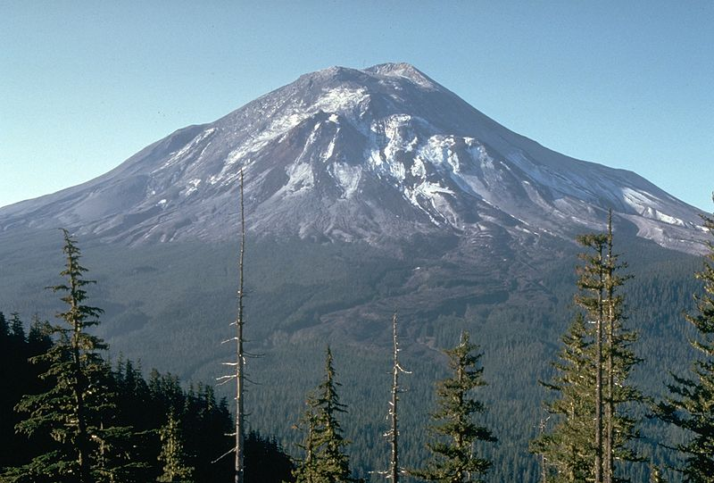
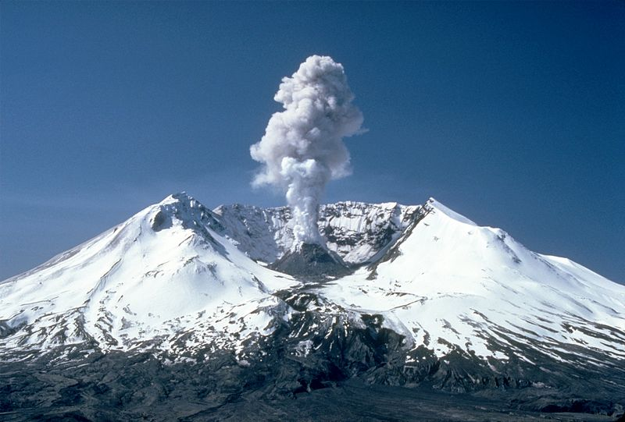
Mt St Helens, Washington, May 18, 1980 http://en.wikipedia.org/wiki/Mount_St._Helens

Slide 40
St. Helens http://en.wikipedia.org/wiki/Mount_St._Helens
“Mount St. Helens is an active stratovolcano located NE of Vancouver, Washington, in the Pacific Northwest
It is 96 miles (154 km) south of Seattle, Washington, and 50 miles (80 km) northeast of Portland, Oregon.
Mount St. Helens takes its English name from the British diplomat Lord St Helens, a friend of explorer George Vancouver who made a survey of the area in the late 18th century.
The volcano is located in the Cascade Range and is part of the Cascade Volcanic Arc, a segment of the Pacific Ring of Fire that includes over 160 active volcanoes.
This volcano is well known for its ash explosions and pyroclastic flows.
Mount St. Helens is most notorious for its catastrophic eruption on May 18, 1980, at 8:32 a.m. PDT, the deadliest and most economically destructive volcanic event in the history of the United States.
Fifty-seven people were killed; 250 homes, 47 bridges, 15 miles (24 km) of railways, and 185 miles (298 km) of highway were destroyed. “

Slide 41
St. Helens http://en.wikipedia.org/wiki/Mount_St._Helens
“Mount St. Helens is geologically young compared with the other major Cascade volcanoes.
It formed only within the past 40,000 years, and the pre-1980 summit cone began rising about 2,200 years ago.
The volcano is considered the most active in the Cascades within the Holocene epoch (the last 10,000 or so years).
Prior to the 1980 eruption, Mount St. Helens was the fifth-highest peak in Washington.
It stood out prominently from surrounding hills because of the symmetry and extensive snow and ice cover of the pre-1980 summit cone, earning it the nickname "Fuji-san of America”.
The peak rose more than 5,000 feet (1,500 m) above its base, where the lower flanks merge with adjacent ridges.
The mountain is 6 miles (9.7 km) across at its base, which is at an altitude of 4,400 feet (1,300 m) on the northeastern side and 4,000 feet (1,200 m) elsewhere.
At the pre-eruption tree line, the width of the cone was 4 miles (6.4 km).”

Slide 42
Eruption, May 18, 1980 http://en.wikipedia.org/wiki/Mount_St._Helens
“On March 20, 1980, Mount St. Helens experienced a magnitude 4.2 earthquake
On March 27, steam venting started.
By the end of April, the north side of the mountain had started to bulge.
On May 18, with little warning, a second earthquake, of magnitude 5.1, triggered a massive collapse of the north face of the mountain.
It was the largest known debris avalanche in recorded history.
The magma in St. Helens burst forth into a large-scale pyroclastic flow that flattened vegetation and buildings over 230 square miles (600 km²).
More than 1.5 million metric tons of sulfur dioxide were released into the atmosphere.
On the Volcanic Explosivity Index (VEI) scale, the eruption was rated a five (a Plinian eruption).”

Slide 43
Eruption, May 18, 1980 http://en.wikipedia.org/wiki/Mount_St._Helens
“Prior to the eruption, the north side of the mountain had bulged outward due to magmatic pressure by as much as 100 meters
A massive debris avalanche triggered by an earthquake with magnitude 5.1 caused an eruption that reduced the elevation of the mountain's summit from 9,677 ft (2,950 m) to 8,365 ft (2,550 m), replacing it with a 1 mile (1.6 km) wide horseshoe-shaped crater.
The debris avalanche was up to 0.7 cubic miles (2.9 km³) in volume.
The Mount St. Helens National Volcanic Monument was created to preserve the volcano and allow for its aftermath to be scientifically studied.
As with most other volcanoes in the Cascade Range, Mount St. Helens is a large eruptive cone consisting of lava rock interlayered with ash, pumice, and other deposits.
The mountain includes layers of basalt and andesite through which several domes of dacite lava have erupted.
The largest of the dacite domes formed the previous summit, and off its northern flank sat the smaller Goat Rocks dome.
Both were destroyed in the 1980 eruption”

Slide 44
Eruption, May 18, 1980 http://en.wikipedia.org/wiki/Mount_St._Helens
“The collapse of the northern flank of St. Helens mixed with ice, snow, and water to create lahars (volcanic mudflows).
The lahars flowed many miles down the Toutle and Cowlitz Rivers, destroying bridges and lumber camps.
A total of 3,900,000 cubic yards (3,000,000 m³) of material was transported 17 miles (27 km) south into the Columbia River by the mudflows.
For more than nine hours, a vigorous plume of ash erupted, eventually reaching 12 to 16 miles (20 to 27 km) above sea level.
The plume moved eastward at an average speed of 60 miles per hour (100 km/h) with ash reaching Idaho by noon.
Ashes from the eruption were found collecting on top of cars and roofs next morning, as far as the city of Edmonton in Alberta, Canada.
The St. Helens May 18 eruption released 24 megatons of thermal energy and ejected more than 0.67 cubic miles (2.79 km³) of material.
The eruption killed 57 people, nearly 7,000 big game animals (deer, elk, and bear), and an estimated 12 million fish from a hatchery.
The noted USGS volcanologist David Johnston was observing the mountain at the time of the explosion from his post about 5 miles north, and was killed in the explosion.
His last words heard on the radio were ‘Vancouver, this is it!’ “

Slide 45
St Helens: Mechanism and Explosion http://volcanoes.usgs.gov/volcanoes/st_helens/st_helens_geo_hist_101.html
The May 18 Eruption (http://www.khq.com)

Slide 46
St Helens: Before and After http://volcanoes.usgs.gov/volcanoes/st_helens/st_helens_geo_hist_101.html
May 17, 1980
May 18, 1980

Slide 47
St Helens http://volcanoes.usgs.gov/volcanoes/st_helens/st_helens_geo_hist_101.html

Slide 48
David Johnston 1950-1980

Slide 49
Mt Pinatubo, Philippines, June 15, 1991 http://en.wikipedia.org/wiki/Mount_Pinatubo
“Mount Pinatubo is an active stratovolcano located on the island of Luzon, near the tripoint of the Philippine provinces of Zambales, Tarlac, and Pampanga.
It is located in the Cabusilan Mountains separating the west coast of Luzon from the central plains.
Before the volcanic activities of 1991, its eruptive history was unknown to most people.
It was heavily eroded, inconspicuous and obscured from view.
It was covered with dense forest which supported a population of several thousand indigenous people, the Aetas, who fled to the mountains during the Spanish conquest of the Philippines.
The volcano's Plinian / Ultra-Plinian eruption on June 15, 1991 produced the second largest terrestrial eruption of the 20th century after the 1912 eruption of Novarupta in the Alaska Peninsula.
Complicating the eruption was the arrival of Typhoon Yunya bringing a lethal mix of ash and rain. “

Slide 50
Mt Pinatubo, Philippines http://en.wikipedia.org/wiki/Mount_Pinatubo
“Successful predictions at the onset of the climactic eruption led to the evacuation of tens of thousands of people from the surrounding areas, saving many lives
But the surrounding areas were severely damaged by pyroclastic flows, ash deposits, and subsequently, by the lahars caused by rainwaters re-mobilizing earlier volcanic deposits
These caused extensive destruction to infrastructure and altered the river systems months to years after the eruption.
The effects of the eruption were felt worldwide.
It ejected roughly 11,000,000,000 tons or 10 km³ (2.4 cu mi) of magma, and 22,000,000 tons SO², bringing vast quantities of minerals and metals to the surface environment.
It injected large amounts of particulate into the stratosphere – more than any eruption since that of Krakatoa in 1883.
Over the following months, the aerosols formed a global layer of sulfuric acid haze.
Global temperatures dropped by about 0.5 °C (0.9 °F), and ozone depletion temporarily increased substantially.”

Slide 51
Eyjafjallajökull, Iceland, April 18, 2010
Start here 2/24/2017
http://video.foxnews.com/v/4120683/toxic-deadly-volcanic-eruption/#sp=show-clips

Slide 52
Air Travel Disruption http://en.wikipedia.org/wiki/2010_eruptions_of_Eyjafjallaj%C3%B6kull
“The 2010 eruptions of Eyjafjallajökull were volcanic events at Eyjafjallajökull in Iceland
Although relatively small for volcanic eruptions, the eruptions caused enormous disruption to air travel across western and northern Europe over an initial period of six days in April 2010.
Additional localized disruption continued into May 2010.
The eruption was declared officially over in October 2010, when snow on the glacier did not melt.
From 14–20 April, ash covered large areas of northern Europe when the volcano erupted. About 20 countries closed their airspace to commercial jet traffic and it affected more than 100,000 travellers.
Seismic activity started at the end of 2009 and gradually increased in intensity until on 20 March 2010, a small eruption started rated as a 1 on the Volcanic Explosivity Index. ”
Composite map of the volcanic ash cloud spanning 14–25 April 2010

Slide 53
Further Eruptions Eyjafjallajökull Volcano http://en.wikipedia.org/wiki/2010_eruptions_of_Eyjafjallaj%C3%B6kull
“Beginning on 14 April 2010, the eruption entered a second phase and created an ash cloud that led to the closure of most of the European IFR airspace from 15 until 20 April 2010.
Consequently, a very high proportion of flights within, to, and from Europe were cancelled, creating the highest level of air travel disruption since the Second World War.
The second phase of the eruption started on 14 April 2010 and resulted in an estimated 250 million cubic metres (330,000,000 cu yd) (0.25 km3) of ejected tephra. The ash plume rose to a height of approximately 9 kilometres (30,000 ft), which rates the explosive power of the eruption as a 4 on the Volcanic Explosivity Index.
By 21 May 2010, the second eruption phase had subsided to the point that no further lava or ash was being produced. More seismic activity was produced.”
Fimmvorduhals fissure, April 2, 2010

Slide 54
Santorini Island http://en.wikipedia.org/wiki/Santorini
“Santorini, classically Thera is an island in the southern Aegean Sea, about 200 km (120 mi) southeast of Greece's mainland.
It is the largest island of a small, circular archipelago which bears the same name and is the remnant of a volcanic caldera.
It forms the southernmost member of the Cyclades group of islands, with an area of approximately 73 km2 (28 sq mi) and a 2011 census population of 15,550.
The municipality of Santorini comprises the inhabited islands of Santorini and Therasia and the uninhabited islands of Nea Kameni, Palaia Kameni, Aspronisi, and Christiana.
The total land area is 90.623 km2 (34.990 sq mi). Santorini is part of the Thira regional unit.”
2/22/2019

Slide 55
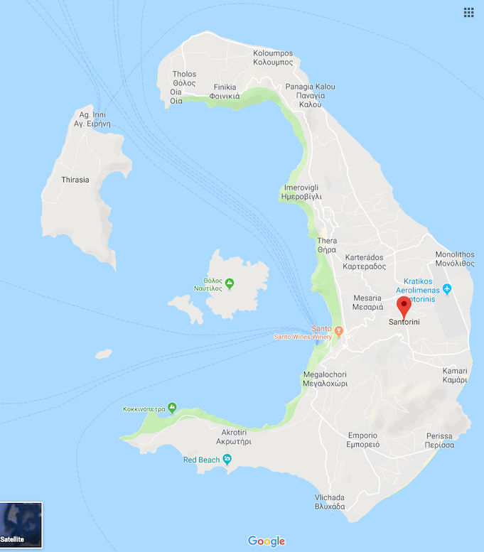

Slide 56
Santorini, Greece (“Atlantis”) http://en.wikipedia.org/wiki/Santorini
“Santorini is essentially what remains after an enormous volcanic explosion that destroyed the earliest settlements on a formerly single island, and created the current geological caldera.
A giant central, rectangular lagoon, which measures about 12 by 7 km (7.5 by 4.3 mi), is surrounded by 300 m (980 ft) high, steep cliffs on three sides.
The main island slopes downward to the Aegean Sea.
On the fourth side, the lagoon is separated from the sea by another much smaller island called Therasia
The lagoon is connected to the sea in two places, in the northwest and southwest.
The depth of the caldera, at 400m, makes it possible for all but the largest ships to anchor anywhere in the protected bay
There is also a newly built marina at Vlychada, on the southwestern coast.
The island's principal port is Athinias.
The capital, Fira, clings to the top of the cliff looking down on the lagoon.”

Slide 57
Santorini Caldera http://en.wikipedia.org/wiki/Santorini
“It is the most active volcanic center in the South Aegean Volcanic Arc, though what remains today is chiefly a water-filled caldera.
The volcanic arc is approximately 500 km (310 mi) long and 20 to 40 km (12 to 25 mi) wide.
The region first became volcanically active around 3–4 million years ago, though volcanism on Thera began around 2 million years ago with the extrusion of dacitic lavas from vents around the Akrotiri.
The island is the site of one of the largest volcanic eruptions in recorded history: the Minoan eruption (sometimes called the Thera eruption), which occurred some 3600 years ago at the height of the Minoan civilization.
The eruption left a large caldera surrounded by volcanic ash deposits hundreds of metres deep and may have led indirectly to the collapse of the Minoan civilization on the island of Crete, 110 km (68 mi) to the south, through a gigantic tsunami.
Another popular theory holds that the Thera eruption is the source of the legend of Atlantis.”

Slide 58
Santorini Caldera http://en.wikipedia.org/wiki/Santorini

Slide 59
Views of Santorini Caldera http://en.wikipedia.org/wiki/Santorini

Slide 60
Tambora Caldera, Indonesia, April 10, 1815 http://en.wikipedia.org/wiki/Mount_Tambora
“Mount Tambora (or Tamboro) is an active stratovolcano on the island of Sumbawa, Indonesia.
Sumbawa is flanked both to the north and south by oceanic crust, and Tambora was formed by the active subduction zone beneath it.
This raised Mount Tambora as high as 4,300 m (14,100 ft), making it, in the 18th century, one of the tallest peaks in the Indonesian archipelago.
After a large magma chamber inside the mountain filled over the course of several decades, volcanic activity reached a historic climax in the eruption of 10 April 1815.
This eruption was approximately VEI-7, the only eruption unambiguously confirmed of that size since the Lake Taupo eruption in about 180 CE.”

Slide 61
Impacts of Tambora Eruption http://en.wikipedia.org/wiki/Mount_Tambora
“With an estimated ejecta volume of 160 km3 (38 cu mi), Tambora's 1815 outburst was the largest volcanic eruption in recorded history.
The explosion was heard on Sumatra island more than 2,000 km (1,200 mi) away.
Heavy volcanic ash falls were observed as far away as Borneo, Sulawesi, Java and Maluku islands.
Most deaths from the eruption were from starvation and disease, as the eruptive fallout ruined agricultural productivity in the local region.
The death toll was at least 71,000 people, of whom 11,000–12,000 were killed directly by the eruption
The eruption caused global climate anomalies that included the phenomenon known as "volcanic winter”
1816 became known as the "Year Without a Summer" because of the effect on North American and European weather.
Crops failed and livestock died in much of the Northern Hemisphere, resulting in the worst famine of the 19th century.
During an excavation in 2004, a team of archaeologists discovered cultural remains buried by the 1815 eruption, kept intact beneath the 3 m (9.8 ft) deep pyroclastic deposits.
At the site, dubbed the Pompeii of the East, the artifacts were preserved in the positions they had occupied in 1815.”

Slide 62
Krakatau, August 26-27,1883, Indonesia http://en.wikipedia.org/wiki/Krakatoa
“Krakatoa, or Krakatau (Indonesian: Krakatau), is a volcanic island situated in the Sunda Strait between the islands of Java and Sumatra in Indonesia.
The name is also used for the surrounding island group comprising the remnants of a much larger island of three volcanic peaks which was obliterated in a cataclysmic 1883 eruption, unleashing huge tsunamis (killing more than 36,000 people) and destroying over two-thirds of the island.
The explosion is considered to be the loudest sound ever heard in modern history, with reports of it being heard up to 3,000 miles (4,800 km) from its point of origin.
The shock waves from the explosion were recorded on barographs around the globe.
In 1927 a new island, Anak Krakatau, or "Child of Krakatoa", emerged from the caldera formed in 1883 and is the current location of eruptive activity.”

Slide 63
Krakatau, August 26-27,1883, Indonesia http://en.wikipedia.org/wiki/Krakatoa
“The most notable eruptions of Krakatoa culminated in a series of massive explosions over August 26–27, 1883, which were among the most violent volcanic events in recorded history.
With an estimated Volcanic Explosivity Index (VEI) of 6, the eruption was equivalent to 200 megatons of TNT (840 PJ):
13,000 times the nuclear yield of the Little Boy bomb (13 to 16 kt) that devastated Hiroshima, Japan, during World War II
Four times the yield of Tsar Bomba (50 Mt), the most powerful nuclear device ever detonated.
The 1883 eruption ejected approximately 21 km3 (5.0 cu mi) of rock, ash, and pumice.
The cataclysmic explosion was heard in Perth in Western Australia, about 1,930 miles (3,110 km) to the south, as well as the island of Rodrigues near Mauritius, about 3,000 miles (4,800 km) to the west.”
An 1888 lithograph of the 1883 eruption of Krakatoa

Slide 64
Anak Krakatau http://en.wikipedia.org/wiki/Krakatoa
“According to the official records of the Dutch East Indies colony, 165 villages and towns were destroyed near Krakatoa, and 132 were seriously damaged.
At least 36,417 people died, and many more thousands were injured, mostly from the tsunamis that followed the explosion. The eruption destroyed two-thirds of the island of Krakatoa.
Eruptions in the area since 1927 have built a new island at the same location, named Anak Krakatau (which is Indonesian for "Child of Krakatoa").
Periodic eruptions have continued since, with recent eruptions in 2009, 2010, 2011, and 2012. As of late 2011, this island has a radius of roughly 2 kilometres (1.2 mi), and a high point of about 324 metres (1,063 ft) above sea level, growing 5 metres (16 ft) each year”

Slide 65
Anak Krakatau http://en.wikipedia.org/wiki/Krakatoa
“Anak Krakatau has grown at an average rate of five inches (13 cm) per week since the 1950s.
This equates to an average growth of 6.8 meters per year.
The island is still active, with its most recent eruptive episode having begun in 1994.
Quiet periods of a few days have alternated with almost continuous Strombolian eruptions since then.
Hot gases, rocks, and lava were released in an eruption in April 2008. Scientists monitoring the volcano have warned people to stay out of a 3 km zone around the island.
Several videos of Krakatoa on YouTube show recent footage of eruptions and of the inside of the crater as seen from the rim of the volcano.
On 6 May 2009 the Volcanological Survey of Indonesia raised the eruption alert status of Anak Krakatau to Level III.
A recent expedition to the volcano has revealed that a 100 m wide lava dome is growing in its crater. The dome has two active vents that eject incandescent gas.”
2008 Eruption of Anak Krakatau

Slide 66
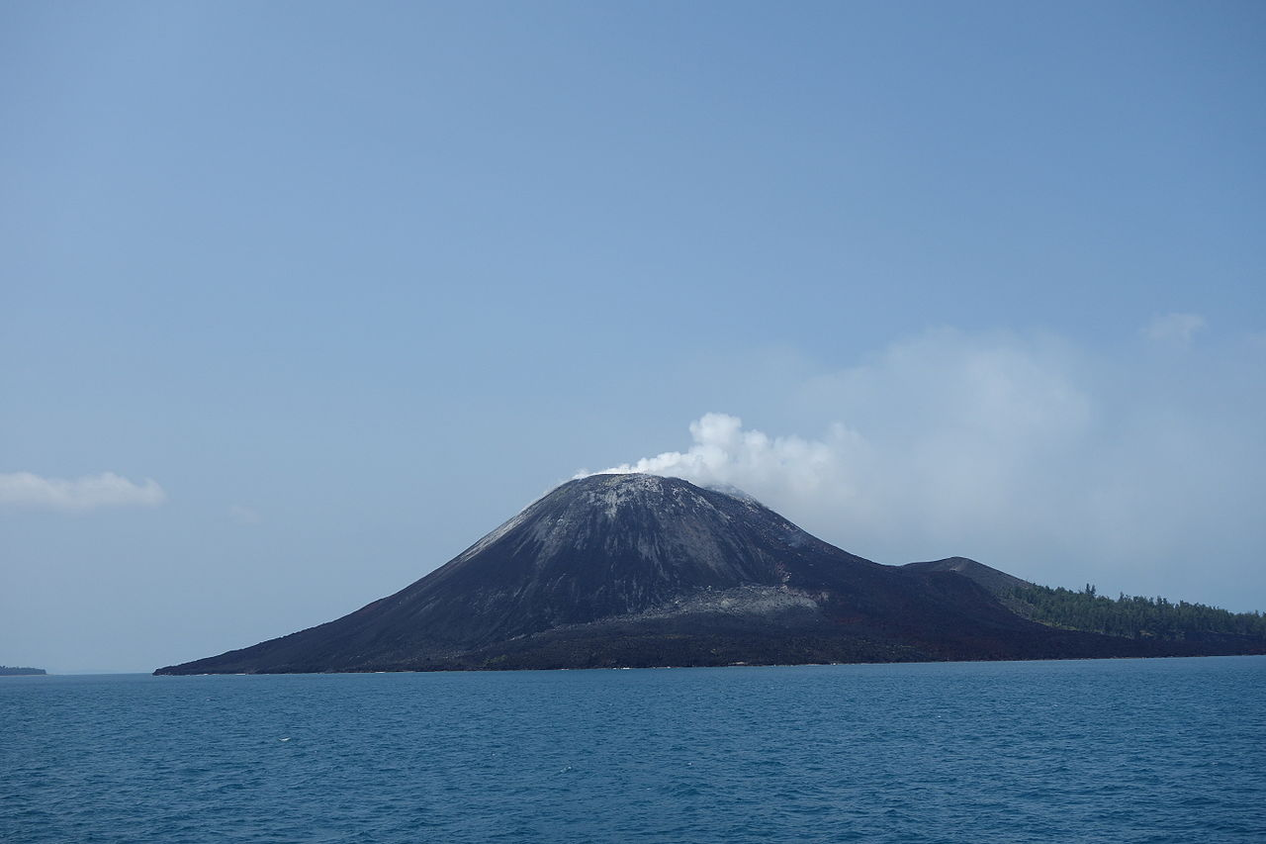
Very Recent Example: Sunda Strait Tsunami, 12/22/2018 https://en.wikipedia.org/wiki/2018_Sunda_Strait_tsunami
On 22 December 2018, a tsunami that followed an eruption and partial collapse of the Anak Krakatau volcano in the Sunda Strait struck several coastal regions of Banten in Java and Lampung in Sumatra, Indonesia.
At least 437 people were killed and 14,059 were injured.
The tsunami was caused by an undersea landslide which followed an eruption of Anak Krakatau, the "Child of Krakatoa".
On 23 December, it was found that much of the island of Anak Krakatau had collapsed into the sea.
Anak Krakatau emerged from the sea in 1927, some time after the August 26-27, 1883 eruption of Krakatoa, one of the most violent eruptions in recorded history.
Via tsunamis and ash fall, the 1883 eruption of Krakatua killed more than 36,000 people, many of whom lived then in the same regions where the 2018 tsunami struck.

Slide 67
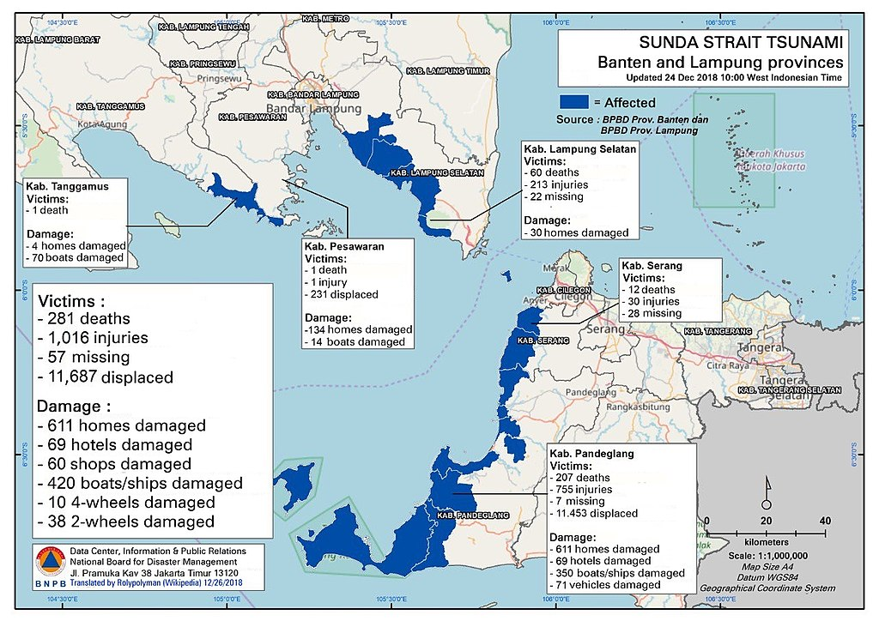
Latest Event

Slide 68
Yellowstone Caldera, Wyoming
“The present Yellowstone is a new volcano that was created during a supereruption that took place 640,000 years ago.
The caldera lies over a hotspot where light, hot, molten rock from the mantle rises toward the surface.
While the Yellowstone hotspot is now under the Yellowstone Plateau, it previously helped create the eastern Snake River Plain (to the west of Yellowstone) through a series of huge volcanic eruptions.
The hotspot appears to move across terrain in the east-northeast direction, but in fact the hotspot is much deeper than terrain and remains stationary while the North American Plate moves west-southwest over it.
Over the past 18 million years or so, this hotspot has generated a succession of violent eruptions and less violent floods of basaltic lava.
Together these eruptions have helped create the eastern part of the Snake River Plain from a once-mountainous region.
At least a dozen of these eruptions were so massive that they are classified as supereruptions. “

Slide 69
Yellowstone Eruptions http://en.wikipedia.org/wiki/Yellowstone_Caldera
“The major features of the caldera measure about 34 by 45 miles (55 by 72 km).
The caldera formed during the last of three supereruptions over the past 2.1 million years.
First came the Huckleberry Ridge eruption 2.1 million years ago, which created the Island Park Caldera and the Huckleberry Ridge Tuff.
Next came the Mesa Falls eruption 1.3 million years ago, which created the Henry's Fork Caldera and the Mesa Falls Tuff.
Finally came the Lava Creek eruption 640,000 years ago, which created the Yellowstone Caldera and the Lava Creek Tuff.
Volcanic eruptions sometimes empty their stores of magma so swiftly that they cause the overlying land to collapse into the emptied magma chamber, forming a caldera
Calderas formed from explosive supereruptions can be as wide and deep as mid- to large-sized lakes and can be responsible for destroying broad swaths of mountain ranges.”
“The northeastern part of Yellowstone Caldera, with the Yellowstone River flowing through Hayden Valley and the caldera rim in the distance”

Slide 70
Yellowstone Caldera, a Super Volcano http://en.wikipedia.org/wiki/Yellowstone_Caldera

Slide 71
Lava Creek Tuff from Yellowstone Eruption http://en.wikipedia.org/wiki/Yellowstone_Caldera
“The Lava Creek Tuff is a tuff formation in Wyoming, created during the Lava Creek eruption around 640,000 years ago, which formed the Yellowstone Caldera.
The Lava Creek Tuff is distributed in a radial pattern around the caldera and is formed of 1,000 cubic kilometers of ash in pyroclastic flows.
The tuff has been exposed by erosion at Tuff Cliff along the Gibbon River
Lava Creek Tuff ranges in color from light-gray to pale red in some locales.
Rock texture of the tuff ranges from fine-grained to aphanitic and is densely welded.
The maximum thickness of the tuff layer is approximately 180–200 m”

Slide 72
Long Valley Caldera,California http://en.wikipedia.org/wiki/Long_Valley_Caldera

Slide 73
Eruption and Caldera Collapse http://en.wikipedia.org/wiki/Long_Valley_Caldera
“Long Valley Caldera is a depression in eastern California that is adjacent to Mammoth Mountain.
The valley is one of the earth's largest calderas, measuring about 20 mi (32 km) long (east-west) and 11 mi (18 km) wide (north-south), and up to 3,000 ft (910 m) deep.
Long Valley was formed 760,000 years ago when a huge volcanic eruption released very hot ash that later cooled to form the Bishop tuff that is common to the area.
The eruption was so colossal that the magma chamber under the now destroyed volcano was emptied to the point of collapse.
The collapse itself caused an even larger secondary eruption of pyroclastic ash that burned and buried thousands of square miles.
Ash from this eruption blanketed much of the western part of what is now the United States.”

Slide 74
Recent Activity in Long Valley http://en.wikipedia.org/wiki/Long_Valley_Caldera
“In May 1980, a strong earthquake swarm that included four Richter magnitude 6 earthquakes struck the southern margin of Long Valley Caldera associated with a 10 in (25 cm), dome-shaped uplift of the caldera floor.
The ongoing unrest includes recurring earthquake swarms and continued dome-shaped uplift of the central section of the caldera (the resurgent dome) accompanied by changes in thermal springs and gas emissions.
After the quake another road was created as an escape route; its name at first was proposed as the "Mammoth Escape Route" but was changed to the Mammoth Scenic Loop after Mammoth area businesses and land owners complained.
In 1982, the United States Geological Survey under the Volcano Hazards Program began an intensive effort to monitor and study geologic unrest in Long Valley Caldera.
The goal of this effort is to provide residents and civil authorities in the area reliable information on the nature of the potential hazards posed by this unrest and timely warning of an impending volcanic eruption, should it develop.
Most, perhaps all, volcanic eruptions are preceded and accompanied by geophysical and geochemical changes in the volcanic system.
Common precursory indicators of volcanic activity include increased seismicity, ground deformation, and variations in the nature and rate of gas emissions.
In April 2006, three members of the Mammoth Mountain Ski Area ski patrol died while on duty. All three died from suffocation by carbon dioxide when they fell into a fumarole on the slopes of the mountain.”

Slide 75
Bishop Tuff http://en.wikipedia.org/wiki/Long_Valley_Caldera
“The caldera is a giant bowl-shaped depression, approximately 20 miles (32 km) wide, surrounded by mountains, but open to the southeast.
The elevation of the bottom of the bowl ranges from 6,500 to 8,500 ft (2,000 to 2,600 m), being higher in the west.
Near the center of the bowl, there is a resurgent dome formed by magmatic uplift.
The southeastern slope from the caldera down towards Bishop, California is filled with the Bishop tuff, solidified ash that was ejected during the stupendous eruption that created the caldera.
The Bishop tuff is thousands of feet thick and is cut by the Owens River Gorge, formed during the Pleistocene when the caldera filled with water and overtopped its rim.
The rim of the caldera is formed from pre-existing rock, rising about 3,000 ft (910 m) above the caldera floor.
However, the eastern rim is less high, only about 500 ft (150 m).”
Exposure of Bishop Tuff. No tuff can be seen in the caldera, as was buried by the caldera collapse. All visible exposures are outside the caldera

Slide 76
Features of Long Valley Caldera http://en.wikipedia.org/wiki/Long_Valley_Caldera
“Mammoth Mountain is a lava dome complex in the southwestern corner of the caldera, consisting of about 12 rhyodacite and dacite overlapping domes.
These domes formed in a long series of eruptions from 110,000 to 57,000 years ago, building a volcano that reaches 11,059 feet (3,371 m) in elevation.
The Mono-Inyo Craters are a 25 mi (40 km)-long volcanic chain that sit along a narrow, north–south-trending fissure system extending along the western rim of the caldera from Mammoth Mountain to the north shore of Mono Lake.
The Mono-Inyo Craters erupted from 40,000 to 600 years ago, from a magma source separate from the Long Valley Caldera.
Although the area is still volcanically active, the caldera itself is extinct: seismic mapping has shown the magma body deep underground is mostly crystallized and not molten anymore.
The caldera has an extensive hydrothermal system. Casa Diablo Hot Springs at the base of the resurgent dome hosts a geothermal power plant.
Hot Creek cuts into part of the resurgent dome and passes through a hot springs area”

Slide 77
View from Glass Mountain Area http://en.wikipedia.org/wiki/Long_Valley_Caldera
View from northeast rim of Long Valley caldera

