Slide 1
Lecture 9
Modern Earthquakes:
Case Studies of Important Earthquakes
John Rundle GEL/EPS 131

Slide 2
Topics
Recent important earthquakes
Chile 1960, 2010
Alaska 1964
Great Andaman Sumatra 2004
Northern Sumatra 2005
Southern Sumatra 2007
West Sumatra 2012

Slide 3
Modern Great Earthquakes http://earthquake.usgs.gov/earthquakes/world/10_largest_world.php
Sorted by Magnitude

Slide 4
Great Earthquakes vs. Time Since 1900 http://www.groundtruthtrekking.org/Graphics/Largest-earthquakes.html

Slide 5
Global Energy Release http://en.wikipedia.org/wiki/1960_Valdivia_earthquake
Energy release (seismic moment) since 1906 - 2005
Almost 25% is due to 1960 Chile event
About 15% from 1964 Alaska event
San Francisco barely shows up

Slide 6
Chile 1960 M9.5 http://en.wikipedia.org/wiki/1960_Valdivia_earthquake
"The 1960 Valdivia earthquake or Great Chilean Earthquake of Sunday, 22 May 1960 was the most powerful earthquake ever recorded via instruments
Magnitude was 9.5 on the moment magnitude scale.
It occurred in the afternoon (19:11 GMT, 15:11 local time)
Resulting tsunami affected southern Chile, Hawaii, Japan, the Philippines, eastern New Zealand, southeast Australia, and the Aleutian Islands in Alaska."

Slide 7
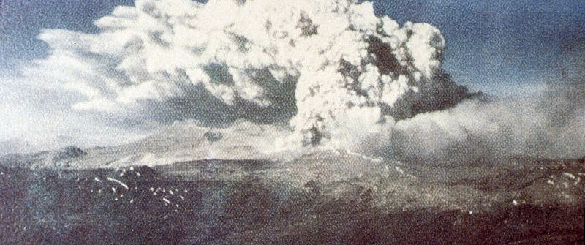
A Tsunami Traveled Across the Pacific http://en.wikipedia.org/wiki/1960_Valdivia_earthquake
"Earthquake-induced tsunamis affected southern Chile, Hawaii, Japan, the Philippines, eastern New Zealand, southeast Australia and the Aleutian Islands.
Some localised tsunamis severely battered the Chilean coast, with waves up to 25 m (82 ft).
Volcanic eruptions also occurred"
Eruption of Cordon Caulle

Slide 8
Major Damage at Hilo, HI http://en.wikipedia.org/wiki/1960_Valdivia_earthquake
"The main tsunami crossed the Pacific Ocean at a speed of several hundred km/h and devastated Hilo, Hawaii, killing 61 people."
Hilo's position in the bay caused a cumulative bounce of tsunami waves far more destructive to Hilo than to other more exposed areas of Hawaii."

Slide 9
Major Damage in Japan http://en.wikipedia.org/wiki/1960_Valdivia_earthquake
"In Japan, the tsunami arrived about 22 hours after the earthquake and 142 people were killed.
Tsunami waves as high as 10.7 m (35 ft) were recorded 10,000 km (6,200 mi) from the epicenter, several as far away as Japan and the Philippines."
In planning for following tsunamis in Japan, this event was used as the model for the worst case scenario
Damage at Kamaishi, Japan

Slide 10
Prince William Sound, Alaska, 1964 http://en.wikipedia.org/wiki/1964_Alaska_earthquake
"At 5:36 p.m. Alaska Standard Time (3:36 a.m. March 28, 1964 UTC), a fault between the Pacific and North American plates ruptured near College Fjord in Prince William Sound.
The epicenter of the earthquake was 61.05°N 147.48°W, 12.4 mi (20 km) north of Prince William Sound, 78 miles (125 km) east of Anchorage and 40 miles (64 km) west of Valdez.
The focus occurred at a depth of approximately 15.5 mi (25 km). Ocean floor shifts created large tsunamis (up to 220 feet (67 m) in height), which resulted in many of the deaths and much of the property damage.
Large rockslides were also caused, resulting in great property damage. Vertical displacement of up to 38 feet (11.5 m) occurred, affecting an area of 100,000 miles² (250,000 km²) within Alaska.
Studies of ground motion have led to a peak ground acceleration estimate of 0.14 - 0.18 g"
Start here 1/28/2019

Slide 11
Alaska 1964 M9.2 http://en.wikipedia.org/wiki/1964_Alaska_earthquake
"The 1964 Alaskan earthquake, was a megathrust earthquake that began at 5:36 P.M. AST on Good Friday, March 27, 1964.
Ground fissures, collapsing structures, and tsunamis resulting from the earthquake caused about 143 deaths.
Lasting nearly three minutes, it was the most powerful recorded earthquake in U.S. and North American history"

Slide 12
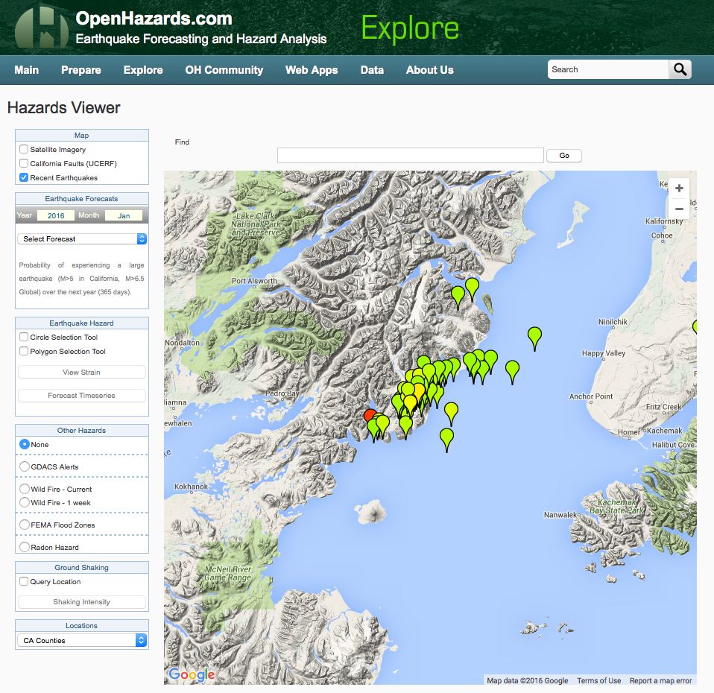
M7.1 Earthquake
Sunday January 24, 2016 at 2:30:30 PST

Slide 13
Anchorage http://en.wikipedia.org/wiki/1964_Alaska_earthquake
"The damage was most severe in Anchorage near the epicenter
Anchorage was not hit by tsunamis, however
Parts of the city built on sandy bluffs near Cook Inlet, most notably the Turnagain neighborhood, suffered landslide damage.
The neighborhood lost 75 houses in the landslide, and the destroyed area has since been turned into Earthquake Park.
Most other areas of the city were only moderately damaged.
The 60-foot concrete control tower at Anchorage International Airport was not engineered to withstand earthquake activity and collapsed, killing one employee."

Slide 14
Ruin of Portage http://en.wikipedia.org/wiki/1964_Alaska_earthquake
"The hamlets of Girdwood and Portage, located 30 and 40 mi (60 km) southeast of central Anchorage on the Turnagain Arm, were destroyed by subsidence and subsequent tidal action.
Girdwood was relocated inland and Portage was abandoned.
About 20 miles (32 km) of the Seward Highway sank below the high-water mark of Turnagain Arm
The highway and its bridges were raised and rebuilt in 1964-66."
1964
2011

Slide 15
January 23, 2018 Gulf of Alaska M7.9 https://www.usgs.gov/news/january-23-2018-m79-gulf-alaska-earthquake-and-tsunami

Slide 16
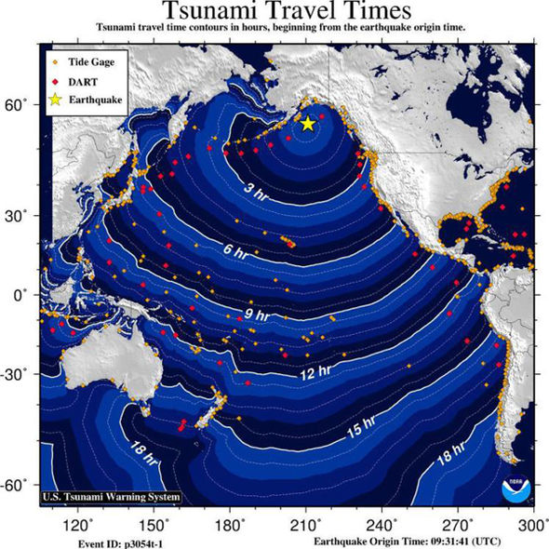
January 23, 2018 Gulf of Alaska M7.9 https://www.usgs.gov/news/january-23-2018-m79-gulf-alaska-earthquake-and-tsunami

Slide 17
Anchorage Earthquake M7.0 November 30, 2018 https://earthquake.usgs.gov/earthquakes/eventpage/us1000hyfh/executive

Slide 18
Anchorage Earthquake M7.0 November 30, 2018 https://earthquake.usgs.gov/earthquakes/eventpage/us1000hyfh/executive
Focal mechanism indicates normal faulting

Slide 19
Great Sumatra-Andaman Earthquake http://en.wikipedia.org/wiki/2004_Indian_Ocean_earthquake
"The 2004 Indian Ocean earthquake was an undersea megathrust earthquake that occurred at 00:58:53 UTC on Sunday, 26 December 2004
Epicenter off the west coast of Sumatra, Indonesia.
The quake is known by the scientific community as the Sumatra–Andaman earthquake.
The earthquake was caused when the Indian Plate was subducted by the Burma Plate and triggered a series of devastating tsunamis along the coasts of most landmasses bordering the Indian Ocean
Killed over 230,000 people in fourteen countries, and inundated coastal communities with waves up to 30 meters (98 ft) high.
It was one of the deadliest natural disasters in recorded history. Indonesia was the hardest-hit country, followed by Sri Lanka, India, and Thailand."

Slide 20
Basic Facts http://en.wikipedia.org/wiki/2004_Indian_Ocean_earthquake
"With a magnitude of Mw 9.1–9.3, it is the third largest earthquake ever recorded on a seismograph.
The earthquake had the longest duration of faulting ever observed, between 8.3 and 10 minutes.
It caused the entire planet to vibrate as much as 1 centimeter (0.4 inches) and triggered other earthquakes as far away as Alaska.
The worldwide community donated more than $14 billion (2004 US$) in humanitarian aid."

Slide 21
Triggering? http://en.wikipedia.org/wiki/2004_Indian_Ocean_earthquake
"The epicenter was between Simeulue and mainland Indonesia.
The 2004 Indian Ocean earthquake came just three days after a magnitude 8.1 earthquake in an uninhabited region west of New Zealand's Auckland Islands, and north of Australia's Macquarie Island.
This is unusual, since earthquakes of magnitude 8 or more occur only about once per year on average.
Some seismologists have speculated about a connection between these two earthquakes"

Slide 22
Tsunami http://en.wikipedia.org/wiki/2004_Indian_Ocean_earthquake
In deep ocean water, tsunami waves form only a small hump, barely noticeable and harmless, which generally travels at a very high speed of 500 to 1,000 km/h (310 to 620 mph)
In shallow water near coastlines, a tsunami slows down to only tens of kilometres per hour, but in doing so forms large destructive waves.

Slide 23
2004 Earthquake and Tsunami

Slide 24
Tsunami Height http://en.wikipedia.org/wiki/2004_Indian_Ocean_earthquake
"Scientists investigating the damage in Aceh found evidence that the wave reached a height of 24 metres (80 ft) when coming ashore along large stretches of the coastline
Tsunami rose to as much as 30 meters (100 ft) in some areas when travelling inland."

Slide 25
Great Sumatra-Andaman Earthquake http://neic.usgs.gov/neis/eq_depot/2004/eq_041226/neic_slav_m.html

Slide 26
Northern Sumatra, M8.6, 3/28/2005 http://en.wikipedia.org/wiki/2004_Indian_Ocean_earthquake#Aftershocks_and_other_earthquakes
"This second event and was most likely triggered by stress changes associated with the 2004 event.
This earthquake was so large that it produced its own aftershocks (some registering a magnitude of as great as 6.1) and presently ranks as the 7th largest earthquake on record since 1900.
Other aftershocks of up to magnitude 6.6 continued to shake the region daily for up to three or four month
At least 1000 people killed, 300 injured and 300 buildings destroyed on Nias
A 3-meter tsunami damaged the port and airport on Simeulue.
Tsunami runup heights as high as 2 meters were observed on the west coast of Nias and 1 meter at Singkil and Meulaboh, Sumatra."

Slide 27
Northern Sumatra http://earthquake.usgs.gov/earthquakes/shakemap/global/shake/weax/

Slide 28
Northern Sumatra http://en.wikipedia.org/wiki/2004_Indian_Ocean_earthquake#Aftershocks_and_other_earthquakes http://earthquake.usgs.gov/earthquakes/shakemap/global/shake/weax/
"Felt (VI) at Banda Aceh and (V) at Medan.
At least 10 people were killed during evacuation of the coast of Sri Lanka. Felt (IV) along the west coast of Malaysia
(IV) at Bangkok and (III) at Phuket, Thailand
(III) at Singapore; (III) at Male, Maldives
Tsunami wave heights (peak to trough) recorded from selected tide stations: about 40 cm on Panjang, Indonesia; about 25 cm at Colombo, Sri Lanka; 40 cm on Hanimadu, 18 cm at Male and 10 cm at Gan, Maldives. "

Slide 29
Southern Sumatra M8.5 9/12/2007 http://earthquake.usgs.gov/earthquakes/eqinthenews/2007/us2007hear/
"At least 25 people killed, 161 injured, 52,522 buildings damaged or destroyed and roads damaged in Bengkulu and Sumatera Barat.
A tsunami with a wave height of 90 cm was measured at Padang. Power and telephone outages occurred.
Felt by people in high-rise buildings at Jakarta and in Malaysia, Singapore and Thailand.
This earthquake occurred just north of the source region of the magnitude 7.9 earthquake on June 4, 2000 "

Slide 30
Southern Sumatra M8.5 9/12/2007 http://earthquake.usgs.gov/earthquakes/eqinthenews/2007/us2007hear/

Slide 31
Southern Sumatra M8.5 9/12/2007 http://earthquake.usgs.gov/earthquakes/eqinthenews/2007/us2007hear
"Another event of magnitude 7.8 occurred the same day.
The September 12, 2007 magnitude 7.8 earthquake occurred about 225 km northwest of the magnitude 8.5 earthquake at the northern end of the aftershock zone.
These two earthquakes and their aftershocks overlay the southern portion of the estimated 1833 rupture zone, which extends from approximately Eggano Island to the northern portion of Siberut Island. "

Slide 32
N. Sumatra-West M8.6, 8.2 4/11/2012 http://earthquake.usgs.gov/earthquakes/eqinthenews/2012/usc000905e/
"The April 11, 2012, M8.6 and M8.2 earthquakes off the west coast of northern Sumatra, Indonesia, occurred as a result of strike-slip faulting within the oceanic lithosphere of the Indo-Australia plate.
The quakes were located respectively 100 km and 200 km to the southwest of the major subduction zone that defines the plate boundary between the India/Australia and Sunda plates offshore Sumatra.
At this location, the India/Australia plates move north-northeast with respect to the Sunda plate at a velocity of approximately 52 mm/yr"

Slide 33
N. Sumatra-West M8.6, 8.2 4/11/2012 http://earthquake.usgs.gov/earthquakes/eqinthenews/2012/usc000905e/
"At least 2 people killed, 8 others died from heart attacks and 12 injured in Aceh.
Felt in much of Sumatra and Java. Felt widely in South and Southeast Asia, including Bangladesh, Brunei, Burma, India, Maldives, Sri Lanka, Thailand and Vietnam.
Felt as far as Pune, India and Broome, Australia. A 31-cm tsunami was recorded at Meulaboh, Indonesia."

Slide 34
N. Sumatra-West M8.6, 8.2 4/11/2012 http://earthquake.usgs.gov/earthquakes/eqinthenews/2012/usc000905e/
Large strike-slip earthquakes are not unprecedented in this area
Since the massive M 9.1 earthquake that ruptured a 1300 km long segment of the Sumatran megathrust plate boundary in December of 2004, three earlier large strike-slip events had occurred within 50 km of the first large April 11, 2012 event.
These earthquakes occurred on April 19 2006 (Mw6.2), October 4 2007 (Mw6.2) and January 10, 2012 (Mw7.2).

Slide 35
N. Sumatra-West M8.6, 8.2 4/11/2012 http://earthquake.usgs.gov/earthquakes/eqinthenews/2012/usc000905e/
"The focal-mechanisms of the three earlier earthquakes and the two great earthquakes of April 11, 2012, imply that each earthquake could have occurred as the result of left-lateral slip on a north-northeast striking fault or right-lateral slip on a west-northwest striking fault
The two different orientations of strike-slip faulting are both possible under the same tectonic stress field; perpendicular strike-slip faults that are both compatible with the same stress field are called "conjugate faults".

Slide 36
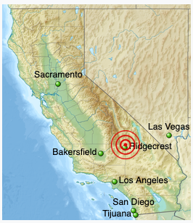
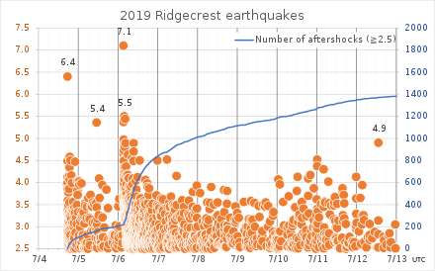
July 4,5 2019 Ridgecrest, CA Earthquakes https://en.wikipedia.org/wiki/2019_Ridgecrest_earthquakes
The July 2019 Ridgecrest earthquakes consist of three main shocks of magnitudes 6.4, 5.4, and 7.1, each followed by a flurry of aftershocks of substantially lower magnitude.

Slide 37
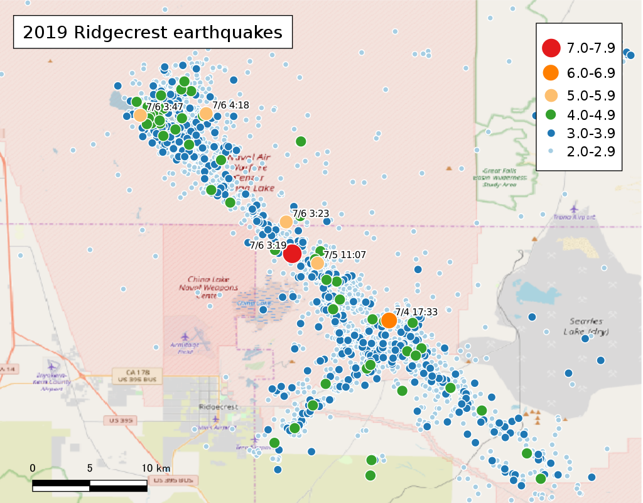
July 4,5, 2019 Ridgecrest CA Earthquakes https://en.wikipedia.org/wiki/2019_Ridgecrest_earthquakes
The aftershocks of the Ridgecrest earthquakes reveal two fault zones. The July 4th M 6.4 event (orange dot) occurred on the SW-NE fault where it intersects the NW-SE oriented fault. The red dot marks the M 7.1 event.

Slide 38
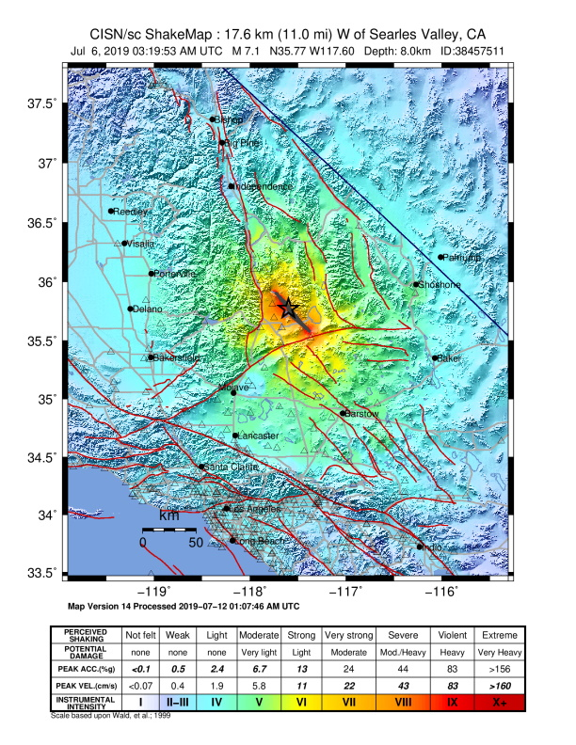
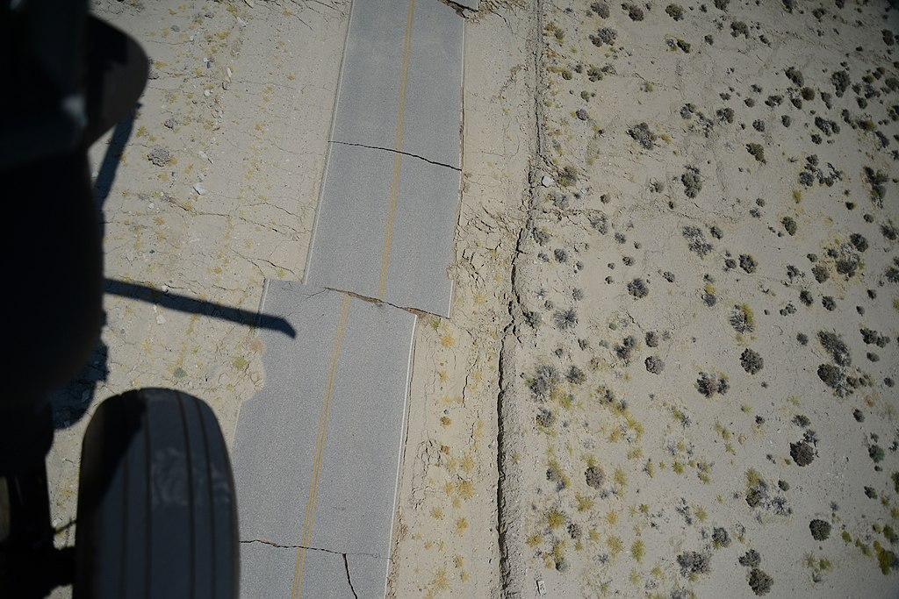
July 4,5, 2019 Ridgecrest CA Earthquakes https://en.wikipedia.org/wiki/2019_Ridgecrest_earthquakes
Aerial view of a 3–5 ft (0.91–1.52 m) lateral offset on a service road within Naval Air Weapons Station China Lake

Slide 40
Seismic Waveforms-1 http://en.wikipedia.org/wiki/2004_Indian_Ocean_earthquake
"Earthquake generated remarkable seismic ground motions around the globe, particularly due to huge Rayleigh (surface) elastic waves that exceeded 1 cm (0.4 in) in vertical amplitude everywhere on Earth.
The record section plot displays vertical displacements of the Earth's surface recorded by seismometers from the IRIS/USGS Global Seismographic Network plotted with respect to time (since the earthquake initiation) on the horizontal axis
Vertical displacements of the Earth on the vertical axis (note the 1 cm scale bar at the bottom for scale). "

Slide 41
Seismic Waveforms-2 http://en.wikipedia.org/wiki/2004_Indian_Ocean_earthquake
"The earliest, lower amplitude, signal is that of the compressional (P) wave, which takes about 22 minutes to reach the other side of the planet (the antipode; in this case near Ecuador).
The largest amplitude signals are seismic surface waves that reach the antipode after about 100 minutes.
The surface waves can be clearly seen to reinforce near the antipode (with the closest seismic stations in Ecuador), and to subsequently encircle the planet to return to the epicentral region after about 200 minutes.
A major aftershock (magnitude 7.1) can be seen at the closest stations starting just after the 200 minute mark. This aftershock would be considered a major earthquake under ordinary circumstances, but is dwarfed by the mainshock."

