Slide 1
Lecture 7
Earthquake Statistics
John Rundle GEL/EPS 131

Slide 2
Topics
Statistics
Seismic Moment
Magnitude Definition
Gutenberg-Richter Relation
Energy-Magnitude Relation
Aftershocks
Omori Relation
Scaling laws

Slide 3
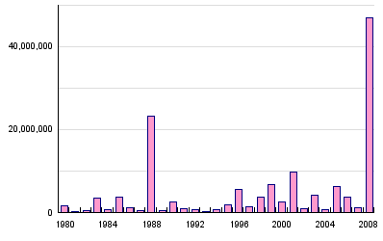
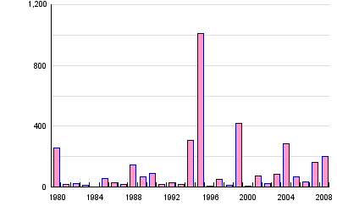
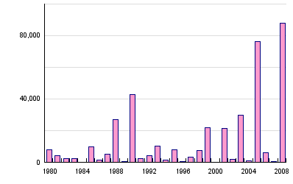
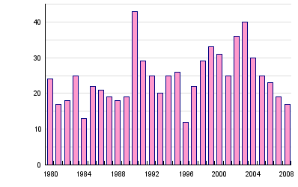
Global Earthquake Statistics, 1980-2008 http://www.preventionweb.net/english/hazards/statistics/?hid=60
Persons Affected
Economic Damage (USD in B$)
Persons Killed
Number of Reported Events

Slide 4
Global Earthquakes Summary Statistics, 1980-2008 http://www.preventionweb.net/english/hazards/statistics/?hid=60

Slide 5
Magnitude and Intensity
We saw in previous lecture that Mercalli Intensity is a measure of ground shaking only
A small earthquake close by can produce the same PGA (Peak Ground Acceleration) and PGV (Peak Ground Velocity) as a large earthquake far away
However, the wave characteristics will be different (duration of shaking, frequency content of waves, etc.)
Note that buildings are sensitive not only to PGA, but shaking duration and frequency
So we need some more general concepts
In about 1927, Richter and Gutenberg introduced the concept of earthquake magnitude

Slide 6
Characteristics of Magnitude
Gutenberg and Richter had noticed that the amplitude of seismic waves decreases away from the earthquake source position (hypocenter/epicenter) with distance
The decay in amplitude depends not only on the earth, but also on the observing instrument characteristics
The sensitivity of the magnitude scale depends on the frequency response of the instrument and its dynamic range (whether waveforms can be "clipped" if the amplitude is too large)
They adopted a standard instrument, the Wood-Anderson torsional seismometer, and defined an amplitude corresponding to a Magnitude=0 earthquake
They decided to create a logarithmic scale similar to the magnitude scale of stellar brightness from astronomy
Strictly speaking, their original scale applies only to earthquakes in southern California, where they were working

Slide 7
Earthquake “Nomogram” crack.seismo.unr.edu
A version of this earthquake "nomogram" was posted in the recording center of the Caltech seismological laboratory for at least 60 years
It was used by generations of seismolab students to determine the magnitude from the seismogram
To apply this, you measure the S-P Time, which gives the Distance in km
Then you measure the trace Amplitude
Drawing the straight line intersects the middle scale at the Magnitude value

Slide 8
Determining Earthquake Location http://academics.concord.edu/sckuehn/VirtualEarthquake.pdf
To compute the epicenter location of the earthquake, you need to "triangulate" the arrivals
The epicenter is the horizontal position of the first motion
The hypocenter is the epicenter + depth information
You need at least 3 earthquake recording stations
Draw circles around the 3 stations using distances determined from the S-P times
Shown here is the form locating the October 17, 1989 Loma Prieta earthquake
The estimated magnitude is M7.1

Slide 9
Problems with Richter Magnitude
It applies only to southern California
It depends on using a certain type of seismometer (Wood Anderson)
The Wood Anderson instrument is most sensitive to wave periods near 1 sec.
Wood Anderson is weakly damped, so amplitudes at 1 sec period tend to be very large (resonance!)
Other types of seismometers, such as the Press-Ewing instrument, are (were) in use, and these are most sensitive to waves at 20s period (surface waves such as Rayleigh and Love waves)
These different seismometers give different magnitudes for the same earthquake
In fact, great earthquakes rarely have Wood-Anderson magnitudes larger than 6, whereas the Press-Ewing magnitude might be 8
Clearly a better means of determining magnitude is needed that does not depend on using a particular seismometer

Slide 10
Seismic Moment
In order to understand earthquake magnitude, we have to return to energy release
We define a quantity called "seismic moment" W, which is related to the source parameters of the earthquake:
W = μ S A
Here μ is a (shear) modulus of elasticity, S is the slip in the earthquake, and A is the slipped area of the fault
It can be shown that W measures the change in stored elastic energy in the earthquake, plus any stored gravitational energy change
Therefore W is a property of the earthquake source alone

Slide 11
Moment Magnitude Scale http://en.wikipedia.org/wiki/Moment_magnitude_scale
The moment magnitude scale (abbreviated as MMS; denoted as M_{W} or M) is used by seismologists to measure the size of earthquakes in terms of the energy released.
The magnitude is based on the seismic moment of the earthquake, which is equal to the rigidity of the Earth multiplied by the average amount of slip on the fault and the size of the area that slipped.
The scale was developed in the 1977 by Hiroo Kanamori and others to succeed the 1930s-era Richter Local magnitude scale (M_{L}).
Even though the formulae are different, the new scale retains the familiar continuum of magnitude values defined by the older one.
The MMS is now the scale used to estimate magnitudes for all modern large earthquakes by the United States Geological Survey.

Slide 12
Moment Magnitude
Moment magnitude M_{w} is defined by:
M_{w}= (2/3) Log₁₀W – 6.0
Here seismic moment W is defined in MKS (SI) units (meters-seconds-kg)
By using moment magnitude, Kanamori was able to unify all measures of earthquake magnitude
Both Richter magnitude and surface wave magnitude, determined using Press-Ewing seismometers, fit smoothly onto the same scale
Start here 10/9/2019

Slide 13
Comparing Magnitude Calculations http://en.wikipedia.org/wiki/Moment_magnitude_scale

Slide 14
Next Question: How is seismic moment determined?
First, it is important to use a class of broad band, high-dynamic range seismometer to record the waves so that no distortions are produced
Then we need at least a dozen or more seismometers, spread out over a variety of directions and distances to adequately sample the waves
We then use computer programs to fit a source model to the actual waveforms
The source model involves both the type of fault, as well as the time-dependence of slip on the fault
We also need an earth model that represents how the seismic waves propagate through the earth
The final result is a complete description of the earthquake source

Slide 15
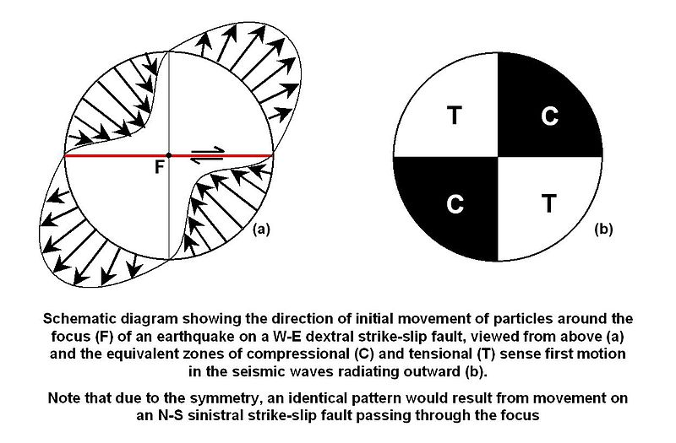
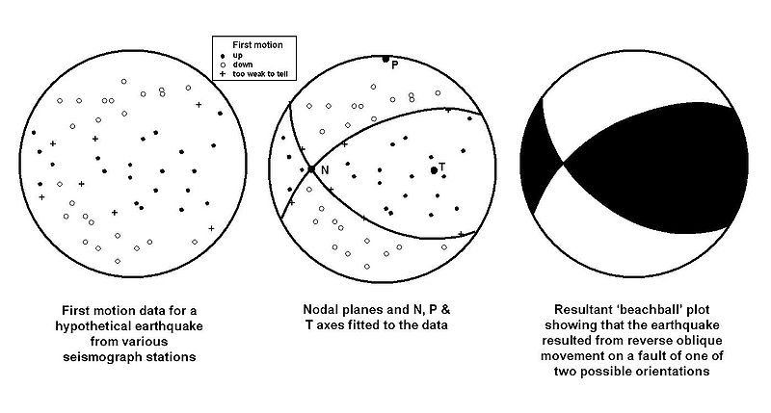
Determination of Focal Mechanism
Simplest method is to use first motion data (up or down, in or out, etc.)
Plot these on focal sphere for various stations
Then choose best fitting "nodal planes”
Either of the nodal planes can represent the actual fault
The most probable fault plane is usually chosen either by reference to local tectonics, or by observing the pattern of aftershocks
Geologists plot fault planes on a “stereonet” in a similar way
https://www.youtube.com/watch?v=JJAMAcf_BEc

Slide 16
Type of Earthquake Focal Mechanisms http://en.wikipedia.org/wiki/Focal_mechanism
Earthquake source mechanisms
Strike-slip, thrust, and normal faults
As determined by analysis of the radiation pattern
Simplest method is to use local first motions

Slide 17
Focal Sphere: Another View

Slide 18
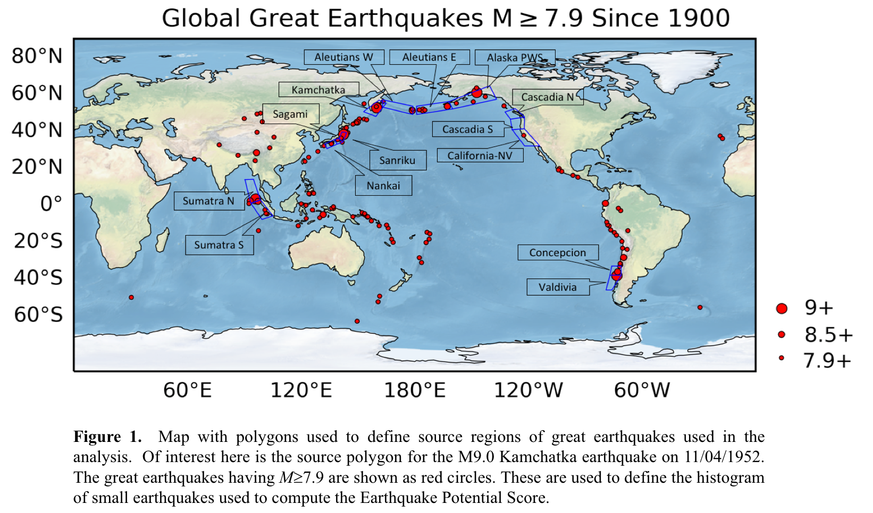
Great Global Earthquakes

Slide 19
Beno Gutenberg http://en.wikipedia.org/wiki/Beno_Gutenberg
Born June 4, 1889, Darmstadt, German Empire
Died January 25, 1960, Pasadena, CA
Graduated from the University of Gottingen

Slide 20
Beno Gutenberg http://en.wikipedia.org/wiki/Beno_Gutenberg
Gutenberg, especially in his collaboration with Charles Francis Richter, made the Caltech Seismological Laboratory the leading seismological institute worldwide.
Collaborating with Richter, Gutenberg developed a relationship between seismic magnitude and energy
They also developed a relationship between seismic magnitude and frequency of occurrence.
This relationship is commonly referred to as the “Gutenberg-Richter Magnitude-Frequency Relation”

Slide 21
Earthquake Statistics: Gutenberg-Richter Relation
In 1942, G&R discovered that earthquake occurrence follows a specific type of law
They observed that the number of small magnitude earthquakes is much larger than the number of large magnitude earthquakes and follows a well-determined relation
The Gutenberg-Richter law is then:
N = 10ª 10^{- bM}
Here N is the cumulative number of earthquakes larger than Magnitude M, and a and b are constants
Also, a represents the level of seismicity, and b ~1 (by observation)

Slide 22
Data from the Global Centroid Moment Catalog of Global Earthquakes (Morgan Page: earthquake.usgs.gov)
A plot of the cumulative number of earthquakes larger than M vs. M shows this characteristic form
The flattening at small magnitudes (M≤5) is due to lack of small earthquakes in the catalog
At the large magnitude end, is often presumed that the catalog is incomplete due to sampling statistics
However, the changes at large magnitude may be real...

Slide 23
Deviations at Large Magnitude (Yoder et al. Tectonophysics, 2012)
If we look at the large magnitude end, we see an interesting deviation beyond M>7.5
The GR b-value changes from ~1 to ~1.5
This implies that large and great earthquakes have lower frequency of occurrence than what would be expected for b~1
The magnitude M~7.5 corresponds to a lithospheric thickness of about 30 km

Slide 24
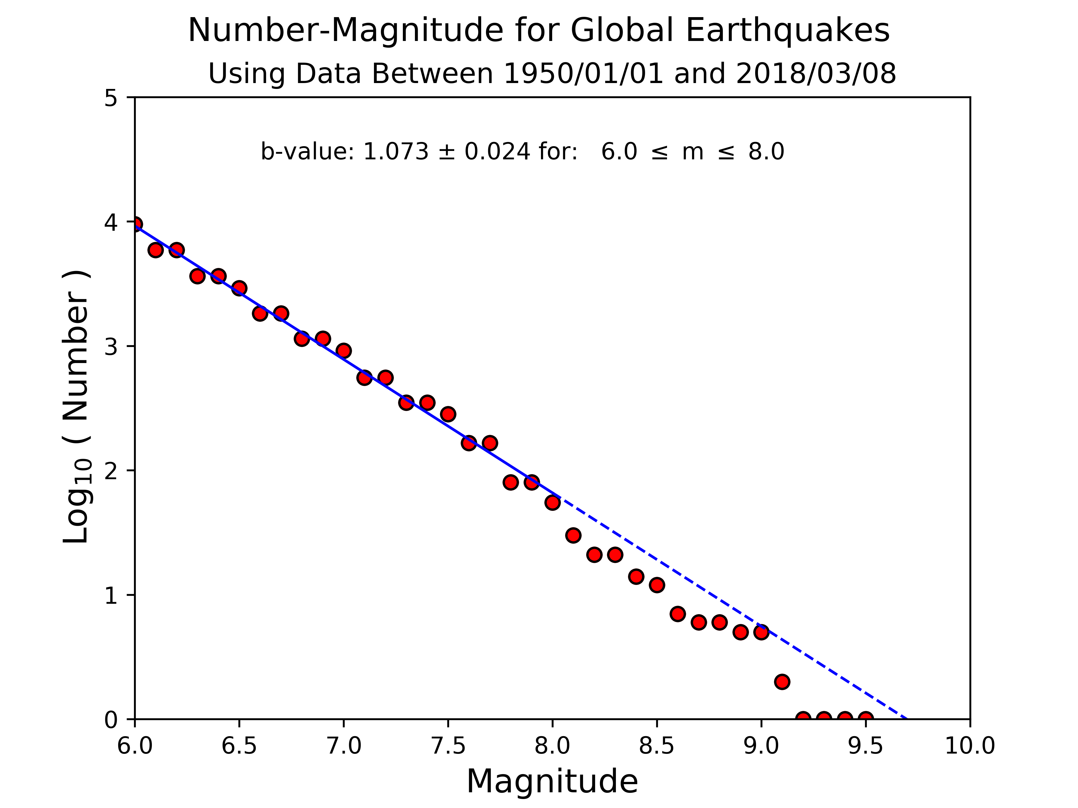
Global Magnitude-Frequency Relation
A long term look with the USGS global catalog

Slide 25
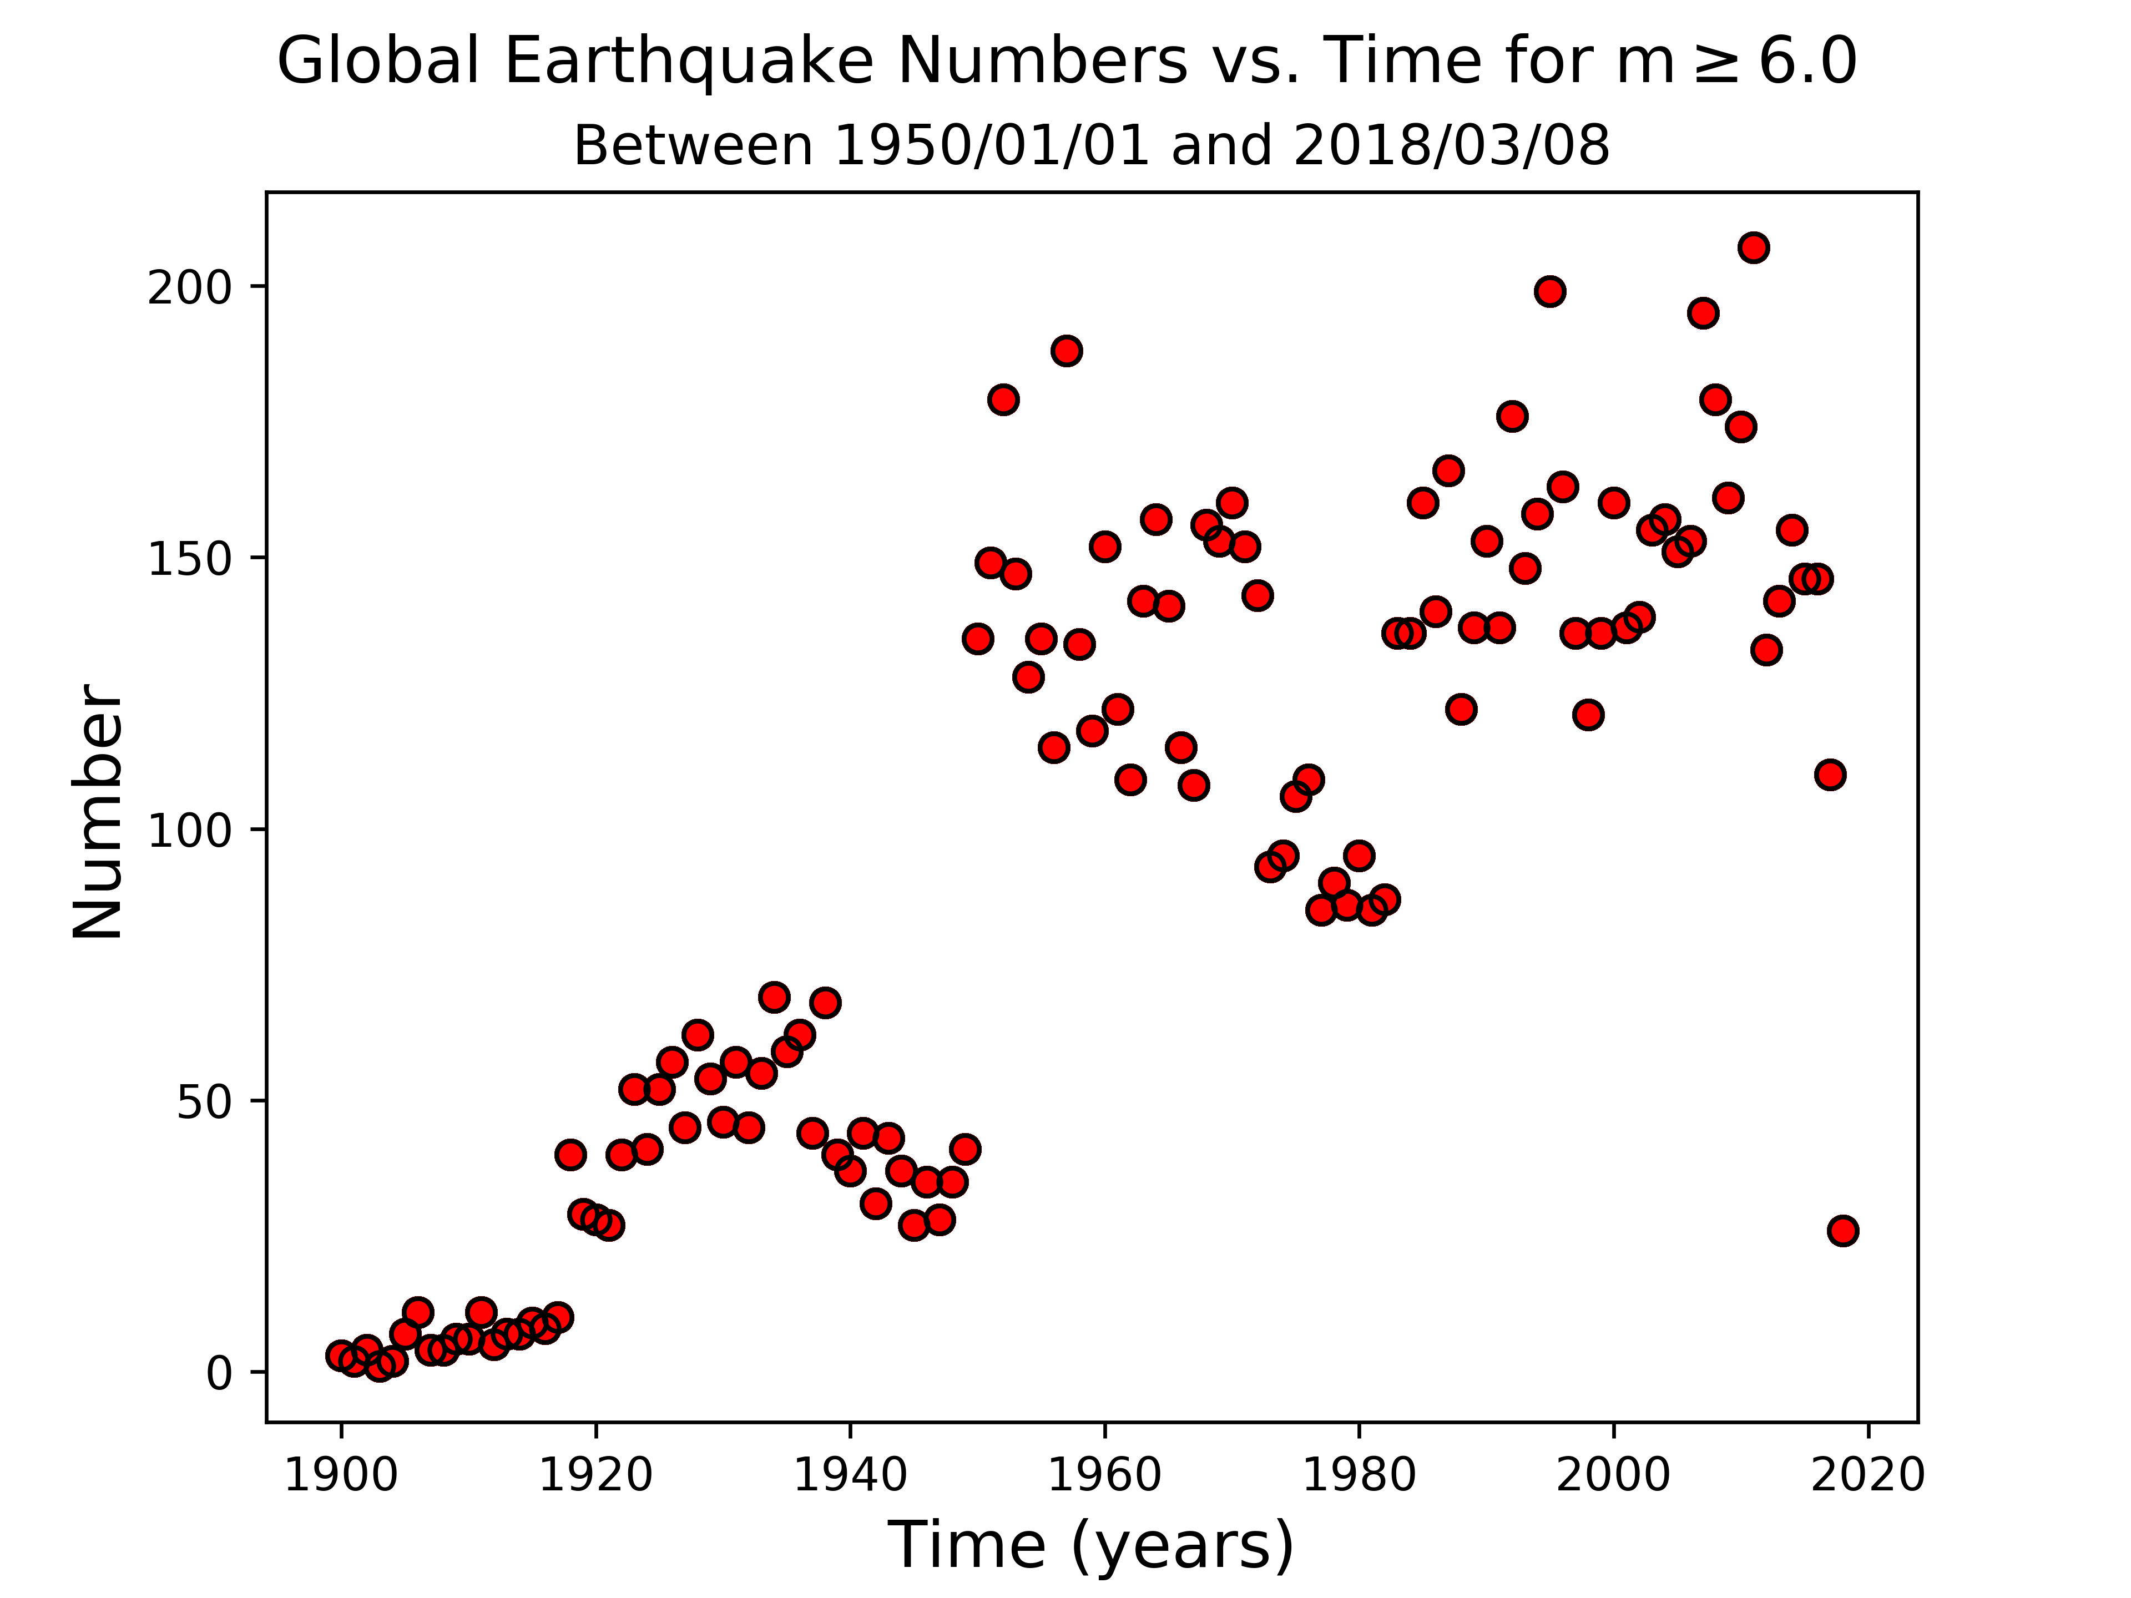
But…Data is Incomplete at Early Times
Global Earthquake Numbers vs. Time for M $≥$ 6.0
Between 1900 and 2018
Why might we see a change in 1950??

Slide 26
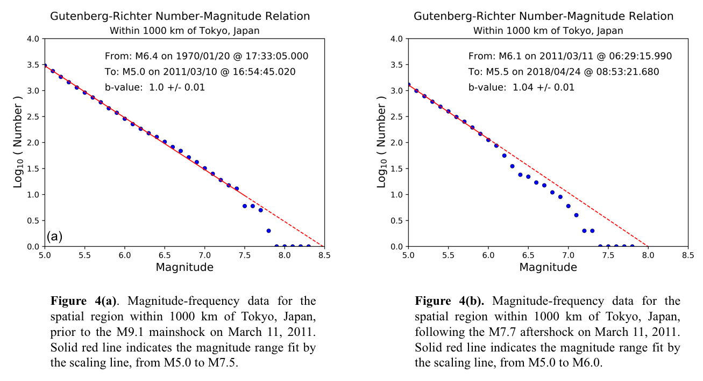
Earthquake Statistics can Vary in Time
Before the M9.1 Tohoku Japan Earthquake
After the M9.1 Tohoku Japan Earthquake

Slide 27
Characteristic Earthquakes whipple_arrowsmith598.asu.edu/
The break in slope of Gutenberg-Richter that we observe globally represents a violation of the simple b =1 GR model
If we could simply extrapolate the GR law to higher magnitudes, we would have a simple way to forecast large damaging earthquakes as we will see
However another problem is that large earthquakes are sometimes observed to occur more often than they should on a fault
In this case, there is a either a change in slope, or in fact a "bump" at the large magnitude end
This has been modeled with the "characteristic earthquake" idea
In this idea, the largest earthquakes recur relatively regularly (~periodic?) but the smaller events are represented by Gutenberg-Richter

Slide 28
Characteristic Earthquakes whipple_arrowsmith598.asu.edu/

Slide 29
Characteristic Earthquakes whipple_arrowsmith598.asu.edu/

Slide 30
Aftershocks http://en.wikipedia.org/wiki/Fusakichi_Omori
Large shallow earthquakes (in fact mostly all earthquakes) are usually followed by a sequence of smaller earthquakes called "aftershocks"
The aftershocks themselves follow the Gutenberg-Richter scaling relation
The aftershocks die away with time, in a process that is observed to obey "Omori's Law of Aftershock Decay"

Slide 31
Examples of Aftershock Patterns http://en.wikipedia.org/wiki/Aftershock

Slide 32
Tohoku, Japan Earthquake 3/11/2011

Slide 33
Omori's Law
Original Omori Law (1894):
Modified Omori Law (Utsu, 1961):
p typically in the range of 0.7 – 1.3

Slide 34
A More Recent Model for Aftershocks Shcherbakov et al., Geophys. Res. Lett., 2004
Here the c-parameter is a function of magnitude

Slide 36
Magnitude Formulae http://en.wikipedia.org/wiki/Richter_magnitude_scale
See: http://en.wikipedia.org/wiki/Richter_magnitude_scale
For examples of energy equivalents

Slide 37
Relation Between Energy and Moment Magnitude http://en.wikipedia.org/wiki/Moment_magnitude_scale

