Slide 1
Lecture 25
Summary and Wildfires
John Rundle GEL/EPS 131

Slide 2
This Week
Due to time constraints, we will not cover:
  Tornadoes and Severe Storms
  Floods
  Droughts
  Landslides
  We will cover:
  Brief summary of natural catastrophes 2020
  Wildfires
  Meteorite impacts and extinction level events

Slide 4
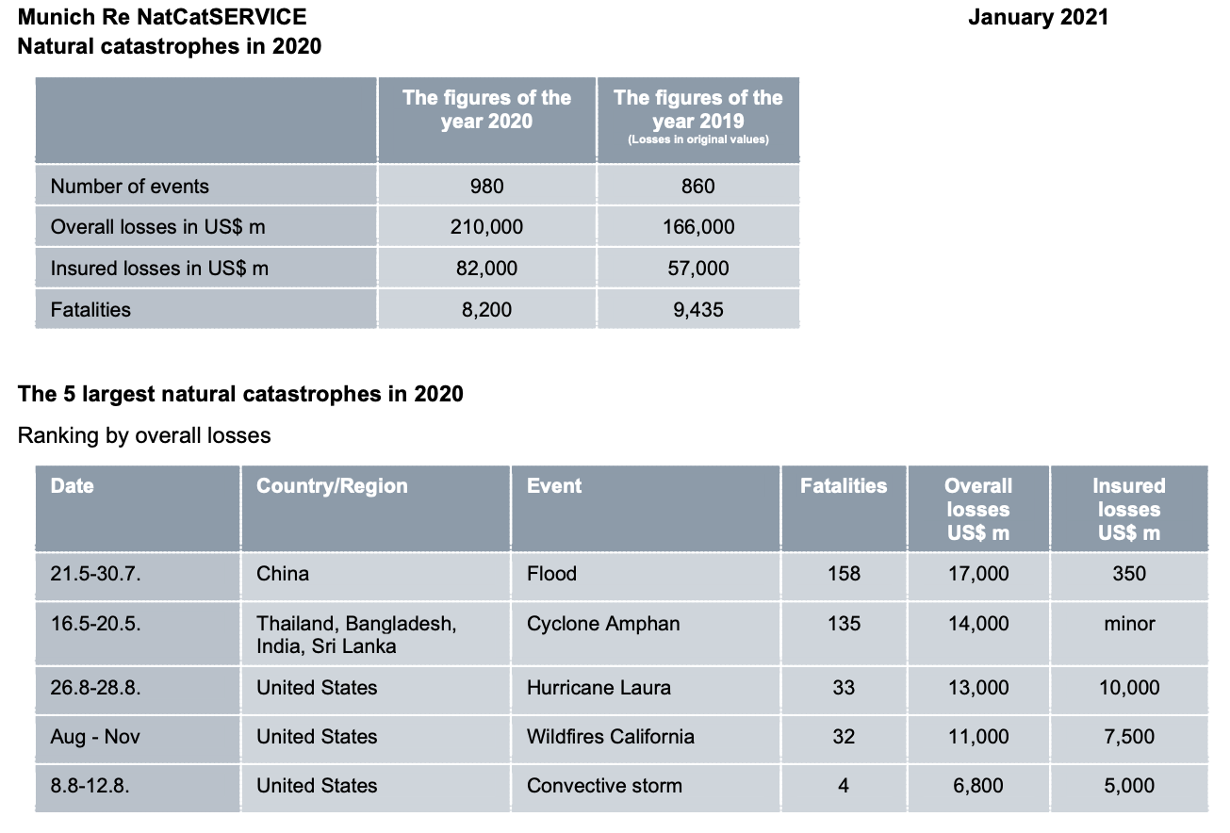
Munich Re Summary

Slide 5
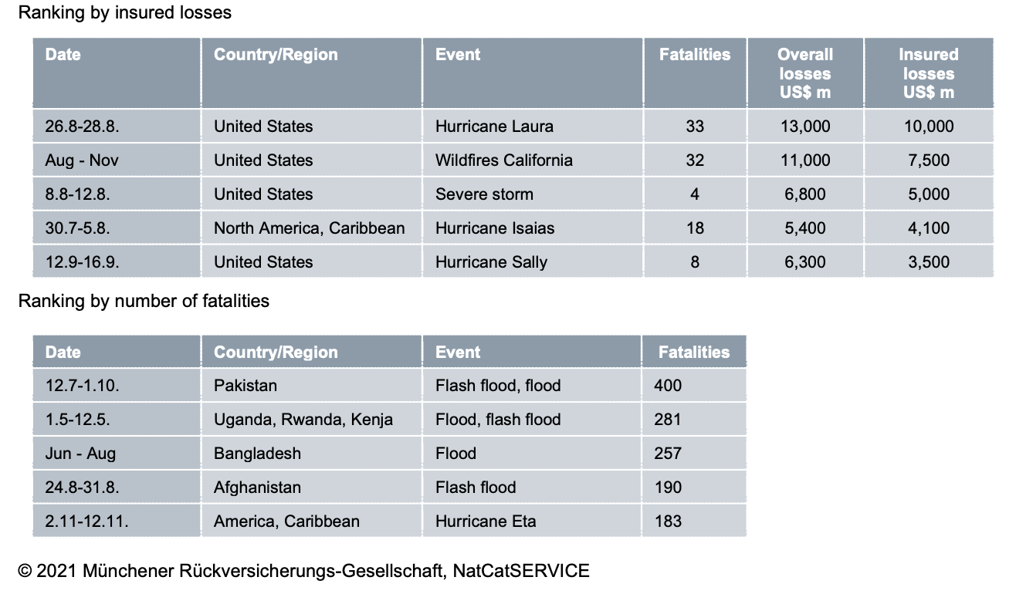
Munich Re Summary

Slide 6
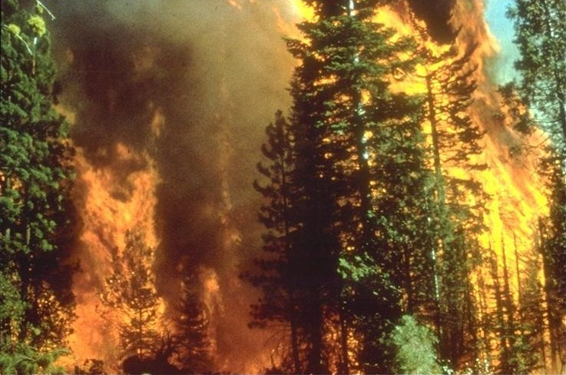
Natural Fires http://en.wikipedia.org/wiki/Wildfire
Wildfire in California, 5 September, 2008

Slide 7
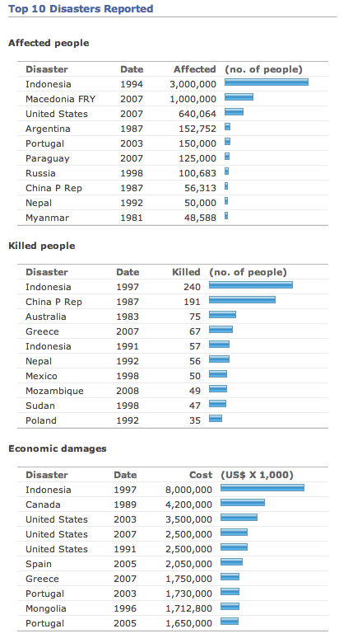
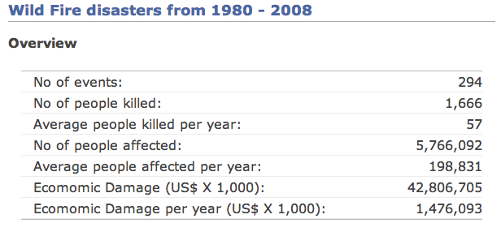
Global Wildfires
Summary Statistics, 1980-2008 http://www.preventionweb.net/english/hazards/statistics/?hid=73

Slide 8
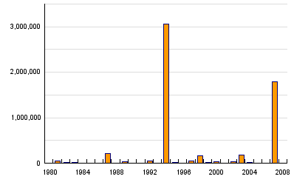
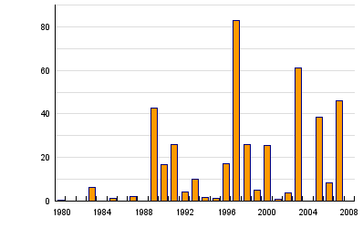
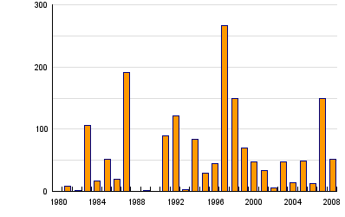
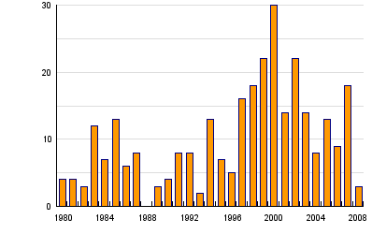
Global Wildfire Statistics, 1980-2008 http://www.preventionweb.net/english/hazards/statistics/?hid=73
Persons Affected
Economic Damage (USD in B$)
Persons Killed
Number of Reported Events

Slide 9
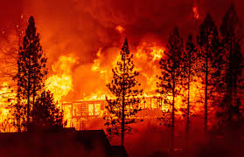
Wildfire http://en.wikipedia.org/wiki/Wildfire
“A wildfire is an uncontrolled fire in an area of combustible vegetation that occurs in the countryside or a wilderness area.
Other names such as brush fire, bushfire, forest fire, desert fire, grass fire, hill fire, peat fire, vegetation fire, and veldfire may be used to describe the same phenomenon depending on the type of vegetation being burned, and the regional variant of English being used.
A wildfire differs from other fires by its extensive size, the speed at which it can spread out from its original source, its potential to change direction unexpectedly, and its ability to jump gaps such as roads, rivers and fire breaks.

Slide 10
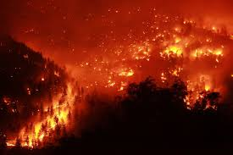
Wildfire http://en.wikipedia.org/wiki/Wildfire
Wildfires are characterized in terms of the cause of ignition, their physical properties such as speed of propagation, the combustible material present, and the effect of weather on the fire.
The name wildfire was once a synonym for Greek fire but now refers to any large or destructive conflagration.
Wildfires differ from other fires in that they take place outdoors in areas of grassland, woodlands, bushland, scrubland, peatland, and other wooded areas that act as a source of fuel, or combustible material.
Buildings may become involved if a wildfire spreads to adjacent communities. “

Slide 11
Characteristics http://en.wikipedia.org/wiki/Wildfire
“While the causes of wildfires vary and the outcomes are always unique, all wildfires can be characterized in terms of their physical properties, their fuel type, and the effect that weather has on the fire.
Wildfire behavior and severity result from the combination of factors such as available fuels, physical setting, and weather.
While wildfires can be large, uncontrolled disasters that burn through 0.4 to 400 square kilometers (100 to 100,000 acres) or more, they can also be as small as 0.001 square kilometres (0.25 acre; 1,000 m²) or less.
Although smaller events may be included in wildfire modeling, most do not earn press attention.
This can be problematic because public fire policies, which relate to fires of all sizes, are influenced more by the way the media portrays catastrophic wildfires than by small fires.
Strategies of wildfire prevention, detection, and suppression have varied over the years, and international wildfire management experts encourage further development of technology and research.
One of the more controversial techniques is controlled burning: permitting or even igniting smaller fires to minimize the amount of flammable material available for a potential wildfire.
While some wildfires burn in remote forested regions, they can cause extensive destruction of homes and other property located in the wildland-urban interface, which is a zone of transition between developed areas and undeveloped wilderness.”

Slide 12
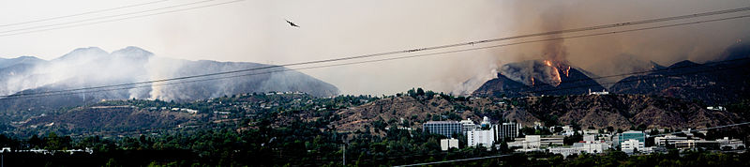
General Facts http://en.wikipedia.org/wiki/Wildfire
The Station Fire approaches southern California’s Jet Propulsion Laboratory in 2009
“In the United States, there are typically between 60,000 and 80,000 wildfires that occur each year, burning 3 million to 10 million acres of land depending on the year.
Fossil records and human history contain accounts of wildfires, as wildfires can occur in periodic intervals.
Wildfires can cause extensive damage, both to property and human life, but they also have various beneficial effects on wilderness areas.
Some plant species depend on the effects of fire for growth and reproduction, although large wildfires may also have negative ecological effects”

Slide 13
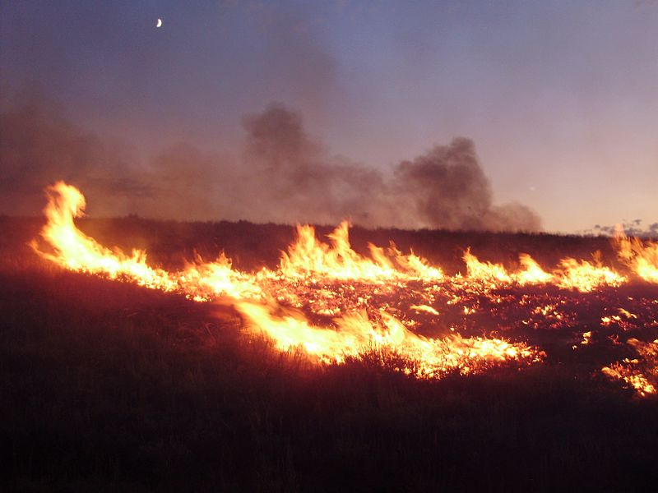
Wildfires in the US http://en.wikipedia.org/wiki/Wildfire
On a yearly basis in the United States, typically more than six times the number of wildfires are caused by human means such as campfires and controlled agricultural burns than by natural means.
However, in any given year there could be far more acres burned by wildfires that are started by natural means than by human means as well as vice-versa.
For example, in 2010, almost 1.4 million acres were burned by human-caused wildfires, and over 2 million acres were burned by naturally-caused wildfires.
However, far more acres were burned by human-caused fires in 2011, when almost 5.4 million acres were burned by human-caused wildfires, and only about 3.4 million acres were caused by naturally-derived wildfires.

Slide 14
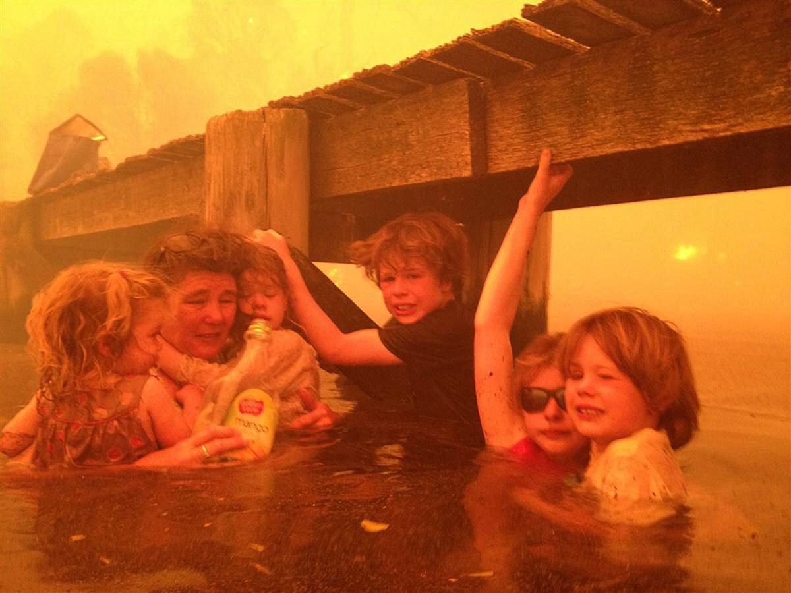
Wildfires in Australia (Bushfires) http://www.nbcnews.com/slideshow/news/the-year-in-pictures-2013-53866483/
“Wildfires, especially bushfires, are a common occurrence in Australia
Because of the generally hot and dry climate in Australia, fires pose a great risk to life and infrastructure during all times of the year, though mostly throughout the hotter months of summer and spring.
90 homes were destroyed in Dunalley, Tasmania, near Hobart, Australia during a wildfire in January, 2013
In the image at right, a family takes refuge beneath a jetty as the wildfire rages nearby.”
(Tim Holmes / Holmes Family via AP)

Slide 15
Causes of Wildfires http://en.wikipedia.org/wiki/Wildfire
“The five major natural causes of wildfire ignitions are humans, lightning, volcanic eruption, sparks from rockfalls, and spontaneous combustion.
The thousands of coal seam fires that are burning around the world, such as those in Centralia, Burning Mountain, and several coal-sustained fires in China, can also flare up and ignite nearby flammable material.
However, many wildfires are attributed to human sources such as arson, discarded cigarettes, sparks from equipment, and power line arcs (as detected by arc mapping).
In societies experiencing shifting cultivation where land is cleared quickly and farmed until the soil loses fertility, slash and burn clearing is often considered the least expensive way to prepare land for future use.
Forested areas cleared by logging encourage the dominance of flammable grasses, and abandoned logging roads overgrown by vegetation may act as fire corridors.
Annual grassland fires in southern Vietnam can be attributed in part to the destruction of forested areas by US military herbicides, explosives, and mechanical land clearing and burning operations during the Vietnam War.
In the Canada and northwest China, lightning is the major source of ignition.

Slide 16
Fuel Type http://en.wikipedia.org/wiki/Wildfire
  Ground fires are fed by subterranean roots, and other buried organic matter. This fuel type is especially susceptible to ignition due to spotting. Ground fires typically burn by smoldering, and can burn slowly for days to months, such as peat fires in Kalimantan and Eastern Sumatra, Indonesia
  Crawling or surface fires are fueled by low-lying vegetation such as leaf and timber litter, debris, grass, and low-lying shrubbery.
  Ladder fires consume material between low-level vegetation and tree canopies, such as small trees, downed logs, and vines.
  Crown, canopy, or aerial fires burn suspended material at the canopy level, such as tall trees, vines, and mosses. The ignition of a crown fire, termed crowning, is dependent on the density of the suspended material, canopy height, canopy continuity, and sufficient surface and ladder fires in order to reach the tree crowns.

Slide 17
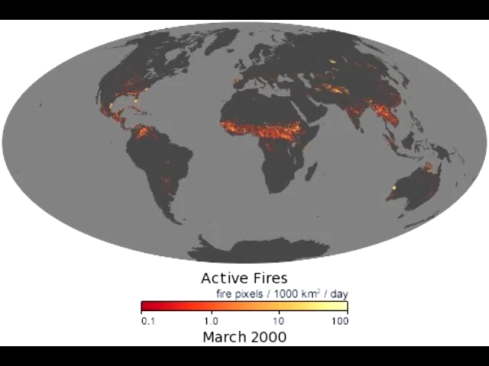
Global Wildfires http://earthobservatory.nasa.gov/GlobalMaps/view.php?d1=MOD14A1_M_FIRE
“On Earth, something is always burning.
In many ecosystems, including boreal forests and grasslands, plants have co-evolved with fire and require periodic burning to reproduce.
Fires can generate large amounts of smoke pollution, release greenhouse gases, and unintentionally degrade ecosystems.
The fire maps show the locations of actively burning fires around the world on a monthly basis, based on observations from the Moderate Resolution Imaging Spectroradiometer (MODIS) on NASA’s Terra satellite.
The colors are based on a count of the number (not size) of fires observed within a 1,000-square-kilometer area.
White pixels show the high end of the count —as many as 100 fires in a 1,000-square-kilometer area per day.
Yellow pixels show as many as 10 fires, orange shows as many as 5 fires, and red areas as few as 1 fire per day.”

Slide 18
Global Wildfires http://earthobservatory.nasa.gov/GlobalMaps/view.php?d1=MOD14A1_M_FIRE
The fire maps show the locations of actively burning fires around the world on a monthly basis, based on observations from the Moderate Resolution Imaging Spectroradiometer (MODIS) on NASA’s Terra satellite.

Slide 19
Global Wildfires http://earthobservatory.nasa.gov/GlobalMaps/view.php?d1=MOD14A1_M_
“Some of the global patterns that appear in the fire maps over time are the result of natural cycles of rainfall, dryness, and lightning.
In other parts of the world, the patterns are the result of human activity.
For example, the intense burning in the heart of South America from August-October is a result of human-triggered fires, both intentional and accidental, in the Amazon Rainforest and the Cerrado (a grassland/savanna ecosystem) to the south.
Across Africa, a band of widespread agricultural burning sweeps north to south over the continent as the dry season progresses each year.
Agricultural burning occurs in late winter and early spring each year across Southeast Asia. “

Slide 20
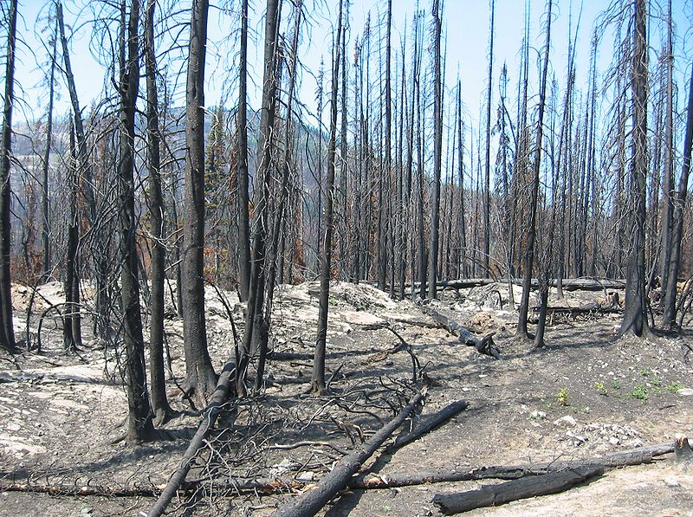
Effects of Weather http://en.wikipedia.org/wiki/Wildfire
“Heat waves, droughts, cyclical climate changes such as El Niño, and regional weather patterns such as high-pressure ridges can increase the risk and alter the behavior of wildfires dramatically.
Years of precipitation followed by warm periods can encourage more widespread fires and longer fire seasons.
Since the mid-1980s, earlier snowmelt and associated warming has also been associated with an increase in length and severity of the wildfire season in the Western United States.
However, one individual element does not always cause an increase in wildfire activity.
For example, wildfires will not occur during a drought unless accompanied by other factors, such as lightning (ignition source) and strong winds (mechanism for rapid spread).”
Charred landscape following crown fire in North Cascades, US

Slide 21
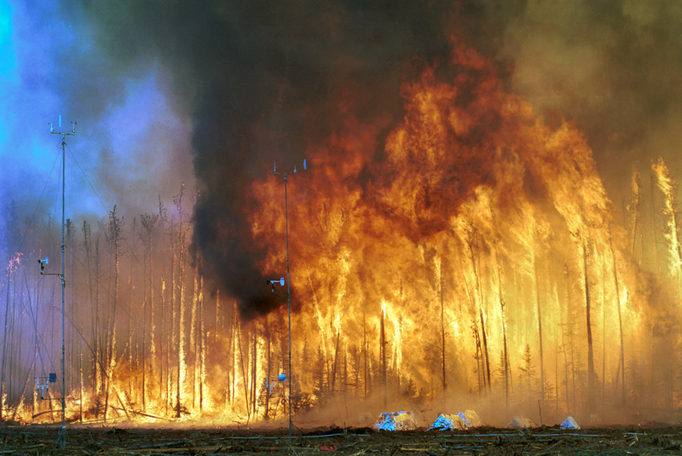
Effects of Weather http://en.wikipedia.org/wiki/Wildfire
“Intensity also increases during daytime hours.
Burn rates of smoldering logs are up to five times greater during the day due to lower humidity, increased temperatures, and increased wind speeds.
Sunlight warms the ground during the day which creates air currents that travel uphill.
At night the land cools, creating air currents that travel downhill.
Wildfires are fanned by these winds and often follow the air currents over hills and through valleys.
Fires in Europe occur frequently during the hours of 12:00 p.m. and 2:00 p.m.
Wildfire suppression operations in the United States revolve around a 24-hour fire day that begins at 10:00 a.m. due to the predictable increase in intensity resulting from the daytime warmth.”
Canadian crown fire experiment

Slide 22
Fire Ecology http://en.wikipedia.org/wiki/Wildfire
“Wildfires are common in climates that are sufficiently moist to allow the growth of vegetation but feature extended dry, hot periods.
Such places include the vegetated areas of Australia and Southeast Asia, the veld in southern Africa, the fynbos in the Western Cape of South Africa, the forested areas of the United States and Canada, and the Mediterranean Basin.
Fires can be particularly intense during days of strong winds, periods of drought, and during warm summer months.
Global warming may increase the intensity and frequency of droughts in many areas, creating more intense and frequent wildfires.
Although some ecosystems rely on naturally occurring fires to regulate growth, many ecosystems suffer from too much fire, such as the chaparral in southern California and lower elevation deserts in the American Southwest.
The increased fire frequency in these ordinarily fire-dependent areas has upset natural cycles, destroyed native plant communities, and encouraged the growth of fire-intolerant vegetation and non-native weeds.
Invasive species can grow rapidly in areas that were damaged by fires.
Because they are highly flammable, they can increase the future risk of fire, creating a positive feedback loop that increases fire frequency and further destroys native growth.”

Slide 23
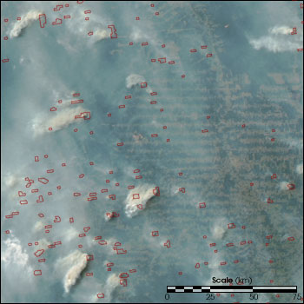
Fire Ecology http://en.wikipedia.org/wiki/Wildfire http://earthobservatory.nasa.gov/Features/AmazonFire/
“In the Amazon Rainforest, drought, logging, cattle ranching practices, and slash-and-burn agriculture damage fire-resistant forests and promote the growth of flammable brush, creating a cycle that encourages more burning.
Fires in the rainforest threaten its collection of diverse species and produce large amounts of CO².
Fires in the rainforest, along with drought and human involvement, could damage or destroy more than half of the Amazon rainforest by the year 2030.
Wildfires generate ash, destroy available organic nutrients, and cause an increase in water runoff, eroding away other nutrients and creating flash flood conditions. “
“During the height of the dry season, fires are widespread along the margin of the Amazon.
Fingers of cleared land typically form a “herringbone” pattern as they extend from roads (right side of image).
This image from the Moderate Resolution Imaging Spectroradiometer was acquired on the afternoon of August 31, 2003.
Red outlines trace the pixels in which fires were burning when the image was taken. The smoke from these fires is so thick it hides the surface in places “

Slide 24
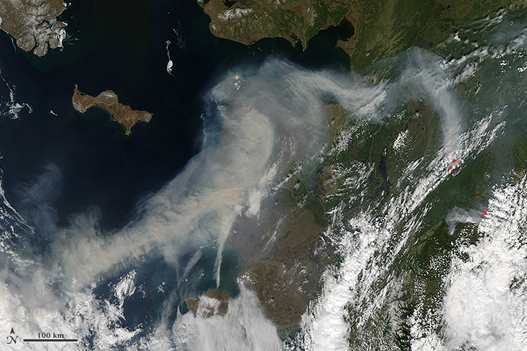
Fire Ecology http://en.wikipedia.org/wiki/Wildfire http://earthobservatory.nasa.gov/NaturalHazards/view.php?id=81444
“Wildfires can also have an effect on climate change, increasing the amount of carbon released into the atmosphere and inhibiting vegetation growth, which affects overall carbon uptake by plants.
In tundra there is a natural pattern of accumulation of fuel and wildfire which varies depending on the nature of vegetation and terrain.
Research in Alaska has shown fire-event return intervals, (FRIs) that typically vary from 150 to 200 years with dryer lowland areas burning more frequently than wetter upland areas.”
On June 19, 2013, the Moderate Resolution Imaging Spectroradiometer (MODIS) on NASA’s Aqua satellite captured this image of smoke from wildfires burning in western Alaska.
The smoke was moving west over Norton Sound. (The center of the image is roughly 163° West and 62° North.) Red outlines indicate hot spots where MODIS detected unusually warm surface temperatures associated with fire.
Record heat and dry fuels have produced record-setting fire potential across boreal spruce forests and tundra landscapes.
The heat wave is the product of an intense ridge of high pressure over the state.

Slide 25
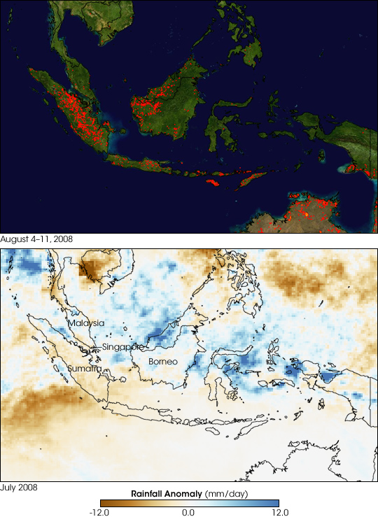
Atmospheric Effects http://en.wikipedia.org/wiki/Wildfire http://earthobservatory.nasa.gov/IOTD/view.php?id=9031
“Wildfires can affect climate and weather and have major impacts on atmospheric pollution.
Wildfire emissions contain fine particulate matter which can cause cardiovascular and respiratory problems.
Forest fires in Indonesia in 1997 were estimated to have released between 0.89 and 2.83 billion tons of CO² into the atmosphere, which is between 13%–40% of the annual global carbon dioxide emissions from burning fossil fuels.
Atmospheric models suggest that these concentrations of sooty particles could increase absorption of incoming solar radiation during winter months by as much as 15%.”
“Officials were concerned that fires (red areas in upper image from MODIS) during the 2008 season could be more intense than normal because the dry season had been especially dry. The lower image confirms the drought. Made with data collected by the Tropical Rainfall Measuring Mission (TRMM) satellite, the image shows rainfall measurements for July 2008 compared to average measurements. Areas that received more rain than average are blue, while regions that received less rain are brown. Sumatra and southern Borneo were dry through the month.”

Slide 26
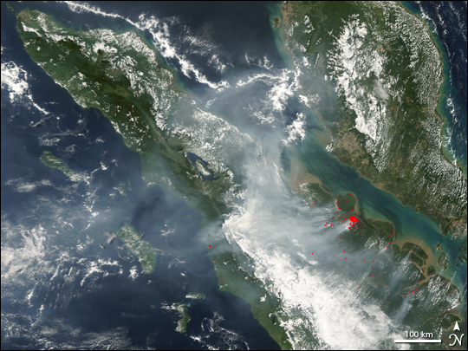
Fires and Smoke in Sumatra
A prolonged dry spell across Malaysia (top right) and Sumatra (center) was contributing to numerous fires burning across the region, which billowed thick, choking smoke out over the Indian Ocean (left) and the Strait of Malacca (between Sumatra and Malaysia).
This image of the region was captured by the Moderate Resolution Imaging Spectroradiometer MODIS on NASA’s Terra satellite on March 9, 2005.
Active fires detected by MODIS have been marked with red dots.

Slide 27
Wildfire Policy in the US http://en.wikipedia.org/wiki/Wildfire
“In 2001, the United States Government implemented a National Fire Plan and the budget increased from $108 million in 2000 to $401 million for the reduction of hazardous fuels.
Today the United States philosophy remains that, “fire, as a critical natural process, will be integrated into land and resource management plans and activities on a landscape scale, and across agency boundaries.
Response to wildfire is based on ecological, social and legal consequences of fire.
The five federal regulatory agencies managing forest fire response and planning for 676 million acres in the United States are the Department of the Interior, the Bureau of Land Management, the Bureau of Indian Affairs, the National Park Service, the United States Department of Agriculture-Forest Service and the United States Fish and Wildlife Services.
Several hundred million U.S. acres of wildfire management are also conducted by state, county, and local fire management organizations.”

Slide 28
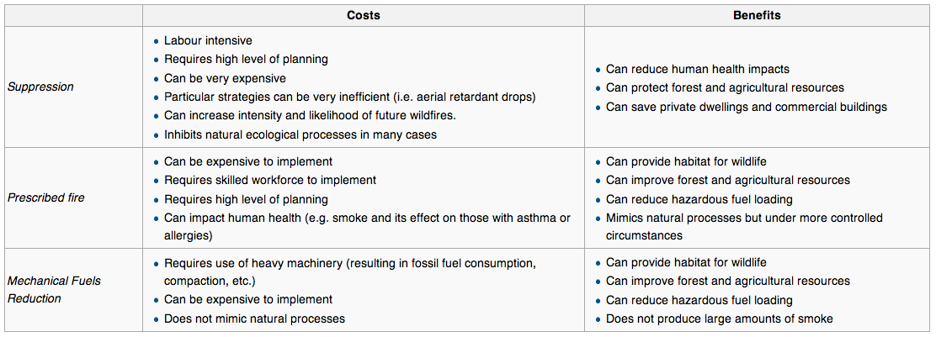
Cost-Benefits of Fire Management http://en.wikipedia.org/wiki/Wildfire

Slide 29
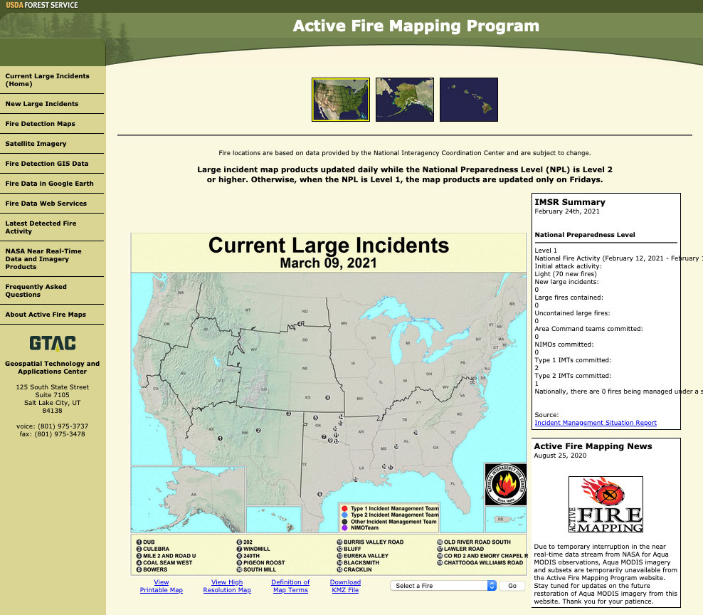
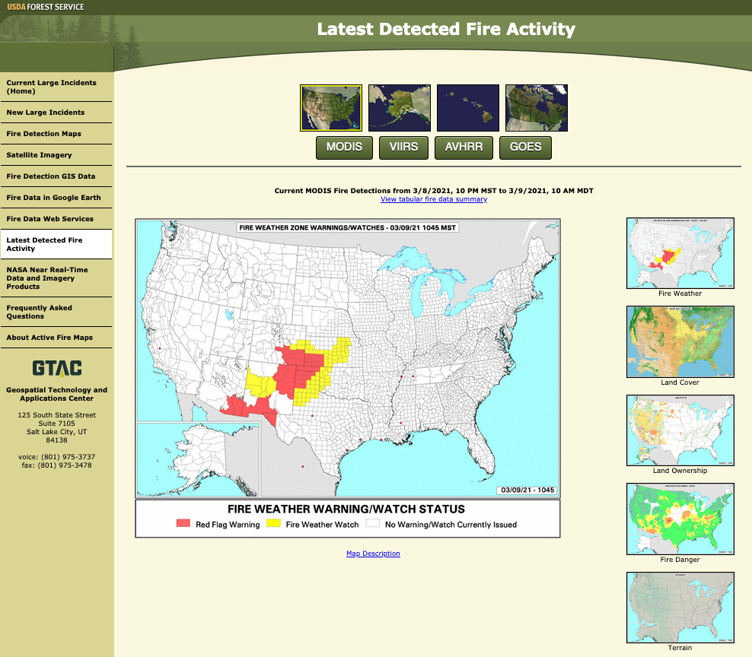
US Forest Service (accessed 3/9/2021) https://fsapps.nwcg.gov/

Slide 30
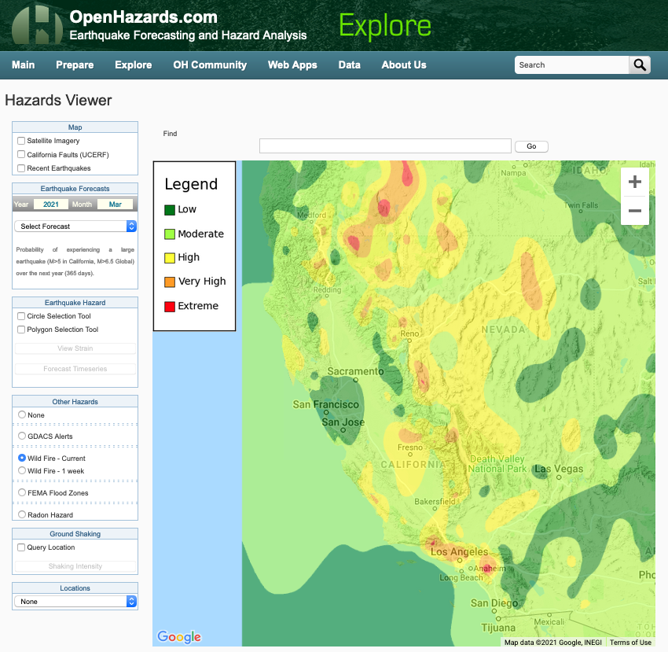
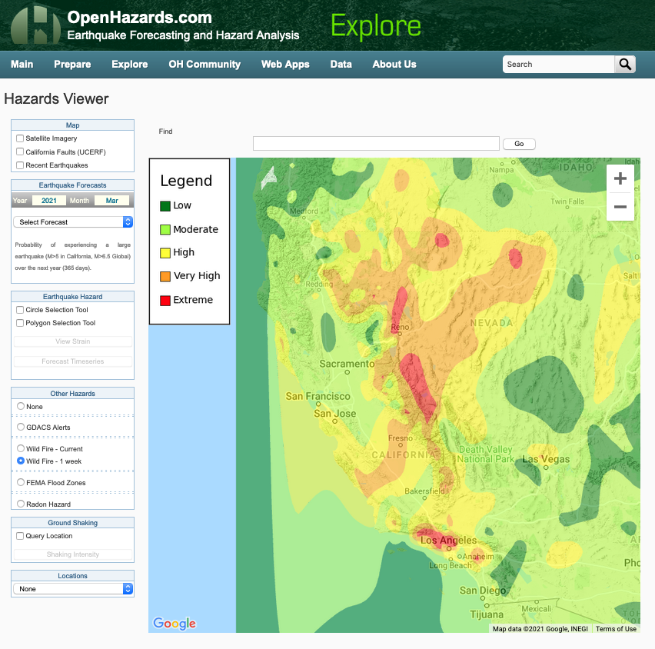
Open Hazards Feed http://www.openhazards.com/viewer
Today: 3/9/2021
Forecast for the Next Week

Slide 31
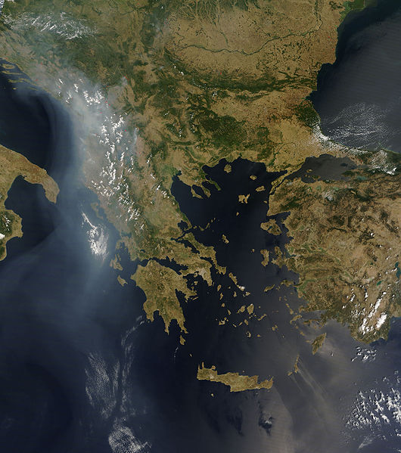
Wildfire Detection http://en.wikipedia.org/wiki/Wildfire
“Satellite and aerial monitoring through the use of planes, helicopter, or UAVs can provide a wider view and may be sufficient to monitor very large, low risk areas.
Satellite-mounted sensors such as Envisat's Advanced Along Track Scanning Radiometer and European Remote-Sensing Satellite's Along-Track Scanning Radiometer can measure infrared radiation emitted by fires, identifying hot spots greater than 39 °C (102 °F).
The National Oceanic and Atmospheric Administration's Hazard Mapping System combines remote-sensing data from satellite sources such as Geostationary Operational Environmental Satellite (GOES), Moderate-Resolution Imaging Spectroradiometer (MODIS), and Advanced Very High Resolution Radiometer (AVHRR) for detection of fire and smoke plume locations.
Wildfires across the Balkans in late July 2007 (MODIS image)

Slide 32
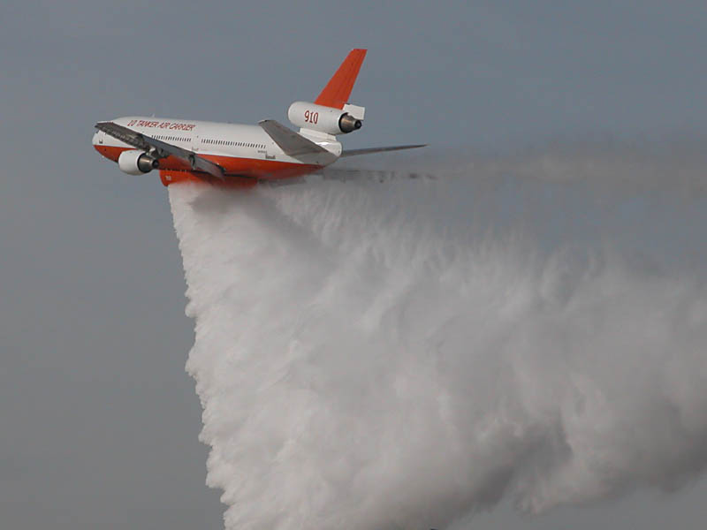
Wildfire Suppression http://en.wikipedia.org/wiki/Wildfire
“Wildfire suppression depends on the technologies available in the area in which the wildfire occurs.
In less developed nations the techniques used can be as simple as throwing sand or beating the fire with sticks or palm fronds.
In more advanced nations, the suppression methods vary due to increased technological capacity.
While more than 99% of the 10,000 new wildfires each year are contained, escaped wildfires can cause extensive damage.
Worldwide damage from wildfires is in the billions of dollars annually.
Wildfires in Canada and the US burn an average of 54,500 square kilometers (13,000,000 acres) per year.”
Tanker 910 during a drop demonstration in December 2006

Slide 33
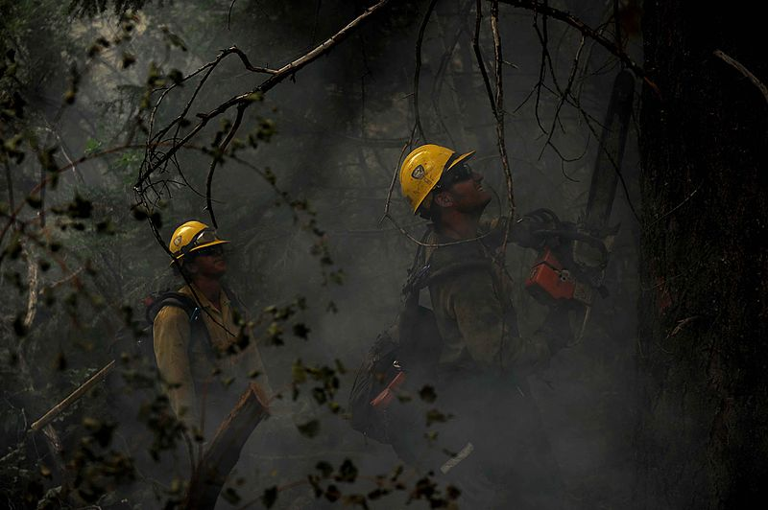
Wildfire Safety http://en.wikipedia.org/wiki/Wildfire
“Fighting wildfires can become deadly.
A wildfire's burning front may also change direction unexpectedly and jump across fire breaks.
Intense heat and smoke can lead to disorientation and loss of appreciation of the direction of the fire, which can make fires particularly dangerous.
During the 1949 Mann Gulch fire in Montana, USA, thirteen smokejumpers died when they lost their communication links, became disoriented, and were overtaken by the fire.
In the Australian February 2009 Victorian bushfires, at least 173 people died and over 2,029 homes and 3,500 structures were lost when they became engulfed by wildfire.”

Slide 34
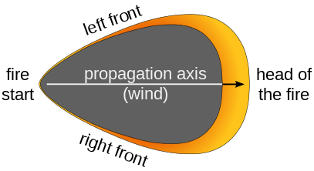
Research and Modeling Studies http://en.wikipedia.org/wiki/Wildfire
“Wildfire modeling is concerned with numerical simulation of wildfires in order to comprehend and predict fire behavior.
Using computational science, wildfire modeling involves the statistical analysis of past fire events to predict spotting risks and front behavior.
Early attempts to determine wildfire behavior assumed terrain and vegetation uniformity.
However, the exact behavior of a wildfire's front is dependent on a variety of factors, including windspeed and slope steepness.
Modern growth models utilize a combination of past ellipsoidal descriptions and Huygens' Principle to simulate fire growth as a continuously expanding polygon.
However, large fires that exceed suppression capabilities are often regarded as statistical outliers in standard analyses, even though fire policies are more influenced by catastrophic wildfires than by small fires.”
Modeling the propagation of a wildfire in France.
Note the characteristic "pear shape".
The dark part is the burnt part, the yellow-red part is the fire front.

Slide 35
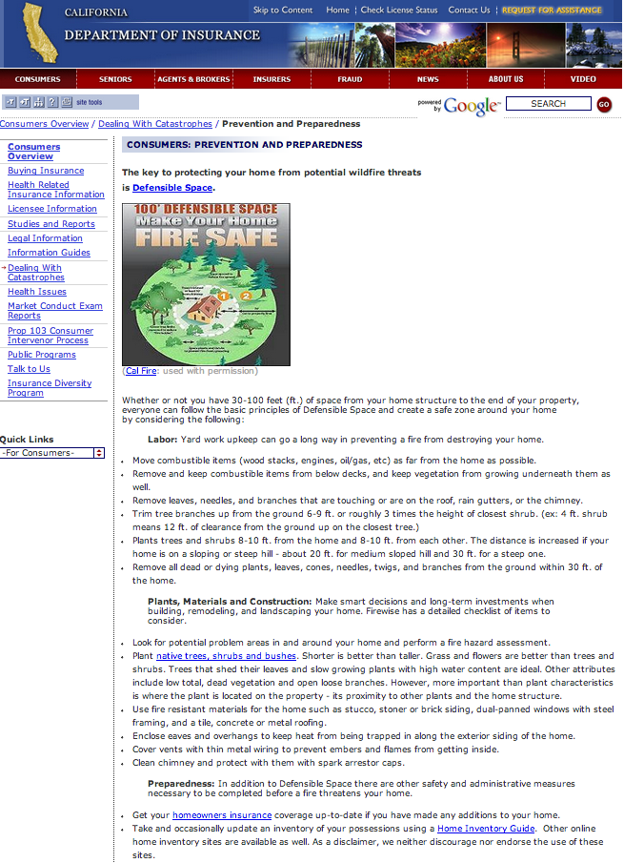
Wildfire Insurance http://www.insurance.ca.gov/0100-consumers/0065-catastrophe/index.cfm
Resources are available in all states in general

Slide 36
Wildfire Case Studies:
United States

Slide 37
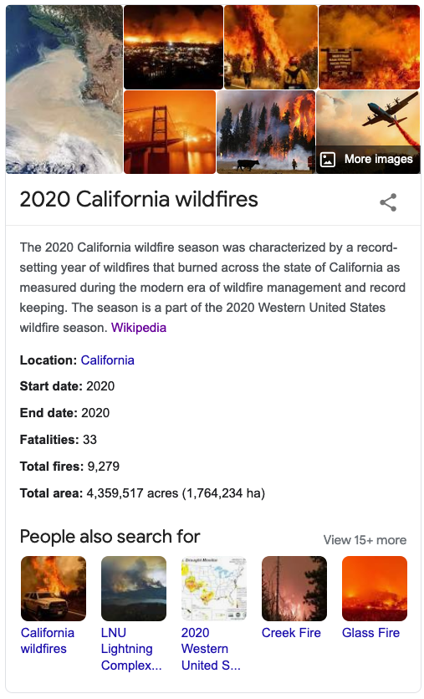
Lecture 25b
The 2020 California Wildfire Season
Wildfires
John Rundle GEL/EPS 131

Slide 38
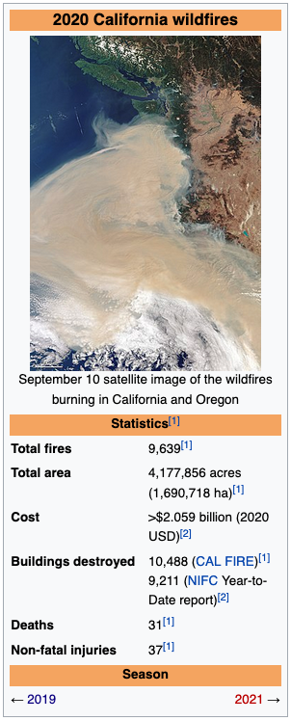
Summary https://en.wikipedia.org/wiki/2020_California_wildfires
The 2020 California wildfire season was characterized by a record-setting year of wildfires that burned across the state of California as measured during the modern era of wildfire management and record keeping.
The season is a part of the 2020 Western United States wildfire season. As of the end of the year, 9,639 fires had burned 4,177,856 acres (1,690,718 ha), more than 4% of the state's roughly 100 million acres of land, making 2020 the largest wildfire season recorded in California's modern history (according to the California Department of Forestry and Fire Protection),
Extent was roughly equivalent to the pre-1800 levels which averaged around 4.4 million acres yearly and up to 12 million in peak years.
California's August Complex fire has been described as the first "gigafire" as the area burned exceeded 1 million acres.
The fire crossed seven counties and has been described as being larger than the state of Rhode Island.
The intensity of the fire season has been attributed in part to decades of poor forest managementas well as increased warming due to climate change.

Slide 39
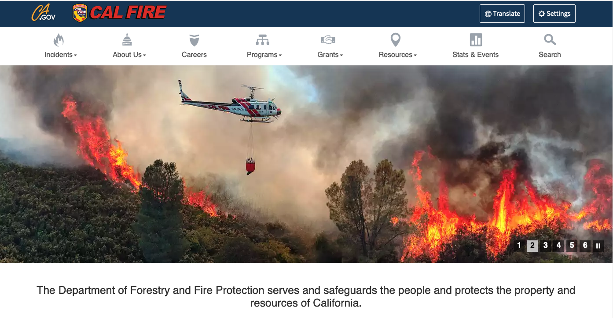
https://www.fire.ca.gov/

Slide 40
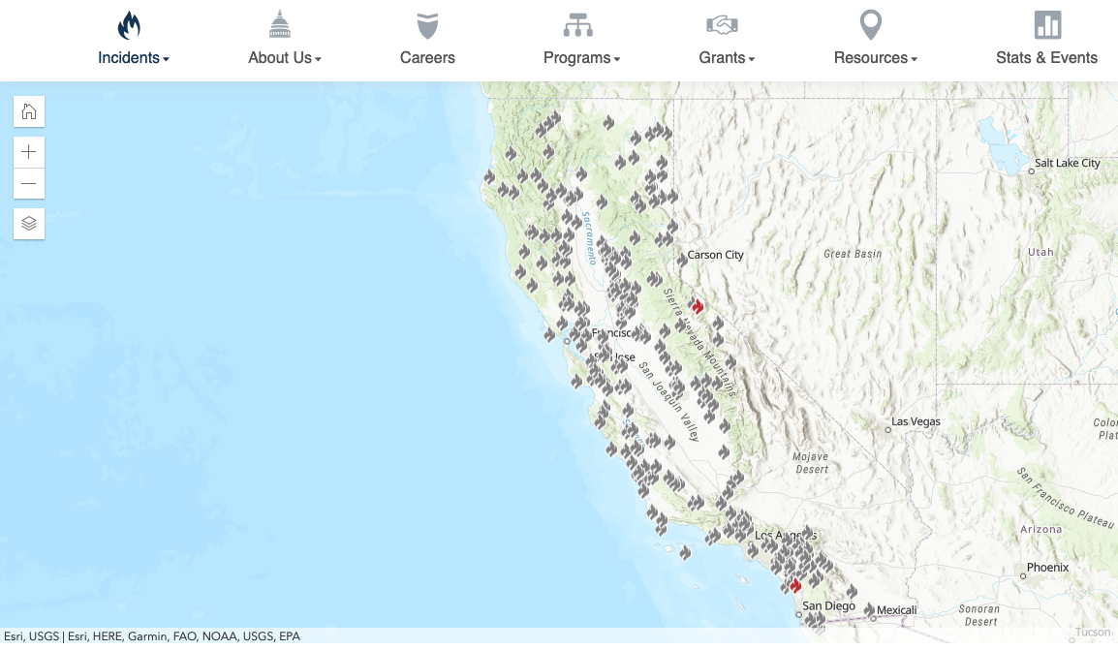
Incident Archive for 2020
https://www.fire.ca.gov/incidents/2020/
Click on an event

Slide 41
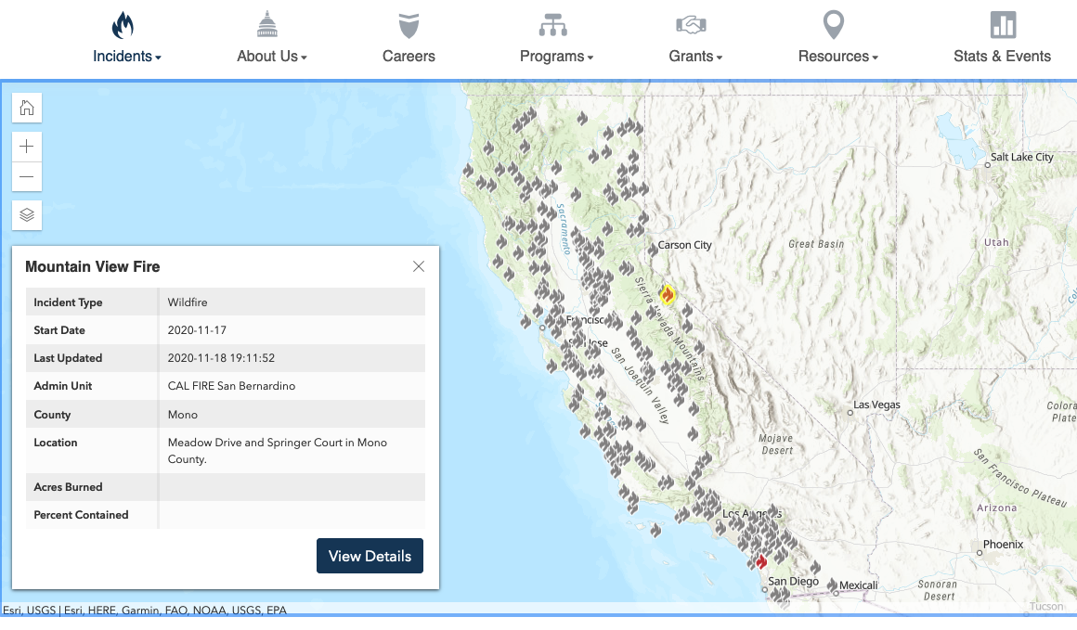
Click on a Fire Icon for Information https://www.fire.ca.gov/incidents/2020/

Slide 42
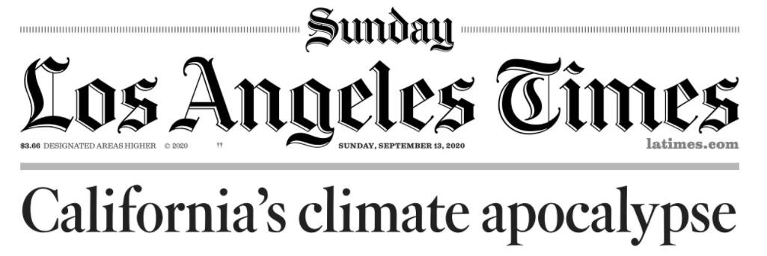

Slide 43
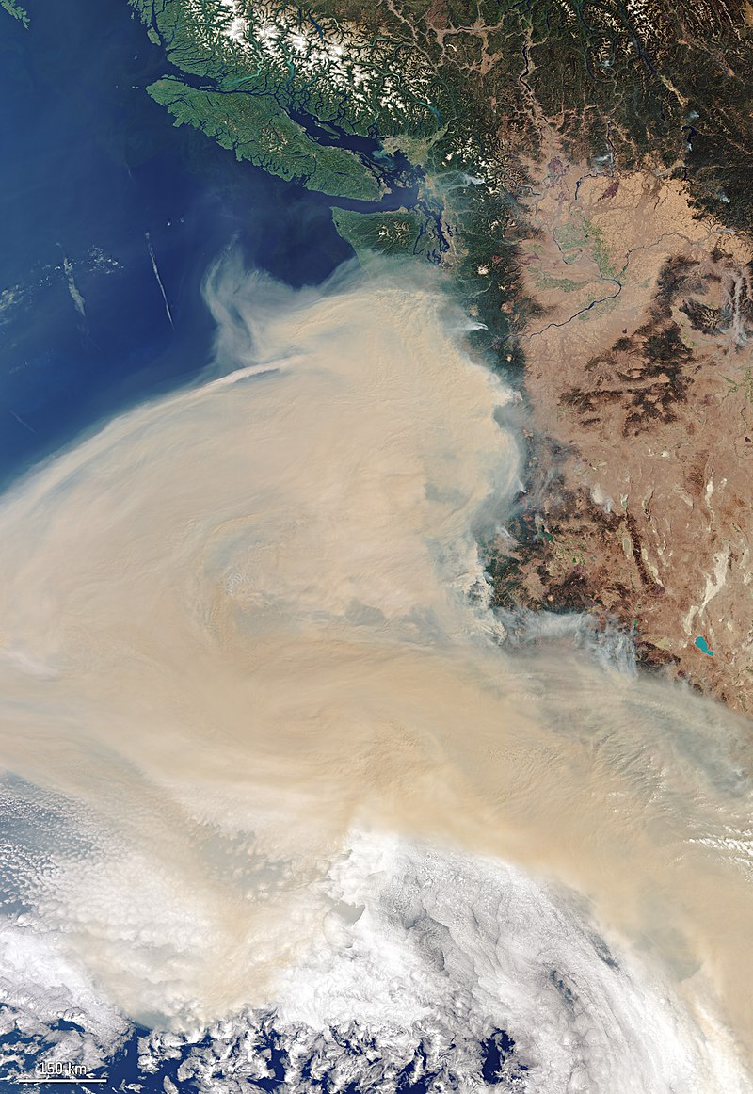
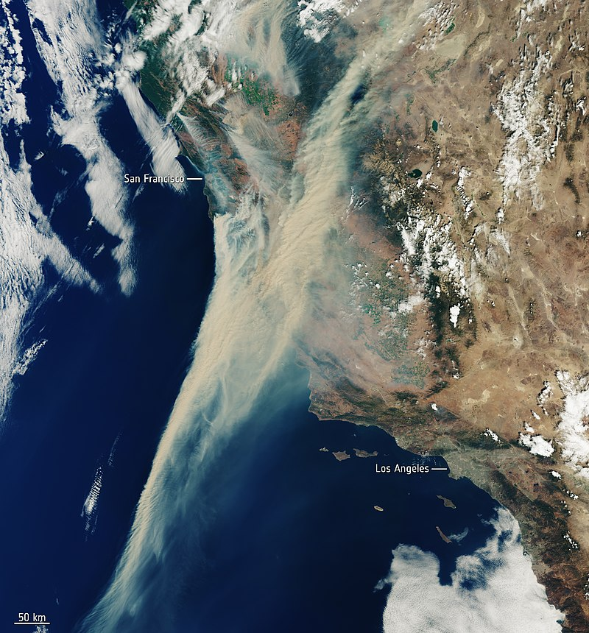
Scenes of the Wildfires

Slide 44
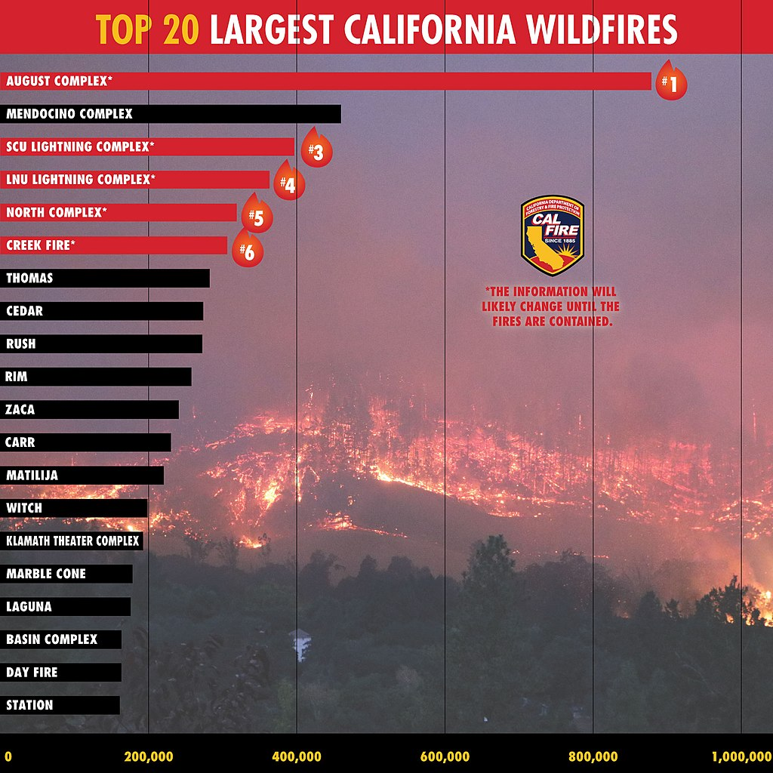
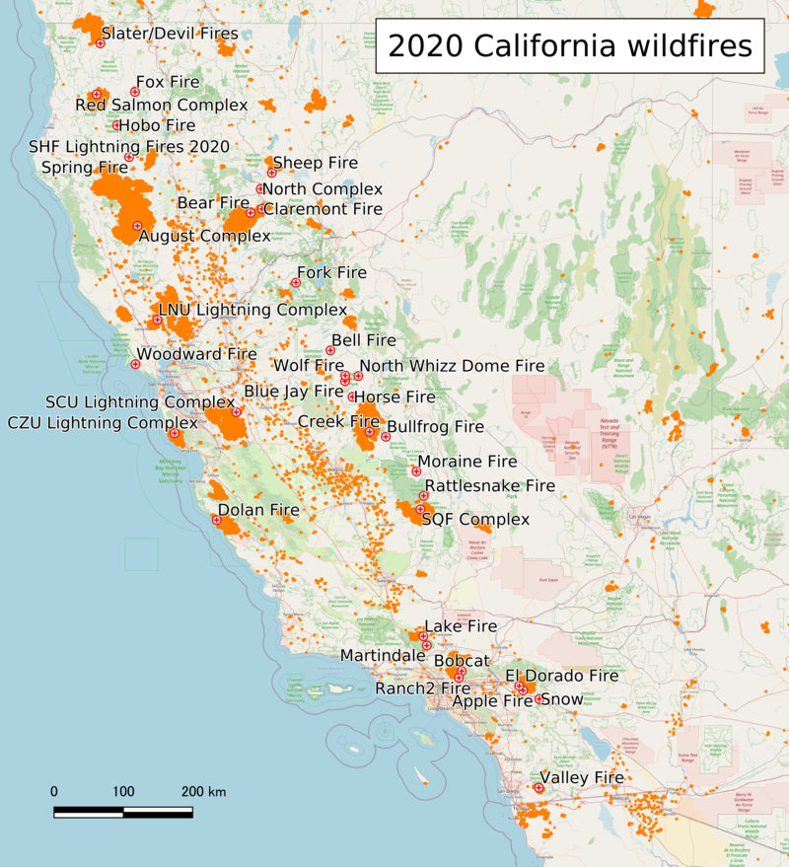
Maps and Facts https://en.wikipedia.org/wiki/2020_California_wildfires
Five of the twenty largest wildfires in California history were part of the 2020 wildfire season.

Slide 45
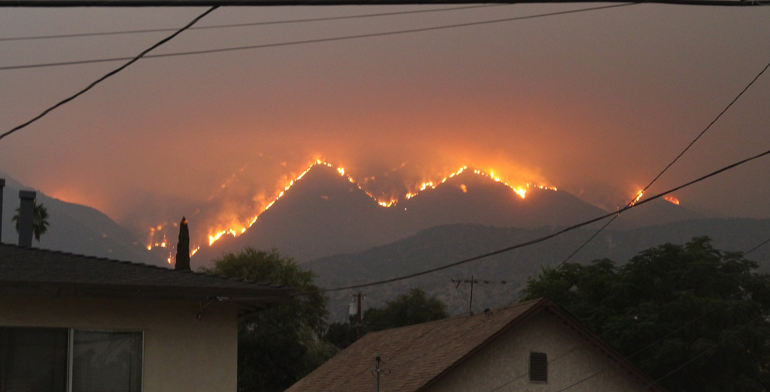
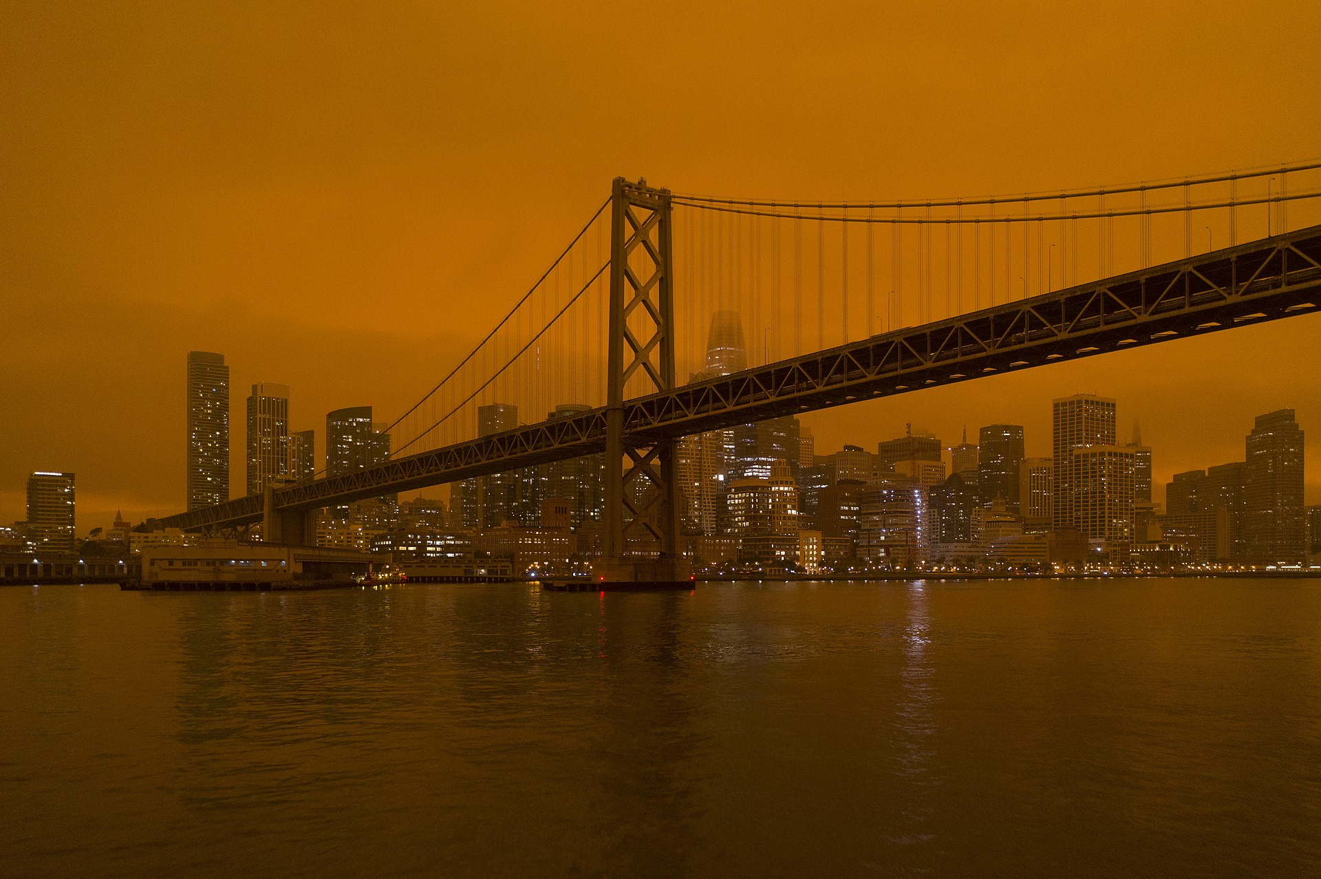
Images of Impacts
Bobcat fire in Southern California
Orange skies in San Francisco

Slide 46
Impacts of Climate Change https://en.wikipedia.org/wiki/2020_California_wildfires
Leading climate scientists argue that climate change increases the temperature of wildfires in California, the risk for drought, and potentially also the frequency of such events.
David Romps, director of the Berkeley Atmospheric Sciences Center summarizes the situation as follows: "To cut to the chase: Were the heat wave and the lightning strikes and the dryness of the vegetation affected by global warming? Absolutely yes. Were they made significantly hotter, more numerous, and drier because of global warming? Yes, likely yes, and yes."[8]
Friederike Otto, acting director of the University of Oxford Environmental Change Institute states, "There is absolutely no doubt that the extremely high temperatures are higher than they would have been without human-induced climate change. A huge body of attribution literature demonstrates now that climate change is an absolute game-changer when it comes to heat waves, and California won't be the exception."
Susan Clark, director of the Sustainability Initiative at the University at Buffalo argues, "This is climate change. This increased intensity and frequency of temperatures and heat waves are part of the projections for the future. [...] There is going to be more morbidity and mortality [from heat.] There are going to be more extremes."

