Slide 1
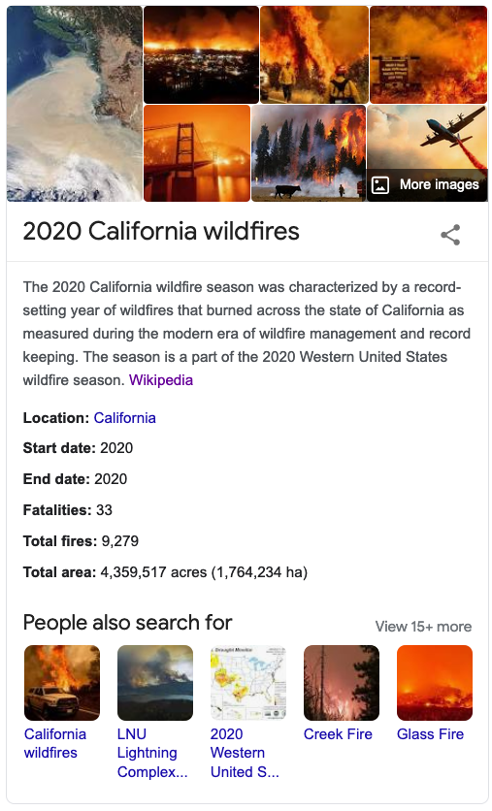
Lecture 25b The 2020 California Wildfire Season
Wildfires
John Rundle GEL/EPS 131

Slide 2
Summary https://en.wikipedia.org/wiki/2020_California_wildfires
The 2020 California wildfire season was characterized by a record-setting year of wildfires that burned across the state of California as measured during the modern era of wildfire management and record keeping.
The season is a part of the 2020 Western United States wildfire season. As of the end of the year, 9,639 fires had burned 4,177,856 acres (1,690,718 ha), more than 4% of the state's roughly 100 million acres of land, making 2020 the largest wildfire season recorded in California's modern history (according to the California Department of Forestry and Fire Protection),
Extent was roughly equivalent to the pre-1800 levels which averaged around 4.4 million acres yearly and up to 12 million in peak years.
California's August Complex fire has been described as the first "gigafire" as the area burned exceeded 1 million acres.
The fire crossed seven counties and has been described as being larger than the state of Rhode Island.
The intensity of the fire season has been attributed in part to decades of poor forest managementas well as increased warming due to climate change.

Slide 3
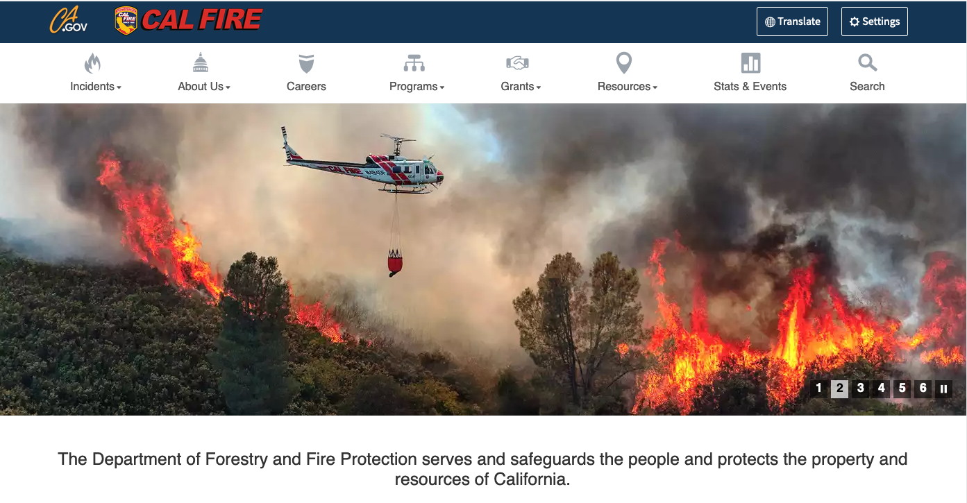
https://www.fire.ca.gov/

Slide 4
Incident Archive for 2020
Click on an event

Slide 5
Click on the Map for Information

Slide 7
Scenes of the Wildfires

Slide 8
Maps and Facts https://en.wikipedia.org/wiki/2020_California_wildfires
Five of the twenty largest wildfires in California history were part of the 2020 wildfire season.

Slide 9
Images of Impacts
Bobcat fire in Southern California
Orange skies in San Francisco

Slide 10
Impacts of Climate Change https://en.wikipedia.org/wiki/2020_California_wildfires
Leading climate scientists argue that climate change increases the temperature of wildfires in California, the risk for drought, and potentially also the frequency of such events.
David Romps, director of the Berkeley Atmospheric Sciences Center summarizes the situation as follows: "To cut to the chase: Were the heat wave and the lightning strikes and the dryness of the vegetation affected by global warming? Absolutely yes. Were they made significantly hotter, more numerous, and drier because of global warming? Yes, likely yes, and yes."[8]
Friederike Otto, acting director of the University of Oxford Environmental Change Institute states, "There is absolutely no doubt that the extremely high temperatures are higher than they would have been without human-induced climate change. A huge body of attribution literature demonstrates now that climate change is an absolute game-changer when it comes to heat waves, and California won't be the exception."[22]
Susan Clark, director of the Sustainability Initiative at the University at Buffalo argues, "This is climate change. This increased intensity and frequency of temperatures and heat waves are part of the projections for the future. [...] There is going to be more morbidity and mortality [from heat.] There are going to be more extremes."

