Slide 1
Lecture 25a
Wildfires
John Rundle GEL/EPS 131

Slide 2
Natural Fires http://en.wikipedia.org/wiki/Wildfire
Wildfire in California, 5 September, 2008

Slide 3
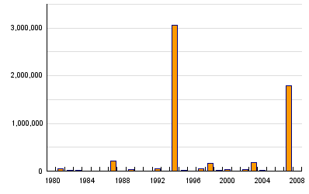
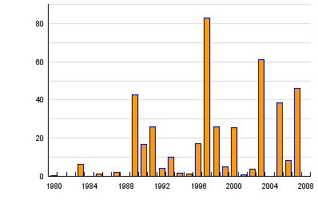
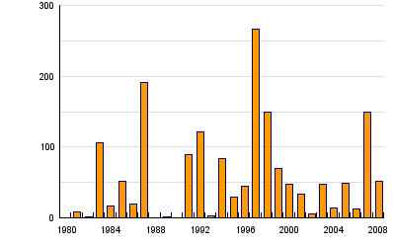
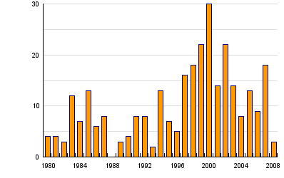
Global Wildfire Statistics, 1980-2008 http://www.preventionweb.net/english/hazards/statistics/?hid=73
Persons Affected
Economic Damage (USD in B$)
Persons Killed
Number of Reported Events

Slide 4
Global Wildfires Summary Statistics, 1980-2008 http://www.preventionweb.net/english/hazards/statistics/?hid=73

Slide 5
Wildfire http://en.wikipedia.org/wiki/Wildfire
“A wildfire is an uncontrolled fire in an area of combustible vegetation that occurs in the countryside or a wilderness area.
A wildfire differs from other fires by its extensive size, the speed at which it can spread out from its original source, its potential to change direction unexpectedly, and its ability to jump gaps such as roads, rivers and fire breaks.
Wildfires are characterized in terms of the cause of ignition, their physical properties such as speed of propagation, the combustible material present, and the effect of weather on the fire.
Wildfires differ from other fires in that they take place outdoors in areas of grassland, woodlands, bushland, scrubland, peatland, and other wooded areas that act as a source of fuel, or combustible material.
Wildfire in western desert of Utah

Slide 6
Characteristics http://en.wikipedia.org/wiki/Wildfire
Wildfire behavior and severity result from the combination of factors such as available fuels, physical setting, and weather.
While wildfires can be large, uncontrolled disasters that burn through 0.4 to 400 square kilometers (100 to 100,000 acres) or more, they can also be as small as 0.001 square kilometres (0.25 acre; 1,000 m²) or less.
Although smaller events may be included in wildfire modeling, most do not earn press attention.
This can be problematic because public fire policies, which relate to fires of all sizes, are influenced more by the way the media portrays catastrophic wildfires than by small fires.
Strategies of wildfire prevention, detection, and suppression have varied over the years, and international wildfire management experts encourage further development of technology and research.
One of the more controversial techniques is controlled burning: permitting or even igniting smaller fires to minimize the amount of flammable material available for a potential wildfire.
While some wildfires burn in remote forested regions, they can cause extensive destruction of homes and other property located in the wildland-urban interface, which is a zone of transition between developed areas and undeveloped wilderness.”

Slide 7
General Facts http://en.wikipedia.org/wiki/Wildfire
The Station Fire approaches southern California’s Jet Propulsion Laboratory in 2009
“In the United States, there are typically between 60,000 and 80,000 wildfires that occur each year, burning 3 million to 10 million acres of land depending on the year.
Fossil records and human history contain accounts of wildfires, as wildfires can occur in periodic intervals.
Wildfires can cause extensive damage, both to property and human life, but they also have various beneficial effects on wilderness areas.
Some plant species depend on the effects of fire for growth and reproduction, although large wildfires may also have negative ecological effects”

Slide 8
Wildfires in the US http://en.wikipedia.org/wiki/Wildfire
On a yearly basis in the United States, typically more than six times the number of wildfires are caused by human means such as campfires and controlled agricultural burns than by natural means.
For example, in 2010, almost 1.4 million acres were burned by human-caused wildfires, and over 2 million acres were burned by naturally-caused wildfires.
However, far more acres were burned by human-caused fires in 2011, when almost 5.4 million acres were burned by human-caused wildfires, and only about 3.4 million acres were caused by naturally-derived wildfires.

Slide 9
Wildfires in Australia (Bushfires) http://www.nbcnews.com/slideshow/news/the-year-in-pictures-2013-53866483/
“Wildfires, especially bushfires, are a common occurrence in Australia
Because of the generally hot and dry climate in Australia, fires pose a great risk to life and infrastructure during all times of the year, though mostly throughout the hotter months of summer and spring.
90 homes were destroyed in Dunalley, Tasmania, near Hobart, Australia during a wildfire in January, 2013
In the image at right, a family takes refuge beneath a jetty as the wildfire rages nearby.”
(Tim Holmes / Holmes Family via AP)

Slide 10
Causes of Wildfires http://en.wikipedia.org/wiki/Wildfire
“The five major natural causes of wildfire ignitions are humans, lightning, volcanic eruption, sparks from rockfalls, and spontaneous combustion.
The thousands of coal seam fires that are burning around the world, such as those in Centralia, Burning Mountain, and several coal-sustained fires in China, can also flare up and ignite nearby flammable material.
However, many wildfires are attributed to human sources such as arson, discarded cigarettes, sparks from equipment, and power line arcs (as detected by arc mapping).
In societies experiencing shifting cultivation where land is cleared quickly and farmed until the soil loses fertility, slash and burn clearing is often considered the least expensive way to prepare land for future use.
Forested areas cleared by logging encourage the dominance of flammable grasses, and abandoned logging roads overgrown by vegetation may act as fire corridors.
Annual grassland fires in southern Vietnam can be attributed in part to the destruction of forested areas by US military herbicides, explosives, and mechanical land clearing and burning operations during the Vietnam War.
In the Canada and northwest China, lightning is the major source of ignition.

Slide 11
Fuel Type http://en.wikipedia.org/wiki/Wildfire
Ground fires are fed by subterranean roots, and other buried organic matter. This fuel type is especially susceptible to ignition due to spotting. Ground fires typically burn by smoldering, and can burn slowly for days to months, such as peat fires in Kalimantan and Eastern Sumatra, Indonesia
Crawling or surface fires are fueled by low-lying vegetation such as leaf and timber litter, debris, grass, and low-lying shrubbery.
Ladder fires consume material between low-level vegetation and tree canopies, such as small trees, downed logs, and vines.
Crown, canopy, or aerial fires burn suspended material at the canopy level, such as tall trees, vines, and mosses. The ignition of a crown fire, termed crowning, is dependent on the density of the suspended material, canopy height, canopy continuity, and sufficient surface and ladder fires in order to reach the tree crowns.

Slide 12
Global Wildfires http://earthobservatory.nasa.gov/GlobalMaps/view.php?d1=MOD14A1_M_FIRE
The fire maps show the locations of actively burning fires around the world on a monthly basis, based on observations from the Moderate Resolution Imaging Spectroradiometer (MODIS) on NASA’s Terra satellite.
The colors are based on a count of the number (not size) of fires observed within a 1,000-square-kilometer area.
White pixels show the high end of the count —as many as 100 fires in a 1,000-square-kilometer area per day. Yellow pixels show as many as 10 fires, orange shows as many as 5 fires, and red areas as few as 1 fire per day.”

Slide 13
Global Wildfires http://earthobservatory.nasa.gov/GlobalMaps/view.php?d1=MOD14A1_M_
“Some of the global patterns that appear in the fire maps over time are the result of natural cycles of rainfall, dryness, and lightning.
In other parts of the world, the patterns are the result of human activity.
For example, the intense burning in the heart of South America from August-October is a result of human-triggered fires, both intentional and accidental, in the Amazon Rainforest and the Cerrado (a grassland/savanna ecosystem) to the south.
Across Africa, a band of widespread agricultural burning sweeps north to south over the continent as the dry season progresses each year.
Agricultural burning occurs in late winter and early spring each year across Southeast Asia. “

Slide 14
Effects of Weather http://en.wikipedia.org/wiki/Wildfire
“Heat waves, droughts, cyclical climate changes such as El Niño, and regional weather patterns such as high-pressure ridges can increase the risk and alter the behavior of wildfires dramatically.
Years of precipitation followed by warm periods can encourage more widespread fires and longer fire seasons.
Since the mid-1980s, earlier snowmelt and associated warming has also been associated with an increase in length and severity of the wildfire season in the Western United States.
Wildfires will not occur during a drought unless accompanied by other factors, such as lightning (ignition source) and strong winds (mechanism for rapid spread).”
Charred landscape following crown fire in North Cascades, US

Slide 15
Effects of Weather http://en.wikipedia.org/wiki/Wildfire
“Intensity also increases during daytime hours.
Burn rates of smoldering logs are up to five times greater during the day due to lower humidity, increased temperatures, and increased wind speeds.
Sunlight warms the ground during the day which creates air currents that travel uphill.
At night the land cools, creating air currents that travel downhill.
Wildfires are fanned by these winds and often follow the air currents over hills and through valleys.
Fires in Europe occur frequently during the hours of 12:00 p.m. and 2:00 p.m.
Wildfire suppression operations in the United States revolve around a 24-hour fire day that begins at 10:00 a.m. due to the predictable increase in intensity resulting from the daytime warmth.”
Canadian crown fire experiment

Slide 16
Fire Ecology http://en.wikipedia.org/wiki/Wildfire
“Wildfires are common in climates that are sufficiently moist to allow the growth of vegetation but feature extended dry, hot periods.
Such places include the vegetated areas of Australia and Southeast Asia, the veld in southern Africa, the fynbos in the Western Cape of South Africa, the forested areas of the United States and Canada, and the Mediterranean Basin.
Fires can be particularly intense during days of strong winds, periods of drought, and during warm summer months.
Global warming may increase the intensity and frequency of droughts in many areas, creating more intense and frequent wildfires.
Although some ecosystems rely on naturally occurring fires to regulate growth, many ecosystems suffer from too much fire, such as the chaparral in southern California and lower elevation deserts in the American Southwest.
The increased fire frequency in these ordinarily fire-dependent areas has upset natural cycles, destroyed native plant communities, and encouraged the growth of fire-intolerant vegetation and non-native weeds.
Invasive species can grow rapidly in areas that were damaged by fires.
Because they are highly flammable, they can increase the future risk of fire, creating a positive feedback loop that increases fire frequency and further destroys native growth.”

Slide 17
Fire Ecology http://en.wikipedia.org/wiki/Wildfire http://earthobservatory.nasa.gov/Features/AmazonFire/
“In the Amazon Rainforest, drought, logging, cattle ranching practices, and slash-and-burn agriculture damage fire-resistant forests and promote the growth of flammable brush, creating a cycle that encourages more burning.
Fires in the rainforest, along with drought and human involvement, could damage or destroy more than half of the Amazon rainforest by the year 2030.
Wildfires generate ash, destroy available organic nutrients, and cause an increase in water runoff, eroding away other nutrients and creating flash flood conditions, as well as producing large amounts of CO2. “
“During the height of the dry season, fires are widespread along the margin of the Amazon.
Fingers of cleared land typically form a “herringbone” pattern as they extend from roads (right side of image).
This image from the Moderate Resolution Imaging Spectroradiometer was acquired on the afternoon of August 31, 2003.
Red outlines trace the pixels in which fires were burning when the image was taken. The smoke from these fires is so thick it hides the surface in places “

Slide 18
Fire Ecology http://en.wikipedia.org/wiki/Wildfire http://earthobservatory.nasa.gov/NaturalHazards/view.php?id=81444
“Wildfires can also have an effect on climate change, increasing the amount of carbon released into the atmosphere and inhibiting vegetation growth, which affects overall carbon uptake by plants.
In tundra there is a natural pattern of accumulation of fuel and wildfire which varies depending on the nature of vegetation and terrain.
Research in Alaska has shown fire-event return intervals, (FRIs) that typically vary from 150 to 200 years with dryer lowland areas burning more frequently than wetter upland areas.”
On June 19, 2013, the Moderate Resolution Imaging Spectroradiometer (MODIS) on NASA’s Aqua satellite captured this image of smoke from wildfires burning in western Alaska.
The smoke was moving west over Norton Sound. (The center of the image is roughly 163° West and 62° North.)
Record heat and dry fuels have produced record-setting fire potential across boreal spruce forests and tundra landscapes.
The heat wave is the product of an intense ridge of high pressure over the state.

Slide 19
Atmospheric Effects http://en.wikipedia.org/wiki/Wildfire http://earthobservatory.nasa.gov/IOTD/view.php?id=9031
“Wildfires can affect climate and weather and have major impacts on atmospheric pollution.
Wildfire emissions contain fine particulate matter which can cause cardiovascular and respiratory problems.
Forest fires in Indonesia in 1997 were estimated to have released between 0.89 and 2.83 billion tons of CO² into the atmosphere, which is between 13%–40% of the annual global carbon dioxide emissions from burning fossil fuels.
Atmospheric models suggest that these concentrations of sooty particles could increase absorption of incoming solar radiation during winter months by as much as 15%.”
“Officials were concerned that fires (red areas in upper image from MODIS) during the 2008 season could be more intense than normal because the dry season had been especially dry. The lower image confirms the drought. Made with data collected by the Tropical Rainfall Measuring Mission (TRMM) satellite, the image shows rainfall measurements for July 2008 compared to average measurements. Areas that received more rain than average are blue, while regions that received less rain are brown. Sumatra and southern Borneo were dry through the month.”

Slide 20
Wildfire Policy in the US http://en.wikipedia.org/wiki/Wildfire
“In 2001, the United States Government implemented a National Fire Plan and the budget increased from $108 million in 2000 to $401 million for the reduction of hazardous fuels.
Today the United States philosophy remains that, “fire, as a critical natural process, will be integrated into land and resource management plans and activities on a landscape scale, and across agency boundaries.
Response to wildfire is based on ecological, social and legal consequences of fire.
The five federal regulatory agencies managing forest fire response and planning for 676 million acres in the United States are the Department of the Interior, the Bureau of Land Management, the Bureau of Indian Affairs, the National Park Service, the United States Department of Agriculture-Forest Service and the United States Fish and Wildlife Services.
Several hundred million U.S. acres of wildfire management are also conducted by state, county, and local fire management organizations.”

Slide 21
Cost-Benefits of Fire Management http://en.wikipedia.org/wiki/Wildfire

Slide 22
US Forest Service (accessed 1/12/2019) https://fsapps.nwcg.gov/afm/index.php

Slide 23
Open Hazards Feed http://www.openhazards.com/viewer
Today: 11/29/2019
Forecast for the Next Week

Slide 24
Wildfire Detection http://en.wikipedia.org/wiki/Wildfire
“Satellite and aerial monitoring through the use of planes, helicopter, or UAVs can provide a wider view and may be sufficient to monitor very large, low risk areas.
Satellite-mounted sensors such as Envisat's Advanced Along Track Scanning Radiometer and European Remote-Sensing Satellite's Along-Track Scanning Radiometer can measure infrared radiation emitted by fires, identifying hot spots greater than 39 °C (102 °F).
The National Oceanic and Atmospheric Administration's Hazard Mapping System combines remote-sensing data from satellite sources such as Geostationary Operational Environmental Satellite (GOES), Moderate-Resolution Imaging Spectroradiometer (MODIS), and Advanced Very High Resolution Radiometer (AVHRR) for detection of fire and smoke plume locations.
Wildfires across the Balkans in late July 2007 (MODIS image)

Slide 25
Wildfire Safety http://en.wikipedia.org/wiki/Wildfire
“Fighting wildfires can become deadly.
A wildfire's burning front may also change direction unexpectedly and jump across fire breaks.
Intense heat and smoke can lead to disorientation and loss of appreciation of the direction of the fire, which can make fires particularly dangerous.
During the 1949 Mann Gulch fire in Montana, USA, thirteen smokejumpers died when they lost their communication links, became disoriented, and were overtaken by the fire.
In the Australian February 2009 Victorian bushfires, at least 173 people died and over 2,029 homes and 3,500 structures were lost when they became engulfed by wildfire.”

Slide 26
Wildfire Insurance http://www.insurance.ca.gov/0100-consumers/0065-catastrophe/index.cfm
Resources are available in all states in general

Slide 27
Wildfire Case Studies: United States

Slide 28
California Wildfires 2009

Slide 29
2009 California Wildfires http://en.wikipedia.org/wiki/2009_California_wildfires
“The 2009 California wildfires were a series of 63 wildfires that were active in the state of California, USA, during the year 2009.
The fires burned more than 336,020 acres (525 sq mi; 1,360 km²) of land from the beginning of July through late November, destroying hundreds of structures and killing two people.
August was especially notable for several very large fires which burned in Southern California, despite being outside of the normal fire season for that region.
The Station Fire, north of Los Angeles, was the largest and deadliest of these wildfires, burning 160,577 acres (251 sq mi; 650 km²) and killing two firefighters since it began in late August. “

Slide 30
2009 Station Fire http://en.wikipedia.org/wiki/2009_California_wildfires
“The Station Fire (August 26 – October 16, 160,577 acres (251 sq mi; 650 km2), 209 structures destroyed, including 89 homes) started in the Angeles National Forest near the U.S. Forest Service ranger station on the Angeles Crest Highway (State Highway 2).
Two firefighters, Captain Tedmund Hall and Firefighter Specialist Arnie Quinones were killed on August 30 while attempting to escape the flames when their fire truck plunged off a cliff.
The blaze threatened 12,000 structures in the National Forest and the nearby communities of La Cañada Flintridge, Glendale, Acton, La Crescenta, Littlerock and Altadena, as well as the Sunland and Tujunga neighborhoods of the City of Los Angeles, as well as the Jet Propulsion Laboratory
The Station Fire burned on the slopes of Mount Wilson, threatening numerous television, radio and cellular telephone antennas on the summit, as well as the Mount Wilson Observatory, which includes several historically significant telescopes and multi-million-dollar astronomical facilities operated by UCLA, USC, UC Berkeley and Georgia State University.”

Slide 31
Yosemite, CA Rim Fire August 20, 2013 http://earthobservatory.nasa.gov/NaturalHazards/view.php?id=81919&src=nhrss
“On August 22, 2013, the MODIS instrument on NASA’s Aqua satellite acquired this image of the drought-fueled Rim fire burning in central California, near Yosemite National Park.
Red outlines indicate hot spots where MODIS detected unusually warm surface temperatures associated with fires.
A smaller fire—American fire—burned to the north. The lower image is a photograph that shows the fire burning at night on August 21”

Slide 32
Rim Fire Views at Night http://earthobservatory.nasa.gov/NaturalHazards/view.php?id=82004&src=nhrss
“Started on August 17, 2013, the fast-moving fire had already charred more than 100,000 acres (40,000 hectares) by August 23, despite the efforts of more than 2,000 firefighters.
Hundreds of people were forced to evacuate their homes, and roads in the area were closed.
The Visible Infrared Imaging Radiometer Suite (VIIRS) on the Suomi NPP satellite tracked the growth of the fire between August 20 and September 4.
The brightest, most intense parts of the fire glow white.
Pale gray smoke streams away, generally to the north.
Thin clouds obscured the view on some days, particularly August 31, September 1, and September 3.
On August 20, the Moon was full, so the landscape was reflecting a large amount of moonlight. “

Slide 33
California Wildfires 2017

Slide 34
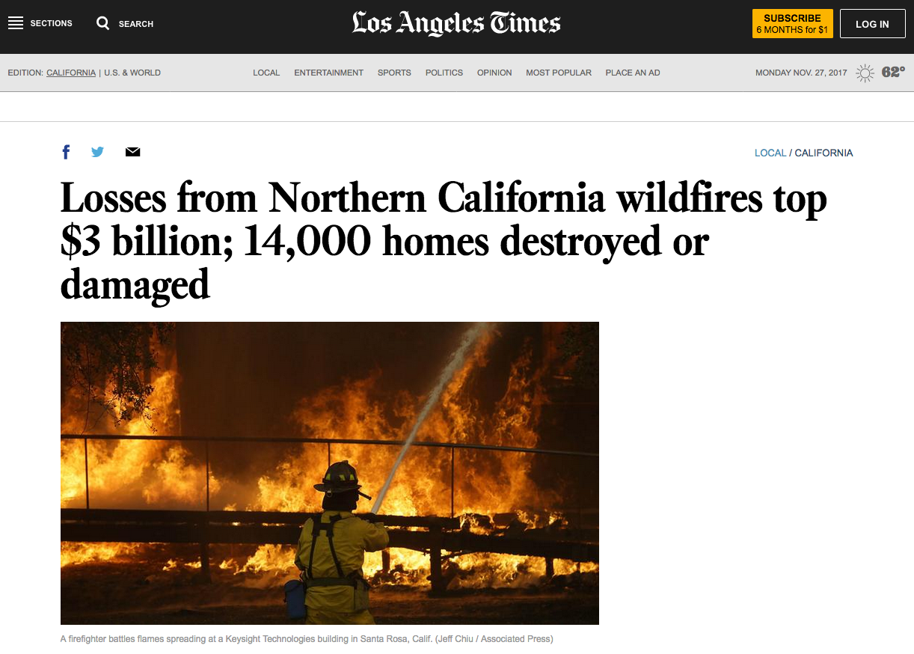

Slide 35
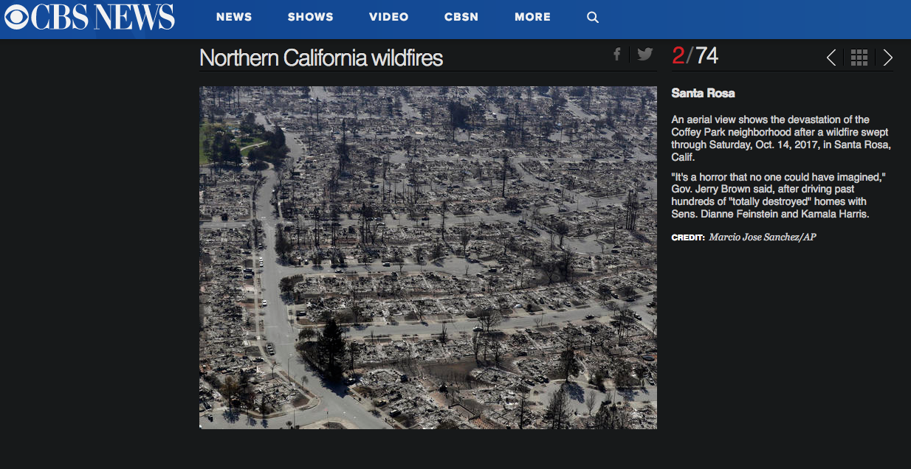

Slide 36
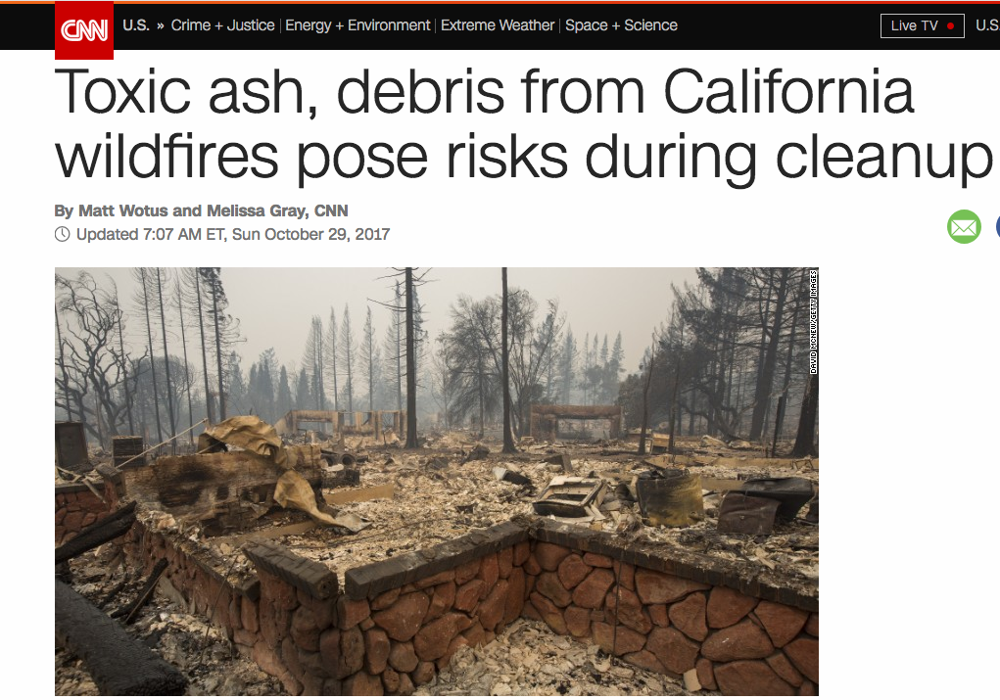

Slide 37
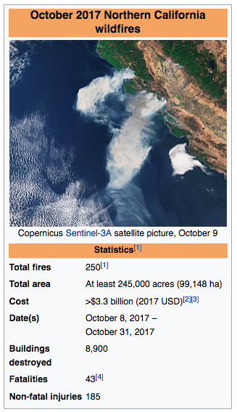
California Wildfires 2017 https://en.wikipedia.org/wiki/October_2017_Northern_California_wildfires
The October 2017 Northern California wildfires were a series of wildfires that started burning across the state of California, United States, beginning in early October
21 of the wildfires became major fires that burned at least 245,000 acres
The wildfires broke out throughout Napa, Lake, Sonoma, Mendocino, Butte, and Solano counties during severe fire weather conditions effectively leading to a major red flag warning from much of the Northern California area.
These fires included the Tubbs Fire (which grew to become the most destructive wildfire in the history of California at that time), the Atlas Fire, Nuns Fire, and others.
These wildfires were the most destructive ones of the 2017 California wildfire season.

Slide 38
Fire Details
Owing to the extreme conditions, shortly after the fires ignited on October 8 and 9, they rapidly grew to become extensive, full-scale incidents spanning from 1,000 acres to well over 20,000 acres, each within a single day.
By October 14, the fires had burned more than 210,000 acres while forcing 90,000 people to evacuate from their homes.
The Northern California fires killed at least 43 people and hospitalized at least 185, making the week of October 8, 2017, the deadliest week of wildfires in California history.
Collectively, this event constitutes the largest loss of life due to wildfires in the United States since 1918.
In total, an estimated 8,900 structures were destroyed.
Video of initial wildfire smoke

Slide 39
A Neighborhood in Santa Rosa https://www.washingtonpost.com/graphics/2017/national/northern-california-fires/?hpid=hp_hp-top-table-main_calif-fires-art-only-1235am%3Ahomepage%2Fstory

Slide 40
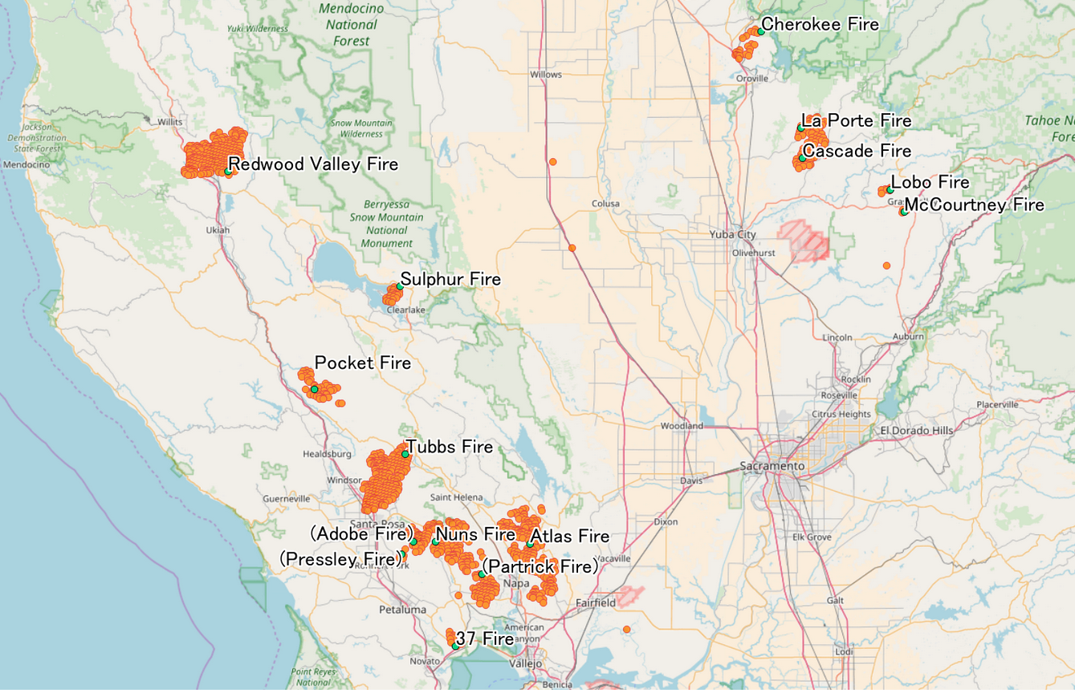
Wildfires from October 7 to October 14, 2017

Slide 41
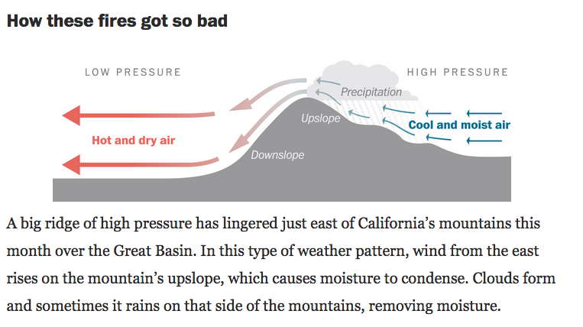
Washington Post Analysis https://www.washingtonpost.com/graphics/2017/national/northern-california-fires/?hpid=hp_hp-top-table-main_calif-fires-art-only-1235am%3Ahomepage%2Fstory

Slide 42
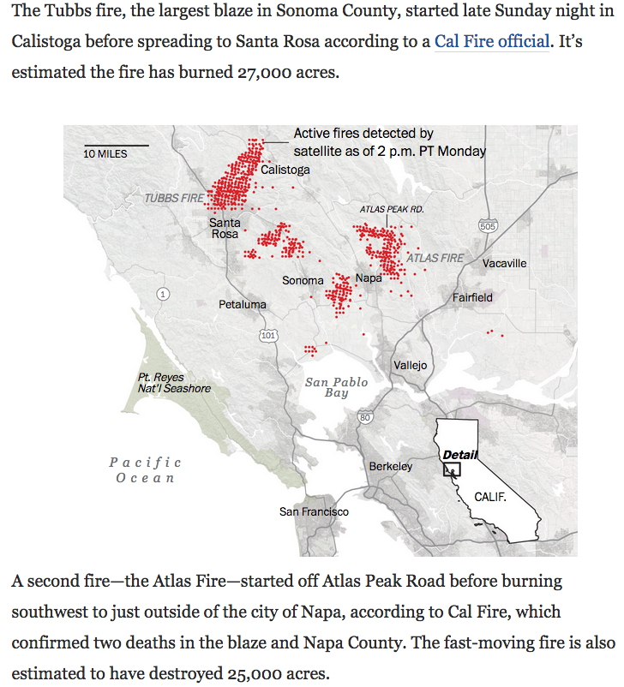
https://www.washingtonpost.com/graphics/2017/national/northern-california-fires/?hpid=hp_hp-top-table-main_calif-fires-art-only-1235am%3Ahomepage%2Fstory

Slide 43
https://www.washingtonpost.com/graphics/2017/national/northern-california-fires/?hpid=hp_hp-top-table-main_calif-fires-art-only-1235am%3Ahomepage%2Fstory

Slide 44
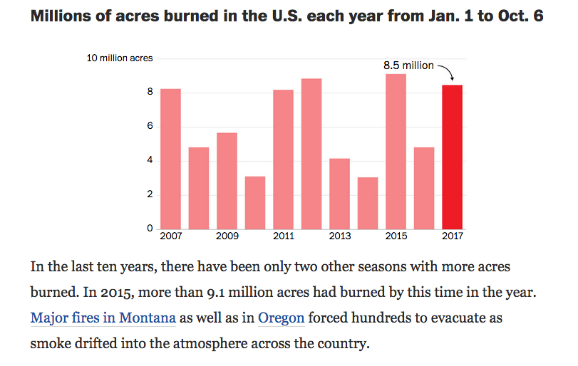
https://www.washingtonpost.com/graphics/2017/national/northern-california-fires/?hpid=hp_hp-top-table-main_calif-fires-art-only-1235am%3Ahomepage%2Fstory

Slide 45
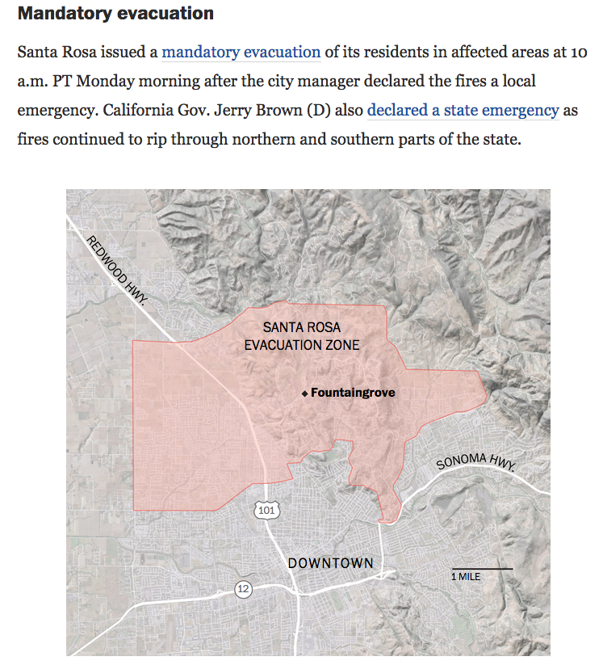
https://www.washingtonpost.com/graphics/2017/national/northern-california-fires/?hpid=hp_hp-top-table-main_calif-fires-art-only-1235am%3Ahomepage%2Fstory

Slide 46
Impacts https://en.wikipedia.org/wiki/October_2017_Northern_California_wildfires
Pacific Gas and Electric Company (PG&E) reported that 310,000 customers lost electricity service and 42,000 customers lost gas service since the wildfires started on October 8.
By October 14, PG&E restored electricity to 92% and gas service to 16,800 of the customers affected.
Reinsurance broker Aon Benfield stated that these are the costliest wildfires in U.S. history at that time, with an estimated eight billion U.S. dollars in insured losses.
The largest portion of these losses was to residential property. Additional losses were to automobiles, commercial property including business interruption insurance, and to crops.

Slide 47
Impacts https://en.wikipedia.org/wiki/October_2017_Northern_California_wildfires

Slide 48
Wildfire Causes (?) https://en.wikipedia.org/wiki/October_2017_Northern_California_wildfires
As of October 12, 2017, the cause of the fires remained under investigation.
News media noted reports of wind-damaged power equipment around the time the fires were starting.
Pacific Gas & Electric stated that strong winds had affected the utility's power lines in the North Bay area on late October 8 and early October 9.
A California Department of Forestry and Fire Protection (CAL FIRE) spokesperson stated that investigators were considering this among other possible causes.
The California Public Utilities Commission sent PG&E a notification to preserve equipment, emails and documents relevant to the utility's tree-trimming program.
CAL FIRE Director Ken Pimlott discouraged premature speculation of causes, stating that "The facts will come out when the investigations are done."

Slide 49
Southern California Wildfires December, 2017

Slide 50
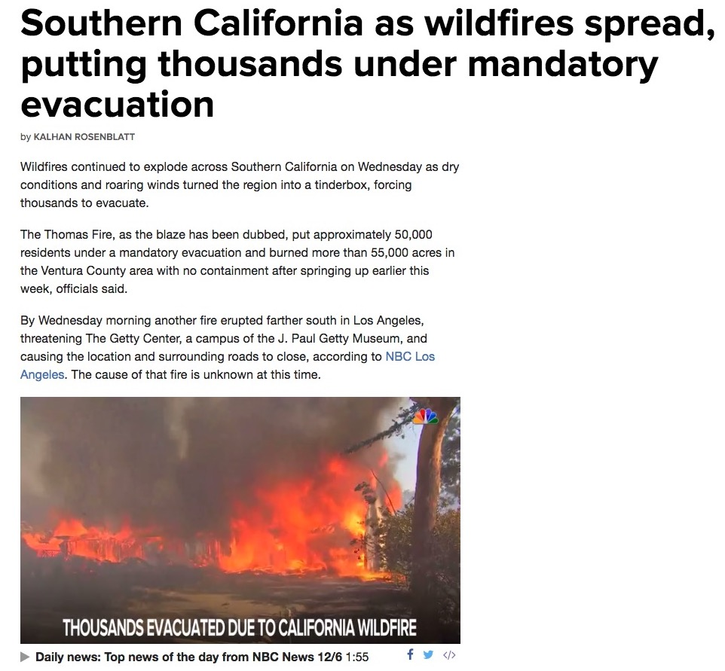
December 6, 2017

Slide 51
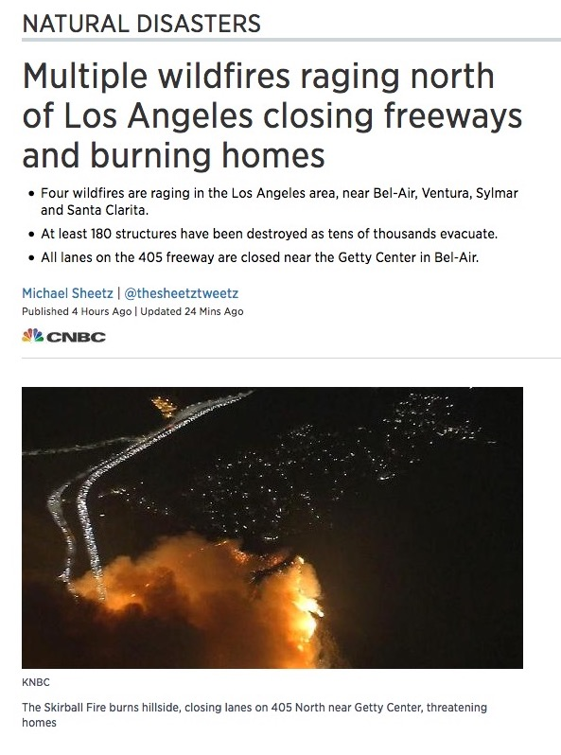
December 6, 2017

Slide 52
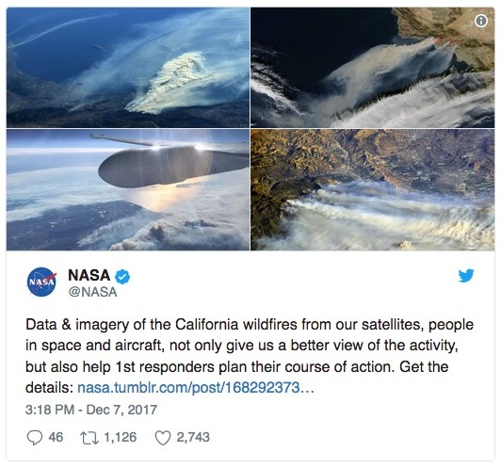

Slide 53
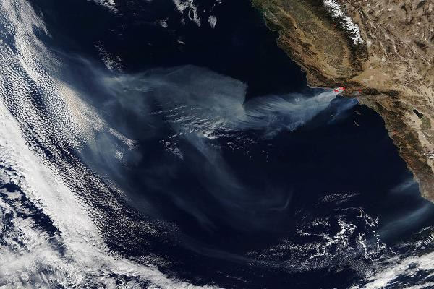

Slide 54
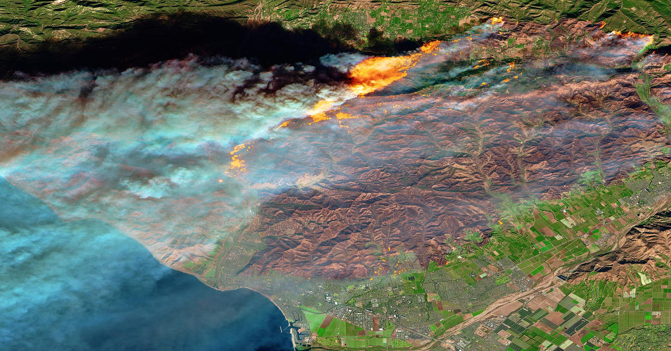

Slide 55
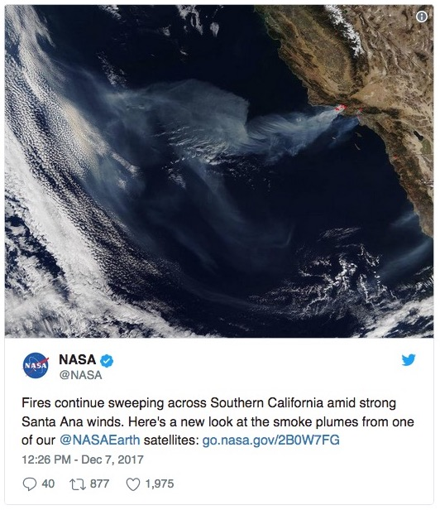

Slide 56
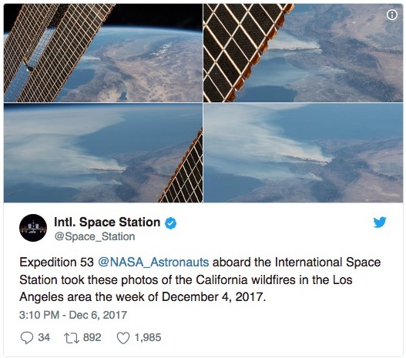

Slide 57
California Wildfires 2018

Slide 58
Carr Fire
The Carr Fire was a large wildfire that burned in Shasta and Trinity Counties in California, United States.
The fire burned 229,651 acres (92,936 ha; 359 sq mi), before it was 100% contained late on August 30, 2018.
The Carr Fire destroyed at least 1,604 structures (at least 1,077 were homes) while damaging 277 others, becoming the sixth-most destructive fire in California history (now the seventh-most destructive fire), as well as the seventh-largest wildfire recorded in modern California history.
The Carr Fire cost over $1.659 billion (2018) in damages, including $1.5 billion in insured losses and more than $158.7 million in suppression costs.
At its height, the fire engaged as many as 4,766 personnel from multiple agencies.
The fire was started when a flat tire on a vehicle caused the wheel's rim to scrape against the asphalt, creating sparks that set off the fire.

Slide 59
Carr Fire: Location and Extent

Slide 60
Camp Fire
The Camp Fire was the deadliest and most destructive wildfire in California history to date.
It is also the deadliest wildfire in the United States since the Cloquet fire in 1918, and is high on the list of the world's deadliest wildfires, and is the sixth-deadliest U.S. wildfire overall.
It was the world's costliest natural disaster in 2018.
Named after Camp Creek Road, its place of origin, the fire started on November 8, 2018, in Butte County, in Northern California.
After exhibiting extreme fire behavior through the community of Concow, an urban firestorm formed in the densely populated foothill town of Paradise.
The fire caused at least 85 civilian fatalities, with 3 persons still missing, and injured 12 civilians, two prison inmate firefighters, and three other firefighters.
It covered an area of 153,336 acres (62,053 ha) (almost 240 sq. miles), and destroyed 18,804 structures, with most of the damage occurring within the first four hours.[19]
Total damage was $16.5 billion; one-quarter of the damage, $4 billion, was not insured.
The fire reached 100 percent containment after seventeen days on November 25, 2018.

Slide 61
Pre-Wildfire Conditions and Behavior
Conditions immediately leading up to and during the fire combined to create a highly combustible fuel load:
Drought conditions for several years
Heavy grass cover sprouted by a late spring rainfall
Dry weather for seven months
Low humidity due to several wind events (23% dropping to 10%)
Unusually dry fuel (5% 1,000-hr. moisture level)
Hot gusting high wind event the day of the fire with gusts of 25-35 mph (similar in concept though different from the Diablo wind in the Coastal Range Mountains).
There were regional previous burn patterns and topography that contributed.
In Paradise, across from Rattlesnake Creek, the fuel had never burned in recorded history, and in addition, steep canyons in the area made access difficult.
Combined, the conditions formed a recipe for a firestorm, a Cal Fire report noted, "When the fire reached the town of Paradise, an urban firestorm began to spread from building to building, independent of vegetation, similar to the firestorm that consumed Hamburg, Germany, in 1943."

Slide 62
California Wildfires 2019

Slide 63
California Wildfires 2019
So far, over 6,402 fires have been recorded according to Cal Fire and the US Forest Service, totaling an estimated of 250,349 acres (101,313 hectares) of burned land as of November 3.
In late October, the Kincade Fire became the largest fire of the year, burning 77,758 acres (31,468 ha) in Sonoma County by November 6.
Massive preemptive public safety power shutoff (PSPS) events have been controversial.
PG&E and other power utilities have preemptively shut off power to over one million residents due to perceived risk of wildfires starting in high winds due to high-voltage power lines.
While large areas have been without power for days, people in fire danger areas had trouble getting updates and critical life support equipment would not work without backup power.

Slide 64
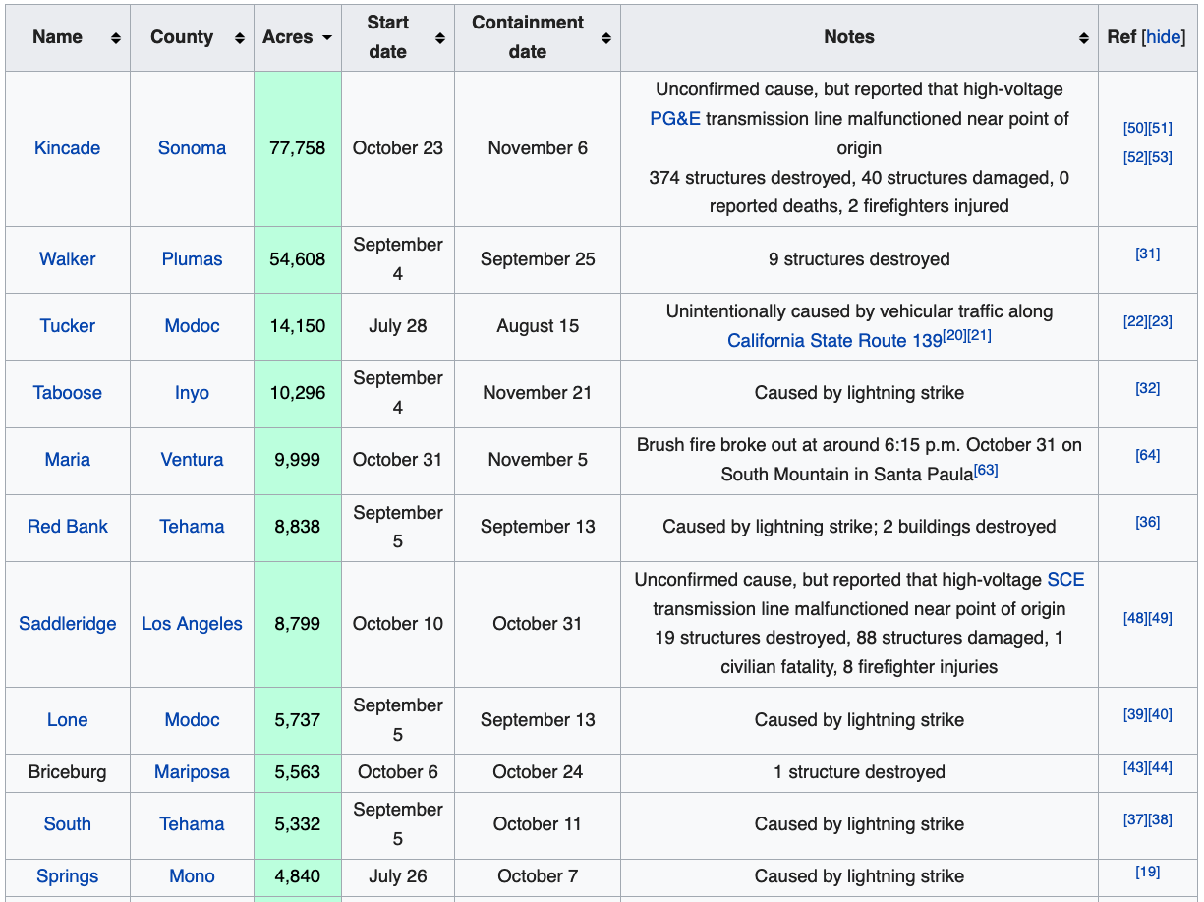
Notes: California Wildfires 2019

Slide 65
Kincaid Fire, 2019
The Kincade Fire was a wildfire that burned in Sonoma County, California in the United States.
The fire started northeast of Geyserville in The Geysers on 9:24 p.m. on October 23, 2019 and subsequently burned 77,758 acres (31,468 ha) until the fire was fully contained on November 6, 2019.
The fire threatened over 90,000 structures and caused widespread evacuations throughout Sonoma County, including the communities of Geyserville, Healdsburg, and Windsor.
The majority of Sonoma County and parts of Lake County were under evacuation warnings.
The fire was the largest of the 2019 California wildfire season, and also the largest wildfire ever to occur in Sonoma County.
Eighty thousand more structures were threatened by the fire, and PG&E said it had cut off power to more than a million customers

Slide 66
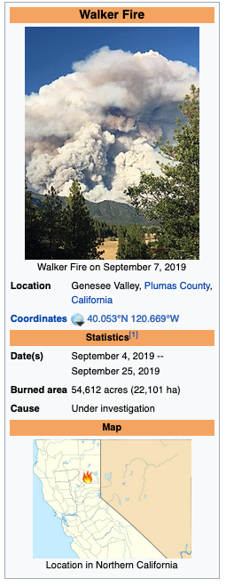
Walker Fire, 2019
The Walker Fire was a wildfire that burned the Genesee Valley in the Plumas National Forest approximately 11 miles east of the community of Taylorsville in Plumas County, California.
The blaze was reported on Wednesday, September 4, 2019 and immediately expanded in size over its several days of burning.
The fire actively threatened homes from Genesee Valley to Antelope Road.
As of September 14, the Walker Fire burned 54,612 acres (22,101 ha) and was 97 percent contained.

Slide 67
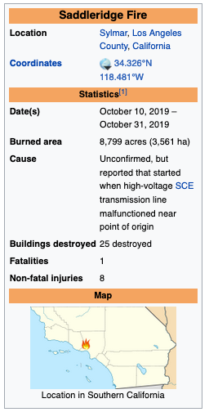
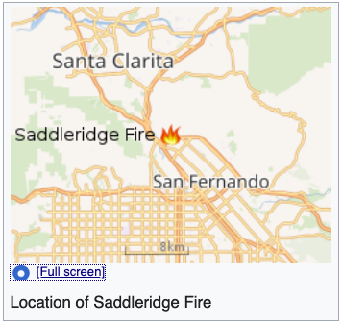
Saddleridge Fire 2019
The Saddleridge Fire was a wildfire burning near the San Fernando Valley of Los Angeles County, California. It broke out roughly around 9:02pm on Thursday October 10, 2019.
It is still undetermined as to how it had started, but believed that the blaze had started beneath a high voltage transmission tower..
The Saddleridge Fire had at least 1 civilian fatality, 8 First Responder injuries, 88 structures damaged, and 19 structures destroyed.

Slide 68
Other US Wildfires

Slide 69
Beaver Creek Fire http://en.wikipedia.org/wiki/2013_Beaver_Creek_Fire
“The Beaver Creek Fire is a forest fire that began on August 7, 2013 after a lightning strike in an area twelve miles northeast of Fairfield, Idaho and northwest of Hailey, Idaho in Sawtooth National Park.
The fire burned through sage trees, pine trees, sagebrush, timber in the understory, grass, and various riparian areas.
The fire coated the resort areas of Hailey and Ketchum, Idaho known as the “Sun Valley” in a layer of thick soot and ash.
By the time the fire was fully contained on August 31, 114,900 acres of the Ketchum Ranger District of Sawtooth National Forest has been burned.
Of the 114,900 acres burned, 57,000 acres were moderately damaged and 9,500 acres were severely damaged.”

Slide 70
Beaver Creek Fire http://en.wikipedia.org/wiki/2013_Beaver_Creek_Fire
“The Beaver Creek Fire was a large fire, larger than the past fires in the same area.
Large fires that burn many acres usually occur in hot, dry temperatures where there is intense build-up of vegetation.
In the beginning of the Beaver Creek Fire, the conditions in the area were dry, windy, low humidity, and a fairly hot temperature, which causes more active fires.
Along with these factors and the fact that the area of the Beaver Creek Fire is a disturbance dependent ecosystem that was in its season where natural fires usually occurred caused the Beaver Creek Fire to grow to be the large, mainly surface fire it became.
With the combination of weather, fuel, and topography that the Beaver Creek Fire took place in, it was hard to stop.
Not until humidity increased, some rainstorms began to take place, and cloud cover appeared in the area was the Beaver Creek Fire able to be drastically slowed and contained.”

Slide 71
Yarnell Hill, AZ Fire http://en.wikipedia.org/wiki/Yarnell_Hill_Fire
“The Yarnell Hill Fire was a wildfire near Yarnell, Arizona, ignited by lightning on June 28, 2013.
On June 30, it overran and killed 19 firefighters with the Prescott Fire Department's interagency Granite Mountain Hotshots.
The wildfire was fully contained by July 10, 2013.
This event resulted in the highest wildland firefighter death toll in the United States since the 1933 Griffith Park Fire killed 29 firefighters, and the highest death toll from any U.S. wildfire since the 1991 East Bay Hills fire killed 25 people.
It is the sixth deadliest American firefighter disaster overall and the deadliest wildfire ever in Arizona.”

Slide 72
Wildfire Case Studies: Australia

Slide 73
Bushfires in Victoria, Australia, 2000’s http://en.wikipedia.org/wiki/Black_Saturday_bushfires
Major bushfires in Victoria in the 2000s, showing the Black Saturday fires in red

Slide 74
Black Saturday, Australia, 2009 http://en.wikipedia.org/wiki/Black_Saturday_bushfires
“The Black Saturday bushfires were a series of bushfires that ignited or were burning across the Australian state of Victoria on and around Saturday, 7 February 2009.
The fires occurred during extreme bushfire-weather conditions and resulted in Australia's highest ever loss of life from a bushfire
173 people died and 414 were injured as a result of the fires.
As many as 400 individual fires were recorded on 7 February.
Following the events of 7 February 2009 and its aftermath, that day has become widely referred to as Black Saturday.”

Slide 75
Temperatures in Australia, 2009 http://earthobservatory.nasa.gov/IOTD/view.php?id=36900
“This map of Australia shows how the land surface temperature from January 25 to February 1 compared to the average mid-summer temperatures the continent experienced between 2000-2008.
Places where temperatures were warmer than average are red, places experiencing near-normal temperatures are white, and places where temperatures were cooler than average are blue.
The data were collected by the Moderate Resolution Imaging Spectroradiometer (MODIS) on NASA’s Terra satellite.
While southern Australia was scorching, a similarly large area of northern and central Australia was several degrees cooler than it was in the previous nine years.
The cool anomaly across that region is probably linked to the above-average rainfall the area has received during that year’s wet season.”
MODIS image from February 10, 2009

Slide 76
Temperatures in Australia, 2009 http://earthobservatory.nasa.gov/IOTD/view.php?id=36900
“The Australian Bureau of Meteorology (BOM) called this heat wave “exceptional,” not only for the high temperatures but for their duration.
One-day records were broken in multiple cities, with temperatures in the mid-40s.
In Kyancutta, South Australia, the temperature reached 48.2 degrees Celsius (118.8 degrees Fahrenheit).
Many places also set records for the number of consecutive days with record-breaking heat.
Nighttime temperatures broke records, too.
In their special statement on the heat wave, the BOM wrote, ‘On the morning of 29 January, an exceptional event also occurred in the northern suburbs of Adelaide around 3 a.m., when strong north-westerly winds mixed hot air aloft to the surface.’
‘At RAAF Edinburgh [a regional airport], the temperature rose to 41.7°C at 3:04 a.m. Such an event appears to be without known precedent in southern Australia.’”
MODIS image from February 10, 2009

Slide 77
Temperatures in Australia, 2014 http://earthobservatory.nasa.gov/NaturalHazards/view.php?id=82790&src=nhrss
2013 turned out to be Australia’s hottest year on record.
Fittingly, the year both started and ended with intense heatwaves.
The most recent heatwave peaked between December 27, 2013, and January 4, 2014.
Between January 1 and 4, 8.8 percent of Australia experienced record-breaking temperatures.
The final day included in the image, January 3, was the hottest day of the heatwave for most places, with 10.2 percent of Queensland and 14.6 percent of New South Wales setting new heat records.
The highest air temperature recorded during the week was in Moomba, Queensland, which reached 49.3 degrees Celsius (120.7 degrees Fahrenheit) on January 2.
Temperatures reached 48 degrees Celsius (118 Fahrenheit) or higher at 12 locations throughout Australia during the heatwave
The hot temperatures baked the earth, raising the land surface temperatures monitored by MODIS indicating that temperatures were significantly higher than average between December 27, 2013 and January 3, 2014, especially in Queensland and New South Wales.
These temperatures reflect how warm the ground would be to the touch, a measurement related to but not the same as more standard air temperatures.

Slide 78
Canberra Bushfires, January 8-21, 2003 http://en.wikipedia.org/wiki/Wildfire
“The Canberra bushfires of 2003 involved several deaths, over 490 injured, and caused severe damage to the outskirts of Canberra, the Australian capital city, during 18–22 January 2003.
Almost 70% of the Australian Capital Territory (ACT) pastures, forests (pine plantations) and nature parks were severely damaged, and most of the renowned Mount Stromlo Observatory was destroyed.
After burning for a week around the edges of the ACT, the fires entered the suburbs of Canberra on 18 January 2003.
Over the next ten hours, four people died and more than 500 homes were destroyed or severely damaged, requiring a significant relief and reconstruction effort.”

Slide 79
Damage by the Canberra Bushfires http://en.wikipedia.org/wiki/2003_Canberra_bushfires

Slide 80
Bushfires Near Darwin, Australia August 5, 2013 http://earthobservatory.nasa.gov/NaturalHazards/view.php?id=81847&src=nhrss
“Astronaut Karen Nyberg shot this photograph on August 5, 2013, while looking west across the Timor Sea from the International Space Station (ISS). (North is to the right in the image.)
Note how the smoke near Darwin is blown by southeasterly winds (pushing it to the northwest), while the winds over Melville Island are mostly blowing to the southwest (influenced by the interaction of land and sea breezes and other local effects).
According to Australian fire researcher Peter Jacklyn, many of the fires on Melville Island were likely prescribed burns, designed to clear brush and dry fuel to prevent more serious wildfire as the weather warms.
The fires near Darwin, however, were probably wildfires, given that most prescribed burning in the area is usually done earlier in the year.”

Slide 81
Sydney Bushfires, October 2013 http://earthobservatory.nasa.gov/IOTD/view.php?id=82189&eocn=home&eoci=iotd_image
“October 17, 2013, will go down as one of the worst fire days New South Wales has seen in recent years.
By 6:30 p.m. local time, 90 wildfires burned, 36 of them out of control and threatening communities near Sydney, Australia.
Dry vegetation, high temperatures (above 34° Celsius or 93° Fahrenheit), and erratic winds gusting to 90 kilometers (56 miles) per hour combined to create extremely dangerous fire conditions.
Fires are outlined in red
To the east, smoke pollution was a problem in populated coastal communities.
The densest plume hangs directly over Sydney, though the brighter white streak is probably a cloud.
The largest fire shown here is the State Mine fire, burning in the Blue Mountains near the Lithgow area.
The fire has burned more than 20,000 hectares and damaged an unknown number of properties, according to the New South Wales Rural Fire Service. “
“The Moderate Resolution Imaging Spectroradiometer (MODIS) on NASA’s Aqua satellite acquired this image at 2:50 p.m. (3:50 UT) on October 17, 2013”

Slide 82
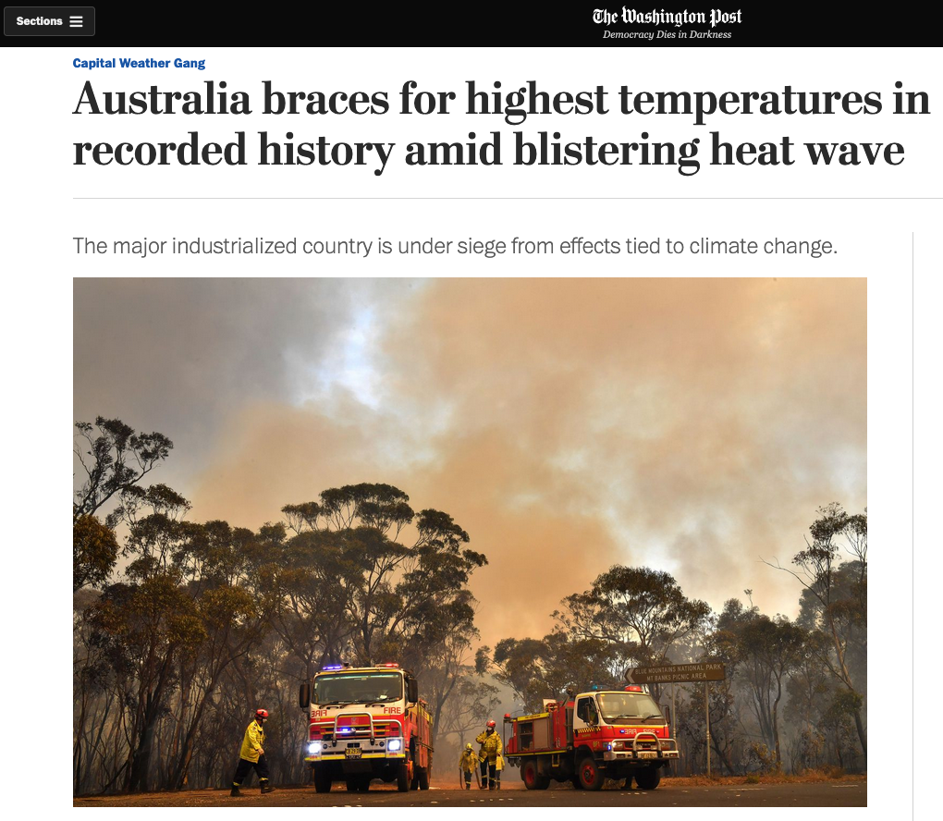
December 17, 2019

Slide 83
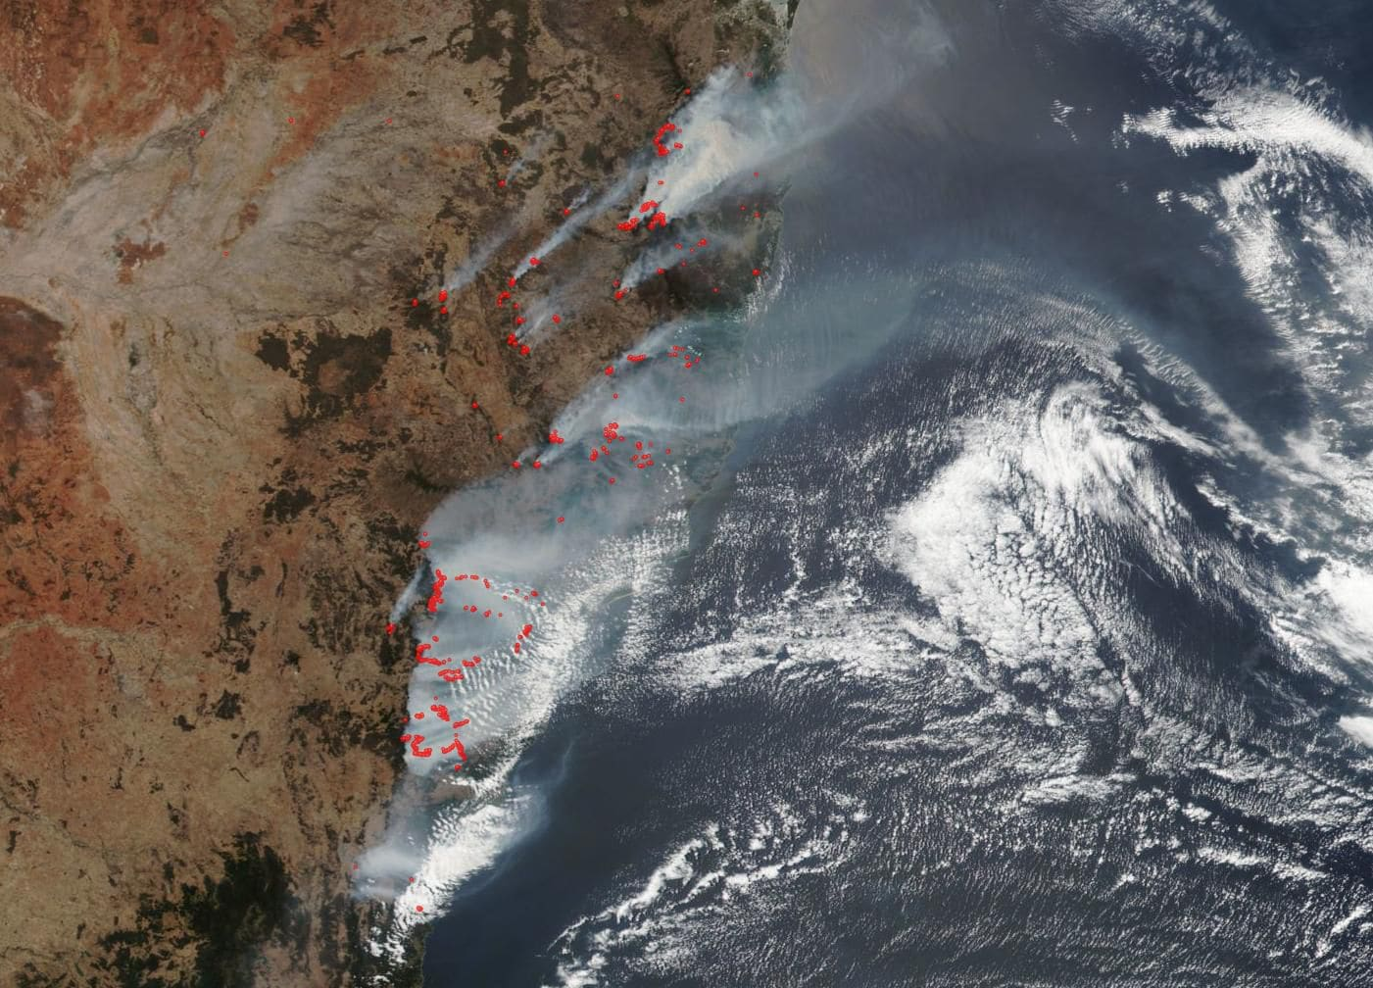
https://www.washingtonpost.com/weather/2019/12/17/australia-braces-highest-temperatures-recorded-history-amid-blistering-heat-wave/
December 17, 2019

Slide 84
http://www.bom.gov.au/climate/change/#tabs=Tracker&tracker=timeseries

Slide 85
http://www.bom.gov.au/climate/change/#tabs=Tracker&tracker=timeseries

Slide 86
http://www.bom.gov.au/climate/change/#tabs=Tracker&tracker=timeseries

Slide 87
http://www.bom.gov.au/climate/change/#tabs=Tracker&tracker=timeseries

Slide 89
Physics of Wildfires http://en.wikipedia.org/wiki/Wildfire
“Wildfires occur when all of the necessary elements of a fire triangle come together in a susceptible area
An ignition source is brought into contact with a combustible material such as vegetation, that is subjected to sufficient heat and has an adequate supply of oxygen from the ambient air.
A high moisture content usually prevents ignition and slows propagation, because higher temperatures are required to evaporate any water within the material and heat the material to its fire point.
Dense forests usually provide more shade, resulting in lower ambient temperatures and greater humidity, and are therefore less susceptible to wildfires.
Less dense material such as grasses and leaves are easier to ignite because they contain less water than denser material such as branches and trunks.
Plants continuously lose water by evapotranspiration, but water loss is usually balanced by water absorbed from the soil, humidity, or rain.
When this balance is not maintained, plants dry out and are therefore more flammable, often a consequence of droughts.”

Slide 90
Physics of Wildfires http://en.wikipedia.org/wiki/Wildfire
“A wildfire front is the portion sustaining continuous flaming combustion, where unburned material meets active flames, or the smoldering transition between unburned and burned material.
As the front approaches, the fire heats both the surrounding air and woody material through convection and thermal radiation.
First, wood is dried as water is vaporized at a temperature of 100 °C (212 °F). Next, the pyrolysis of wood at 230 °C (450 °F) releases flammable gases.
Finally, wood can smoulder at 380 °C (720 °F) or, when heated sufficiently, ignite at 590 °C (1,000 °F).
Even before the flames of a wildfire arrive at a particular location, heat transfer from the wildfire front warms the air to 800 °C (1,470 °F), which pre-heats and dries flammable materials, causing materials to ignite faster and allowing the fire to spread faster.
High-temperature and long-duration surface wildfires may encourage flashover or torching: the drying of tree canopies and their subsequent ignition from below.
Wildfires have a rapid forward rate of spread (FROS) when burning through dense, uninterrupted fuels.
They can move as fast as 10.8 kilometres per hour (6.7 mph) in forests and 22 kilometres per hour (14 mph) in grasslands. “

Slide 91
Physics of Wildfires http://en.wikipedia.org/wiki/Wildfire
“Wildfires can advance tangential to the main front to form a flanking front, or burn in the opposite direction of the main front by backing.
They may also spread by jumping or spotting as winds and vertical convection columns carry firebrands (hot wood embers) and other burning materials through the air over roads, rivers, and other barriers that may otherwise act as firebreaks.
Torching and fires in tree canopies encourage spotting, and dry ground fuels that surround a wildfire are especially vulnerable to ignition from firebrands.
Spotting can create spot fires as hot embers and firebrands ignite fuels downwind from the fire.
In Australian bushfires, spot fires are known to occur as far as 20 kilometres (12 mi) from the fire front.
Especially large wildfires may affect air currents in their immediate vicinities by the stack effect: air rises as it is heated, and large wildfires create powerful updrafts that will draw in new, cooler air from surrounding areas in thermal columns.
Great vertical differences in temperature and humidity encourage pyrocumulus clouds, strong winds, and fire whirls with the force of tornadoes at speeds of more than 80 kilometres per hour (50 mph).
Rapid rates of spread, prolific crowning or spotting, the presence of fire whirls, and strong convection columns signify extreme conditions.”

Slide 92
Wildfire Policy in the US http://en.wikipedia.org/wiki/Wildfire
“Since the turn of the 20th century, various federal and state agencies have been involved in wildland fire management in one form or another.
In the early 20th century, for example, the federal government, through the U.S. Army and the U.S. Forest Service, solicited fire suppression as a primary goal of managing the nation’s forests.
At this time in history fire was viewed as a threat to timber, an economically important natural resource.
For example, the Forest Fire Emergency Fund Act of 1908 permitted deficit spending in the case of emergency fire situations.
Following the same tone of timber resource protection, the U.S. Forest Service adopted the “10 AM Policy” in 1935.
Through this policy the agency advocated the control of all fires by 10 o’clock of the morning following the discovery of a wildfire.
Fire prevention was also heavily advocated through public education campaigns such as Smokey the Bear.
Through these and similar public education campaigns the general public was, in a sense, trained to perceive all wildfire as a threat to civilized society and natural resources.

Slide 93
Wildfire Policy in the US http://en.wikipedia.org/wiki/Wildfire
“Beginning in the 1970s public perception of wildland fire management began to shift.
Despite substantial funding for fire suppression in the first half of the 20th century, massive wildfires continued to be prevalent across the landscape of North America.
Natural resource professionals and ordinary citizens alike became curious about the ecological effects of wildfire.
Ecologists were beginning to recognize the presence and ecological importance of natural lightning-ignited wildfires across the United States.
Along with this new discovery of fire knowledge and the emergence of fire ecology as a science came an effort to apply fire to land in a controlled manner.
It was learned that suppression of fire in certain ecosystems actually increases the likelihood that a wildfire will occur and increases the intensity of those wildfires.
This was in fact happening across the United States. However, suppression is still the main tactic when a fire is set by a human or if it threatens life or property.
By the 1980s funding efforts began to support prescribed burning.
In light of emerging information about wildland fire, rational thought justified funding prescribed burning in order to prevent catastrophic wildfire events.”

Slide 94
Economics and Fire Management http://en.wikipedia.org/wiki/Wildfire
“In economic terms, expenditures used for wildfire suppression in the early 20th century have contributed to increased suppression costs which are being realized today.
As is the case with many public policy issues, costs and benefits associated with particular fire management tools are difficult to accurately quantify.
Ultimately, costs and benefits should be weighed against one another on a case-by-case basis in planning wildland fire management operations.
Depending on the tradeoffs that a land manager is willing to make, a combination of the following fire management tools could be used.
For instance, prescribed fire and/or mechanical fuels reduction could be used to help prevent or lessen the intensity of a wildfire thereby reducing or eliminating suppression costs.
In addition, prescribed fire and/or mechanical fuels reduction could be used to improve soil conditions in fields or in forests to the benefit of wildlife or natural resources.
On the other hand, the use of prescribed fire requires much advanced planning and can have negative impacts on human health in nearby communities.”

Slide 95
Wildfire Detection http://en.wikipedia.org/wiki/Wildfire
“Fast and effective detection is a key factor in wildfire fighting.
Early detection efforts were focused on early response, accurate results in both daytime and nighttime, and the ability to prioritize fire danger.
Fire lookout towers were used in the United States in the early 20th century and fires were reported using telephones, carrier pigeons, and heliographs.
Aerial and land photography using instant cameras were used in the 1950s until infrared scanning was developed for fire detection in the 1960s.
However, information analysis and delivery was often delayed by limitations in communication technology.
During the Yellowstone fires of 1988, a data station was established in West Yellowstone, permitting the delivery of satellite-based fire information in approximately four hours.[162]
Currently, public hotlines, fire lookouts in towers, and ground and aerial patrols can be used as a means of early detection of forest fires. “
Dry Mountain Fire Lookout in the Ochoco National Forest, Oregon, circa 1930

Slide 96
Wildfire Safety http://en.wikipedia.org/wiki/Wildfire
“Wildland fire fighters face several life-threatening hazards including heat stress, fatigue, smoke and dust, as well as the risk of other injuries such as burns, cuts and scrapes, and animal bites.
Heat stress can progress into heat strain, which entails physiological changes such as increased heart rate and core body temperature.
Various factors can contribute to the risks posed by heat stress, including strenuous work, personal risk factors such as age and fitness, dehydration, sleep deprivation, and burdensome personal protective equipment.
Smoke, ash, and debris can also pose serious respiratory hazards to wildland fire fighters.
The smoke and dust from wildfires can contain gases such as carbon monoxide, sulfur dioxide and formaldehyde, as well as particulates such as ash and silica. “
To reduce smoke exposure, wildfire fighting crews should, whenever possible, rotate firefighters through areas of heavy smoke, avoid downwind firefighting, use equipment rather than people in holding areas, and minimize mop-up.
Camps and command posts should also be located upwind of wildfires.
Protective clothing and equipment can also help minimize exposure to smoke and ash.

Slide 97
Regional Wildfire Burdens in the US http://en.wikipedia.org/wiki/Wildfire
“Nationally, the burden of wildfires is disproportionally heavily distributed in the southern and western regions.
The Geographic Area Coordinating Group (GACG)[204] divides the United States and Alaska into 11 geographic areas for the purpose of emergency incident management.
A national assessment of wildfire risk in the United States based on GACG identified regions (with the slight modification of combining Southern and Northern California, and the West and East Basin)
California (50.22% risk) and the Southern Area (15.53% risk) are the geographic areas with the highest wildfire risk.
The western areas of the nation are experiencing an expansion of human development into and beyond what is called the wildland-urban interface (WUI).
When wildfires inevitably occur in these fire-prone areas, often communities are threatened due to their proximity to fire-prone forest.
The south is one of the fastest growing regions with 88 million acres classified as WUI.
The south consistently has the highest number of wildfires per year.
More than 50, 000 communities are estimated to be at high to very high risk of wildfire damage. These statistics are greatly attributable to the South’s year-round fire season.”

Slide 98
Risks to Human Health http://en.wikipedia.org/wiki/Wildfire
“The most noticeable adverse effect of wildfires is the destruction of property and biomass.
However, the release of hazardous chemicals from the burning of wildland fuels significantly impacts health in humans.
Wildfire smoke is composed primarily of carbon dioxide and water vapor.
Other common smoke components present in lower concentrations are carbon monoxide, formaldehyde, acrolein, polyaromatic hydrocarbons, and benzene.[208]
Small particulates suspended in air which come in solid form or in liquid droplets are also present in smoke. 80 -90% of wildfire smoke, by mass, is within the fine particle size class of 2.5 micrometers in diameter or smaller.
Despite carbon dioxides high concentration in smoke, it poses low health risk due to its low toxicity.
Carbon monoxide and fine particulate matter, particularly 2.5 µm in diameter and smaller, have been identified as the major health threats.
Other chemicals are considered to be significant hazards but are found in concentrations that are too low to cause detectable health effects.”

Slide 99
Risks to Human Health http://en.wikipedia.org/wiki/Wildfire
“The degree of wildfire smoke exposure to an individual is dependent on the length, severity, duration, and proximity of the fire. People are exposed directly to smoke via the respiratory tract though inhalation of air pollutants. Indirectly, communities are exposed to wildfire debris that can contaminate soil and water supplies.
Firefighters are at the greatest risk for acute and chronic health effects resulting from wildfire smoke exposure.
Residents in communities surrounding wildfires are exposed to lower concentrations of chemicals, but they are at a greater risk for indirect exposure through water or soil contamination.
Exposure to residents is greatly dependent on individual susceptibility. Vulnerable persons such as children (ages 0–4), the elderly (ages 65 and older), smokers, and pregnant women are at an increased risk due to already compromised body systems, even when the exposures are present at low chemical concentrations and for relatively short exposure periods.
The U.S Environmental Protection Agency (EPA) developed the Air Quality Index (AQI), a public resource that provides national air quality standard concentrations for common air pollutants based on visibility range.”

Slide 100
Economics and Fire Management http://en.wikipedia.org/wiki/Wildfire
“Similar to that of military operations, fire management is often very expensive in the U.S.
Today, it is not uncommon for suppression operations for a single wildfire to exceed costs of $1 million in just a few days.
The United States Department of Agriculture allotted $2.2 billion for wildfire management in 2012.
Although fire suppression offers many benefits to society, other options for fire management exist.
While these options cannot completely replace fire suppression as a fire management tool, other options can play an important role in overall fire management and can therefore affect the costs of fire suppression.
The application of fire management tools requires making certain tradeoffs.
Below is a sample of some costs and benefits associated with the tools currently used in fire management.
Current approaches to fire management are an almost complete turnaround compared to historic approaches.
In fact, it is commonly accepted that past fire suppression, along with other factors, has resulted in larger, more intense wildfire events which are seen today.”

Slide 101
Atmospheric Effects http://en.wikipedia.org/wiki/Wildfire
“Most of the Earth's weather and air pollution resides in the troposphere, the part of the atmosphere that extends from the surface of the planet to a height of about 10 kilometers (6 mi).
The vertical lift of a severe thunderstorm or pyrocumulonimbus can be enhanced in the area of a large wildfire, which can propel smoke, soot, and other particulate matter as high as the lower stratosphere.
Previously, prevailing scientific theory held that most particles in the stratosphere came from volcanoes, but smoke and other wildfire emissions have been detected from the lower stratosphere.[99]
Pyrocumulus clouds can reach 6,100 meters (20,000 ft) over wildfires. Increased fire byproducts in the stratosphere can increase ozone concentration beyond safe levels.
Satellite observation of smoke plumes from wildfires revealed that the plumes could be traced intact for distances exceeding 1,600 kilometers (1,000 mi).
Computer-aided models such as CALPUFF may help predict the size and direction of wildfire-generated smoke plumes by using atmospheric dispersion modeling.”

Slide 102
Beaver Creek Fire http://en.wikipedia.org/wiki/2013_Beaver_Creek_Fire
“The area where the Beaver Creek Fire took place has a history of fires.
The Castle Rock Fire took place in 2007 near this area and before that the 2001 Sage Fire.
The Beaver Creek Fire was easily the biggest of these three.
The Beaver Creek Fire is extremely similar to the Castle Rock Fire.
The Castle Rock Fire was started by lightning, exactly like the Beaver Creek Fire.
Both fires began around the same time. The Castle Rock Fire began August 16, and the Beaver Creek Fire began August 7.
Neither fire destroyed any structures or killed any people.
The Castle Rock fire differed from the Beaver Creek Fire in that the Castle Rock Fire only burnt 48,520 acres.
Despite this difference both fires affected their ecosystem in similar ways and will use similar recovery methods.
For a fire to cause as much damage as the Beaver Creek Fire, several factors play a part in the behavior of the fire. “

Slide 103
Analysis of the Canberra Bushfires http://en.wikipedia.org/wiki/2003_Canberra_bushfires
“The loss of life and damage to property, and the destruction of forests to the west of the city, caused not just economic loss but significant social impacts.
Many people were affected by depression, particularly those who had lost their homes in the fires.
The community questioned the lack of preparation for the fires and the total confusion at the time.
In the weeks after 18 January, the impact of the fires was studied in detail to determine how the damage had been done, and how to better work against such natural disasters in future.
The Cities Project compiled information on as many as 431 damaged properties, stratified into the groups of "destroyed", "heavy damage", "medium damage", "light damage", and "superficial damage".
This data was split by suburb to form a table which illustrated which areas had taken the most damage.
The data allowed them to conclude that the high levels of "destroyed" property (91%) indicated the high speed with which the fire had moved.
It was also concluded that once the establishments had caught fire, there was little chance of their being put out.
In addition, the study showed that it was not only the fire which caused damage, but also the fierce winds recorded on the day, which were strong enough to uproot some small trees. “

