Slide 1
Lecture 23d
Catastrophic Cyclones
John Rundle GEL/EPS 131
https://en.wikipedia.org/wiki/2020_Atlantic_hurricane_season

Slide 2
2020 Atlantic Hurricane Season https://en.wikipedia.org/wiki/2020_Atlantic_hurricane_season
The 2020 Atlantic hurricane season was the most active and the seventh costliest Atlantic hurricane season on record.
In addition, it was the fifth consecutive above average Atlantic hurricane season from 2016 onward.
The season featured a total of 31 (sub)tropical cyclones, all but one of which became a named storm.
Of the 30 named storms, 13 developed into hurricanes, and six further intensified into major hurricanes, with one, Hurricane Iota, attaining Category 5 strength on the Saffir–Simpson scale.
It was the second season to use the Greek letter storm naming system, the first being 2005.
Of the 30 named storms, 12 of them made landfall in the contiguous United States, breaking the record of nine set in 1916.
The season was also the fifth consecutive season in which at least one Category 5 hurricane formed.
uring the season, 27 tropical storms established a new record for the earliest formation by storm number. This season also featured a record 10 tropical cyclones that underwent rapid intensification, tying it with 1995.
This unprecedented activity was fueled by a La Niña that developed in the summer months of 2020.

Slide 3
Storm Tracks https://en.wikipedia.org/wiki/2020_Atlantic_hurricane_season

Slide 4
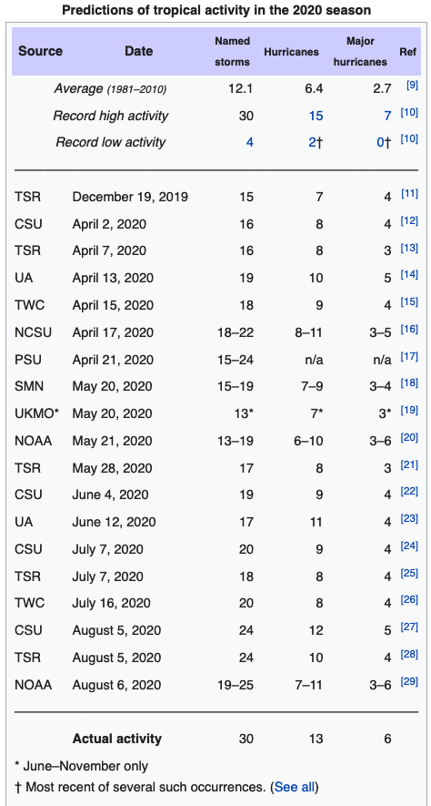
Preseason Predictions
Forecasts of hurricane activity are issued before each hurricane season by noted hurricane experts, such as Philip J. Klotzbach and his associates at Colorado State University, and separately by NOAA forecasters.
Klotzbach's team (formerly led by William M. Gray) defined the average (1981 to 2010) hurricane season as featuring 12.1 tropical storms, 6.4 hurricanes, 2.7 major hurricanes (storms reaching at least Category 3 strength in the Saffir–Simpson scale), and an accumulated cyclone energy (ACE) index of 106 units.
NOAA defines a season as above normal, near normal or below normal by a combination of the number of named storms, the number reaching hurricane strength, the number reaching major hurricane strength, and the ACE Index.

Slide 5
Seasonal Summary

Slide 6
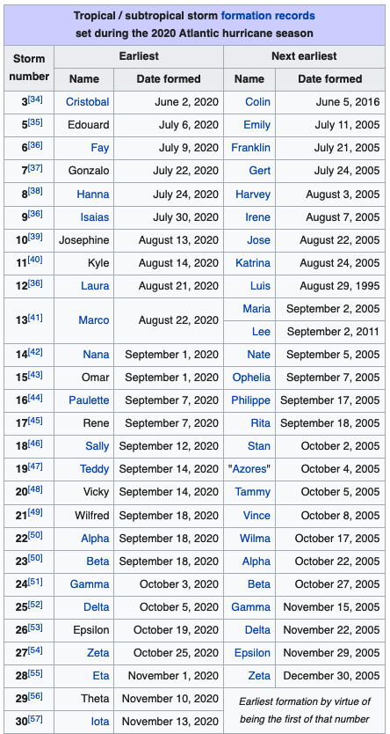
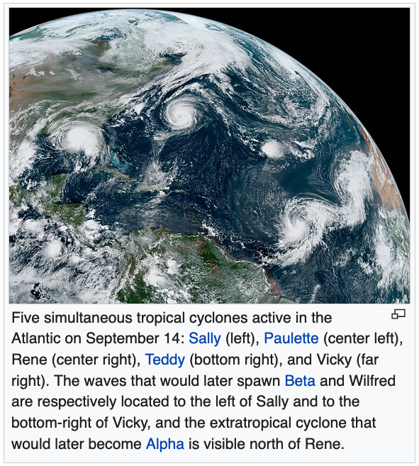
Activity

Slide 7
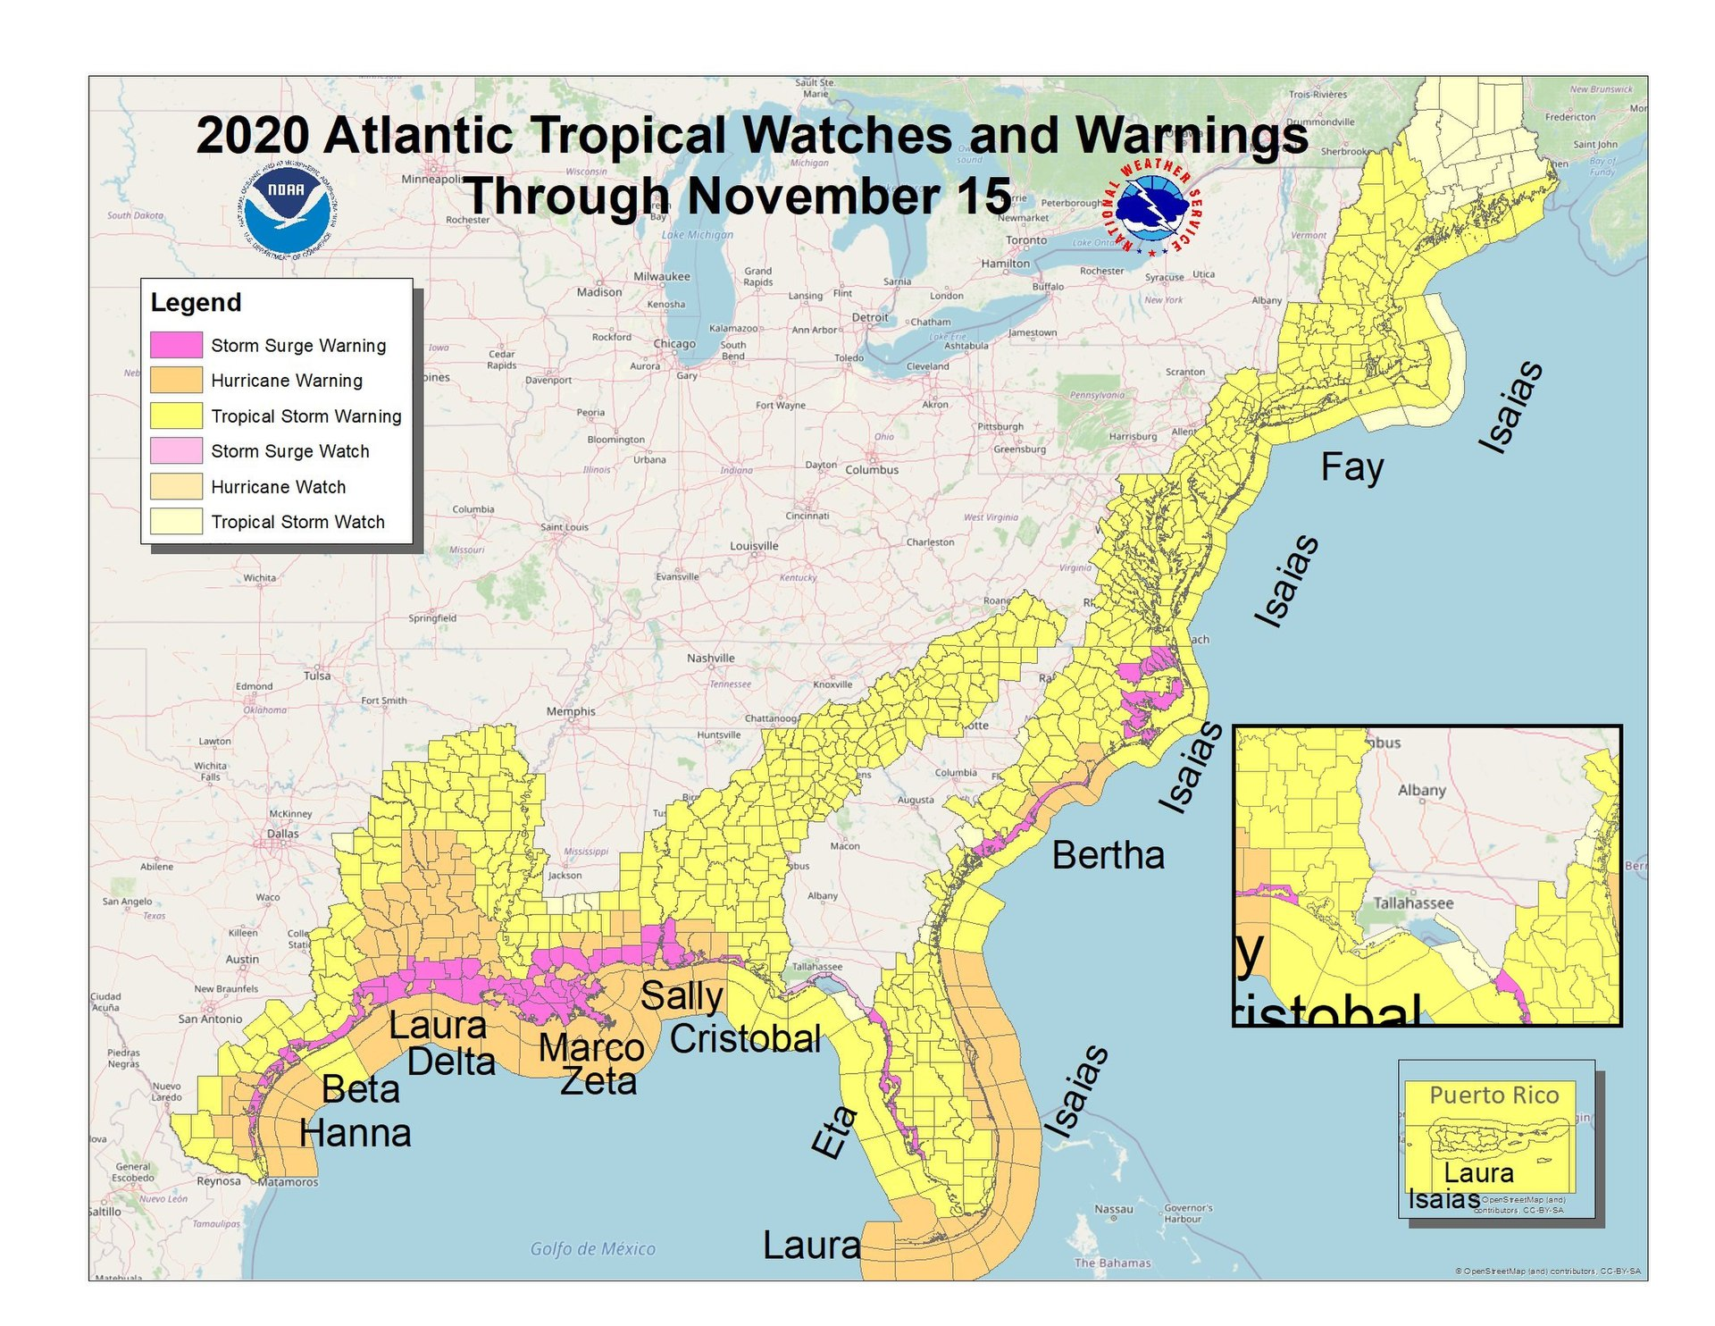

Slide 8
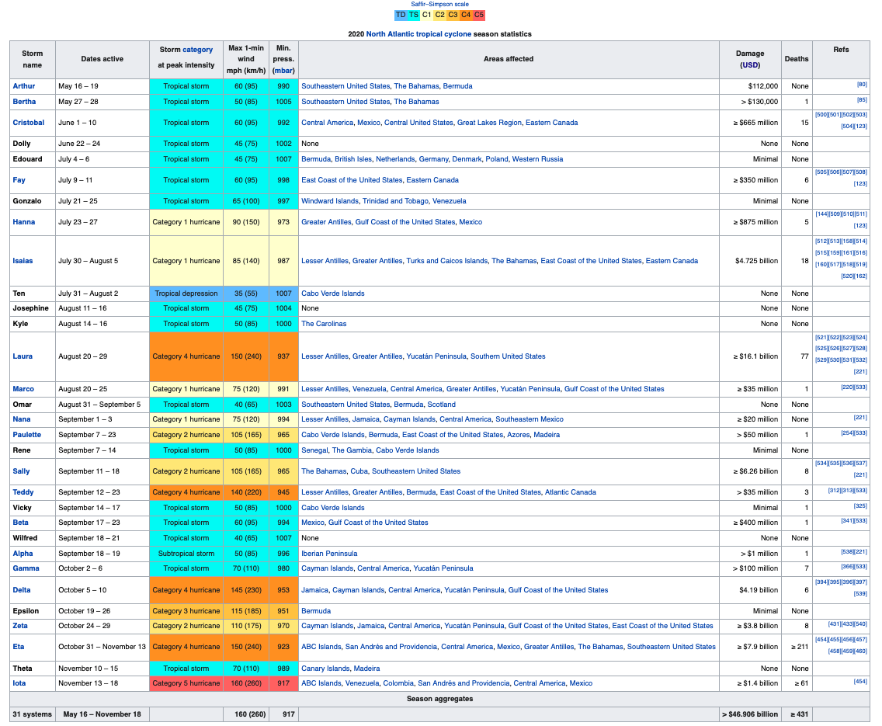
Summary

