Slide 1
Lecture 23a
Catastrophic Cyclones
John Rundle GEL/EPS 131

Slide 2
Ten Deadliest Tropical Cyclones http://en.wikipedia.org/wiki/List_of_natural_disasters_by_death_toll

Slide 3
Tropical Cyclone Records http://en.wikipedia.org/wiki/List_of_tropical_cyclone_records

Slide 4
US Hurricanes http://en.wikipedia.org/wiki/1900_Galveston_hurricane

Slide 5
US Landfalling Hurricanes http://en.wikipedia.org/wiki/Hurricane_Andrew

Slide 6
Galveston Hurricane, September 8, 1900 http://en.wikipedia.org/wiki/1900_Galveston_hurricane
“The Hurricane of 1900 made landfall on September 8, 1900, in the city of Galveston, Texas, in the United States.
It had estimated winds of 145 miles per hour (233 km/h) at landfall, making it a Category 4 storm on the Saffir–Simpson Hurricane Scale.
It was the deadliest hurricane in US history, and the second costliest hurricane in U.S. history based on the dollar's 2005 value (to compare costs with those of Hurricane Katrina and others).
The hurricane caused great loss of life with the estimated death toll between 6,000 and 12,000 individuals
The number most cited in official reports is 8,000, giving the storm the third-highest number of deaths or injuries of any Atlantic hurricane, after the Great Hurricane of 1780 and 1998's Hurricane Mitch.
The Galveston Hurricane of 1900 is the deadliest natural disaster ever to strike the United States.
By contrast, the second-deadliest storm to strike the United States, the 1928 Okeechobee hurricane, caused more than 2,500 deaths, and the deadliest storm of recent times, Hurricane Katrina, claimed the lives of approximately 1,800 people. ”

Slide 7
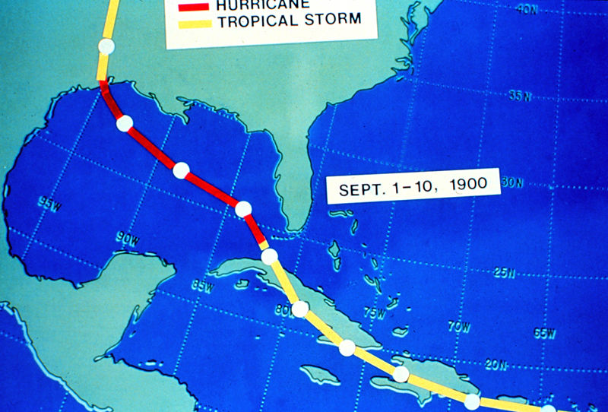
Galveston Hurricane, September 8, 1900 http://en.wikipedia.org/wiki/1900_Galveston_hurricane
“The 1900 storm, like many powerful Atlantic hurricanes, is believed to have begun as a Cape Verde-type hurricane—a tropical wave moving off the western coast of Africa.
The first formal sighting of the hurricane's precursor occurred on August 27, about 1,000 miles (1,600 km) east of the Windward Islands, when a ship recorded an area of "unsettled weather.”
The storm passed through the Leeward Islands on August 30, probably as a tropical depression as indicated by barometric pressure reports from Antigua.[4]
Three days later, Antigua reported a severe thunderstorm passing over, followed by the hot, humid calmness that often occurs after the passage of a tropical cyclone.
By September 1, U.S. Weather Bureau observers were reporting on a "storm of moderate intensity (not a hurricane)" southeast of Cuba.
Continuing westward, the storm made landfall on southwest Cuba on September 3, dropping heavy rains. On September 5, it emerged into the Florida Straits as a tropical storm or a weak hurricane.”
Storm Track

Slide 8
Galveston Hurricane, September 8, 1900 http://en.wikipedia.org/wiki/1900_Galveston_hurricane
“The storm was reported to be north of Key West on September 6, and in the early morning hours of Friday, September 7, the Weather Bureau office in New Orleans, Louisiana, issued a report of heavy damage along the Louisiana and Mississippi coasts.
Details of the storm were not widespread, damage to telegraph lines limited communication.[6]
The Weather Bureau's central office in Washington, D.C., ordered storm warnings raised from Pensacola, Florida, to Galveston.
By the afternoon of the 7th, large swells from the southeast were observed on the Gulf, and clouds at all altitudes began moving in from the northeast.
The Galveston Weather Bureau office raised its double square flags; a hurricane warning was in effect.
The ship Louisiana encountered the hurricane at 1 p.m. that day after departing New Orleans. Captain Halsey estimated wind speeds of 100 mph (160 km/h).
These winds correspond to a Category 2 hurricane in the modern-day Saffir–Simpson Hurricane Scale.
By early afternoon on Saturday, September 8, a steady northeasterly wind had picked up.
By 5 p.m., the Bureau office was recording sustained hurricane-force winds.
That night, the wind direction shifted to the east, and then to the southeast as the hurricane's eye began to pass over the island just west of the city.
On Sunday morning, clear skies and a 20 mph (30 km/h) breeze off the Gulf of Mexico greeted the Galveston survivors.”

Slide 9
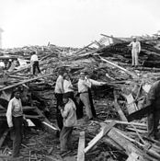
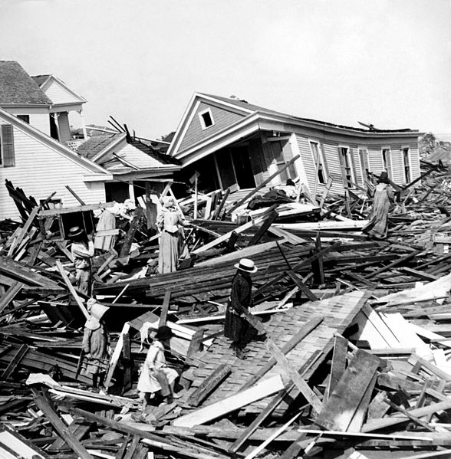
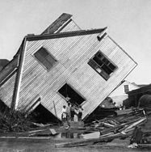
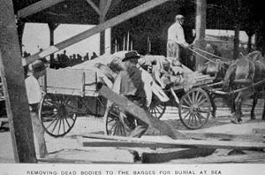
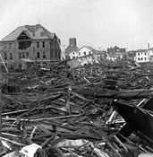
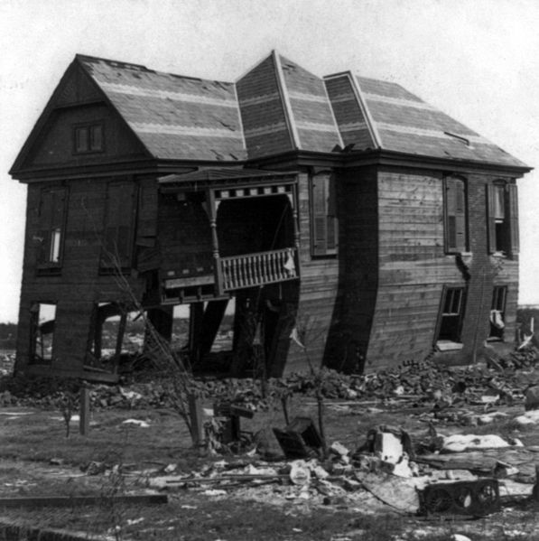
Impacts: Galveston Hurricane http://en.wikipedia.org/wiki/1900_Galveston_hurricane
Corpses were piled in wagons for burial at sea

Slide 10
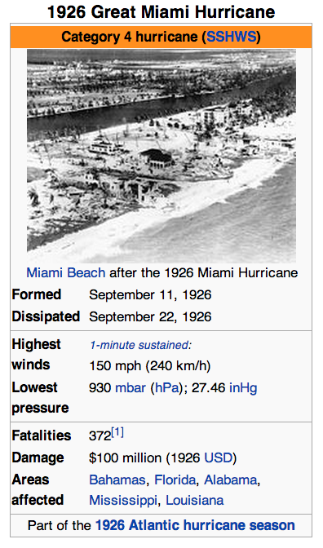
Miami, September 18, 1926 http://en.wikipedia.org/wiki/1926_Miami_hurricane
“The 1926 Miami hurricane (or Great Miami Hurricane) was a Category 4 hurricane that devastated Miami in September 1926.
The storm also particularly damaged Sanibel Island and the Florida Panhandle, the U.S. state of Alabama, and the Bahamas.
The storm's enormous regional economic impact helped end the Florida land boom of the 1920s and pushed the region on an early start into the Great Depression.
The Cape Verde-type hurricane formed on September 10 and later passed near St. Kitts on September 14.
By September 17 it was battering the Bahamas, impacting the Turks and Caicos Islands with winds estimated at 150 mph (240 km/h).
Then, in the early morning hours of September 18, it made landfall just south of Miami between Coral Gables and South Miami as a devastating Category 4 hurricane on the Saffir-Simpson Hurricane Scale.
The storm crossed the peninsula south of Lake Okeechobee, entered the Gulf of Mexico, and made another landfall near Mobile, Alabama as a Category 3 hurricane on September 20 before hooking westward along coastal Alabama and Mississippi, eventually dissipating on September 22 after moving inland over Louisiana.”

Slide 11
Impacts (Miami) http://en.wikipedia.org/wiki/1926_Miami_hurricane
“In Florida, winds on the ground were reported around 145 mph (233 km/h) and the pressure measured at 930 mbar (27.46 inHg) — though all such data is suspect.
Most of the coastal inhabitants had not evacuated, partly because of short warning (a hurricane warning was issued just a few hours before landfall) and partly because the "young" city's population knew little about the danger a major hurricane posed.
A 15-foot (4.6 m) storm surge inundated the area, causing massive property damage and some fatalities.
As the eye of the hurricane crossed over Miami Beach and downtown Miami, many people believed the storm had passed.
Some tried to leave the barrier islands, only to be swept off the bridges by the rear eyewall.
"The lull lasted 35 minutes, and during that time the streets of the city became crowded with people," wrote Richard Gray, the local weather chief. ”
As a result, many lives were lost during the second phase of the storm.”
Inland, Lake Okeechobee experienced a high storm surge that broke a portion of the dikes, flooding the town of Moore Haven and killing many.
This was just a prelude to the deadly 1928 Okeechobee Hurricane, which would cause a massive number of fatalities estimated at 2,500 around the lake.
According to the Red Cross there were 373 fatalities. Other estimates vary, since there were a large number of people listed as "missing". Between 25,000 and 50,000 people were left homeless, mostly in the Miami”
The damage from the storm was immense; few buildings in Miami or Miami Beach were left intact.
The Fulford–Miami Speedway in North Miami Beach was destroyed by the storm.
The toll for the storm was $100 million ($1.32 billion 2013 USD).
It is estimated that if an identical storm hit in the year 2005, with modern development and prices, the storm would have caused $140–157 billion in damage.
After the hurricane, the Great Depression started in South Florida, slowing recovery.
John J. Farrey was appointed chief building, plumbing and electrical inspector.
He initiated and enforced the first building code in the United States, which more than 5000 US cities duplicated.

Slide 12
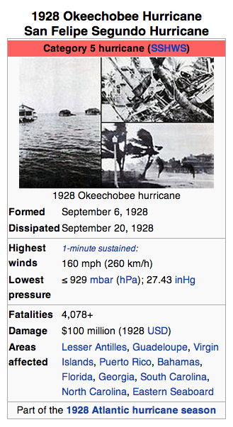
Okeechobee, FL, 1928 http://en.wikipedia.org/wiki/1928_Okeechobee_hurricane
“The Okeechobee hurricane, or San Felipe Segundo hurricane, was a deadly hurricane that struck the Leeward Islands, Puerto Rico, the Bahamas, and Florida in September of the 1928 Atlantic hurricane season.
As of 2010, it is the only recorded hurricane to strike Puerto Rico at Category 5 strength on the Saffir-Simpson Hurricane Scale, and one of the ten most intense ever recorded to make landfall in the United States.
The storm directly struck Puerto Rico at peak strength, killing at least 300 and leaving hundreds of thousands homeless.
In South Florida at least 2,500 were killed when a storm surge from Lake Okeechobee breached the dike surrounding the lake, flooding an area covering hundreds of square miles.
In total, the hurricane killed at least 4,078 people and caused around US$100 million ($1.36 billion 2013 USD) in damages over the course of its path.”

Slide 13
Bhola Cyclone http://en.wikipedia.org/wiki/1970_Bhola_cyclone
“The 1970 Bhola cyclone was a devastating tropical cyclone that struck East Pakistan (now Bangladesh) and India's West Bengal on November 12, 1970.
It remains the deadliest tropical cyclone ever recorded, and one of the deadliest natural disasters in modern times.[2]
Up to 500,000 people lost their lives in the storm, primarily as a result of the storm surge that flooded much of the low-lying islands of the Ganges Delta.
This cyclone was the sixth cyclonic storm of the 1970 North Indian Ocean cyclone season, and also the season's strongest, reaching a strength equivalent to a strong Category 3 hurricane.
The cyclone formed over the central Bay of Bengal on November 8 and traveled north, intensifying as it did so.
It reached its peak with winds of 185 km/h (115 mph) on November 11, and made landfall on the coast of East Pakistan (now Bangladesh) the following afternoon.
The storm surge devastated many of the offshore islands, wiping out villages and destroying crops throughout the region.
In the most severely affected upazila, Tazumuddin, over 45% of the population of 167,000 was killed by the storm.”

Slide 14
Bhola Cyclone http://en.wikipedia.org/wiki/1970_Bhola_cyclone
“The remnants of this Tropical Storm Nora from the south China sea contributed to the development of a new depression in the central Bay of Bengal on the morning of November 8.
The depression intensified as it moved slowly northward, and the India Meteorological Department upgraded it to a cyclonic storm the next day.
The storm became nearly stationary that evening near 14.5° N, 87° E, but began to accelerate to the north on November 10.
No country in the region had ever named tropical cyclones during this time.
The hurricane intensified into a severe cyclonic storm on November 11 and began to turn towards the northeast as it approached the head of the bay.
A clear eye formed in the storm, and it reached its peak later that day with sustained winds of 185 km/h (115 mph) and a central pressure of 966 hPa, equivalent to that of a Category 3 hurricane on the Saffir-Simpson Hurricane Scale.
The cyclone made landfall on the East Pakistan coastline during the evening of November 12, around the same time as the local high tide.”
This storm would also inspire ex-Beatle George Harrison and Bengali musician Ravi Shankar to organize The Concert for Bangladesh, the prototype benefit concert, to raise money for aid, in 1971.

Slide 15
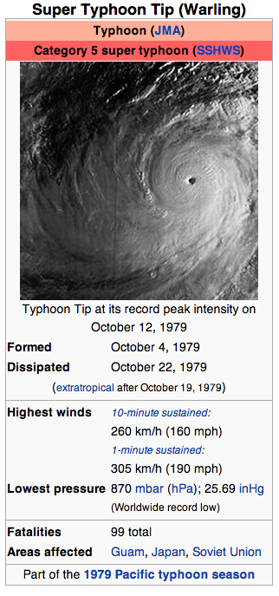
Super Typhoon Tip, August 1992 Largest Typhoon http://en.wikipedia.org/wiki/Typhoon_Tip
“Typhoon Tip (international designation: 7920, JTWC designation: 23W, PAGASA name: Warling) was the largest and most intense tropical cyclone ever recorded.
The nineteenth storm and twelfth typhoon of the 1979 Pacific typhoon season, Tip developed out of a disturbance in the monsoon trough on October 4 near Pohnpei.
Initially, a tropical storm to the northwest hindered the development and motion of Tip, though after it tracked farther north Tip was able to intensify.
After passing Guam, Tip rapidly intensified and reached peak winds of 305 km/h (190 mph) and a worldwide record-low sea-level pressure of 870 mbar (870.0 hPa; 25.69 inHg) on October 12.
At its peak strength, it was also the largest tropical cyclone on record with a wind diameter of 2,220 km (1,380 mi).
Tip slowly weakened as it continued west-northwestward and later turned to the northeast in response to an approaching trough.
The typhoon made landfall on southern Japan on October 19 and became an extratropical cyclone shortly thereafter.”

Slide 16
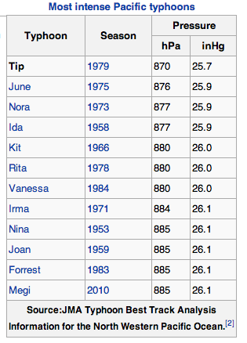
Typhoon Tip http://en.wikipedia.org/wiki/Typhoon_Tip
“U.S. Air Force aircraft flew 60 weather reconnaissance missions into the typhoon, making Tip one of the most closely observed tropical cyclones.
Rainfall from Tip indirectly led to a fire that killed 13 Marines and injured 68 at a United States Marine Corps training camp in the Kanagawa Prefecture of Japan.
Elsewhere in the country, the typhoon caused widespread flooding and 42 deaths; offshore shipwrecks left 44 people killed or missing.
Typhoon Tip was the largest tropical cyclone on record, with a diameter of 1,380 mi (2,220 km)
The temperature inside the eye of Typhoon Tip at peak intensity was 30 °C (86 °F) and described as exceptionally high.
With 10-minute sustained winds of 160 mph (260 km/h), Typhoon Tip is the strongest cyclone in the complete tropical cyclone listing by the Japan Meteorological Agency.
The typhoon was also the most intense tropical cyclone on record with a pressure of 870 mbar (870.0 hPa; 25.69 inHg), 6 mbar (6.0 hPa; 0.18 inHg) lower than the previous record set by Super Typhoon June in 1975.
The records set by Tip still stand, though with the end of routine reconnaissance aircraft in the western Pacific Ocean in August 1987, modern researchers questioned if Tip is the strongest on record. “

Slide 17
1953 Atlantic Hurricanes http://en.wikipedia.org/wiki/1953_Atlantic_hurricane_season
“The 1953 Atlantic hurricane season was the first time an organized list of female names was used to name Atlantic storms.
It officially began on June 15, and lasted until November 15, although activity occurred both before and after the season's limits.
It is one of only four seasons to have a pre-season storm and a post-season storm, the others being the 1887, 2003, and 2007 seasons.
The season was active with fourteen total storms, six of which developed into hurricanes; four of the hurricanes attained major hurricane status, or a Category 3 or greater on the Saffir-Simpson scale.
The strongest hurricane of the season was Carol, although by the time it struck Atlantic Canada it was much weaker.
Bermuda was threatened by three hurricanes within two weeks
The final named storm of the season, Hazel, produced additional rainfall in Florida after previous flooding conditions.
There were several unnamed storms, the last of which dissipated on December 9.”

Slide 18
Hurricane Carol http://en.wikipedia.org/wiki/1953_Atlantic_hurricane_season
“On August 28, a tropical wave developed into a tropical depression near Cape Verde.
After moving west-southwestward, it turned to the northwest, intensifying into a tropical storm on August 31 and into a hurricane on September 2.
Passing northeast of the Lesser Antilles, Carol rapidly intensified to reach peak winds of 150 mph (240 km/h) on September 3, making it the strongest hurricane of the season.
It gradually weakened, bypassing Bermuda on September 6 and producing high waves.
Carol later turned to the north-northeast, brushing Cape Cod and causing boating accidents across New England.
Four people were killed in the region.
Fishing losses totaled around $1 million (1953 USD, $8.73 million 2013 USD).
After bypassing New England, Carol brushed western Nova Scotia before moving ashore near Saint John, New Brunswick as a minimal hurricane.
As it moved ashore, it produced hurricane conditions in eastern Maine, one of only six Atlantic hurricanes to do so.”

Slide 19
Hurricane Dolly http://en.wikipedia.org/wiki/1953_Atlantic_hurricane_season
“The origins of Dolly were from a tropical wave that moved through the eastern Caribbean Sea, producing 10 in (250 mm) in Saint Thomas in the U.S. Virgin Islands.
On September 8, a tropical storm developed north of Puerto Rico, which moved slowly west-southwestward before turning to the north.
It quickly intensified, and after Hurricane Hunters reported an eye, Dolly reached hurricane status on September 9.
At that time, hurricane warnings were issued in the Bahamas, although the storm turned away from the archipelago.
It rapidly intensified to peak winds of 115 mph (185 km/h) on September 10, as reported by aircraft.
After continued weakening, Dolly passed over the island on September 11, producing only gale-force winds, rains, and little to no damage.
It deteriorated into a tropical storm on September 12 and transitioned into an extratropical cyclone later that day.
The remnants of Dolly later turned eastward, dissipating just west of Portugal on September 17.”
Dolly weakened as it accelerated northeastward, although it still threatened to strike Bermuda with strong winds.
As a result, the United States Air Force ordered all of the planes on the island to fly to the mainland.

Slide 20
Hurricane Edna http://en.wikipedia.org/wiki/1953_Atlantic_hurricane_season
“Shortly behind Dolly, another tropical wave spawned a tropical depression over the Lesser Antilles on September 14.
As it moved through the region, it produced unsettled conditions across the northeast Caribbean.
Dolly quickly intensified as it tracked northwestward, attaining hurricane status on September 15 and peak winds of 125 mph (205 km/h) the next day.
After peaking, the hurricane turned to the northeast and maintained most of its intensity for a few days.
It passed just north of Bermuda early on September 18 with winds of 115 mph (185 km/h), before beginning a steady weakening trend as it accelerated
Before Edna struck Bermuda, the islanders were well-prepared due to being previously impacted by hurricanes Carol and Dolly, and they boarded up their homes.
The hurricane caused "considerable damage", with wind gusts reaching 120 mph (190 km/h).
The winds downed trees, blocking roads, and also caused disruptions to the power and water services.
During its passage, Edna produced heavy rainfall and also damaged several roofs. There were three injuries on the island.”

Slide 21
Hurricane Carla http://en.wikipedia.org/wiki/Hurricane_Carla
“One of the first hurricanes to be captured on satellite imagery
Hurricane Carla ranks as the most intense U.S. tropical cyclone landfall on the Hurricane Severity Index.
The third named storm and first Category 5 hurricane of the 1961 Atlantic hurricane season, Carla developed from an area of squally weather in the southwestern Caribbean Sea on September 3.
Initially a tropical depression, it strengthened slowly while heading northwestward, and by September 5, the system was upgraded to Tropical Storm Carla.
About 24 hours later, Carla was upgraded to a hurricane. Shortly thereafter, the storm curved northward while approaching the Yucatán Channel. Late on September 7, Carla entered the Gulf of Mexico while passing just northeast of the Yucatán Peninsula.
By early on the following day, the storm became a major hurricane after reaching Category 3 intensity.
Resuming its northwestward course, Carla continued intensification and on September 11, it was upgraded to a Category 5 hurricane.
Later that day, Carla weakened slightly, but was still a large and intense hurricane when the storm made landfall near Port O'Connor, Texas.
It weakened quickly inland and was reduced to a tropical storm on September 12. Heading generally northward, Carla transitioned into an extratropical cyclone on September 13, while centered over southern Oklahoma.”

Slide 22
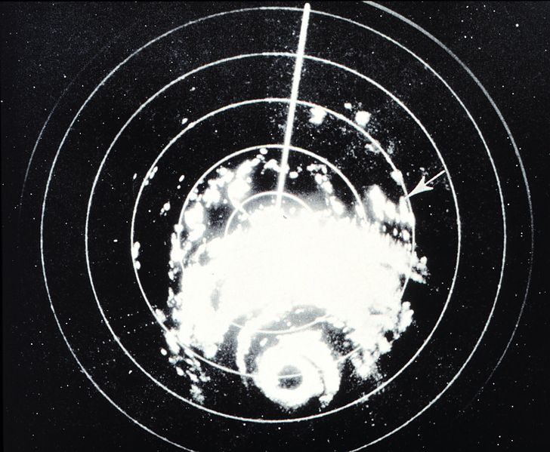
Hurricane Carla http://en.wikipedia.org/wiki/Hurricane_Carla
“Carla spawned the largest hurricane-related tornado outbreak on record at the time, when 26 tornadoes touched down within its circulation.
However, it was overwhelmingly surpassed by Hurricane Beulah in 1967, which spawned at least 115 tornadoes.
Throughout its path, 43 fatalities and about $325.74 million in damage were attributed to Carla.
Most of the impact occurred in Texas, where the storm made landfall as a large and strong Category 4 hurricane.
In Texas, wind gusts as high as 170 mph (280 km/h) were observed in Port Lavaca.
Additionally, several tornadoes spawned in the state caused notable impacts, with the most destructive twister resulting in 200 buildings severely damaged, of which at least 60 were destroyed, and 8 deaths and 55 injuries.”
Storm Track
Radar Image

Slide 23
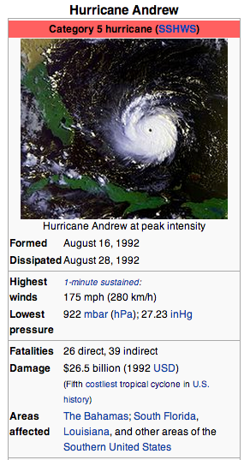
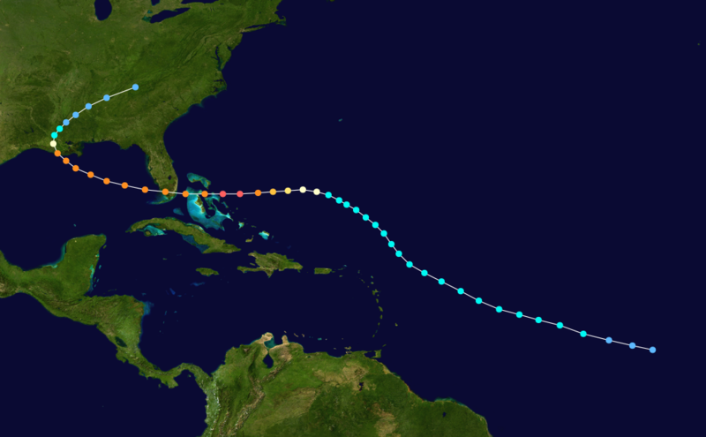
Hurricane Andrew http://en.wikipedia.org/wiki/Hurricane_Andrew
“Hurricane Andrew was, at the time of its occurrence in August 1992, the costliest hurricane in United States history, superceded now by Harvey and Irma (2017)
The fourth tropical cyclone and the first hurricane of the 1992 Atlantic hurricane season, Andrew originated from a tropical wave over the central Atlantic.
Initially, strong wind shear prevented much intensification, though increasingly favorable conditions allowed the system to become a tropical storm on August 17 and a minimal hurricane six days later.
After turning westward, Andrew entered a stage of rapid intensification, strengthening into a Category 5 hurricane near the Bahamas on August 23.
It briefly weakened to a Category 4 hurricane over the island nation, but regained Category 5 intensity on August 24 before making landfall on Elliott Key and later in Homestead.
Several hours later, the hurricane emerged into the Gulf of Mexico at Category 4 strength as it curved toward the Gulf Coast of the United States.
After weakening to a low-end Category 3 hurricane, Andrew moved ashore near Morgan City, Louisiana.
Interaction with land hastened the weakening process, and the Andrew was downgraded to a tropical depression by August 27 while crossing Mississippi.
The next day, the storm merged with a frontal system over the southern Appalachian Mountains.”

Slide 24
Hurricane Andrew http://en.wikipedia.org/wiki/Hurricane_Andrew
“In the Bahamas, Andrew brought high tides, hurricane force winds, and tornadoes, which caused considerable damage in the archipelago, especially on Cat Cays.
At least 800 houses were destroyed and there was substantial damage to the transport, communications, water, sanitation, agriculture, and fishing sectors.
Overall, Andrew caused four deaths and $250 million (1992 USD) in damage in the Bahamas.
Andrew led to the founding of several catastrophe modeling companies
Throughout the southern portions of Florida, Andrew brought very high winds; a wind gust of 177 mph (282 km/h) was reported at a house in Perrine.
Strong winds caused catastrophic damage in Florida, with Miami-Dade County cities of Florida City, Homestead, and Kendall receiving the brunt of the storm. “
About 63,000 homes were destroyed and over 101,000 others were damaged.
This left roughly 175,000 people homeless. As many as 1.4 million people were left without electricity at the height of the storm.
In the Everglades, 70,000 acres (280 km2) of trees were knocked down.
Additionally, rainfall in Florida was substantial, peaking at 13.98 in (355 mm) in western Miami-Dade County.
About $25 billion in damage and 44 fatalities were reported in Florida.

Slide 25
Hurricane Andrew http://en.wikipedia.org/wiki/Hurricane_Andrew
“Considerable damage to oil platforms was reported, with one company reporting 13 platforms lost, 104 structures damaged, and five drilling wells blown off course.
Total losses to oil companies reached approximately $500 million.
In Louisiana, Andrew produced hurricane force winds along its path, which left about 152,000 without electricity, downed 80% of trees in the Atchafalaya River Basin, and caused significant agricultural damage.
Also in the Atchafalaya River Basin and Bayou Lafourche, about 187 million freshwater fish were killed. An F3 tornado in St. John the Baptist Parish damaged or destroyed 163 structures.
Seventeen deaths were reported in Louisiana, six of which were drowning victims offshore.
With 23,000 homes damaged, and 985 homes and 1,951 mobile homes destroyed, property losses in the state exceeded $1.5 billion.
Elsewhere, the storm spawned at least 28 tornadoes, especially in Alabama, Georgia, and Mississippi.
Overall, Andrew caused 65 fatalities and $26 billion in damage, and it is currently the fifth costliest hurricane in Atlantic hurricane history, behind only Hurricanes Katrina and Wilma in 2005, Ike in 2008, and Sandy in 2012.
Other sources state that damage from Andrew reached as high as $32 billion.
Due to the destruction, the name was retired in the spring of 1993.”

Slide 26
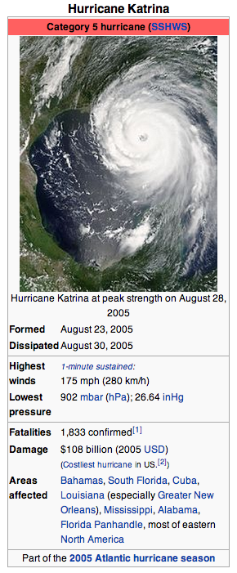
Hurricane Katrina http://en.wikipedia.org/wiki/Hurricane_Katrina
“Hurricane Katrina was the deadliest and most destructive Atlantic tropical cyclone of the 2005 Atlantic hurricane season.
It was the costliest natural disaster, as well as one of the five deadliest hurricanes, in the history of the United States (since superceded by Harvey, Maria and Irma)
Among recorded Atlantic hurricanes, it was the sixth strongest overall.
At least 1,833 people died in the hurricane and subsequent floods, making it the deadliest U.S. hurricane since the 1928 Okeechobee hurricane
Total property damage was estimated at $81 billion (2005 USD), nearly triple the damage brought by Hurricane Andrew in 1992.
Hurricane Katrina formed over the Bahamas on August 23, 2005 and crossed southern Florida as a moderate Category 1 hurricane, causing some deaths and flooding there before strengthening rapidly in the Gulf of Mexico.
The hurricane strengthened to a Category 5 hurricane over the warm Gulf water, but weakened before making its second landfall as a Category 3 hurricane on the morning of Monday, August 29 in southeast Louisiana.
It caused severe destruction along the Gulf coast from central Florida to Texas, much of it due to the storm surge. “

Slide 27
Hurricane Katrina http://en.wikipedia.org/wiki/Hurricane_Katrina
“The most significant number of deaths occurred in New Orleans, Louisiana, which flooded as the levee system catastrophically failed, in many cases hours after the storm had moved inland.
Eventually 80% of the city and large tracts of neighboring parishes became flooded, and the floodwaters lingered for weeks.
However, the worst property damage occurred in coastal areas, such as all Mississippi beachfront towns, which were flooded over 90% in hours, as boats and casino barges rammed buildings, pushing cars and houses inland, with waters reaching 6–12 miles (10–19 km) from the beach.
The hurricane surge protection failures in New Orleans are considered the worst civil engineering disaster in U.S. history and prompted a lawsuit against the U.S. Army Corps of Engineers (USACE), the designers and builders of the levee system as mandated by the Flood Control Act of 1965.
Responsibility for the failures and flooding was laid squarely on the Army Corps in January 2008 by Judge Stanwood Duval, U.S. District Court
But the federal agency could not be held financially liable because of sovereign immunity in the Flood Control Act of 1928. ”
“There was an investigation of the responses from federal, state and local governments, resulting in the resignation of Federal Emergency Management Agency (FEMA) director Michael D. Brown, and of New Orleans Police Department (NOPD) Superintendent Eddie Compass.”

Slide 28
Hurricane Katrina http://en.wikipedia.org/wiki/Hurricane_Katrina

Slide 29
Run-Up to the Catastrophe http://en.wikipedia.org/wiki/Hurricane_Katrina
“By August 26, many of the computer models had shifted the potential path of Katrina 150 miles (240 km) westward from the Florida Panhandle, putting the city of New Orleans directly in the center of their track probabilities
The chances of a direct hit were forecast at 17%, with strike probability rising to 29% by August 28.
This scenario was considered a potential catastrophe because some parts of New Orleans and the metro area are below sea level.
Since the storm surge produced by the hurricane's right-front quadrant (containing the strongest winds) was forecast to be 28 feet (8.5 m), emergency management officials in New Orleans feared that the storm surge could go over the tops of levees protecting the city, causing major flooding.
At a news conference at 10 am on August 28, shortly after Katrina was upgraded to a Category 5 storm, New Orleans mayor Ray Nagin ordered the first-ever mandatory evacuation of the city, calling Katrina "a storm that most of us have long feared.”
The city government also established several "refuges of last resort" for citizens who could not leave the city, including the massive Louisiana Superdome, which sheltered approximately 26,000 people and provided them with food and water for several days as the storm came ashore.”

Slide 30
Levees in New Orleans http://en.wikipedia.org/wiki/Hurricane_Katrina

Slide 31
Failure of the Levees http://en.wikipedia.org/wiki/Hurricane_Katrina
“Katrina's storm surge led to 53 levee breaches in the federally built levee system protecting metro New Orleans and the failure of the 40 Arpent Canal levee.
Nearly every levee in metro New Orleans was breached as Hurricane Katrina passed just east of the city limits.
Failures occurred in New Orleans and surrounding communities, especially St. Bernard Parish.
The Mississippi River Gulf Outlet (MR-GO) breached its levees in approximately 20 places, flooding much of east New Orleans, most of Saint Bernard Parish and the East Bank of Plaquemines Parish. ‘The major levee breaches in the city included breaches at the 17th Street Canal levee, the London Avenue Canal, and the wide, navigable Industrial Canal, which left approximately 80% of the city flooded.
Most of the major roads traveling into and out of the city were damaged.
The only routes out of the city were the westbound Crescent City Connection and the Huey P. Long Bridge, as large portions of the I-10 Twin Span Bridge traveling eastbound towards Slidell, Louisiana had collapsed.
Both the Lake Pontchartrain Causeway and the Crescent City Connection only carried emergency traffic.
On August 29, at 7:40 am CDT, it was reported that most of the windows on the north side of the Hyatt Regency New Orleans had been blown out, and many other high rise buildings had extensive window damage.
The Hyatt was the most severely damaged hotel in the city, with beds reported to be flying out of the windows.
Insulation tubes were exposed as the hotel's glass exterior was completely sheared off.”

Slide 32
Flooding in New Orleans http://en.wikipedia.org/wiki/File:KatrinaNewOrleansFlooded_edit2.jpg

Slide 33
Other Impacts of Katrina
“The storm caused oil spills from 44 facilities throughout southeastern Louisiana, which resulted in over 7 million U.S. gallons (26 million L) of oil being leaked.
Some spills were as small as a few hundred gallons; the largest are tabulated to the right. While most of the spills were contained on-site, some oil entered the ecosystem, and the town of Meraux was flooded with a blend of water and oil.
Unlike Hurricane Ivan no offshore oil spills were officially reported after Hurricane Katrina.
However, Skytruth reported some signs of surface oil in the Gulf of Mexico.
Finally, as part of the cleanup effort, the flood waters that covered New Orleans were pumped into Lake Pontchartrain, a process that took 43 days to complete.
These residual waters contained a mix of raw sewage, bacteria, heavy metals, pesticides, toxic chemicals, and oil, which sparked fears in the scientific community of massive numbers of fish dying. ”
Prior to the storm, subsidence and erosion caused erosion in the Louisiana wetlands and bayous. This, along with the canals built in the area, allowed for Katrina to maintain more of its intensity when it struck.

