Slide 1
Lecture 20
Global Warming
John Rundle GEL/EPS 131

Slide 2
Global Warming http://en.wikipedia.org/wiki/Global_warming
“Global warming is the rise in the average temperature of Earth's atmosphere and oceans since the late 19th century and its projected continuation.
Since the early 20th century, Earth's mean surface temperature has increased by about 0.8 °C (1.4 °F), with about two-thirds of the increase occurring since 1980.
Warming of the climate system is unequivocal, and scientists are 95-100% certain that it is primarily caused by increasing concentrations of greenhouse gases produced by human activities such as the burning of fossil fuels and deforestation.
These findings are recognized by the national science academies of all major industrialized nations”
Global mean land-ocean temperature change from 1880–2012, relative to the 1951–1980 mean. Source: NASA GISS.

Slide 3
Comparison of Data from Different Analyses

Slide 4
Keeling Curve Since 1960 https://en.wikipedia.org/wiki/Keeling_Curve
The Keeling Curve is a graph that plots the ongoing change in concentration of carbon dioxide in Earth's atmosphere since the 1950s.
It is based on continuous measurements taken at the Mauna Loa Observatory in Hawaii that began under the supervision of Charles David Keeling.
Keeling's measurements showed the first significant evidence of rapidly increasing carbon dioxide levels in the atmosphere.
Many scientists credit Keeling's graph with first bringing the world's attention to the current increase of carbon dioxide in the atmosphere

Slide 5
Keeling Curve as of May, 2019 https://www.washingtonpost.com/weather/2019/05/14/it-was-degrees-near-arctic-ocean-this-weekend-carbon-dioxide-hit-its-highest-level-human-history/?utm_term=.7d391d1837e1
https://twitter.com/Keeling_curve

Slide 6
Climate Model Projections http://en.wikipedia.org/wiki/Global_warming
“Climate model projections were summarized in the 2007 Fourth Assessment Report (AR4) by the Intergovernmental Panel on Climate Change (IPCC).
They indicated that during the 21st century the global surface temperature is likely to rise a further 1.1 to 2.9 °C (2 to 5.2 °F change) for their lowest emissions scenario and 2.4 to 6.4 °C (4.3 to 11.5 °F change) for their highest.
The ranges of these estimates arise from the use of models with differing sensitivity to greenhouse gas concentrations.
Future climate change and associated impacts will vary from region to region around the globe.
The effects of an increase in global temperature include a rise in sea levels and a change in the amount and pattern of precipitation, as well as a probable expansion of subtropical deserts.
Warming is expected to be strongest in the Arctic, with the continuing retreat of glaciers, permafrost and sea ice.
Other likely effects of the warming include more frequent extreme weather events including heat waves, droughts and heavy rainfall; ocean acidification; and species extinctions due to shifting temperature regimes.
Effects significant to humans include the threat to food security from decreasing crop yields and the loss of habitat from inundation.”

Slide 7
Proposed Policy Changes http://en.wikipedia.org/wiki/Global_warming
“Proposed policy responses to global warming include mitigation by emissions reduction, adaptation to its effects, and possible future geoengineering.
Most countries are parties to the United Nations Framework Convention on Climate Change (UNFCCC),[whose ultimate objective is to prevent dangerous anthropogenic (i.e., human-induced) climate change.
Parties to the UNFCCC have adopted a range of policies designed to reduce greenhouse gas emissions, and to assist in adaptation to global warming.
Parties to the UNFCCC have agreed that deep cuts in emissions are required,and that future global warming should be limited to below 2.0 °C (3.6 °F) relative to the pre-industrial level.
Reports published in 2011 by the United Nations Environment Program and the International Energy Agency suggest that efforts as of the early 21st century to reduce emissions may be inadequate to meet the UNFCCC's 2 °C target.”
On June 1, 2017, President Trump withdrew the US from the Paris Accord whose goal is to limit greenhouse gas emissions

Slide 8
CO₂ Emissions and Temperature http://en.wikipedia.org/wiki/Global_warming
1960-1969
“The map shows the 10-year average (1960–1969) global mean temperature anomaly relative to the 1951–1980 mean. The largest temperature increases are in the Arctic and the Antarctic Peninsula. Source: NASA Earth Observatory”
“Fossil fuel related CO₂ emissions compared to five of the IPCC's "SRES" emissions scenarios. The dips are related to global recessions. Image source: Skeptical Science.”

Slide 9
CO₂ Emissions and Temperature http://en.wikipedia.org/wiki/Global_warming
1970-1979
“The map shows the 10-year average (1970–1979) global mean temperature anomaly relative to the 1951–1980 mean. The largest temperature increases are in the Arctic and the Antarctic Peninsula. Source: NASA Earth Observatory”
“Fossil fuel related CO₂ emissions compared to five of the IPCC's "SRES" emissions scenarios. The dips are related to global recessions. Image source: Skeptical Science.”

Slide 10
CO₂ Emissions and Temperature http://en.wikipedia.org/wiki/Global_warming
1980-1989
“The map shows the 10-year average (1980–1989) global mean temperature anomaly relative to the 1951–1980 mean. The largest temperature increases are in the Arctic and the Antarctic Peninsula. Source: NASA Earth Observatory”
“Fossil fuel related CO₂ emissions compared to five of the IPCC's "SRES" emissions scenarios. The dips are related to global recessions. Image source: Skeptical Science.”

Slide 11
CO₂ Emissions and Temperature http://en.wikipedia.org/wiki/Global_warming
1990-1999
“The map shows the 10-year average (1990–1999) global mean temperature anomaly relative to the 1951–1980 mean. The largest temperature increases are in the Arctic and the Antarctic Peninsula. Source: NASA Earth Observatory”
“Fossil fuel related CO₂ emissions compared to five of the IPCC's "SRES" emissions scenarios. The dips are related to global recessions. Image source: Skeptical Science.”

Slide 12
CO₂ Emissions and Temperature http://en.wikipedia.org/wiki/Global_warming
2000-2009
“The map shows the 10-year average (2000–2009) global mean temperature anomaly relative to the 1951–1980 mean. The largest temperature increases are in the Arctic and the Antarctic Peninsula. Source: NASA Earth Observatory”
“Fossil fuel related CO₂ emissions compared to five of the IPCC's "SRES" emissions scenarios. The dips are related to global recessions. Image source: Skeptical Science.”

Slide 13
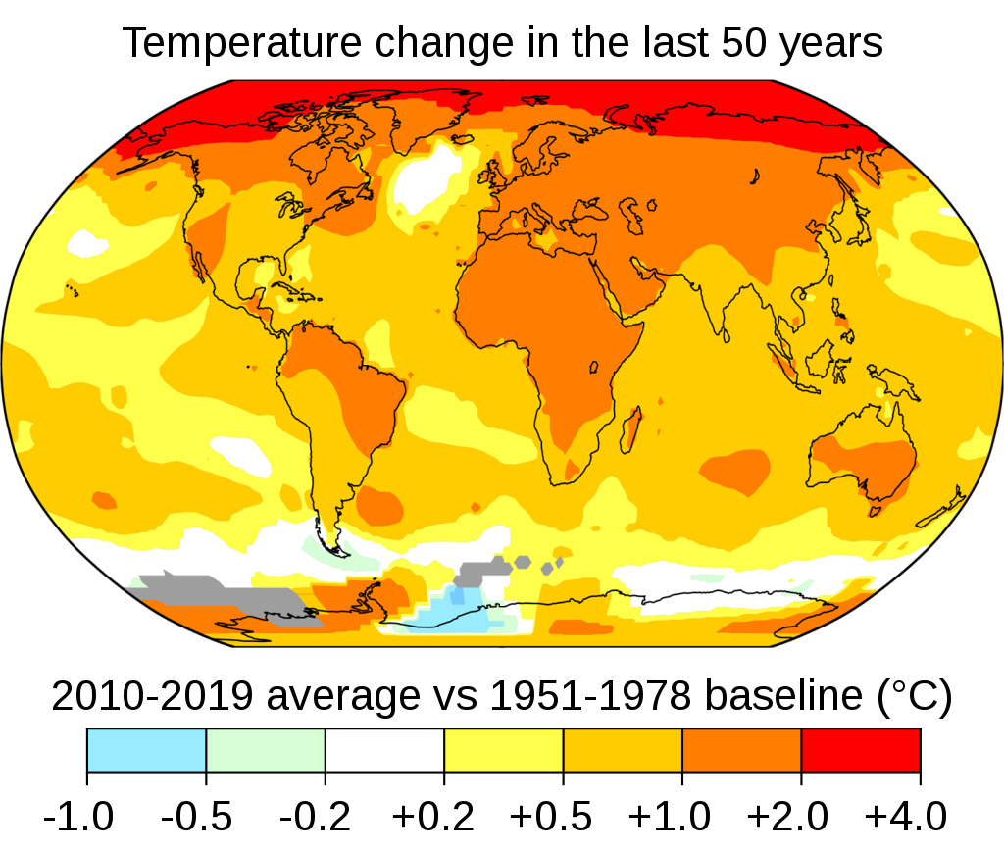
https://en.wikipedia.org/wiki/Global_warming

Slide 14
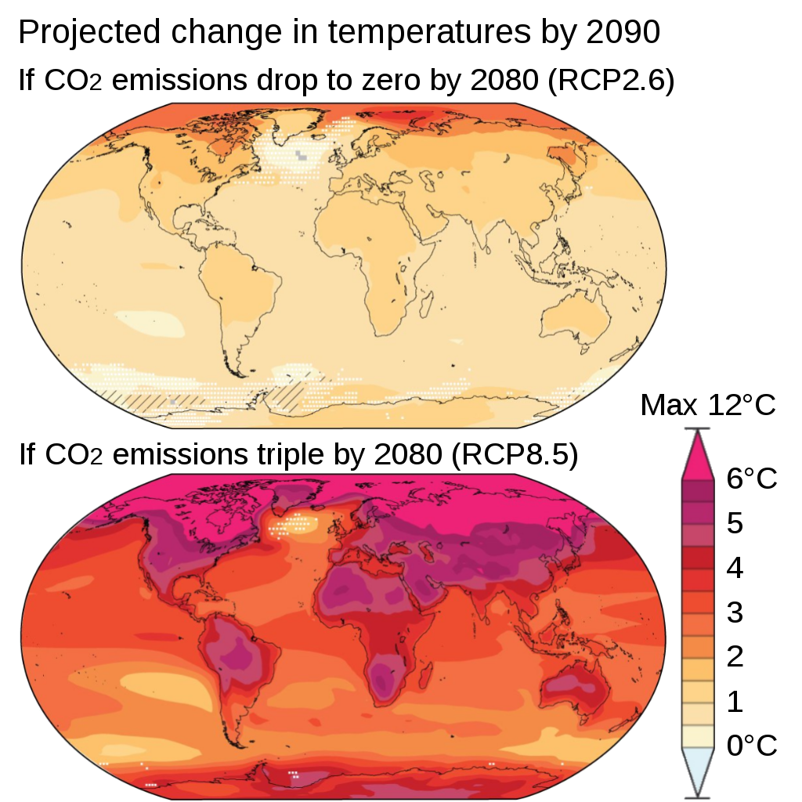
https://en.wikipedia.org/wiki/Climate_change

Slide 15
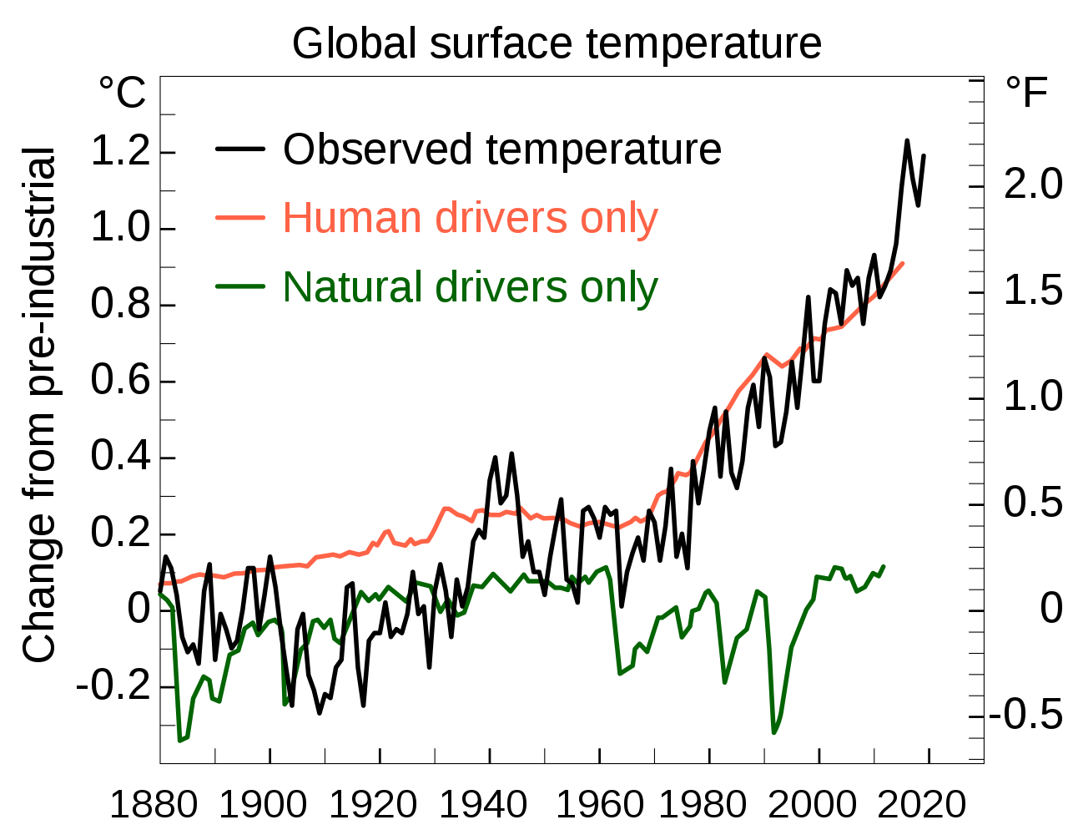
https://en.wikipedia.org/wiki/Climate_change

Slide 16
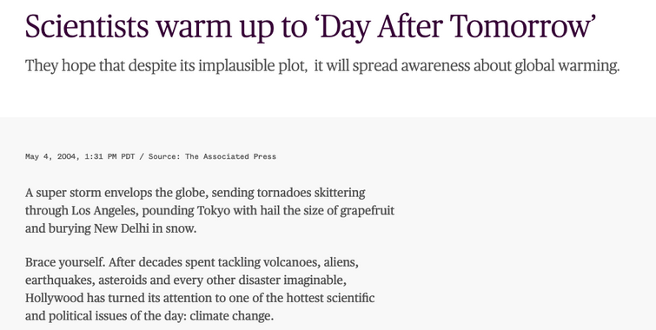

Slide 17
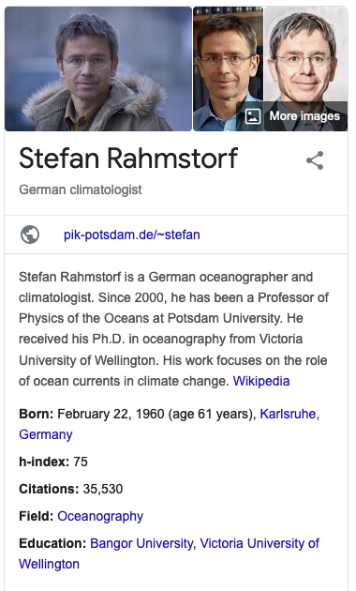

Slide 18
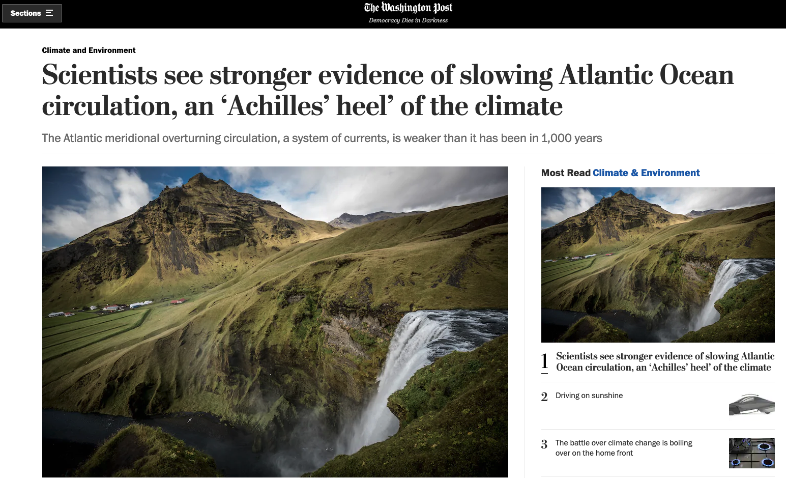
Washington Post 2/25/2021
https://www.washingtonpost.com/climate-environment/2021/02/25/atlantic-ocean-currents-weakening-amoc-gulf-stream/
Start Here 2/26/2021

Slide 19
Global Temperature History https://www.ncdc.noaa.gov/sotc/global/202101

Slide 20
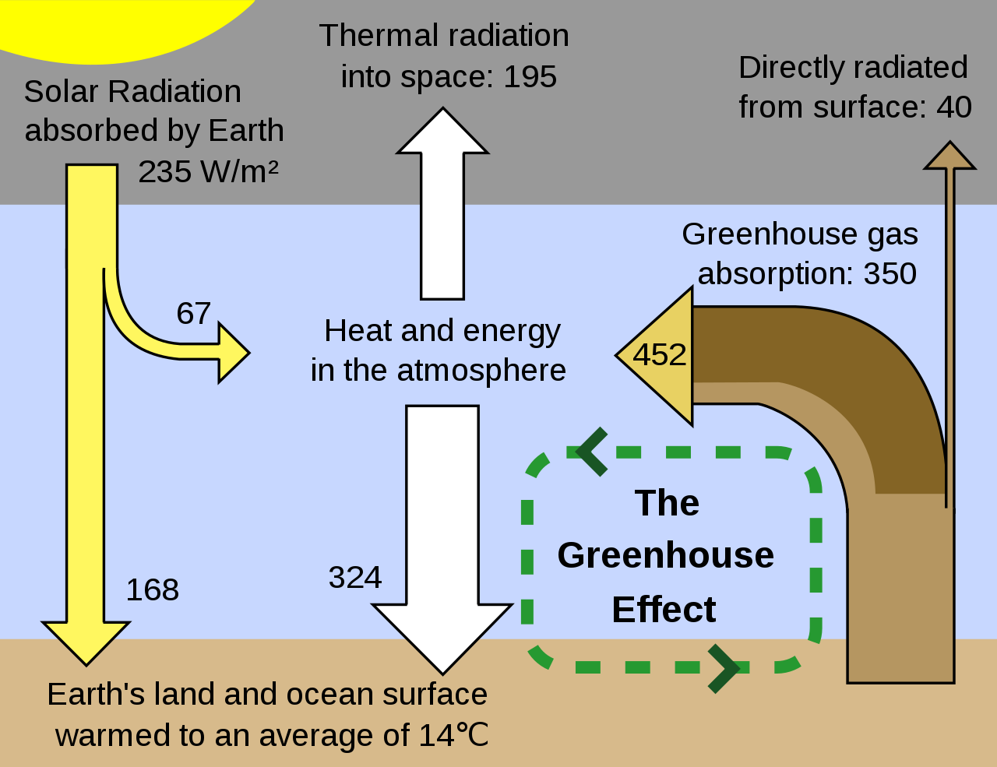
https://en.wikipedia.org/wiki/Climate_change

Slide 21
Observations of Temperature Changes and Proxy Temperature Changes http://en.wikipedia.org/wiki/Global_warming
“Climate proxies show the temperature to have been relatively stable over the one or two thousand years before 1850, with regionally varying fluctuations such as the Medieval Warm Period and the Little Ice Age.
The warming that is evident in the instrumental temperature record is consistent with a wide range of observations, as documented by many independent scientific groups.
Examples include sea level rise (water expands as it warms), widespread melting of snow and ice, increased heat content of the oceans, increased humidity, and the earlier timing of spring events,e.g., the flowering of plants.
The probability that these changes could have occurred by chance is virtually zero.”
Climate Proxy Examples Here
“Two millennia of mean surface temperatures according to different reconstructions from climate proxies, each smoothed on a decadal scale, with the instrumental temperature record overlaid in black.”

Slide 22
https://en.wikipedia.org/wiki/Climate_change

Slide 23
https://en.wikipedia.org/wiki/Climate_change

Slide 24
https://en.wikipedia.org/wiki/Climate_change

Slide 25
Historical Data on CO₂ http://en.wikipedia.org/wiki/Carbon_dioxide_in_Earth%27s_atmosphere

Slide 26
https://en.wikipedia.org/wiki/Climate_change

Slide 27
Milankovitch Cycles https://en.wikipedia.org/wiki/Milankovitch_cycles
Milankovitch cycles describe the collective effects of changes in the Earth's movements on its climate over thousands of years.
The term is named for Serbian geophysicist and astronomer Milutin Milanković.
In the 1920s, he hypothesized that variations in eccentricity, axial tilt, and precession resulted in cyclical variation in the solar radiation reaching the Earth, and that this orbital forcing strongly influenced the Earth's climatic patterns.
Now, materials on Earth that have been unchanged for millennia (obtained via ice, rock, and deep ocean cores) are being studied to indicate the history of Earth's climate.
Though they are consistent with the Milankovitch hypothesis, there are still several observations that the hypothesis does not explain.

Slide 28
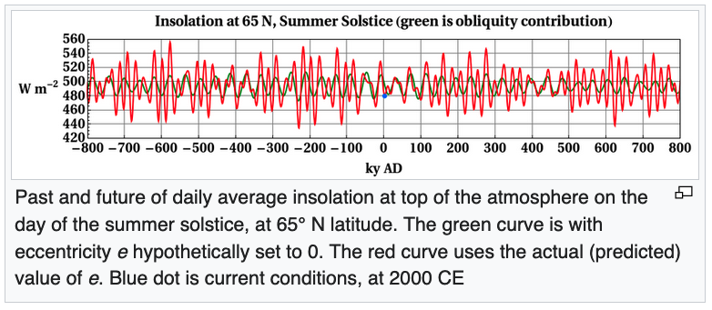
What Does Milankovich Theory Say About the Present and Future? https://en.wikipedia.org/wiki/Milankovitch_cycles
Since orbital variations are predictable, any model that relates orbital variations to climate can be run forward to predict future climate, with two caveats:
The mechanism by which orbital forcing influences climate is not definitive; and
Non-orbital effects can be important (for example, the human impact on the environment principally increases greenhouse gases resulting in a warmer climate.
An often-cited 1980 orbital model by Imbrie predicted "the long-term cooling trend that began some 6,000 years ago will continue for the next 23,000 years."
More recent work suggests that orbital variations should gradually increase 65° N summer insolation over the next 25,000 years.
Earth's orbit will become less eccentric for about the next 100,000 years, so changes in this insolation will be dominated by changes in obliquity, and should not decline enough to permit a new glacial period in the next 50,000 years.

Slide 29
Impacts

Slide 30
https://en.wikipedia.org/wiki/Climate_change
Deforestation in Brazil, 2016

Slide 31
https://en.wikipedia.org/wiki/Climate_change
Melting Sea Ice. Sea ice reflects 50% to 70% of incoming solar radiation while the dark ocean surface only reflects 6%, so melting sea ice is a self-reinforcing feedback.

Slide 32
https://en.wikipedia.org/wiki/Climate_change
Intergovernmental Panel on Climate Change Projections

Slide 33
https://en.wikipedia.org/wiki/Climate_change
Intergovernmental Panel on Climate Change Projections

Slide 34
https://en.wikipedia.org/wiki/Climate_change
The Orroral Valley Fire viewed from Tuggeranong, Australia on the evening of 28 January

Slide 35
https://en.wikipedia.org/wiki/Climate_change
In Noatak National Preserve, Alaska, an exceptionally warm summer in 2004 triggered this 300m long slump associated with thawing permafrost. NPS photo

Slide 36
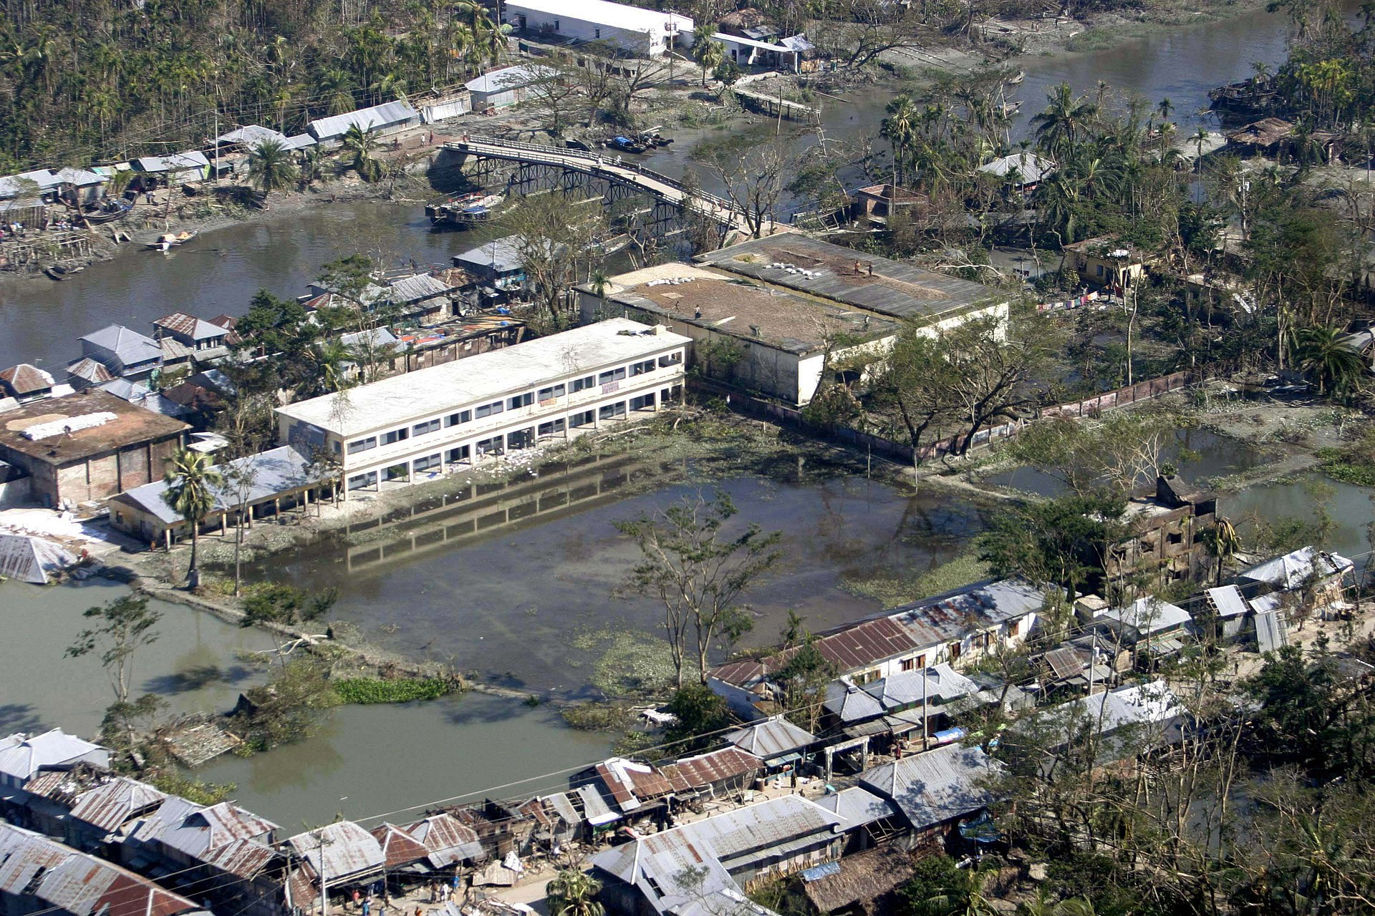
https://en.wikipedia.org/wiki/Climate_change
Flooding in Venice, Italy due to rising sea levels (Wolfgang Morodor photo).
Bangladesh after Cyclone Sidr is an example of catastrophic flooding from increased rainfall. Photo by Julius Hawkins, US Marine Corps.

Slide 37
https://en.wikipedia.org/wiki/Climate_change
Heat wave in Europe, July 2019

Slide 38
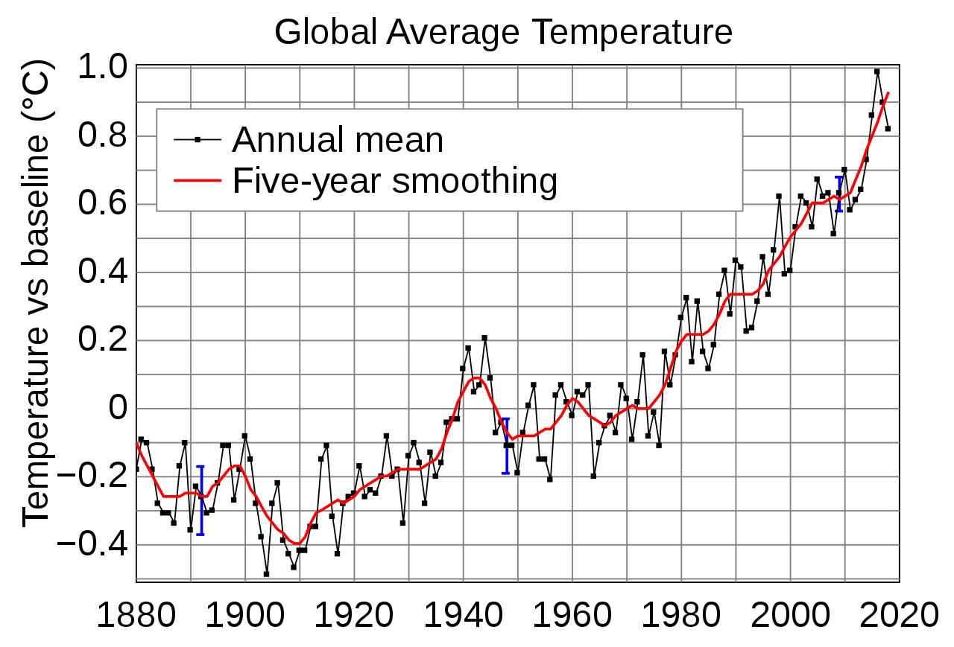
https://en.wikipedia.org/wiki/Global_warming

Slide 39
https://en.wikipedia.org/wiki/Climate_change
Scenarios of global greenhouse gas emissions. If all countries achieve their current Paris Agreement pledges, average warming by 2100 will go far beyond the target of the Paris Agreement to keep warming "well below 2°C".

Slide 40
https://en.wikipedia.org/wiki/Climate_change
Per person, the United States generates CO₂ at a far faster rate than other primary regions.

Slide 41
Climate Models https://en.wikipedia.org/wiki/Climate_model

Slide 42
Global Circulation Models (GCMs) https://en.wikipedia.org/wiki/General_circulation_model

Slide 43
Rendered Climate GCM https://en.wikipedia.org/wiki/General_circulation_model
This visualization shows early test renderings of a global computational model of Earth's atmosphere based on data from NASA's Goddard Earth Observing System Model, Version 5 (GEOS-5).

Slide 44
https://en.wikipedia.org/wiki/Climate_change
One deceptive approach is cherry picking data from short time periods to falsely assert that global average temperatures are not rising. Blue trendlines show short-term countertrends that mask longer-term warming trends (red trendlines). Blue dots show the so-called global warming hiatus.

Slide 45
Observations of Temperature Changes and Proxy Temperature Changes http://en.wikipedia.org/wiki/Global_warming
“The Earth's average surface temperature rose by 0.74±0.18 °C over the period 1906–2005.
The rate of warming over the last half of that period was almost double that for the period as a whole (0.13±0.03 °C per decade, versus 0.07±0.02 °C per decade).
Temperatures in the lower troposphere have increased between 0.13 and 0.22 °C (0.22 and 0.4 °F) per decade since 1979, according to satellite temperature measurements.
Recent estimates by NASA's Goddard Institute for Space Studies (GISS) and the National Climatic Data Center show that 2005 and 2010 tied for the planet's warmest year since reliable, widespread instrumental measurements became available in the late 19th century, exceeding 1998 by a few hundredths of a degree.
Estimates by the Climatic Research Unit (CRU) show 2005 as the second warmest year, behind 1998 with 2003 and 2010 tied for third warmest year, however, ‘the error estimate for individual years ... is at least ten times larger than the differences between these three years.’
The World Meteorological Organization (WMO) statement on the status of the global climate in 2010 explains that, ‘The 2010 nominal value of +0.53 °C ranks just ahead of those of 2005 (+0.52 °C) and 1998 (+0.51 °C), although the differences between the three years are not statistically significant…’
Every year from 1986 to 2012 has seen world annual mean temperatures above the 1961-1990 average.

Slide 46
CO2 Change J. Tierney, C. Poulsen, I. Montanez (Science, v370, p680, 2020)

Slide 47
Observations of Temperature Changes and Relation to El Nino/La Nina http://en.wikipedia.org/wiki/Global_warming
“Temperatures in 1998 were unusually warm because global temperatures are affected by the El Niño-Southern Oscillation (ENSO)
The strongest El Niño in the past century occurred during that year.
Global temperature is subject to short-term fluctuations that overlay long term trends and can temporarily mask them.
The relative stability in temperature from 2002 to 2009 is consistent with such an episode.
2010 was also an El Niño year.
On the low swing of the oscillation, 2011 as a La Niña year was cooler but it was still the 11th warmest year since records began in 1880.
Of the 13 warmest years since 1880, 11 were the years from 2001 to 2011.
Over the more recent record, 2011 was the warmest La Niña year in the period from 1950 to 2011, and was close to 1997 which was not at the lowest point of the cycle.”
“NOAA graph of Global Annual Temperature Anomalies 1950–2012, showing the El Niño-Southern Oscillation”

Slide 48
Global Temperature Distributions http://en.wikipedia.org/wiki/Global_warming
“Since 1979, land temperatures have increased about twice as fast as ocean temperatures (0.25 °C per decade against 0.13 °C per decade).
Ocean temperatures increase more slowly than land temperatures because of the larger effective heat capacity of the oceans and because the ocean loses more heat by evaporation.
The northern hemisphere is also naturally warmer than the southern hemisphere mainly because of meridional heat transport in the oceans from the ocean conveyor and other currents
This differential is about 0.9 petawatts northwards, with an additional contribution from the albedo differences between the polar regions.
Since the beginning of industrialization the inter-hemispheric temperature difference has increased due to melting of sea ice and snow in the North.
Average arctic temperatures have been increasing at almost twice the rate of the rest of the world in the past 100 years, however arctic temperatures are also highly variable.
Although more greenhouse gases are emitted in the Northern than Southern Hemisphere this does not contribute to the difference in warming because the major greenhouse gases persist long enough to mix between hemispheres.”

Slide 49
Thermal Energy Changes http://en.wikipedia.org/wiki/Global_warming
“The thermal inertia of the oceans and slow responses of other indirect effects mean that climate can take centuries or longer to adjust to changes in forcing.
Climate commitment studies indicate that even if greenhouse gases were stabilized at 2000 levels, a further warming of about 0.5 °C (0.9 °F) would still occur.
Earth has been in radiative imbalance since at least the 1970s, where less energy leaves the atmosphere than enters it.
Most of this extra energy has been absorbed by the oceans.
It is very likely that human activities substantially contributed to this increase in ocean heat content.”

Slide 50
Greenhouse Gases: Natural Forcings http://en.wikipedia.org/wiki/Global_warming
“The greenhouse effect is the process by which absorption and emission of infrared radiation by gases in the atmosphere warm a planet's lower atmosphere and surface.
It was proposed by Joseph Fourier in 1824, discovered in 1860 by John Tyndall, was first investigated quantitatively by Svante Arrhenius in 1896, and was developed in the 1930s through 1960s by Guy Stewart Callendar.
The climate system responds to changes in external forcings as well as other factors.
External forcings can "push" the climate in the direction of warming or cooling.
Examples of external forcings include changes in atmospheric composition (e.g., increased concentrations of greenhouse gases), solar luminosity, volcanic eruptions, and variations in Earth's orbit around the Sun.
Orbital (Milankovich) cycles vary slowly over tens of thousands of years and at present are in an overall cooling trend which would be expected to lead towards an ice age
But the 20th century instrumental temperature record shows a sudden rise in global temperatures.”
“Greenhouse effect schematic showing energy flows between space, the atmosphere, and earth's surface. Energy exchanges are expressed in watts per square meter (W/m²).”

Slide 51
Greenhouse Gases http://en.wikipedia.org/wiki/Global_warming
“Naturally occurring amounts of greenhouse gases have a mean warming effect of about 33 °C (59 °F).
Without the earth's atmosphere the temperature across almost the entire surface of the earth would be below freezing.
The major greenhouse gases are water vapor, which causes about 36–70% of the greenhouse effect; carbon dioxide (CO₂), which causes 9–26%; methane (CH₄), which causes 4–9%; and ozone (O₃), which causes 3–7%
Clouds also affect the radiation balance through cloud forcings similar to greenhouse gases.”

Slide 52
Greenhouse Gases http://en.wikipedia.org/wiki/Global_warming
“Human activity since the Industrial Revolution has increased the amount of greenhouse gases in the atmosphere, leading to increased radiative forcing from CO₂, methane, tropospheric ozone, CFCs and nitrous oxide.
According to work published in 2007, the concentrations of CO₂ and methane have increased by 36% and 148% respectively since 1750.
These levels are much higher than at any time during the last 800,000 years, the period for which reliable data has been extracted from ice cores.
Less direct geological evidence indicates that CO₂ values higher than this were last seen about 20 million years ago.”
Atmospheric CO2 concentration from 650,000 years ago to near present, using ice core proxy data and direct measurements

Slide 53
Even BlackRock Investments is Worried (From Daily Shot, May 6, 2019)

Slide 54
Greenhouse Gases http://en.wikipedia.org/wiki/Global_warming
“Over the last three decades of the 20th century, gross domestic product per capita and population growth were the main drivers of increases in greenhouse gas emissions.
CO₂ emissions are continuing to rise due to the burning of fossil fuels and land-use change.
Emissions can be attributed to different regions, e.g., see the figure opposite. Attribution of emissions due to land-use change is a controversial issue.
Emissions scenarios, estimates of changes in future emission levels of greenhouse gases, have been projected that depend upon uncertain economic, sociological, technological, and natural developments.”

Slide 55
Production of CO₂ by Region http://en.wikipedia.org/wiki/Global_warming
“In most scenarios, emissions continue to rise over the century, while in a few, emissions are reduced.
Fossil fuel reserves are abundant, and will not limit carbon emissions in the 21st century.
Emission scenarios, combined with modelling of the carbon cycle, have been used to produce estimates of how atmospheric concentrations of greenhouse gases might change in the future.
Using the six IPCC SRES "marker" scenarios, models suggest that by the year 2100, the atmospheric concentration of CO₂ could range between 541 and 970 ppm.
This is an increase of 90–250% above the concentration in the year 1750.”
Bubble diagram showing the share of global cumulative energy-related carbon dioxide emissions for major emitters between 1890-2007.

Slide 56
Feedbacks http://en.wikipedia.org/wiki/Global_warming
“The climate system includes a range of feedbacks which alter the response of the system to changes in external forcings.
Positive feedbacks increase the response of the climate system to an initial forcing, while negative feedbacks reduce the response of the climate system to an initial forcing.
There are a range of feedbacks in the climate system, including water vapor, changes in ice-albedo (snow and ice cover affect how much the Earth's surface absorbs or reflects incoming sunlight), clouds, and changes in the Earth's carbon cycle (e.g., the release of carbon from soil).
The main negative feedback is the energy which the Earth's surface radiates into space as infrared radiation.
Feedbacks are an important factor in determining the sensitivity of the climate system to increased atmospheric greenhouse gas concentrations.
Other factors being equal, a higher climate sensitivity means that more warming will occur for a given increase in greenhouse gas forcing.
Uncertainty over the effect of feedbacks is a major reason why different climate models project different magnitudes of warming for a given forcing scenario.
More research is needed to understand the role of clouds and carbon cycle feedbacks in climate projections.”

Slide 57
Climate Models http://en.wikipedia.org/wiki/Global_warming
“A climate model is a computerized representation of the five components of the climate system: Atmosphere, hydrosphere, cryosphere, land surface, and biosphere.
Such models are based on scientific disciplines such as fluid dynamics, thermodynamics as well as physical processes such as radiative transfer.
The models take into account various components, such as local air movement, temperature, clouds, and other atmospheric properties; ocean temperature, salt content, and circulation; ice cover on land and sea; the transfer of heat and moisture from soil and vegetation to the atmosphere; chemical and biological processes; solar variability and others.
Although researchers attempt to include as many processes as possible, simplifications of the actual climate system are inevitable because of the constraints of available computer power and limitations in knowledge of the climate system.
Results from models can also vary due to different greenhouse gas inputs and the model's climate sensitivity.
For example, the uncertainty in IPCC's 2007 projections is caused by (1) the use of multiple models with differing sensitivity to greenhouse gas concentrations, (2) the use of differing estimates of humanities' future greenhouse gas emissions, (3) any additional emissions from climate feedbacks that were not included in the models IPCC used to prepare its report, i.e., greenhouse gas releases from permafrost.”

Slide 58
Climate Models http://en.wikipedia.org/wiki/Global_warming
One of the mathematical results of these complex equations is a prediction whether warming or cooling will occur.
Recent research has called special attention to the need to refine models with respect to the effect of clouds and the carbon cycle.
Models are also used to help investigate the causes of recent climate change by comparing the observed changes to those that the models project from various natural and human-derived causes.
Although these models do not unambiguously attribute the warming that occurred from approximately 1910 to 1945 to either natural variation or human effects, they do indicate that the warming since 1970 is dominated by man-made greenhouse gas emissions
“Calculations of global warming prepared in or before 2001 from a range of climate models under the SRES A2 emissions scenario, which assumes no action is taken to reduce emissions and regionally divided economic development.”

Slide 59
Climate Models http://en.wikipedia.org/wiki/Global_warming
The physical realism of models is tested by examining their ability to simulate contemporary or past climates.
Climate models produce a good match to observations of global temperature changes over the last century, but do not simulate all aspects of climate.
Not all effects of global warming are accurately predicted by the climate models used by the IPCC.
Observed Arctic shrinkage has been faster than that predicted.
Precipitation increased proportional to atmospheric humidity, and hence significantly faster than global climate models predict.
“Projected change in annual mean surface air temperature from the late 20th century to the middle 21st century, based on a medium emissions scenario (SRES A1B).
This scenario assumes that no future policies are adopted to limit greenhouse gas emissions.
Image credit: NOAA Geophysical Fluid Dynamics Laboratory (GFDL)”

Slide 60
Projected Impacts http://en.wikipedia.org/wiki/Global_warming
During the 21st century, glaciers and snow cover are projected to continue their widespread retreat.
Projections of declines in Arctic sea ice vary.
Recent projections suggest that Arctic summers could be ice-free (defined as ice extent less than 1 million square km) as early as 2025-2030.

Slide 61
Other Projected Impacts http://en.wikipedia.org/wiki/Global_warming
“Over the 21st century, the IPCC projects that global mean sea level could rise by 0.18-0.59 m.
The IPCC do not provide a best estimate of global mean sea level rise, and their upper estimate of 59 cm is not an upper-bound, i.e., global mean sea level could rise by more than 59 cm by 2100.
The IPCC's projections are conservative, and may underestimate future sea level rise.
Over the 21st century, Parris and others suggest that global mean sea level could rise by 0.2 to 2.0 m (0.7-6.6 ft), relative to mean sea level in 1992.
Widespread coastal flooding would be expected if several degrees of warming is sustained for millennia.
For example, sustained global warming of more than 2 °C (relative to pre-industrial levels) could lead to eventual sea level rise of around 1 to 4 m due to thermal expansion of sea water and the melting of glaciers and small ice caps.
Melting of the Greenland ice sheet could contribute an additional 4 to 7.5 m over many thousands of years.
Changes in regional climate are expected to include greater warming over land, with most warming at high northern latitudes, and least warming over the Southern Ocean and parts of the North Atlantic Ocean.
Future changes in precipitation are expected to follow existing trends, with reduced precipitation over subtropical land areas, and increased precipitation at subpolar latitudes and some equatorial regions.
Projections suggest a probable increase in the frequency and severity of some extreme weather events, such as heat waves.”

Slide 62
Projected Sea Level Rise http://en.wikipedia.org/wiki/Global_warming

