Slide 1
Lecture 11a
Modern Earthquakes:
March 11, 2011 Tohoku, Japan Earthquake
John Rundle GEL/EPS 131

Slide 2
Topics
Background
Tectonics and Geology
Seismology
Tsunami
Fukushima disaster
Response
Implications

Slide 3
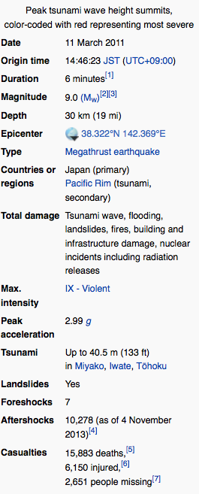
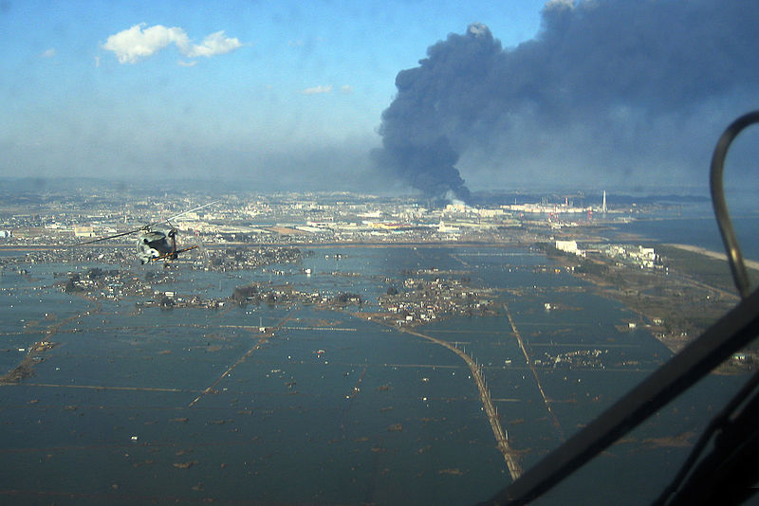
March 11, 2011 Tohoku, Japan
Earthquake and Tsunami
http://en.wikipedia.org/wiki/2011_Tohoku_earthquake_and_tsunami

Slide 4
Geology http://en.wikipedia.org/wiki/2011_Tohoku_earthquake_and_tsunami
The Pacific plate moves at a rate of 8 to 9 cm (3.1 to 3.5 in) per year, dips under Honshu's underlying plate building large amounts of elastic energy.
The break caused the sea floor to rise by several meters.
A quake of this magnitude usually has a rupture length of at least 500 km (300 mi) and generally requires a long, relatively straight fault surface.
Because the plate boundary and subduction zone in the area of the Honshu rupture is not very straight, it is unusual for the magnitude of its earthquake to exceed 8.5
The magnitude of this earthquake was a surprise to some seismologists (see following)

Slide 5
Geology http://en.wikipedia.org/wiki/2011_Tohoku_earthquake_and_tsunami
The hypocentral region of this earthquake extended from offshore Iwate Prefecture to offshore Ibaraki Prefecture.
The Japanese Meteorological Agency said that the earthquake may have ruptured the fault zone from Iwate to Ibaraki with a length of 500 km (310 mi) and a width of 200 km (120 mi).
Analysis showed that this earthquake consisted of a set of three events.
The earthquake may have had a mechanism similar to that of another large earthquake in 869, which is called the Jogan event.
That event had an estimated moment magnitude (Ms) of 8.6, and produced an even larger tsunami.
Other major earthquakes with tsunamis struck the Sanriku Coast region in 1896 and in 1933.

Slide 6
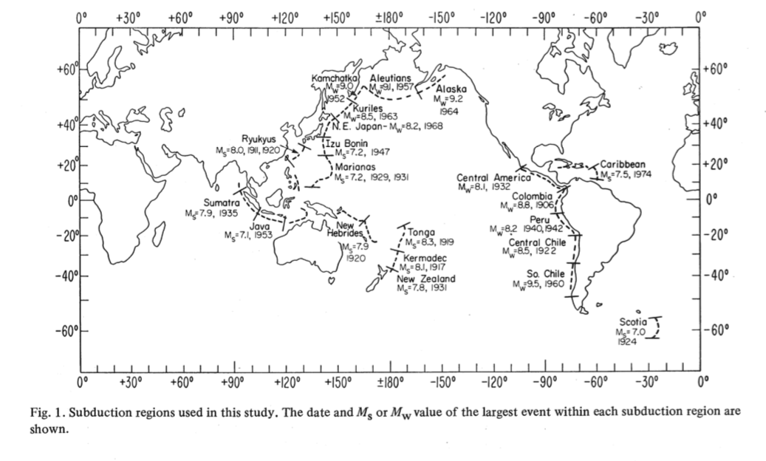
Earlier studies of subduction fault zones had suggested that earthquakes in Tohoku could be no larger than 8.5
Study Area
Image from H. Kanamori and L Ruff, PEPI, 23, 240 (1980)

Slide 7
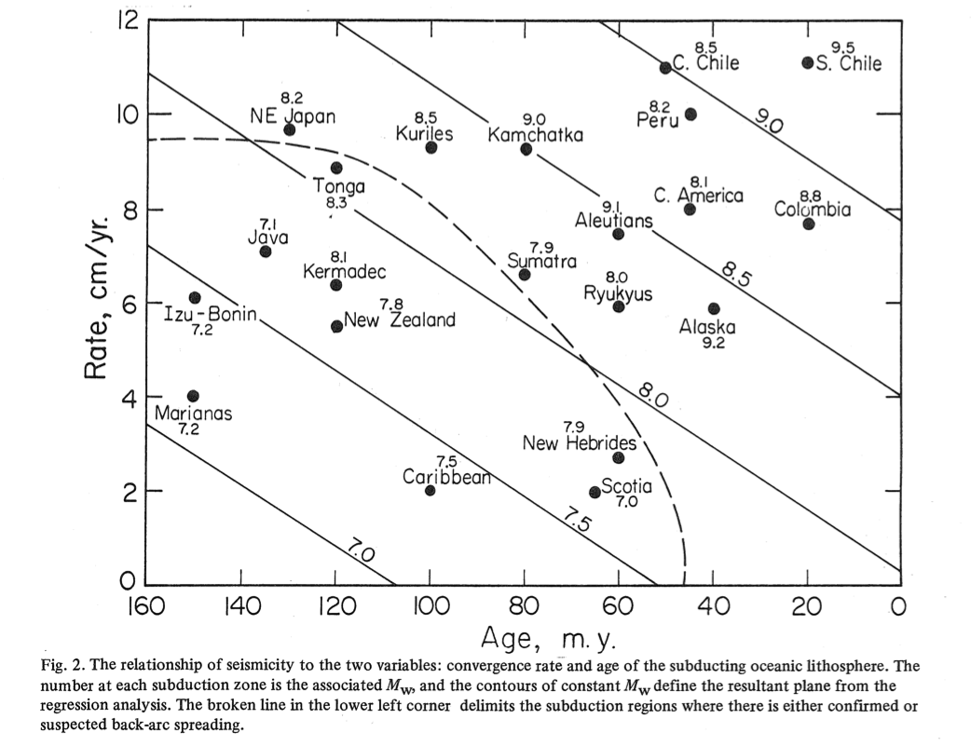
Earlier studies of subduction fault zones had suggested that earthquakes in Tohoku could be no larger than 8.5
Results
Image from H. Kanamori and L Ruff, PEPI, 23, 240 (1980)

Slide 8
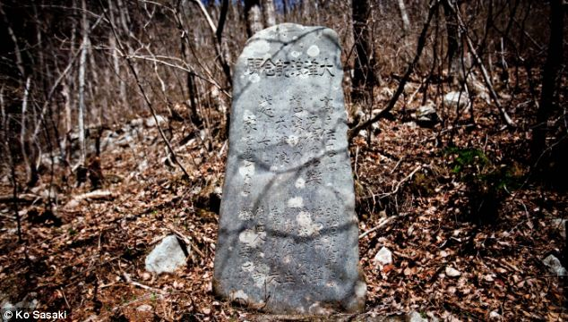
A warning from history. Tsunami stone near Aneyoshi, Japan. Carved into its weather-worn rock is a warning - 'Do not build your homes below this point!' - because they would be at risk from floods in a tsunami. The villagers obeyed the ancient warning and the tiny community of just 11 houses and 34 residents were rewarded with survival at a key geographical point. Some of these stones are more than 600 years old
(UK Daily Mail Online)

Slide 9
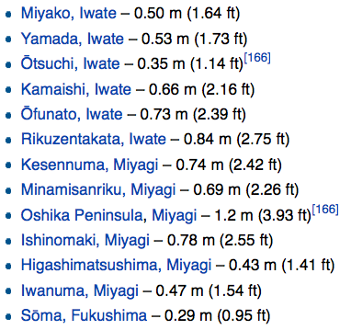
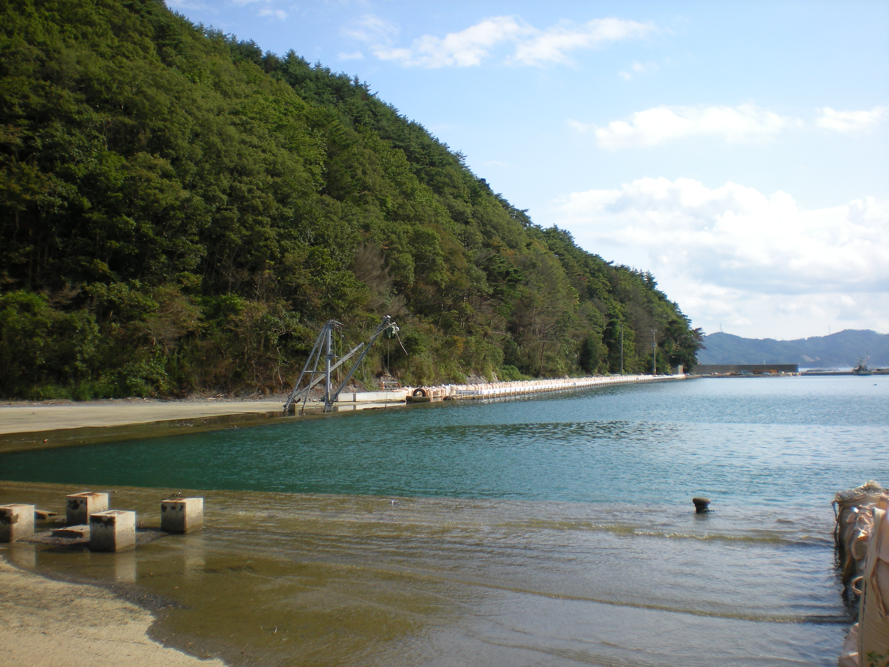
Coastal Subsidence http://en.wikipedia.org/wiki/2011_Tohoku_earthquake_and_tsunami
Submerged dock at Takenoura,
~10 km NE of Onagawa Town

Slide 10
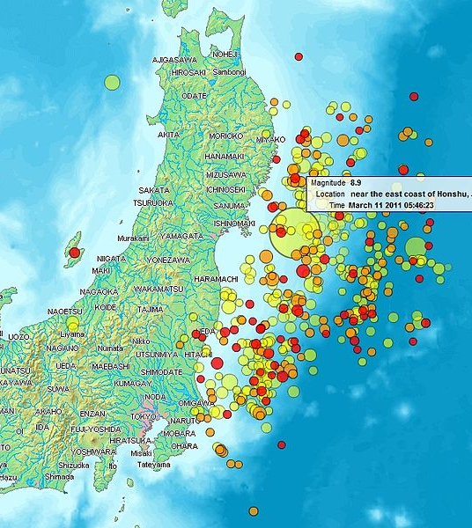
Earthquake and Tsunami http://en.wikipedia.org/wiki/2011_Tohoku_earthquake_and_tsunami
“The 9.0 magnitude (MW) undersea megathrust earthquake occurred on 11 March 2011 at 14:46 JST (05:46 UTC) in the north-western Pacific Ocean at a relatively shallow depth of 32 km (19.9 mi)
Epicenter approximately 72 km (45 mi) east of the Oshika Peninsula of Tōhoku, Japan, lasting approximately six minutes.
The earthquake was initially reported as 7.9 MW by the USGS before it was quickly upgraded to 8.8 MW, then to 8.9 MW,and then finally to 9.0 MW.
Sendai was the nearest major city to the earthquake, 130 km (81 mi) from the epicenter; the earthquake occurred 373 km (232 mi) from Tokyo.”

Slide 11
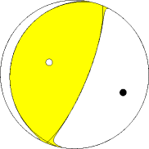
Focal Mechanism http://en.wikipedia.org/wiki/2011_Tohoku_earthquake_and_tsunami
The earthquake focal mechanism indicates thrusting on a nearly horizontal fault plane
The Pacific plate, which moves at a rate of 8 to 9 cm (3.1 to 3.5 in) per year, dips under Honshu's underlying plate building large amounts of elastic energy.
The break caused the sea floor to rise by several meters which led to the tsunami
A quake of this magnitude usually has a rupture length of at least 500 km (300 mi) and generally requires a long, relatively straight fault surface.

Slide 12
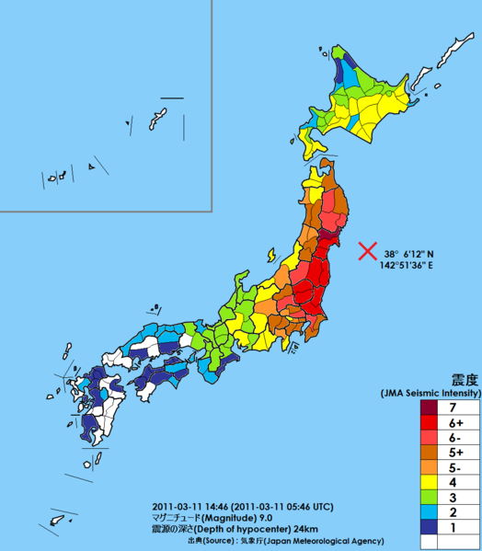
Ground Shaking - JMA http://en.wikipedia.org/wiki/2011_Tohoku_earthquake_and_tsunami
The JMA intensity scale is different than the Modified Mercalli scale that most countries use
“Soil liquefaction was evident in areas of reclaimed land around Tokyo, particularly in Urayasu, Chiba City, Funabashi, Narashino (all in Chiba Prefecture) and in the Koto, Edogawa, Minato, Chūō, and Ōta Wards of Tokyo.
Approximately 30 homes or buildings were destroyed and 1,046 other buildings were damaged to varying degrees.
Nearby Haneda Airport, built mostly on reclaimed land, was not damaged. Odaiba also experienced liquefaction, but damage was minimal.”

Slide 13
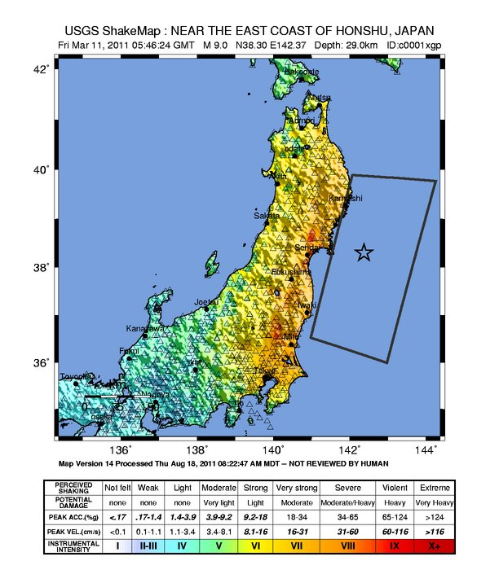
Ground Shaking - USGS http://en.wikipedia.org/wiki/2011_Tohoku_earthquake_and_tsunami
The USGS intensity map shows a generally similar appearance to the JMA intensity map
A report by the Japan Agency for Marine-Earth Science and Technology, published in Science on 2 December 2011, concluded that the seabed in the area between the epicenter and the Japan Trench moved 50 meters east-southeast and rose about 7 meters as a result of the quake.
The report also stated that the quake had caused several major landslides on the seabed in the affected area.
A 400 km (250 mi) stretch of coastline dropped vertically by 0.6 m (2.0 ft), allowing the tsunami to travel farther and faster onto land.

Slide 14
Geophysical Effects http://en.wikipedia.org/wiki/2011_Tohoku_earthquake_and_tsunami
The earthquake shifted the Earth's axis by estimates of between 10 cm (4 in) and 25 cm (10 in) at the poles
This deviation led to a number of small planetary changes, including the length of a day, the tilt of the Earth, and the Chandler wobble.
The speed of the Earth's rotation increased, shortening the day by 1.8 microseconds due to the redistribution of Earth's mass.
The axial shift was caused by the redistribution of mass on the Earth's surface, which changed the planet's moment of inertia. Because of conservation of angular momentum, such changes of inertia result in small changes to the Earth's rate of rotation.

Slide 15
Geophysical Effects http://en.wikipedia.org/wiki/2011_Tohoku_earthquake_and_tsunami
The earthquake also generated sound waves detected by the GOCE satellite, which thus serendipitously became the first seismograph in orbit.
A GPS station located nearest the epicenter moved almost 13 feet (4.0 m).
This motivated government researchers to look into other ways the earthquake may have had large scale effects on the planet.
Calculations by scientists at NASA’s Jet Propulsion Laboratory determined that the Earth’s rotation was changed by the earthquake to the point where the days are now 1.8 microseconds shorter. (LOD = Length of Day)

Slide 16
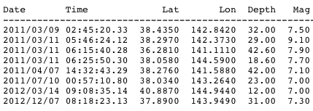
Aftershocks http://en.wikipedia.org/wiki/2011_Tohoku_earthquake_and_tsunami
“Japan has experienced thousands aftershocks since the earthquake, with over 100 registering over magnitude 6.0 Mw and a half dozen that have been over magnitude 7.0 Mw .
A magnitude 7.7 Mw and a 7.9 Mw quake occurred on 11 March and the third one struck offshore on 7 April with a disputed magnitude.
As of 16 Mar 2012 aftershocks continued, totaling 1887 events over magnitude 4.0”
The chart at right shows all earthquakes within 1000 Tokyo since March 12, 2011
GR Relation for all earthquakes within 1000 Tokyo since March 12, 2011
All earthquakes M>7 within 1000 Tokyo since March 9, 2011

Slide 17
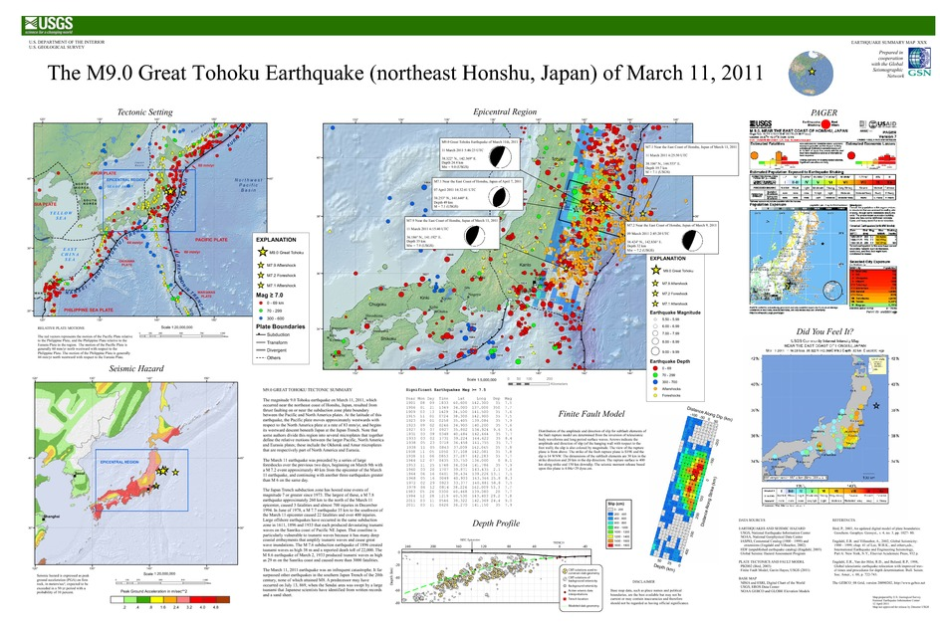

Slide 18
Damage Summary - I http://en.wikipedia.org/wiki/2011_Tohoku_earthquake_and_tsunami
“The degree and extent of damage caused by the earthquake and resulting tsunami were enormous, with most of the damage being caused by the tsunami.
Video footage of the towns that were worst affected shows little more than piles of rubble, with almost no parts of any structures left standing.
Estimates of the cost of the damage range well into the tens of billions of US dollars; before-and-after satellite photographs of devastated regions show immense damage to many regions.
Although Japan has invested the equivalent of billions of dollars on anti-tsunami seawalls which line at least 40% of its 34,751 km (21,593 mi) coastline and stand up to 12 m (39 ft) high, the tsunami simply washed over the top of some seawalls, collapsing some in the process.[203]
Japan's National Police Agency said on 3 April 2011, that 45,700 buildings were destroyed and 144,300 were damaged by the quake and tsunami. “

Slide 19
Damage Summary - II http://en.wikipedia.org/wiki/2011_Tohoku_earthquake_and_tsunami
“The damaged buildings included 29,500 structures in Miyagi Prefecture, 12,500 in Iwate Prefecture and 2,400 in Fukushima Prefecture.
Three hundred hospitals with 20 beds or more in Tōhoku were damaged by the disaster, with 11 being completely destroyed.
The earthquake and tsunami created an estimated 24–25 million tons of rubble and debris in Japan.
An estimated 230,000 automobiles and trucks were damaged or destroyed in the disaster.
As of the end of May 2011, residents of Iwate, Miyagi, and Fukushima prefectures had requested deregistration of 15,000 vehicles, meaning that the owners of those vehicles were writing them off as unrepairable or unsalvageable.”

Slide 20
Damage Summary - III http://en.wikipedia.org/wiki/2011_Tohoku_earthquake_and_tsunami
“All of Japan's ports were briefly closed after the earthquake, though the ones in Tokyo and southwards soon re-opened.
Fifteen ports were located in the disaster zone. The north-eastern ports of Hachinohe, Sendai, Ishinomaki and Onahama were destroyed, while the Port of Chiba (which serves the hydrocarbon industry) and Japan's ninth-largest container port at Kashima were also affected, though less severely.
The ports at Hitachinaka, Hitachi, Soma, Shiogama, Kesennuma, Ofunato, Kamashi and Miyako were also damaged and closed to ships.
All 15 ports reopened to limited ship traffic by 29 March 2011.
A total of 319 fishing ports, about 10% of Japan's fishing ports, were damaged in the disaster.
Most ports were restored to operating condition by 18 April 2012.
The Port of Tokyo suffered slight damage; the effects of the quake included visible smoke rising from a building in the port with parts of the port areas being flooded, including soil liquefaction in Tokyo Disneyland's parking lot.”

Slide 21
Damage Summary – IV http://en.wikipedia.org/wiki/2011_Tohoku_earthquake_and_tsunami
“According to the Japanese trade ministry, around 4.4 million households served by Tōhoku Electric Power (TEP) in northeastern Japan were left without electricity.
Several nuclear and conventional power plants went offline after the earthquake, reducing TEPCO's total capacity by 21 GW.
Rolling blackouts began on 14 March due to power shortages caused by the earthquake.
The Tokyo Electric Power Company (TEPCO), which normally provides approximately 40 GW of electricity, announced that it could only provide about 30 GW.
This was because 40% of the electricity used in the greater Tokyo area was supplied by reactors in the Niigata and Fukushima prefectures.

Slide 22
Damage Summary – V http://en.wikipedia.org/wiki/2011_Tohoku_earthquake_and_tsunami
The reactors at the Fukushima Daiichi and Fukushima Daini plants were automatically taken offline when the first earthquake occurred and sustained major damage related to the earthquake and subsequent tsunami.
Rolling blackouts of approximately three hours were experienced throughout April and May while TEPCO scrambled to find a temporary power solution.
The blackouts affected Tokyo, Kanagawa, Eastern Shizuoka, Yamanashi, Chiba, Ibaraki, Saitama, Tochigi, and Gunma prefectures.
Voluntary reduced electricity use by consumers in the Kanto area helped reduce the predicted frequency and duration of the blackouts.”

Slide 23
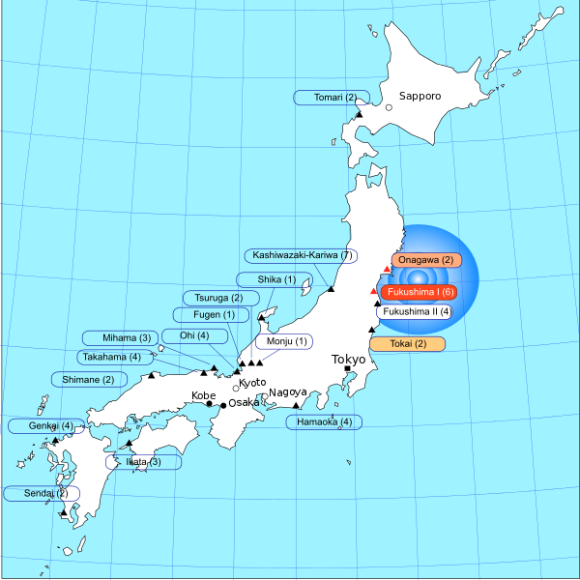
Damage Summary – VI http://en.wikipedia.org/wiki/2011_Tohoku_earthquake_and_tsunami
“The Fukushima Daiichi, Fukushima Daini, Onagawa Nuclear Power Plant and Tōkai nuclear power stations, eleven reactors, were automatically shut down following the earthquake.
Higashidōri, also on the northeast coast, was already shut down for a periodic inspection.
At Fukushima Daiichi and Daini, tsunami waves overtopped seawalls and destroyed diesel backup power systems, leading to severe problems at Fukushima Daiichi, including three large explosions and radioactive leakage.
Subsequent analysis found that many Japanese nuclear plants, including Fukushima Daiichi, were not adequately protected against tsunami.
Over 200,000 people were evacuated.”
More Detailed Discussion of Nuclear Reactor Damage in Lecture 12

Slide 24
Damage Summary – VII http://en.wikipedia.org/wiki/2011_Tohoku_earthquake_and_tsunami
“A report by the IAEA in 2012 found that the Onegawa Nuclear Power Plant, the closest nuclear plant to the epicenter of the 2011 earthquake and tsunami, had remained largely undamaged.
The plant's 3 reactors automatically shut down without damage and all safety systems functioned as designed. The plant's 14 meter (46-foot) high seawall successfully withstood the tsunami.
Nuclear experts stated that Fukushima will go down in history as the second-worst nuclear accident ever.... while not as bad as Chernobyl disaster, worse than Three Mile Island accident.
It could take months or years to learn how damaging the release of dangerous isotopes has been to human health and food supplies, and the surrounding countryside.
Later analysis indicated three reactors at Fukushima I (Units 1, 2, and 3) had suffered meltdowns and continued to leak coolant water, and by summer the Vice-minister for Economy, Trade and Industry, the head of the Nuclear and Industrial Safety Agency, and the head of the Agency for Natural Resources and Energy, had lost their jobs.”

Slide 25
Damage Summary – IX http://en.wikipedia.org/wiki/2011_Tohoku_earthquake_and_tsunami
“In particular, the earthquake and tsunami seriously damaged nuclear power plants in the Tohoku region, which depends heavily on such plants for electricity.
Measures to contain overheating at some reactors may render them unusable.
Most of of Japan’s domestic nuclear capacity was closed at least temporarily since the earthquake, resulting in electricity shortages.
The authorities planned rolling blackouts in the eastern half of Honshu for at least several weeks beginning 14 March.
Power shortages and the need to repair the damage caused by the earthquake and tsunami has forced many factories to suspend production, including in the car and electric equipment sectors.
The adverse effects in areas hit by the disaster may spread to other areas of the country and overseas due to shortages of parts. Consequently, industrial production in March is likely to fall, followed by further weakness in April.”

