Slide 1
Lecture 7
Arbitrage and Leverage
John Rundle Econophysics PHYS 250

Slide 2
Arbitrage https://en.wikipedia.org/wiki/Arbitrage
In economics and finance, arbitrage is the practice of taking advantage of a price difference between two or more markets
The idea is to strike a combination of matching deals that capitalize upon the imbalance, the profit being the difference between the market prices.
When used by academics, an arbitrage is a (imagined, hypothetical, thought experiment) transaction that involves no negative cash flow at any probabilistic or temporal state and a positive cash flow in at least one state
In simple terms, it is the possibility of a risk-free profit after transaction costs.
For instance, an arbitrage is present when there is the opportunity to instantaneously buy low and sell high.

Slide 3
Arbitrage https://en.wikipedia.org/wiki/Arbitrage
In principle and in academic use, an arbitrage is risk-free
In common use, as in statistical arbitrage, it may refer to expected profit, though losses may occur
In practice, there are always risks in arbitrage, some minor (such as fluctuation of prices decreasing profit margins), some major (such as devaluation of a currency or derivative).
In academic use, an arbitrage involves taking advantage of differences in price of a single asset or identical cash-flows
In common use, it is also used to refer to differences between similar assets (relative value or convergence trades), as in merger arbitrage.

Slide 4
Arbitrage https://en.wikipedia.org/wiki/Arbitrage
Arbitrage is possible when one of three conditions is met:
The same asset does not trade at the same price on all markets ("the law of one price").
Two assets with identical cash flows do not trade at the same price.
An asset with a known price in the future does not today trade at its future price discounted at the risk-free interest rate
Or, the asset has significant costs of storage; as such, for example, this condition holds for grain but not for securities

Slide 5
Arbitrage Examples https://en.wikipedia.org/wiki/Arbitrage
FOREX
Suppose that an exchange rate (after taking out the fees for making the exchange) in London is £5 = ¥1000 and the exchange rate in Tokyo is ¥1000 = £6.
Converting ¥2000 to £12 in Tokyo and converting that £12 into ¥2400 in London, for a profit of ¥400, would be arbitrage.
In reality, this arbitrage is so simple that it almost never occurs.
However, HFT makes such arbitrage opportunities more common
But more complicated foreign exchange arbitrages, such as the spot-forward arbitrage (see interest rate parity) are much more common.

Slide 6
Arbitrage Examples https://en.wikipedia.org/wiki/Arbitrage
Stocks and Futures
Different Exchanges. One example of arbitrage involves the New York Stock Exchange and the Security Futures Exchange OneChicago (OCX).
When the price of a stock on the NYSE and its corresponding futures contract on OCX are out of sync, one can buy the less expensive one and sell it on the more expensive market.
Because the differences between the prices are likely to be small (and not to last very long), this can be done profitably only with computers (HFT) examining a large number of prices and automatically exercising a trade when the prices are far enough out of balance.
The activity of other arbitrageurs can make this risky.
Those with the fastest computers (i.e. lowest latency to respond to the market = HFT) and the most expertise take advantage of series of small differences that would not be profitable if taken individually.

Slide 7
Arbitrage Examples https://en.wikipedia.org/wiki/Arbitrage
Exchange-traded fund arbitrage
Exchange Traded Funds allow authorized participants to exchange back and forth between shares in underlying securities held by the fund and shares in the fund itself, rather than allowing the buying and selling of shares in the ETF directly with the fund sponsor.
ETFs trade in the open market, with prices set by market demand.
An ETF may trade at a premium or discount to the value of the underlying assets.
When a significant enough premium appears, an arbitrageur will buy the underlying securities, convert them to shares in the ETF, and sell them in the open market.
When a discount appears, an arbitrageur will do the reverse.
In this way, the arbitrageur makes a low-risk profit, while keeping ETF prices in line with their underlying value (“supplies liquidity”)

Slide 8
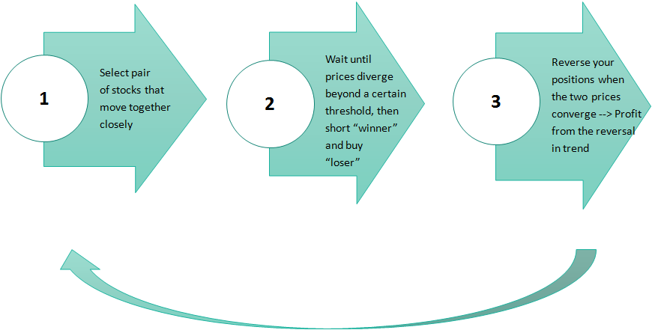
To Summarize

Slide 9
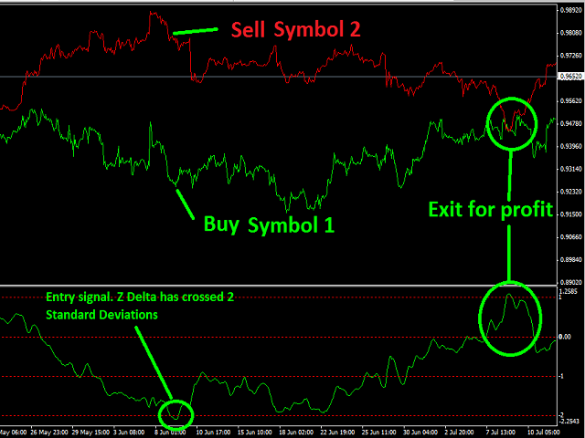
Arbitrage Examples https://www.mql5.com/en/job/44619

Slide 10
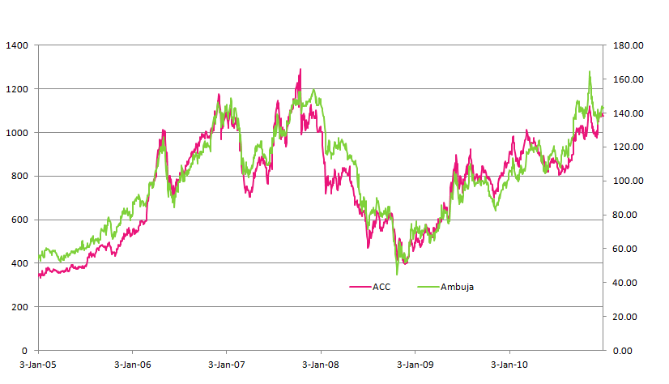
Arbitrage Examples https://www.quantinsti.com/blog/statistical-arbitrage/
Statistical Arbitrage between two stocks under “Cement” Industry: ACC and Ambuja both listed at National Stock Exchange of India.

Slide 11
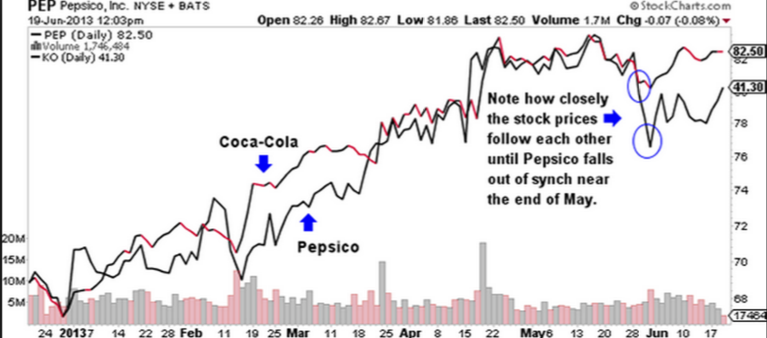
Arbitrage Examples http://www.tradingtips.com/trade-like-a-hedge-fund-with-this-simple-tactic/
Pepsi and Coca-Cola should trade together on average

Slide 12
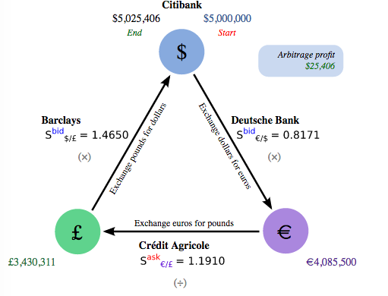
Forex Arbitrage Example https://en.wikipedia.org/wiki/Arbitrage
Triangular Aribitrage

Slide 13
Arbitrage Risks https://en.wikipedia.org/wiki/Arbitrage
Arbitrage transactions in modern securities markets involve fairly low day-to-day risks, but can face extremely high risk in rare situations, particularly financial crises, and can lead to bankruptcy.
Formally, arbitrage transactions have negative skew – prices can get a small amount closer (but often no closer than 0), while they can get very far apart.
The day-to-day risks are generally small because the transactions involve small differences in price, so an execution failure will generally cause a small loss (unless the trade is very big or the price moves rapidly).
The rare case risks are extremely high because these small price differences are converted to large profits via leverage (borrowed money), and in the rare event of a large price move, this may yield a large loss.

Slide 14
Statistical Arbitrage https://en.wikipedia.org/wiki/Statistical_arbitrage
In the world of finance and investments, arbitrage is used in two related but distinct ways:
In deterministic arbitrage, a sure profit can be obtained from being long some securities and short others.
In statistical arbitrage, there is a statistical mispricing of one or more assets based on the expected value of these assets.
In other words, statistical arbitrage conjectures statistical mis-pricings of price relationships that are true in expectation, in the long run when repeating a trading strategy.

Slide 15
Statistical Arbitrage https://en.wikipedia.org/wiki/Statistical_arbitrage
Among those who follow the hedge fund industry, "statistical arbitrage" refers to a particular category of hedge fund.
In this narrower sense, statistical arbitrage is often abbreviated as Stat Arb or StatArb.
According to Andrew Lo, StatArb refers to:
  Highly technical short-term mean reversion strategies involving large numbers of securities (hundreds to thousands, depending on the amount of risk capital),
  Very short holding periods (measured in days to seconds), and
  Substantial computational, trading, and information technology (IT) infrastructure

Slide 16
Statistical Arbitrage https://en.wikipedia.org/wiki/Statistical_arbitrage
As a trading strategy, statistical arbitrage is a heavily quantitative and computational approach to equity trading.
It involves data mining and statistical methods, as well as automated trading systems.
Historically, StatArb evolved out of the simpler pairs trade strategy, in which stocks are put into pairs by fundamental or market-based similarities.
When one stock in a pair outperforms the other, the poorer performing stock is bought long with the expectation that it will climb towards its outperforming partner, the other is sold short.
This hedges risk from whole-market movements.
Various statistical tools have been used in the context of pairs trading ranging from simple distance-based approaches to more complex tools such as cointegration and copula concepts.

Slide 17
Statistical Arbitrage https://en.wikipedia.org/wiki/Statistical_arbitrage
StatArb considers not pairs of stocks but a portfolio of a hundred or more stocks—some long, some short—that are carefully matched by sector and region to eliminate exposure to beta and other risk factors.
Portfolio construction is automated and consists of two phases.
In the first or "scoring" phase, each stock in the market is assigned a numeric score or rank that reflects its desirability
High scores indicate stocks that should be held long and low scores indicate stocks that are candidates for shorting.
Peter Muller formerly Morgan Stanley developed this strategy extensively

Slide 18
Statistical Arbitrage https://en.wikipedia.org/wiki/Statistical_arbitrage
The details of the scoring formula vary and are highly proprietary, but, generally (as in pairs trading), they involve a short term mean reversion principle (to be discussed)
E.g., stocks that have done unusually well in the past week receive low scores and stocks that have underperformed receive high scores.
In the second or "risk reduction" phase, the stocks are combined into a portfolio in carefully matched proportions so as to eliminate, or at least greatly reduce, market and factor risk.

Slide 19
Beta https://en.wikipedia.org/wiki/Beta_(finance)
In finance, the Beta (β or beta coefficient) of an investment indicates whether the investment is more or less volatile than the market.
Here the “market” generally refers to the Standard and Poors 500 index (SPX or GSPC)
In general, a beta less than 1 indicates that the investment is less volatile than the market, while a beta more than 1 indicates that the investment is more volatile than the market.
Volatility is measured as the fluctuation of the price around the mean: the standard deviation.
Beta is a measure of the risk arising from exposure to general market movements as opposed to idiosyncratic factors.

Slide 20
Beta https://en.wikipedia.org/wiki/Beta_(finance)
The market portfolio of all investable assets has a beta of exactly 1 (Beta of SPY Exchange Traded Fund = 1).
A beta below 1 can indicate either an investment with lower volatility than the market, or a volatile investment whose price movements are not highly correlated with the market.
An example of the first is a treasury bill: the price does not go up or down very much, so it has a low beta.
An example of the second is gold: The price of gold does go up and down by a large factor, but not in the same direction or at the same time as the market.
An interesting example is oil, which historically is inversely correlated to the market, except for brief periods such as 12/2015 – 4/2016
A final example is Bitcoin, whose value derives from other independent factors

Slide 21
Beta https://en.wikipedia.org/wiki/Beta_(finance)
A beta greater than one generally means that the asset both is volatile and tends to move up and down with the market.
An example is a stock in a big technology company.
Another example is a highly levered ETF or Fund, an example being the UPRO, which is a 3X levered version of the SPY
Negative betas are possible for investments that tend to go down when the market goes up, and vice versa.
There are few fundamental investments with consistent and significant negative betas, but some derivatives like put options can have large negative betas.

Slide 22
Beta https://en.wikipedia.org/wiki/Beta_(finance)
Beta is important because it measures the risk of an investment that cannot be reduced by diversification.
It does not measure the risk of an investment held on a stand-alone basis, but the amount of risk the investment adds to an already-diversified portfolio.
In the capital asset pricing model (to be discussed), beta risk is the only kind of risk for which investors should receive an expected return higher than the risk-free rate of interest, which is generally taken to be a US government bond or bill

Slide 23
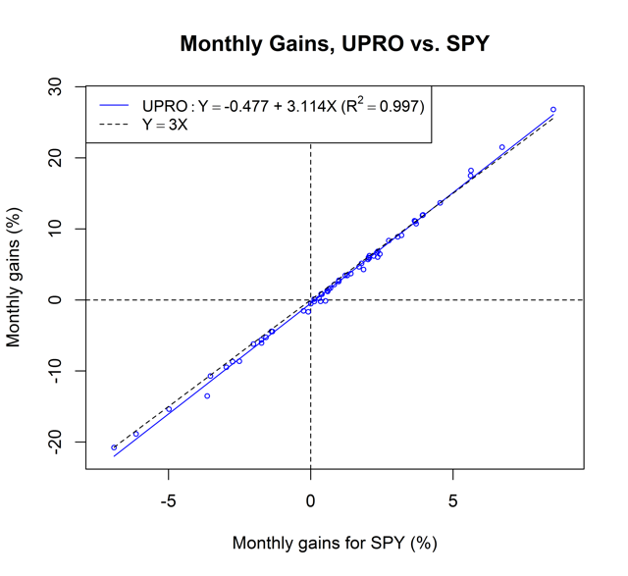
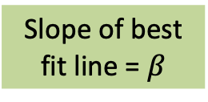
Calculating Beta
UPRO vs SPY
Monthly gains for UPRO (%)
Slope of best fit line = $β$
The UPRO from ProShares is a 3X levered derivative of the SPY
https://seekingalpha.com/article/4235173-vanguard-bans-leveraged-etfs-failing-consider-100-percent-allocation

Slide 24
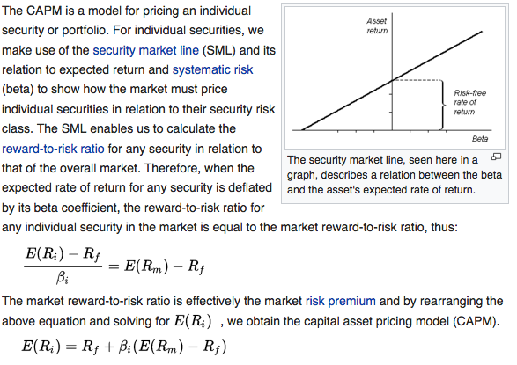
Capital Asset Pricing Model
https://en.wikipedia.org/wiki/Capital_asset_pricing_model
i refers to the security, m to the market, and f to the risk free investment

Slide 25
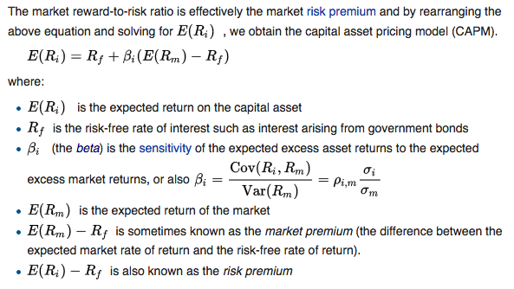
Capital Asset Pricing Model
https://en.wikipedia.org/wiki/Capital_asset_pricing_model

Slide 26
Leverage https://en.wikipedia.org/wiki/Leverage_(finance)
In finance, leverage is any technique involving the use of borrowed funds in the purchase of an asset
Normally, the finance provider would set a limit on how much risk it is prepared to take and will set a limit on how much leverage it will permit, and would require the acquired asset to be provided as collateral security for the loan.
For example, for a residential property the finance provider may lend up to, say, 80% of the property's market value, for a commercial property it may be 70%, while on shares it may lend up to, say, 60% or none at all on some shares.
Leveraging enables gains and losses to be multiplied.
On the other hand, there is a risk that leveraging will result in a loss — i.e., if it actually turns out that financing costs exceed the income from the asset, or because the value of the asset has fallen.

Slide 27
Leverage https://en.wikipedia.org/wiki/Leverage_(finance)
Leverage can arise in a number of situations, such as:
Individuals leverage their savings when buying a home by financing a portion of the purchase price with mortgage debt.
Individuals leverage their exposure to financial investments by borrowing from their broker.
Securities like options and futures contracts are bets between parties where the principal is implicitly borrowed/lent at very short T-bill rates.
Hedge funds may leverage their assets by financing a portion of their portfolios with the cash proceeds from the short sale of other positions.

Slide 28
Financial Leverage Example https://corporatefinanceinstitute.com/resources/knowledge/finance/financial-leverage/
Assume that Company X wants to acquire an asset that costs $100,000.
The company can either use equity or debt financing. If the company opts for the first option, it will own 100% of the asset, and there will be no interest payments.
If the asset appreciates in value by 30%, the asset’s value will increase to $130,000 and the company will earn a profit of $30,000.
Similarly, if the asset depreciates by 30%, the asset will be valued at $70,000 and the company will incur a loss of $30,000.

Slide 29
Financial Leverage Example https://corporatefinanceinstitute.com/resources/knowledge/finance/financial-leverage/
Alternatively, the company may go with the second option and finance the asset using 50% common stock and 50% debt.
If the asset appreciates by 30%, the asset will be valued at $130,000.
It means that if the company pays back the debt of $50,000, it will have $80,000 remaining, which translates into a profit of $30,000.
Similarly, if the asset depreciates by 30%, the asset will be valued at $70,000.
This means that after paying the debt of $50,000, the company will remain with $20,000 which translates to a loss of $30,000 ($50,000 – $20,000).

Slide 30
Measurement of Financial Leverage https://corporatefinanceinstitute.com/resources/knowledge/finance/financial-leverage/
The debt-to-equity ratio is used to determine the amount of financial leverage of an entity, and it shows the proportion of debt to the company’s equity.
It helps the company’s management, lenders, shareholders, and other stakeholders understand the level of risk in the company’s capital structure.
It shows the likelihood of the borrowing entity facing difficulties in meeting its debt obligations or if its levels of leverage are at healthy levels.

Slide 31
Measurement of Financial Leverage https://corporatefinanceinstitute.com/resources/knowledge/finance/financial-leverage/
Total debt, in this case, refers to the company’s current liabilities (debts that the company intends to pay within one year or less) and long-term liabilities (debts with a maturity of more than one year).
Equity refers to the shareholder’s equity (the amount that shareholders have invested in the company) plus the amount of retained earnings (the amount that the company retained from its profits).
Companies in the manufacturing sector typically report a higher debt to equity ratio than companies in the service industry, reflecting the higher amount of the former’s investment in machinery and other assets.
Usually, the ratio exceeds the US average debt to equity ratio of 54.62%.

Slide 32
Other Leverage Ratios https://corporatefinanceinstitute.com/resources/knowledge/finance/financial-leverage/
Common leverage ratios used to measure financial leverage include:
Debt to Capital Ratio (Debt/[Debt plus Shareholders Equity])
Debt to EBITDA Ratio (Earnings Before Interest, Taxes, Debt and Amortization)
Interest Coverage Ratio (Earnings Before Interest and Taxes/Interest Expense = EBIT/Interest)
While the Debt to Equity Ratio is the most commonly used leverage ratio, the above three ratios are also used frequently in corporate finance to measure a company’s leverage.

Slide 33
Leverage - Risk https://en.wikipedia.org/wiki/Leverage_(finance)
While leverage magnifies profits when the returns from the asset more than offset the costs of borrowing, leverage may also magnify losses.
A corporation that borrows too much money might face bankruptcy or default during a business downturn, while a less-leveraged corporation might survive.
Risk may be attributed to a loss in value of collateral assets.
Brokers may require the addition of funds when the value of securities hold declines.
This is a “margin call” : There must always be the original amount of borrowed money in the margin account at all times.
Banks may fail to renew mortgages when the value of real estate declines below the debt's principal.
Even if cash flows and profits are sufficient to maintain the ongoing borrowing costs, loans may be called.

Slide 34
Leverage – Risk Example https://en.wikipedia.org/wiki/Leverage_(finance)
Example:
An investor who buys a stock on 50% margin will lose 40% of the money invested if the stock declines 20% :
$50,000 in your account, you margin another $50,000 by borrowing from your broker and placing in a margin account.
Next day, value of investment declines to $80,000, a loss of 20%.
Broker can’t lose money, so sh/e requires that you keep $50,000 in the margin account. (“margin call”)
Thus you must replenish margin account from your own account.
Margin account ends up with $50,000 and your account with $30,000.
You have thus lost 40% of your $50,000 capital.

Slide 35
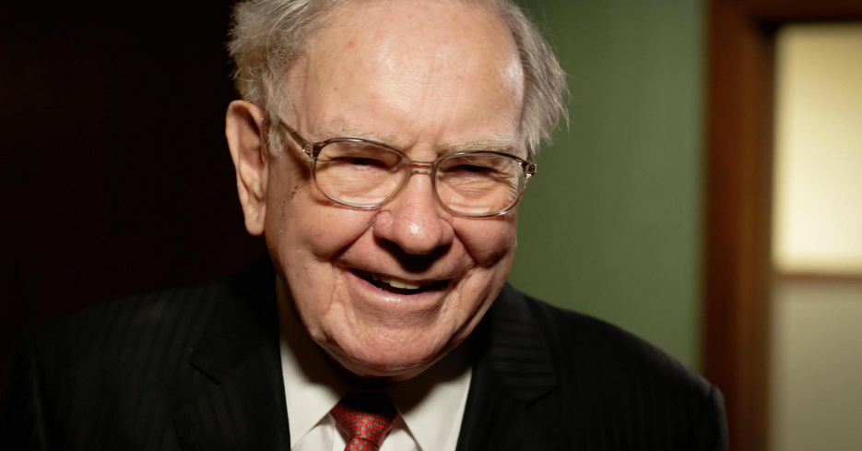
Warren Buffett’s (Ben Graham’s) Rules http://www.cnbc.com/2017/01/31/hbs-rejection-was-the-best-thing-that-ever-happened-to-warren-buffett.html
Rule #1: Don’t lose money
Rule #2: Never forget Rule #1

Slide 36
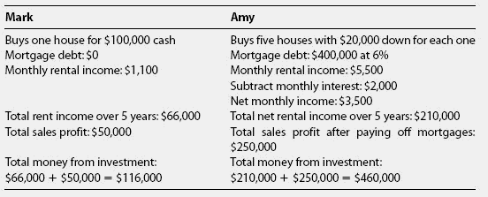
Leverage - Example https://en.wikipedia.org/wiki/Leverage_(finance)
Assume that at the end of 5 years, houses are sold for a $50,000 net profit each

Slide 37
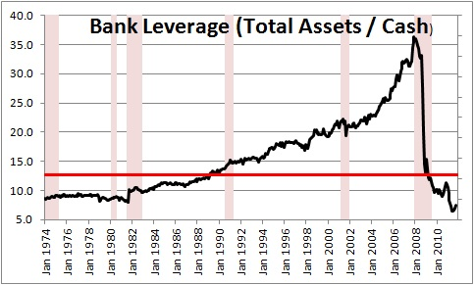
Bank Leverage http://www.pragcap.com/could-the-fed-have-avoided-2008/

Slide 38
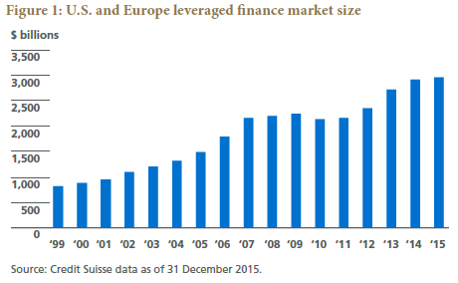
Leverage Debt Market Size https://www.pimco.com/insights/investment-strategies/featured-solutions/harnessing-value-in-dislocated-credit

Slide 39
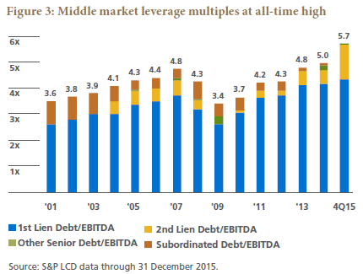
Leverage – Middle Market https://www.pimco.com/insights/investment-strategies/featured-solutions/harnessing-value-in-dislocated-credit
Middle market: Companies with debt less than $750 million, or EBITA (earnings) less than $100 million

Slide 40
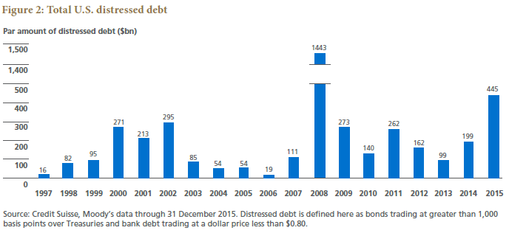
Leverage – Distressed Debt https://www.pimco.com/insights/investment-strategies/featured-solutions/harnessing-value-in-dislocated-credit

Slide 41
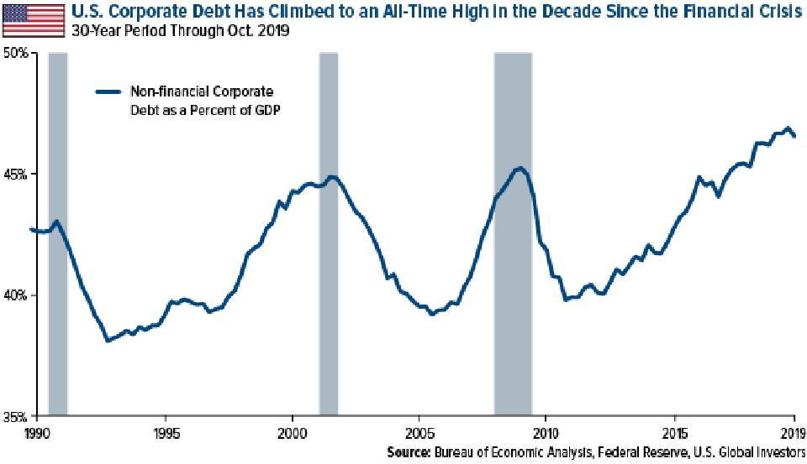
Corporate Debt to Equity Ratio https://www.forbes.com/sites/greatspeculations/2020/04/02/these-us-companies-have-the-highest-debt-to-equity-ratios-right-now/?sh=65dc75ec5826

Slide 42
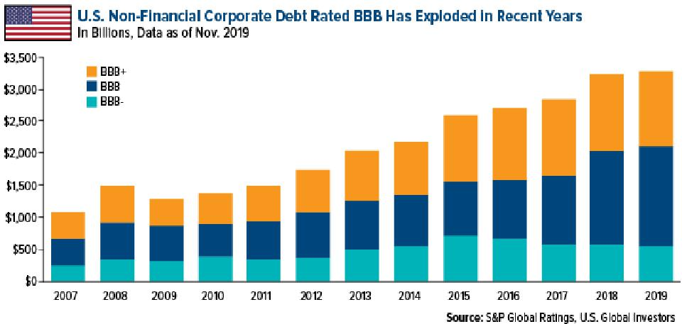
Corporate Debt to Equity Ratio https://www.forbes.com/sites/greatspeculations/2020/04/02/these-us-companies-have-the-highest-debt-to-equity-ratios-right-now/?sh=65dc75ec5826

Slide 43
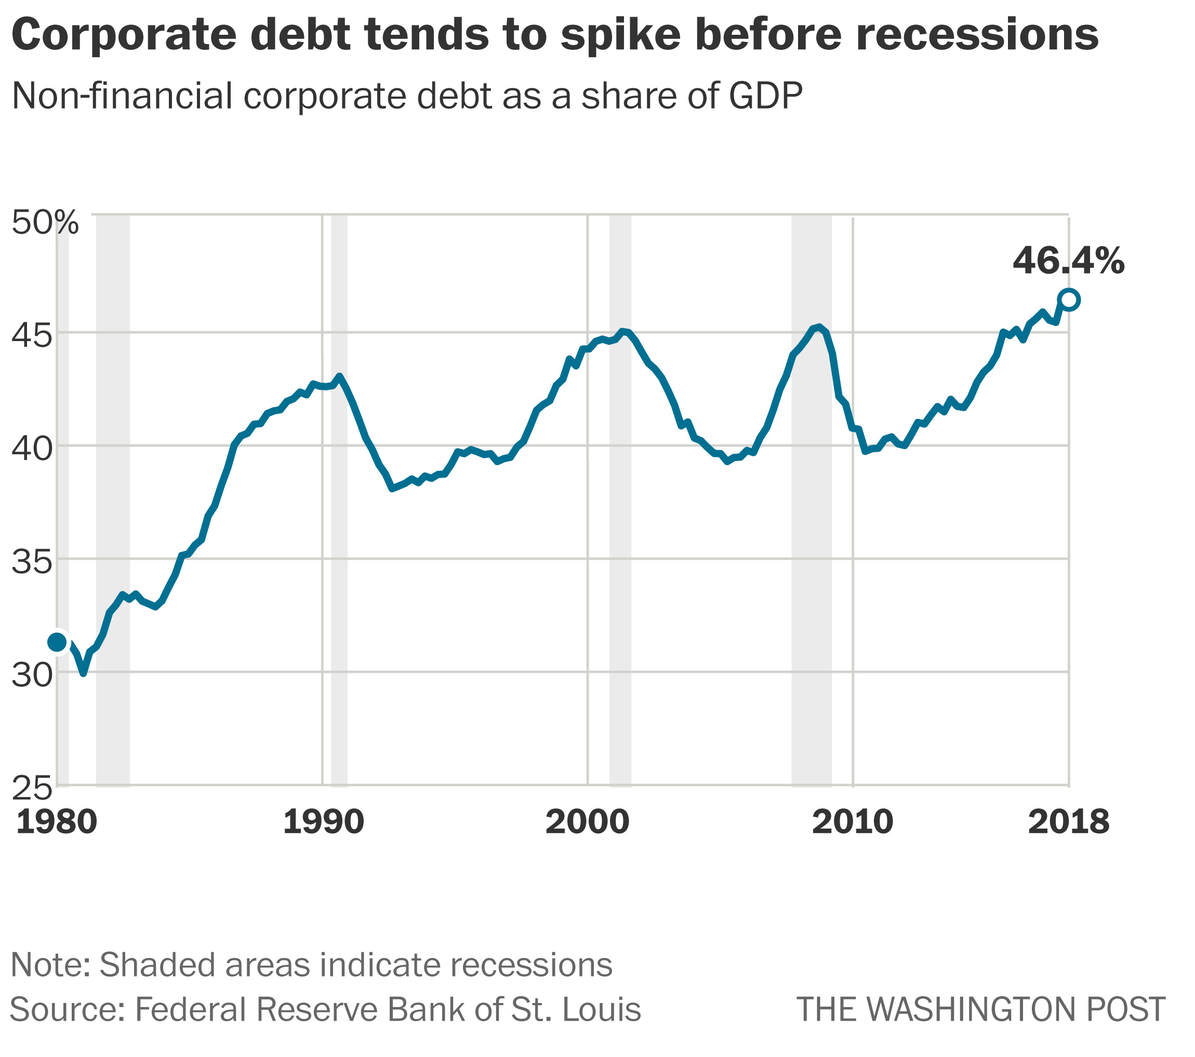
Potential Corporate Debt Bomb https://www.washingtonpost.com/business/2020/03/10/coronavirus-markets-economy-corporate-debt/

Slide 44
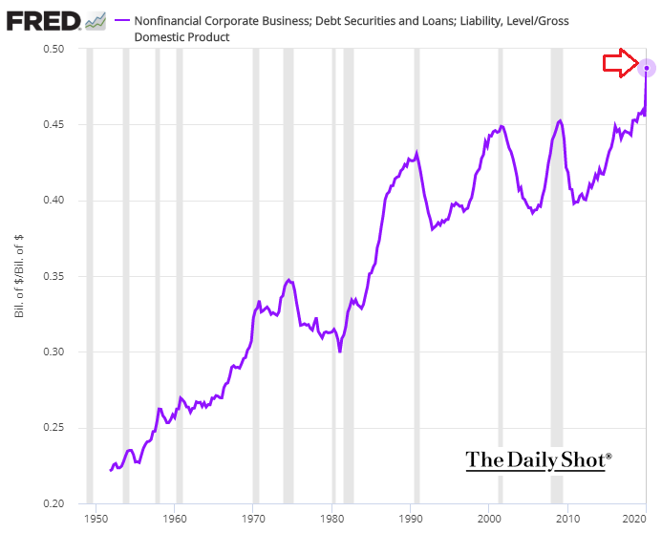
Federal Reserve Bank: Business Debt https://www.investing.com/analysis/this-is-crazy-this-is-crazy-this-is-crazy--corporate-debt-rising-200527576

