Slide 1
Lecture 6
Investing
John Rundle Econophysics PHYS 255

Slide 2
Value Investing https://en.wikipedia.org/wiki/Value_investing
Value investing is an investment paradigm that derives from the ideas on investment that Ben Graham and David Dodd began teaching at Columbia Business School in 1928 and subsequently developed in their 1934 text Security Analysis.
Although value investing has taken many forms since its inception, it generally involves buying securities that appear underpriced by some form of fundamental analysis.
As examples, such securities may be stock in public companies that trade at discounts to book value or tangible book value, have high dividend yields, have low price-to-earning multiples, have high projected free cash flow, or have low price-to-book ratios.
PEG = Price to Earnings/GrowthRate ~ 1

Slide 3
Value Investing and Warren Buffett https://en.wikipedia.org/wiki/Value_investing
High-profile proponents of value investing, including Berkshire Hathaway chairman Warren Buffett, have argued that the essence of value investing is buying stocks at less than their intrinsic value.
The discount of the market price to the intrinsic value is what Benjamin Graham called the "margin of safety".
The intrinsic value is the discounted value of all future revenues, dividends, and other distributions
However, the future distributions and the appropriate discount rate can only be assumptions.
Graham never recommended using future numbers, only past ones.
For the last 25 years, Warren Buffett has taken the value investing concept even further with a focus on "finding an outstanding company at a sensible price" rather than generic companies at a bargain price.

Slide 4
Value Investors – Charlie Munger https://en.wikipedia.org/wiki/Value_investing
Graham's most famous student is Warren Buffett, who ran successful investing partnerships before closing them in 1969 to focus on running Berkshire Hathaway.
Charlie Munger joined Buffett at Berkshire Hathaway in the 1970s and has since worked as Vice Chairman of the company.
Buffett has credited Munger with encouraging him to focus on long-term sustainable growth rather than on simply the valuation of current cash flows or assets

Slide 5
Value Investors –Michael Larson https://en.wikipedia.org/wiki/Value_investing
Michael Larson is the Chief Investment Officer of Cascade Investments, which is the investment vehicle for the Bill & Melinda Gates Foundation and the Gates personal fortune.
Cascade is a diversified investment shop established in 1994 by Gates and Larson
Larson is a well known value investor but his specific investment and diversification strategies are not known.
Larson has consistently outperformed the market since the establishment of Cascade and has rivaled or outperformed Berkshire Hathaway's returns as well as other funds based on the value investing strategy.
Alan Heuberger
(Senior Investment Manager at BMGI)

Slide 6
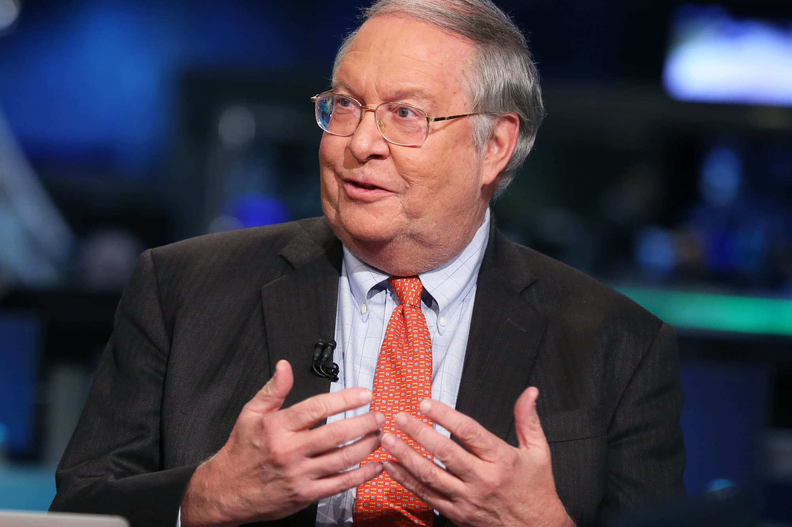
Value Investors – Bill Miller https://en.wikipedia.org/wiki/Value_investing
Bill Miller is the former Chairman and Chief Investment Officer of Legg Mason Capital Management, now a part of ClearBridge and formerly a standalone subsidiary of Legg Mason, Inc.
Miller was named “Fund Manager of the Decade” in the 1990’s by Morningstar.com
He is also formerly the portfolio manager of the Legg Mason Capital Management Value Trust (Mutual fund: LMVTX) and was the portfolio manager of the Legg Mason Opportunity Trust (Mutual fund: LMOPX) mutual funds
Miller is also Chairman Emeritus of the Santa Fe Institute.
Miller has now formed his own investment company, Miller Value Partners in Baltimore.
He is frequently seen on CNBC as a commentator

Slide 7
Value Investors – Bill Miller https://en.wikipedia.org/wiki/Value_investing
The Legg Mason Capital Management Value Trust's after-fee return beat the S&P 500 index for 15 consecutive years from 1991 through 2005
Consistently producing market beating returns is considered to be very unlikely according to the efficient market hypothesis
Miller once said, "As for the so-called streak, that's an accident of the calendar. If the year ended on different months it wouldn't be there and at some point the mathematics will hit us. We've been lucky. Well, maybe it's not 100% luck—maybe 95% luck.”
Miller’s focus is on finding companies that have high free cash flow, i.e., cash that is left after expenses are deducted from revenues

Slide 8
Legg Mason Opportunity Trust http://quotes.morningstar.com/chart/fund/chart?t=LMOPX&region=usa&culture=en_US

Slide 9
Legg Mason Opportunity Trust http://quotes.morningstar.com/chart/fund/chart?t=LMOPX&region=usa&culture=en_US

Slide 10
Role of Central Banks https://en.wikipedia.org/wiki/Central_bank
A central bank, reserve bank, or monetary authority is an institution that manages a state's currency, money supply, and interest rates.
Central banks also usually oversee the commercial banking system of their respective countries.
In contrast to a commercial bank, a central bank possesses a monopoly on increasing the monetary base in the state, and usually also prints the national currency, which usually serves as the state's legal tender.
US: Federal Reserve (FED). UK: Bank of England (BE). Japan: Bank of Japan (BOJ). EU: European Central Bank (ECB). Peoples Bank of China (PBOC).

Slide 11
Role of Central Banks https://en.wikipedia.org/wiki/Central_bank
The primary function of a central bank is to control the nation's money supply (monetary policy), through active duties such as:
Managing short term interest rates,
Setting the reserve requirement, and
Acting as a lender of last resort to the banking sector during times of bank insolvency or financial crisis.
Central banks usually also have supervisory powers, intended to prevent bank runs and to reduce the risk that commercial banks and other financial institutions engage in reckless or fraudulent behavior.
Central banks in most developed nations are institutionally designed to be independent from political interference.

Slide 12
FED: Primary Dealers https://en.wikipedia.org/wiki/Primary_dealer
In the United States, a primary dealer is a bank or securities broker-dealer that is permitted to trade directly with the Federal Reserve System ("the Fed").
Such firms are required to make bids or offers when the Fed conducts open market operations, provide information to the Fed's open market trading desk, and to participate actively in U.S. Treasury securities auctions.
They consult with both the U.S. Treasury and the Fed about funding the budget deficit and implementing monetary policy.
Many former employees of primary dealers work at the Treasury because of their expertise in the government debt markets, though the Fed avoids a similar revolving door policy.

Slide 13
FED: Primary Dealers https://en.wikipedia.org/wiki/Primary_dealer
The relationship between the Fed and the primary dealers is governed by the Primary Dealers Act of 1988 and the Fed's operating policy "Administration of Relationships with Primary Dealers.”
Primary dealers purchase the vast majority of the U.S. Treasury securities (T-bills, T-notes, and T-bonds) sold at auction, and resell them to the public.
Their activities extend well beyond the Treasury market, for example, according to the Wall Street Journal Europe (2/9/06 p. 20), all of the top ten dealers in the foreign exchange market are also primary dealers, and between them account for almost 73% of foreign exchange trading volume.

Slide 14
FED: Primary Dealers http://marginofdoubt.blogspot.com/2011/06/pomo-and-quantitative-easing-qe.html
POMO: Permanent Open Market Operations

Slide 15
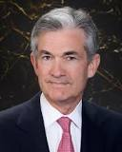
FED and Credit Creation http://davidstockmanscontracorner.com/inside-the-monetary-machinery-part-1-how-the-primary-dealers-drive-credit-and-asset-inflation/

Slide 16
FED: Primary Dealers https://en.wikipedia.org/wiki/Primary_dealer
Bank of Nova Scotia, New York Agency
BMO Capital Markets Corp.
BNP Paribas Securities Corp.
Barclays Capital Inc.
Cantor Fitzgerald & Co.
Citigroup Global Markets Inc.
Credit Suisse Securities (USA) LLC
Daiwa Capital Markets America Inc.
Deutsche Bank Securities Inc.
Goldman, Sachs & Co.
HSBC Securities (USA) Inc.
Jefferies LLC
J.P. Morgan Securities LLC
Merrill Lynch, Pierce, Fenner & Smith Incorporated
Mizuho Securities USA Inc.
Morgan Stanley & Co. LLC
Nomura Securities International, Inc.
RBC Capital Markets, LLC
RBS Securities Inc.
Societe Generale, New York Branch
TD Securities (USA) LLC
UBS Securities LLC.
Wells Fargo Securities LLC.

Slide 17
FED Lending Programs 2007-2010 https://www.mpls.frb.org/publications/the-region/federal-reserve-liquidity-programs-an-update?sc_camp=16C883BC3D314E2E899021FBD04A7AF9

Slide 18
FED Lending Programs 2007-2010 https://www.mpls.frb.org/publications/the-region/federal-reserve-liquidity-programs-an-update?sc_camp=16C883BC3D314E2E899021FBD04A7AF9
To respond to pressures in the interbank funding market, the Federal Reserve created the Term Auction Facility (TAF) (December 2007–March 2010), which allowed any depository institution eligible to borrow under the primary credit program to bid for a loan at an interest rate determined in an auction process.
This facility was introduced on the heels of the introduction of term lending by the Federal Reserve, which first allowed 30-day and later 90-day loans from the discount window.
The Federal Reserve has long engaged in short-term backup lending to depository institutions through its discount window. Pricing above market-based terms for lending and other factors led the window to be a contingency, rather than primary, source of funding for banks.

Slide 19
FED Lending Programs 2007-2010 https://www.mpls.frb.org/publications/the-region/federal-reserve-liquidity-programs-an-update?sc_camp=16C883BC3D314E2E899021FBD04A7AF9

Slide 20
FED Lending Programs 2007-2010 https://www.mpls.frb.org/publications/the-region/federal-reserve-liquidity-programs-an-update?sc_camp=16C883BC3D314E2E899021FBD04A7AF9
PDCF usage was high immediately, spiking to $40 billion.
It then declined as the financing arrangements with Bear Stearns were concluded.
Usage spiked higher yet to $150 billion in September 2008, when Lehman filed for bankruptcy and the Federal Reserve expanded PDCF-eligible collateral in response.
This chart also shows the effective fed funds rate spread over comparable Treasuries.
Repo market financing often closely tracks fed funds pricing, with overall rates running slightly below the fed funds market.
Accordingly, using the more broadly available fed funds spread over Treasuries is a good proxy for what was taking place. The chart shows the significant jumps in this spread during the crisis period, with noted peaks around the Bear Stearns and Lehman events.

Slide 21
Current FED Balance Sheet
7 Trillion USD

Slide 23
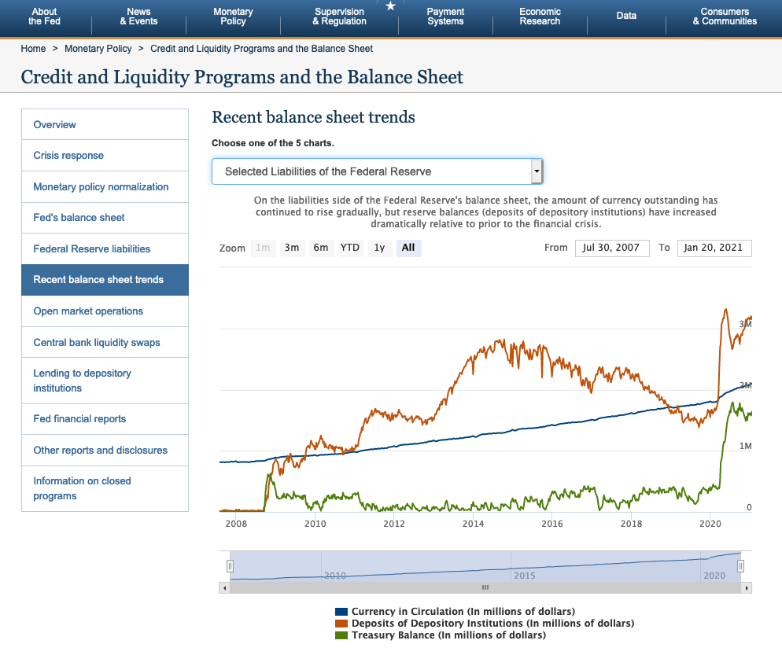

Slide 24
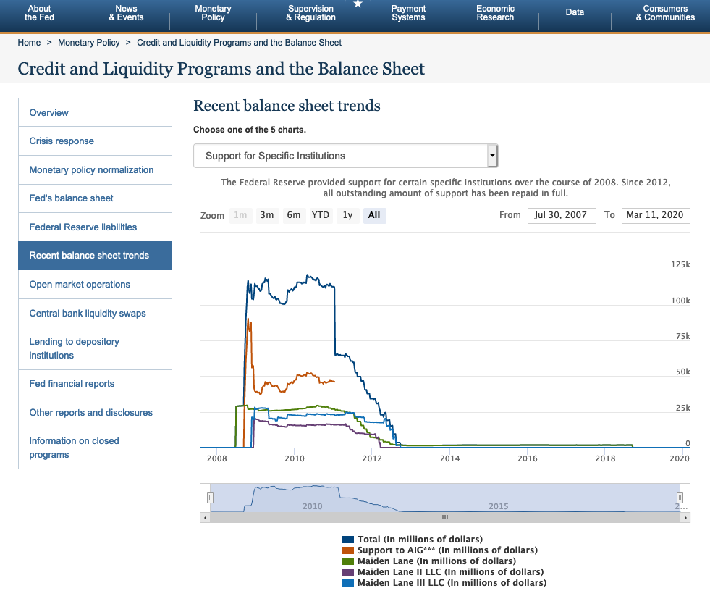

Slide 25
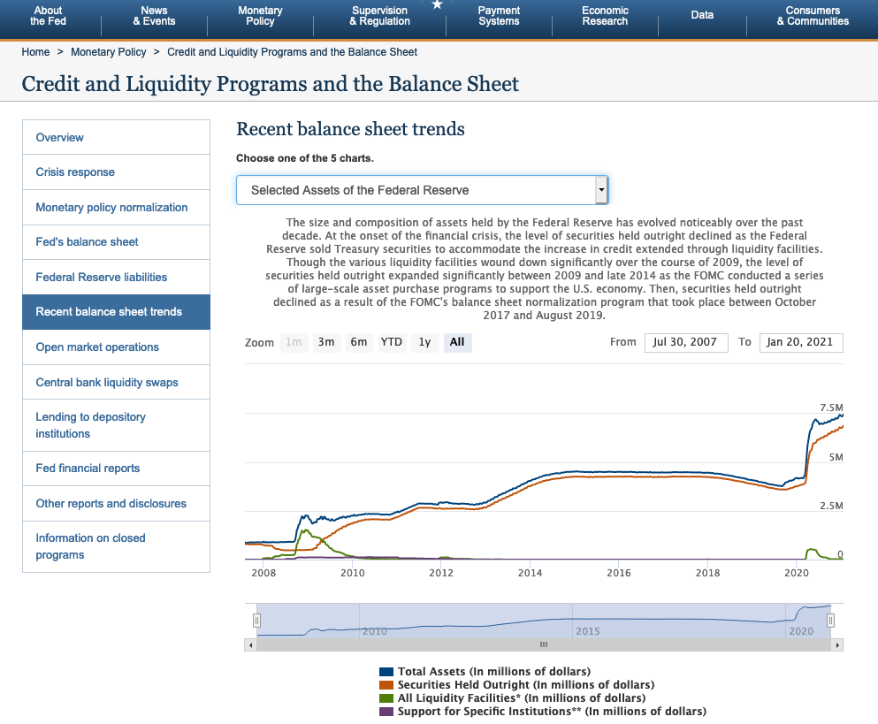

Slide 26
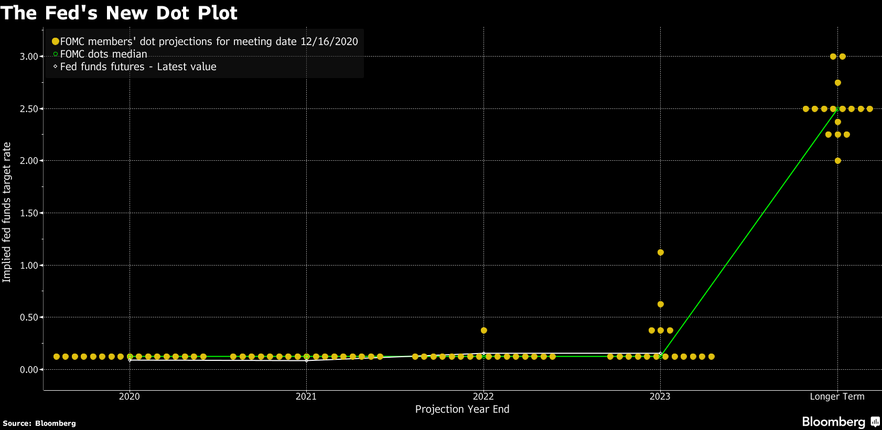
The FED Dot Plot A projection of future interest rates

