Slide 1
Lecture 6
ETFs and High Frequency Trading
John Rundle Econophysics PHYS 250

Slide 2
Exchange Traded Funds https://en.wikipedia.org/wiki/Exchange-traded_fund
An exchange-traded fund (ETF) is an investment fund traded on stock exchanges, much like stocks.
An ETF holds assets such as stocks, commodities, or bonds, and trades close to its net asset value over the course of the trading day.
Most ETFs track an index, such as a stock index or bond index.
ETFs may be attractive as investments because of their low costs, tax efficiency, and stock-like features.
By 2013, ETFs were the most popular type of exchange-traded product.

Slide 3
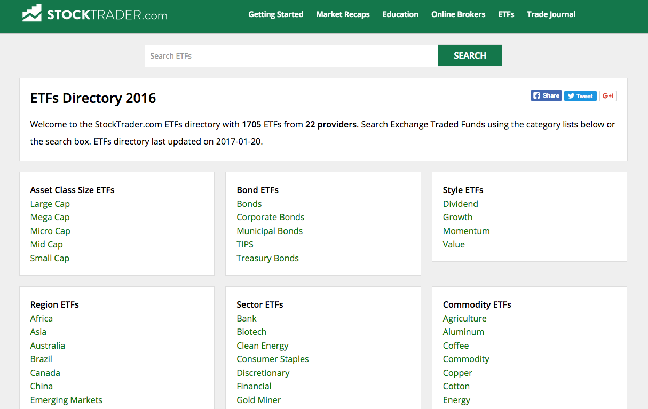
A Universe of ETFs https://www.stocktrader.com/etfs/

Slide 4
ETF Authorized Participants https://en.wikipedia.org/wiki/Exchange-traded_fund
Only authorized participants, large broker-dealers who have entered into agreements with the ETF's distributor, actually buy or sell shares of an ETF directly from or to the ETF, and then only in creation units
Creation units are large blocks of tens of thousands of ETF shares, usually exchanged in-kind with baskets of the underlying securities.
Authorized Participants may wish to invest in the ETF shares for the long-term, but they usually act as market makers on the open market
APs use their ability to exchange creation units with their underlying securities to provide liquidity of the ETF shares and help ensure that their intraday market price approximates the net asset value of the underlying assets.
Other investors, such as individuals using a retail broker, trade ETF shares on this secondary market.

Slide 5
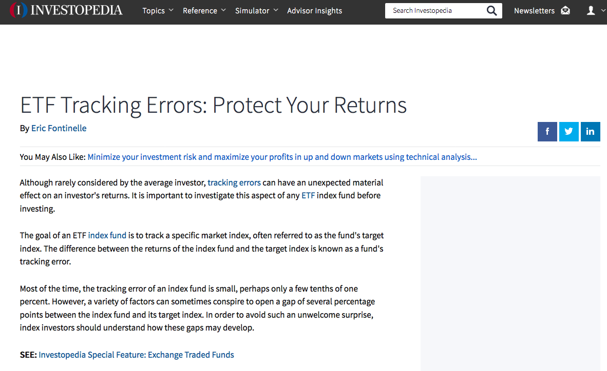
ETF Tracking Error http://www.investopedia.com/articles/exchangetradedfunds/09/tracking-error-etf-funds.asp

Slide 6
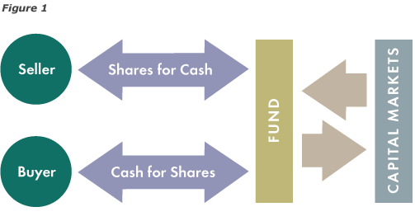
Comparison: Mutual Fund Mechanics https://www.flexshares.com/education/what-are-etfs/how-do-etfs-work

Slide 7
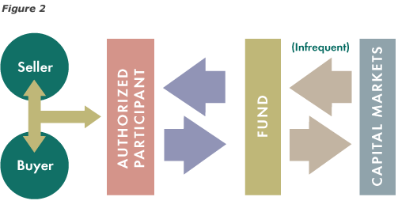
ETF Mechanics https://www.flexshares.com/education/what-are-etfs/how-do-etfs-work
Start here 1/25/2017

Slide 8
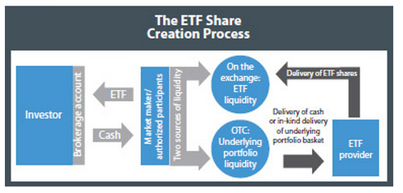
ETF Mechanics https://www.flexshares.com/education/what-are-etfs/how-do-etfs-work
Example of an ETF Provider:
State Street Bank, or Blackrock Group
Example of an Authorized Participant: Wells Fargo or BAML

Slide 9
ETFs – History https://en.wikipedia.org/wiki/Exchange-traded_fund
An ETF combines the valuation feature of a mutual fund or unit investment trust with the tradability feature of a closed-end fund
Mutual funds can only be bought or sold at the end of each trading day for its net asset value
Closed-end fund trades throughout the trading day at prices that may be more or less than its net asset value.
Closed-end funds are not considered to be ETFs, even though they are funds and are traded on an exchange.
ETFs have been available in the US since 1993 (SPY) and in Europe since 1999.
ETFs traditionally have been index funds, but in 2008 the U.S. Securities and Exchange Commission began to authorize the creation of actively managed ETFs.

Slide 10
Markets and Exchanges https://en.wikipedia.org/wiki/Financial_market
Primary market: A market for new issues or new financial claims, thus called new issue market. The primary market deals with those securities which are issued to the public for the first time.
Secondary market: A market for secondary sale of securities that have already passed through the new issue. Generally, such securities are quoted in the stock exchange and it provides a continuous and regular market for buying and selling of securities

Slide 11
Components of Markets https://en.wikipedia.org/wiki/Financial_market
Money market (short term bonds): A market for dealing with financial assets and securities which have a maturity period of up to one year, thus a market for short term funds.
Capital market (long term bonds): A market for financial assets which have a long or indefinite maturity. Generally it deals with long term securities that have a maturity period of above one year. Capital market may be further divided into: (a) industrial securities market (b) Govt. securities market and (c) long term loans market.
Equity markets: A market where ownership of securities are issued and subscribed is known as equity market. An example of a secondary equity market for shares is the Bombay stock exchange.
Debt market (repo markets): The market where funds are borrowed and lent is known as debt market. Arrangements are made in such a way that the borrowers agree to pay the lender the original amount of the loan plus some specified amount of interest.
Derivative markets (options, swaps, etc.): A market where financial instruments are derived and traded based on an underlying asset such as commodities or stocks

Slide 12
Examples of Exchanges
NYSE / ARCA - New York Stock Exchange
NASDAQ - Over the counter
CME – Chicago Mercantile Exchange
CBOT Chicago Board of Trade (contract market for CME)

Slide 13
Trading
All trading is automated now, using methods that were first invented by Josh Levine with his Island Trading System (late 90’s)
Dark Pools – dozens of these that match buy/sell orders, but are not required to publicize trades like the lit pools (major public exchanges)
Dark Pools are private exchanges but market transactions are reported
Lit pools are public exchanges where pricing is transparent to the public

Slide 14
High Frequency Trading https://en.wikipedia.org/wiki/High-frequency_trading
High-frequency trading (HFT) is a type of algorithmic trading characterized by high speeds, high turnover rates, and high order-to-trade ratios that leverages high-frequency financial data and electronic trading tools.
High Frequency Trading (HFT) are algorithms* that issue buy/sell orders in microseconds. They use a variety of strategies to profit from rapid fire transactions, and are limited by the speed of light
While there is no single definition of HFT, among its key attributes are highly sophisticated algorithms, specialized order types, co-location, very short-term investment horizons, and high cancellation rates of orders.
HFT can be viewed as a primary form of algorithmic trading*
*algorithms are computer codes that automatically trade securities
according to proprietary models

Slide 15
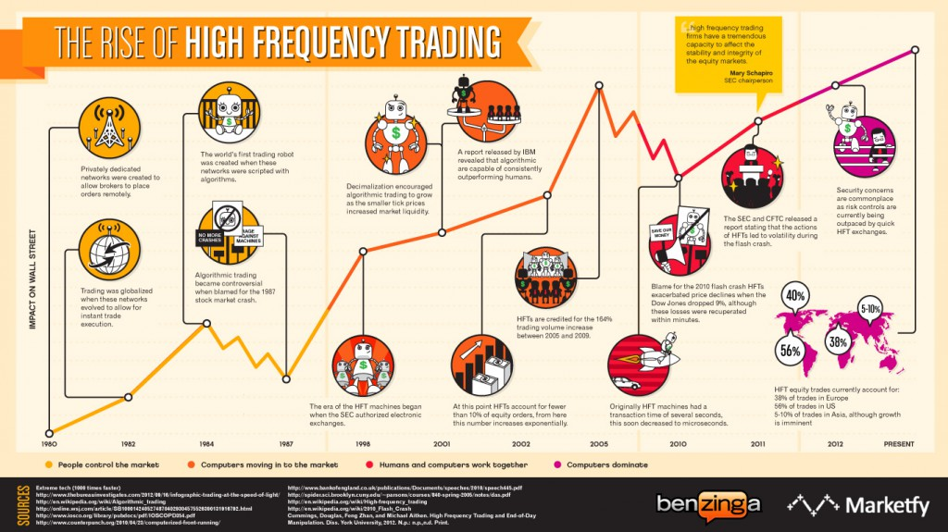
High Frequency Trading http://www.rifuture.org/providence-sues-wall-street-over-high-frequency-trading/high-frequency-trading/

Slide 16
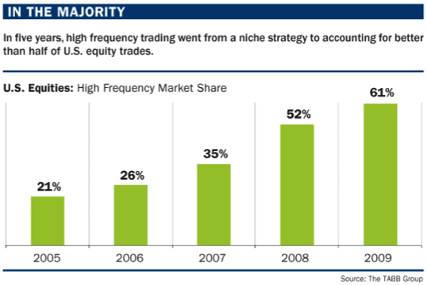
Growth in HFT http://greenvestmentcenter.com/financial-reform/does-high-frequency-trading-create-market-efficiency

Slide 17
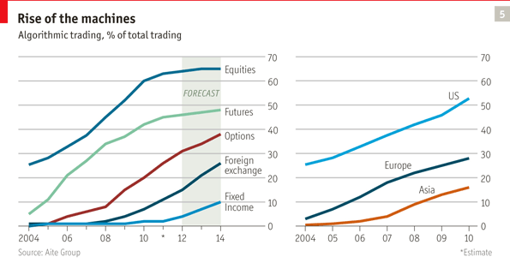
High Frequency Trading http://www.economist.com/node/21547988

Slide 18
High Frequency Trading https://en.wikipedia.org/wiki/High-frequency_trading
HFT uses proprietary trading strategies carried out by computers to move in and out of positions in seconds or fractions of a second.
It is estimated that as of 2009, HFT accounted for 60-73% of all US equity trading volume, with that number falling to approximately 50% in 2012.
High-frequency traders move in and out of short-term positions at high volumes and high speeds aiming to capture sometimes a fraction of a cent in profit on every trade.
HFT firms make up the low margins with incredibly high volumes of trades, frequently numbering in the millions.
HFT traders often use stimulus-response methods (rapid fire placement and then immediate cancellation of orders) to discern the depth of the “order book”

Slide 19
High Frequency Trading - History https://en.wikipedia.org/wiki/High-frequency_trading
In the early 2000s, high-frequency trading still accounted for fewer than 10% of equity orders.
According to data from the NYSE, trading volume grew by about 164% between 2005 and 2009 for which high-frequency trading might be responsible.
As of the first quarter in 2009, total assets under management for hedge funds with high-frequency trading strategies were $141 billion, down about 21% from their peak before the worst of the crises.
The high-frequency strategy was first made popular by Renaissance Technologies who use both HFT and quantitative aspects in their trading.
Many high-frequency firms are market makers and provide liquidity to the market which lowers volatility and helps narrow bid-offer spreads, making trading and investing cheaper for other market participants.

Slide 20
High Frequency Trading - Problems https://en.wikipedia.org/wiki/High-frequency_trading
A substantial body of research argues that HFT and electronic trading pose new types of challenges to the financial system.
Algorithmic and high-frequency traders were both found to have contributed to volatility in the Flash Crash of May 6, 2010, when high-frequency liquidity providers rapidly withdrew from the market.
Several European countries have proposed curtailing or banning HFT due to concerns about volatility.

Slide 21
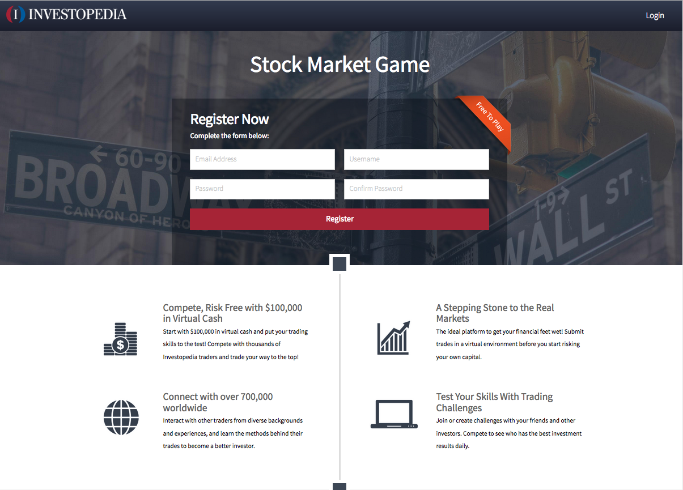
Free Stock Market Simulator http://www.investopedia.com/simulator/?source=dfp&subid=dfp-note-pf

Slide 22
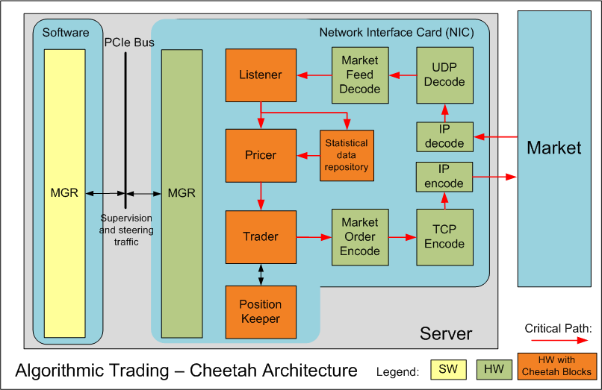
High Frequency Trading http://www.economist.com/node/21547988

