Slide 1
Lecture 5
Types of Markets
John Rundle Econophysics PHYS 250

Slide 2
Market Slang https://en.wikipedia.org/wiki/Financial_market
Bps, meaning basis points. A basis point is a financial unit of measurement used to describe the magnitude of percent change in a variable. One basis point is the equivalent of one hundredth of a percent. For example, if a stock price were to rise 100 bps, it means it would increase 1%.
Quant, a quantitative analyst with advanced training in mathematics and statistical methods.
Rocket scientist, a financial consultant at the zenith of mathematical and computer programming skill. They are able to invent derivatives of high complexity and construct sophisticated pricing models. They generally handle the most advanced computing techniques adopted by the financial markets since the early 1980s. Typically, they are physicists and engineers by training. (i.e., that is us!!)
IPO, stands for initial public offering, which is the process a new private company goes through to "go public" or become a publicly traded company on some index.
Spread, the difference between the highest bid and the lowest offer.
Pegging, when a country wants to obtain price stability, it can use pegging to fix their exchange rate relative to another currency
Counterparties, the (generally) two groups involved in a contract

Slide 3
History of Futures https://en.wikipedia.org/wiki/Futures_contract
The first futures exchange market was the Dōjima Rice Exchange in Japan in the 1730s, to meet the needs of samurai who—being paid in rice, and after a series of bad harvests—needed a stable conversion to coin.
The Chicago Board of Trade (CBOT) listed the first-ever standardized 'exchange traded' forward contracts in 1864, which were called futures contracts.
The 1972 creation of the International Monetary Market (IMM), the world's first financial futures exchange, launched currency futures.
In 1976, the IMM added interest rate futures on US treasury bills, and in 1982 they added stock market index futures.

Slide 4
Futures https://en.wikipedia.org/wiki/Futures_contract
In finance, a futures contract (more colloquially, futures) is a standardized contract which can be easily traded between parties other than the two initial parties to the contract.
The parties initially agree to buy and sell an asset for a price agreed upon today (the forward price), with delivery and payment occurring at a future point, the delivery date.
Because it is a function of an underlying asset, a futures contract is a derivative product.
A forward is a non-standard type of future that is likewise conducted between counterparties, but is generally not traded.

Slide 5
Futures Exchanges https://en.wikipedia.org/wiki/Futures_contract
Contracts are negotiated at futures exchanges, which act as a marketplace between buyers and sellers.
There are generally no exchanges for forwards
The buyer of a contract is said to be long position holder, and the selling party is said to be short position holder.
As both parties risk their counter-party walking away if the price goes against them, the contract may involve both parties lodging a margin (or fraction) of the value of the contract with a mutually trusted third party (“clearing house”).
For example, in gold futures trading, the margin varies between 2% and 20% (more typically 5%-15%) depending on the volatility of the spot market

Slide 6
Margins in Futures Contracts https://en.wikipedia.org/wiki/Futures_contract
The first futures contracts were negotiated for agricultural commodities, and later futures contracts were negotiated for natural resources such as oil.
Financial futures were introduced in 1972, and in recent decades, currency futures, interest rate futures and stock market index futures have played an increasingly large role in the overall futures markets.
The original use of futures contracts was to mitigate the risk of price or exchange rate movements by allowing parties to fix prices or rates in advance for future transactions.
This could be advantageous when (for example) a party expects to receive payment in foreign currency in the future, and wishes to guard against an unfavorable movement of the currency in the interval before payment is received.

Slide 7
Futures https://en.wikipedia.org/wiki/Futures_contract
To minimize credit risk to the exchange, traders must post a margin or a performance bond, typically 5%-15% of the contract's value.
To minimize counterparty risk to traders, trades executed on regulated futures exchanges are guaranteed by the clearing house.
The clearing house becomes the buyer to each seller, and the seller to each buyer, so that in the event of a counterparty default the clearing house assumes the risk of loss.
This enables traders to transact without needing to perform due diligence on their counterparty.

Slide 8
Marking to Market https://en.wikipedia.org/wiki/Futures_contract
If the margin account goes below a certain value set by the Exchange, then a margin call is made and the account owner must replenish the margin account.
This process is known as marking to market.
Thus on the delivery date, the amount exchanged is not the specified price on the contract but the spot value (i.e. the original value agreed upon, since any gain or loss has already been previously settled by marking to market).

Slide 9
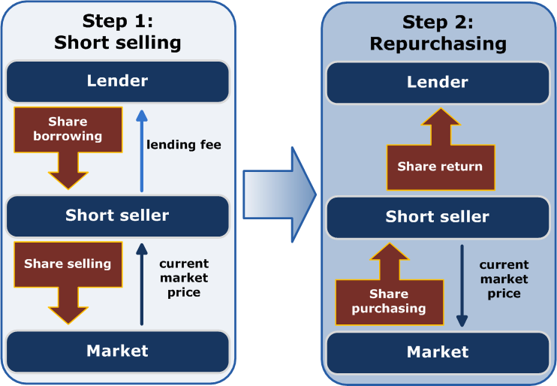
Futures – Short Selling (Repo) https://en.wikipedia.org/wiki/Futures_contract

Slide 10
Futures – “Contango” https://en.wikipedia.org/wiki/Futures_contract
Contango is a situation where the futures price (or forward price) of a commodity is higher than the spot price.
In a contango situation, hedgers (commodity producers and commodity users) or arbitrageurs/speculators (non-commercial investors), are "willing to pay more [now] for a commodity at some point in the future than the actual expected price of the commodity [at that future point].
This may be due to people's desire to pay a premium to have the commodity in the future rather than paying the costs of storage and carry costs of buying the commodity today."
The default assumption is that prices don’t change much during the period covered by the contract
Contango
Spot Price at
maturity
Backwardation
Current Price

Slide 11
Futures – “Backwardation” https://en.wikipedia.org/wiki/Futures_contract
The opposite market condition to contango is known as Backwardation
A market is “in backwardation” when the current futures price is below the spot price for a particular commodity.
This is favorable for investors who have long positions since they want the futures price to rise to the level of the current spot price.
Contango
Spot Price at
maturity
Backwardation
Current Price

Slide 12
Trading Futures https://en.wikipedia.org/wiki/Futures_contract
Futures contracts also offer opportunities for speculation in that a trader who predicts that the price of an asset will move in a particular direction can contract to buy or sell it in the future at a price which (if the prediction is correct) will yield a profit.
Futures contracts are often highly levered, meaning that a small investment of money can control a much more valuable contract.
For example, the e-mini futures contract on the SP500 is typically levered 25 to 1, meaning that a margin of $5000 might control a contract valued at $130,000
To mitigate the risk of default, the product is marked to market on a daily basis where the difference between the initial agreed-upon price and the actual daily futures price is reevaluated daily.
This is sometimes known as the variation margin, where the Futures Exchange will draw money out of the losing party's margin account and put it into that of the other party, ensuring the correct loss or profit is reflected daily.

Slide 13
Trading Futures http://www.investopedia.com/ask/answers/042315/how-do-sp-500-futures-work.asp
The first S&P 500 futures contracts were introduced by the CME in 1982. The CME added the e-mini option in 1997.
The big futures contract was originally priced by multiplying the quoted futures price by $500.
For example, if the S&P was trading at $800, the value of the big contract was $400,000, or $500 x $800.
Eventually, the CME cut the contract multiplier in half to $250 times the price of the futures index.
E-mini futures are one-tenth the value of the big contract. If the S&P 500 futures price is $800, this results in an e-mini being valued at $40,000. The "e" in e-mini stands for electronic.
As with all futures, investors are only required to front a fraction of the contract value (the margin) to take a position.
This represents the margin on the futures contract - futures margins show "skin in the game," which must be offset or settled.

Slide 14
Options (Details Later) https://en.wikipedia.org/wiki/Option_(finance)
In finance, an option is a contract which gives the buyer (the owner or holder of the option) the right, but not the obligation, to buy or sell an underlying asset or instrument at a specified strike price on a specified date, depending on the form of the option.
The strike price may be set by reference to the spot price (market price) of the underlying security or commodity on the day an option is taken out, or it may be fixed at a discount or at a premium.
The seller has the corresponding obligation to fulfill the transaction – to sell or buy – if the buyer (owner) "exercises" the option.
An option that conveys to the owner the right to buy at a specific price is referred to as a call
An option that conveys the right of the owner to sell at a specific price is referred to as a put.
There are “American” and “European” options with different characteristics
Start here 1/24/2019

Slide 15
Swaps https://en.wikipedia.org/wiki/Swap_(finance)
A swap is a derivative in which two counterparties exchange cash flows of one party's financial instrument for those of the other party's financial instrument.
The benefits in question depend on the type of financial instruments involved.
For example, in the case of a swap involving two bonds, the benefits in question can be the periodic interest (coupon) payments associated with such bonds.
Often this involves swapping a variable rate of interest for a fixed rate
Specifically, two counterparties agree to exchange one stream of cash flows against another stream.

Slide 16
Trading Swaps for Hedging https://en.wikipedia.org/wiki/Swap_(finance)
Swaps can be used to hedge certain risks such as interest rate risk, or to speculate on changes in the expected direction of underlying prices.
Swaps were first introduced to the public in 1981 when IBM and the World Bank entered into a swap agreement.
Today, swaps are among the most heavily traded financial contracts in the world: the total amount of interest rates and currency swaps outstanding is more than $348 trillion in 2010, according to Bank for International Settlements (BIS).

Slide 17
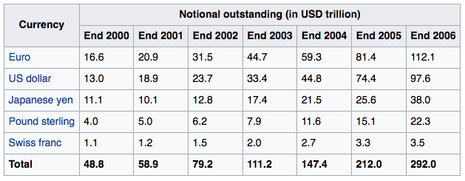
Total Value of Derivatives (Swaps) https://en.wikipedia.org/wiki/Swap_(finance)
The Bank for International Settlements (BIS) publishes statistics on the notional amounts outstanding in the OTC derivatives market.
At the end of 2006, this was USD 415.2 trillion, more than 8.5 times the 2006 gross world product.

Slide 18
Credit Default Swaps (CDS) https://en.wikipedia.org/wiki/Credit_default_swap
A credit default swap (CDS) is a financial swap agreement that the seller of the CDS will compensate the buyer (usually the creditor of the reference loan) in the event of a loan default (by the debtor) or other credit event.
The seller of the CDS insures the buyer against some reference loan defaulting.
The buyer of the CDS makes a series of payments (the CDS "fee" or "spread") to the seller and, in exchange, receives a payoff if the loan defaults. It was invented by Blythe Masters from JP Morgan in 1994.

Slide 19
CDS: Mechanics https://en.wikipedia.org/wiki/Credit_default_swap
In the event of default the buyer of the CDS receives compensation (usually the face value of the loan), and the seller of the CDS takes possession of the defaulted loan.
However, anyone can purchase a CDS, even buyers who do not hold the loan instrument and who have no direct insurable interest in the loan (these are called "naked" CDSs)
Credit default swaps have existed since 1994, and increased in use after 2003. By the end of 2007, the outstanding CDS amount was $62.2 trillion, falling to $26.3 trillion by mid-year 2010 and reportedly $25.5 trillion in early 2012.
CDSs are not traded on an exchange and there is no required reporting of transactions to a government agency.

Slide 20
Comparison of Swaps https://en.wikipedia.org/wiki/Credit_default_swap

Slide 21
Complexity! https://en.wikipedia.org/wiki/Credit_default_swap
Most CDSs are documented using standard forms drafted by the International Swaps and Derivatives Association (ISDA), although there are many variants.
In addition to the basic, single-name swaps, there are basket default swaps (BDSs), index CDSs, funded CDSs (also called credit-linked notes), as well as loan-only credit default swaps (LCDS).
In addition to corporations and governments, the reference entity can include a special purpose vehicle issuing asset-backed securities.
The many feedback loops allow for the possibility of growth of instabilities!! (as happened in 2008)

Slide 22
Securitized Cat Bond Structure

Slide 23
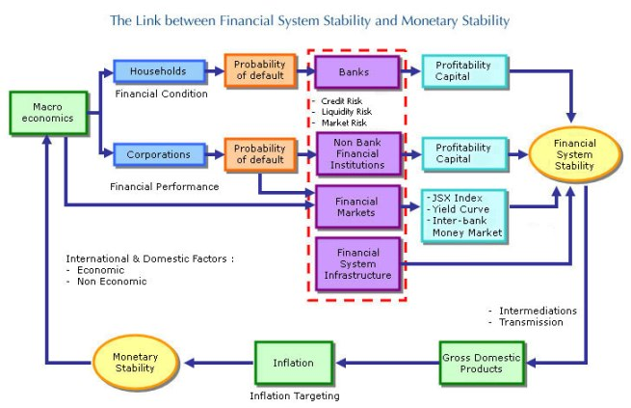
Stability http://www.bi.go.id/en/perbankan/ssk/ikhtisar/definisi/Contents/Default.aspx

Slide 24
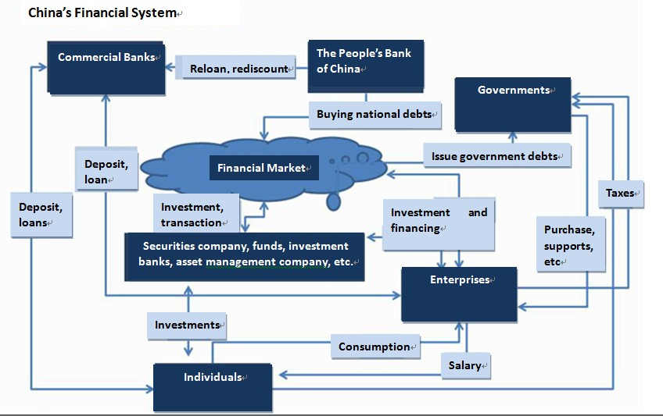
China’s Financial System https://tfasasia.wordpress.com/2012/05/30/understanding-chinas-financial-system/

Slide 25
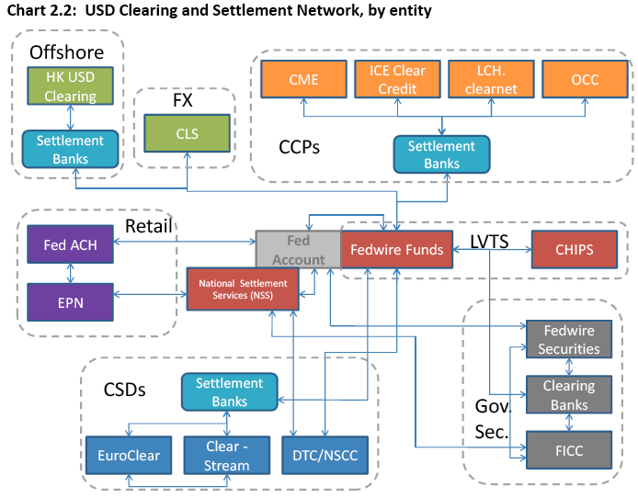
USD Clearing Network http://simonthorpesideas.blogspot.com/2013/03/how-us-financial-system-processes.html

