Slide 1
Lecture 2
Basics of Economics
John Rundle Econophysics PHYS 250
https://en.wikipedia.org/wiki/Economics

Slide 2
Introduction
Economics is the social science that studies the production, distribution, and consumption of goods and services.
Economics focuses on the behavior and interactions of economic agents and how economies work.
Macroeconomics analyzes the entire economy (meaning aggregated production, consumption, savings, and investment) and issues affecting it, including unemployment of resources (labor, capital, and land), inflation, economic growth, and the public policies that address these issues (monetary, fiscal, and other policies (Think “thermodynamics”)
Microeconomics analyzes basic elements in the economy, including individual agents and markets, their interactions, and the outcomes of interactions. Individual agents may include, for example, households, firms, buyers, and sellers. (Think “statistical mechanics”)

Slide 3
Introduction
There are a variety of modern definitions of economics
Some reflect evolving views of the subject or different views among economists.
Scottish philosopher Adam Smith (1776) defined what was then called political economy as "an inquiry into the nature and causes of the wealth of nations”
Various definitions of economics by:
Jean-Baptiste Say (1803)
Alfred Marshall (1890)
Lionel Robbins (1932)
A map of world economies by size of Gross Domestic Product (nominal) in USD, World Bank, 2014. GDP is the value of all goods and services produced by a country

Slide 4
Macroeconomics Study of Market “Equilibrium” Think: “Thermodynamics”
Macroeconomics examines the economy as a whole to explain broad aggregates and their interactions "top down", that is, using a simplified form of general-equilibrium theory.
Such aggregates include national income and output, the unemployment rate, and price inflation and sub-aggregates like total consumption and investment spending and their components.
It also studies effects of monetary policy and fiscal policy.
Since at least the 1960s, macroeconomics has been characterized by further integration as to micro-based modelling of sectors, including rationality of players, efficient use of market information, and imperfect competition.
The circulation of money in an economy in a macroeconomic model.

Slide 5
Growth Economics
Growth economics studies factors that explain economic growth – the increase in output per capita of a country over a long period of time.
The same factors are used to explain differences in the level of output per capita between countries, in particular why some countries grow faster than others, and whether countries converge at the same rates of growth.
Much-studied factors include the rate of investment, population growth, and technological change.
These are represented in theoretical and empirical forms (as in the neoclassical and endogenous growth models) and in growth accounting.

Slide 6
Business Cycle
The economics of the Great Depression were the spur for the creation of "macroeconomics" as a separate discipline field of study.
During the Great Depression of the 1930s, John Maynard Keynes authored a book entitled The General Theory of Employment, Interest and Money outlining the key theories of Keynesian economics.
Keynes contended that aggregate demand for goods might be insufficient during economic downturns, leading to unnecessarily high unemployment and losses of potential output. (Failure of Demand)
He therefore advocated active policy responses by the public sector, including monetary policy actions by the central bank and fiscal policy actions by the government to stabilize output over the business cycle.
Thus, a central conclusion of Keynesian economics is that, in some situations, no strong automatic mechanism moves output and employment towards full employment levels.
John Hicks' IS/LM model has been the most influential interpretation of The General Theory.

Slide 7
IS–LM model (Investment-Savings / Liquidity Money) https://en.wikipedia.org/wiki/IS%E2%80%93LM_model
Quirk of this chart. Independent variable is on the ordinate, the real interest rate R. Dependent variable GDP is on the abscissa. Intersection of LM and IS curves represents economic “equilibrium”
The IS–LM model, or Hicks–Hansen model, is a macroeconomic tool that shows the relationship between interest rates (ordinate) and the assets market (also known as the real output in goods and services market plus money market, as abscissa).
The intersection of the "investment–saving" (IS) and "liquidity preference–money supply" (LM) curves models "general equilibrium" where supposed simultaneous equilibrium occurs in both interest and asset markets.
The IS curve slopes downward and to the right, implying that the level of investment and consumption is negatively correlated with the interest rate but positively correlated with gross output. (The higher the interest rate, the lower the level of consumption and investment in fixed assets of companies because they have to borrow funds at the higher interest rate.)
By contrast, the LM curve slopes upward, suggesting the quantity of money demanded is positively correlated with the interest rate and with increases in total spending, or income. (Higher interest rates are required to compete with other forms of investment if GDP is high)
Supply of Money
(from the FED)
LM Curve is fixed. IS curve moves when interest rates change
Demand for Money
(from bank loans etc. )
A higher level of output (GDP) is associated with higher interest rates R in economic “equilibrium”
Real Interest Rate R
Output in Goods and Services + Cash = GDP
The IS curve moves to the right, causing higher interest rates (i) and expansion in the "real" economy (real GDP, or Y)
A more complete explanation is given here: https://www.economics.utoronto.ca/jfloyd/modules/islm.html

Slide 8
Unemployment
The amount of unemployment in an economy is measured by the unemployment rate, the percentage of workers without jobs in the labor force.
The labor force only includes workers actively looking for jobs.
People who are retired, pursuing education, or discouraged from seeking work by a lack of job prospects are excluded from the labour force.
Classical models of unemployment occurs when wages are too high for employers to be willing to hire more workers.
While some types of unemployment may occur regardless of the condition of the economy, cyclical unemployment occurs when growth stagnates.
Okun's law represents the empirical relationship between unemployment and economic growth.
The original version of Okun's law states that a 3% increase in output would lead to a 1% decrease in unemployment.

Slide 9
“Don’t Fight the Fed”
Historical record of Federal Open Market Committee (FOMC, or “the Fed”) cycles of raising and lowering overnight interest rates to control inflation and the business cycle

Slide 10
Inflation and Monetary Policy
Money is a means of final payment for goods in most price system economies, and is the unit of account in which prices are typically stated.
Money has general acceptability, relative consistency in value, divisibility, durability, portability, elasticity in supply, and longevity with mass public confidence.
It includes currency held by the nonbank public and checkable deposits.
As a medium of exchange, money facilitates trade.
It is essentially a measure of value and more importantly, a store of value being a basis for credit creation.
Its economic function can be contrasted with barter (non-monetary exchange).
Money can reduce the transaction cost of exchange because of its ready acceptability. Then it is less costly for the seller to accept money in exchange, rather than what the buyer produces.
At the level of an economy, theory and evidence are consistent with a positive relationship running from the total money supply to the nominal value of total output and to the general price level. For this reason, management of the money supply is a key aspect of monetary policy.

Slide 11
Fiscal Policy
Governments implement fiscal policy to influence macroeconomic conditions by adjusting spending and taxation policies to alter aggregate demand.
When aggregate demand falls below the potential output of the economy, there is an output gap where some productive capacity is left unemployed.
Governments increase spending and cut taxes to boost aggregate demand.
For example:
Unemployed home builders can be hired to expand highways.
Tax cuts allow consumers to increase their spending, which boosts aggregate demand.
Both tax cuts and spending have multiplier effects where the initial increase in demand from the policy percolates through the economy and generates additional economic activity.
The effects of fiscal policy can be limited by crowding out.
When there is no output gap, the economy is producing at full capacity and there are no excess productive resources.
If the government increases spending in this situation, the government uses resources that otherwise would have been used by the private sector, so there is no increase in overall output.

Slide 12
Quantitative Easing (“QE”) https://en.wikipedia.org/wiki/Quantitative_easing
Quantitative easing (QE), also known as large-scale asset purchases, is an expansionary monetary policy whereby a central bank buys predetermined amounts of government bonds or other financial assets in order to stimulate the economy and increase liquidity.
An unconventional form of monetary policy, it is usually used when inflation is very low or negative, and standard expansionary monetary policy has become ineffective.
A central bank implements quantitative easing by buying specified amounts of financial assets from commercial banks and other financial institutions, thus raising the prices of those financial assets and lowering their yield, while simultaneously lowering short term interest rates which increases the money supply.
This differs from the more usual policy of buying or selling short-term government bonds to keep interbank interest rates at a specified target value.

Slide 13
Yield Curve (Recent, ~11/2018)
Expansionary monetary policy to stimulate the economy typically involves the central bank buying short-term government bonds to lower short-term market interest rates.
However, when short-term interest rates reach or approach zero, this method can no longer work.
In such circumstances, monetary authorities may then use quantitative easing to further stimulate the economy, by buying riskier or longer maturity assets (other than short-term government bonds), thereby lowering interest rates further out on the yield curve.

Slide 14
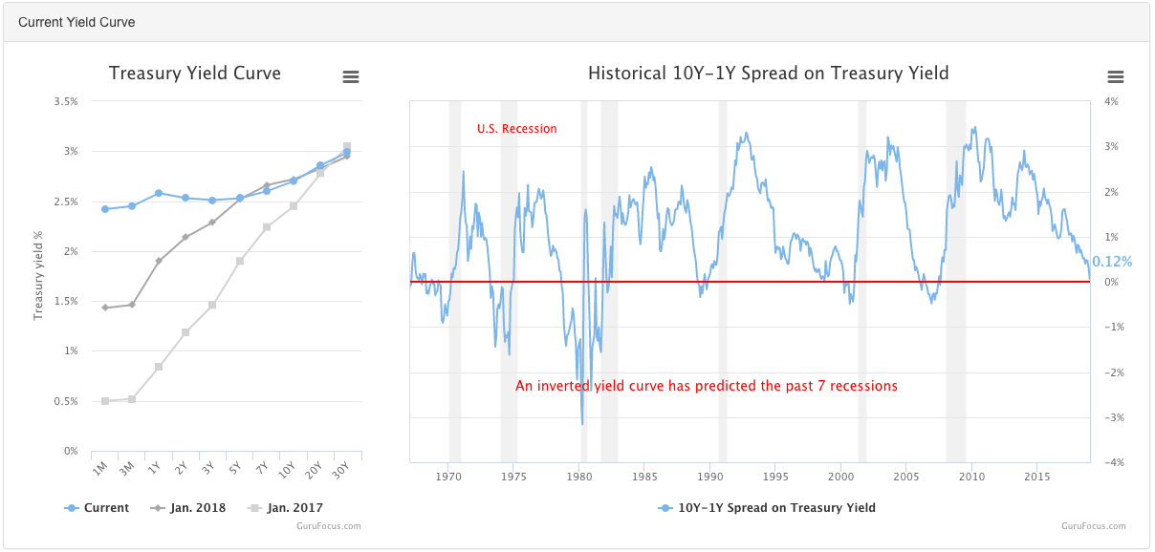
Yield Curve as of 1/9/2019
https://www.gurufocus.com/yield_curve.php

Slide 15
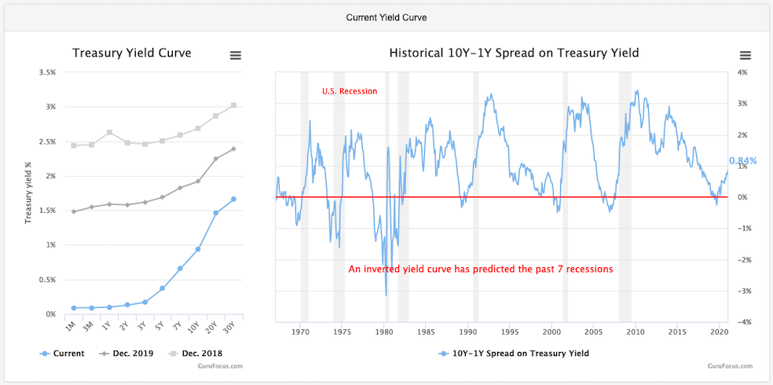
Yield Curve as of 12/28/2020
https://www.gurufocus.com/yield_curve.php

Slide 16
Effects of QE
Quantitative easing can help ensure that inflation does not fall below a target.
Risks include the policy being more effective than intended in acting against deflation (leading to higher inflation in the longer term, due to increased money supply), or not being effective enough if banks remain reluctant to lend and potential borrowers are unwilling to borrow.
According to the International Monetary Fund, the U.S. Federal Reserve System, and various economists, quantitative easing undertaken since the global financial crisis of 2007–08 has mitigated some of the economic problems since the crisis.

Slide 17
Example: The Capitol Hill Babysitting Cooperative
The Capitol Hill Babysitting Cooperative (CHBC) is a cooperative located in Washington D.C., whose purpose is to fairly distribute the responsibility of babysitting between its members.
The co-op is often used as an allegory for a demand-oriented model of an economy.
The allegory illustrates several economic concepts, including the paradox of thrift and the importance of the money supply to an economy's well being.
The allegory has received continuing attention, particularly in the wake of the late-2000s recession.
Former members Joan Sweeney and Richard James Sweeney first presented the co-op as an allegory for an economy in a 1977 article, but it was little known until popularized by Paul Krugman in his book Peddling Prosperity and subsequent writings.

Slide 18
Example: The Capitol Hill Babysitting Cooperative - Recession
The co-op gave each new member twenty hours worth of "scrip," and required them to return the same amount when they left the co-op.
Members of the co-op used scrip to pay for babysitting.
Each piece of scrip was contractually deemed to pay for half an hour of babysitting.
To earn more scrip, couples babysat other member's children.
Administrators in the co-op were responsible for various tasks, such as matching couples needing a babysitter with couples that wanted to babysit.
To "pay" for the administrative costs of the system, each member had an obligation to contribute fourteen hours worth of scrip a year (i.e. 28 scrip). Some of the administration's scrip went to administrators to be spent and some was simply saved.
At first, new members of the co-op felt, on average, that they should save more scrip before they began spending.
So they babysat whenever the opportunity arose, but did not spend the scrip they acquired.
Since babysitting opportunities only arise when other couples want to go out, there was a shortage of demand for babysitting. (failure of demand)
As a result, the co-op fell into a "recession".
This illustrates the phenomenon known as the paradox of thrift.

Slide 19
Example: The Capitol Hill Babysitting Cooperative – Solution: Control the Supply of “Money” in Circulation through a “Central Bank”
The administration's initial reaction to the co-op's recession was add new rules.
But the measures did not resolve the inadequate demand for babysitting.
Eventually, the co-op was able to alleviate the issue by giving new members thirty hours worth of scrip, but only requiring them to return twenty when they left the co-op.
Within a few years a new problem arose.
There was too much scrip and a shortage of babysitting.
As new members joined, more scrip was added to the system until couples had too much, but new members were not able to spend it because no one else wanted to babysit.
In general, the cooperative experienced regular problems because the administration took in more than it spent, and at times the system added too much scrip into the system via the amount issued to new members.
The co-op issued scrip, each piece was worth ½ hour of babysitting time.

Slide 20
International Economics
Currency exchange rates as of 11/23/2018 @ 13:37 PM PT
International trade studies determinants of goods-and-services flows across international boundaries.
It also concerns the size and distribution of gains from trade. Policy applications include estimating the effects of changing tariff rates and trade quotas.
International finance is a macroeconomic field which examines the flow of capital across international borders, and the effects of these movements on exchange rates.
Increased trade in goods, services and capital between countries is a major effect of contemporary globalization.
Levels of international trade are strongly influenced by the Foreign Exchange Rates (FOREX) between currencies
https://www.investing.com/currencies/streaming-forex-rates-majors

Slide 21
International Economics
International economics is concerned with the effects upon economic activity from international differences in productive resources and consumer preferences and the international institutions that affect them. It seeks to explain the patterns and consequences of transactions and interactions between the inhabitants of different countries, including trade, investment and migration.
International trade studies goods-and-services flows across international boundaries from supply-and-demand factors, economic integration, international factor movements, and policy variables such as tariff rates and trade quotas.
International finance studies the flow of capital across international financial markets, and the effects of these movements on exchange rates.
International monetary economics and international macroeconomics study flows of money across countries and the resulting effects on their economies as a whole.
International political economy, a sub-category of international relations, studies issues and impacts from for example international conflicts, international negotiations, and international sanctions; national security and economic nationalism; and international agreements and observance.

Slide 22
Microeconomics Study of the Approach to Market “Equilibrium” Think: “Statistical Mechanics” (e.g., mechanisms to reach equilibrium)
Microeconomics (from Greek prefix mikro- meaning "small" + economics) is a branch of economics that studies the behavior of individuals and firms in making decisions regarding the allocation of scarce resources and the interactions among these individuals and firms.
One goal of microeconomics is to analyze the market mechanisms that establish relative prices among goods and services and allocate limited resources among alternative uses.
Microeconomics shows conditions under which free markets lead to desirable allocations.
It also analyzes market failure, where markets fail to produce efficient results.
Economists study trade, production and consumption decisions, such as those that occur in a traditional marketplace.

Slide 23
Market Structures
Various market structures exist.
In perfectly competitive markets, no participants are large enough to have the market power to set the price of a homogeneous product.
In other words, every participant is a "price taker" as no participant influences the price of a product. In the real world, markets often experience imperfect competition.
Forms of markets include:
Monopoly (in which there is only one seller of a good),
Duopoly (in which there are only two sellers of a good),
Oligopoly (in which there are few sellers of a good),
Monopolistic competition (in which there are many sellers producing highly differentiated goods),
Monopsony (in which there is only one buyer of a good), and
Oligopsony (in which there are few buyers of a good).
Unlike perfect competition, imperfect competition invariably means market power is unequally distributed.
Firms under imperfect competition have the potential to be "price makers", which means that, by holding a disproportionately high share of market power, they can influence the prices of their products.

Slide 24
Market Dynamics
Microeconomics studies individual markets via simplifying the economic system.
It assumes that activity in the market being analyzed does not affect other markets (no correlations!)
This method of analysis is known as partial-equilibrium analysis (supply and demand).
This method aggregates (the sum of all activity) in only one market.
General-equilibrium theory studies various markets and their behavior.
It aggregates (the sum of all activity) across all markets.
This method studies both changes in markets and their interactions leading towards equilibrium.
Electronic trading brings together buyers and sellers through an electronic trading platform and network to create virtual market places. Pictured: São Paulo Stock Exchange, Brazil.

Slide 25
Role of Consumption in Economics
Krugman: “My spending is your income, your spending is my income”
Krugman: “Recessions represent a failure of demand”
Consumption is a major concept in economics and is also studied in many other social sciences.
Economists are particularly interested in the relationship between consumption and income, as modeled with the consumption function.
Different schools of economists define production and consumption differently.
According to mainstream economists, only the final purchase of goods and services by individuals constitutes consumption, while other types of expenditure — in particular, fixed investment, intermediate consumption, and government spending — are placed in separate categories
Other economists define consumption much more broadly, as the aggregate of all economic activity that does not entail the design, production and marketing of goods and services (e.g. the selection, adoption, use, disposal and recycling of goods and services)

Slide 26
Production
In microeconomics, production is the conversion of inputs into outputs.
It is an economic process that uses inputs to create a commodity or a service for exchange or direct use.
Production is a flow and thus a rate of output per period of time.
Distinctions include such production alternatives as for consumption (food, haircuts, etc.) vs. investment goods (new tractors, buildings, roads, etc.), public goods (national defense, smallpox vaccinations, etc.) or private goods (new computers, bananas, etc.), and "guns" vs "butter".
Inputs used in the production process include such primary factors of production as labor services, capital (durable produced goods used in production, such as an existing factory), and land (including natural resources).
Other inputs may include intermediate goods used in production of final goods, such as the steel in a new car.
Economic efficiency measures how well a system generates desired output with a given set of inputs and available technology.

Slide 27
Scarcity and Tradeoff
Classic “guns vs butter” chart
The production–possibility frontier (PPF) is an expository figure for representing scarcity, cost, and efficiency. In the simplest case an economy can produce just two goods (say "guns" and "butter").
The PPF is a table or graph (as at the right) showing the different quantity combinations of the two goods producible with a given technology and total factor inputs, which limit feasible total output.
Each point on the curve shows potential total output for the economy, which is the maximum feasible output of one good, given a feasible output quantity of the other good.
Scarcity is represented in the figure by people being willing but unable in the aggregate to consume beyond the PPF (such as at X) and by the negative slope of the curve.
If production of one good increases along the curve, production of the other good decreases, an inverse relationship.
This is because increasing output of one good requires transferring inputs to it from production of the other good, decreasing the latter.
By construction, each point on the curve shows productive efficiency in maximizing output for given total inputs.
A point inside the curve (as at A), is feasible but represents production inefficiency (wasteful use of inputs), in that output of one or both goods could increase by moving in a northeast direction to a point on the curve.

Slide 28
Specialization (And the advantages of International Trade)
Specialization is considered key to economic efficiency based on theoretical and empirical considerations.
Different individuals or nations may have different real opportunity costs of production, say from differences in stocks of human capital per worker or capital/labor ratios.
According to theory, this may give a comparative advantage in production of goods that make more intensive use of the relatively more abundant, thus relatively cheaper, input.
Even if one region has an absolute advantage as to the ratio of its outputs to inputs in every type of output, it may still specialize in the output in which it has a comparative advantage and thereby gain from trading with a region that lacks any absolute advantage but has a comparative advantage in producing something else.
An example that combines features above is a country that specializes in the production of high-tech knowledge products, as developed countries do (e.g. USA), and trades with developing nations (e.g. China) for goods produced in factories where labor is relatively cheap and plentiful, resulting in different in opportunity costs of production.
Map showing the main trade routes for goods within late medieval Europe.

Slide 29
Supply and Demand
Supply is the relation between the price of a good and the quantity available for sale at that price.
It may be represented as a table or graph relating price and quantity supplied.
Producers, for example business firms, are hypothesized to be profit maximizers, meaning that they attempt to produce and supply the amount of goods that will bring them the highest profit.
Supply is typically represented as a function relating price and quantity, if other factors are unchanged.
Demand is the relation of the quantity that all buyers would be prepared to purchase at each unit price of the good.
Demand is often represented by a table or a graph showing price and quantity demanded.
Demand theory describes individual consumers as rationally choosing the most preferred quantity of each good, given income, prices, tastes, etc.
A term for this is "constrained utility maximization" (with income and wealth as the constraints on demand).
Here, utility refers to the hypothesized relation of each individual consumer for ranking different commodity bundles as more or less preferred.

Slide 30
Supply and Demand
Price is independent variable in economics
Prices and quantities have been described as the most directly observable attributes of goods produced and exchanged in a market economy.
The theory of supply and demand is an organizing principle for explaining how prices coordinate the amounts produced and consumed.
In microeconomics, it applies to price and output determination for a market with perfect competition, which includes the condition of no buyers or sellers large enough to have price-setting power.
Demand theory describes individual consumers as rationally choosing the most preferred quantity of each good, given income, prices, tastes, etc.
The supply and demand model describes how prices vary as a result of a balance between product availability and demand.
The graph depicts an increase (that is, right-shift) in demand from D1 to D2 along with the consequent increase in price and quantity required to reach a new equilibrium point on the supply curve (S).

Slide 31
Dynamics
Price is independent variable in economics
The law of demand states that, in general, price and quantity demanded in a given market are inversely related.
That is, the higher the price of a product, the less of it people would be prepared to buy (other things unchanged).
As the price of a commodity falls, consumers move toward it from relatively more expensive goods (the substitution effect).
In addition, purchasing power from the price decline increases ability to buy (the income effect).
Other factors can change demand; for example an increase in income will shift the demand curve for a normal good outward relative to the origin, as in the figure.
All determinants are predominantly taken as constant factors of demand and supply.
The supply and demand model describes how prices vary as a result of a balance between product availability and demand.
The graph depicts an increase (that is, right-shift) in demand from D1 to D2 along with the consequent increase in price and quantity required to reach a new equilibrium point on the supply curve (S).

Slide 32
“Equilibrium”
Generally speaking, an equilibrium is defined to be the price-quantity pair where the quantity demanded is equal to the quantity supplied. It is represented by the intersection of the demand and supply curves.
The analysis of various equilibria is a fundamental aspect of microeconomics:
Market equilibrium: A situation in a market when the price is such that the quantity demanded by consumers is correctly balanced by the quantity that firms wish to supply. In this situation, the market clears.
Changes in market equilibrium: Practical uses of supply and demand analysis often center on the different variables that change equilibrium price and quantity, represented as shifts in the respective curves. Comparative statics of such a shift traces the effects from the initial equilibrium to the new equilibrium.
Partial equilibrium, as the name suggests, takes into consideration only a part of the market to attain equilibrium.
The supply-and-demand model is a partial equilibrium model of economic equilibrium, where the clearance on the market of some specific goods is obtained independently from prices and quantities in other markets.
Here the dynamic process is that prices adjust until supply equals demand. It is a powerfully simple technique that allows one to study equilibrium, efficiency and comparative statics. The stringency of the simplifying assumptions may produce results which do not effectively model real world economic phenomena.
Question: Are economic equilibria stable or unstable??

Slide 33
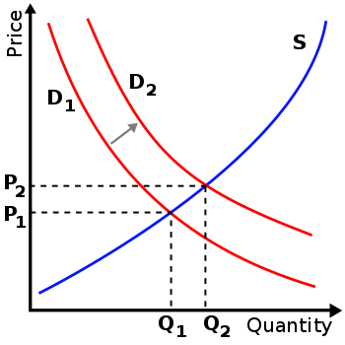
”Equilibrium”
Market equilibrium occurs where quantity supplied equals quantity demanded, the intersection of the supply and demand curves in the figure.
At a price below equilibrium, there is a shortage of quantity supplied compared to quantity demanded.
This is assumed to bid the price up.
At a price above equilibrium, there is a surplus of quantity supplied compared to quantity demanded.
This pushes the price down.
The model of supply and demand predicts that for given supply and demand curves, price and quantity will stabilize at the price that makes quantity supplied equal to quantity demanded.
Similarly, demand-and-supply theory predicts a new price-quantity combination from a shift in demand (as to the figure), or in supply.
For a given quantity of a consumer good, the point on the demand curve indicates the value, or marginal utility, to consumers for that unit.
It measures what the consumer would be prepared to pay for that unit.
The corresponding point on the supply curve measures marginal cost, the increase in total cost to the supplier for the corresponding unit of the good.
The price in equilibrium is determined by supply and demand.
In a perfectly competitive market, supply and demand equate marginal cost and marginal utility at equilibrium.
Price is independent variable in economics

Slide 34
Uncertainty and Game Theory
Uncertainty in economics is an unknown prospect of gain or loss, whether quantifiable as risk or not.
Game theory is a branch of applied mathematics that considers strategic interactions between agents, one kind of uncertainty.
It provides a mathematical foundation of industrial organization, discussed above, to model different types of firm behavior, for example in an industry with few sellers, but equally applicable to wage negotiations, bargaining, contract design, and any situation where individual agents are few enough to have perceptible effects on each other.
In behavioral economics, it has been used to model the strategies agents choose when interacting with others whose interests are at least partially adverse to their own.

Slide 35
Market Failures
The term "market failure" encompasses several problems which may undermine standard economic assumptions.
Information asymmetries and incomplete markets may result in economic inefficiency but also a possibility of improving efficiency through market, legal, and regulatory remedies
Natural monopoly, or the overlapping concepts of "practical" and "technical" monopoly, is an extreme case of failure of competition as a restraint on producers. Extreme economies of scale are one possible cause.
Externalities occur where there are significant social costs or benefits from production or consumption that are not reflected in market prices. For example, air pollution may generate a negative externality, and education may generate a positive externality (less crime, etc.)
Public goods are goods which are under-supplied in a typical market. The defining features are that people can consume public goods without having to pay for them and that more than one person can consume the good at the same time. Related to the Tragedy of the Commons
Governments often tax and otherwise restrict the sale of goods that have negative externalities and subsidize or otherwise promote the purchase of goods that have positive externalities in an effort to correct the price distortions caused by these externalities.
Elementary demand-and-supply theory predicts equilibrium but not the speed of adjustment for changes of equilibrium due to a shift in demand or supply.

Slide 36
History
The phrase "supply and demand" was first used by James Denham-Steuart in his Inquiry into the Principles of Political Economy, published in 1767.
Adam Smith used the phrase in his 1776 book The Wealth of Nations, and David Ricardo titled one chapter of his 1817 work Principles of Political Economy and Taxation "On the Influence of Demand and Supply on Price".
In The Wealth of Nations, Smith generally assumed that the supply price was fixed but that its "merit" (value) would decrease as its "scarcity" increased, in effect what was later called the law of demand also.
Ricardo, in Principles of Political Economy and Taxation, more rigorously laid down the idea of the assumptions that were used to build his ideas of supply and demand.
Antoine Augustin Cournot first developed a mathematical model of supply and demand in his 1838 Researches into the Mathematical Principles of Wealth, including diagrams.
Adam Smith

