Slide 1
Lecture 15
Technical Analysis and Trading
John Rundle Econophysics PHYS 255

Slide 2
Technical Analysis https://en.wikipedia.org/wiki/Technical_analysis
In finance, technical analysis is a security analysis methodology for forecasting the direction of prices through the study of past market data, primarily price and volume.
Behavioral economics and quantitative analysis use many of the same tools of technical analysis, which, being an aspect of active management, stands in contradiction to much of modern portfolio theory.
The efficacy of both technical and fundamental analysis is disputed by the efficient-market hypothesis which states that stock market prices are essentially unpredictable.

Slide 3
Technical Analysis https://en.wikipedia.org/wiki/Technical_analysis
The principles of technical analysis are derived from hundreds of years of financial market data.
In the 1920s and 1930s Richard W. Schabacker published several books which continued the work of Charles Dow and William Peter Hamilton in their books Stock Market Theory and Practice and Technical Market Analysis.
In 1948 Robert D. Edwards and John Magee published Technical Analysis of Stock Trends which is widely considered to be one of the seminal works of the discipline.
It is exclusively concerned with trend analysis and chart patterns and remains in use to the present.
Early technical analysis was almost exclusively the analysis of charts, because the processing power of computers was not available for the modern degree of statistical analysis.

Slide 5
Fundamental vs. Technical Analysis https://en.wikipedia.org/wiki/Technical_analysis
Fundamental analysts examine earnings, dividends, assets, quality, ratio, new products, research and the like.
Technicians employ many methods, tools and techniques as well, one of which is the use of charts.
Using charts, technical analysts seek to identify price patterns and market trends in financial markets and attempt to exploit those patterns.
Technicians using charts search for archetypal price chart patterns, such as the well-known head and shoulders or double top/bottom reversal patterns, study technical indicators, moving averages, and look for forms such as lines of support, resistance, channels, and more obscure formations such as flags, pennants, balance days and cup and handle patterns.

Slide 6
Fundamental vs. Technical Analysis https://en.wikipedia.org/wiki/Technical_analysis
Technical analysts also widely use market indicators of many sorts, some of which are mathematical transformations of price, often including up and down volume, advance/decline data and other inputs.
These indicators are used to help assess whether an asset is trending, and if it is, the probability of its direction and of continuation.
Technicians also look for relationships between price/volume indices and market indicators. Examples include the moving average, relative strength index, and MACD (Moving Average Convergence-Divergence).
Other avenues of study include correlations between changes in Options (implied volatility=VIX for SP500) and put/call ratios with price.
Also important are sentiment indicators such as Put/Call ratios, bull/bear ratios, short interest, Implied Volatility, etc.

Slide 7
Fundamental vs. Technical Analysis https://en.wikipedia.org/wiki/Technical_analysis
There are many techniques in technical analysis.
Adherents of different techniques (for example, candlestick charting, Dow theory, and Elliott wave theory) may ignore the other approaches, yet many traders combine elements from more than one technique.
Some technical analysts use subjective judgment to decide which pattern(s) a particular instrument reflects at a given time and what the interpretation of that pattern should be.
Others employ a strictly mechanical or systematic approach to pattern identification and interpretation.

Slide 8
Examples of Chart Patterns http://stockcharts.com/school/doku.php?id=chart_school:chart_analysis:introduction_to_chart_patterns
A Head and Shoulders (Top) reversal pattern forms after an uptrend, and its completion marks a trend reversal.
The pattern contains three successive peaks with the middle peak (head) being the highest and the two outside peaks (shoulders) being low and roughly equal.
The reaction lows of each peak can be connected to form support, or a neckline.
As its name implies, the Head and Shoulders reversal pattern is made up of a left shoulder, a head, a right shoulder, and a neckline.
Other parts playing a role in the pattern are volume, the breakout, price target and support turned resistance.

Slide 9
Examples of Chart Patterns http://stockcharts.com/school/doku.php?id=chart_school:chart_analysis:introduction_to_chart_patterns
The Head and Shoulders (Bottom), sometimes referred to as an Inverse Head and Shoulders, is a pattern that shares many common characteristics with its comparable partner, but relies more heavily on volume patterns for confirmation.
As a major reversal pattern, the Head and Shoulders Bottom forms after a downtrend, and its completion marks a change in trend.
The pattern contains three successive troughs with the middle trough (head) being the deepest and the two outside troughs (shoulders) being shallower.
Ideally, the two shoulders would be equal in height and width.
The reaction highs in the middle of the pattern can be connected to form resistance, or a neckline.

Slide 10
“Candlesticks” http://wikifinancepedia.com/wikifinance/investing/trading/technical-analysis

Slide 11
Fundamental Analysis https://en.wikipedia.org/wiki/Technical_analysis
Contrasting with Technical Analysis is Fundamental Analysis, the study of economic factors that influence the way investors price financial markets.
Technical analysis holds that prices already reflect all the underlying fundamental factors.
Uncovering the trends is what technical indicators are designed to do, although neither technical nor fundamental indicators are perfect.
Some traders use technical or fundamental analysis exclusively, while others use both types to make trading decisions.

Slide 12
Fundamental Analysis http://wikifinancepedia.com/wikifinance/investing/trading/technical-analysis

Slide 13
Fundamental Analysis https://www.google.com/finance?q=NYSEARCA%3ASPY&ei=hCrUUfjdJ5qAlgPtOw

Slide 14
Fundamental Analysis https://en.wikipedia.org/wiki/Technical_analysis
Fundamental analysts focus on the equation M = P/E, where M is the stock multiple.
Stock multiples involve psychology, i.e. the extent of willingness to buy/sell.
Also in M is the ability to pay as, for instance, a spent-out bull can't make the market go higher and a well-heeled bear won't.
Technical analysis analyzes price, volume, psychology, money flow and other market information, whereas fundamental analysis looks at the facts of the company, market, currency or commodity.
Most large brokerage, trading group, or financial institutions will typically have both a technical analysis and fundamental analysis team.

Slide 15
Technical Analysis https://en.wikipedia.org/wiki/Technical_analysis
Technical analysis is widely used among traders and financial professionals and is very often used by active day traders, market makers and pit traders.
In the 1960s and 1970s it was widely dismissed by academics.
In a recent review, Irwin and Park reported that 56 of 95 modern studies found that it produces positive results but noted that many of the positive results were rendered dubious by issues such as data snooping*, so that the evidence in support of technical analysis was inconclusive
It is still considered by many academics to be pseudoscience.
Academics such as Eugene Fama say the evidence for technical analysis is sparse and is inconsistent with the weak form of the efficient-market hypothesis.
Users hold that even if technical analysis cannot predict the future, it helps to identify trends, tendencies, and trading opportunities.
*Data snooping refers to statistical inference that the researcher decides to perform after looking at the data (as contrasted with pre-planned inference, which the researcher plans before looking at the data).

Slide 16
Components of Technical Analysis https://en.wikipedia.org/wiki/Technical_analysis
John Murphy states that the principal sources of information available to technicians are price, volume and open interest.
However, many technical analysts reach outside pure technical analysis, combining other market forecast methods with their technical work.
One advocate for this approach is John Bollinger, who coined the term rational analysis in the middle 1980s for the intersection of technical analysis and fundamental analysis.
Another such approach, fusion analysis, overlays fundamental analysis with technical, in an attempt to improve portfolio manager performance.
Technical analysis is also often combined with quantitative analysis and economics.
For example, neural networks may be used to help identify intermarket relationships.
Investor and newsletter polls, and magazine cover sentiment indicators, are also used by technical analysts.

Slide 17
Support and Resistance http://wikifinancepedia.com/wikifinance/investing/trading/technical-analysis
New high = “resistance level”
New low = “support level”

Slide 18
Technical Analysis: Criticisms https://en.wikipedia.org/wiki/Technical_analysis
Whether technical analysis actually works is a matter of controversy.
Methods vary greatly, and different technical analysts can sometimes make contradictory predictions from the same data.
Many investors claim that they experience positive returns, but academic appraisals often find that it has little predictive power.
Of 95 modern studies, 56 concluded that technical analysis had positive results, although data-snooping bias and other problems make the analysis difficult.
Nonlinear prediction using neural networks occasionally produces statistically significant prediction results.
A Federal Reserve working paper regarding support and resistance levels in short-term foreign exchange rates "offers strong evidence that the levels help to predict intraday trend interruptions," although the "predictive power" of those levels was "found to vary across the exchange rates and firms examined".

Slide 19
Burton Malkiel
My Econ 101 Professor at Princeton in 1972

Slide 20
Burton Malkiel on Technical Analysis https://en.wikipedia.org/wiki/Technical_analysis
The random walk hypothesis may be derived from the weak-form efficient markets hypothesis, which is based on the assumption that market participants take full account of any information contained in past price movements (but not necessarily other public information).
In his book A Random Walk Down Wall Street, Princeton economist Burton Malkiel said that technical forecasting tools such as pattern analysis must ultimately be self-defeating:
"The problem is that once such a regularity is known to market participants, people will act in such a way that prevents it from happening in the future.”
Malkiel has stated that while momentum may explain some stock price movements, there is not enough momentum to make excess profits.
Malkiel has compared technical analysis to "astrology”.

Slide 21
Andrew Lo on Technical Analysis https://en.wikipedia.org/wiki/Technical_analysis
In the late 1980s, Andrew Lo and Craig McKinlay published a paper which cast doubt on the random walk hypothesis.
In a 1999 response to Malkiel, Lo and McKinlay collected empirical papers that questioned the hypothesis' applicability that suggested a non-random and possibly predictive component to stock price movement, though they were careful to point out that rejecting random walk does not necessarily invalidate EMH, which is an entirely separate concept from RWH.
In a 2000 paper, Andrew Lo back-analyzed data from U.S. from 1962 to 1996 and found that "several technical indicators do provide incremental information and may have some practical value”.
Burton Malkiel dismissed the irregularities mentioned by Lo and McKinlay as being too small to profit from
The success of Jim Simons’ Renaissance Technologies Medallion Fund may lend some support to Lo and McKinlay’s conclusions

Slide 22
Andrew Lo on Technical Analysis https://en.wikipedia.org/wiki/Technical_analysis
From a paper published in the Journal of Finance by Dr. Andrew W. Lo, director MIT Laboratory for Financial Engineering, working with Harry Mamaysky and Jiang Wang found that:
“Technical analysis, also known as "charting", has been a part of financial practice for many decades, but this discipline has not received the same level of academic scrutiny and acceptance as more traditional approaches such as fundamental analysis.
One of the main obstacles is the highly subjective nature of technical analysis – the presence of geometric shapes in historical price charts is often in the eyes of the beholder.
In this paper, we propose a systematic and automatic approach to technical pattern recognition using nonparametric kernel regression, and apply this method to a large number of U.S. stocks from 1962 to 1996 to evaluate the effectiveness of technical analysis.
By comparing the unconditional empirical distribution of daily stock returns to the conditional distribution – conditioned on specific technical indicators such as head-and-shoulders or double-bottoms – we find that over the 31-year sample period, several technical indicators do provide incremental information and may have some practical value¹.”
[1] Foundations of Technical Analysis: Computational Algorithms, Statistical Inference, and Empirical Implementation, Andrew Lo, Harry Mamaysky and Jiang Wang, Journal of Finance 55(2000), 1705-1765.

Slide 23
On the Other Hand… https://en.wikipedia.org/wiki/Technical_analysis
Technicians claim that the EMH and random walk theories both ignore the realities of markets, in that participants are not completely rational and that current price moves are not independent of previous moves.
Other signal processing researchers dispute the random walk hypothesis, that stock market prices resemble Wiener processes, because the statistical moments of such processes and real stock data vary significantly with respect to window size and similarity measure.
They argue that feature transformations used for the description of audio and biosignals can also be used to predict stock market prices successfully which would contradict the random walk hypothesis.

Slide 24
On the Other Hand… https://en.wikipedia.org/wiki/Technical_analysis
Caginalp and Balenovich in 1994¹ used their asset-flow differential equations model to show that the major patterns of technical analysis could be generated with some basic assumptions.
Some of the patterns such as a triangle continuation or reversal pattern can be generated with the assumption of two distinct groups of investors with different assessments of valuation.
The major assumptions of the models are that the finiteness of assets and the use of trend as well as valuation in decision making.
Many of the patterns follow as mathematically logical consequences of these assumptions.
One of the problems with conventional technical analysis has been the difficulty of specifying the patterns in a manner that permits objective testing.
It is possible that this situation may change with better pattern recognition classifiers
[1] Gunduz Caginalp & Donald Balenovich (2003), A theoretical foundation for technical analysis, Journal of Technical Analysis. 59: 5–22.

Slide 25
Charting Terms and Indicators https://en.wikipedia.org/wiki/Technical_analysis
Average true range – averaged daily trading range, adjusted for price gaps.
Breakout – the concept whereby prices forcefully penetrate an area of prior support or resistance, usually, but not always, accompanied by an increase in volume.
Chart pattern – distinctive pattern created by the movement of security prices on a chart
Cycles – time targets for potential change in price action (price only moves up, down, or sideways)
Dead cat bounce – the phenomenon whereby a spectacular decline in the price of a stock is immediately followed by a moderate and temporary rise before resuming its downward movement
Elliott wave principle and the golden ratio to calculate successive price movements and retracements
Fibonacci ratios – used as a guide to determine support and resistance (see below)
Momentum – the rate of price change
Point and figure analysis – A priced-based analytical approach employing numerical filters which may incorporate time references, though ignores time entirely in its construction
Resistance – a price level that may prompt a net increase of selling activity
Support – a price level that may prompt a net increase of buying activity
Trending – the phenomenon by which price movement tends to persist in one direction for an extended period of time

Slide 26
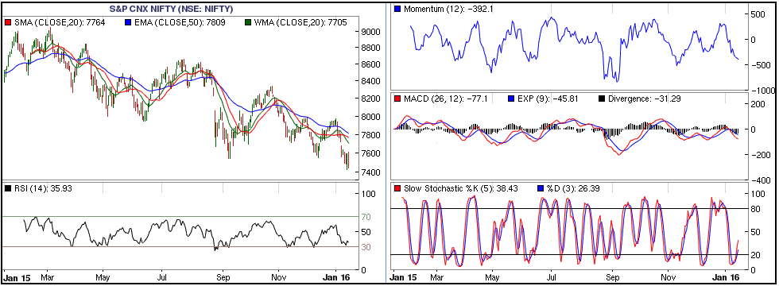
Indicators http://wikifinancepedia.com/wikifinance/investing/trading/technical-analysis
The MACD indicator (or "oscillator") is a collection of three time series calculated from historical price data, most often the closing price.
These three series are: the MACD series proper, the "signal" or "average" series, and the "divergence" series which is the difference between the two.
The MACD series is the difference between a "fast" (short period) exponential moving average (EMA), and a "slow" (longer period) EMA of the price series.
The average series is an EMA of the MACD series itself.

Slide 27
Types of Charts https://en.wikipedia.org/wiki/Technical_analysis
Candlestick chart – Of Japanese origin and similar to OHLC, candlesticks widen and fill the interval between the open and close prices to emphasize the open/close relationship.
In the West, often black or red candle bodies represent a close lower than the open, while white, green or blue candles represent a close higher than the open price.
Line chart – Connects the closing price values with line segments.
Open-high-low-close chart – OHLC charts, also known as bar charts, plot the span between the high and low prices of a trading period as a vertical line segment at the trading time, and the open and close prices with horizontal tick marks on the range line, usually a tick to the left for the open price and a tick to the right for the closing price.
Point and figure chart – a chart type employing numerical filters with only passing references to time, and which ignores time entirely in its construction.

Slide 28
Overlays https://en.wikipedia.org/wiki/Technical_analysis
Overlays are generally superimposed over the main price chart:
Bollinger bands – a range of price volatility based on standard deviations
Channel – a pair of parallel trend lines
Ichimoku kinko hyo – a moving average-based system that factors in time and the average point between a candle's high and low
Moving average – an average over a window of time before and after a given time point that is repeated at each time point in the given chart. A moving average can be thought of as a kind of dynamic trend-line.
Parabolic SAR – Wilder's trailing stop based on prices tending to stay within a parabolic curve during a strong trend
Pivot point – derived by calculating the numerical average of a particular currency's or stock's high, low and closing prices
Trend line – a sloping line described by at least two peaks or two troughs

Slide 29
Breadth Indicators https://en.wikipedia.org/wiki/Technical_analysis
These indicators are based on statistics derived from the broad market.
Advance–decline line – a popular indicator of market breadth.
McClellan Oscillator - a popular closed-form indicator of breadth.
McClellan Summation Index - a popular open-form indicator of breadth.

Slide 30
Price-Based Indicators https://en.wikipedia.org/wiki/Technical_analysis
These indicators are generally shown below or above the main price chart.
%C – denotes current markets environment as range expansion or a range contraction, it also forecast when extremes in trend or choppiness are being reached, so the trader can expect change.
Average directional index – a widely used indicator of trend strength.
Commodity Channel Index – identifies cyclical trends.
MACD – moving average convergence/divergence.
Momentum – the rate of price change.
Relative strength index (RSI) – oscillator showing price strength.
Relative Vigor Index (RVI) – oscillator measures the conviction of a recent price action and the likelihood that it will continue.
Stochastic oscillator – close position within recent trading range.
Trix – an oscillator showing the slope of a triple-smoothed exponential moving average.

Slide 31
Examples of Chart Patterns http://stockcharts.com/school/doku.php?id=chart_school:chart_analysis:introduction_to_chart_patterns
The ascending triangle is a bullish formation that usually forms during an uptrend as a continuation pattern.
There are instances when ascending triangles form as reversal patterns at the end of a downtrend, but they are typically continuation patterns.
Regardless of where they form, ascending triangles are bullish patterns that indicate accumulation.
Two or more equal highs form a horizontal line at the top.
Two or more rising troughs form an ascending trend line that converges on the horizontal line as it rises. If both lines were extended right, the ascending trend line could act as the hypotenuse of a right triangle.

Slide 32
Examples of Chart Patterns http://stockcharts.com/school/doku.php?id=chart_school:chart_analysis:introduction_to_chart_patterns
A price channel is a continuation pattern that slopes up or down and is bound by an upper and lower trend line.
The upper trend line marks resistance and the lower trend line marks support.
Price channels with negative slopes (down) are considered bearish and those with positive slopes (up) bullish.

Slide 33
Examples of Chart Patterns http://stockcharts.com/school/doku.php?id=chart_school:chart_analysis:introduction_to_chart_patterns
The symmetrical triangle, which can also be referred to as a coil, usually forms during a trend as a continuation pattern.
The pattern contains at least two lower highs and two higher lows.
When these points are connected, the lines converge as they are extended and the symmetrical triangle takes shape.
You could also think of it as a contracting wedge, wide at the beginning and narrowing over time.
While there are instances when symmetrical triangles mark important trend reversals, they more often mark a continuation of the current trend.
Regardless of the nature of the pattern, continuation or reversal, the direction of the next major move can only be determined after a valid breakout.

Slide 34
Examples of Chart Patterns http://stockcharts.com/school/doku.php?id=chart_school:chart_analysis:introduction_to_chart_patterns
Flags and Pennants are short-term continuation patterns that mark a small consolidation before the previous move resumes.
These patterns are usually preceded by a sharp advance or decline with heavy volume, and mark a mid-point of the move.

Slide 35
My Favorite http://jeffhirsch.tumblr.com/post/123059521013/three-peaks-and-a-domed-house-top

Slide 36
Fibonacci Retracement https://en.wikipedia.org/wiki/Fibonacci_retracement
Fibonacci sequence:
[X_{n}] = 1, 1, 2, 3, 5, 8, 13, 21, 34, 55, …
Retracement points:
1st: X_{n}/X_{n+1} -> 0.618
2nd: X_{n}/X_{n+2} -> 0.382

Slide 37
Fibonacci Retracement https://en.wikipedia.org/wiki/Fibonacci_retracement
In finance, Fibonacci retracement is a method of technical analysis for determining support and resistance levels.
They are named after their use of the Fibonacci sequence.
Fibonacci retracement is based on the idea that markets will retrace a predictable portion of a move, after which they will continue to move in the original direction.

Slide 38
Fibonacci Retracement https://en.wikipedia.org/wiki/Fibonacci_retracement
The appearance of retracement can be ascribed to ordinary price volatility as described by Burton Malkiel, a Princeton economist in his book A Random Walk Down Wall Street, who found no reliable predictions in technical analysis methods taken as a whole.
Malkiel argues that asset prices typically exhibit signs of random walk and that one cannot consistently outperform market averages.

Slide 39
Fibonacci Retracement https://en.wikipedia.org/wiki/Fibonacci_retracement
Fibonacci retracement is created by taking two extreme points on a chart and dividing the vertical distance by the key Fibonacci ratios.
0.0% is considered to be the start of the retracement, while 100.0% is a complete reversal to the original part of the move.
Once these levels are identified, horizontal lines are drawn and used to identify possible support and resistance levels.
The significance of such levels, however, could not have been statistically confirmed.[
Arthur Merrill, CMT (Chartered Market Technician) determined there is no reliable standard retracement; not 50%, 33%, 38.2,61.8%,or any other.
The 0.618 Fibonacci retracement that is often used by stock analysts approximates to the "golden ratio”.

Slide 40
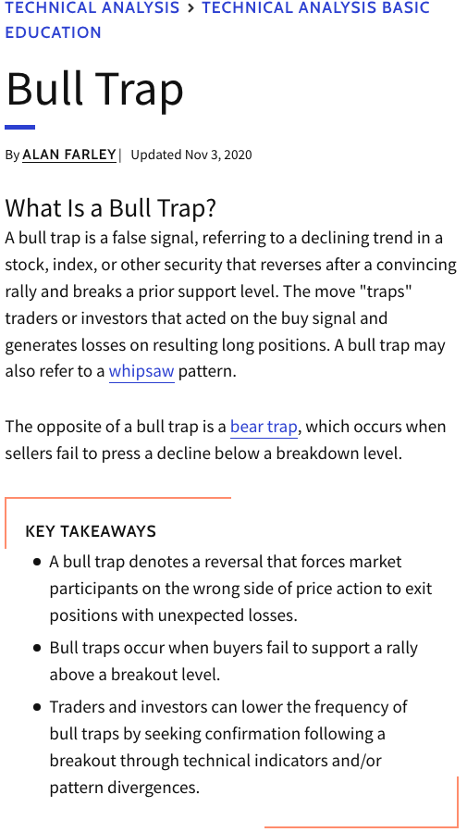
Example of a pattern that didn’t pan out:
SPY “Bull Trap”
(Investopedia)

Slide 41
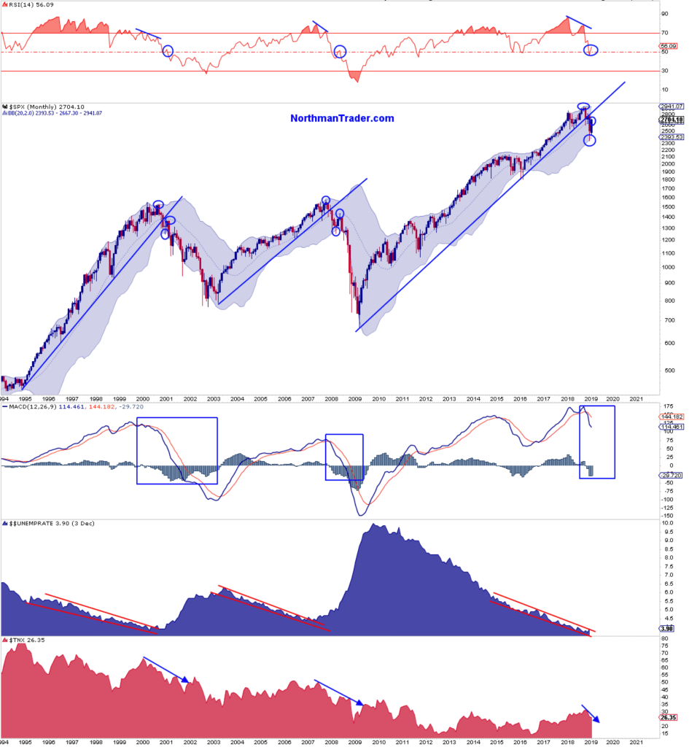
The Case for a “Bull Trap” (2/2/2019) https://www.marketwatch.com/story/the-evidence-is-in-stocks-are-in-a-bull-trap-2019-02-02
Relative Strength Index
Closing Price with Bollinger Bands
(1$σ$ around 1 Year Exponential Moving Average)
2/1995
Moving Average Convergence Divergence)
Unemployment Rate
TNX 10 Year Bond Yield
Notes:
$$σ$$

Slide 42
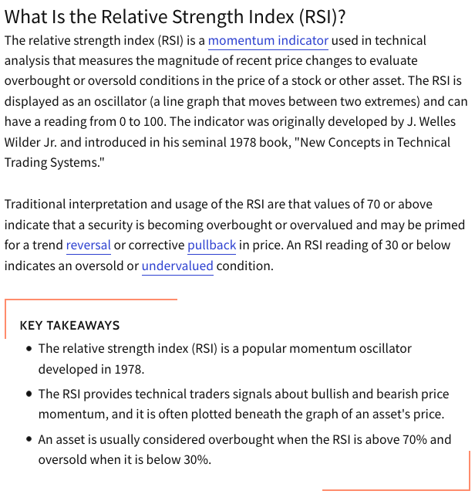
Investopedia

Slide 43
Investopedia

Slide 44
The Case for a “Bull Trap” (2/2/2019) Analysis of Data
New market highs tagging the upper monthly Bollinger band on a monthly negative RSI (relative strength index) divergence — check.
A steep correction off the highs that breaks a multi-year trend line — check.
A turning of the monthly MACD (Moving Average Convergence Divergence) toward south and the histogram to negative — check.
A correction that transverses all the way from the upper monthly Bollinger band to the lower monthly Bollinger band before bouncing — check.
A counter rally that moves all the way from the lower Bollinger band to the middle Bollinger band, the 20MA — check.
A counter rally that produces a bump in the RSI around the middle zone, alleviating oversold conditions — check.
All these events occurring following an extended trend of lower unemployment, signaling the coming end of a business cycle — check.
All these events coinciding with a reversal in yields — check.
All these events coinciding with a Federal Reserve suddenly halting its rate hike cycle — check.

Slide 45
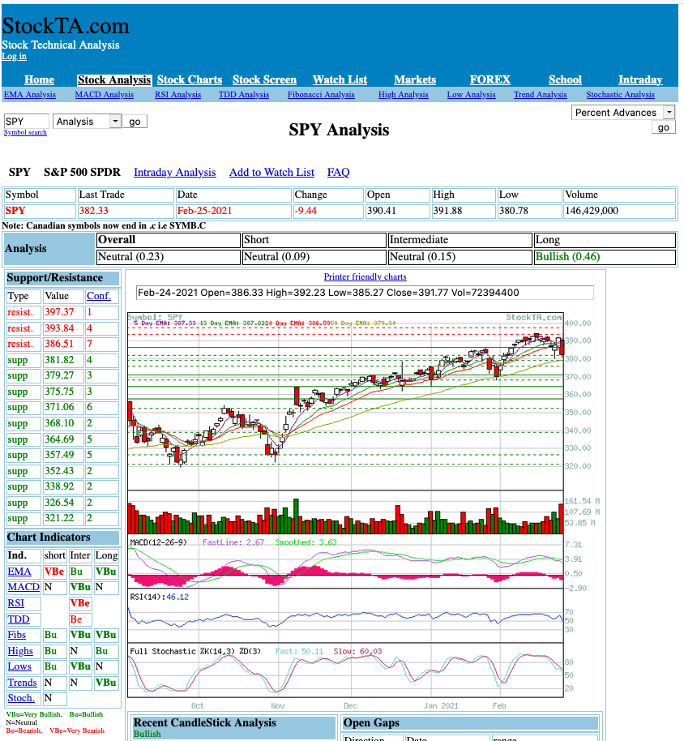
Charting Web Site

Slide 46
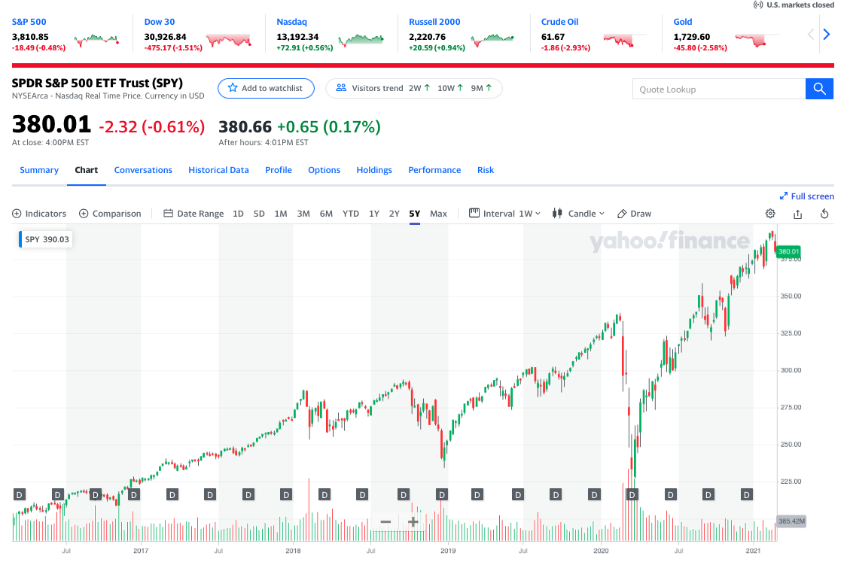
2/26/2021
2/1995

Slide 47
Nassim Nicholas Taleb

