Slide 1
Lecture 14
Introduction to Stochastic Processes: Hurst Exponent
John Rundle Econophysics PHYS 250

Slide 2
Stochastic Processes https://en.wikipedia.org/wiki/Stochastic_process
In probability theory and related fields, a stochastic or random process is a mathematical object usually defined as a collection of random variables.
Historically, the random variables were associated with or indexed by a set of numbers, usually viewed as points in time, giving the interpretation of a stochastic process representing numerical values of some system randomly changing over time
Stochastic processes are widely used as mathematical models of systems and phenomena that appear to vary in a random manner.

Slide 3
Stochastic Processes https://en.wikipedia.org/wiki/Stochastic_process
They have applications in many disciplines including sciences such as biology, chemistry, ecology, neuroscience, and physics as well as technology and engineering fields such as image processing, signal processing, information theory, computer science, cryptography and telecommunications.
Examples include the growth of a bacterial population, an electrical current fluctuating due to thermal noise, or the movement of a gas molecule.
Furthermore, seemingly random changes in financial markets have motivated the extensive use of stochastic processes in finance.

Slide 4
Stochastic Processes https://en.wikipedia.org/wiki/Stochastic_process
Applications of stochastic processes to new phenomena have inspired the growth of new areas of study
Examples of such stochastic processes and their applications include the Wiener process or Brownian motion process, used by Louis Bachelier to study price changes on the Paris Bourse, and the Poisson process, used by A.K. Erlang to study the number phone calls occurring in a certain period of time.
These two stochastic processes (Weiner and Poisson) are considered the most important and central in the theory of stochastic processes, and were discovered repeatedly and independently, both before and after Bachelier and Erlang,

Slide 5
Random Walk: Bottom Line
For an unbiased random walk with Gaussian increments:
where:
is an average over time
R(t) is the distance of the walker from the origin
t is elapsed time
N is the number of steps (moves or jumps) of the walker
Also, note that for an unbiased walk,

Slide 6
Random Walks https://tamino.wordpress.com/2010/03/11/not-a-random-walk/
“First Passage Time” is the time at which the walker returns to the origin.

Slide 7
Random Walks in Higher Dimensions https://en.wikipedia.org/wiki/Random_walk
For an unbiased walk, mean distance <R> from the origin averaged over all realizations: <R> = 0.
Mean square distance <R²> from the origin grows like the number N of steps, <R^{2>}≈ N, averaged over all realizations.
Or, if NΔt = t, then <R²> ~ t

Slide 8
Simulation of Asset Prices See Python Code at: http://www.turingfinance.com/random-walks-down-wall-street-stochastic-processes-in-python/

Slide 9
Collection of Apps http://www.math.uah.edu/stat/

Slide 10
Stochastic Processes https://en.wikipedia.org/wiki/Stochastic_process
Based on their properties, stochastic processes can be divided into various categories, which include random walks, martingales, Markov processes, Lévy processes, Gaussian processes, and random fields, renewal processes, and branching processes.
The term random function is also used to refer to a stochastic or random process, because a stochastic process can also be interpreted as a random element in a function space.
The terms stochastic process and random process are used interchangeably, often with no specific mathematical space for the set that indexes the random variables.

Slide 11
Stochastic Processes https://en.wikipedia.org/wiki/Stochastic_process
A stochastic or random process can be defined as a collection of random variables that is indexed by some mathematical set, meaning that each random variable of the stochastic process is uniquely associated with an element in the set.
The set used to index the random variables is called the index set.
Historically, the index set was some subset of the real line, such as the natural numbers, giving the index set the interpretation of time.
Each random variable in the collection takes values from the same mathematical space known as the state space, which can be for example, the integers, the real line or n-dimensional Euclidean space.
An increment is the amount that a stochastic process changes between two index values, often interpreted as two points in time.
A stochastic process can have many outcomes, due to its randomness, and a single outcome of a stochastic process is called, among other names, a sample function or realization.[

Slide 12
Stochastic Processes https://en.wikipedia.org/wiki/Stochastic_process
When interpreted as time, if the index set of a stochastic process has a finite or countable number of elements, such as a finite set of numbers, the set of integers, or the natural numbers, then the stochastic process is said to be in discrete time.
If the index set is some interval of the real line, then time is said to be continuous.
The two types of stochastic processes are respectively referred to as discrete-time and continuous-time stochastic processes.
Discrete-time stochastic processes are considered easier to study because continuous-time processes require more advanced mathematical techniques and knowledge, particularly due to the index set being uncountable.
If the index set is the integers, or some subset of them, then the stochastic process can also be called a random sequence.

Slide 13
Stochastic Processes - Examples https://en.wikipedia.org/wiki/Stochastic_process
Bernoulli Trials
One of the simplest stochastic processes is the Bernoulli process, which is a sequence of independent and identically distributed (iid) random variables, where each random variable takes either the value 1 with probability p, and value 0 with probability 1 − p .
This process can be likened to a coin flip, where the probability of obtaining a head is p and its value is 1, while the value of a tail is 0.
In other words, a Bernoulli process is a sequence of iid Bernoulli random variables,where each coin flip is a Bernoulli trial.

Slide 14
Stochastic Processes - Examples https://en.wikipedia.org/wiki/Stochastic_process
Random Walks
Random walks are stochastic processes that are usually defined as sums of iid random variables or random vectors in Euclidean space, so they are processes that change in discrete time.
But some also use the term to refer to processes that change in continuous time, particularly the Wiener process used in finance, which has led to some confusion, resulting in its criticism.
There are other various types of random walks, defined so their state spaces can be other mathematical objects, such as lattices and groups, and in general they are highly studied and have many applications in different disciplines.

Slide 15
Stochastic Processes - Examples https://en.wikipedia.org/wiki/Stochastic_process
Random Walks
A classic example of a random walk is known as the simple random walk, which is a stochastic process in discrete time with the integers as the state space, and is based on a Bernoulli process, where each iid Bernoulli variable takes either the value +1 or -1.
In other words, the simple random walk takes place on the integers, and its value increases by +1 with probability p , or decreases by -1 with probability 1 − p
So the index set of this random walk is the natural numbers, while its state space is the integers.
If the p = 0.5 , this random walk is called a symmetric or unbiased random walk. If p ≠ 0.5, it is called a biased random walk
For a simple unbiased walk, the mean distance <R> from the origin the origin is 0, and the mean square distance <R²> grows like time, or the number of steps N: <R²> ≈ t ≈ NΔt

Slide 16
Stochastic Processes - Examples https://en.wikipedia.org/wiki/Stochastic_process
Weiner process
The Wiener process is a stochastic process with stationary and independent increments that are normally distributed based on the size of the increments.
The Wiener process is named after Norbert Wiener, who proved its mathematical existence, but the process is also called the Brownian motion process or just Brownian motion due to its historical connection as a model for Brownian movement in liquids.
Playing a central role in the theory of probability, the Wiener process is often considered the most important and studied stochastic process, with connections to other stochastic processes

Slide 17
Stochastic Processes - Examples https://en.wikipedia.org/wiki/Stochastic_process
Weiner process
The Weiner process index set and state space are the non-negative numbers and real numbers, respectively, so it has both continuous index set and state space.
But the process can be defined more generally so its state space can be n-dimensional Euclidean space.
If the mean of any increment is zero, then the resulting Wiener or Brownian motion process is said to have zero drift.
If the mean of the increment for any two points in time is equal to the time difference multiplied by some constant μ, which is a real number, then the resulting stochastic process is said to have drift μ

Slide 18
Stochastic Processes - Examples https://en.wikipedia.org/wiki/Stochastic_process
In general, a sample path of a Wiener process is continuous everywhere but nowhere differentiable.
It can be considered a continuous version of the simple random walk.
The Wiener process is a member of some important families of stochastic processes, including Markov processes, Lévy processes and Gaussian processes.
It plays a central role in quantitative finance, where it is used, for example, in the Black–Scholes–Merton model for option pricing.
The process is also used in different fields, including the majority of natural sciences as well as some branches of social sciences, as a mathematical model for various random phenomena.

Slide 19
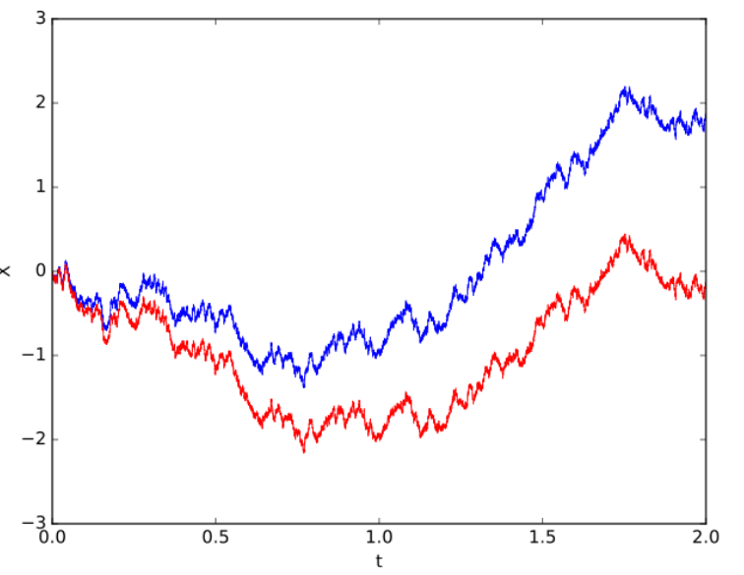
Stochastic Processes - Example https://en.wikipedia.org/wiki/Stochastic_process

Slide 20
Collection of Apps http://www.math.uah.edu/stat/

Slide 21
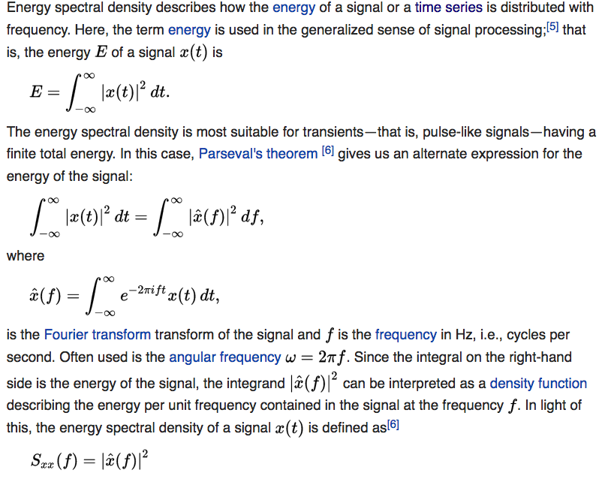
Spectral Density (Reminder) https://en.wikipedia.org/wiki/Spectral_density

Slide 22
Power Spectral Density: Example http://www2.meteo.uni-bonn.de/staff/venema/essays/2005/online_generation_of_spatial_temporal_noise/
“By integrating white noise, you obtain a correlated time series.
This is called Brownian noise in analogy to the random Brownian motion made by small particles in a fluid.
The random walk made by these small particles is determined by many small collisions with molecules, our white noise.
Its position (the value of our Brownian noise) is the integration of many small collisions.
Normally a Brownian time series has a power law power spectrum with exponent -2, in our example the exponent is -1.8.
This may be due to the bias, or due to a limited sample size and averaging.”

Slide 23
Power Spectral Density: Example of White Noise http://www2.meteo.uni-bonn.de/staff/venema/essays/2005/online_generation_of_spatial_temporal_noise/

Slide 24
Power Spectral Density: Example of Red Noise http://www2.meteo.uni-bonn.de/staff/venema/essays/2005/online_generation_of_spatial_temporal_noise/

Slide 25
Ornstein-Uhlenbeck Process https://en.wikipedia.org/wiki/Ornstein-Uhlenbeck_process
Note:
A Langevin equation describes the motion or evolution of a particle or degree of freedom in a system under the action of a random forcing.
Langevin equation (named after Paul Langevin) is a stochastic differential equation describing the time evolution of a subset of the degrees of freedom.
These degrees of freedom typically are collective (macroscopic) variables changing only slowly in comparison to the other (microscopic) variables of the system.
A Master equation, or equivalently a Fokker-Planck equation, is a partial differential equation that describes the time evolution of the probability density function of the velocity of a particle under the influence of drag forces and random forces, as in Brownian motion.

Slide 26
Example of the Evolution of a PDF under a Fokker-Planck Equation

Slide 27
Ornstein-Uhlenbeck Process https://en.wikipedia.org/wiki/Ornstein-Uhlenbeck_process
The Ornstein–Uhlenbeck process (named after Leonard Ornstein and George Eugene Uhlenbeck), is a stochastic process that, roughly speaking, describes the velocity of a massive Brownian particle under the influence of friction.
The process is a stationary Gauss–Markov process (which means that it is both a Gaussian and Markovian process
Over time, the process tends to drift towards its long-term mean: such a process is called mean-reverting.
The process can be considered to be a modification of the random walk in continuous time, or Wiener process
In such a process, the properties of the process have been changed so that there is a tendency of the walk to move back towards a central location, with a greater attraction when the process is further away from the center.

Slide 28
Ornstein-Uhlenbeck Process https://en.wikipedia.org/wiki/Ornstein-Uhlenbeck_process
(random Gaussian increments)
The above representation can be taken as the primary definition of an Ornstein–Uhlenbeck process or sometimes also mentioned as the Vasicek model.

Slide 29
Ornstein-Uhlenbeck Process https://en.wikipedia.org/wiki/Ornstein-Uhlenbeck_process

Slide 30
Ornstein-Uhlenbeck Process: Examples https://en.wikipedia.org/wiki/Ornstein-Uhlenbeck_process

Slide 31
Ornstein-Uhlenbeck Process: Examples https://en.wikipedia.org/wiki/Ornstein-Uhlenbeck_process
The Ornstein–Uhlenbeck process is an example of a Gaussian process that has a bounded variance and admits a stationary probability distribution, in contrast to the Wiener process
The difference between the two is in their "drift" term.
For the Wiener process the drift term is constant, whereas for the Ornstein–Uhlenbeck process it is dependent on the current value of the process:
if the current value of the process is less than the (long-term) mean, the drift will be positive
if the current value of the process is greater than the (long-term) mean, the drift will be negative.
In other words, the mean acts as an equilibrium level for the process. This gives the process its informative name, "mean-reverting."
The stationary (long-term) variance is given by:

Slide 32
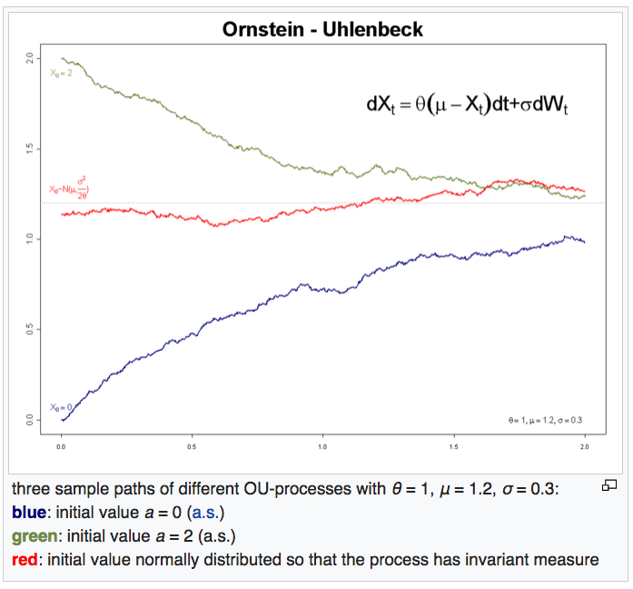
Ornstein-Uhlenbeck Process: Examples https://en.wikipedia.org/wiki/Ornstein-Uhlenbeck_process

Slide 33
Ornstein-Uhlenbeck Process: Other Examples https://en.wikipedia.org/wiki/Ornstein-Uhlenbeck_process
Application to finance:
The Ornstein–Uhlenbeck process is one of several approaches used to model (with modifications) interest rates, currency exchange rates, and commodity prices stochastically.
The parameter μ represents the equilibrium or mean value supported by fundamentals
σ the degree of volatility around it caused by shocks
θ represents the rate by which these shocks dissipate and the variable reverts towards the mean.
One application of the process is a trading strategy known as pairs trade (arbitrage)

Slide 34
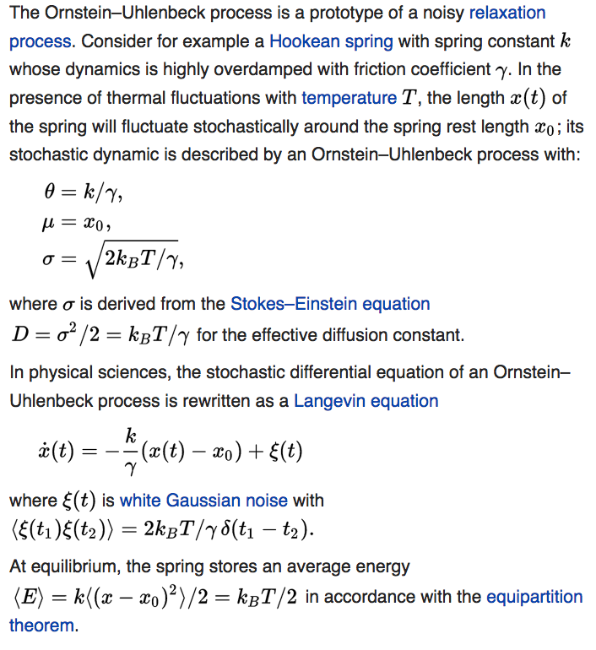
Ornstein-Uhlenbeck Process: Other Examples https://en.wikipedia.org/wiki/Ornstein-Uhlenbeck_process
An overdamped Hooke spring subject to random noise

Slide 35
Ornstein-Uhlenbeck Process: Other Examples https://en.wikipedia.org/wiki/Ornstein-Uhlenbeck_process
Many stochastic processes in physics are described by Langevin equations.

Slide 36
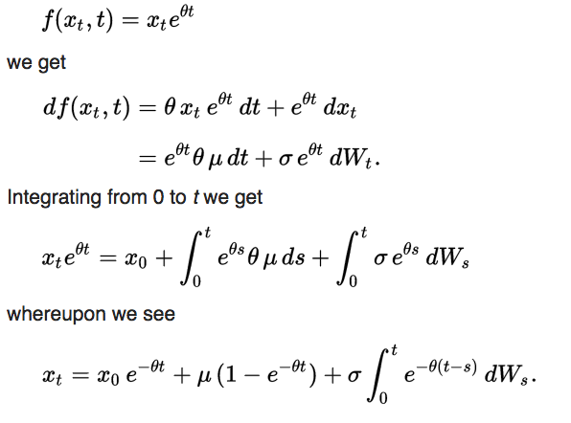
Ornstein-Uhlenbeck Process: Solution https://en.wikipedia.org/wiki/Ornstein-Uhlenbeck_process
Changing variables:

Slide 37
Markov Process https://en.wikipedia.org/wiki/Markov_chain
In probability theory and related fields, a Markov process is a specific type of a mathematical object known as a stochastic or random process, which is usually defined as a collection of random variables.
Historically, the random variables were indexed by time
Markov processes are stochastic processes that have the property that the next value of the process depends on the current value, but it is conditionally independent of the previous values of the stochastic process
In other words, the behavior of the process in the future is stochastically independent of its behavior in the past, given the current state of the process.

Slide 38
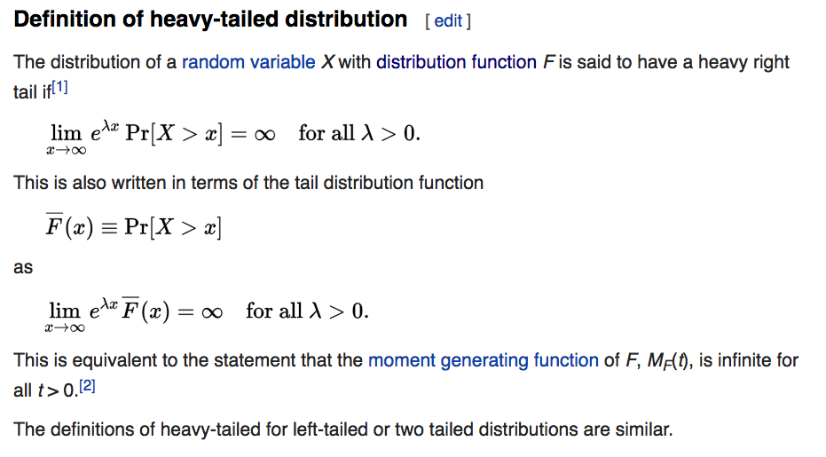
Fat Tail (or Heavy Tail) Distributions https://en.wikipedia.org/wiki/Heavy-tailed_distribution

Slide 39
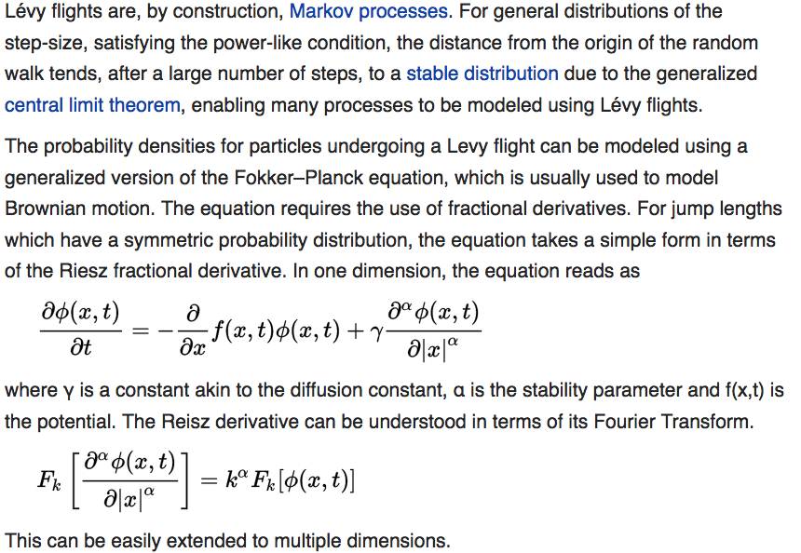
Levy Flights https://en.wikipedia.org/wiki/Levy_flight

Slide 40
Levy Flights https://en.wikipedia.org/wiki/Levy_flight
A Lévy flight, named for French mathematician Paul Lévy, is a random walk in which the step-lengths have a probability distribution that is heavy-tailed.
When defined as a walk in a space of dimension greater than one, the steps made are in isotropic random directions.
The term "Lévy flight" was coined by Benoît Mandelbrot, who used this for one specific definition of the distribution of step sizes.
Later researchers have extended the use of the term "Lévy flight" to include cases where the random walk takes place on a discrete grid rather than on a continuous space.

Slide 41
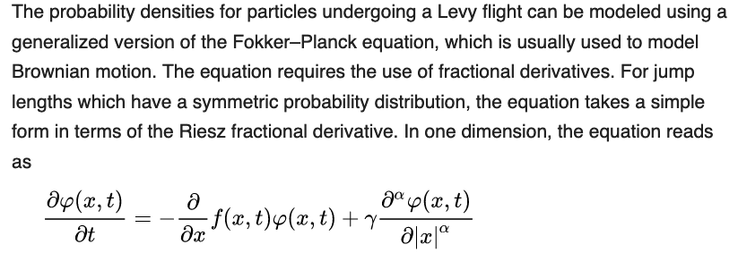
Levy Flights https://en.wikipedia.org/wiki/Levy_flight
Lévy flights are, by construction, Markov processes.
For general distributions of the step-size, satisfying the power-like condition, the distance from the origin of the random walk tends, after a large number of steps, to a stable distribution due to the generalized central limit theorem, enabling many processes to be modeled using Lévy flights.

Slide 42
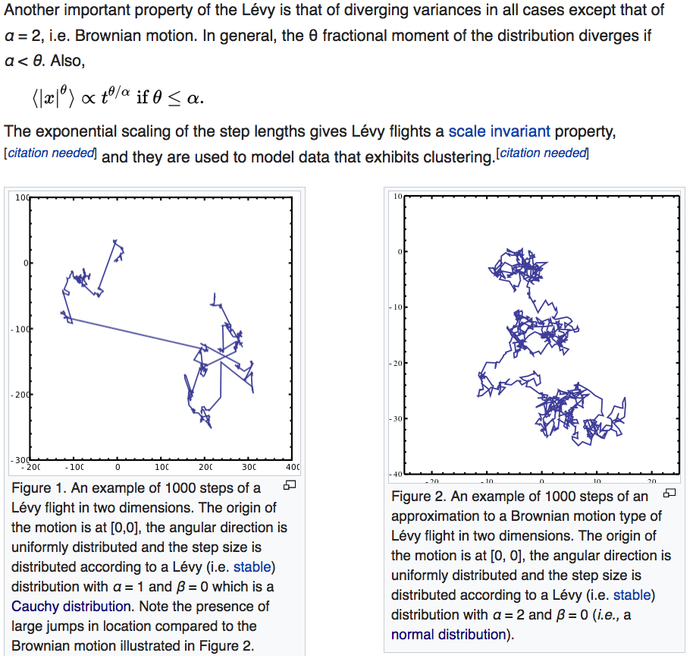
Levy Flights https://en.wikipedia.org/wiki/Levy_flight

Slide 43
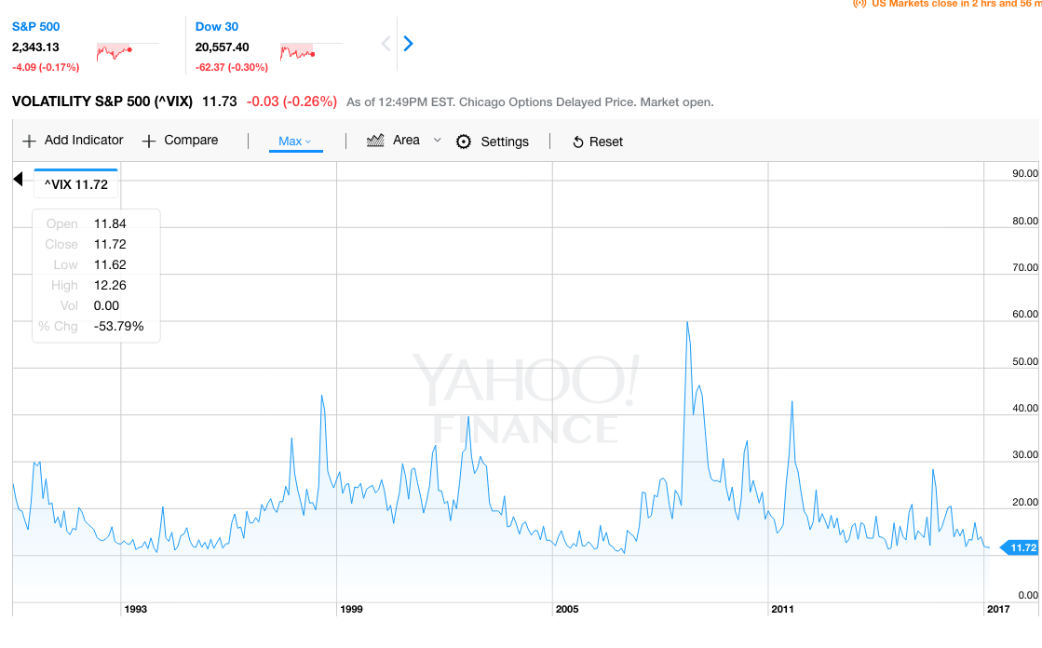
Possible Example of Levy Flight: VIX Yahoo Finance

Slide 44
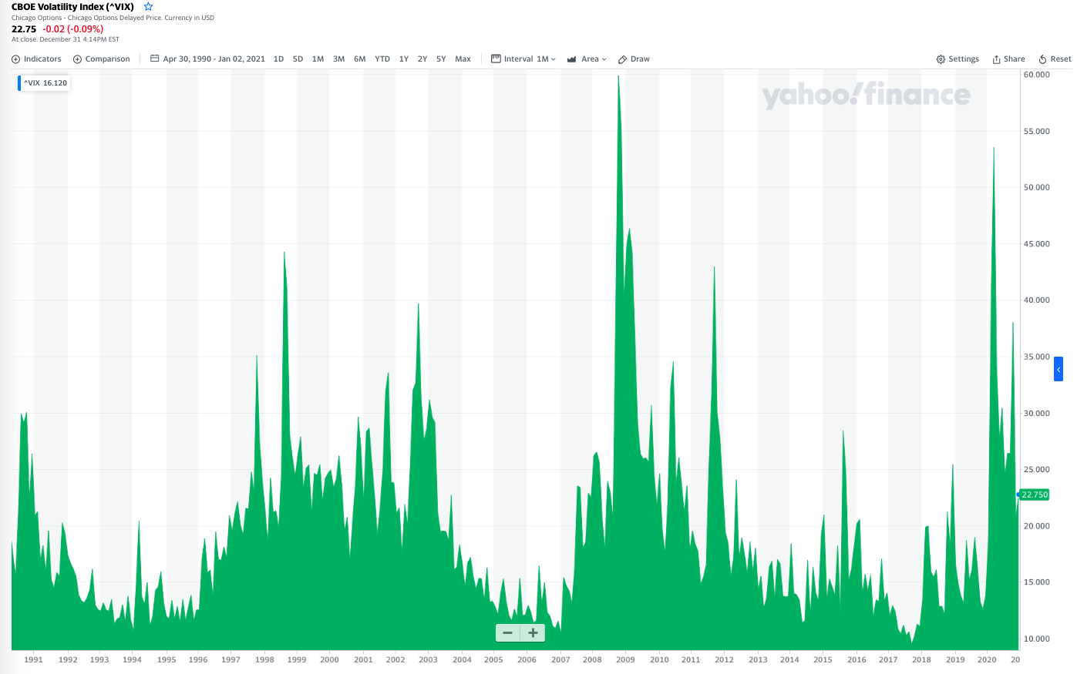
Possible Example of Levy Flight: VIX Yahoo Finance

